Slide 1

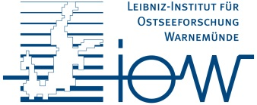
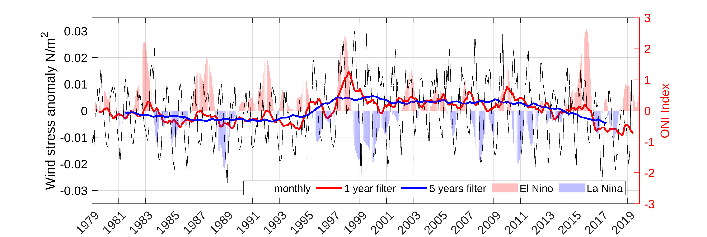
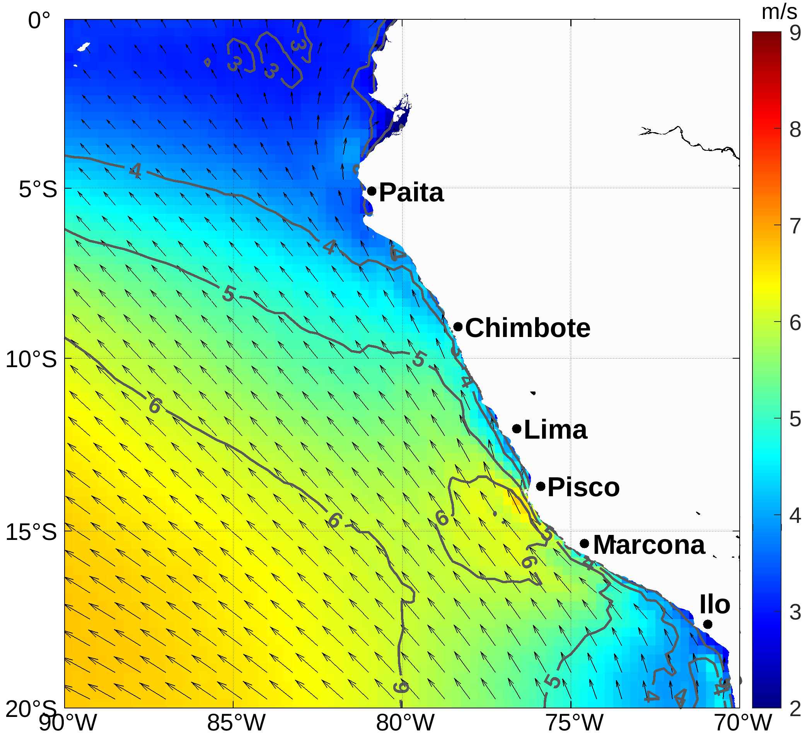
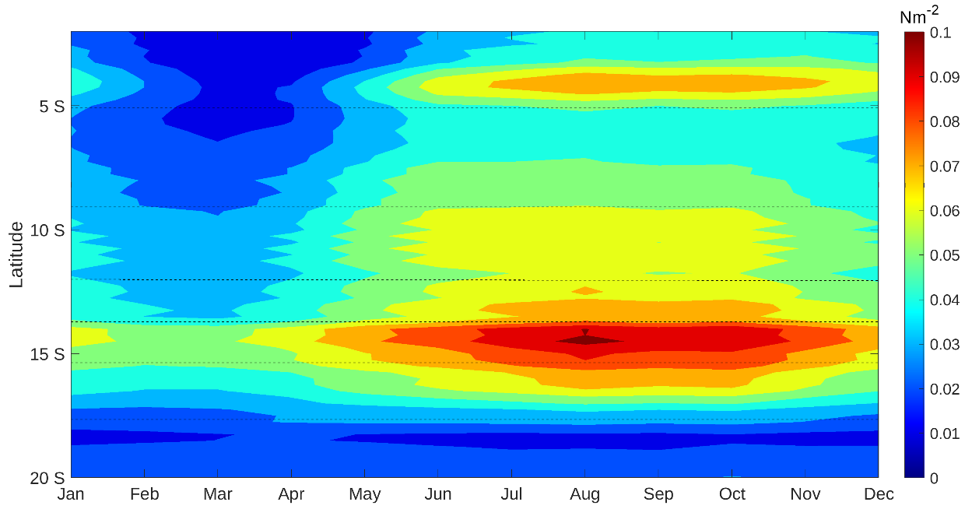
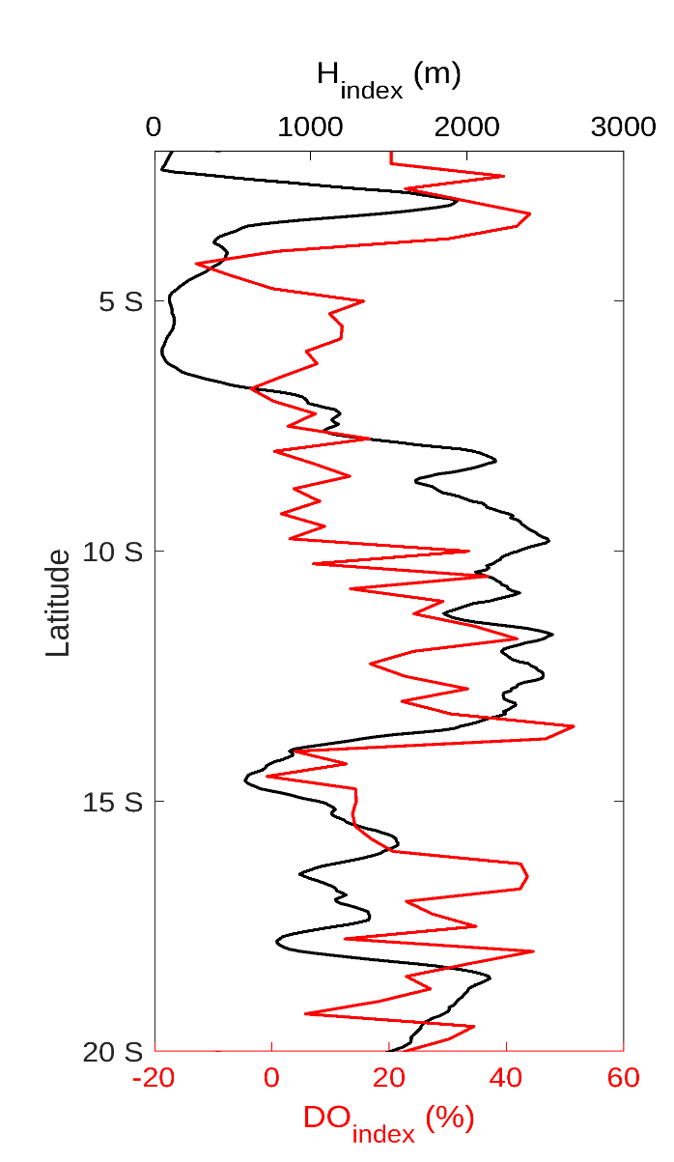
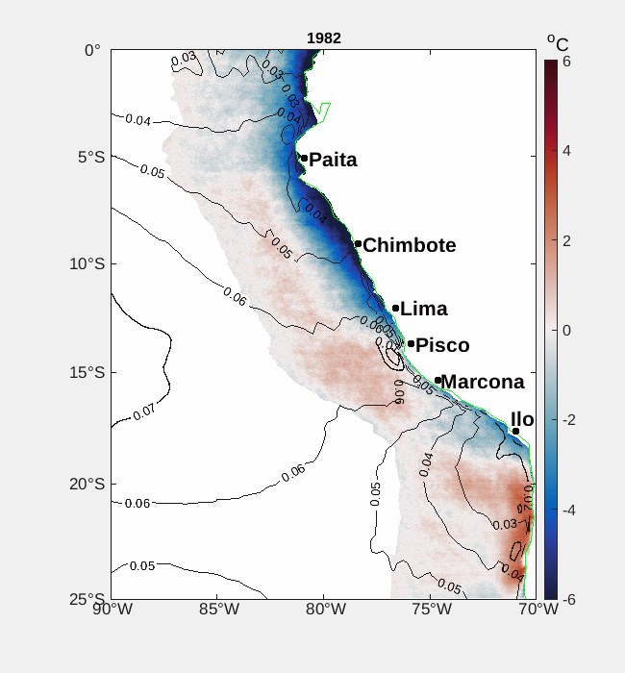
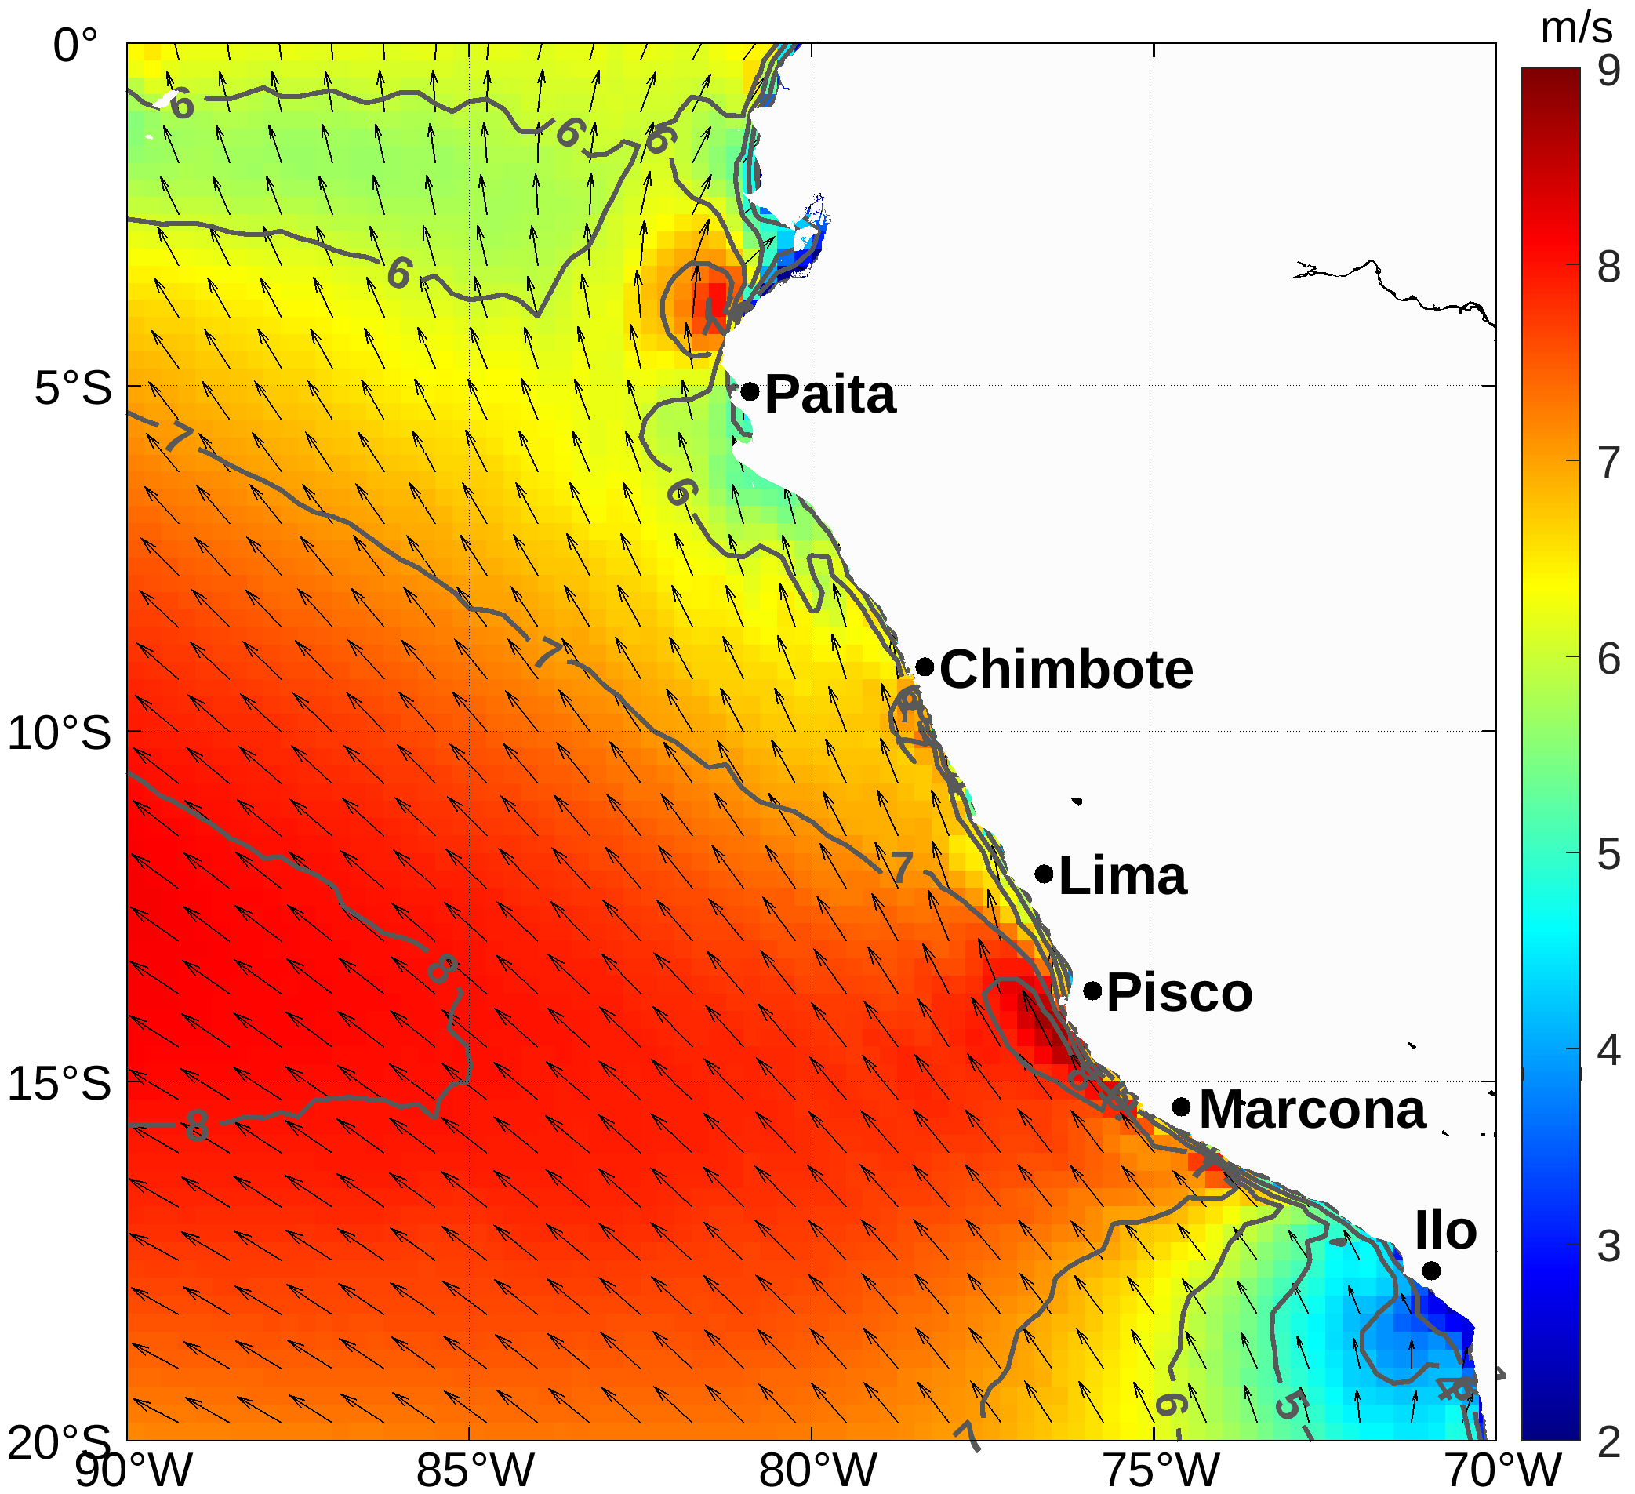
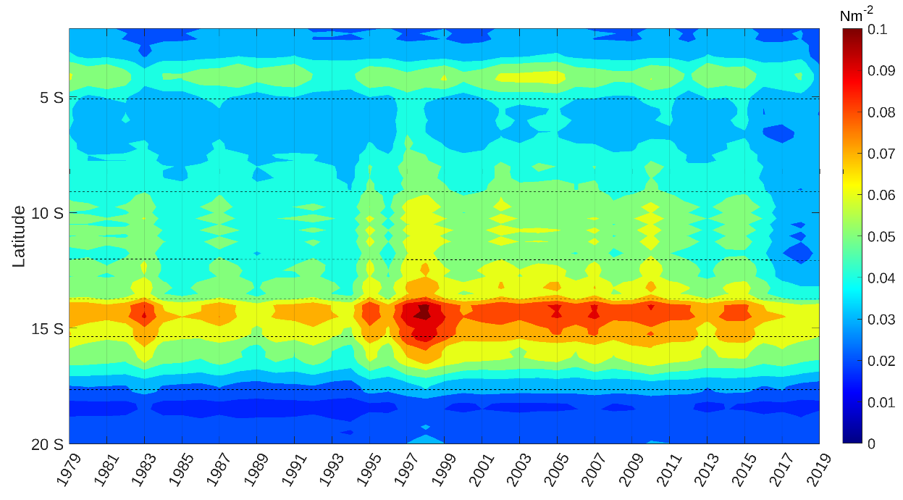
Inter-decadal variations of surface winds off Peruvian coast
Dr. Sadegh Yari, Dr. Volker Mohrholz
Leibniz Institute for Baltic Sea Research Warnemünde (IOW)
The Peruvian Upwelling System (part of Humboldt upwelling system) is the most productive among the main Eastern Boundary Upwelling Systems (EBUS). The spatio-temporal variations of the wind off Peru is investigated by analysing the long term wind data of ERA5 (1979-2019) data set.
The wind is controlled by:
Seasonal variations
ENSO oscillations
Inter-decadal Pacific Oscillation (IPO)
IPO +
IPO -
Summer
Seasonal cycle of wind stress in 100km coastal domain
SST-wind coupling (local effect)
Winer
Mean annual wind stress in 100km coastal domain
Orography index vs wind drop-off

