Slide 1
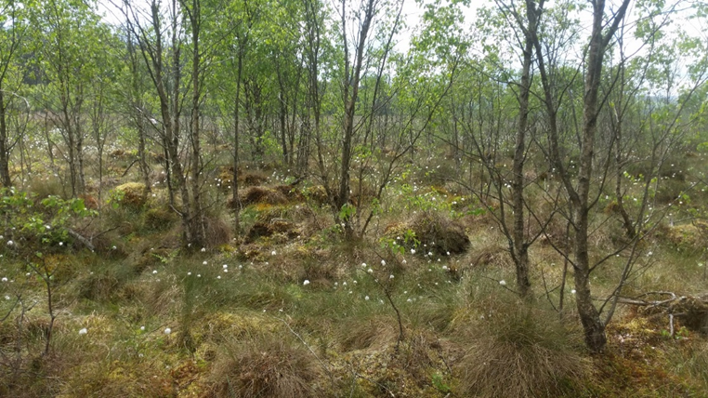
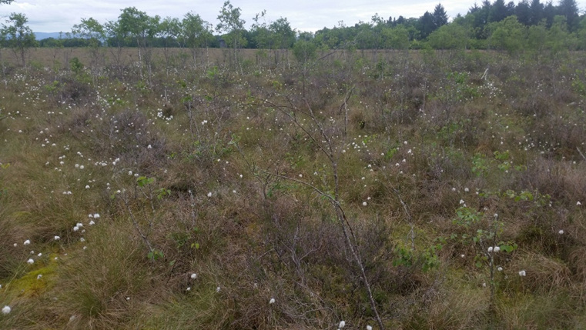
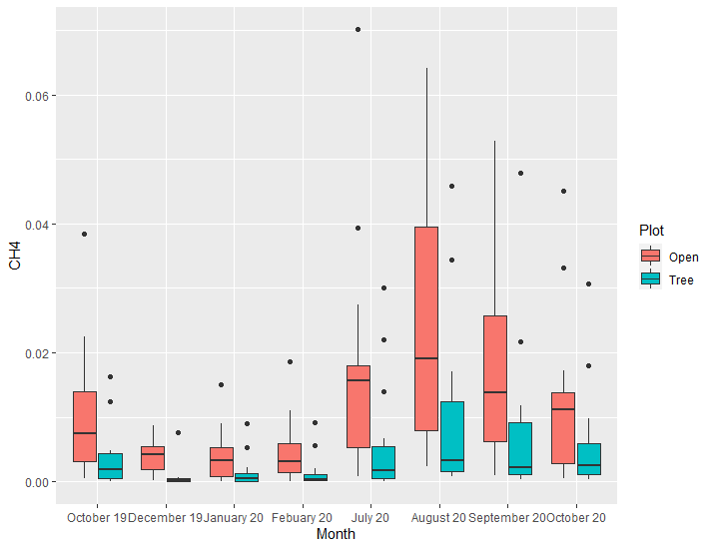
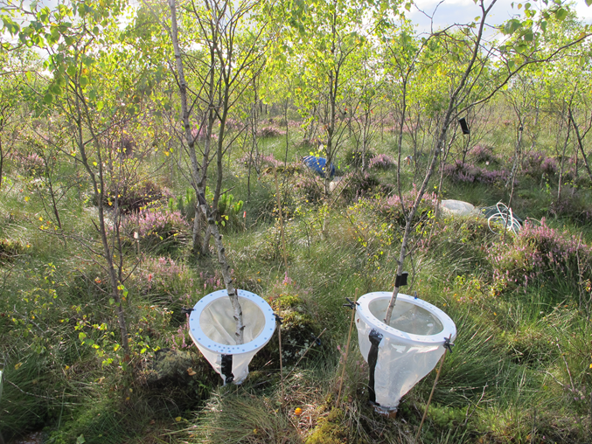
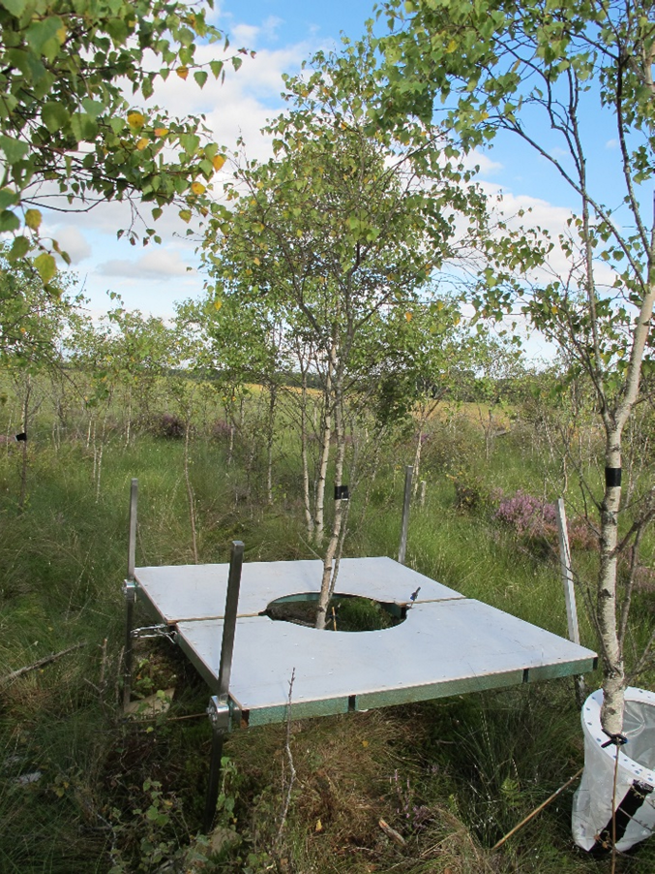
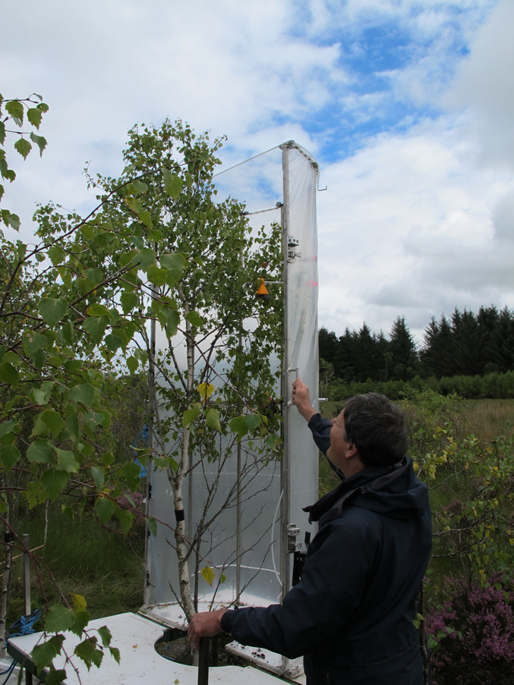
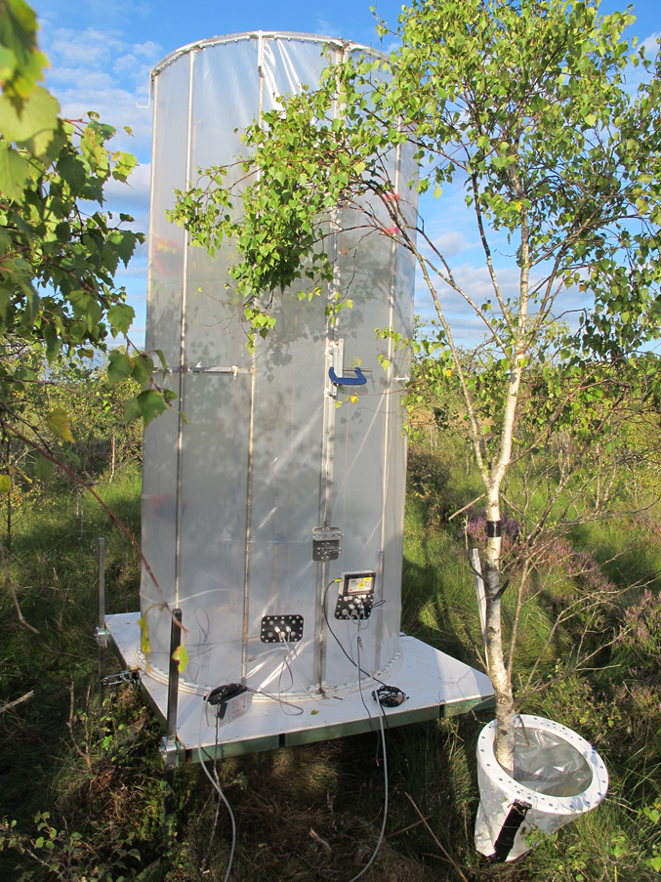
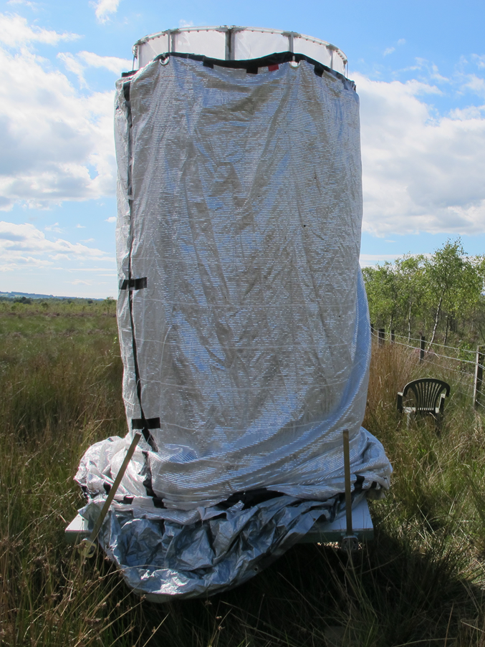
Introduction
Ombrotrophic, naturally open peatlands are increasingly susceptible to invasion by scrub and trees due to human disturbance, N deposition and climate change. These trees are conventionally believed to have a negative impact on greenhouse gas emission as they have a drying effect on the peat which can in turn lead to increased CO₂ emissions by oxidative peat decay. However there is limited research on the effect these trees have on such ecosystem functions and their removal can be costly, making decisions over best management practice challenging. The adverse growing conditions associated with many of these peatlands can result in stunted tree growth meaning that complete enclosure of a tree remains a practical possibility. In this study we aim to quantify the CH₄ and CO₂ fluxes from whole trees growing on a disturbed peatland and assess their significance relative to the fluxes between the vegetated peat surface and atmosphere. We also aim to identify if the establishment of trees impacts CH₄ and CO₂ fluxes from the vegetated peat surface, as compared to adjacent open peatland.
Complete Enclosure of Stunted Trees to Study Greenhouse Gas Fluxes in Birch-Invaded Peatland
William Barrop (University of York, UK), Russell Anderson (Forest Research, UK), Roxane Andersen (University of the Highlands and Islands, UK) and Sylvia Toet (University of York, UK)
Results – Tree Chamber
Note: Data collection with the tree chamber has been limited – in part due to Covid-19 restrictions. So far light and dark measurements have been taken from 5 trees at 2 time points, in August and October 2020. We are also currently lacking good data for upscaling the fluxes to estimate flux across the whole plot.
The data so far show that the trees are sources of CH4 but that the flux of CH₄ is minor compared to the fluxes from the peat surface, accounting for no more than 1/20 of the CH₄ emissions from the tree plot. In contrast the trees are large contributors to CO₂ flux in the plots, with our initial data indicating the trees contribute as much or more to carbon sequestration as the ground flora in the tree plot in the summer months.
Birch-invaded ‘Tree plot’
Adjacent control ‘Open plot’
Results – Peat surface collars
Data has been collected from ground collars in the wooded and open plot over the course of a year. These have shown similar CO₂ fluxes between the open and wooded plot but significantly higher CH₄ fluxes in the open plot. This is thought to be due to the wetter conditions and relative abundance of Eriophorum vaginatum in the open plot compared to the tree plot.
CH4 flux from the peat surface collars in the open and tree plot
Methods
We have developed a removable chamber capable of enclosing whole trees of up to 3 metres high, making it suitable for use on juvenile or stunted trees. Being able to enclose an entire tree removes potential errors caused by estimating whole tree fluxes by upscaling measurements from a subsample of tree surfaces. The chamber is constructed with a transparent membrane and removable cover so that light and dark measurements can be taken. We use the chamber to take CH₄ and CO₂ flux measurements on a site with approximately 20-year-old silver birch trees (Betula pendula) of an average height of 2-3 metres. Flux measurements have been taken from the trees and peat surface at different times of year. Fluxes have also been measured from peat surface collars in an adjacent open area to assess the effect of the trees on fluxes from the peat surface itself.
1
2
3a
3b
4
Discussion
The data indicates the presence of stunted trees at our field site has a net decrease on CO₂ and CH₄ emission from the site compared to the open control plot.
The implication of the results is that removal of stunted birch regeneration from restored peatland sites might not necessarily be required to restore carbon sequestration benefits
The study successfully develops apparatus to detect fluxes from whole stunted trees. This apparatus could be used to investigate a range of questions. This includes the possibility to compare results from whole tree enclose to stem only measurement methods to assess the accuracy of stem only measurements on estimating total tree flux.
Collars – the base of the collar seals to the base of the tree. A polythene sheath arises from this base seal and connects to a magnetic O-ring at the top of the collar
Supportive table – assembled around each tree to support the weight of the chamber above the soft peat soil
The chamber consists of two halves. The first half is lifted into position. Half of the O-ring connects to the underside of each half of the chamber. The two halves of the chamber can then be clamped together
A dark cover can be attached for tree respiration measurements

