Slide 1



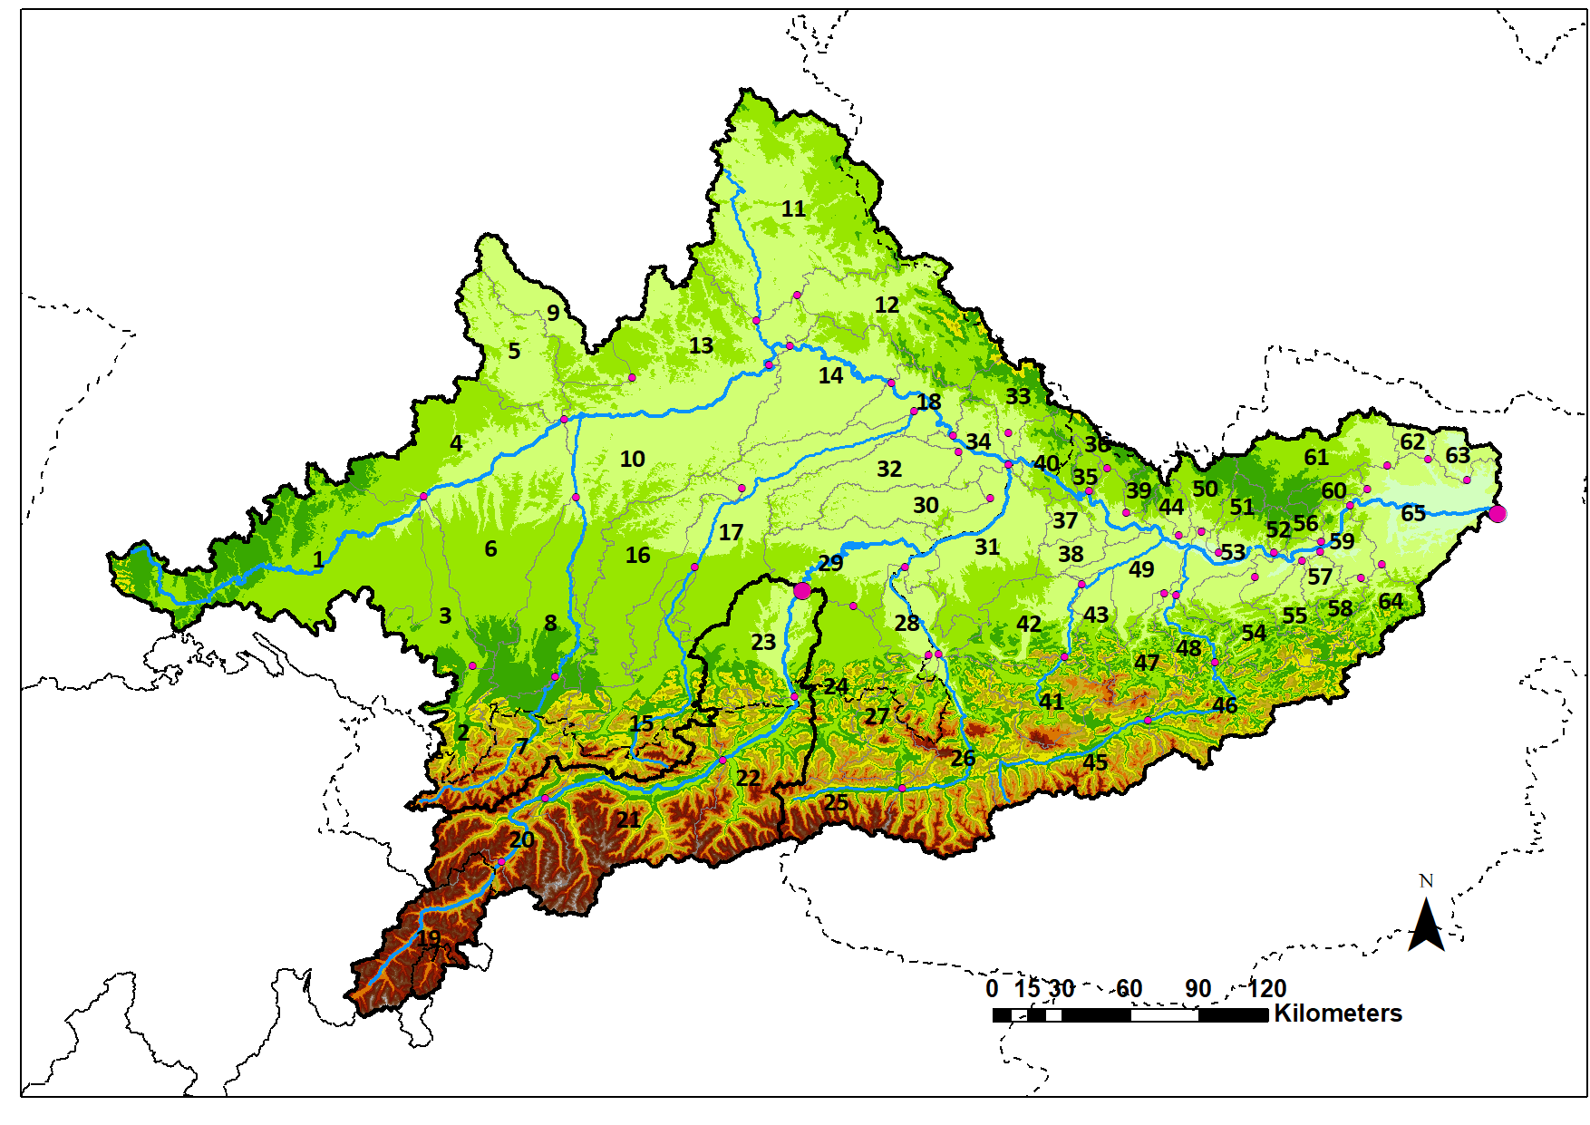
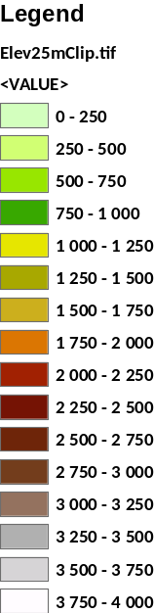
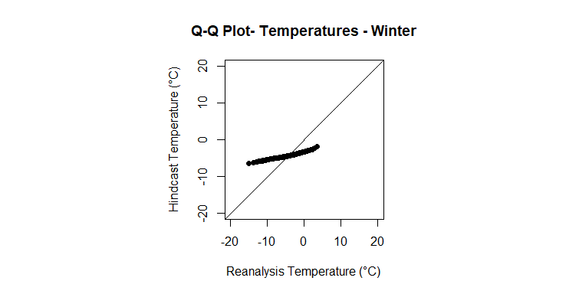
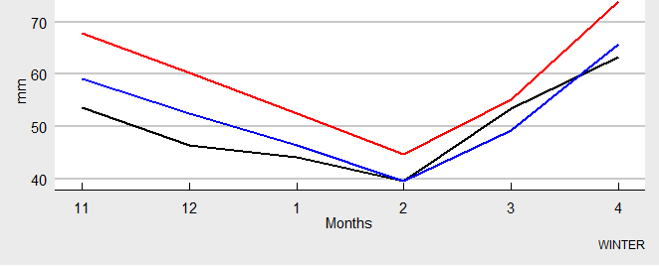
Impact of bias correction techniques on an ensemble of seasonal discharge forecast for the Danube upstream of Vienna
Ignacio Martin Santos, Mathew Herrnegger, Hubert Holzmann (ignacio.martin-santos@boku.ac.at)
Danube upstream of Vienna
Elevation [m.a.s.l]
German Climate Forecast System
(daily, ~100km) (daily, ~6km)
Downscaling (EPISODES)
Bias correction
Reanalysis
met data
(daily,~6km)
Calibrated - Hydrological Model
COSERO
Area : 101.810 Km²
Runoff
gauges
(daily,subbasin)
Ensemble seasonal discharge forecasts
(monthly aggregation, 6 months ahead)
*Calibration:2001-2010 / *Validation: 2011-2015
Bias correction techniques
Scale factor
Quantile mapping
(different approaches)
Q-Q plot Temperatures
Winter (SB 23)
Bias correction
Precitation
Winter (SB 23)
Ensemble seasonal discharge forecasts
(monthly aggregation, 6 months ahead)
SF 1
SF 2
OBS

