Slide 1



Satellite Radar Interferometry on corner reflectors
in the area of mining region in Poland
Natalia Wielgocka¹, Kamila Pawluszek-Filipiak¹, Damian Tondaś¹, Andrzej Borkowski¹
¹Wrocław University of Environmental
and Life Sciences
OVERVIEW
DATA
INFO:
Click on the pictures to enlarge them,
Click buttons for more information,
Click on to go back to the menu section.
METHODS
RESULTS

Slide 2



OVERVIEW
MOTIVATION
CHALLENGES OF UNDERGROUND MINING DEFORMATION MONITORING:
https://www.istockphoto.com/
high deformation
gradient
non-linear
deformation pattern
loss of coherence
OUR GOALS:
Evaluation of two Synthetic Aperture Radar (SAR) techniques (DInSAR and PSInSAR) in monitoring mining-induced deformation,
Installation of Corner Reflectors in the area of mining deformations,
Assessment of advantages and limitations of both techniques.
Start
Study area
EPOS-PL+

Slide 3
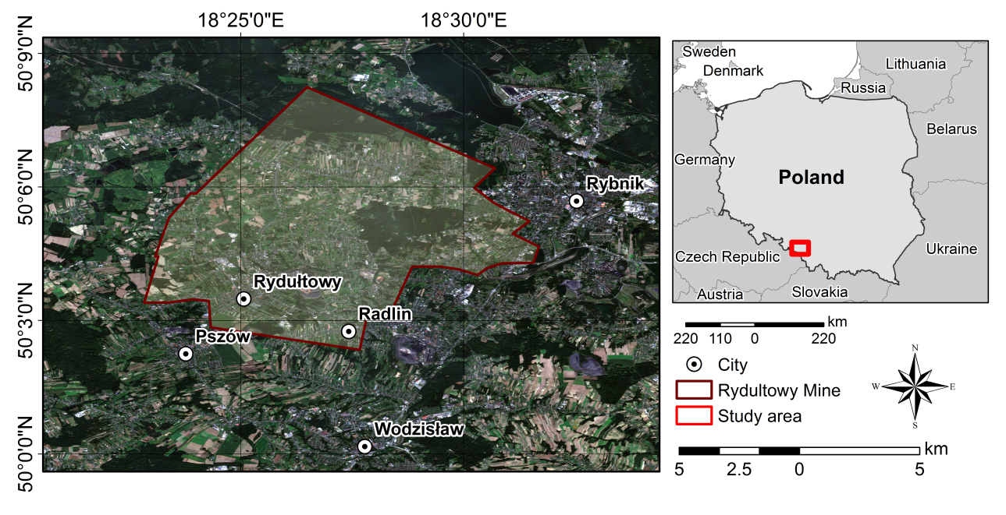
STUDY AREA
Rydułtowy Mine
The Rydułtowy mine is the oldest active mining plant in Upper Silesia Coal Basin (USCB),
Is one of the largest hard coal mining areas in Europe,
Located in southwester part of USCB and covers around 46 km²,
The beginning of the excavation is dated back in 1792,
The average daily production of the mine ranges between 9000 to 9500 t/day.
More INFO:
Click on the pictures to enlarge them
Fig. 1. Area of Rydułtowy Mine (a) and its location on Poland’s map (b).
Start
OVERVIEW

Slide 4
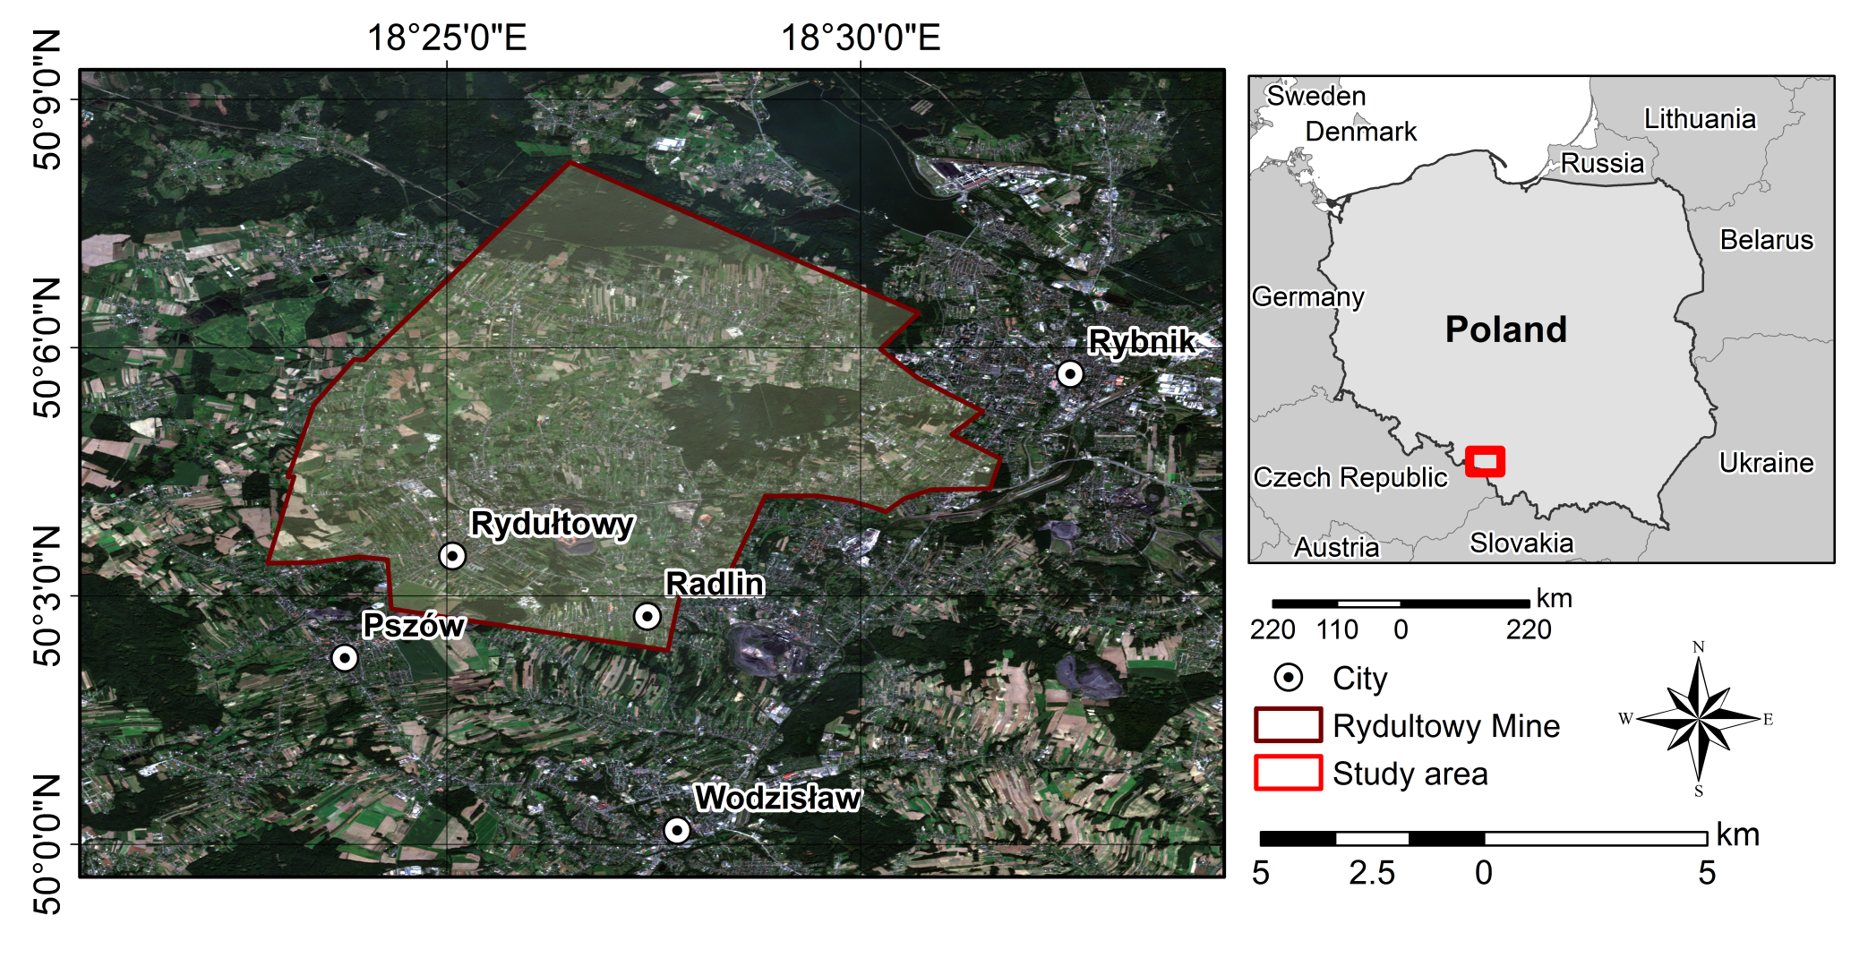

Rydułtowy Mine
(b)
(a)
Fig. 1. Area of Rydułtowy Mine (a) and its location on Poland’s map (b).
Exit

Slide 5


EPOS-PL+
About EPOS-PL+ project
The EPOS-PL project is the Polish realization of the European Plate Observing System (EPOS) initiative, which aims at the integration of existing and newly created research infrastructures to facilitate the use of multidisciplinary data and products in the field of Earth sciences in Europe.
EPOS-PL+ is the continuation of EPOS-PL project.
Start
OVERVIEW

Slide 6
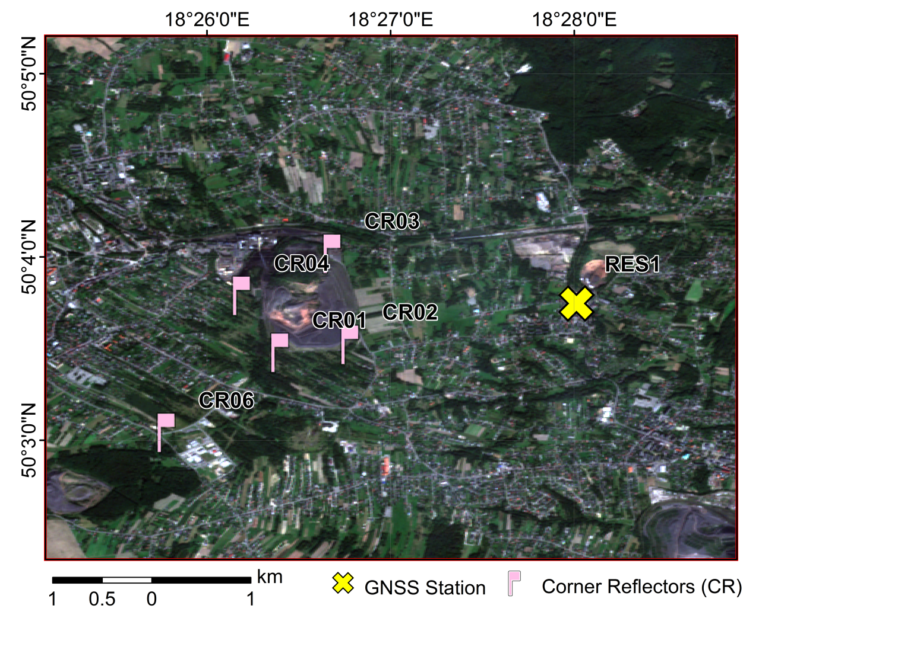
DATA
OUR INFRASTRUCTURE AND DATA
SAR Data
GNSS Data
More INFO:
Click buttons,
Click on the pictures to enlarge them
Others
Fig. 2. Available infrastructure located in Rydułtowy mine
Five Corner Reflectors (CRs). These CRs have been mounted on stable pillars at the height of 1.5 m and located in stable areas as well as in the area of deformation with various patterns.
One high-frequency GNSS receiver working permanently has been placed in the area. This GNSS station (RES01) enables estimating of deformation time-series based on multi-GNSS observations in Near Real Time (NRT) as well as in post-processing.
Start

Slide 7
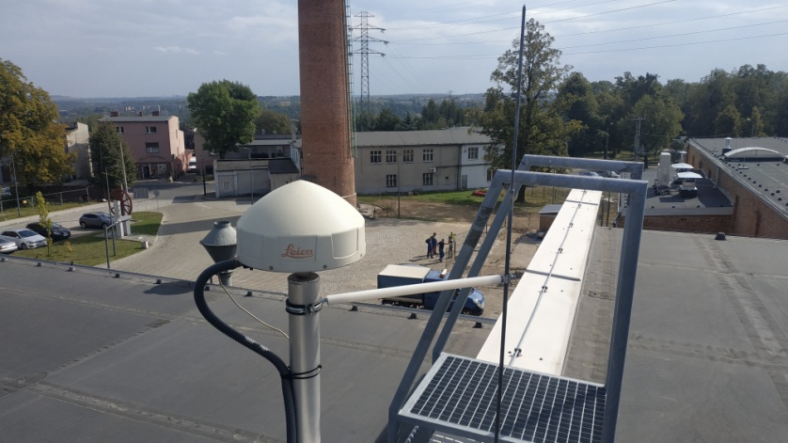
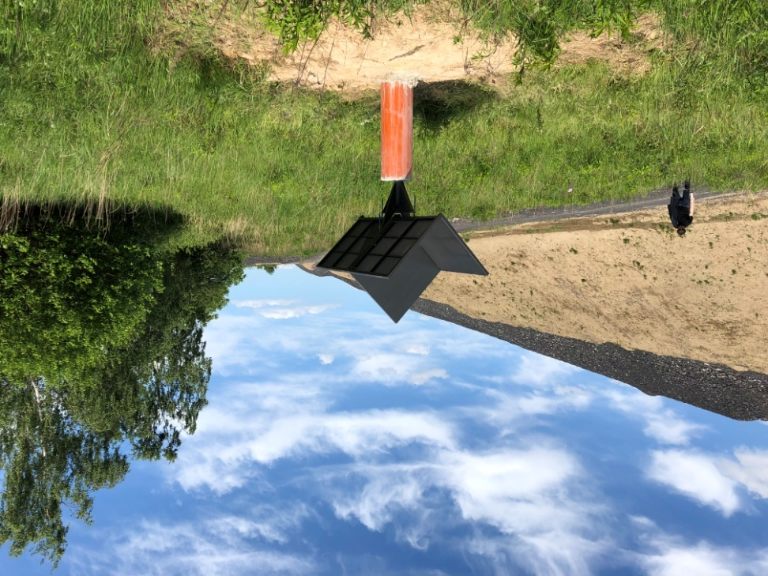
Infrastructure
(b)
(a)
(c)
Fig. 2. Avalible infrastructure located in Rydułtowy mine (a):
RES01 permanent GNSS station (b) and Corner Reflector (c).
Exit

Slide 8
DATA
SAR DATA
We used ascending and descending Sentinel-1A/B TOPSAR images covering the study area with 6-day revisit period acquired between 25 June 2018 and 14 July 2019 (Tab.1).
Table 1. Data specification
Dataset | Parameters | Data specification
Descending 51 | Mean Incidence angle | -77.41
 | Azimuth angle | 35.46
 | Number of images | 61
 | Time span | 26 June 2018 - 9 July 2019
Descending 124 | Mean Incidence angle | -78.98
 | Azimuth angle | 44.03
 | Number of images | 63
 | Time span | 25 June 2018 - 14 July 2019
Ascending 175 | Mean Incidence angle | 38.35
 | Azimuth angle | 81.77
 | Number of images | 62
 | Time span | 28 June 2018 - 5 July 2019
Start
DATA

Slide 9



DATA
GNSS DATA
The RES01 permanent station is equipped with one high-frequency GNSS receiver. In contrary to Sentinel-1 measurements, which revisiting time is 6-day, GNSS allows constantly measuring deformation in time.
The coordinates of RES01 has been estimated in postprocessing. Bernese GNSS Software v. 5.2 was used as well as observations from multi-GNSS satellite systems: GPS, GLONASS and Galileo.
RES01 started working since the 10th of August 2018, therefore the data collected since then are used in this study. This solution was used for validation of InSAR measurements.
Start
DATA

Slide 10


DATA
OTHERS
CRs have been measured by campaigned GNSS static observation and levelling. Two campaigns have been performed – in July 2018 and in June 2019.
Simultaneously with GNSS observations, two measurement teams performed levelling measurements between the CRs. The resulted data was used for validation of InSAR measurements.
To investigate the quality of the InSAR measurements, weather information acquired from Institute of Meteorology and Water Management (IMGW) at the Rybnik meteorological station.
Start
DATA

Slide 11
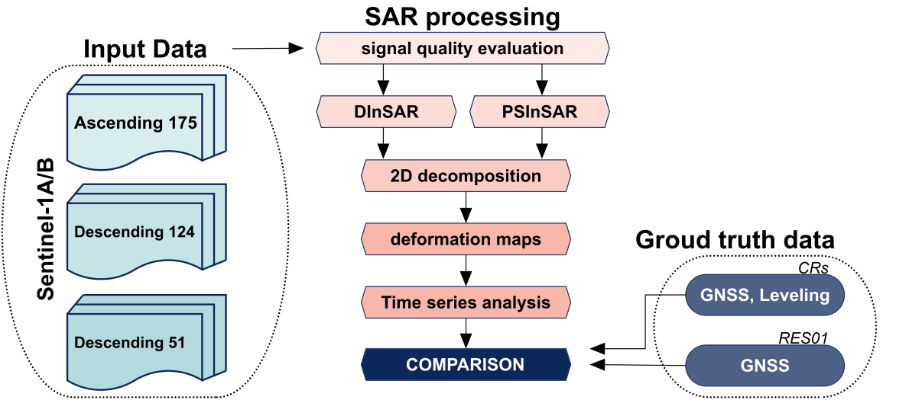
METHODS
DATA PROCESSING
The deformations were estimated using two independent techniques – DInSAR and PSInSAR. Additionally, to increase the final results in terms of pixel density as well as interferogram quality, we investigated weather information and multitemporal coherence.
STEP 1:
STEP 2:
Deformations from all geometries were decomposed from Line of Sight (LOS) into 2D deformation components (vertical and easting).
STEP 3:
The results were compared with ground truth data such as GNSS and Leveling measuraments on CRs as well as permanent GNSS measurament at RES01 station.
More INFO:
Click on the picture to enlarge them
Start

Slide 12

PROCESSING WORKFLOW
Exit

Slide 13
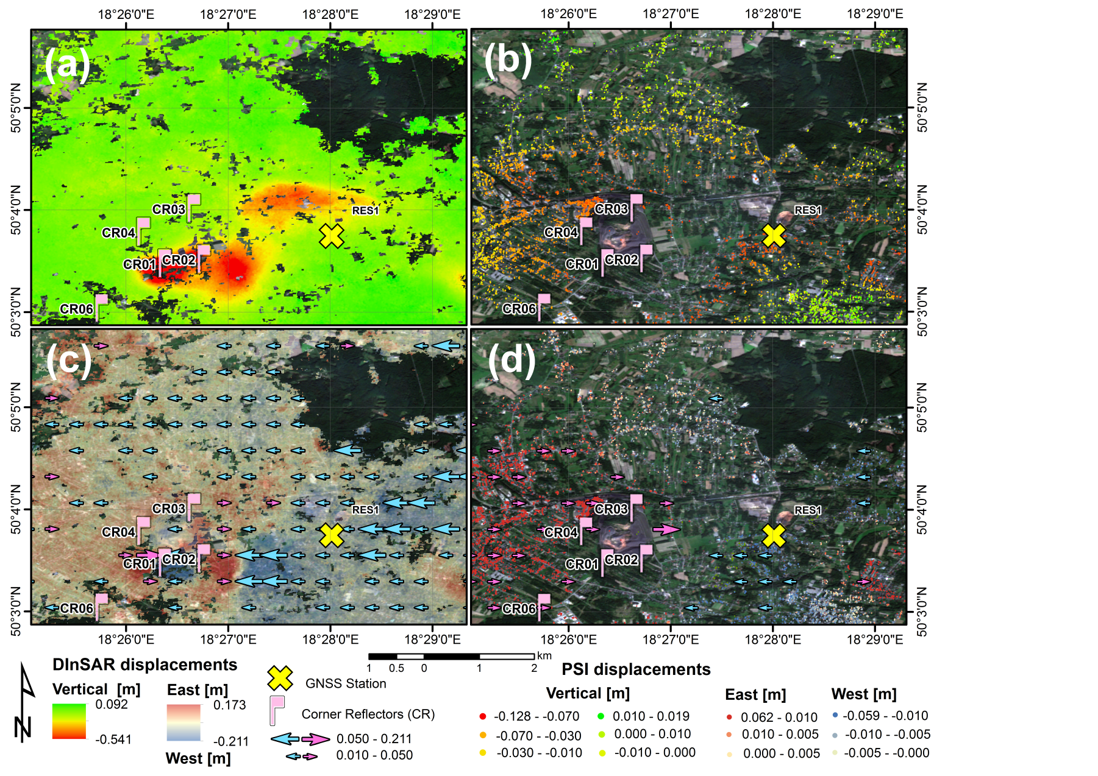
RESULTS
OUR RESULTS
DInSAR-> the maximum deformation gradient reaches 54.1 cm and 21.1 cm for vertical and easting component, respectively and was only detected with DInSAR method (Fig.3 a,c)
PSInSAR-> the area of the maximal deformation gradient in the centre of the subsidence were not estimated. The maximal deformation gradient which could reaches 12.8 cm and 6.2 cm for vertical and easting deformation component (Fig.3 b,d).
Corner Reflectors
RES01 Station
More INFO:
Click on the picture to enlarge them
Click buttons
Conclusions
Fig. 3. Vertical (a,b) and easting (c,d) deformation components for DInSAR (a,c) and PSI (b,d) methods, respectively.
Start

Slide 14

Fig. 3. Vertical (a,b) and easting (c,d) deformation components for DInSAR (a,c) and PSI (b,d) methods, respectively.
Exit

Slide 15
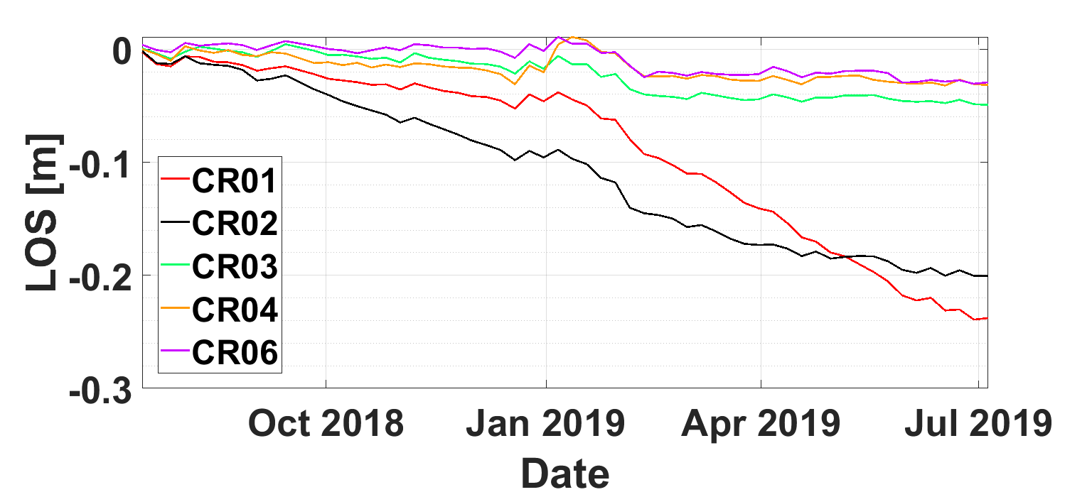
RESULTS
CRs results
PSInSAR
it was impossible to determine the deformation for reflectors CR01, CR02 located in two main subsidence basin characterized by high nonlinearity and high defromation gradient (Fig. 4)
accuracy of the measurement are very high reaching 5 mm and 7 mm for vertical and horizontal deformation component (Tab.2)
it was possible to determine deformation for all CRs (Fig.4)
accuracy of the technique is lower than PSI, reaching 2.6 cm and 3.5 cm for easting and vertiacal deformation component (Tab. 2)
DInSAR
Table 2. Results for all CRs from DInSAR and PSInSAR technique.
CR |  | East - West [m] |  | Up[m]
 | GNSS | PSI | DInSAR | Levelling | PSI | DInSAR
CR01 | -0.125 | - | -0.135 | -0.457 | - | -0.385
CR02 | 0.079 | - | 0.056 | -0.216 | - | -0.194
CR03 | 0.019 | 0.023 | 0.005 | -0.050 | -0.038 | -0.038
CR04 | 0.030 | 0.027 | -0.008 | -0.020 | -0.025 | -0.012
CR06 | 0.026 | 0.019 | -0.005 | -0.015 | -0.015 | -0.025
RMSE: |  | 0.005 | 0.026 |  | 0.007 | 0.035
Fig. 4. DInSAR time series results from 175 ascending orbit for all CRs.
More INFO:
Click on the picture to enlarge them
Start
RESULTS

Slide 16
Fig. 4. DInSAR time series results from 175 ascending orbit for all CRs. The deformations are presented in the LOS direction. At CR01 and CR02 the fast and non-linear deformation pattern are observed.
Exit

Slide 17
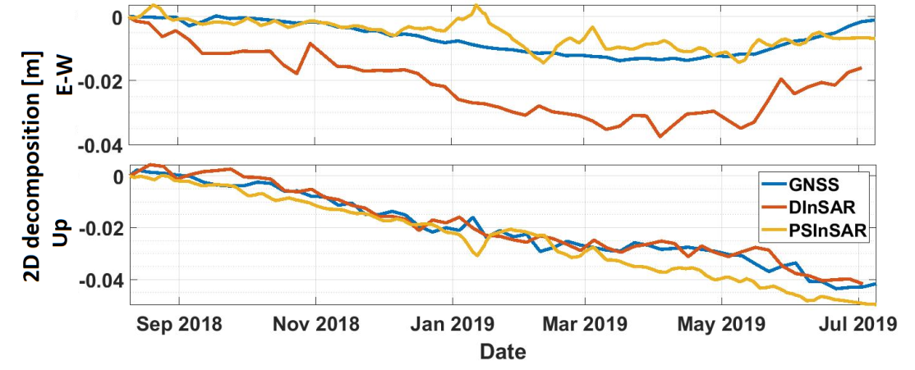
RESULTS
RES01 permanent station
The deformation time series in the vertical direction for the DInSAR and PSInSAR solutions are convergent to the GNSS-based deformations estimated by post-processing approach (Fig.5),
There are not significant fluctuations visible in PSInSAR or DInSAR results (Fig.5). In the case of the east component, it is noticeable that there is a larger discrepancy for DInSAR than PSInSAR solution. Probably it is connected with the presence of atmospheric artifacts in the DInSAR results,
Root Mean Square Error (RMSE) between deformations measured by GNSS and SAR techniques are presented in Table 3.
Table 3. RMSE value on RES01 station
Method | RMSE [m]
 | E-W | Up
DInSAR | 0.015 | 0.003
PSInSAR | 0.004 | 0.005
Fig. 5. East and Up components from DInSAR and PSI decomposition in comparison with GNSS RES01 station results
Start
RESULTS
More INFO:
Click on the picture to enlarge them

Slide 18

Fig. 5. East and Up components from DInSAR and PSInSAR decomposition in comparison with GNSS RES01 station results.
Exit

Slide 19



RESULTS
Conclusions
Installation of artificial CRs in such areas may allow to restore stability of the radar signal
PSInSAR:
precisely deformation estimation (the mm level)
allowed to estimate deformations only for three of the five CRs due to the fast and non-linear deformation pattern
DInSAR:
deformations determined for the whole area of intrest
lower accuracy than in PSInSAR solution due to lack of atmospheric artifacts modelling
The synergic application of both methods seems to be the golden mean. Thus, future work will aim to integrate both methods for mining deformation monitoring.
Start
RESULTS

Slide 20

Satellite Radar Interferometry on corner reflectors
in the area of mining region in Poland
Natalia Wielgocka¹, Kamila Pawluszek-Filipiak¹, Damian Tondaś¹, Andrzej Borkowski¹
¹Wrocław University of Environmental and Life Sciences
contact: natalia.wielgocka@upwr.edu.pl
Thank you for your attention!

