Slide 1


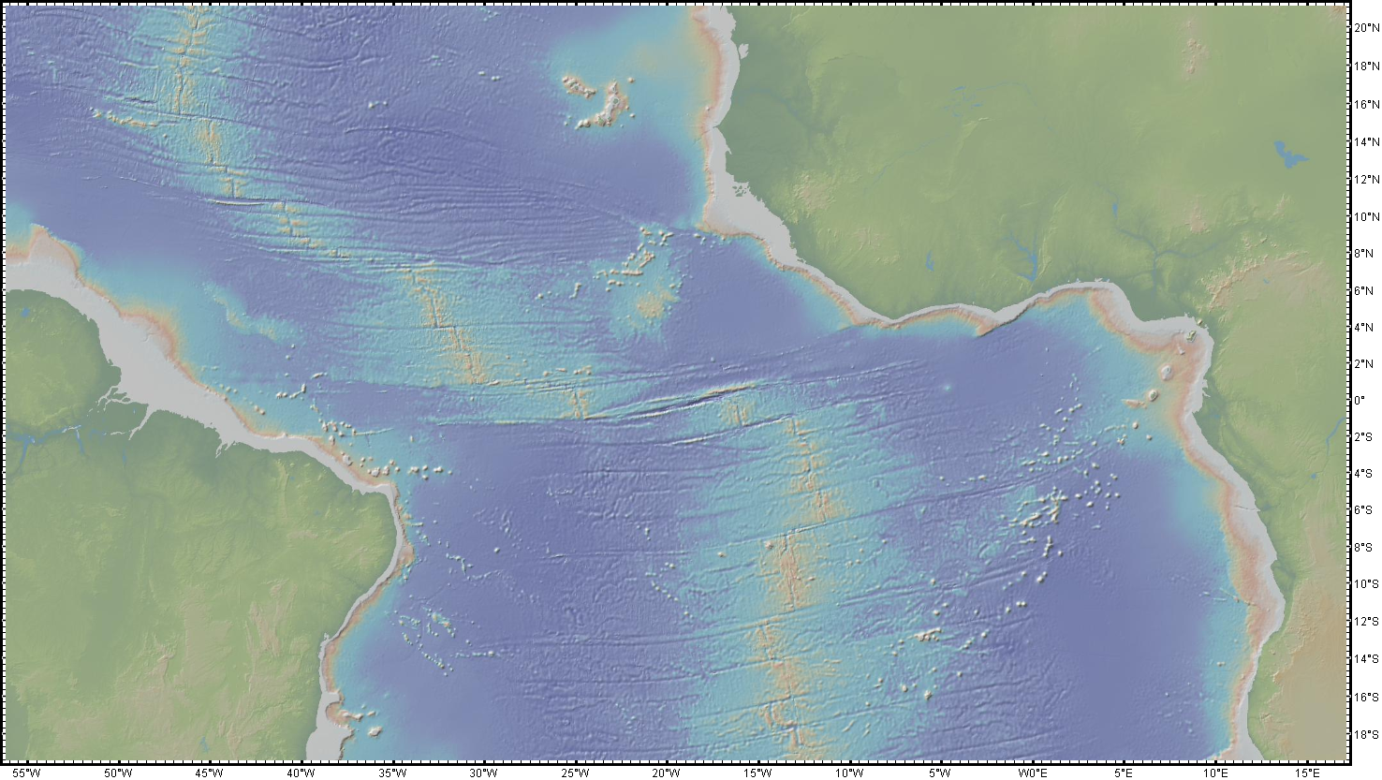



Transform faults are forever
Are Fracture Zones tectonically active?
Paola Vannucchi, Jason P. Morgan, David Iacopini

Slide 2
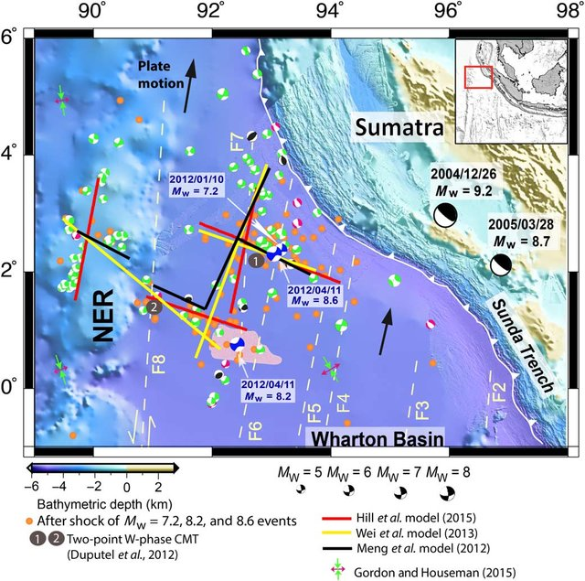
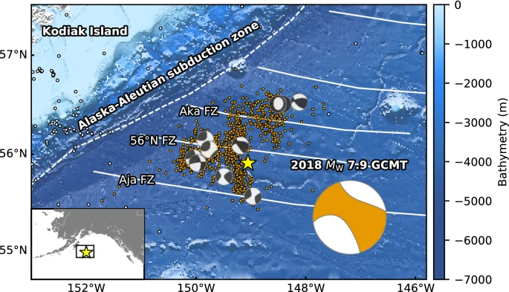
We know Fracture Zones can remain seismically active
Singh et al, 2017
Yamashita et al., 2021
What about FZs associated with a rifted transform margin?

Slide 3
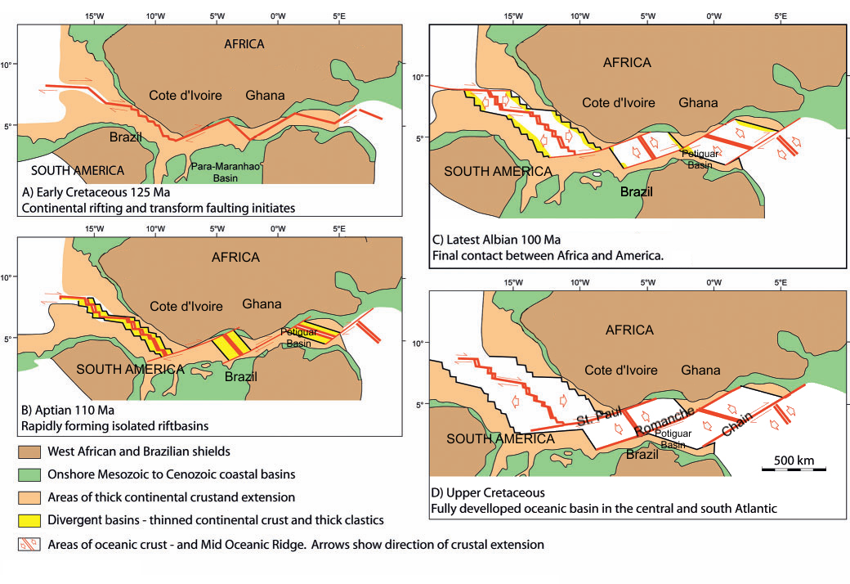
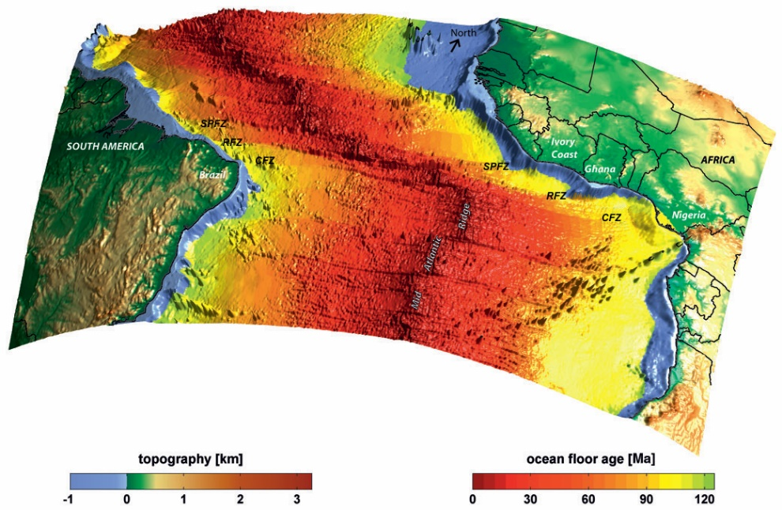
Brazilian Equatorial Margin
Ruepke et al., 2010
Large-age-offset fracture zones
Modified from Mascle et al., 1988

Slide 4
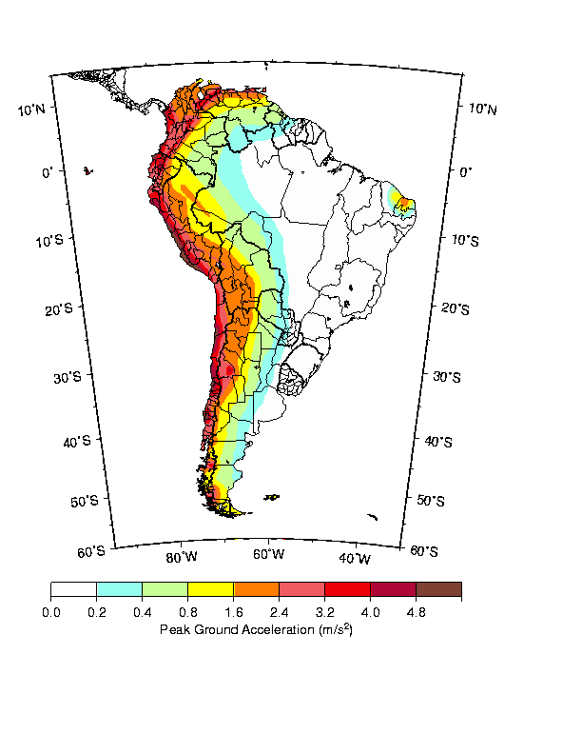
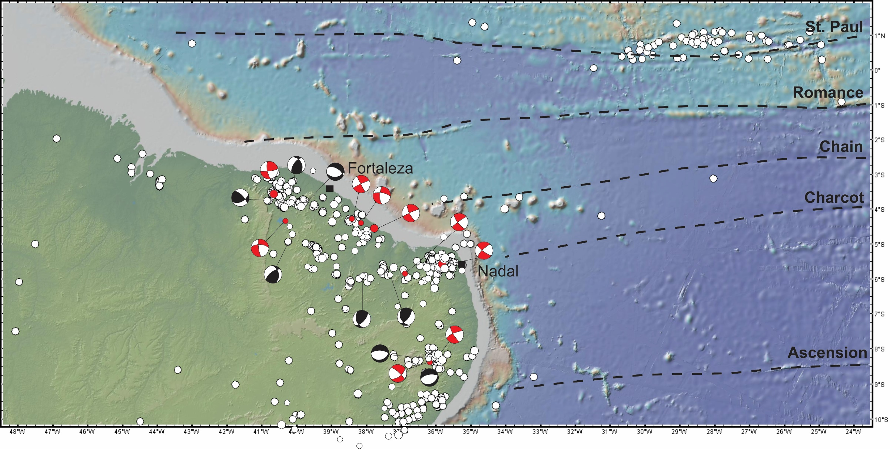
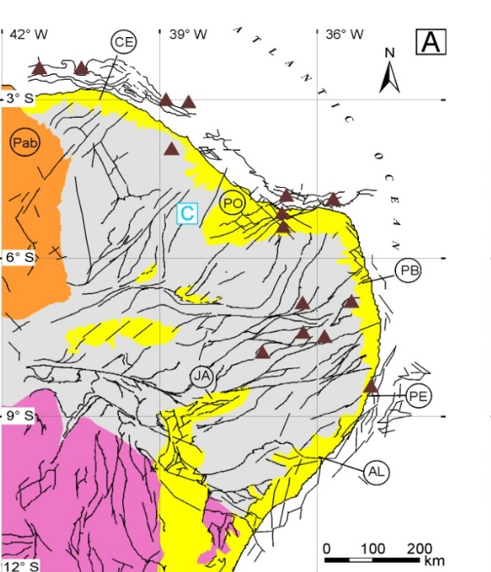
Active deformation occurs mainly in a strike-slip stress regime and it is partitioned between a complex network of Neoproterozoic faults
Shedlock & Tanner, 1999
Earthquake magnitude between 2 and 5.1
From the earthquake catalogue 1900-2021 of the Seismological Center at the University of Sāo Paulo
Bezerra et al., 2011
Borborema Province
Sāo Francisco Craton

Slide 5
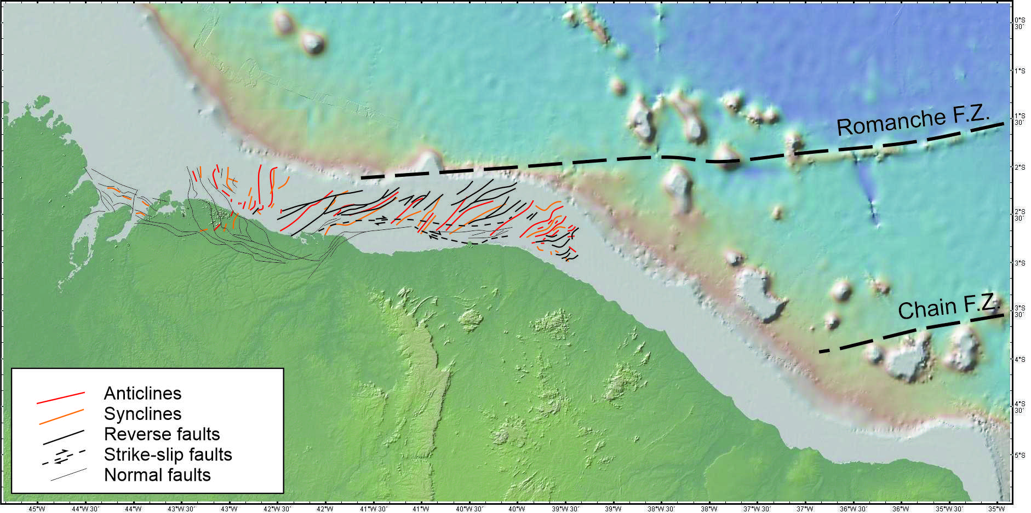
Offshore deformation
Mapped structures mostly indicate contraction (NW-SE)
From Davison et al., 2016 and this study

Slide 6
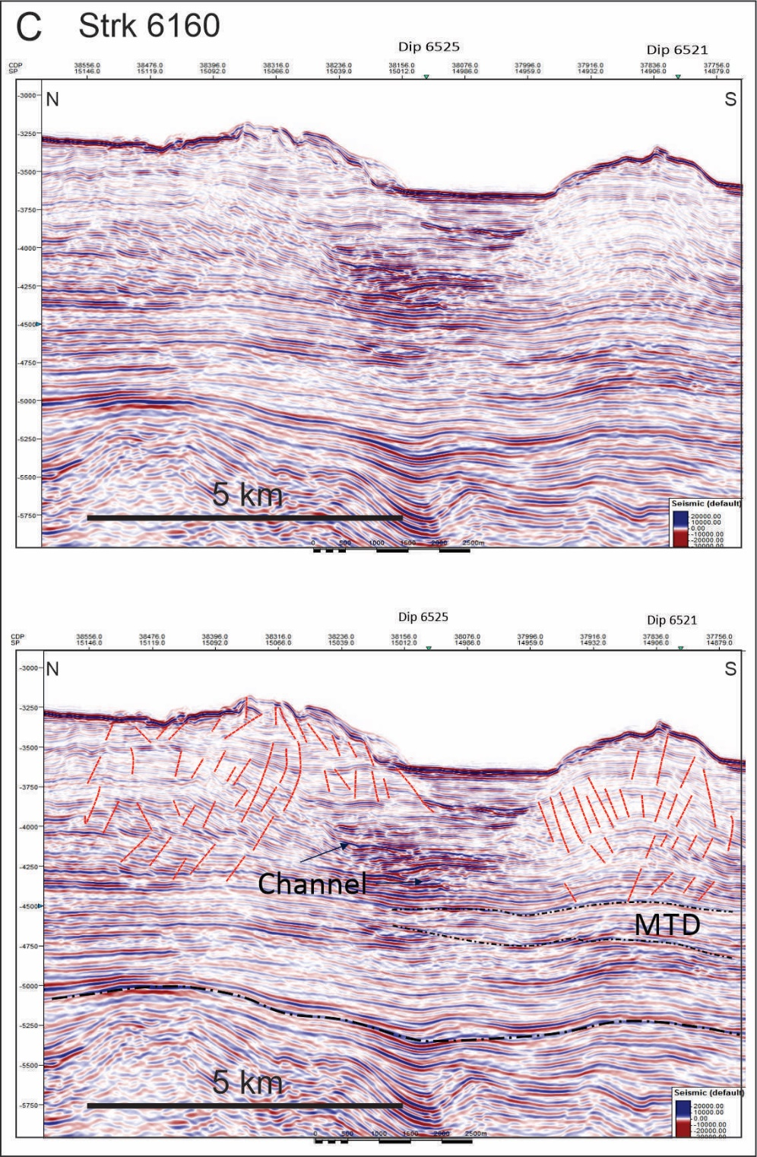
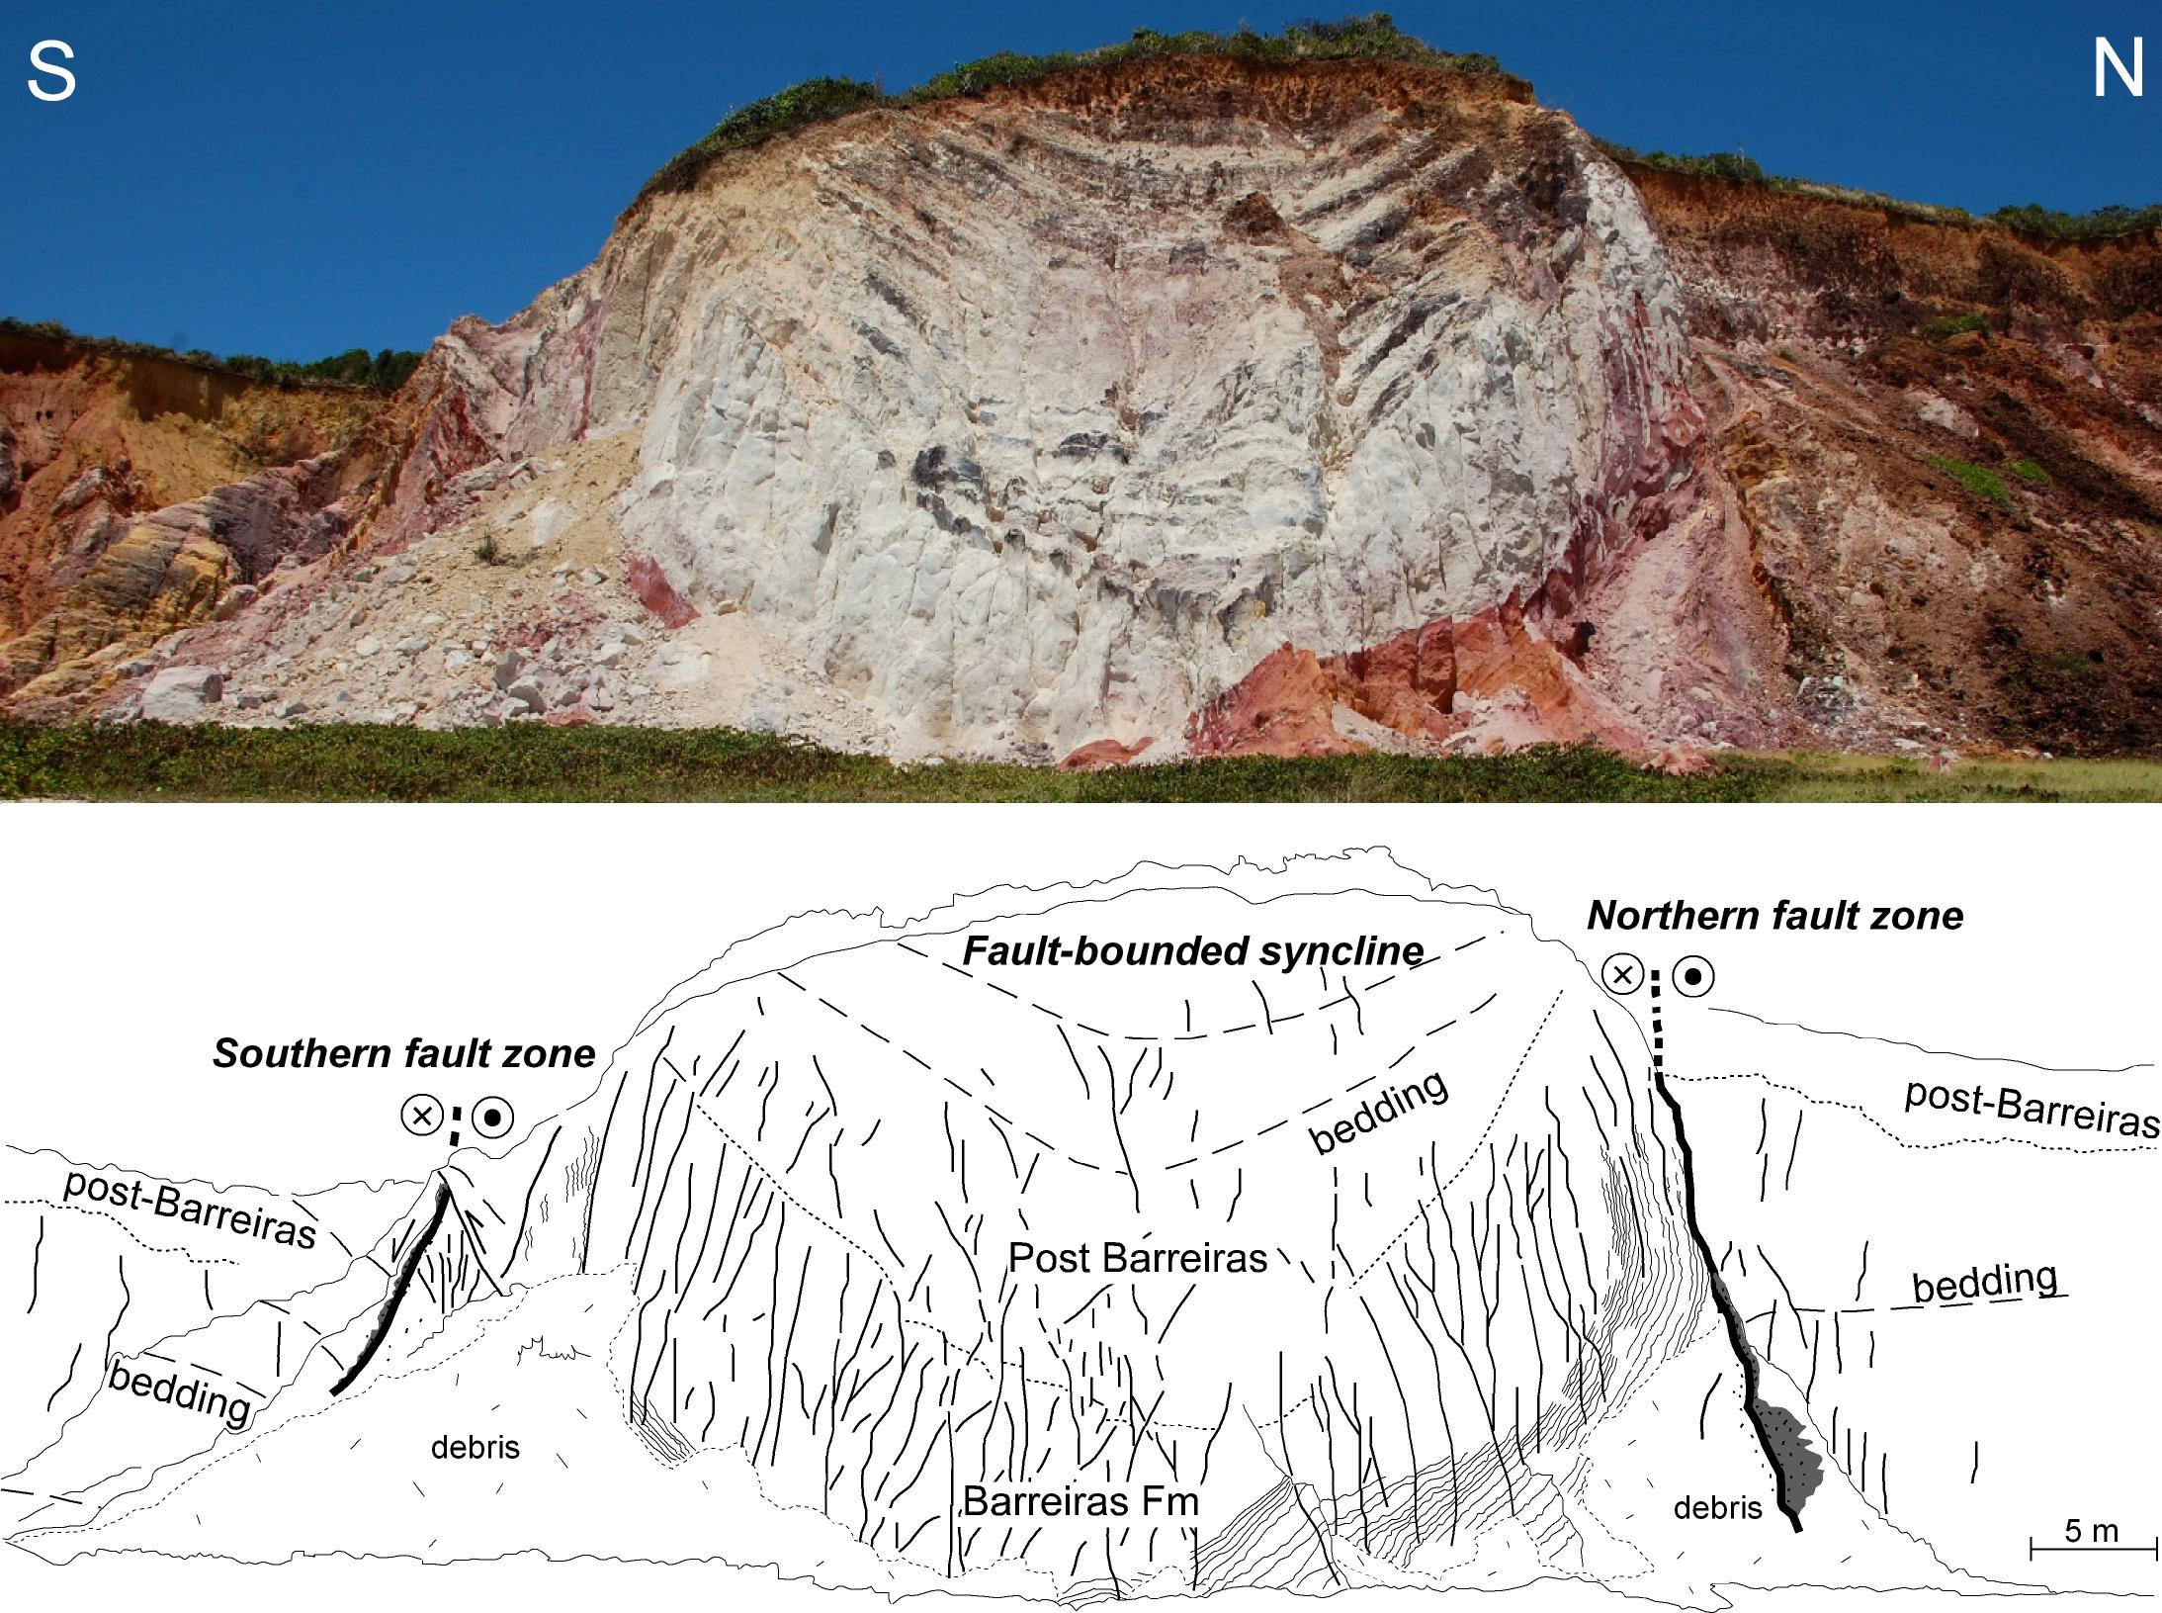
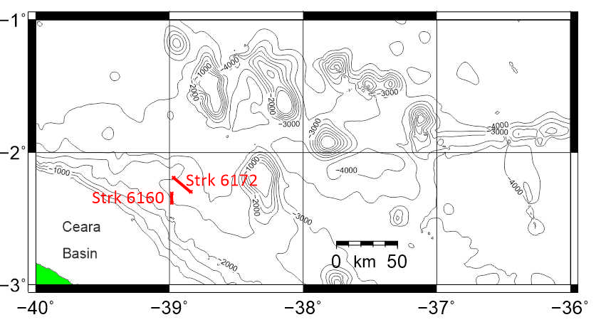
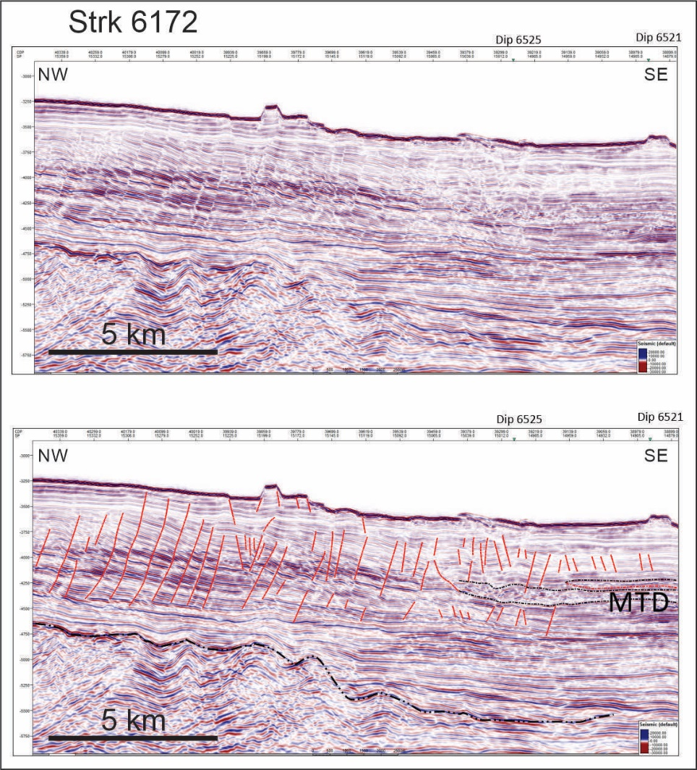
Active deformation of the ocean floor
Late Quaternary
Miocene
Seismic data provided thanks to Western Geco
Balsamo et al., 2013

Slide 7
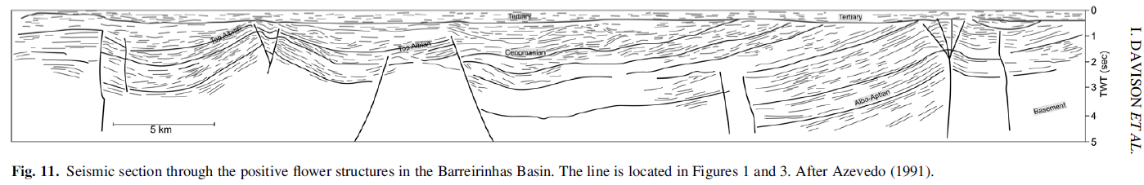
At depth E-W strike-slip accommodated by lithospheric flower structures

Slide 8
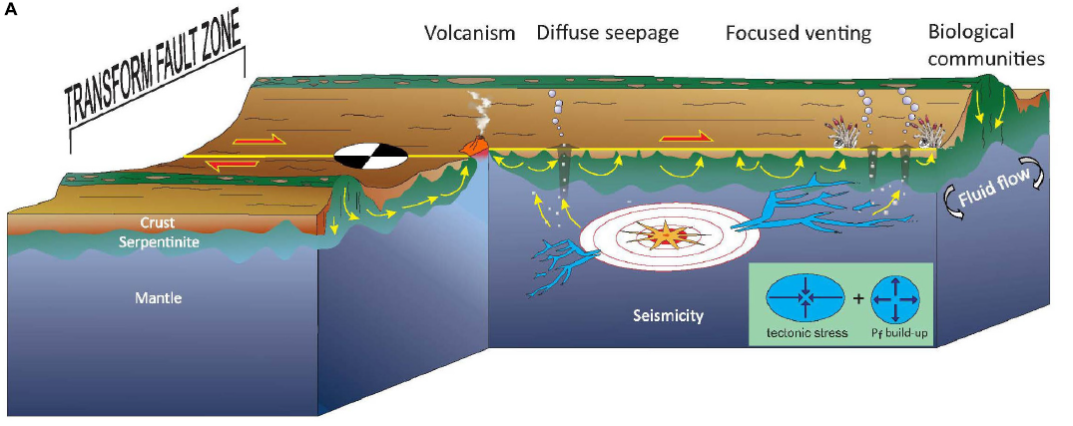
Fracture Zones are born as weak faults
Serpentinite persistently weak
Weakness alone does not explain why it is persistently loaded.
What generates these stresses?
Hensen et al., 2019

Slide 9
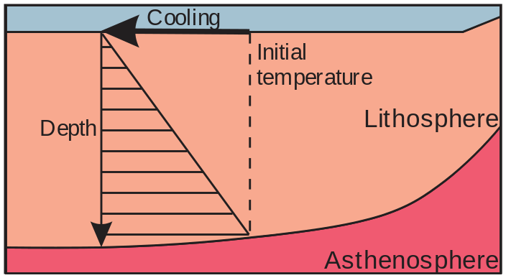
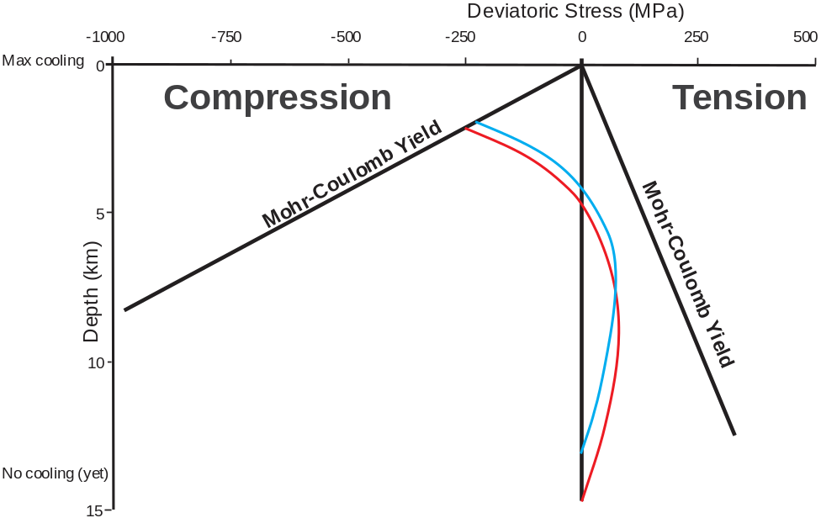
Thermal stresses are permanent
Thickness-averaged thermal contraction in the plate
As the lithosphere keeps moving away from the ridge it keeps thickening with age.
When it thickens at the bottom, that bottom material cools and contract.
The cooling increment puts the entire lithosphere under additional stress that causes the top to fail in compression.
Largest unbalanced thermal stresses are anticipated to occur across large-age-offset fracture zones — like those that intersect the northern Brazilian margin.
Extra deviatoric stress
10 Ma
12 Ma
Thermal bending stress accumulation→ incremental stresses will set up an incremental thermal bending that will cause flexure at the transform fault
Modified from Haxby and Parmentier, 1988

Slide 10
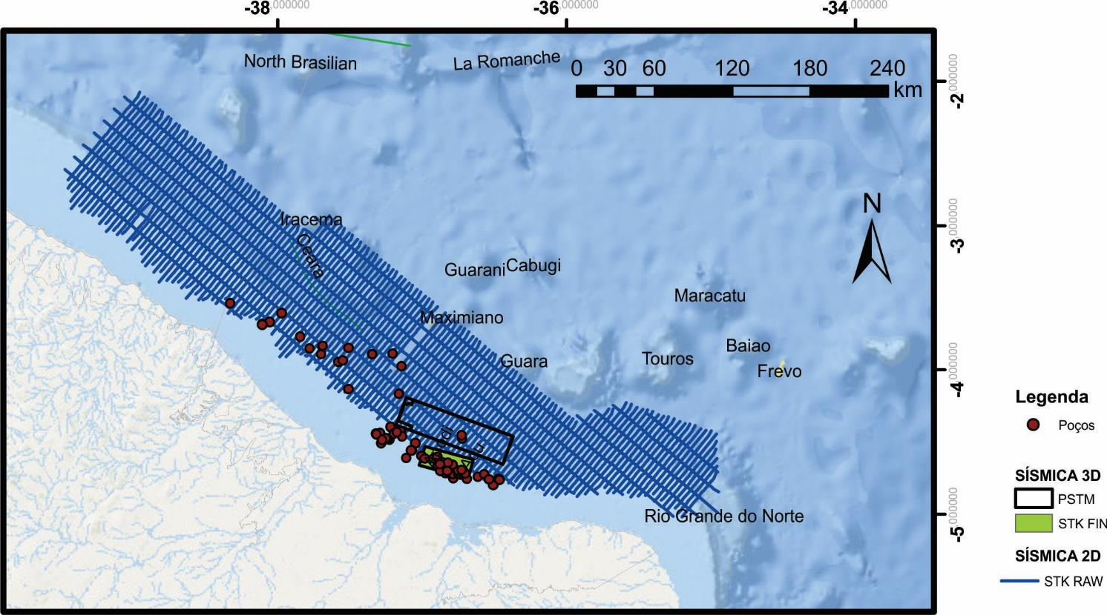
Future work
La Romanche
La Chain

Slide 11
Conclusions
Fracture zones associated with rifted transform margins can remain tectonically, and maybe even seismically active.
Fracture zone tectonic activity is also able to influence deformation in the continent.

