Slide 1



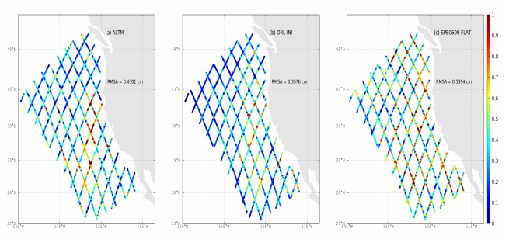
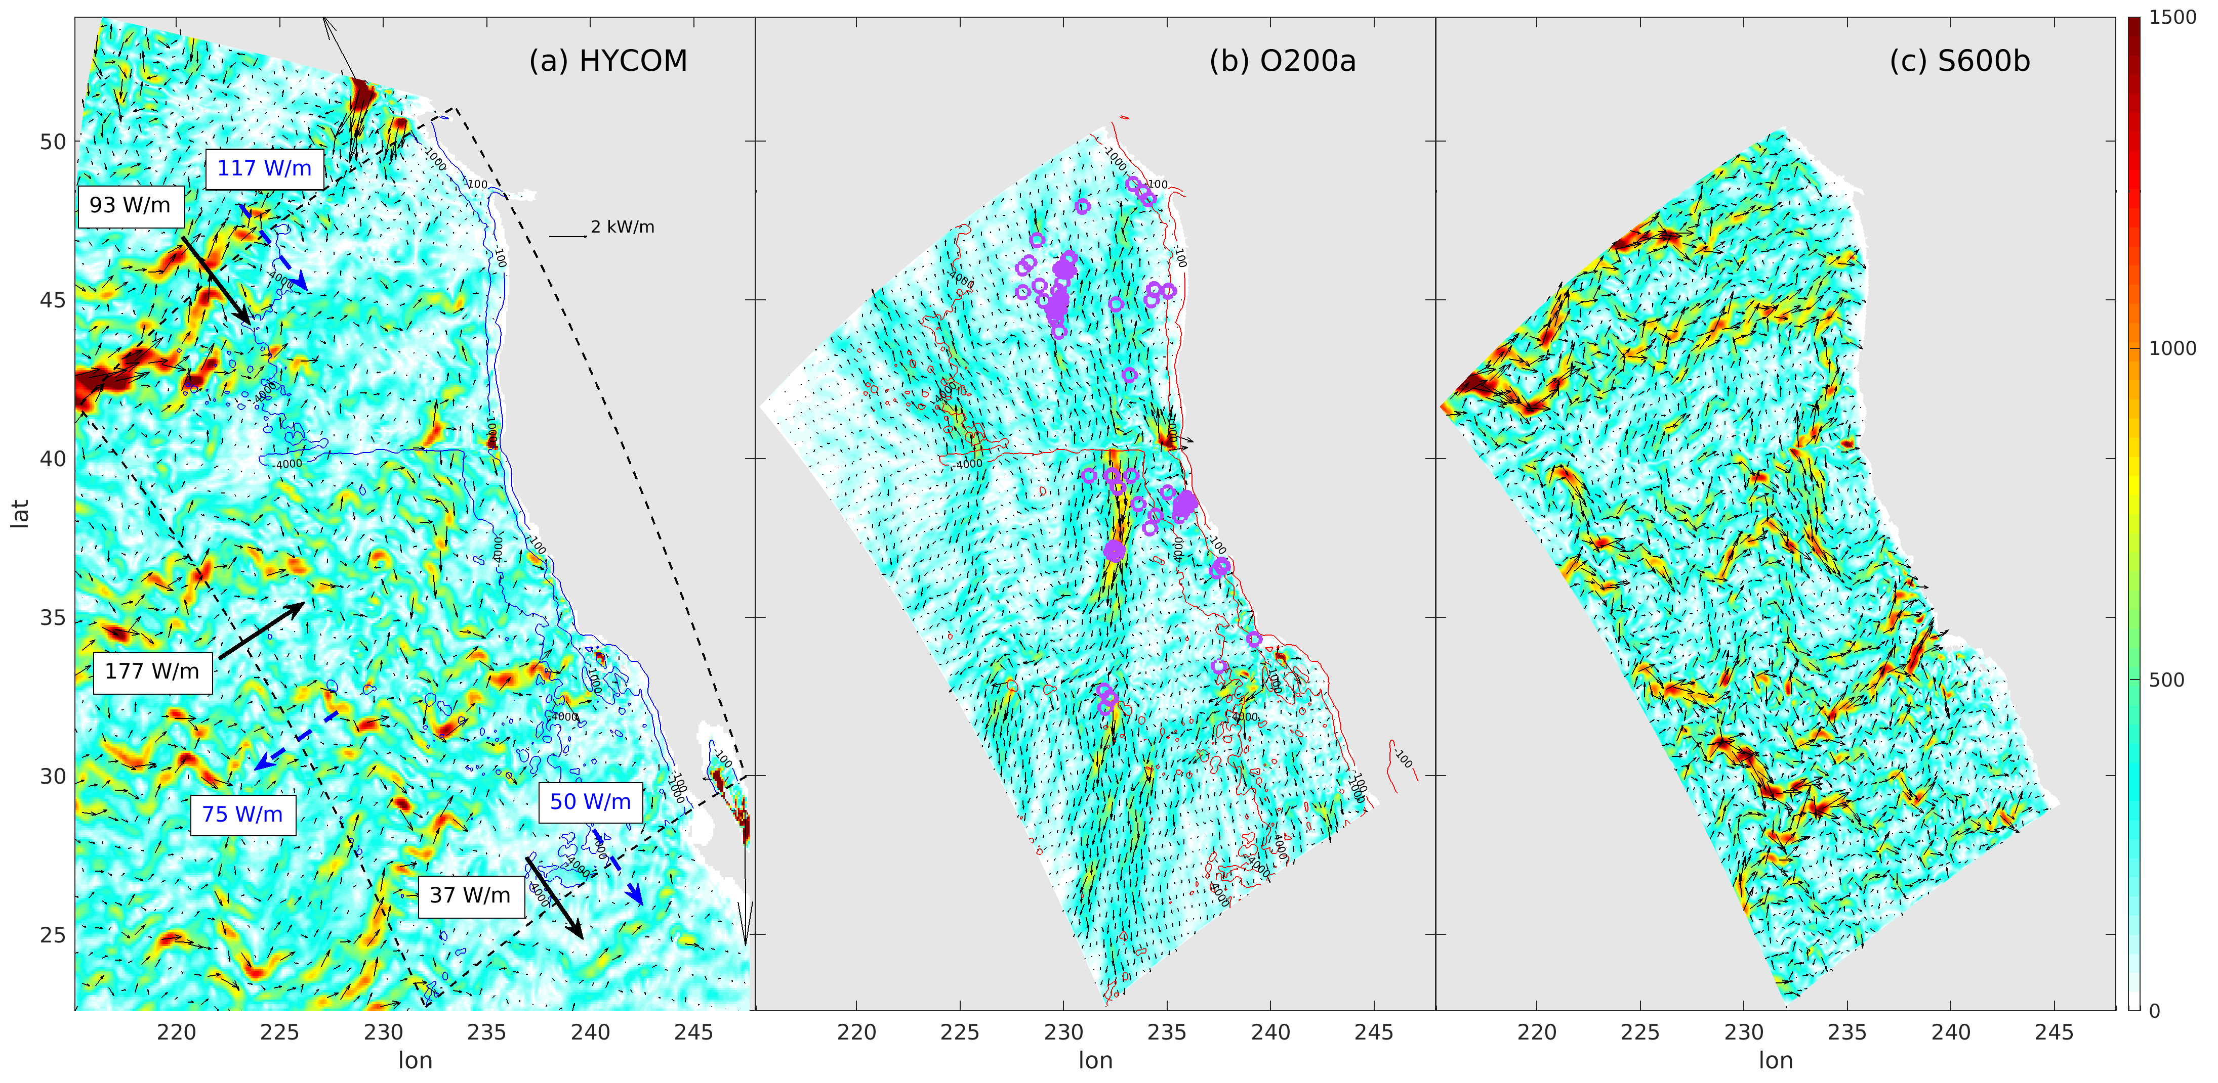

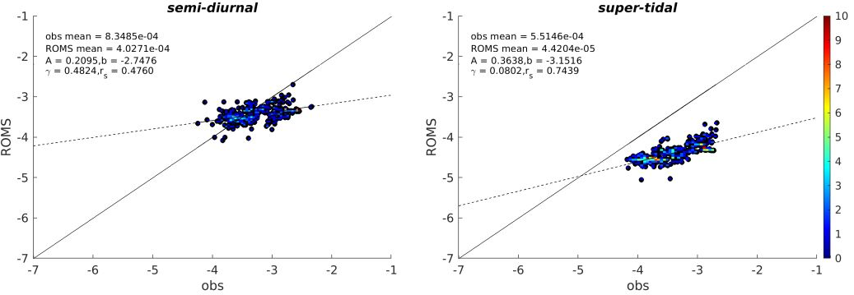
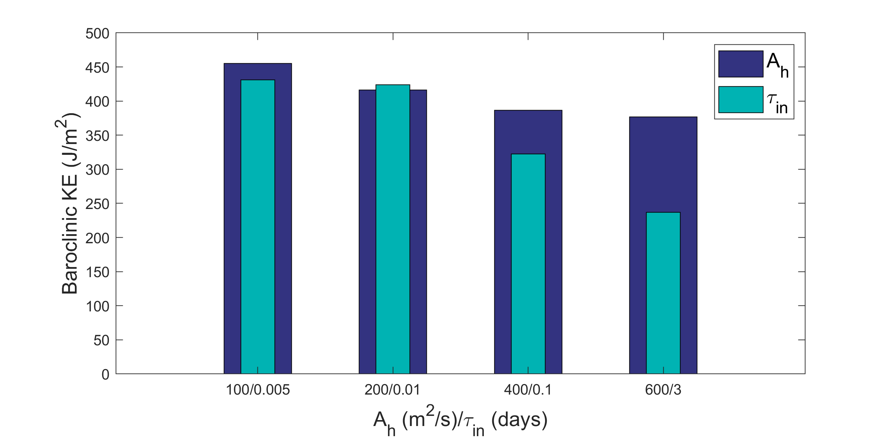
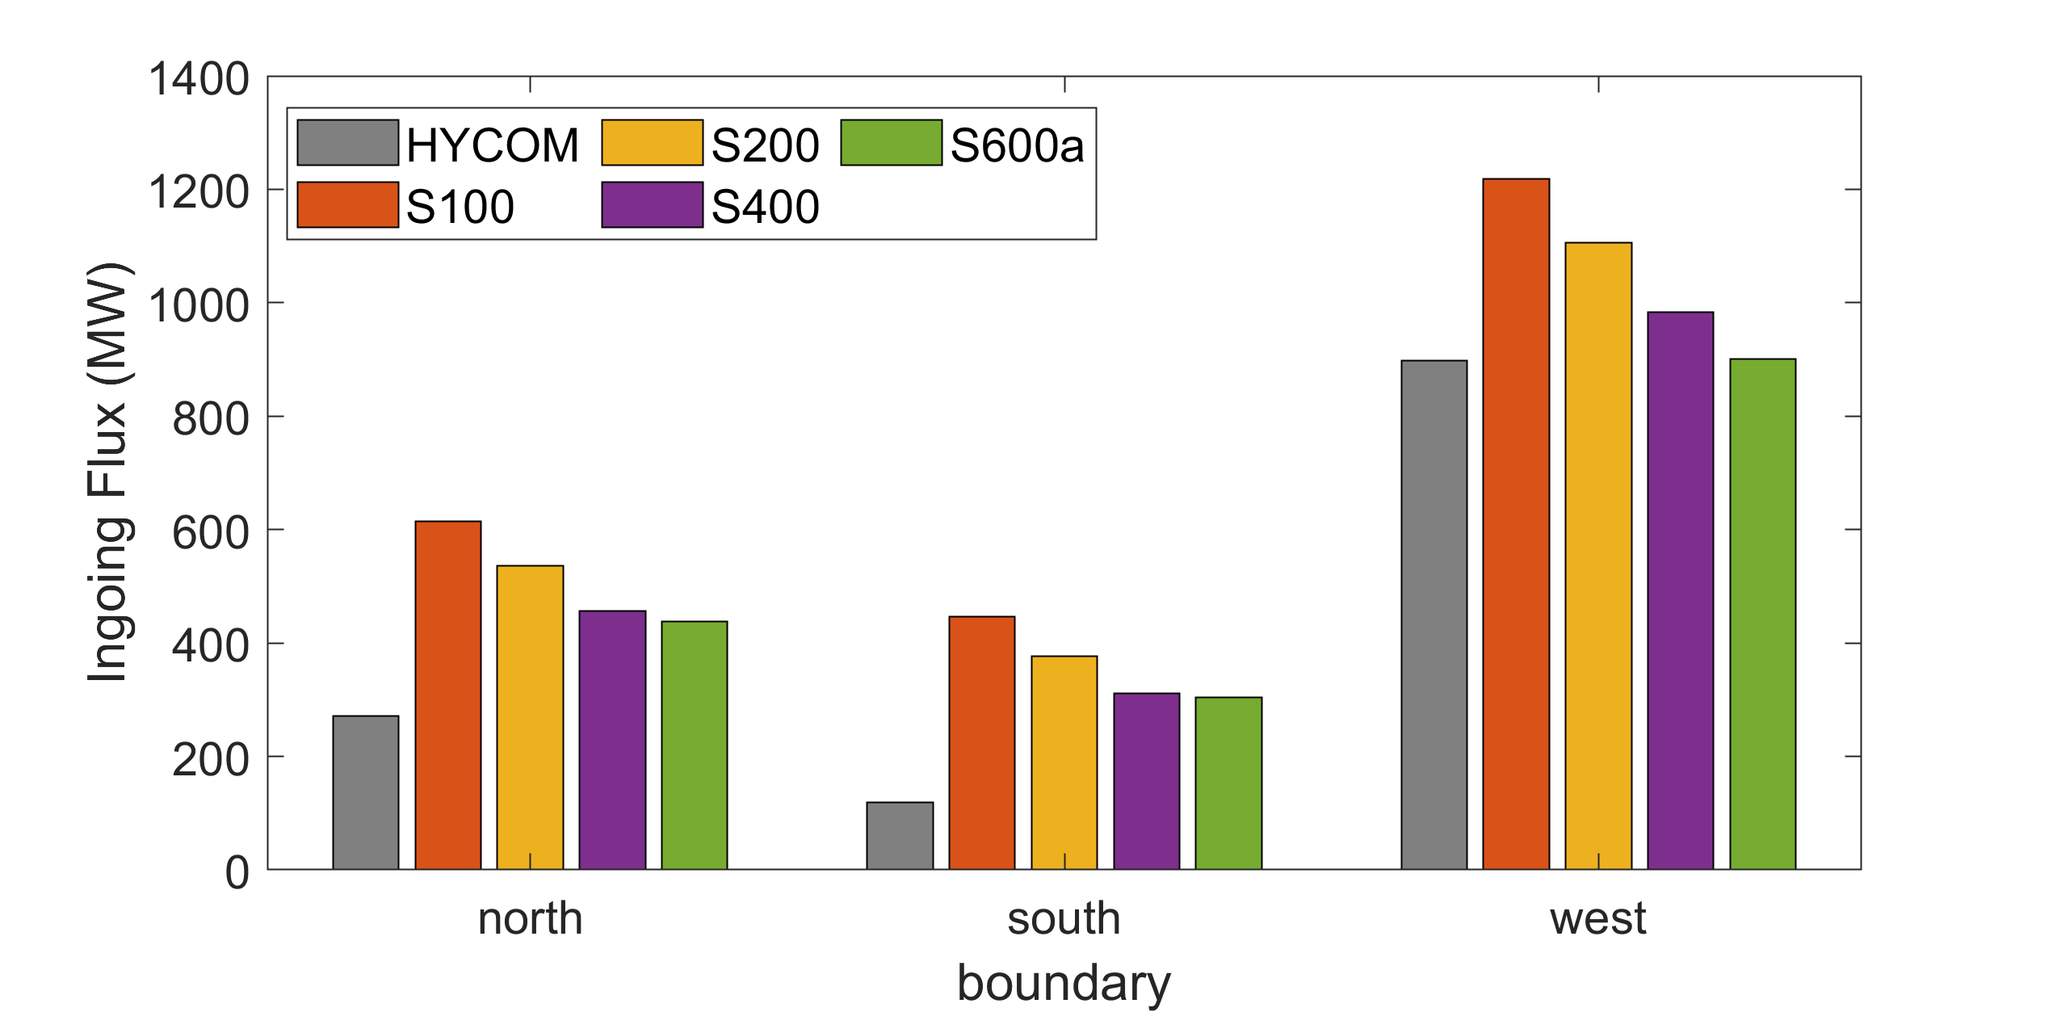
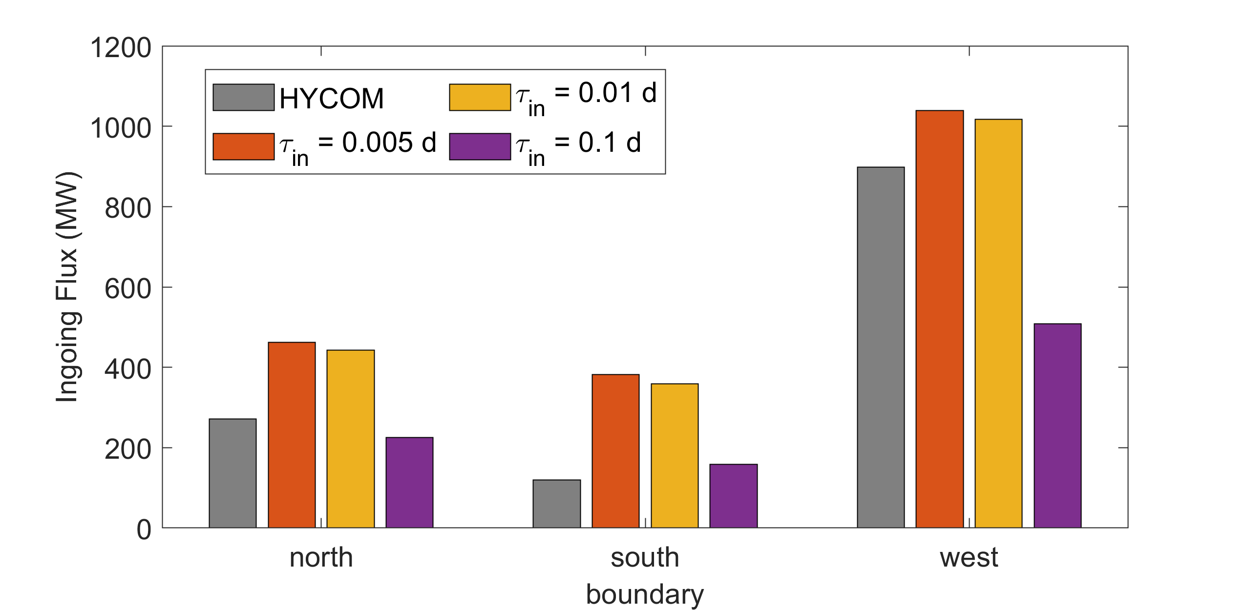

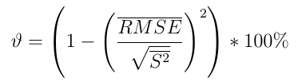
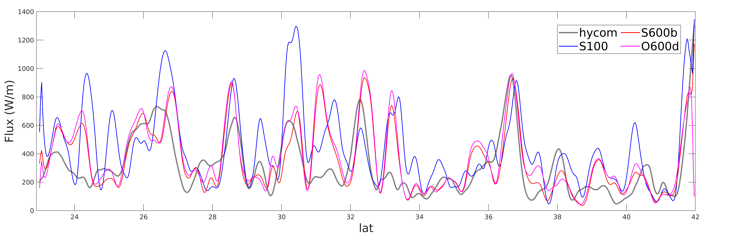
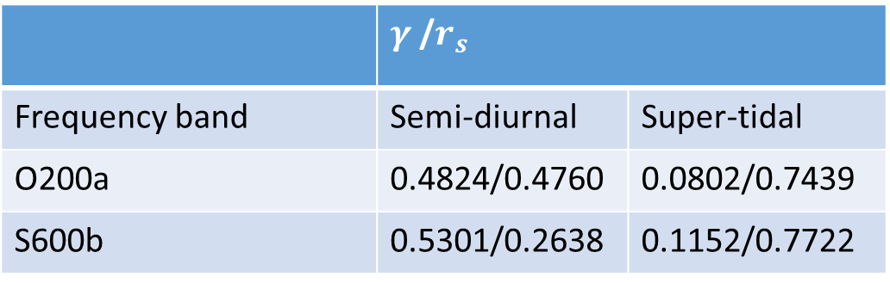

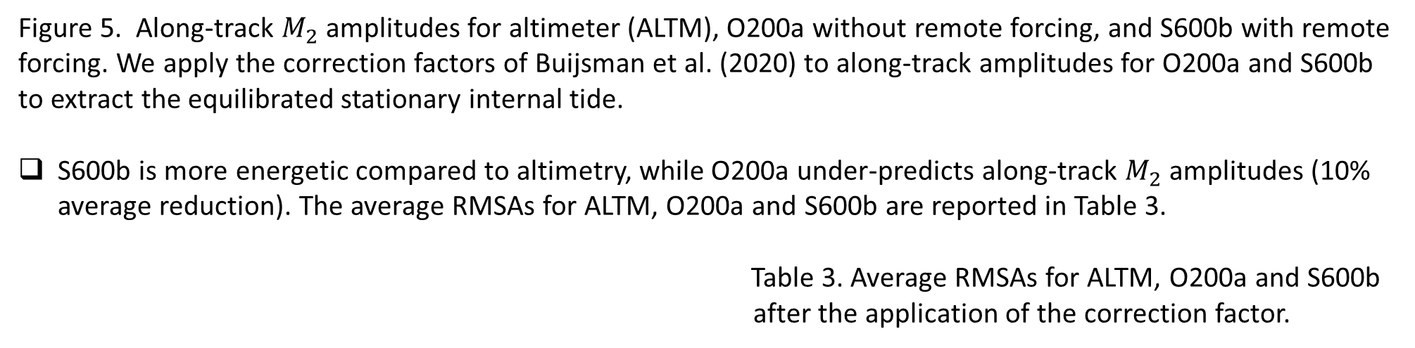
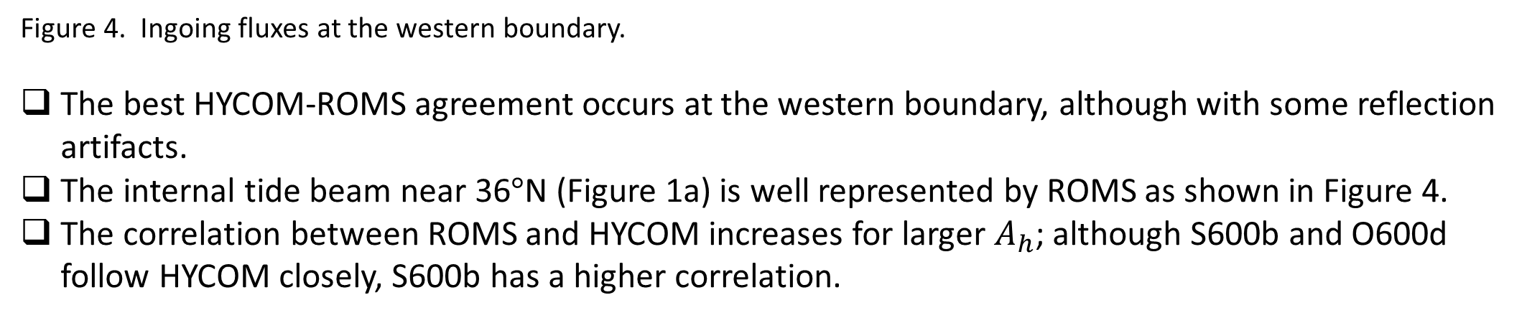
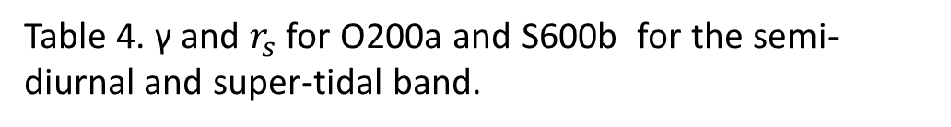
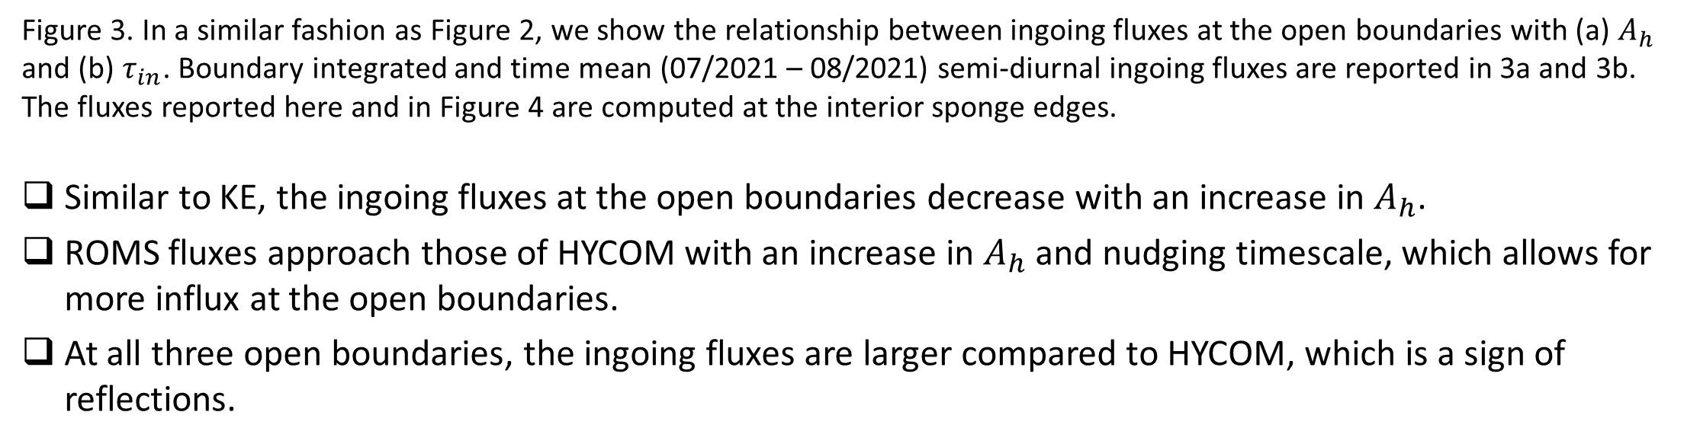
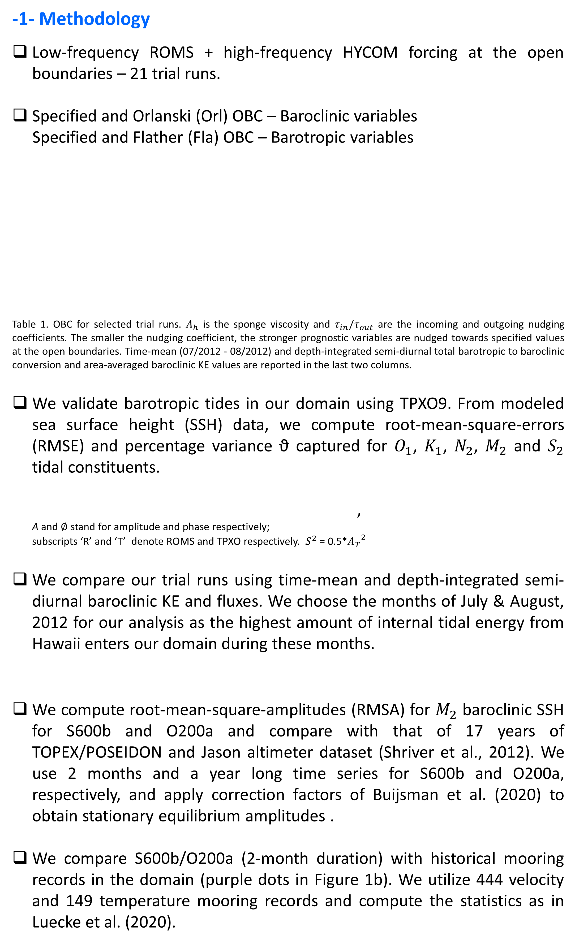
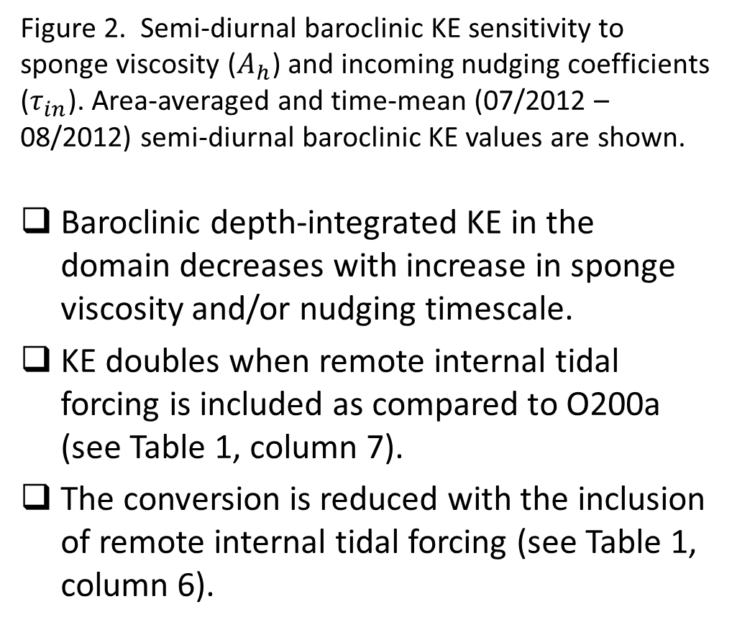
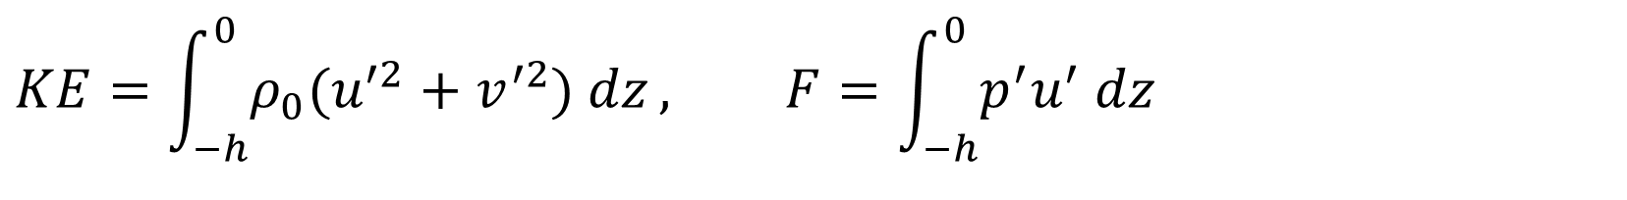
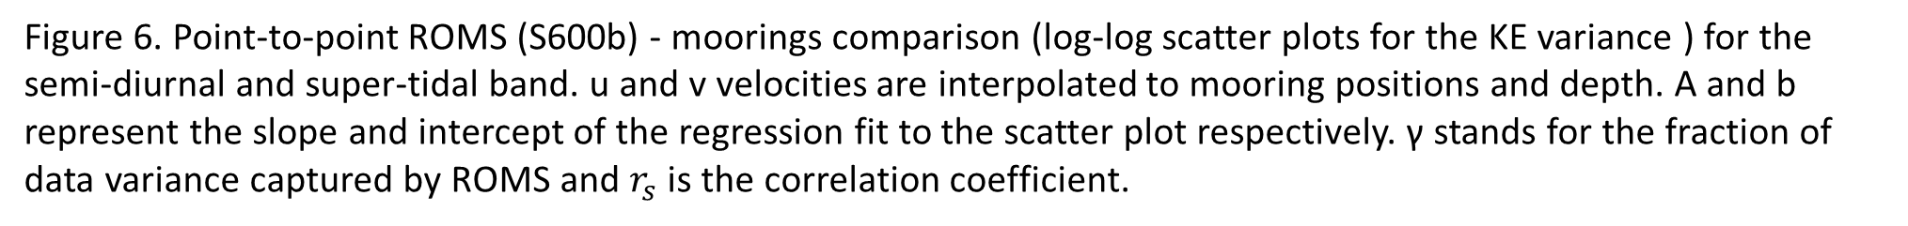

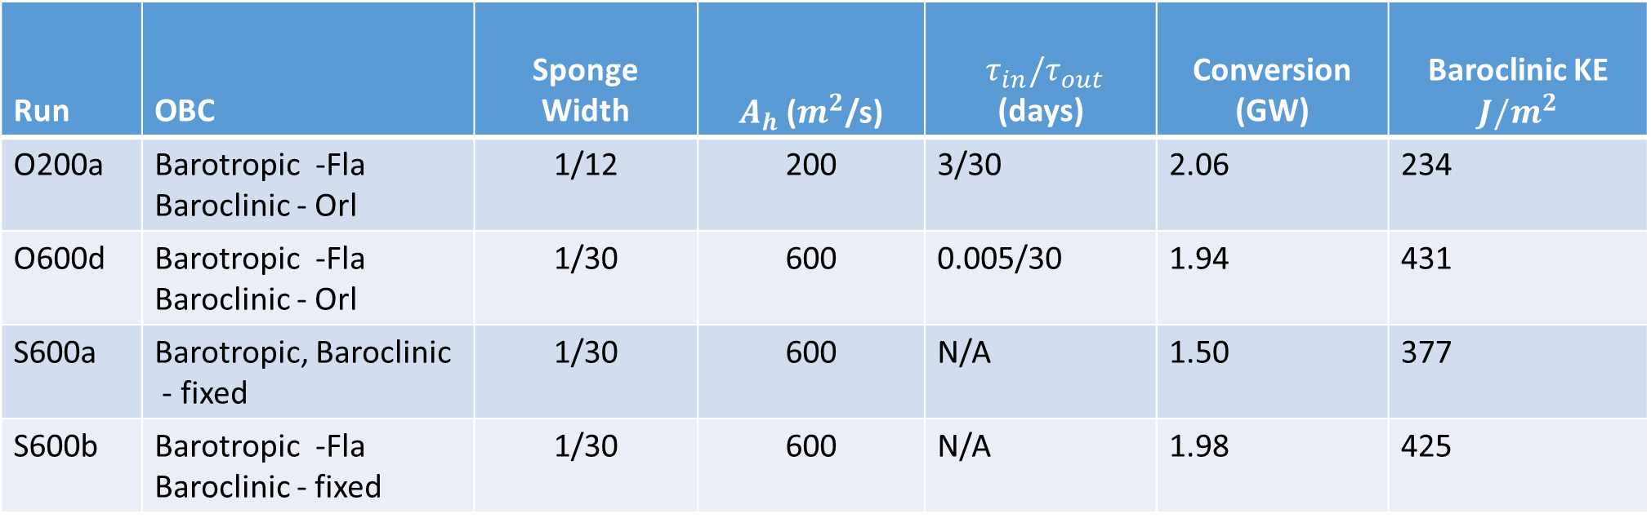
Finding appropriate Boundary Conditions for High Frequency Forcing of Regional Simulations: California Current System as a Case Study.
Oladeji Siyanbola (oladeji.siyanbola@usm.edu) & Maarten Buijsman, University of Southern Mississippi
Roy Barkan, Tel Aviv University & Brian Arbic, University of Michigan
Introduction
In this study, we conduct realistic 4-km resolution regional simulations of the California Current System (CCS) using Regional Ocean Modelling System (ROMS). The ROMS simulations are boundary-forced with surface tides, non-locally generated internal tides, and inertial waves. Forcing fields are obtained from the offline 8-km (H12) resolution global HYbrid Coordinate Ocean Model (HYCOM). Time-mean (October 2011-September 2012) and depth-integrated high-frequency baroclinic energy fluxes from remote waves from HYCOM at the ROMS boundaries are shown in Figure 1a.
The objective of this poster presentation is to show how well different open boundary conditions (OBC) perform in propagating remote internal tides into the ROMS domain while minimizing reflections at the boundaries.
We also conduct model-data comparisons with the use of altimetry and historical mooring data. We show that the simulations agree better with observations in the high-frequency regime when high-frequency remotely generated internal tides are included at the open boundaries.
The layout of this poster is as follows:
Methodology (panel 1)
Results (panel 2)
Conclusions (panel 3)
Future Work and References (panel 4).
Figure 2. Baroclinic KE
sensitivity to sponge viscosity ($A_{h}$) and incoming nudging coefficients ($τ_{in}$). Blue bars are used to show how area-averaged time-mean and depth-integrated baroclinic KE changes with $A_{h}$ while the relationship between baroclinic KE and $τ_{in}$ is shown using green bars.
$γ$ /$r_{s}$
-2- Results
-2b- Baroclinic (contd.)
-2c- Model-data comparison: Moorings
-2a- Barotropic
ALTM
O200a
S600b
Flather OBC has smaller RMSE and higher percentage variance captured compared to fixed OBC for all the five tidal constituents
OBC
 | Tidal constituent | O1 | K1 | N2 | M2 | S2
Fixed (S600a) | RMSE (cm) | 3.19 | 5.69 | 3.39 | 16.75 | 4.18
 | ϑ (%) | 94.26 | 93.34 | 73.54 | 71.22 | 80.00
Flather (S600b) | RMSE (cm) | 3.04 | 5.31 | 3.43 | 16.52 | 3.76
 | ϑ (%) | 95.07 | 94.58 | 74.58 | 74.40 | 88.10
Table 2. SSH RMSE and percentage variance captured for Flather (S600b) and fixed OBC (S600a).
-2b- Baroclinic
Figure 5. Along-track $M_{2}$ amplitudes for altimeter (ALTM), O200a without remote forcing, and S600b with remote forcing. We apply the correction factors of Buijsman et al. (2020) to along-track amplitudes for O200a and S600b to extract the equilibrated stationary internal tide.
S600b is more energetic compared to altimetry, while O200a under-predicts along-track $M_{2}$ amplitudes (10% average reduction). The average RMSAs for ALTM, O200a and S600b are reported in Table 3.
Table 3. Average RMSAs for ALTM, O200a and S600b after the application of the correction factor.
Run | ALTM | O200a | S600b
RMSA (cm) | 0.43 | 0.39 | 0.68
-1- Methodology
Low-frequency ROMS + high-frequency HYCOM forcing at the open boundaries – 21 trial runs.
Specified and Orlanski (Orl) OBC – Baroclinic variables
Specified and Flather (Fla) OBC – Barotropic variables
Table 1. OBC for selected trial runs. $A_{h}$ is the sponge viscosity and $τ_{in}/τ_{out}$ are the incoming and outgoing nudging coefficients. The smaller the nudging coefficient, the stronger prognostic variables are nudged towards specified values at the open boundaries. Time-mean (07/2012 - 08/2012) and depth-integrated semi-diurnal total barotropic to baroclinic conversion and area-averaged baroclinic KE values are reported in the last two columns.
We validate barotropic tides in our domain using TPXO9. From modeled sea surface height (SSH) data, we compute root-mean-square-errors (RMSE) and percentage variance ϑ captured for $O_{1}$, $K_{1}$, $N_{2}$, $M_{2}$ and $S_{2}$ tidal constituents.
,
A and $∅$ stand for amplitude and phase respectively;
subscripts ‘R’ and ‘T’ denote ROMS and TPXO respectively. $S^{2}$ = 0.5*${A_{T}}^{2}$
We compare our trial runs using time-mean and depth-integrated semi-diurnal baroclinic KE and fluxes. We choose the months of July & August, 2012 for our analysis as the highest amount of internal tidal energy from Hawaii enters our domain during these months.
We compute root-mean-square-amplitudes (RMSA) for $M_{2}$ baroclinic SSH for S600b and O200a and compare with that of 17 years of TOPEX/POSEIDON and Jason altimeter dataset (Shriver et al., 2012). We use 2 months and a year long time series for S600b and O200a, respectively, and apply correction factors of Buijsman et al. (2020) to obtain stationary equilibrium amplitudes .
We compare S600b/O200a (2-month duration) with historical mooring records in the domain (purple dots in Figure 1b). We utilize 444 velocity and 149 temperature mooring records and compute the statistics as in Luecke et al. (2020).
Figure 1. Depth-integrated and time-mean semi-diurnal baroclinic fluxes. Left – HYCOM, middle – O200a (ROMS run without remote forcing) and right – S600b (ROMS run with remote forcing). In 1a, the black polygon (dashed) represents the extent of our regional domain and the solid (dashed) black (blue) arrows are the boundary-mean and annual-mean semi-diurnal band (inertial band) energy fluxes. Mooring positions are shown in 1b using purple circles.
Figure 2. Semi-diurnal baroclinic KE sensitivity to sponge viscosity ($A_{h}$) and incoming nudging coefficients ($τ_{in}$). Area-averaged and time-mean (07/2012 – 08/2012) semi-diurnal baroclinic KE values are shown.
Baroclinic depth-integrated KE in the domain decreases with increase in sponge viscosity and/or nudging timescale.
KE doubles when remote internal tidal forcing is included as compared to O200a (see Table 1, column 7).
The conversion is reduced with the inclusion of remote internal tidal forcing (see Table 1, column 6).
Figure 6. Point-to-point ROMS (S600b) - moorings comparison (log-log scatter plots for the KE variance ) for the semi-diurnal and super-tidal band. u and v velocities are interpolated to mooring positions and depth. A and b represent the slope and intercept of the regression fit to the scatter plot respectively. γ stands for the fraction of data variance captured by ROMS and $r_{s}$ is the correlation coefficient.
Run | OBC | Sponge Width | $A_{h}$ ($m^{2}$/s) | $τ_{in}/τ_{out}$ (days) | Conversion (GW) | Baroclinic KE $$J/m^{2}$$
O200a | Barotropic -Fla Baroclinic - Orl | 1/12 | 200 | 3/30 | 2.06 | 234
O600d | Barotropic -Fla Baroclinic - Orl | 1/30 | 600 | 0.005/30 | 1.94 | 431
S600a | Barotropic, Baroclinic - fixed | 1/30 | 600 | N/A | 1.50 | 377
S600b | Barotropic -Fla Baroclinic - fixed | 1/30 | 600 | N/A | 1.98 | 425
The variance captured by ROMS for the semi-diurnal band is higher than in the super-tidal band.
We expect an increase in γ for the super-tidal band when we nest down to finer resolutions.
γ increases for the semi-diurnal and super-tidal bands when simulations are forced with remotely generated internal tides
 | $γ$ /$r_{s}$
Frequency band | Semi-diurnal | Super-tidal
O200a | 0.4824/0.4760 | 0.0802/0.7439
S600b | 0.5301/0.2638 | 0.1152/0.7722
Table 4. γ and $r_{s}$ for O200a and S600b for the semi-diurnal and super-tidal band.
-3- Conclusions
Accumulation of dynamical errors with the use of specified OBC for barotropic tides.
Increase in baroclinic KE with the inclusion of remote high-frequency baroclinic forcing at the open boundaries – KE doubling for the semi-diurnal band with remote forcing.
Decrease in baroclinic KE/ingoing fluxes with increase in sponge viscosity for specified and Orlanski runs.
Increase in baroclinic KE/ingoing fluxes with decrease in incoming nudging coefficients for Orlanski runs.
The agreement in energy flux between HYCOM and ROMS is poor at the southern boundary, which radiates energy outward.
Increased data variance captured in the high-frequency regime with the inclusion of remote forcing.
For high-frequency forcing, strong incoming nudging of the order of 0.01 day or less should be adopted for Orslanski OBC.
Inclusion of sponge layers with sufficient viscosity should be adopted at the open boundaries to minimize energy build-up due to reflections.
-4- Future Work
We plan to study internal tide non-stationarity in the CCS. In addition to the effect of internal tides, we will also study the effect of remotely generated near-inertial waves on the local energetics.
References
Luecke et al., 2020. doi:10.1029/2019JC015306, Marchesiello et al., 2001. doi:10.1016/S1463-5003(00)00013-5, Shriver et al., 2012. doi:10.1029/2012JC008170, Buijsman et al., 2020. doi.org/10.1016/j.ocemod.2020.101656
Figure 3. In a similar fashion as Figure 2, we show the relationship between ingoing fluxes at the open boundaries with $\text{(}\text{a}\text{)}{ A}_{h}$ and (b) $τ_{in}$. Boundary integrated and time mean (07/2021 – 08/2021) semi-diurnal ingoing fluxes are reported in 3a and 3b. The fluxes reported here and in Figure 4 are computed at the interior sponge edges.
Similar to KE, the ingoing fluxes at the open boundaries decrease with an increase in $A_{h}$.
ROMS fluxes approach those of HYCOM with an increase in $A_{h}$ and nudging timescale, which allows for more influx at the open boundaries.
At all three open boundaries, the ingoing fluxes are larger compared to HYCOM, which is a sign of reflections.
$$KE=\int_{−h}^{0}{{ρ_{0}(u}^{′2}+v^{′2}) dz}, F=\int_{−h}^{0}{p^{′}u^{′} dz}$$
Figure 4. Ingoing fluxes at the western boundary.
The best HYCOM-ROMS agreement occurs at the western boundary, although with some reflection artifacts.
The internal tide beam near 36$°$N (Figure 1a) is well represented by ROMS as shown in Figure 4.
The correlation between ROMS and HYCOM increases for larger $A_{h}$; although S600b and O600d follow HYCOM closely, S600b has a higher correlation.

