Slide 1







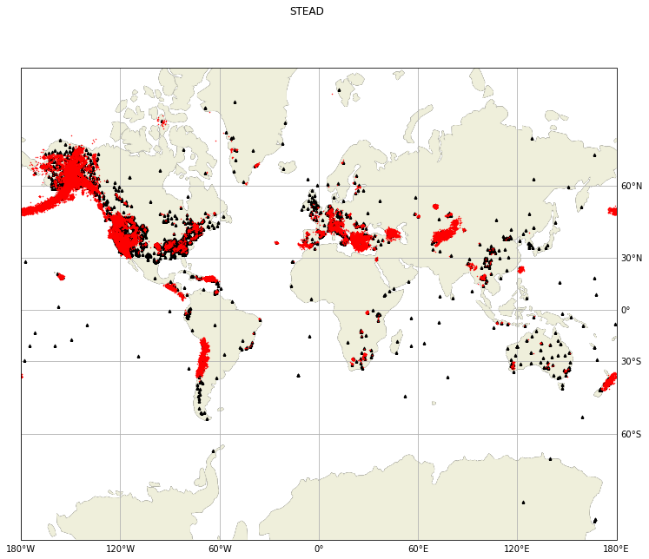
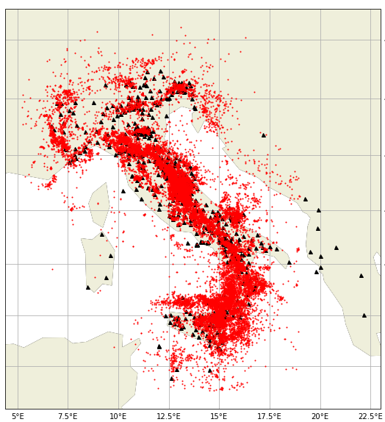
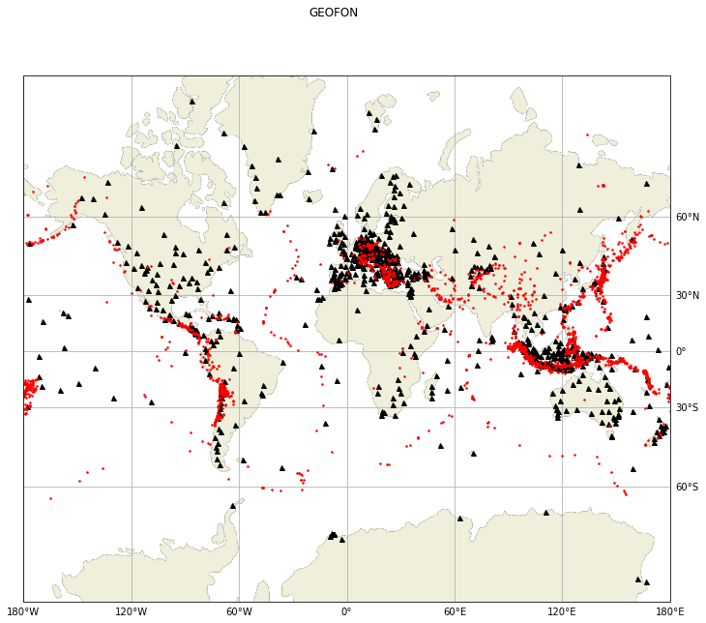
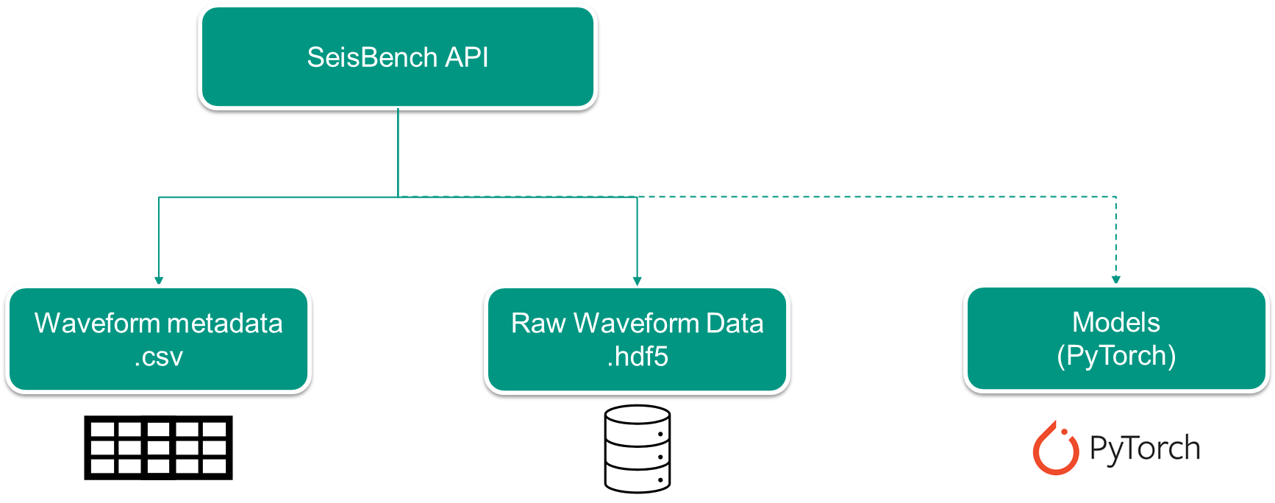
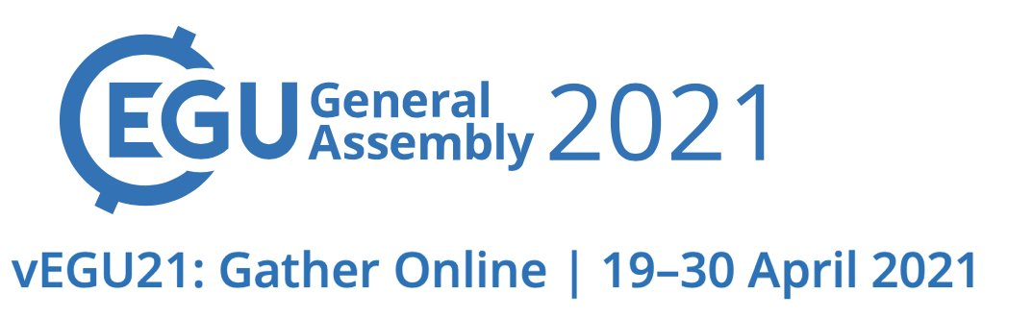
A toolbox for benchmarking and applying machine learning in seismology
What is SeisBench?
SeisBench is an open-source python library for training and deploying machine learning algorithms.
Motivation
Access to open-source, labelled datasets, pre-trained models, and trainable model architectures vital for comparison studies.
Datasets
Unified data interface enabling easy comparison and benchmarking
4 Benchmark Datasets currently incorporated (4 more in preparation)
Users can extend and add their own datasets
Models
Unified model interface for easy comparison and benchmarking
Naturally extensible for users to add their own models
Model API designed for general application of ML to seismological tasks
Community driven!
STEAD
INSTANCE
GEOFON
How does it work?
EQT
PhaseNet
GPD
CRED

Slide 2

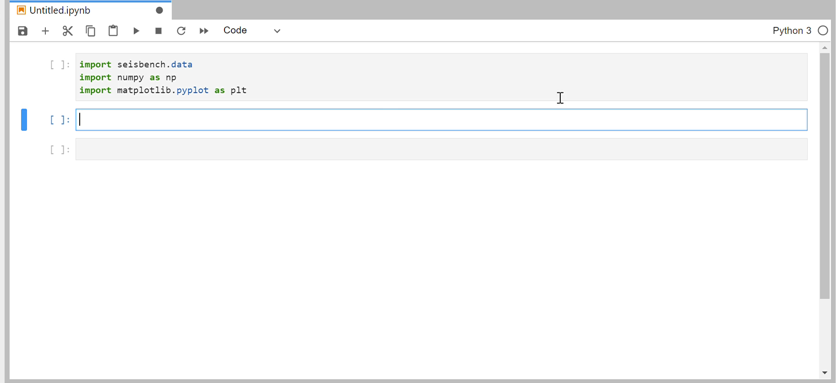
A toolbox for benchmarking and applying machine learning in seismology
What is SeisBench?
SeisBench is an open-source python library for training and deploying machine learning algorithms.
Motivation
Access to open-source, labelled datasets, pre-trained models, and trainable model architectures vital for comparison studies.
Usage:
How does it work?

Slide 3
Currently integrated data (Benchmark Datasets)
Currently integrated datasets, along with some selected statistics:
STEAD
  Mousavi, S. M., Sheng, Y., Zhu, W., & Beroza, G. C. (2019). STanford EArthquake Dataset (STEAD): A global data set of seismic signals for AI. IEEE Access, 7, 179464-179476.
SCEDC
  SCEDC (2013): Southern California Earthquake Center. Caltech.Dataset. doi:10.7909/C3WD3xH1
  Ross, Z. E., Meier, M.‐A., & Hauksson, E. (2018). P wave arrival picking and first‐motion polarity determination with deep learning. Journal of Geophysical Research: Solid Earth, 123, 5120– 5129. https://doi.org/10.1029/2017JB015251
LEN-DB
  Magrini, F., Jozinović, D., Cammarano, F., Michelini, A., & Boschi, L. (2020). Local earthquakes detection: A benchmark dataset of 3-component seismograms built on a global scale. Artificial Intelligence in Geosciences, 1, 1-10.
NEIC
  Yeck, W.L., and Patton, J., 2020, Waveform Data and Metadata used to National Earthquake Information Center Deep-Learning Models: U.S. Geological Survey data release, https://doi.org/10.5066/P9OHF4WL.
450,000 earthquakes | 2613 receivers | ~1,200,000 time series
273,882 earthquakes | 692 receivers | 4,847,248 time series
304,878 earthquakes | 1487 receivers | 629,095 time series

Slide 4
Currently integrated data (Benchmark Datasets)
Additional data currently under the process of integration into SeisBench:
GEOFON
GEOMAR
ETHZ
INSTANCE (INGV)

Slide 5
Currently integrated models
Currently integrated models:
PhaseNet
  Zhu, W., & Beroza, G. C. (2019). PhaseNet: a deep-neural-network-based seismic arrival-time picking method. Geophysical Journal International, 216(1), 261-273.
GPD
  Ross, Z. E., Meier, M. A., Hauksson, E., & Heaton, T. H. (2018). Generalized seismic phase detection with deep learning. Bulletin of the Seismological Society of America, 108(5A), 2894-2901.
CRED
  Mousavi, S. M., Zhu, W., Sheng, Y., & Beroza, G. C. (2019). CRED: A deep residual network of convolutional and recurrent units for earthquake signal detection. Scientific reports, 9(1), 1-14.
EQTransformer
  Mousavi, S. M., Ellsworth, W. L., Zhu, W., Chuang, L. Y., & Beroza, G. C. (2020). Earthquake transformer—an attentive deep-learning model for simultaneous earthquake detection and phase picking. Nature communications, 11(1), 1-12.

