Slide 1
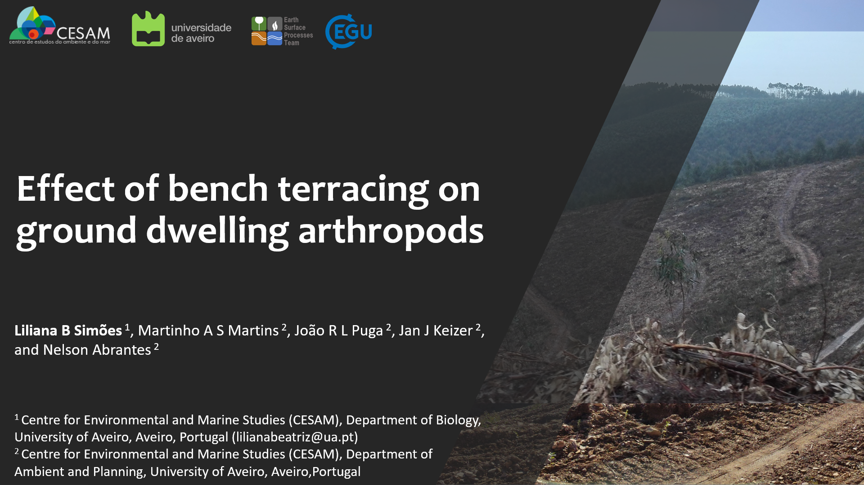

Slide 2
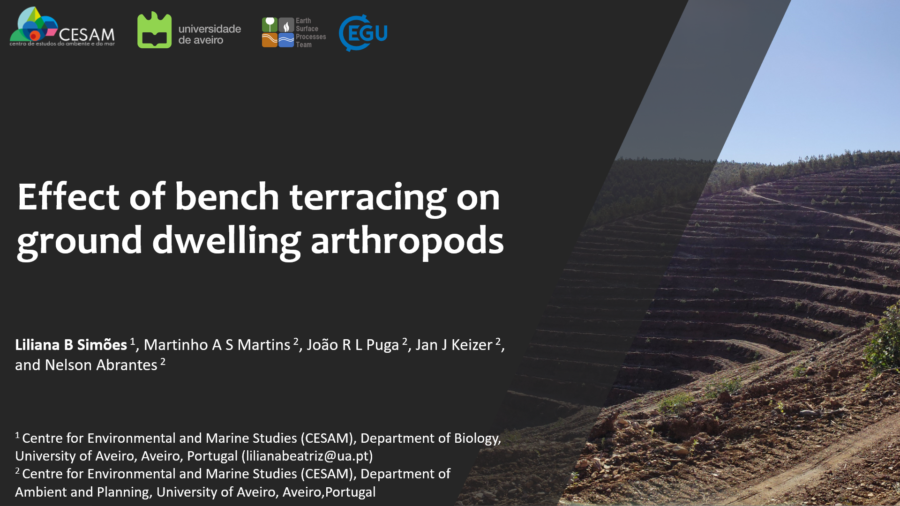

Slide 3
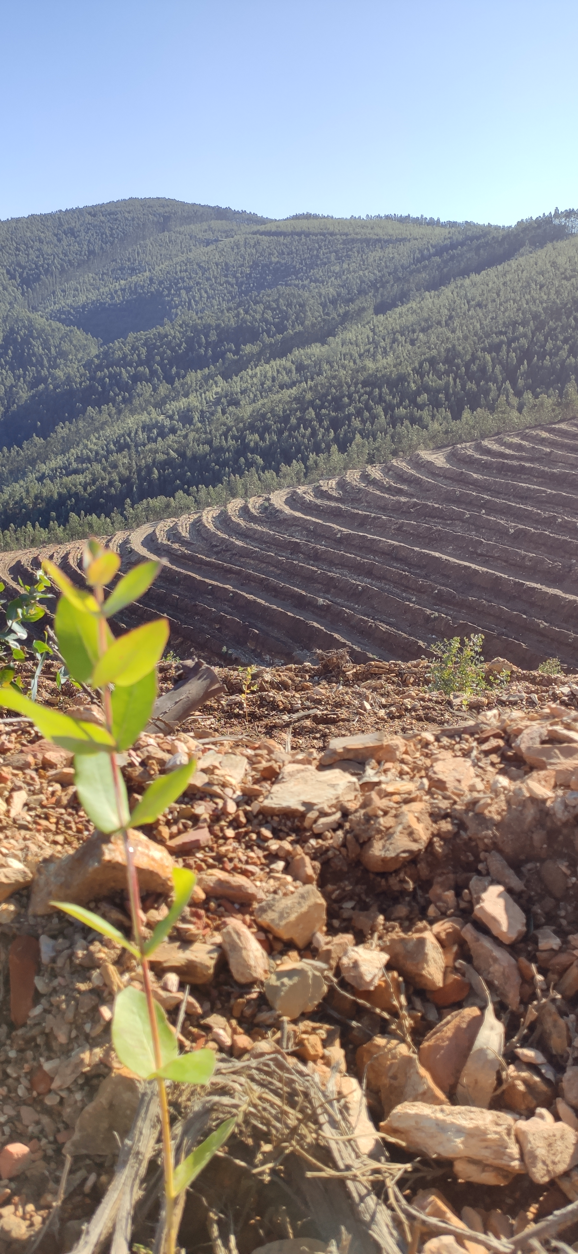




Terracing
Old agriculture technic
More arable area
Water infiltration increased
Reduced runoff and erosion
Huge soil movement in new terraces
Soil inversion
Litter and vegetation removal
3
Notes:
Lavragem 20 -30 cm
Terraços 1m-1,5m de profundidade
Paredes de 2-3 metros
Impacto maior

Slide 4
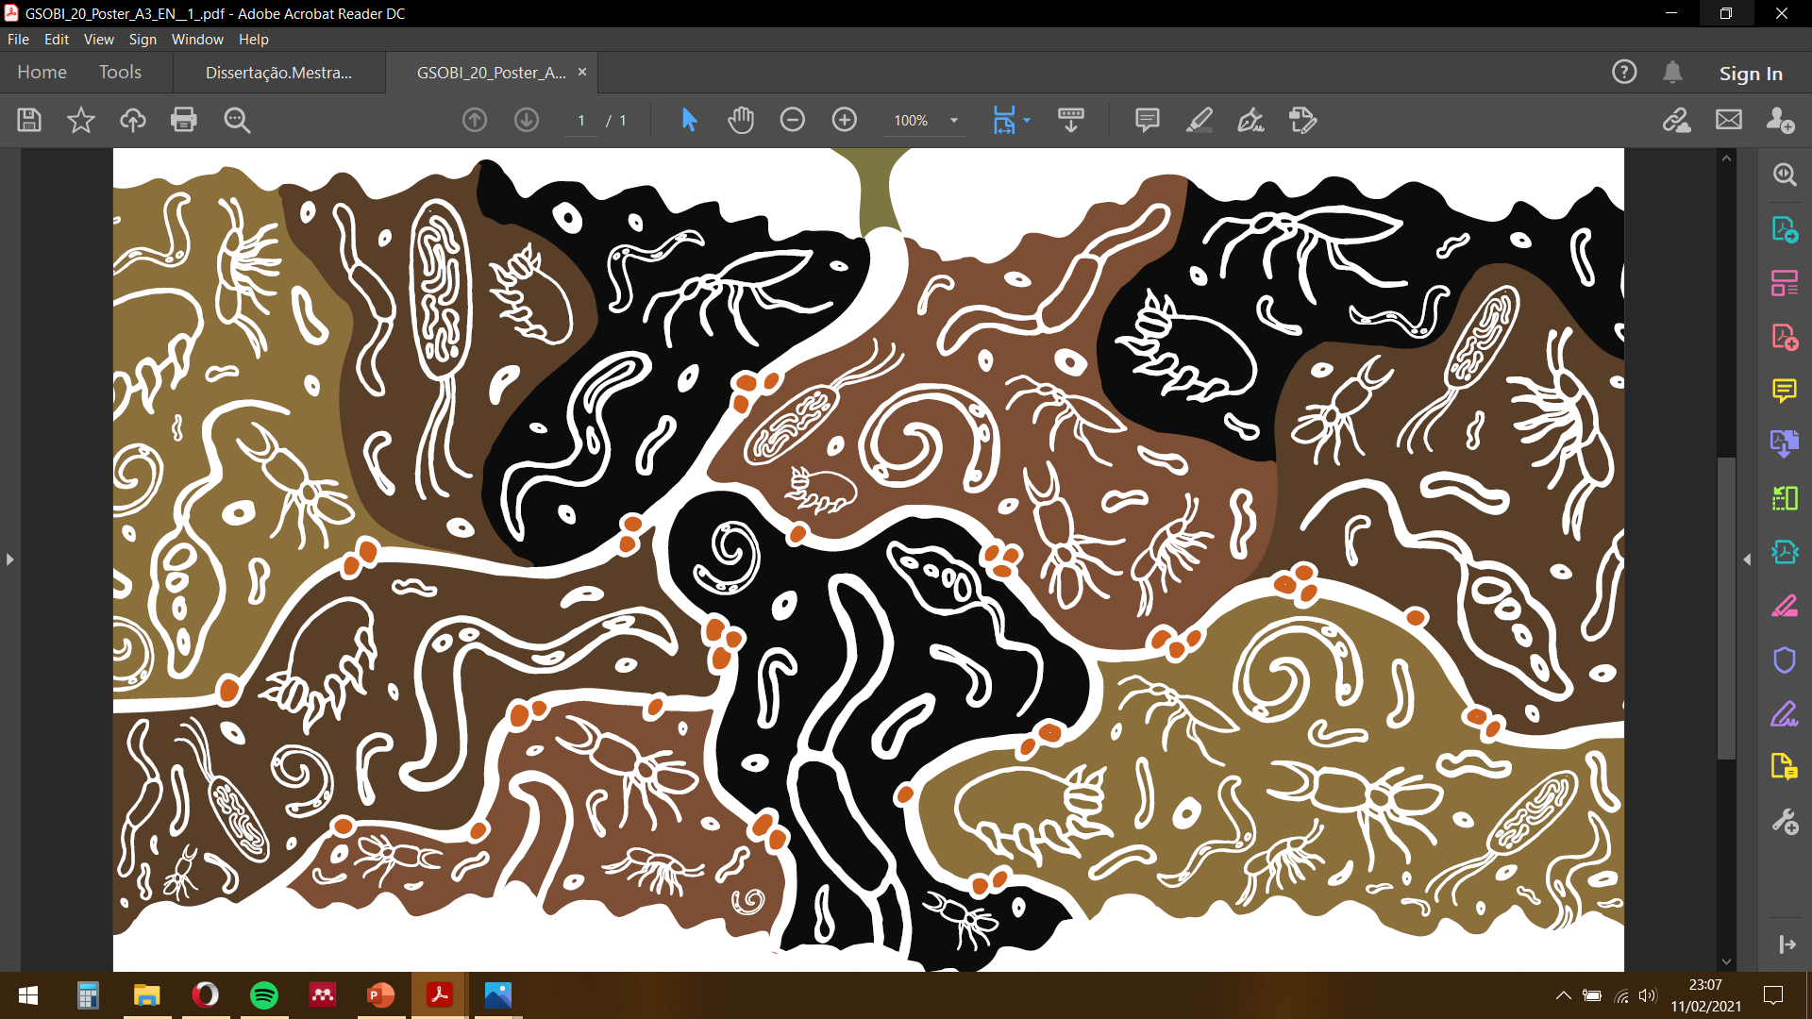


Soil arthropods
Ecological Services
Soil fertility
Water filtration
Bioindicators
Diversity and abundance
Fast response to disturbance
4

Slide 5
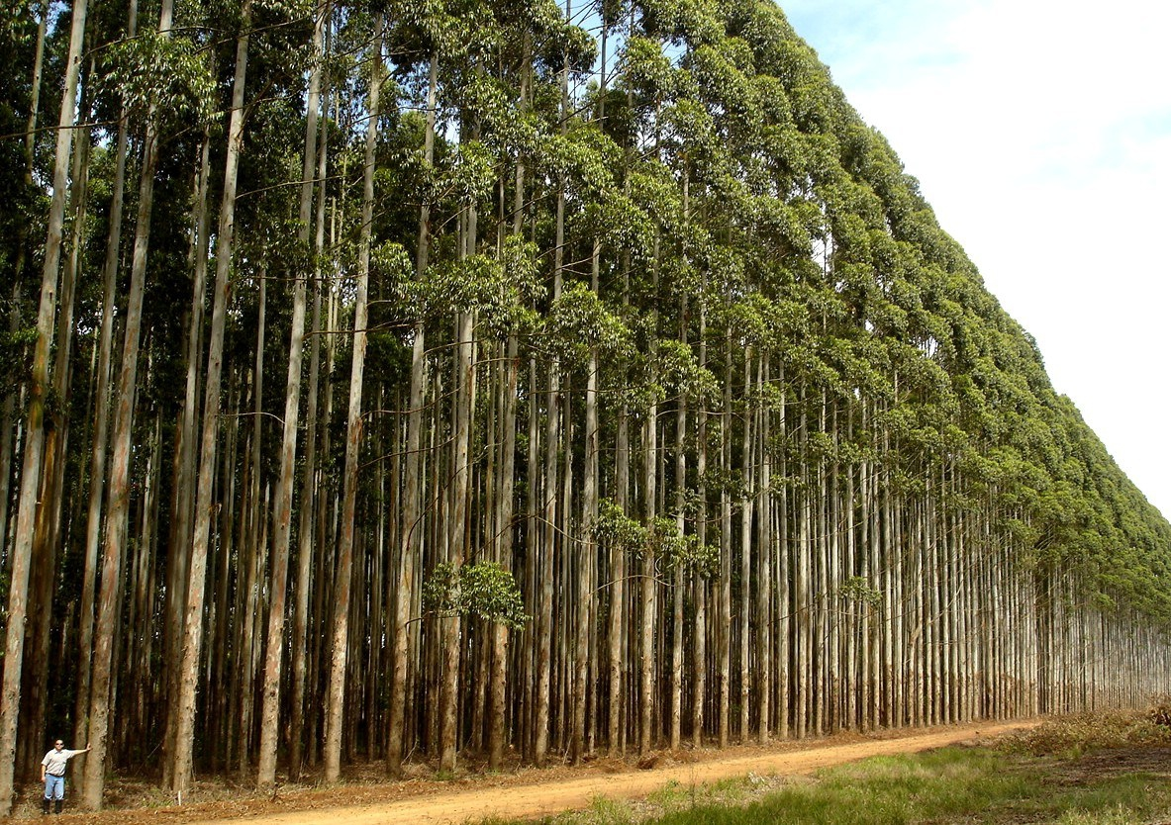
Main Goal
Eucalypt plantations
Terracing
?
Soil Arthropods
Abundance
Diversity
Community changes
5

Slide 6
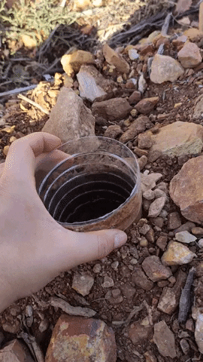
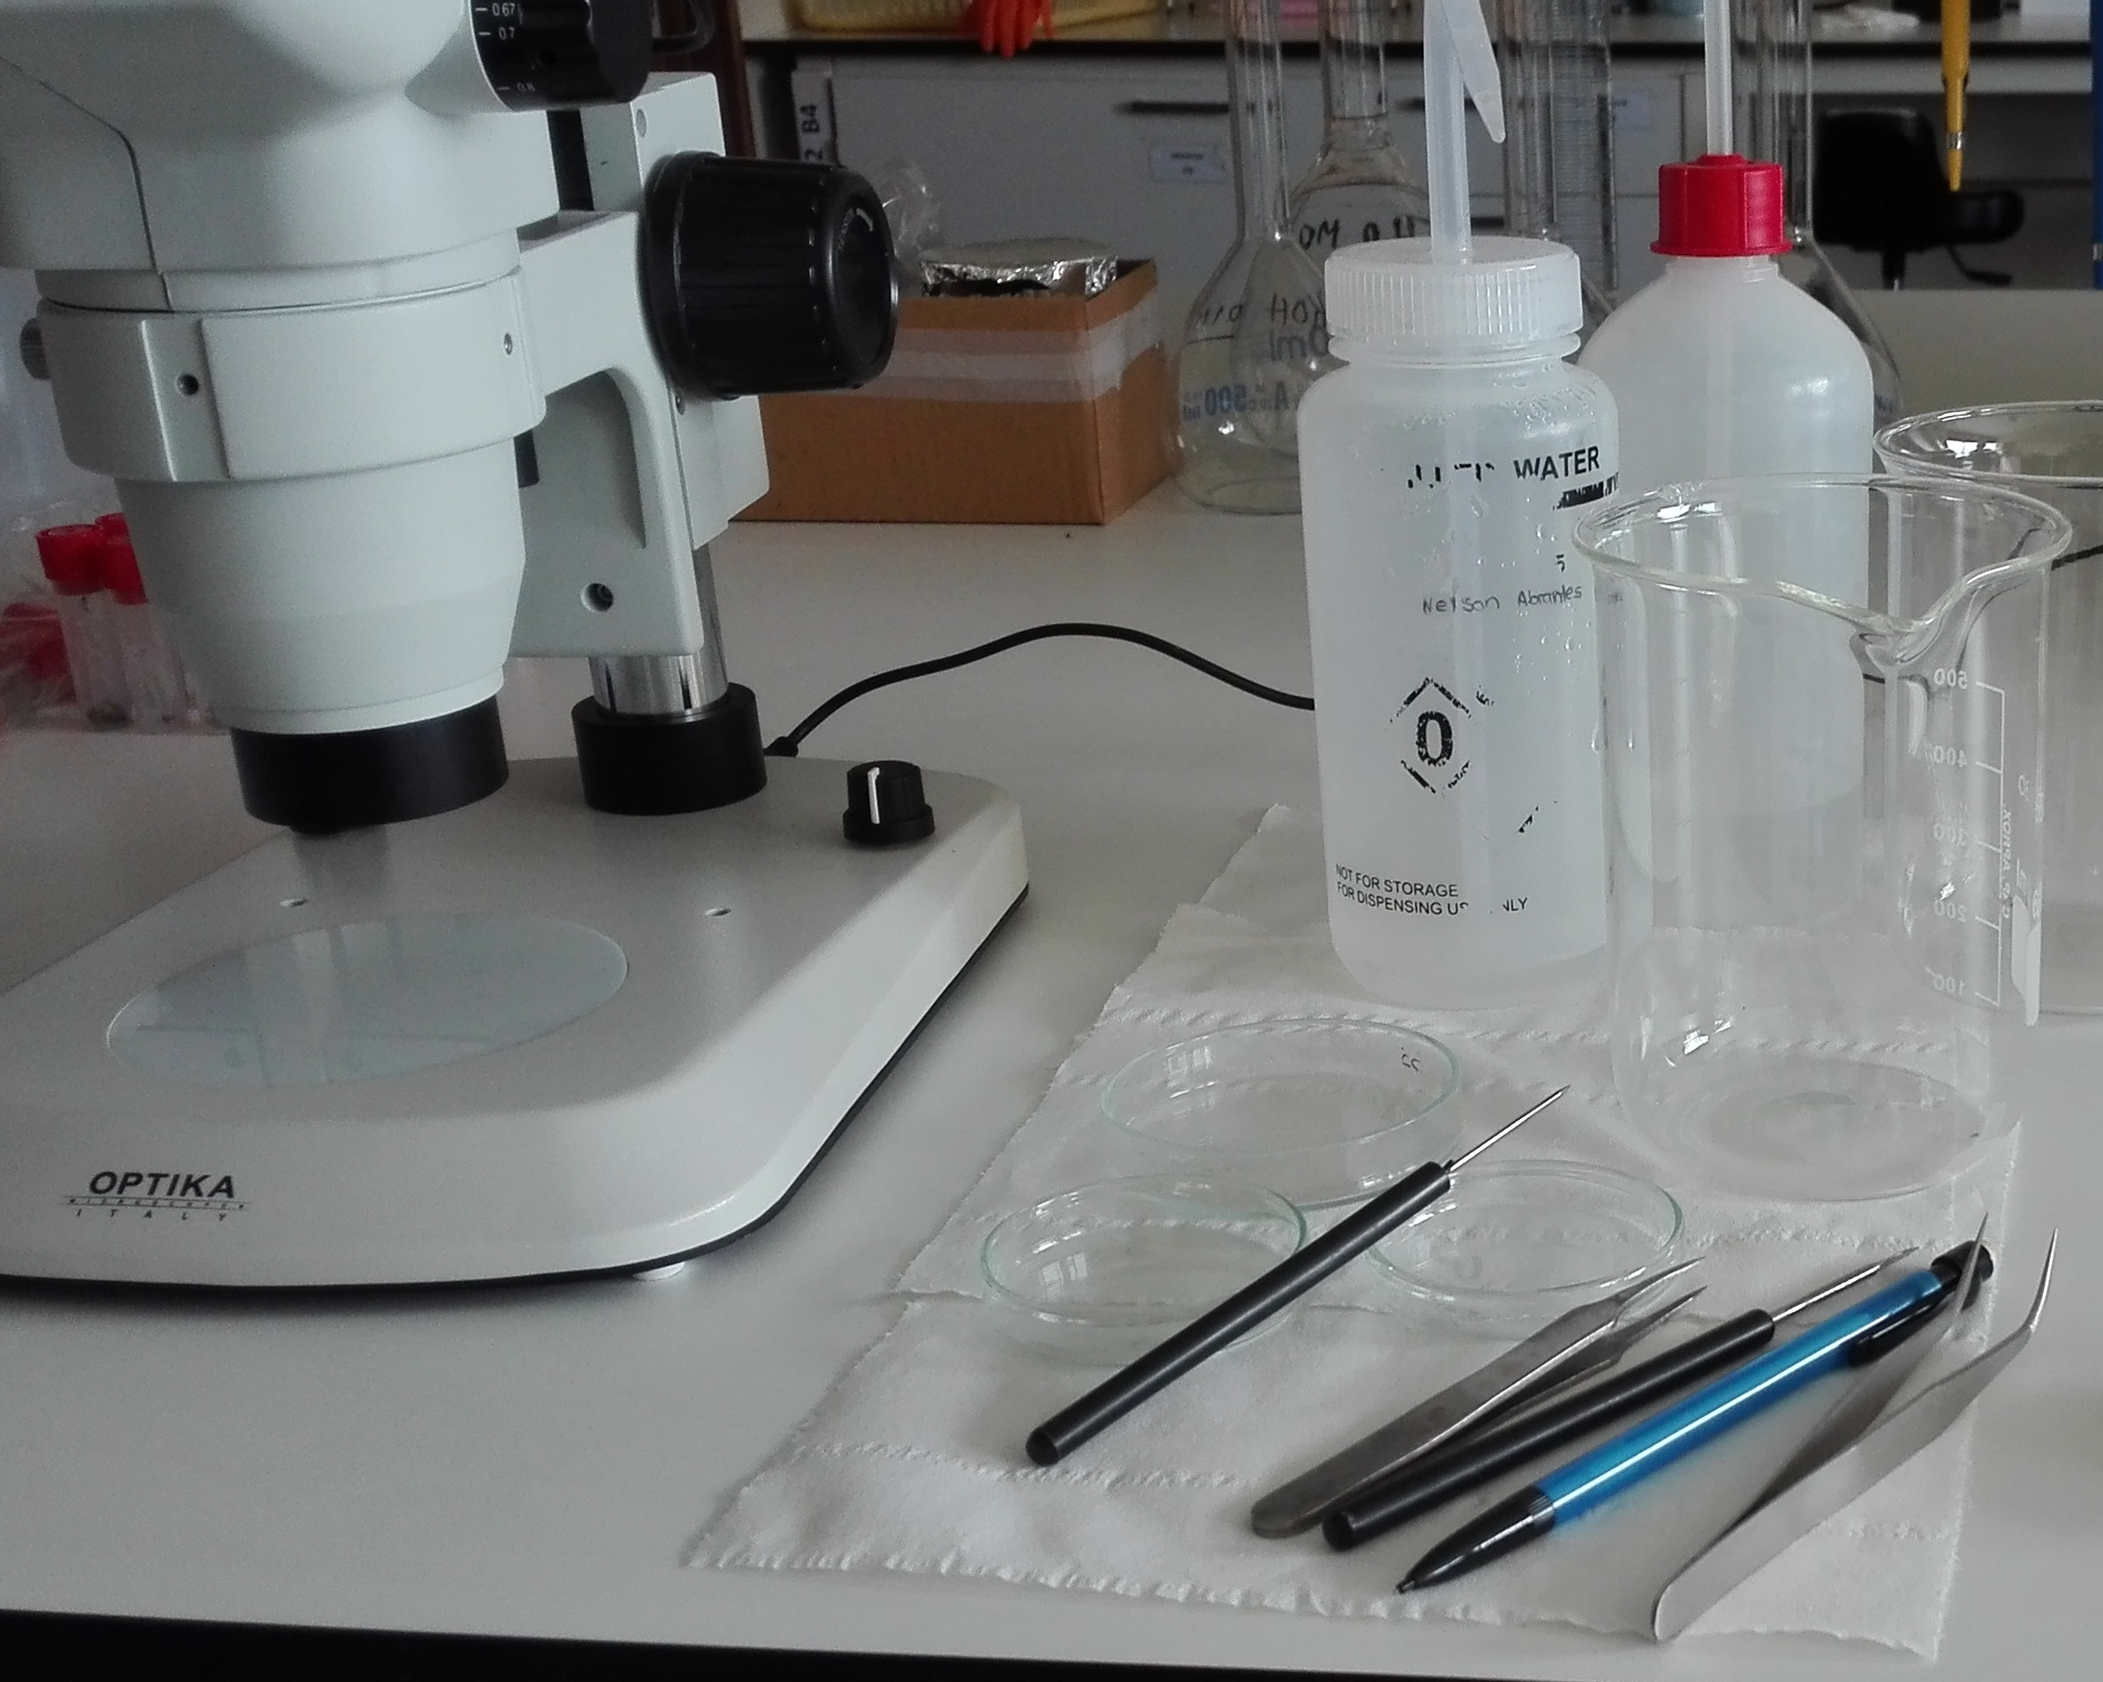
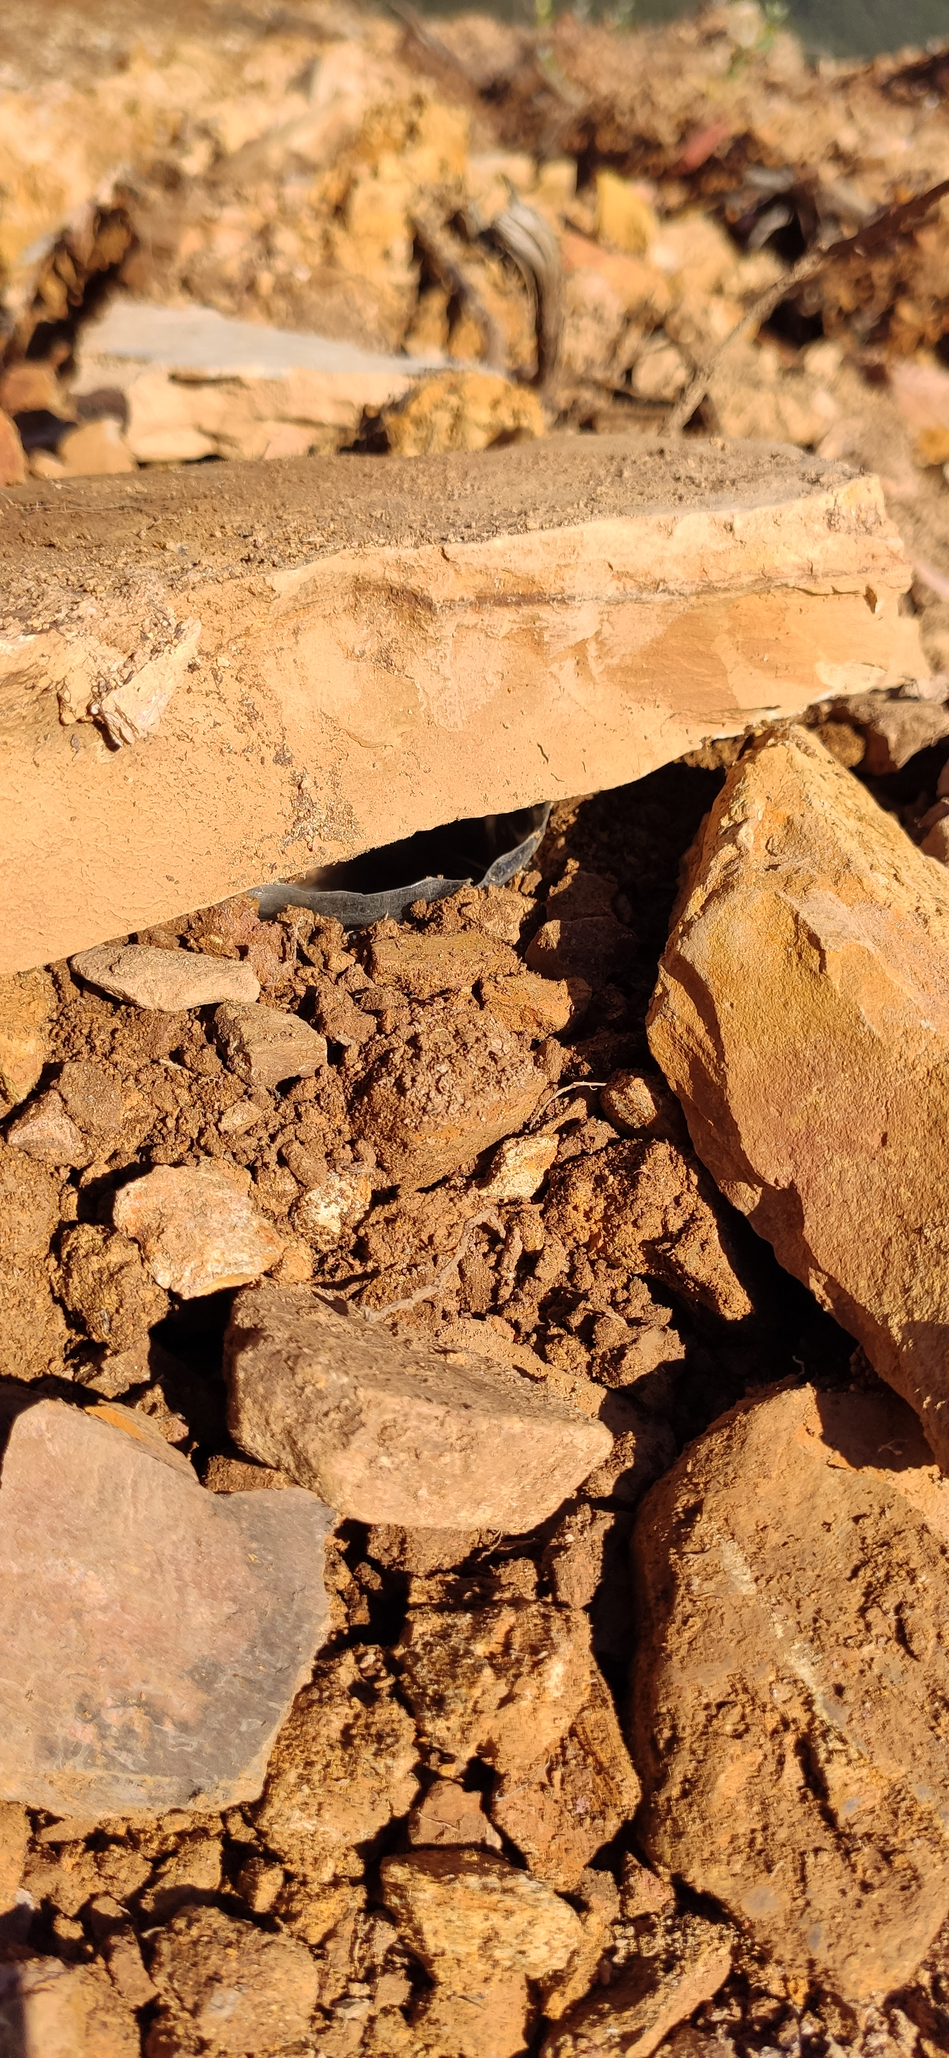
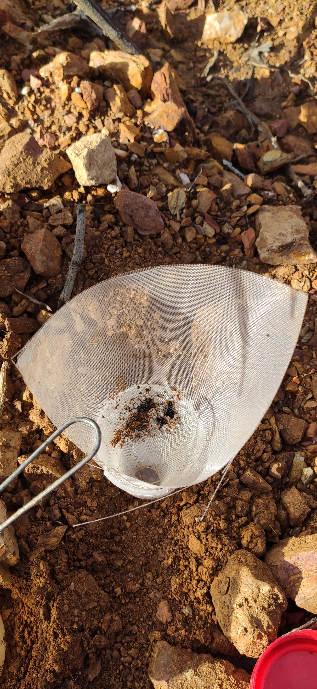






Methodology
Selection of study site
  Sampling design
Pitfall installation
  7 days
Laboratory
Content separated and identified
Coleoptera
All to Order
To Family
Araneae
Hymenoptera
6

Slide 7
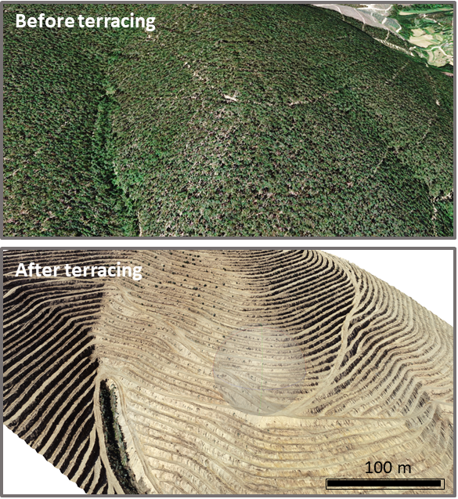
Boialvo – North central Portugal
Aim:
BT.
Before Terracing (BT)
Spring 2019 (Sp)
vs
After Terraces (AT)
Summer 2019 (Su)
Autumn 2019 (Au)
Winter 2020 (Wi)
Spring 2020 (Sp)
AT.
7

Slide 8
Soil cover and soil characteristics
Vegetation
Litter
Bare soil
Stones
Soil Moisture Content (SMC)
Soil Organic Matter (SOM)
Bulk Density (BD)
Arthropods
Average Abundance
Average Richness
Shannon-Wiener Diversity Index (H’)
Pielou’s Evenness Index (J’)
8

Slide 9
Soil cover and soil characteristics
c
a
b
b
b
b
c
c
a
c
a
b
b
b
b
BT.Sp – Before terraces Spring
AT.Su – After terraces Summer
AT.Au – After terraces Autumn
AT.Wi – After terraces Winter AT.Sp – After terraces Spring
9

Slide 10
Arthropods
(Average per pitfall)
BT.Sp – Before terraces Spring
AT.Su – After terraces Summer
AT.Au – After terraces Autumn
AT.Wi – After terraces Winter AT.Sp – After terraces Spring
10

Slide 11
Arthropods
(Average per pitfall)
Coleoptera
Araneae
Hymenoptera
*
*
11

Slide 12
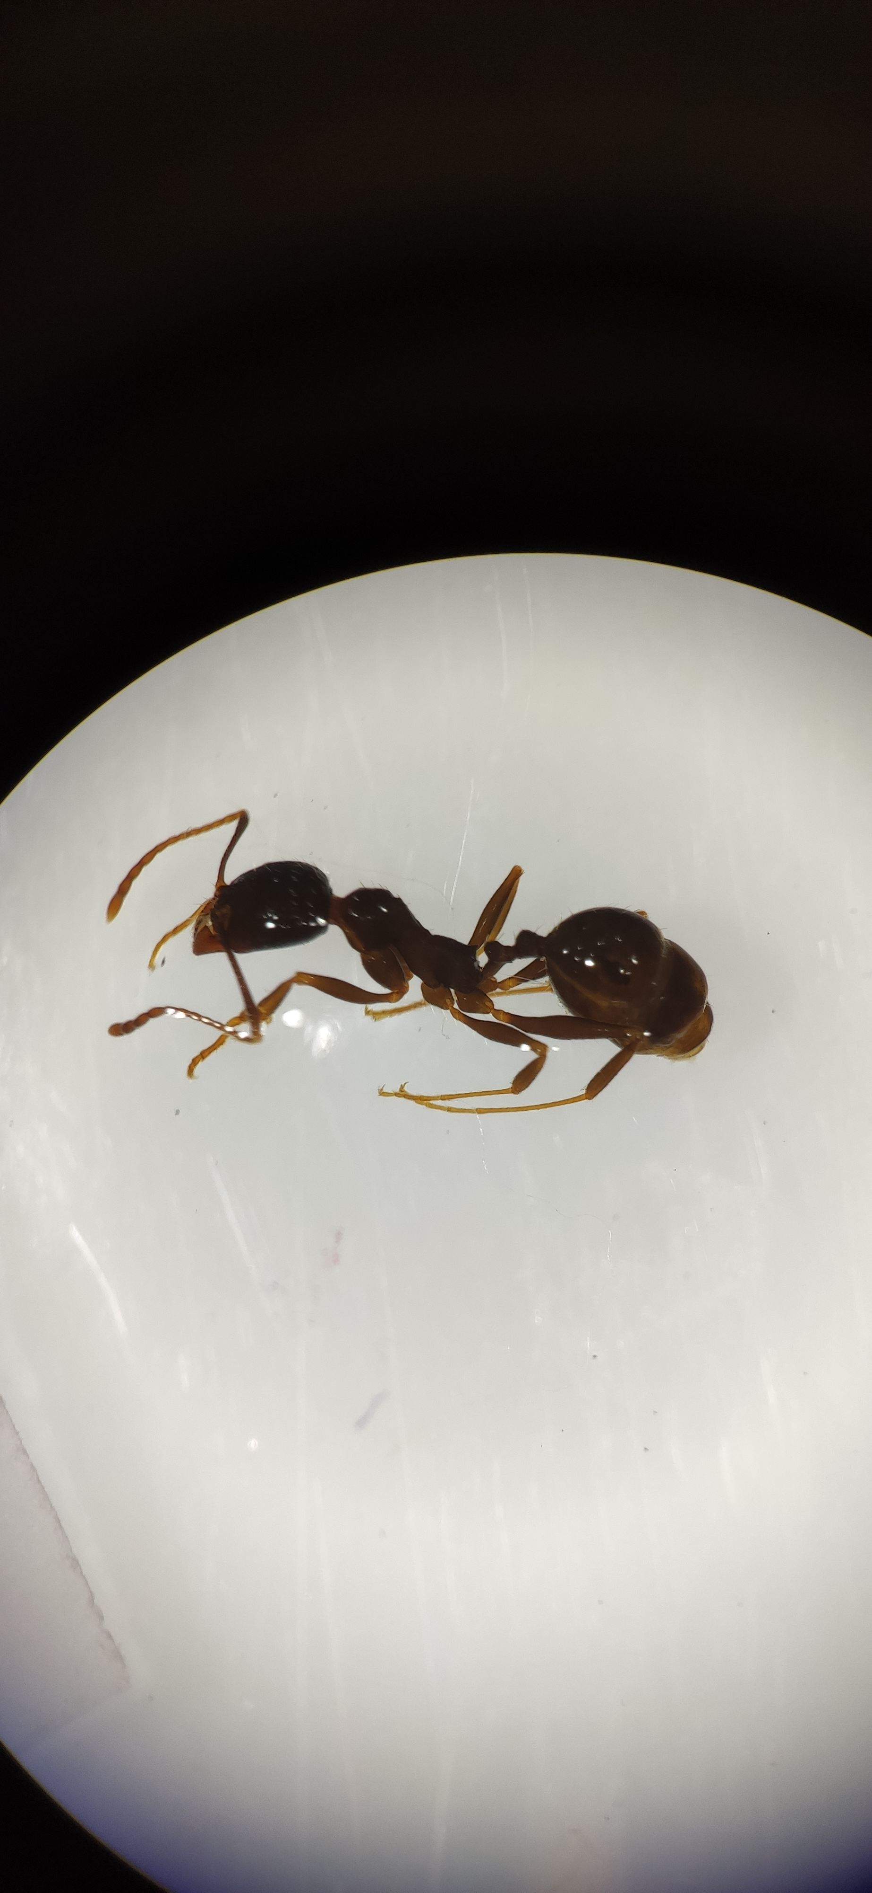
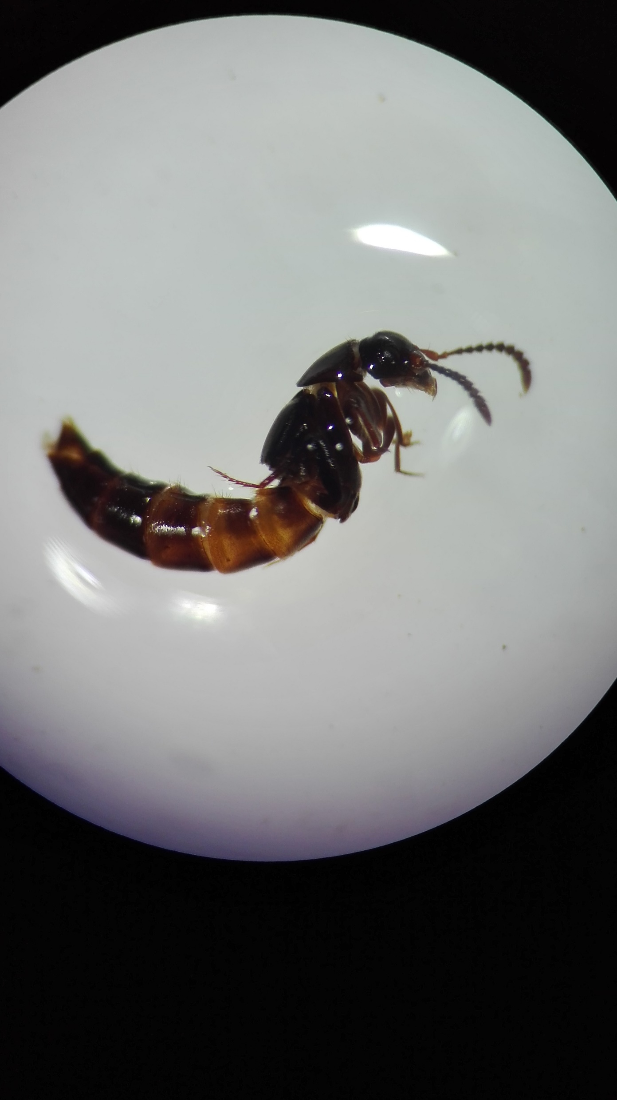
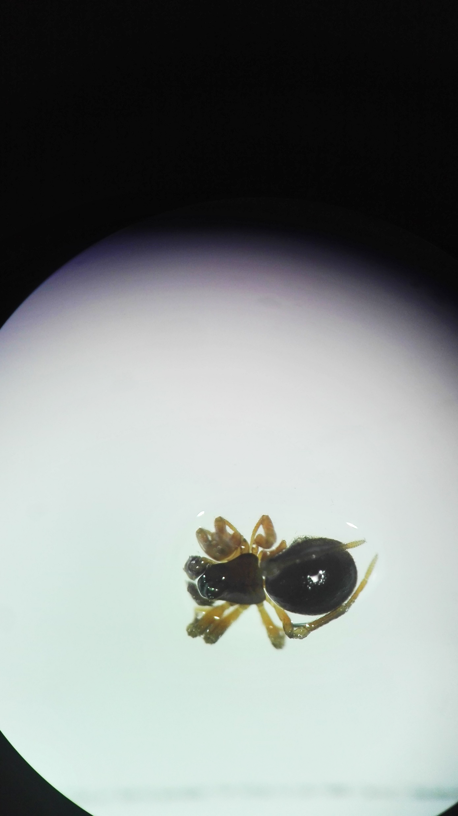

Conclusion
1 year after
$$≈$$
Coleoptera
Araneae
Hymenoptera
Staphylinidae
Ground Hunter
Myrmicinae
Generalist and opportunistic beetles
Web Weaver
Opportunistic ants
12

Slide 13
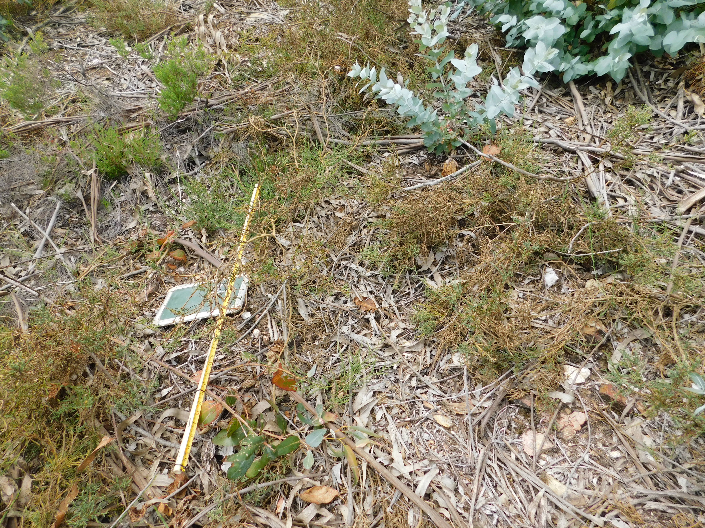
Final consideration
Knowing the organism
Understanding how disturbance affects them
Management adaptation
Soil health
13

Slide 14
