Slide 1


Identification and quantification of sources and sinks of carbonyl sulfide
Alessandro Zanchetta, Linda M.J. Kooijmans, Steven van Heuven, Andrea Scifo, Bert Scheeren, Jin Ma,
Ivan Mammarella, Ute Karstens, Harro A.J. Meijer, Maarten Krol, and Huilin Chen
Alessandro Zanchetta – ESRIG-CIO, University of Groningen
vEGU21 – April 27th, 2021 – BG2.2

Slide 2
Table of Contents
Introduction
  What is COS?
  Current knowledge
Research question
Methodology
Current results
What’s next?

Slide 3
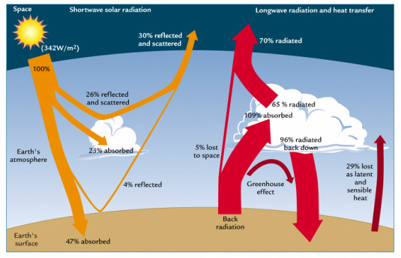
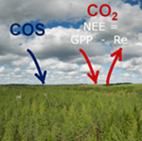
Introduction – what is COS?
Carbonyl sulfide – COS: a gas species involved in C and S cycles.
Currently associated to a slightly negative net radiative forcing.
Absorbed by plants similarly to CO₂: potential tracer for GPP.
But the budget needs to be assessed more precisely…

Slide 4
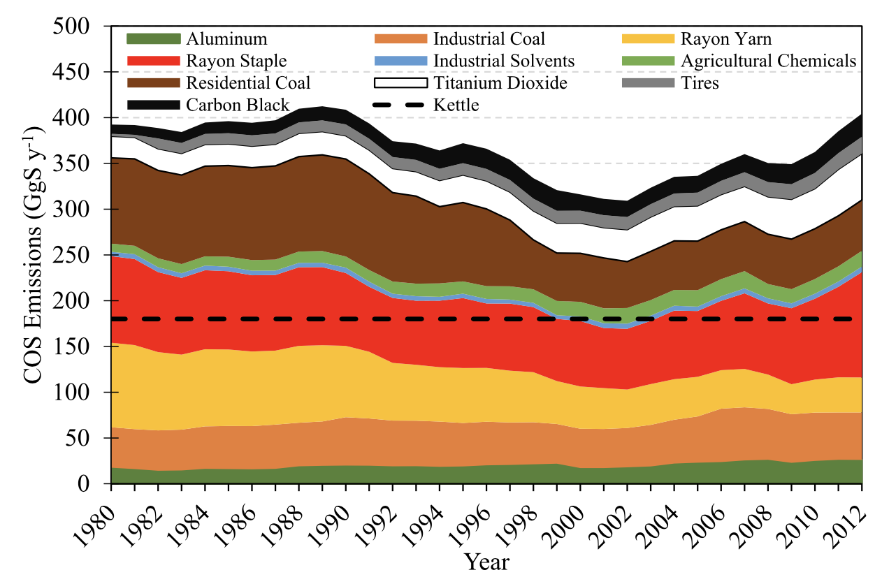
Current knowledge
Sinks
Plants, oxic soils, photolysis, reaction with OH•
Current atmospheric concentration baseline ~500 ppt.
Sources
Natural
Oceans, wetlands, marshes, anoxic soils
Anthropogenic
Fossil fuels and biomass burning, aluminium smelting, rayon, solvents, chemicals, rayon, paper industries, tyre wear…
But there are many uncertainties: estimated missing source is 230-800 GgS/year.
Zumkehr et al. (2018): global modelled COS emissions from anthropogenic sources

Slide 5
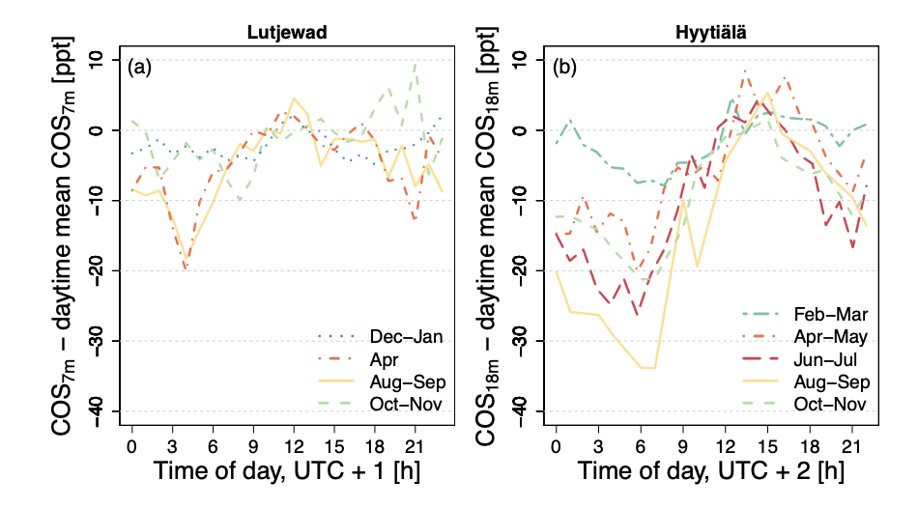
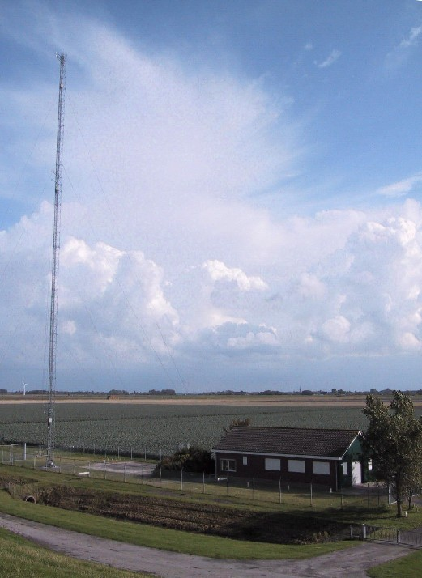
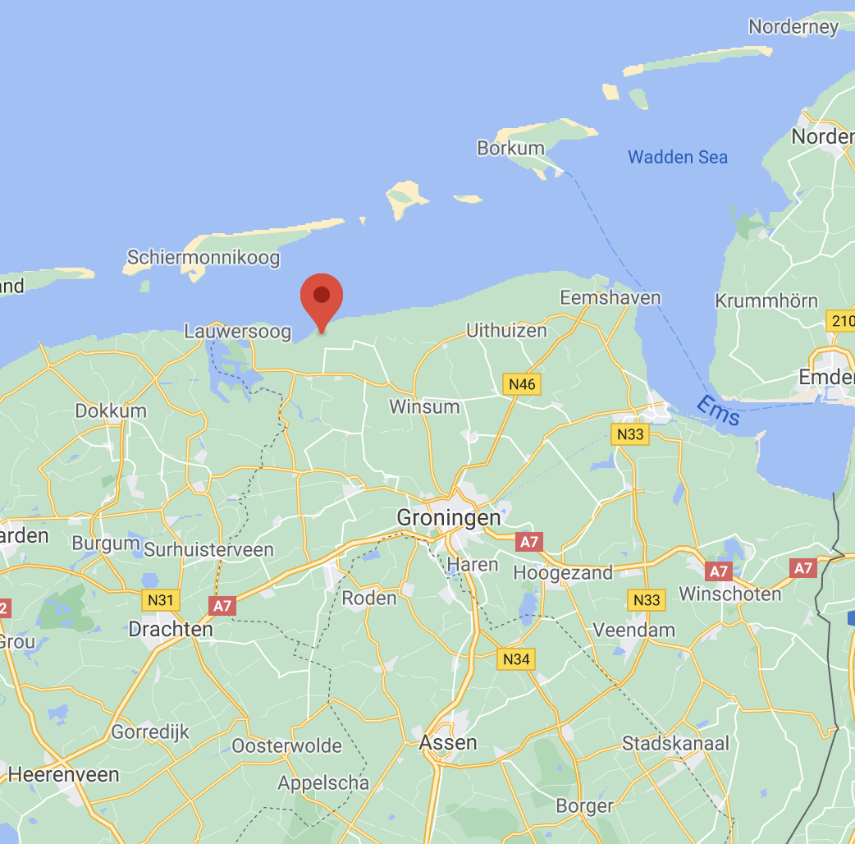
Current knowledge
Nighttime sinks related to sites rich in vegetation
Median nighttime F(COS) = -3.0 ± 2.6 pmol m⁻² s⁻¹
-2.9 ± 2.2 pmol m⁻² s⁻¹ from August to November 2015
-7.2 ± 2.8 pmol m⁻² s⁻¹ in April 2015
A few positive F(COS) were measured during
nighttime in the ploughing season
(Kooijmans, 2018)
(Kooijmans, 2018)
Lutjewad
Kooijmans (2018): Monthly average diurnal cycle of COS mole fractions minus the mean daytime mole fractions to indicate the seasonal variation of the diurnal cycle amplitude.

Slide 6
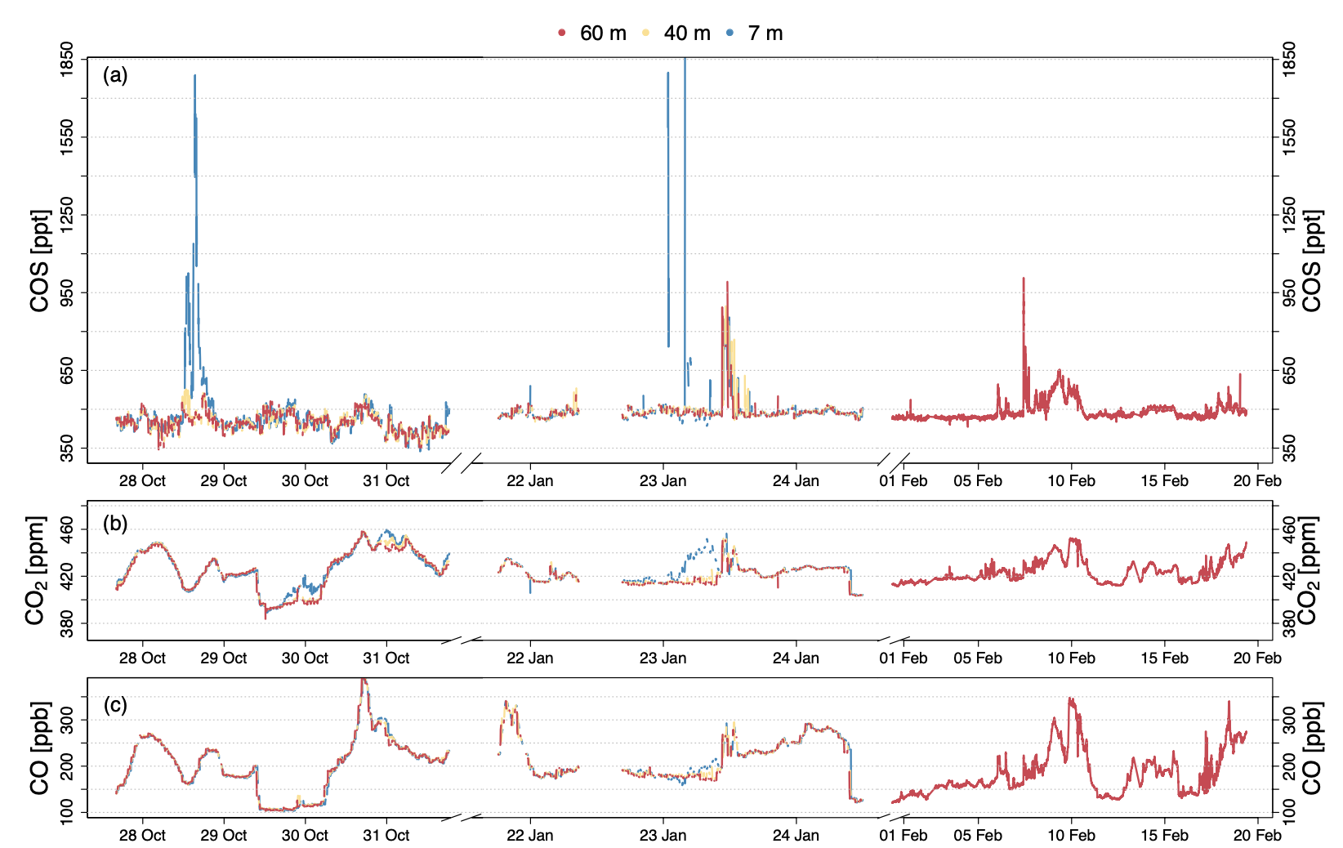
Research questions
COS spikes observed in Lutjewad,
suspected to come from ploughing
Are there known and/or unaccounted anthropogenic COS sources in the province of Groningen?
Could they explain the enhancements
that have been observed in Lutjewad?
(Kooijmans, 2018)

Slide 7
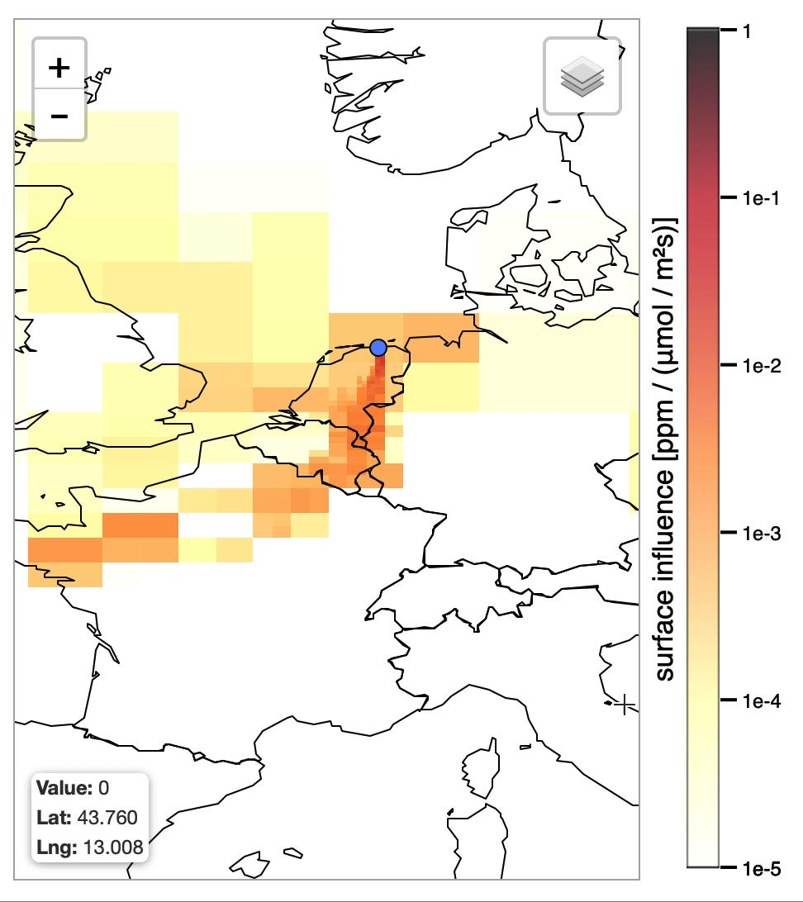
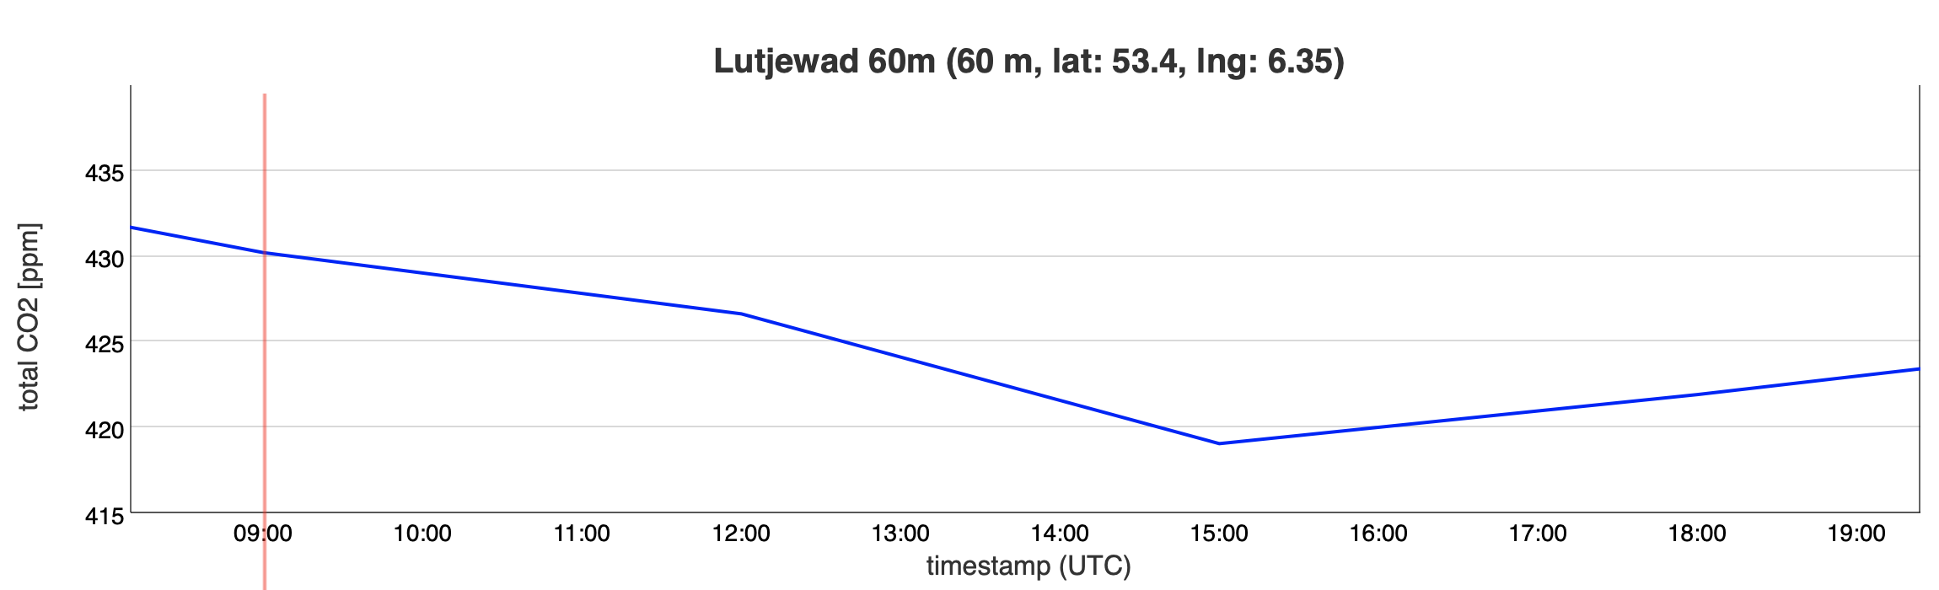
Methodology
Identification of local anthropogenic sources
  Sampling activities
  Known sources from literature (e.g. industries, power plants)
  Potential sources (mobile sampling)
Quantification of COS emissions
Implementation of COS data in available models and databases
  Stocastic Time-Inversted Lagrangian Transport (STILT)
  F(COS) – biospheric and anthropogenic databases

Slide 8
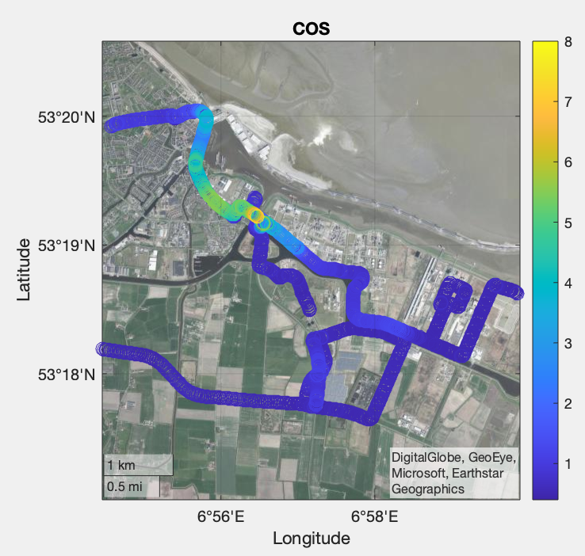
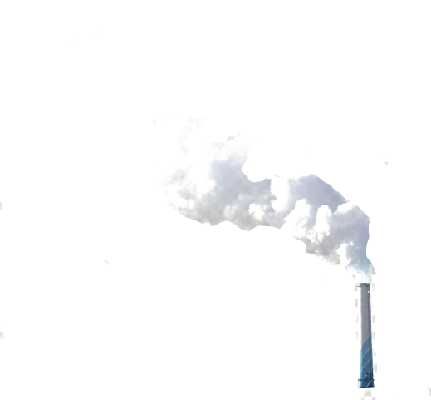
Current results
ppb
In-situ mobile sampling and
flasks measurements:
COS emissions at biodigesters and at (bio)gas- and coal-related industries.
Correlation with CO emissions
(2-10 pptCOS/ppbCO), occasional correlations with CH₄ and CO₂
Somewhat similar to the emissions
measured in Lutjewad…
Ploughing was not proven as a COS source.
Delfzijl
Wind direction
Farmsum

Slide 9
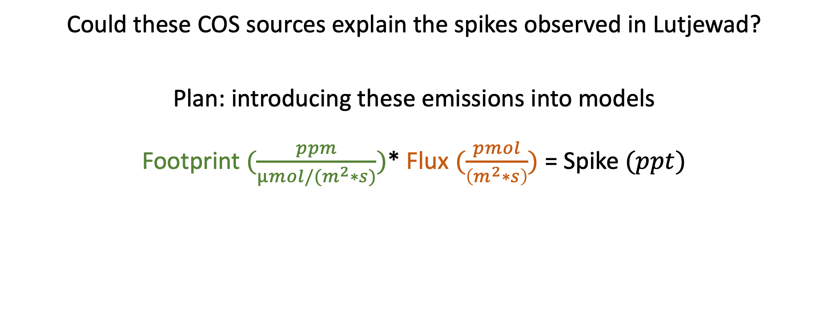
Current results
Could these COS sources explain the spikes observed in Lutjewad?
Plan: introducing these emissions into models
Footprint $(\frac{ppm}{µmol/(m^{2}∗s)})$* Flux $(\frac{pmol}{\left(m^{2}∗s\right)})$ = Spike $(ppt)$
STILT
Biospheric + Anthropogenic
(ICOS carbon portal)
(SiB4, Kooijmans)
Zumkehr et al. (2018)

Slide 10
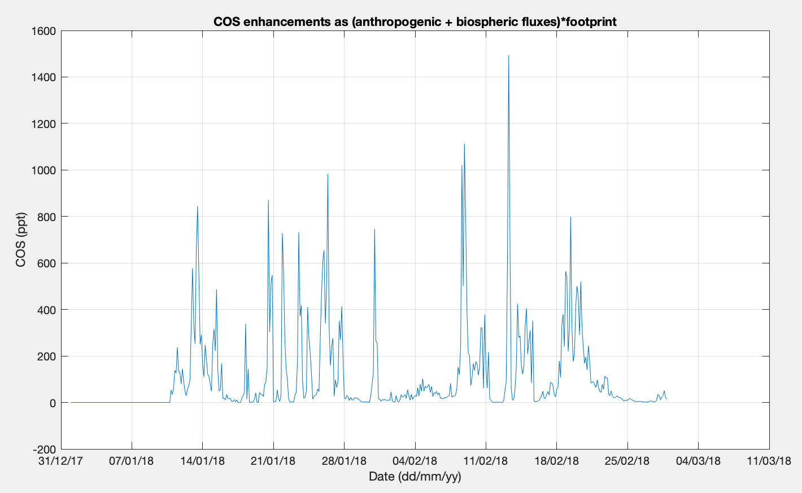
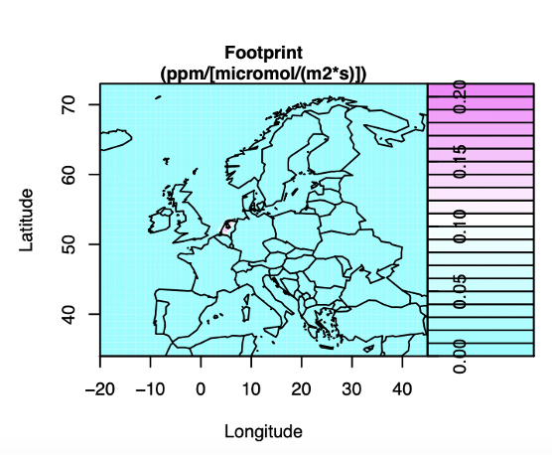
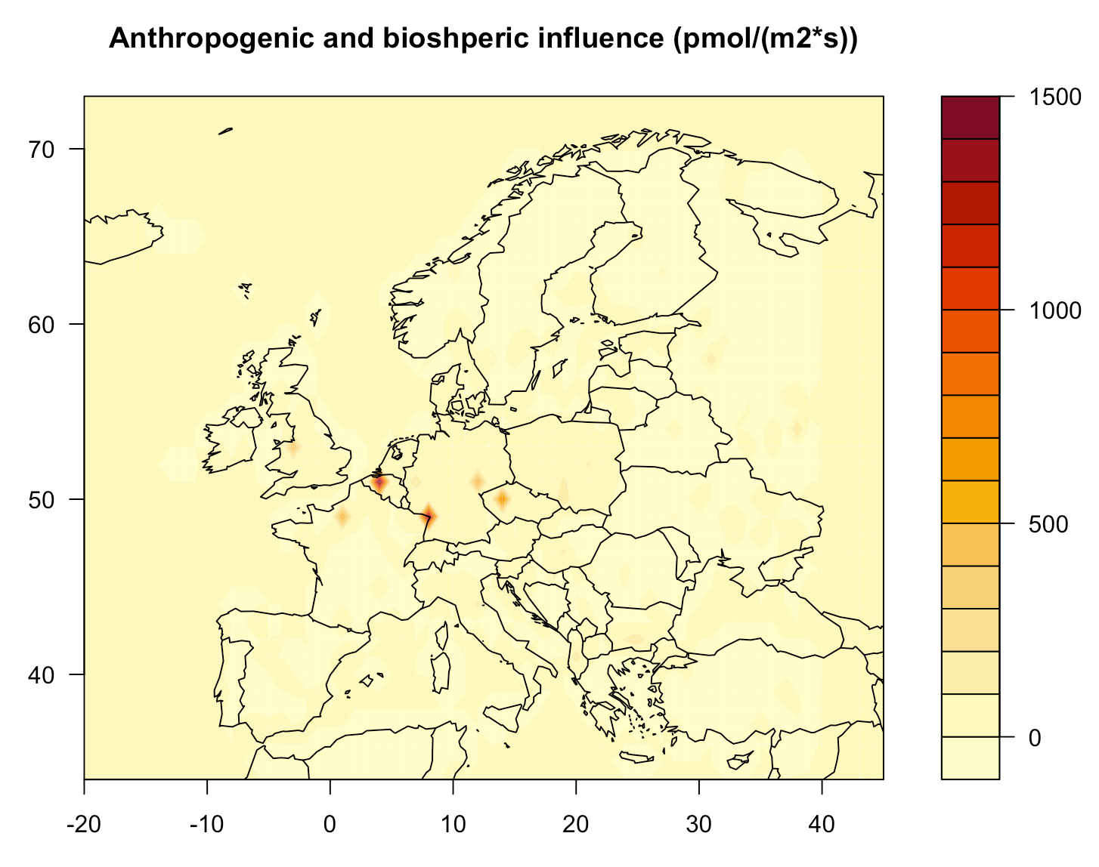
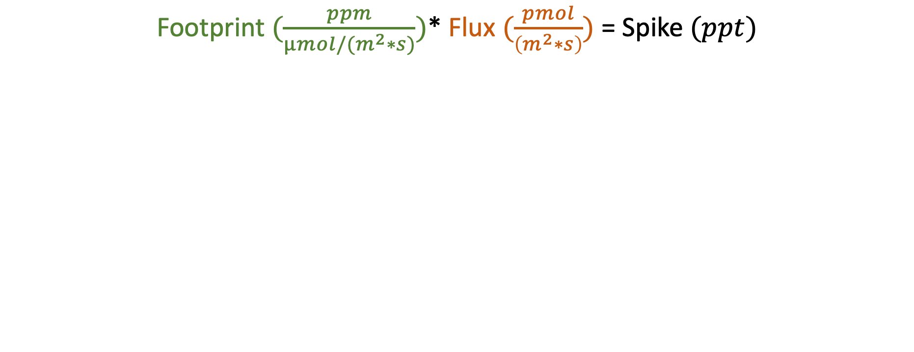
Current results
Footprint $(\frac{ppm}{µmol/(m^{2}∗s)})$* Flux $(\frac{pmol}{\left(m^{2}∗s\right)})$ = Spike $(ppt)$
Kooijmans (2018)

Slide 11
What’s next?
Further investigation of modelled enhancements
Introduce emissions from “new sources” in F(COS)
Possibly, scale “new sources” on higher levels (e.g. Europe)

Slide 12

Thank you!
Questions?

Slide 13
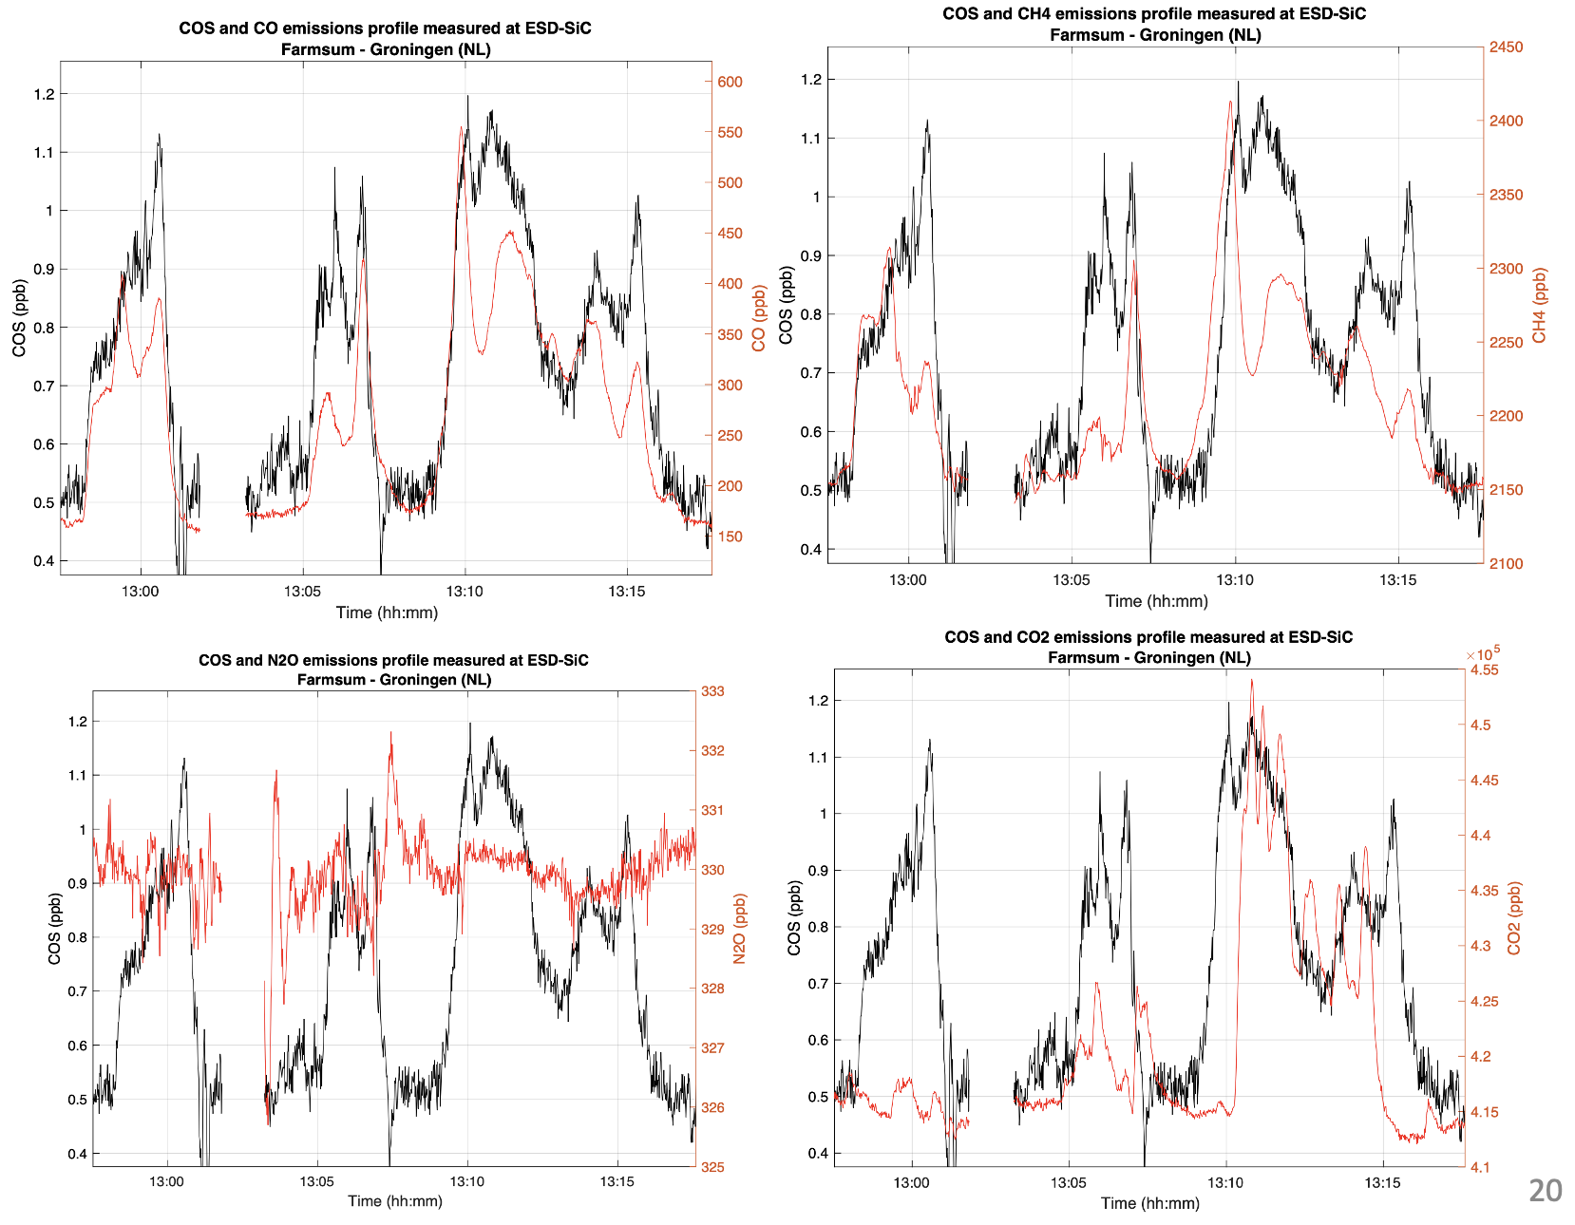
Starting Point
In-situ mobile sampling: COS emissions at biodigesters and at (bio)gas- and coal-related industries
Correlation with CO emissions
(2-10 pptCOS/ppbCO)
Occasional correlations with CH₄ and CO₂
Somewhat simlar to the emissions measured in Lutjewad…

Slide 14
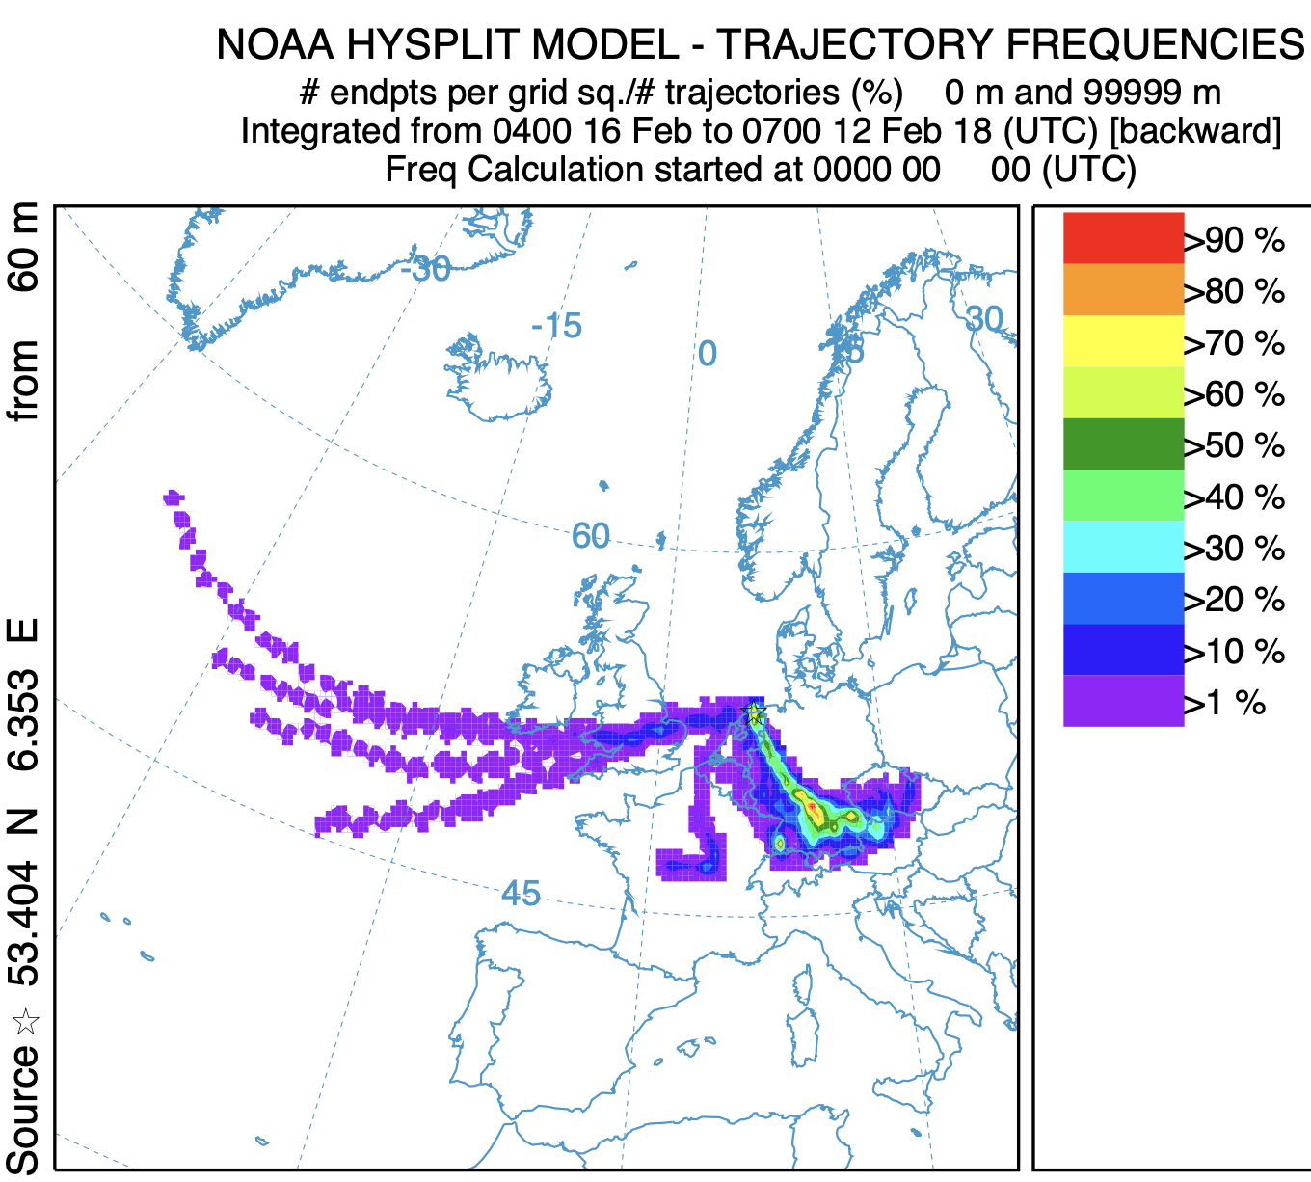
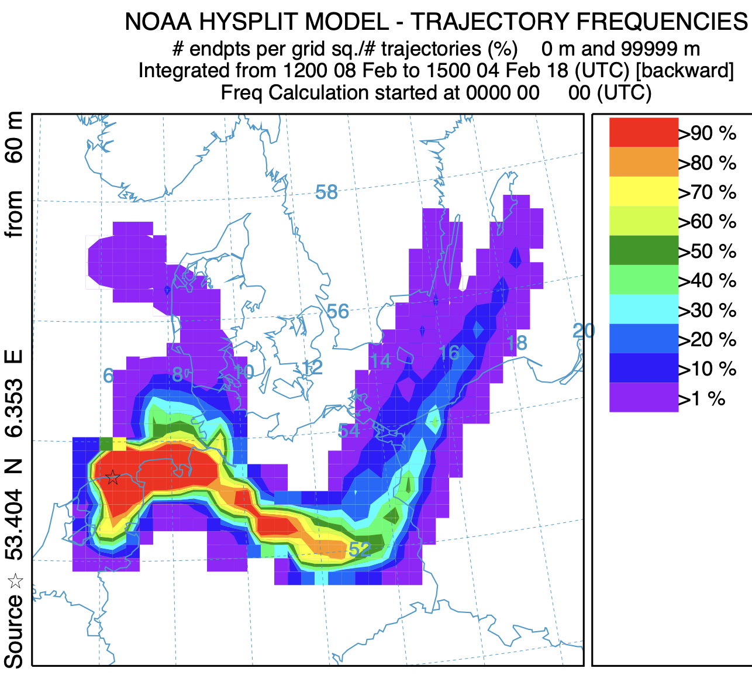
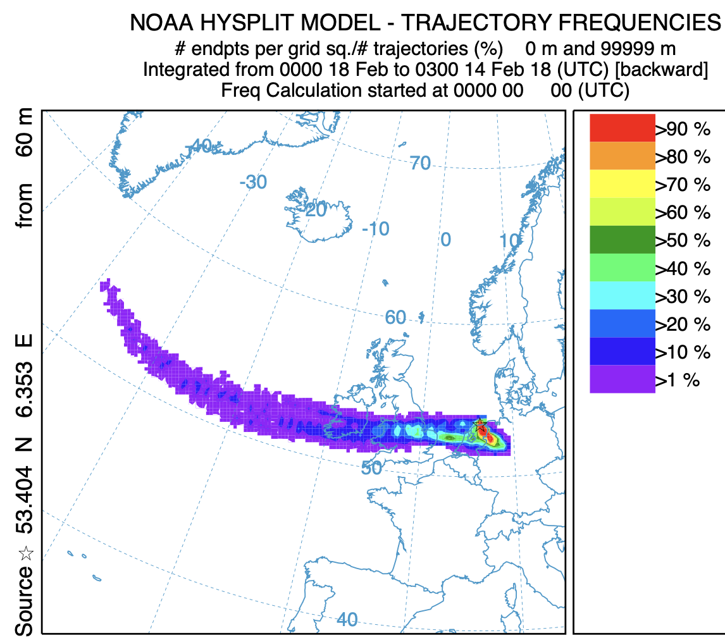
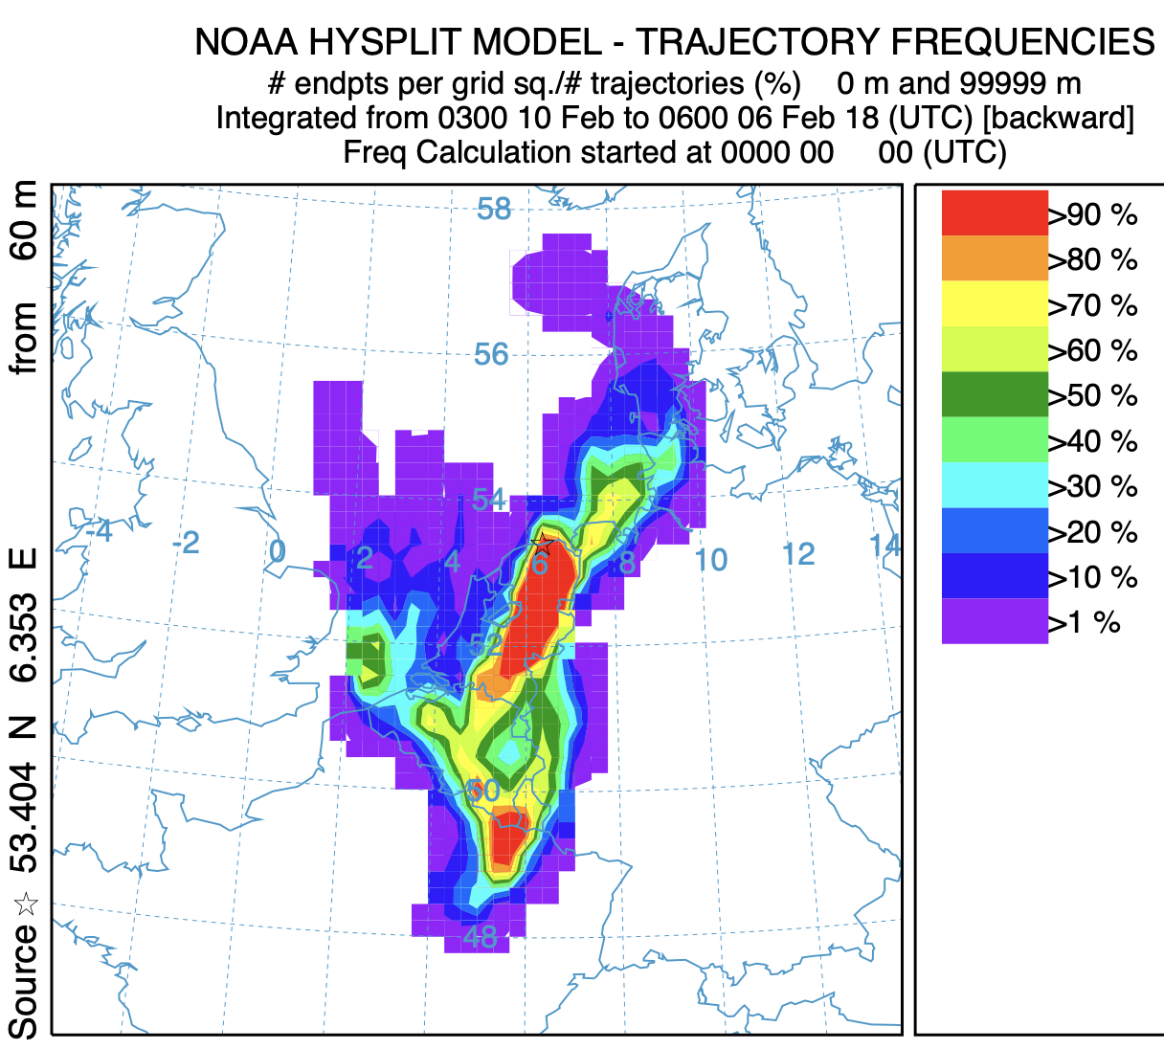
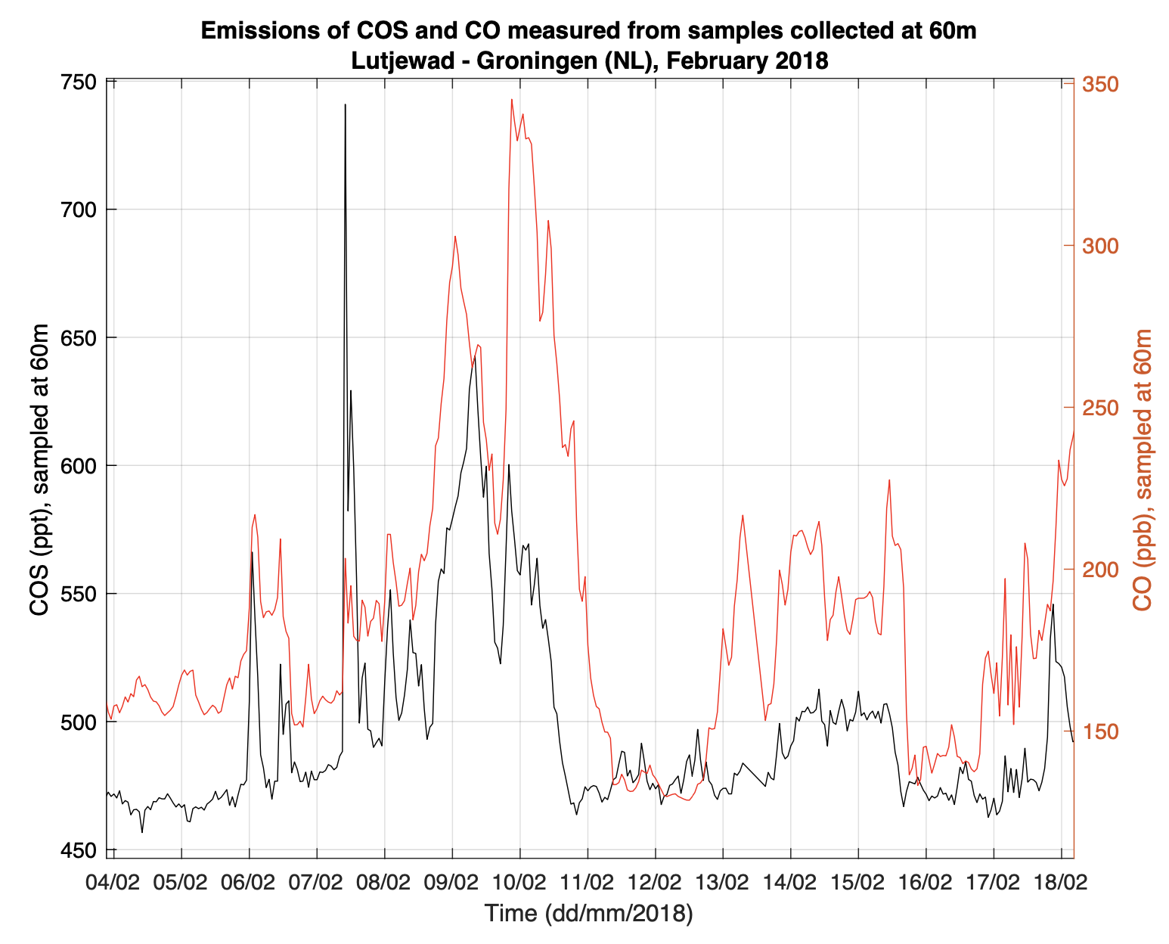
Results – ploughing in Lutjewad (4)
Application of a backward trajectory model to retrieve potential sources (HYSPLIT)
Emissions seemed to be related to air transported from the Delfzijl area
Explosions ESD-SiC: Feb 5th, 6th, 12th, 13th, 14th, 16th.
Notes:
number of endpoints (from all trajectories) / total n. of trajectories

Slide 15
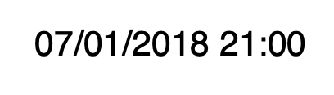
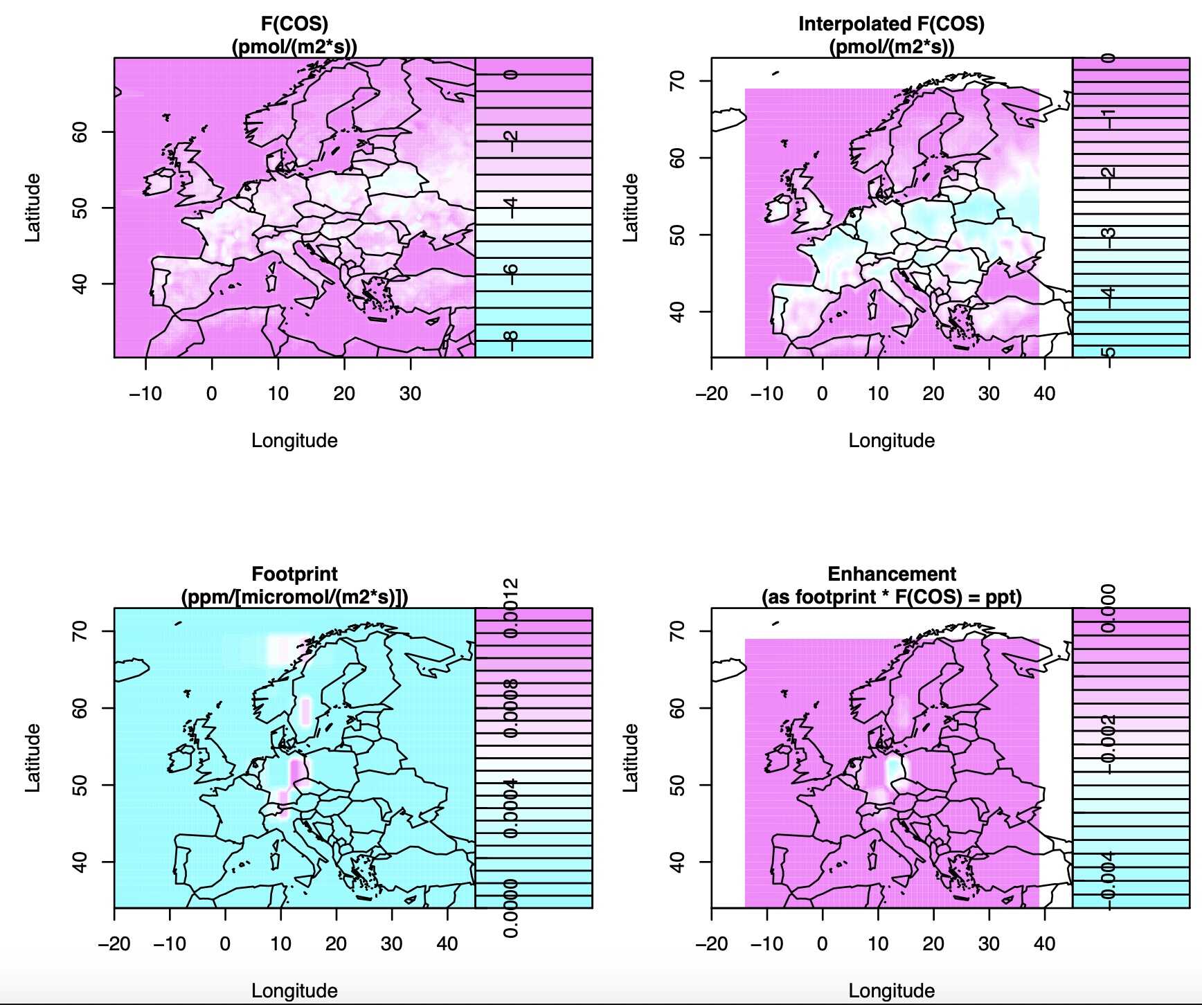
Progress – COS fluxes
STILT and SiB4 have been combined
Max resolution: 0.5°x0.5° (after SiB4)
Current resolution: 1.0°x1.0° (STILT parameters)
A higher resolution might be available for SiB4
(Auke van der Woude).
No oceanic COS fluxes.

Slide 16
Anthropogenic + biospheric fluxes
Anthropogenic fluxes are constant over time
Interpolation might have “moved” some data
The anthropogenic emissions “cover” the biospheric ones.
Where there are no anthropogenic emissions, biospheric uptake still takes place ("lighter yellow” areas – better with high screen brightness)

Slide 17
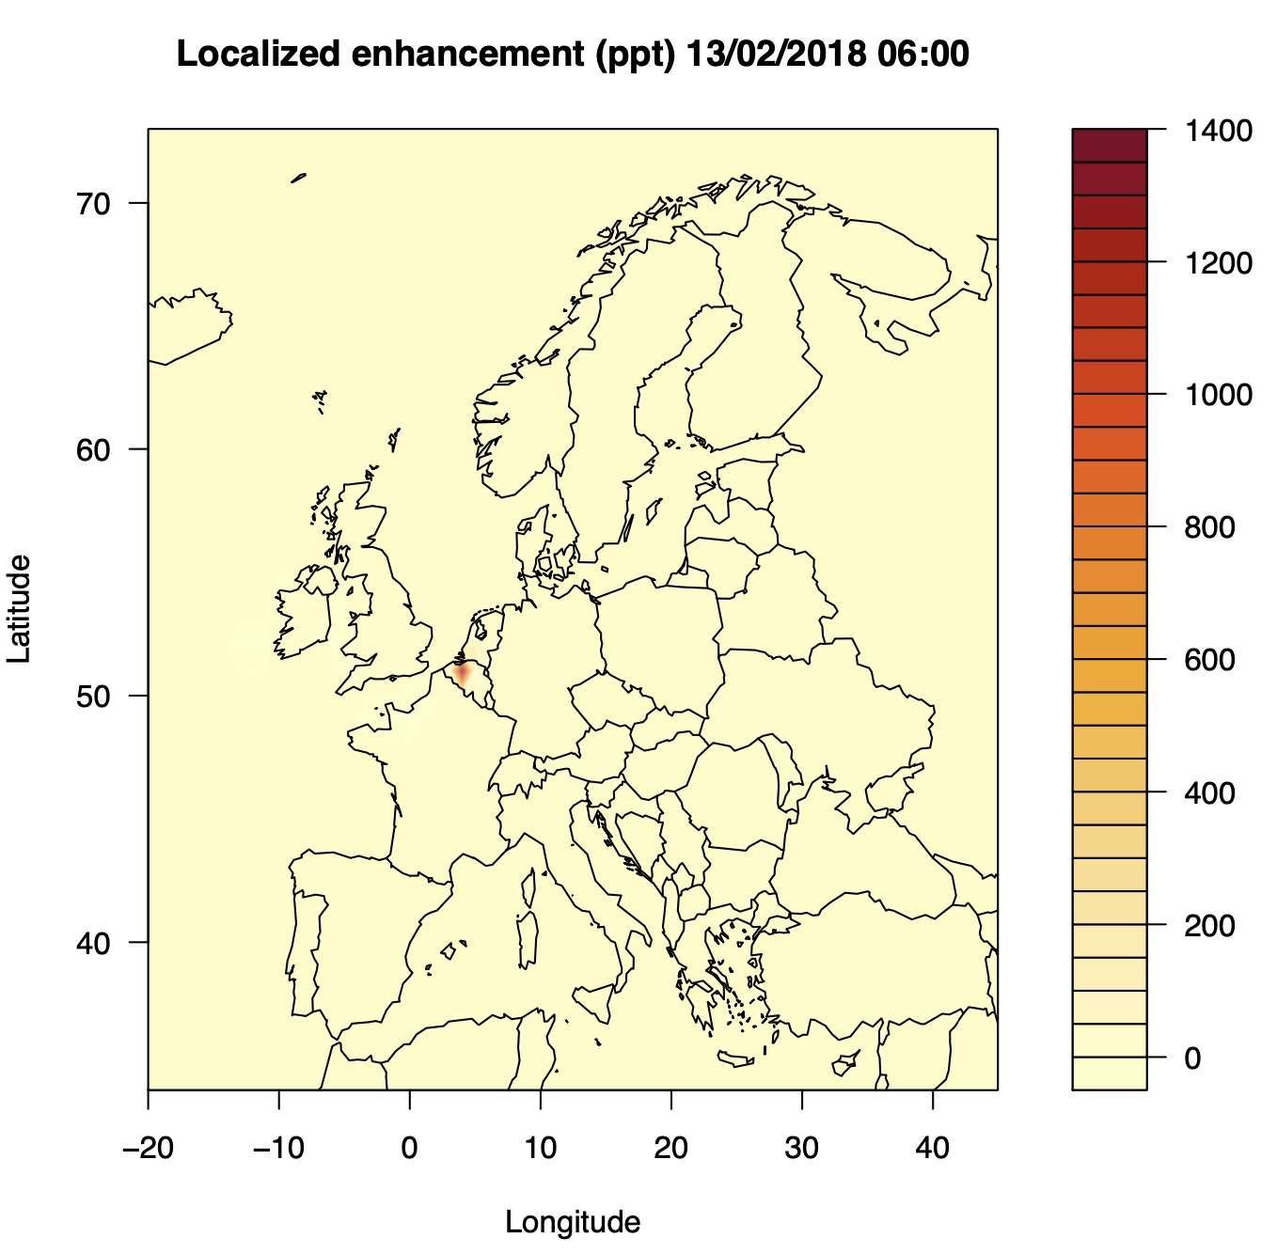
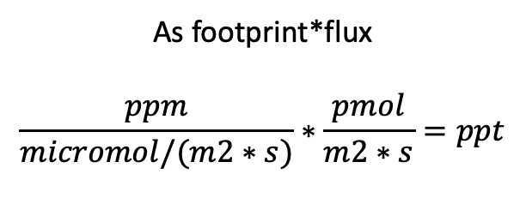
Enhancement related to highest peak
As footprint*flux
$$\frac{ppm}{micromol/(m2∗s)}∗\frac{pmol}{m2∗s}=ppt$$

