Slide 1
Exploring the uncertainty of Weather Generators’ extreme estimates associated with the length of the input data series
By:
Carles Beneyto¹, José Ángel Aranda¹, and Félix Francés¹
¹Research Group of Hydrological and Environmental Modelling (GIMHA)
Research Institute of Water and Environmental Engineering (IIAMA)
Universitat Politècnica de València, Valencia, Spain

Slide 2
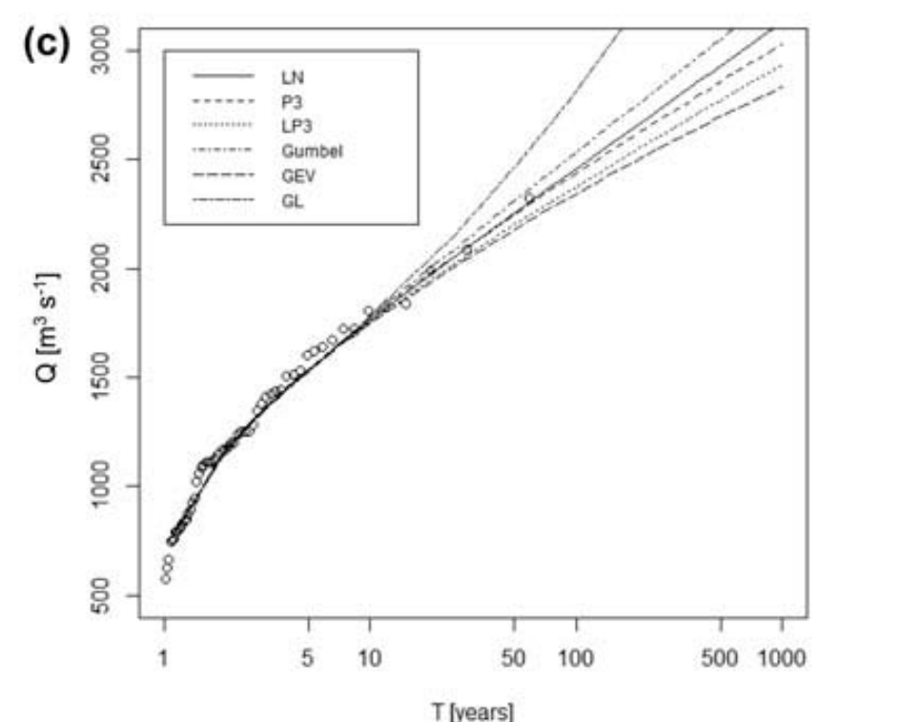
Introduction
Stochastic Weather Generators (WGs)
  Plan and manage natural resources
  Climate Downscaling
  Hydrological Modeling
  Etc..
Produce synthetic time series of weather data of unlimited length for a location based on the statistical characteristics of observed weather at that location (IPCC)
Therefore, strongly dependent upon the “quality” of the observed weather
Short available precipitation records
High Uncertainty for extreme estimates
Extra information
Beneyto et al. (2020)

Slide 3
Objective
Estimate the uncertainty of WGs’ extreme P_{d} estimates introduced by the sample length and the existence of a Regional Study through the analysis of the RRMSE, CV and the RB of a population and their estimated P_{d} quantiles
Relative Root Mean Squared Error (RRMSE)
Relative bias (RB)
Coefficient of Variation (CV)

Slide 4
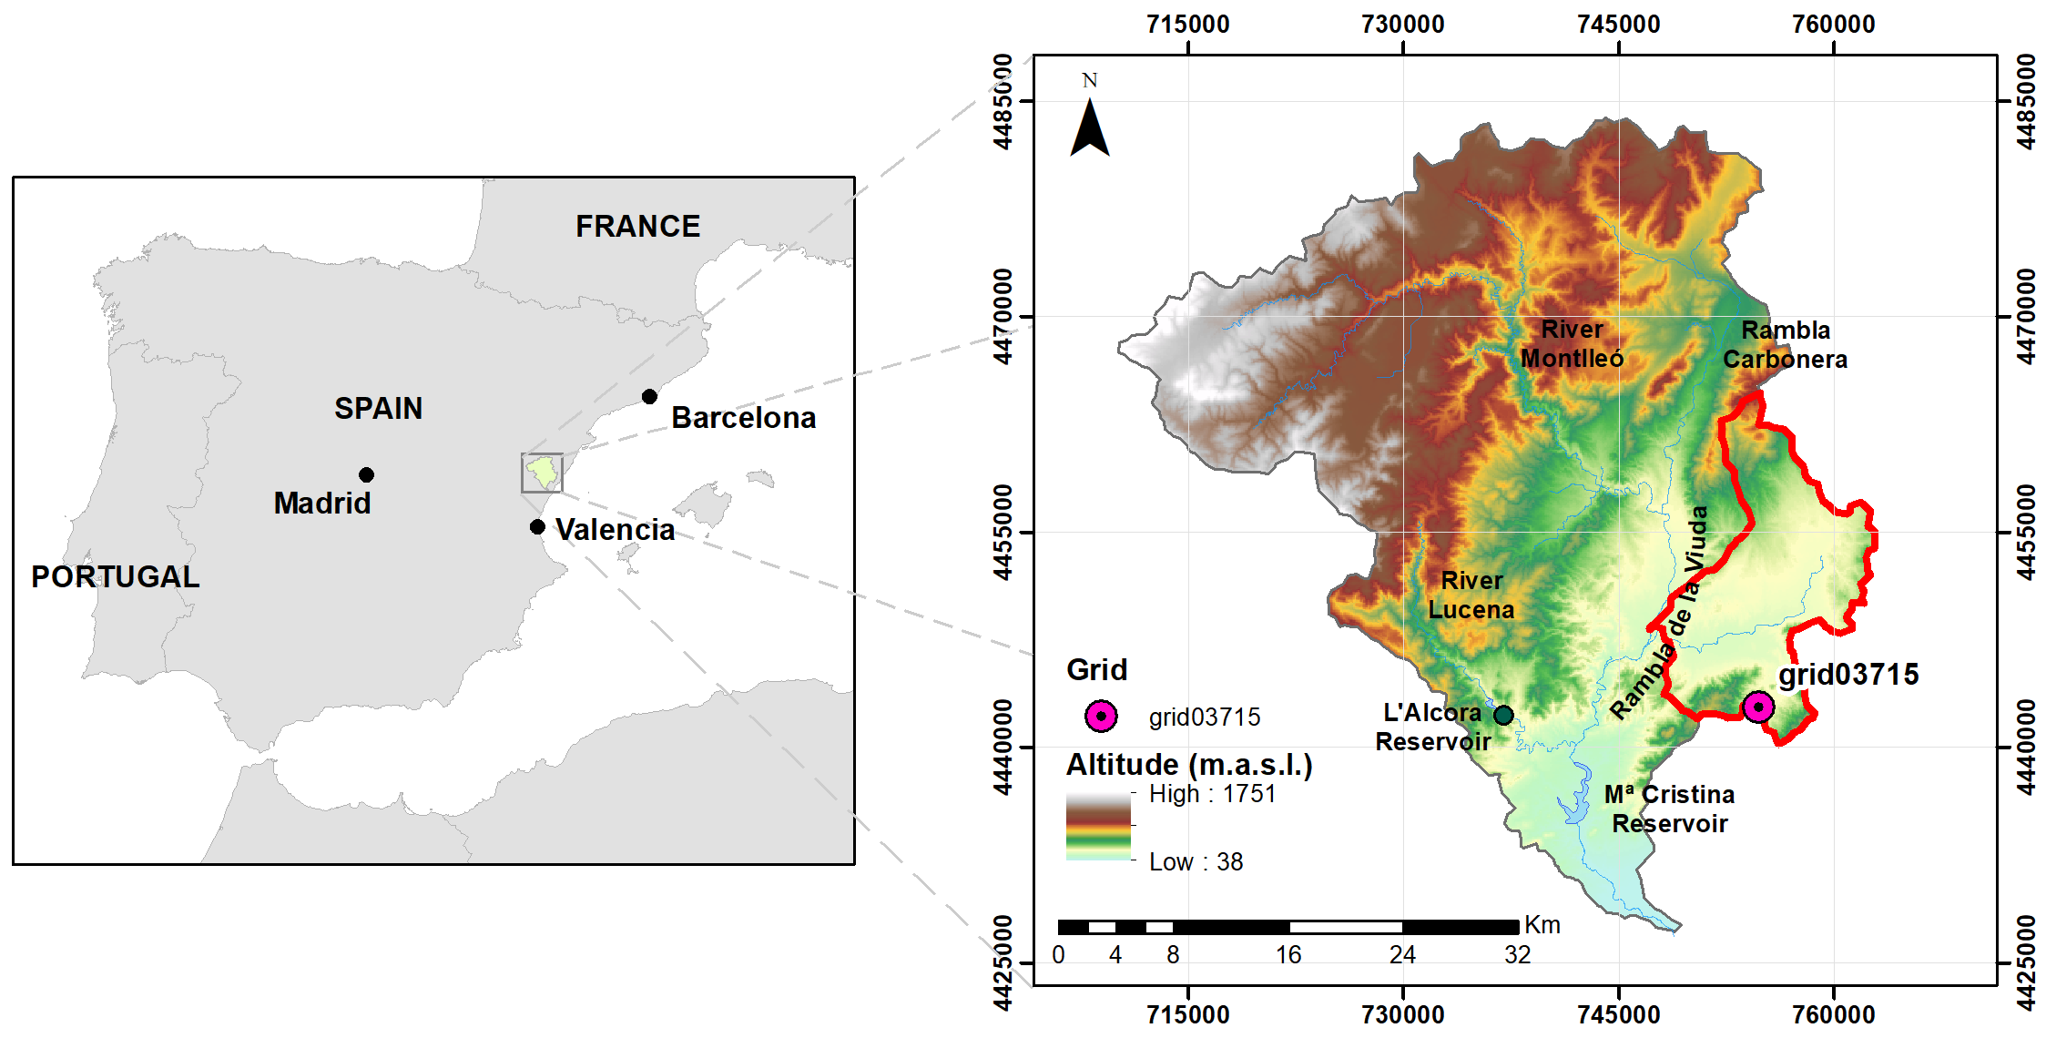
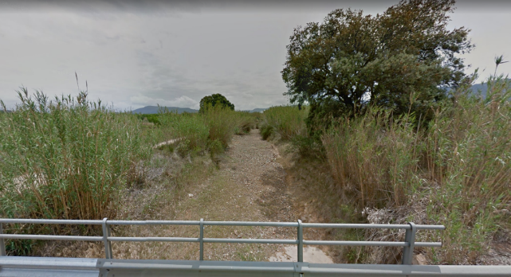
Case study: study area
Barranc de Cabanes: ephemeral river
1 Pluviometer from Spain02-v5 (1950-2015) (Herrera et al., 2016)
Semi-arid Mediterranean climate
Annual mean prec.: 570 mm
High precipitation variability
>75% of dry days
High torrentiality

Slide 5
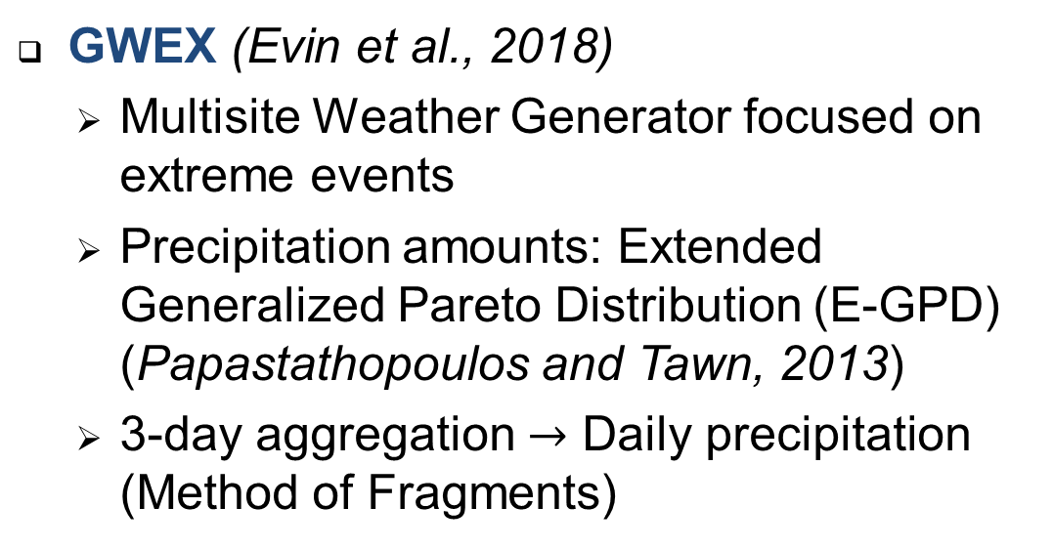

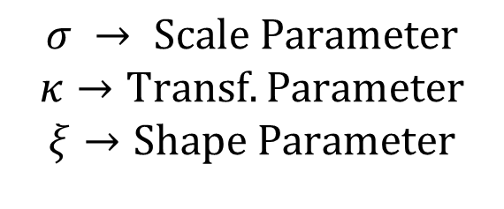
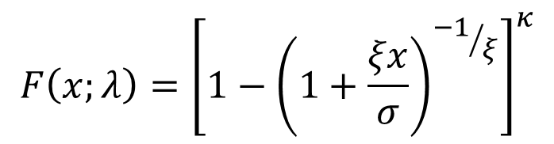
Case study: Weather Generator
GWEX (Evin et al., 2018)
  Multisite Weather Generator focused on extreme events
  Precipitation amounts: Extended Generalized Pareto Distribution (E-GPD) (Papastathopoulos and Tawn, 2013)
  3-day aggregation $→$ Daily precipitation (Method of Fragments)
$$F\left(x;λ\right)={\left[1−{\left(1+\frac{ξx}{σ}\right)}^{{−1}/ξ}\right]}^{κ}$$
$$σ → Scale Parameter$$
$$κ→Transf. Parameter$$
$$ξ→Shape Parameter$$
$$(ξ directly affecting the right tail)$$

Slide 6
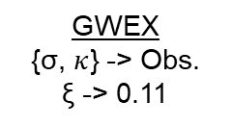
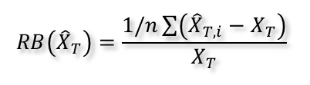
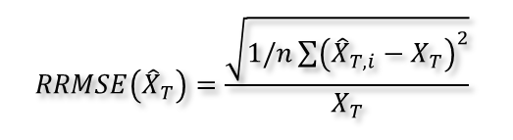
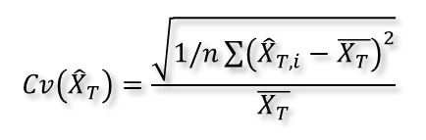

Methodology
GWEX
{σ, $κ$} -> Obs.
ξ -> 0.11
One pluviometer
66 yrs of precipitation records
15,000 yrs synthetic precipitation
Monte Carlo Simulation
50 Simulations
Sample lengths: 30, 60, 90, 120,150, 200 and 300yrs
For each package
$$RRMSE\left({\hat{X}}_{T}\right)=\frac{\sqrt{1/n\sum{{\left({\hat{X}}_{T,i}−X_{T}\right)}^{2}}}}{X_{T}}$$
T | Prec (mm)
T = 2 yrs | 55.7
T = 5 yrs | 81.3
T = 10 yrs | 100.7
T = 25 yrs | 125.8
T = 50 yrs | 146.7
T = 75 yrs | 158.8
T = 100 yrs | 168.4
T = 200 yrs | 192.0
T = 500 yrs | 238.1
T = 1,000 yrs | 262.8
T | Prec (mm)
T = 2 yrs | 53.2
T = 5 yrs | 78.2
T = 10 yrs | 105.2
T = 25 yrs | 126.4
T = 50 yrs | 151.3
T = 75 yrs | 160.8
T = 100 yrs | 165.6
T = 200 yrs | 198.9
T = 500 yrs | 235.1
T = 1,000 yrs | 254.6
ξ -> set to 0.05 (Unknown)
GWEX
{σ, $κ$} -> Obs.
$$RB\left({\hat{X}}_{T}\right)=\frac{1/n\sum{\left({\hat{X}}_{T,i}−X_{T}\right)}}{X_{T}}$$
ξ -> set to 0.11 (Known)
$$Cv\left({\hat{X}}_{T}\right)=\frac{\sqrt{1/n\sum{{\left({\hat{X}}_{T,i}−\overline{X_{T}}\right)}^{2}}}}{\overline{X_{T}}}$$
ξ -> Regional study (Q₁₀₀ fit)

Slide 7
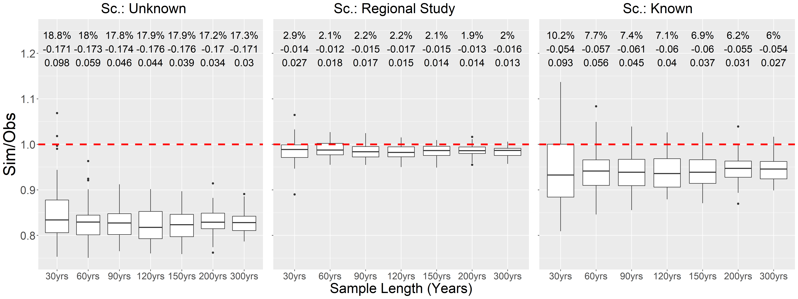



Results
T = 50 years
$$RRMSE\left({\hat{X}}_{T}\right)$$
RB $\left({\hat{X}}_{T}\right)$
$$Cv\left({\hat{X}}_{T}\right)$$

Slide 8
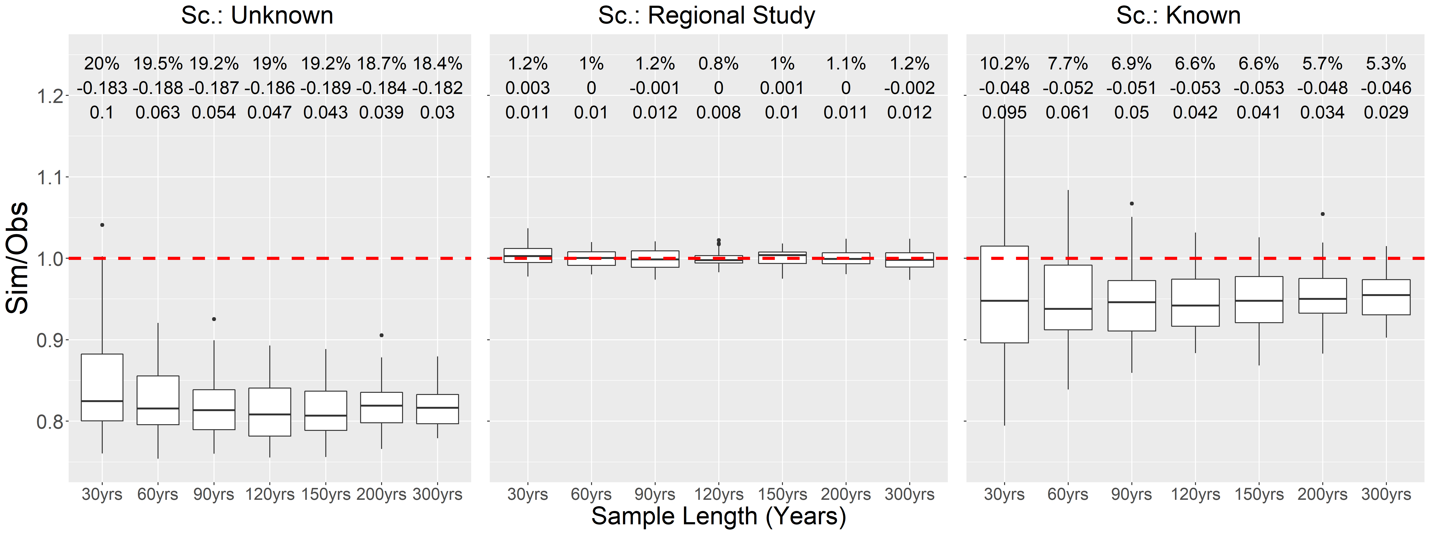
Results
T = 100 years (regional study fit)
$$RRMSE\left({\hat{X}}_{T}\right)$$
RB $\left({\hat{X}}_{T}\right)$
$$Cv\left({\hat{X}}_{T}\right)$$

Slide 9
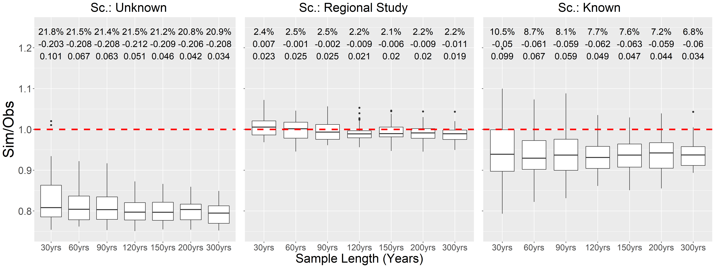
Results
T = 200 years
$$RRMSE\left({\hat{X}}_{T}\right)$$
RB $\left({\hat{X}}_{T}\right)$
$$Cv\left({\hat{X}}_{T}\right)$$

Slide 10
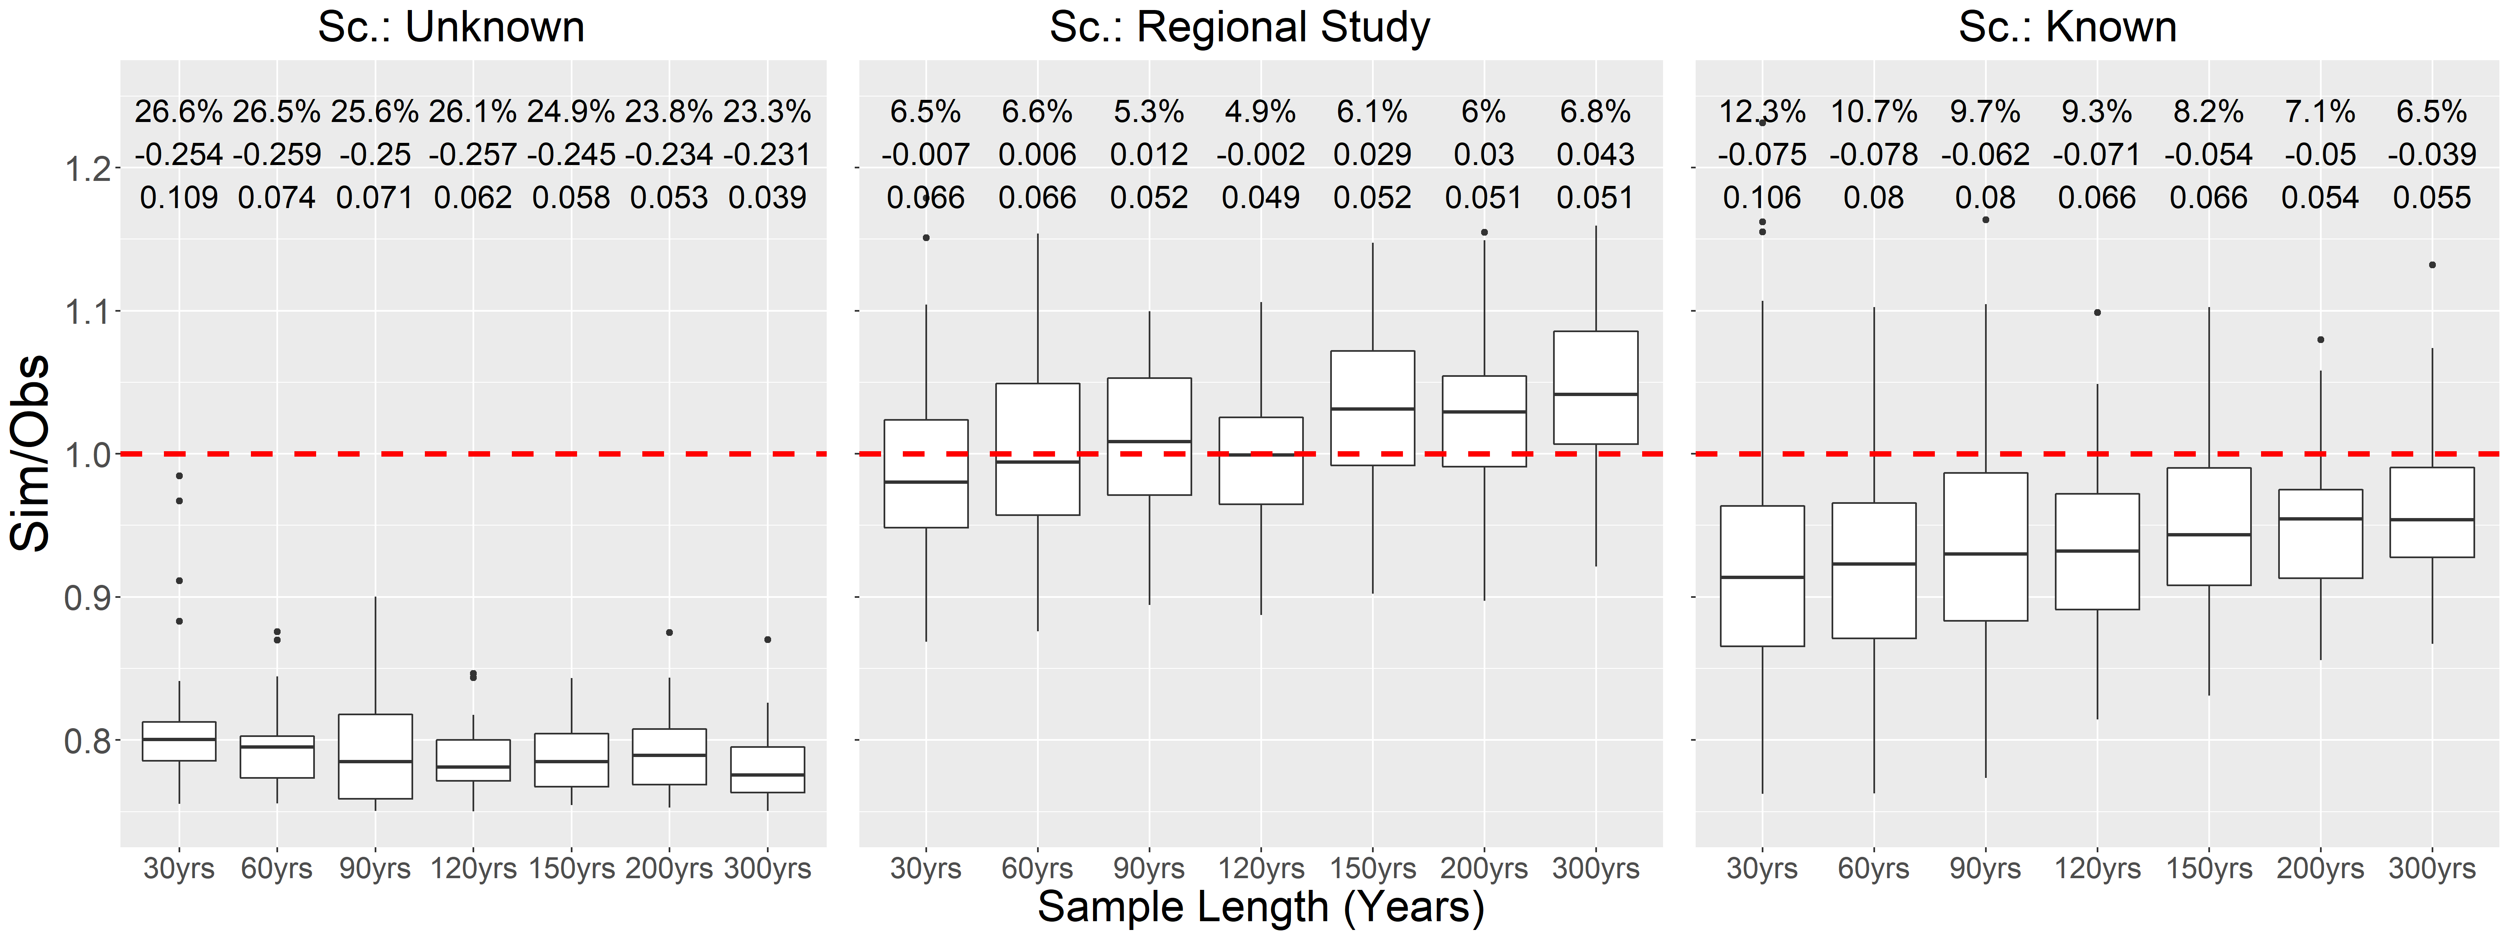
Results
T = 500 years
$$RRMSE\left({\hat{X}}_{T}\right)$$
RB $\left({\hat{X}}_{T}\right)$
$$Cv\left({\hat{X}}_{T}\right)$$

Slide 11
Conclusions
CV decreases with the sample length
However, both RRMSE and RB do not significantly change with the sample length, which means that:
  The incorporation of a Regional Study for the implementation of a Weather Generator adds more information than a larger sample length and, therefore, reduce the uncertainty of the extremes estimates
  Moreover, knowing information of just one quantile (e.g. Q₁₀₀), it is possible to obtain satisfactory estimates for the higher quantiles

Slide 12
References
Beneyto, C., Aranda, J.Á., Benito, G., Francés, F., 2020. New approach to estimate extreme flooding using continuous synthetic simulation supported by regional precipitation and non-systematic flood data. Water (Switzerland) 12, 1–16. https://doi.org/10.3390/w12113174
Evin, G., Favre, A.C., Hingray, B., 2018. Stochastic generation of multi-site daily precipitation focusing on extreme events. Hydrology and Earth System Sciences 22, 655–672. https://doi.org/10.5194/hess-22-655-2018
Herrera, S., Fernández, J., Gutiérrez, J.M., 2016. Update of the Spain02 gridded observational dataset for EURO-CORDEX evaluation: Assessing the effect of the interpolation methodology. International Journal of Climatology 36, 900–908. https://doi.org/10.1002/joc.4391
IPCC, 1999. Stochastic weather generators [WWW Document]. URL http://www.ipcc-data.org/guidelines/pages/weather_generators.html (accessed 4.21.21).
Papastathopoulos, I., Tawn, J.A., 2013. Extended generalised Pareto models for tail estimation. Journal of Statistical Planning and Inference 143, 131–143. https://doi.org/10.1016/j.jspi.2012.07.001

Slide 13
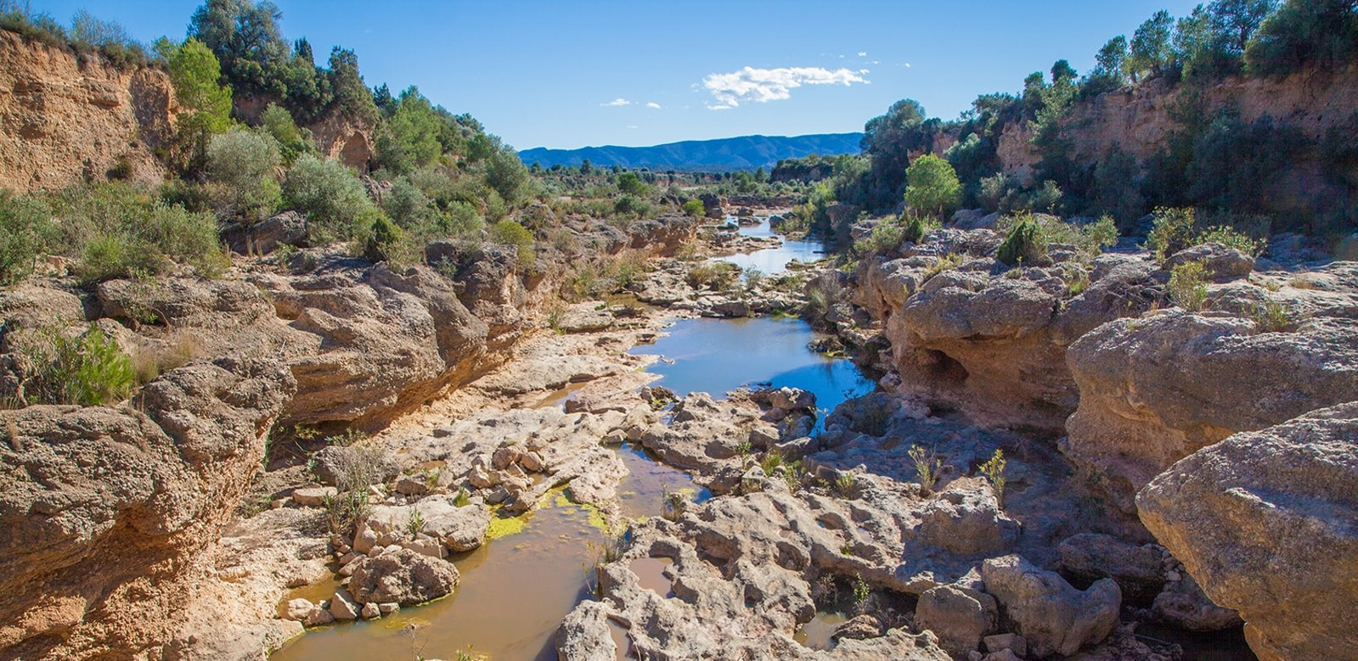
Thanks for your attention!
Research Group of Hydrological and Environmental Modeling
lluvia.dihma.upv.es
Research Institute of Water and Environmental Engineering
Universitat Politècnica de València
This study has been supported by the Ministry of Science, Innovation and Universities of Spain through the Research Projects TETISCHANGE (RTI2018-093717-B-100).

