Slide 1

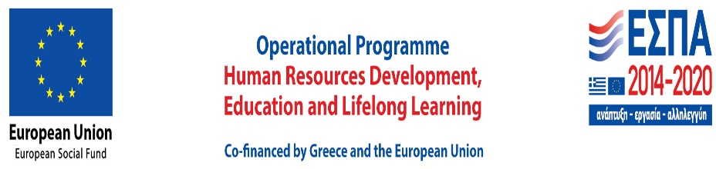
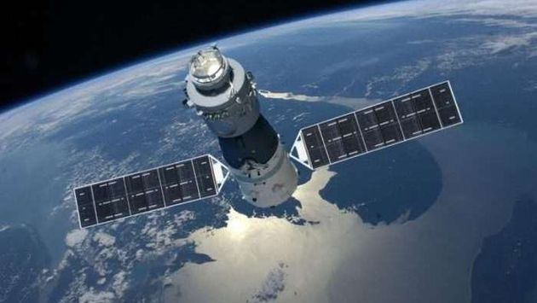
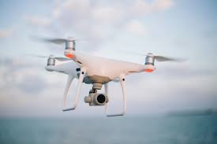
“Application of Remote Sensing Technologies in environmental monitoring:
legal framework, limitations and potential in the European Union”
,
M. Maniadaki*, A. Papathanasopoulos*, L. Mitrou**, E-A Maria*
*School of Environmental Engineering
Technical University of Crete
**Department of Information and Communication Systems Engineering University of the Aegean
EGU 2021,
29 April 2021

Slide 2
Τηε
About the Paper
Main goals of the paper are:
Briefly present the European legal framework regarding the application of Remote Sensing Technologies in environmental monitoring
Outline certain legal limitations of such technologies
Approach important ECtHR and CJEU case law on the issue
Present recent developments in Greek legislation
Examine under what legal circumstances a wider application of Remote Sensing Technologies in environmental monitoring could be envisaged
ΔΡΑΣΗ Α1 LIFE - NATURA THEMIS

Slide 3
Article 37 of EU Charter of Fundamental Rights-
Articles 3 and 191 of the Consolidated version of the Treaty on the Functioning of the European Union
“A high level of environmental protection and the improvement of the quality of the environment must be integrated into the policies of the Union and ensured in accordance with the principles of sustainable development”
ΔΡΑΣΗ Α1 LIFE - NATURA THEMIS
“Union policy on the environment shall contribute to pursuit of
- preserving, protecting and improving the quality of the environment …
In preparing its policy on the environment, the Union shall take account of: - available scientific and technical data ”
“The Union shall work for … a high level of protection and improvement of the quality of the environment”

Slide 4
Remote Sensing Technologies:
valuable tools for the environment
Remote Sensing may be broadly defined as the collection of information about an object without being in physical contact with the object. Aircrafts and satellites are the common platforms from which remote sensing observations are made. The term remote sensing is restricted to methods that employ electromagnetic energy as the means of detecting and measuring target characteristics (Sabins 1978)
Remote Sensing Technologies, such as satellite and drone imagery, are used in numerous fields for environmental purposes.
Extremely useful for environmental monitoring, as they may collect and provide data pertaining to natural disasters, state of oceans, atmosphere, land, vegetation, food, public health etc, which are further essential for the effective decision making of public authorities.
They may facilitate the right for access to environmental information to the public
They consist valuable tools for environmental law enforcement (for environmental compliance assurance, for collecting reliable information that provide evidence to combat environmental crime)
ΔΡΑΣΗ Α1 LIFE - NATURA THEMIS

Slide 5
Legal Framework on Satellite technologies
International Space Law (Outer Space Treaty and the four follow- on treaties)
The Resolution 41/65 on the Principles of Remote Sensing of the Earth from Outer Space- Principle X: Remote sensing shall promote the protection of the Earth's natural environment.
Council Decision of 29 April 2004 on the conclusion of the Framework Agreement between the European Community and the European Space Agency (2004/578/EC). According to Article 3 the fields of cooperation involve also earth observation.
Copernicus programme (former Global Monitoring for Environment and Security)- Regulation (EU) 377/2014 of the European Parliament and of the Council. According to Article 4 Copernicus shall contribute amongst others to the protection of the environment and to autonomous access to environmental knowledge.
ΔΡΑΣΗ Α1 LIFE - NATURA THEMIS

Slide 6
an
Legal framework on unmanned aerial vehicles or drones
International Law: trend for harmonization
Subject to national civil aviation law of the States
Regulation (EU) 2018/1139 of the European Parliament and of the Council on 11 of September 2018 consolidated the scope of European Union competence to cover the full spectrum of the aviation landscape and reinforce the European aviation system as a whole.
According to the Commission Delegated Regulation (EU) 2019/945 of 12 March 2019 on unmanned aircraft systems and on third-country operators of unmanned aircraft systems, operations shall be performed in the ‘open’, ‘specific’ or ‘certified’ category.
Commission Implementing Regulation 2019/947 of 24 May 2019 on the rules and procedures for the operation of unmanned aircraft UAS includes requirements for the implementation of three foundations of the U-space system, namely registration, geo-awareness and remote identification
ΔΡΑΣΗ Α1 LIFE - NATURA THEMIS

Slide 7
Limitations of Remote Sensing Technologies
Need for data verification
Need for data procession according to privacy and personal data law requirements
ΔΡΑΣΗ Α1 LIFE - NATURA THEMIS

Slide 8
Need for data verification
Data collected by Remote Sensing Technologies are of digital nature, and therefore may be subject to alterations→ Strict control of the whole process of data collection and interpretation is essential, from the moment the data is obtained
Many potential cases of pollution that are discovered by satellites turn out to be a false alarm. Images do not make a clear distinction between natural phenomena and discharges of pollutants. → An “interpretation stage” is necessary, the opinions of experts
! For these reasons Remote Sensing Technologies should be preferably used as complementary means of proof
ΔΡΑΣΗ Α1 LIFE - NATURA THEMIS

Slide 9
Need for data procession according to
privacy and personal data law requirements
Monitoring by Remote Sensing Technologies as “an invasion to privacy”
Very High Resolution Imagery (VHR) creates considerable challenges for personal data protection (interactive GIS maps, facial recognition technology and big data analytical software, may make available personal information)
Chilling and panopticon effect syndrome from a large scale use of drones
ΔΡΑΣΗ Α1 LIFE - NATURA THEMIS

Slide 10
Legal Framework on the protection of privacy and personal data
Article 8 ECHR: “Everyone has the right to respect for his private and family life, his home and his correspondence”
Article 7 of the EU Charter of Fundamental Rights, respect for private and family life
Article 16 of the Treaty on the Functioning of the European Union (TFEU) in accordance with Article 8 of the EU Charter of Fundamental Rights, protection of personal data
General Data Protection Regulation (GDPR)
Justice and Police Directive (EU) 2016/680
ΔΡΑΣΗ Α1 LIFE - NATURA THEMIS

Slide 11
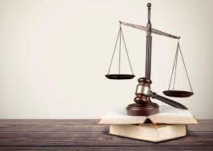
The principle of proportionality
as a tool for balancing fundamental rights –
Article 52 (1) of the EU Charter, Article 8 (2) ECHR
“Limitations on the exercise of the rights and freedoms must be necessary and appropriate”
ΔΡΑΣΗ Α1 LIFE - NATURA THEMIS

Slide 12

Case law on the reliability of Satellite Imagery-
CJEU case law
ΔΡΑΣΗ Α1 LIFE - NATURA THEMIS
C-390/07 European Commission v United Kingdom of Great Britain and Northern Ireland: capture of images by remote sensing cannot, as such, be regarded as unreliable, constitute a means capable of revealing the existence of accelerated growth of algae and higher forms of plant life.
C-485/12 Maatschap T. van Oosterom en A. van Oosterom-Boelhouwer: photo interpretation of satellite images or aerial photographs may also be used in the course of administrative checks in order to determine the area eligible for aid. The authority cannot be required to carry out a physical measurement of the parcels in question where it has no doubts as to the measurement data inferred from the aerial photographs available.

Slide 13
Case law on lawful limitations of privacy and personal data protection- ECtHR and CJEU case law
No ad hoc case law regarding Remote Sensing Technologies (no case law concerning the balance between the right for a high level of Environmental Protection and the rights for privacy and personal data)
Use of rich ECtHR and CJEU case law by analogy, which approves limitations of privacy and personal data as long as they are proportionate to the legitimate aims pursued and they are imposed with sufficient safeguards against abuse
Leander v. Sweden No 9248/81, S. and Marper v. the UK (GC) No 30562/04 & 30566/04, Roman Zakharov v. Russia (GC) No 47143/06, Szabo and Vissy v. Hungary No. 37138/14, P.N v. Germany No 74440/17
C-293/12 and C-594/12 Digital Rights Ireland, C-203/15 and C-698/15 Tele 2, C-207/16 Ministerio Fiscal, C-623/17 Privacy International, C-746/18 H.K v. Prokuratuur, C-73/16 Peter Puskar
ΔΡΑΣΗ Α1 LIFE - NATURA THEMIS

Slide 14
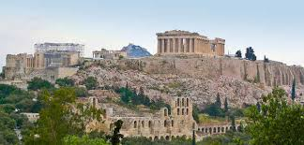
Nations still have their own role in legislation and regulation- The Greek case
Recent introduction of a specific regulatory framework for the use of Monitoring Technologies in public places (Presidential Decree 75/2020)
Legal framework set by the Presidential Decree may be limited to crime prevention and repression, however its provisions follow all current European trends on personal data protection
Forms the necessary legal background for any other future laws regarding the use of Remote Sensing Technologies
ΔΡΑΣΗ Α1 LIFE - NATURA THEMIS

Slide 15
Towards a wider application of Remote Sensing Technologies in environmental monitoring- how?
Remote Sensing Technologies can be now used with sufficient guarantees for the effective protection of privacy and personal data, provided that no other less restrictive means exist.
There is still a need for a consistent regulatory framework, which will envisage the wider lawful use of Remote Sensing Technologies in the environmental sector.
ΔΡΑΣΗ Α1 LIFE - NATURA THEMIS

Slide 16
Acknowledgements
“This research is co-financed by Greece and the European Union (European Social Fund- ESF) through the Operational Programme «Human Resources Development, Education and Lifelong Learning 2014-2020» in the context of the project “Legal issues derived from the use of monitoring and earth observation technologies to ensure environmental compliance in the Hellenic legal order- HELLASNOMOSAT” (MIS 5047355).”
ΔΡΑΣΗ Α1 LIFE - NATURA THEMIS

Slide 17
Thank you for your attention!
M. Maniadaki*, A. Papathanasopoulos*, L. Mitrou**, E-A Maria*
*School of Environmental Engineering
Technical University of Crete
**Department of Information and Communication Systems Engineering
University of the Aegean
For correspondence: mmaniadaki@isc.tuc.gr

