Slide 1
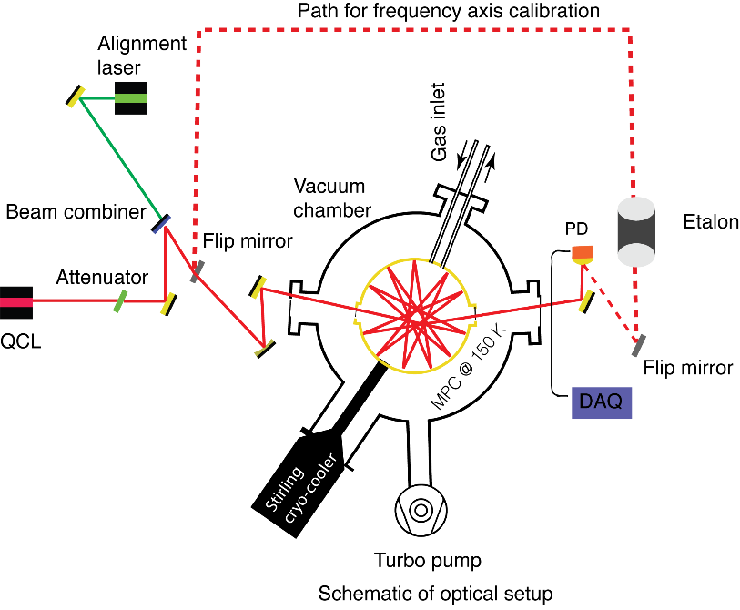
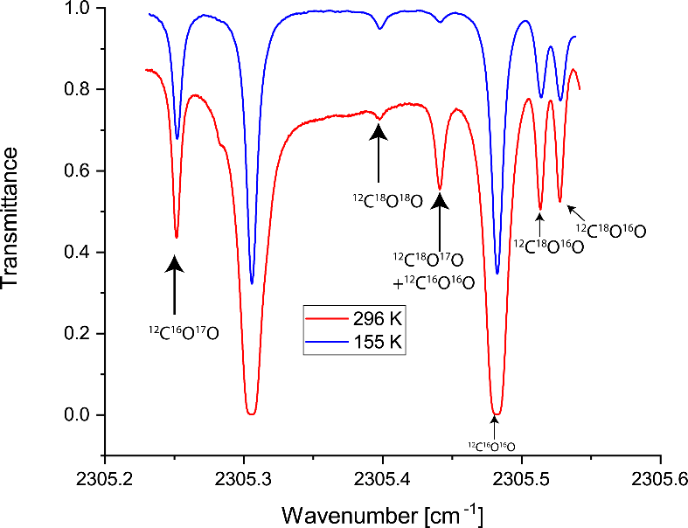
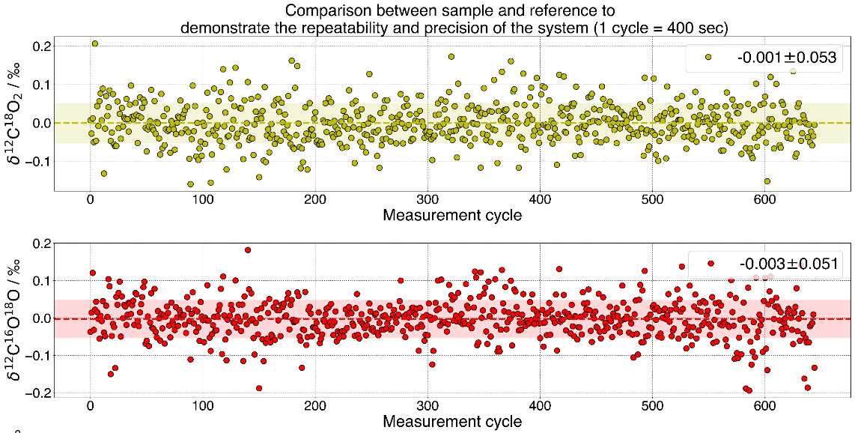



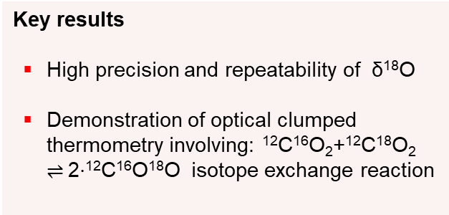
Quantum Cascade Laser absorption spectroscopy (QCLAS) of clumped ¹⁸O¹²C¹⁸O
Akshay Nataraj^{1,2}, Michele Gianella¹, Ivan Prokhorov¹, Béla Tuzson¹, Jérôme Faist² and Lukas Emmenegger¹
¹ Empa, Swiss Federal Laboratories of Materials Science and Technology, 8600 Dübendorf, Switzerland
² ETH Zurich, Institute for Quantum Electronics, 8093 Zürich, Switzerland
Key components
DFB-QCL emitting at 4.3 μm driven in intermittent continuous wave (icw) mode
Cryo-cooled (150 K) segmented circular multipass cell (SC-MPC).
OPL = 6 m, P = 10 mbar
Multi-port inlet for rapid gas switching
Transmittance
Wavenumber (cm⁻¹)
Measured transmission spectra of CO₂ isotopologues at room (red) and low (blue) temperatures.
Schematic of the optical setup.
Key results
High precision and repeatability of δ¹⁸O
Demonstration of optical clumped thermometry involving: $\text{12}\text{C}\text{16}\text{O}\text{2}\text{+}\text{12}\text{C}\text{18}\text{O}\text{2 }\text{⇌} \text{2⋅}\text{12}\text{C}\text{16}\text{O}\text{18}\text{O}$ isotope exchange reaction
EGU General Assembly 2021: Gather Online (#vEGU21), Session BG 2.2, 27 April 2021

Slide 2

Outline
Introduction
Optical setup
Instrument performance
Optical clumped thermometry
Acknowledgements

Slide 3
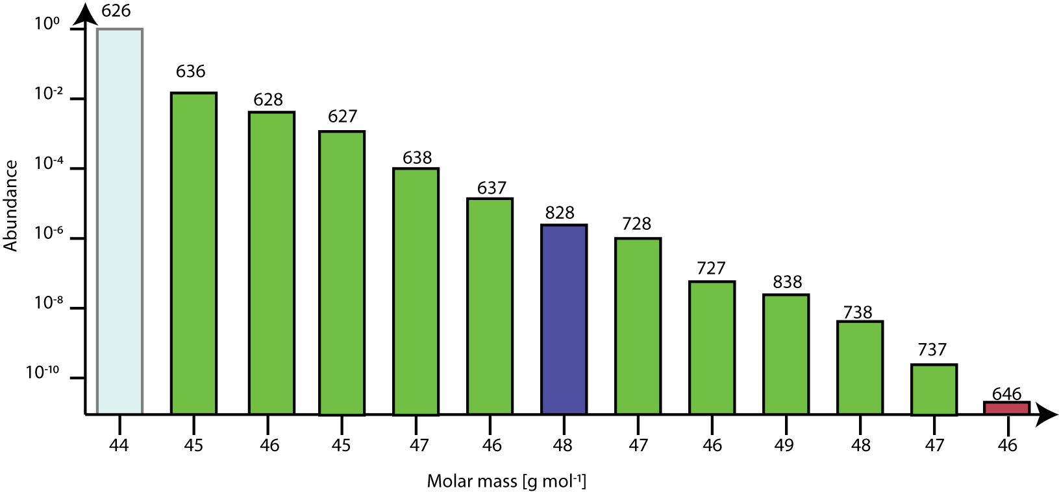
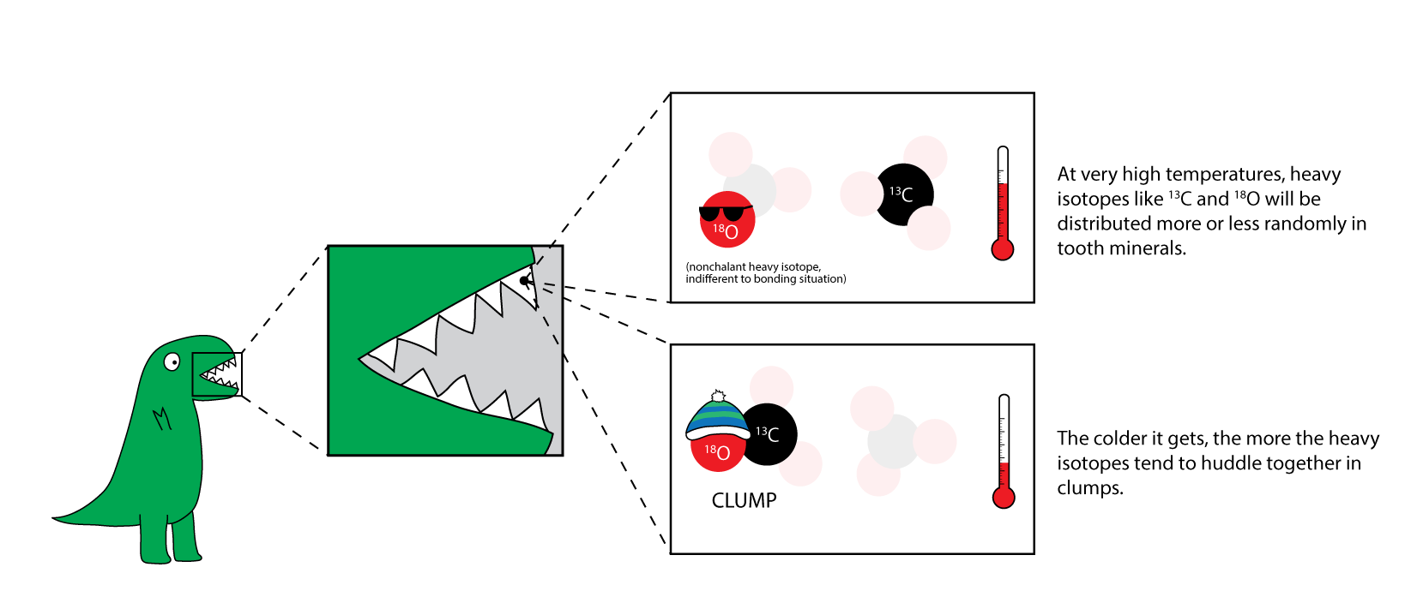
Introduction
Carbon has 2 stable (¹²C and ¹³C) and 1 radioactive (¹⁴C) isotopes
Oxygen has 3 stable isotopes (¹⁶O, ¹⁷O, ¹⁸O)
Isotopologues of Carbon Dioxide
$$\text{12}\text{C}\text{16}\text{O}\text{2}\text{+}\text{12}\text{C}\text{18}\text{O}\text{2} \text{⇌} \text{2⋅}\text{12}\text{C}\text{16}\text{O}\text{18}\text{O}$$
Terminology: ¹⁶O¹²C¹⁶O = 626
At very high temperatures, heavier isotopes ¹³C and ¹⁸O will be randomly distributed
Abundance
At lower temperatures, heavier isotopes ¹³C and ¹⁸O tend to clump together
Molar mass [g mol⁻¹]
https://dinotopes.wordpress.com/
Multiply substituted or ‘clumped isotope’ species with 4 ppm relative abundance (¹⁸O¹²C¹⁸ O)
Quantified as deviation Δ of the isotopologue ratio 𝑅 w.r.t. random distribution 𝑅∗: 𝑅 = (1 + Δ) 𝑅∗.
Δ is independent of 𝜹.

Slide 4
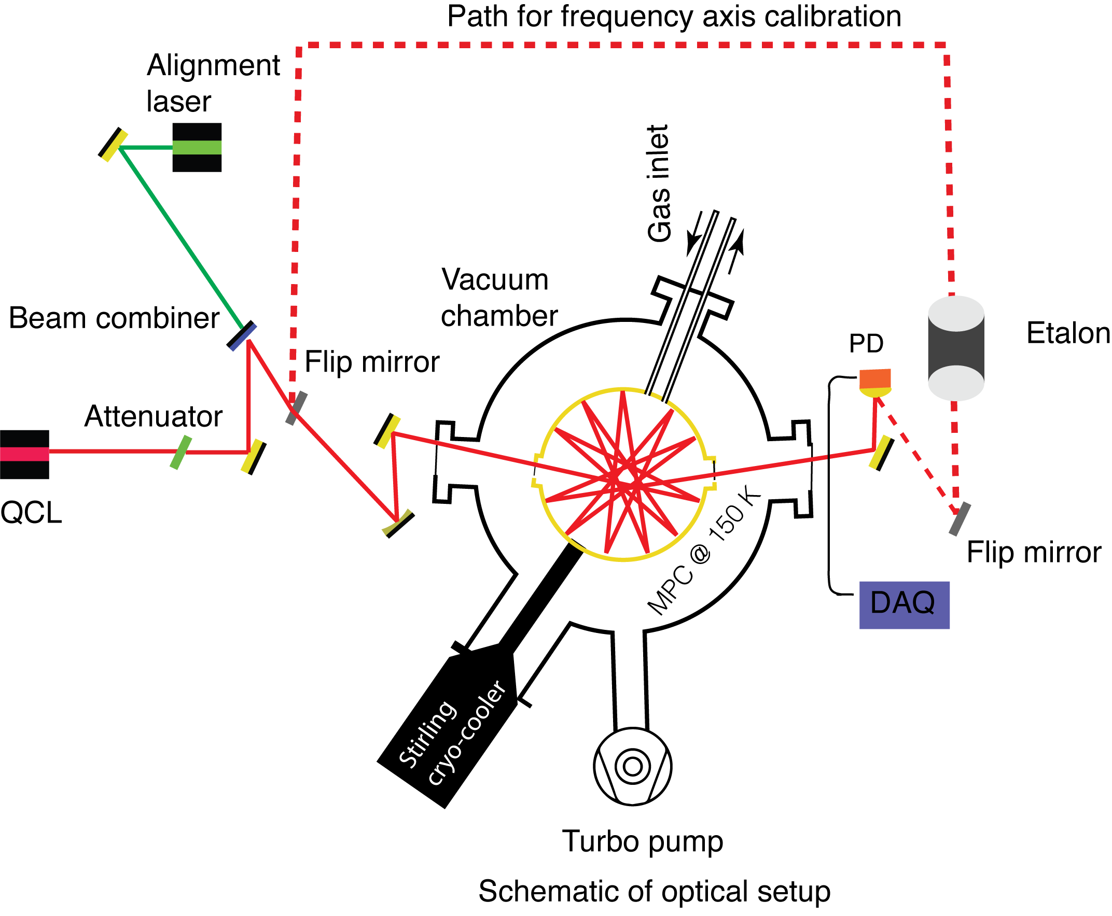
Optical system
Key elements
4.3 μm DFB-QCL operated in intermittent continuous wave (icw) mode ^{[1]}
Segmented circular multipass cell (SC-MPC)^{[2]} installed in vacuum chamber and kept at 10 mbar in a flow through mode.
Optical path length: 6 m
Vibration controlled Stirling-cooler to cool the MPC to 150 K
Temperature stabilized custom made acrylic glass housing
Automatic gas handling using multi-port Vici valve
^{[1]}Fischer, M et. al “Intermittent Operation of QC-Lasers for Mid-IR Spectroscopy with Low Heat Dissipation: Tuning Characteristics and Driving Electronics.” Optics Express 22 (6): 7014. https://doi.org/10.1364/OE.22.007014.
^{[2]}Graf, Manuel et al. “Compact, Circular, and Optically Stable Multipass Cell for Mobile Laser Absorption Spectroscopy.” Optics Letters 43 (11): 2434. https://doi.org/10.1364/OL.43.002434.

Slide 5
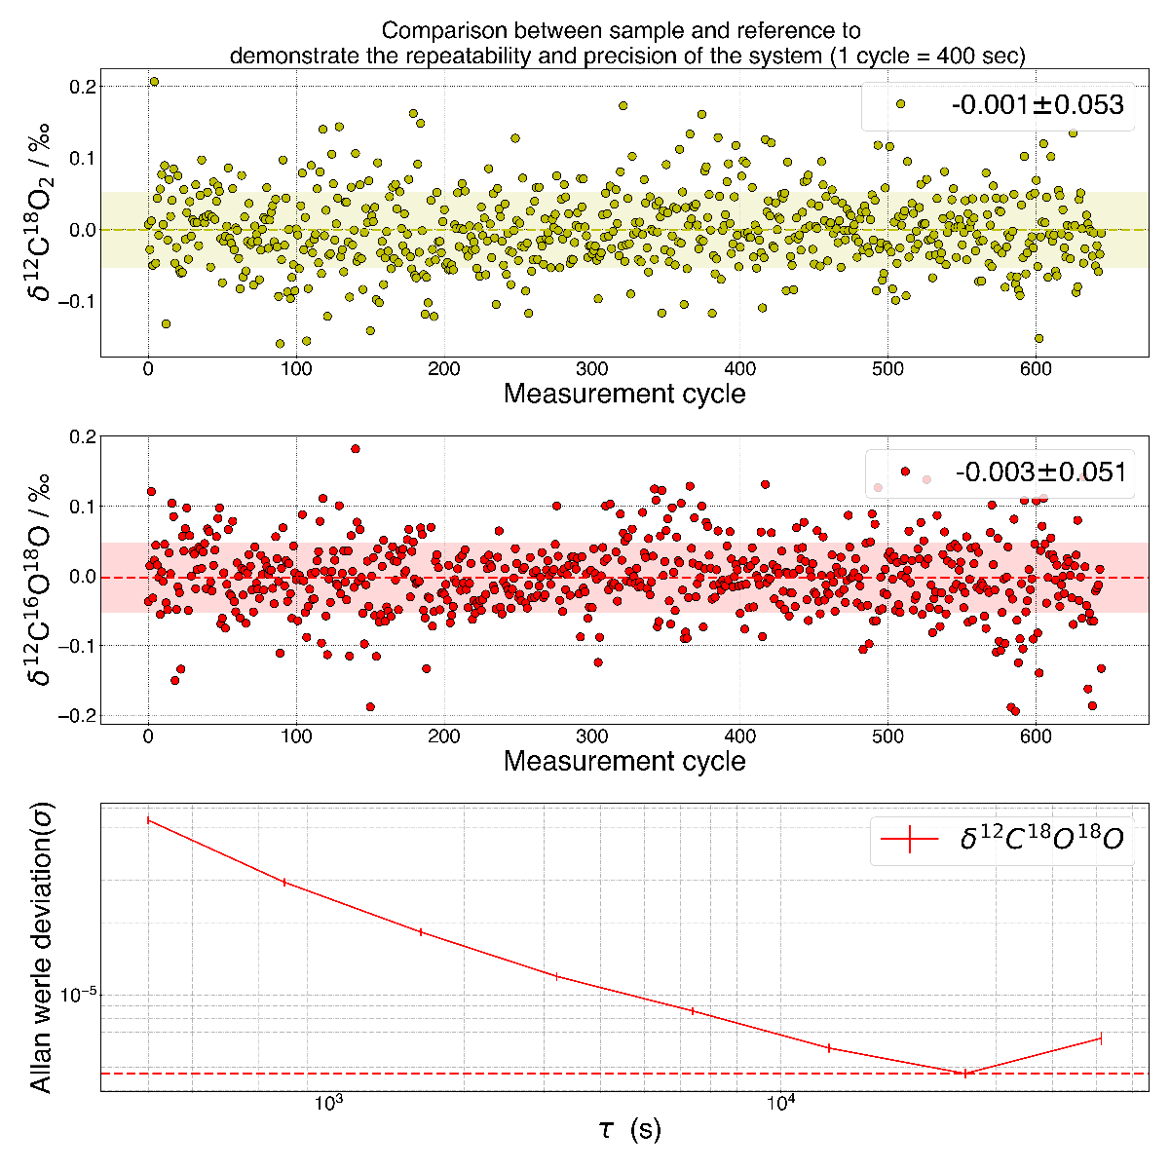
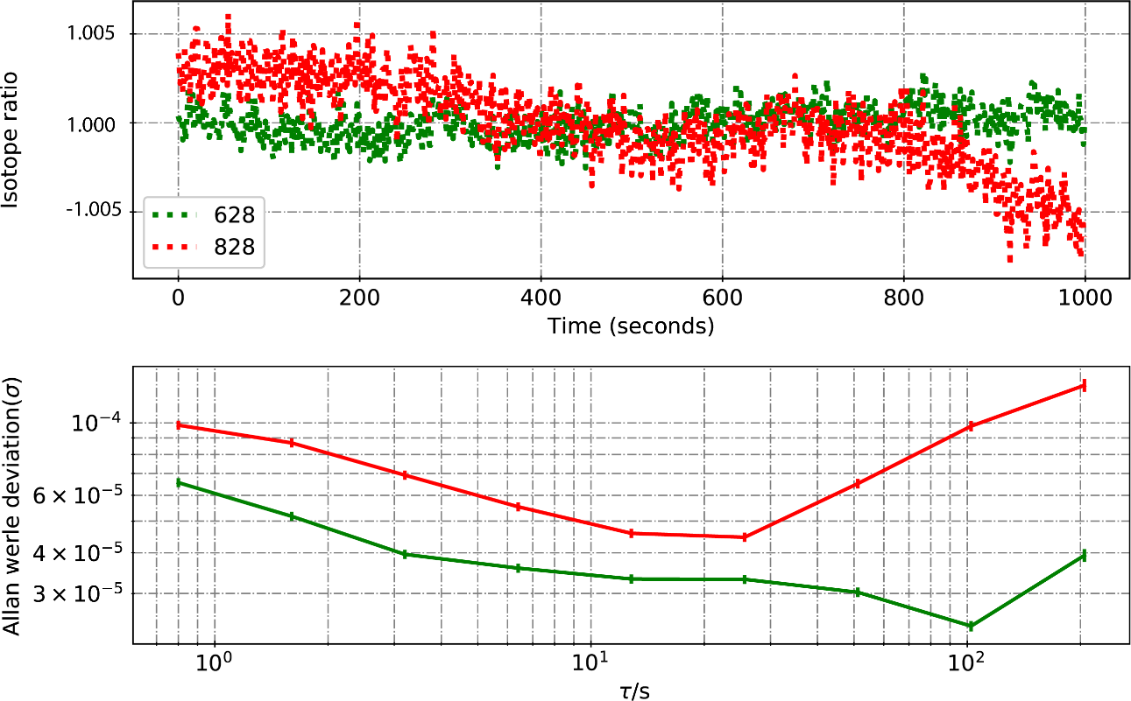
Instrument performance
Precision of the instrument
Isotope ratio
R1
R2
R1 = ¹²C¹⁸O₂/¹²C¹⁶O₂
R2 = ¹²C¹⁶O¹⁸O/¹²C¹⁶O₂
Time (s)
Allan deviation (σ)
Allan deviation (σ)
τ (s)
10⁻⁵
0.005 ‰
10³
10⁴
Single measurement of isotope ratio yields a precision of 0.03 ‰ for R2 and 0.05 ‰ for R1
Alternative switching between reference and sample (cycle = 400 sec) yields a precision on δ of 0.005 ‰

Slide 6
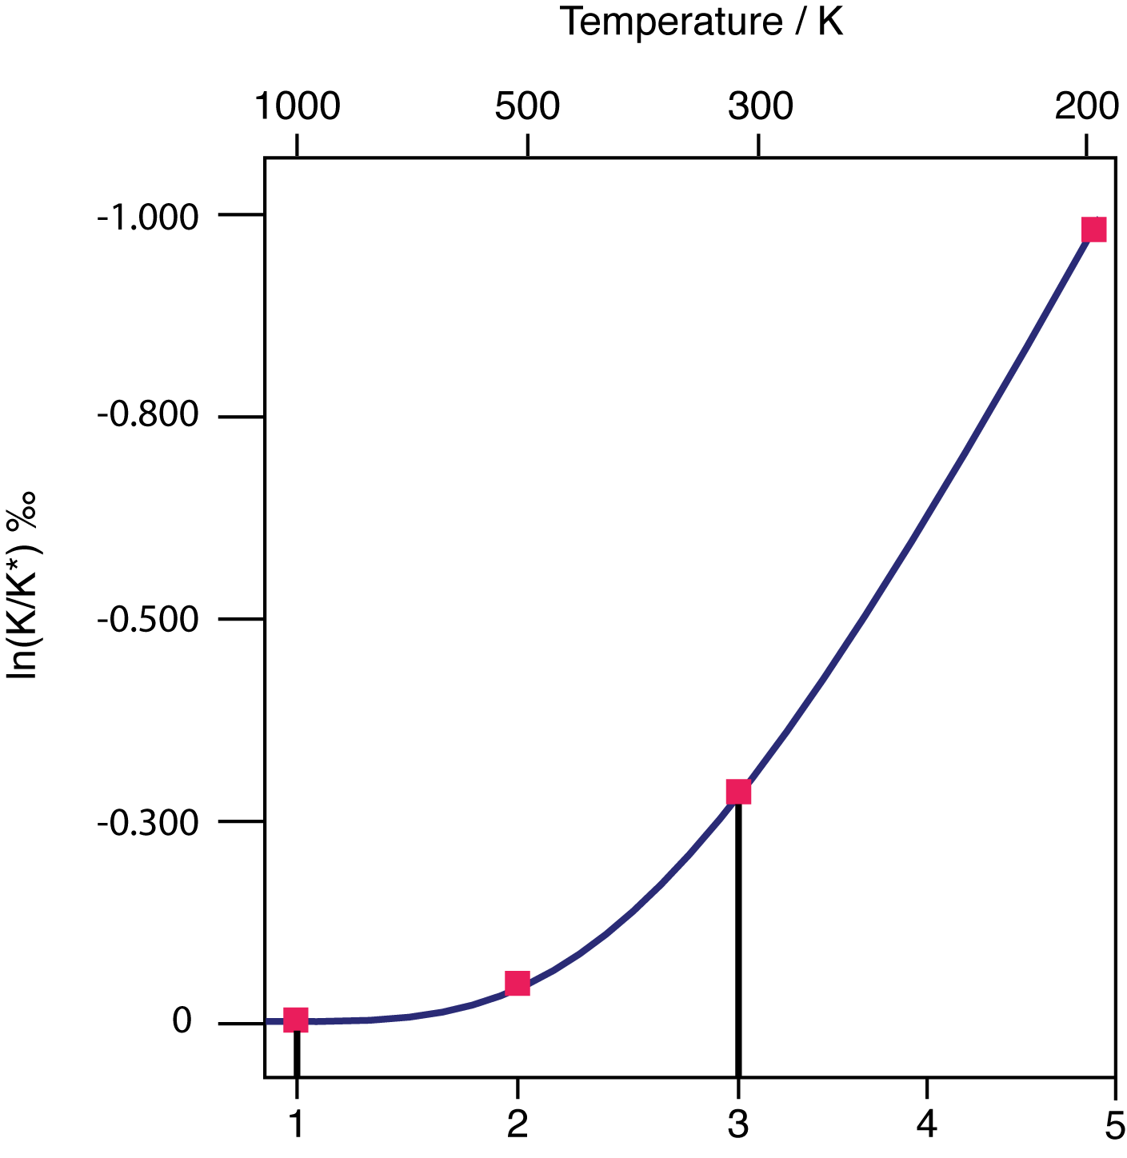
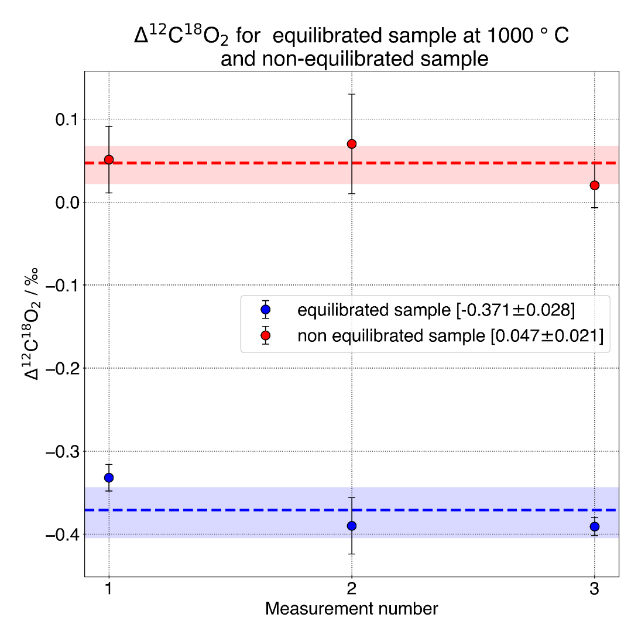



Clumped isotope thermometry
Δ¹²C¹⁸O₂ for non-equilibrated sample (red) and equilibrated sample (blue) at 1000 ºC
$$\text{K}\left[\text{T}\right]\text{= }\frac{\left[\text{12}\text{C}\text{16}\text{O}\text{2}\right]\text{[}\text{12}\text{C}\text{18}\text{O}\text{18}\text{O}\text{2}\text{]}}{\left[\text{12}\text{C}\text{16}\text{O}\text{18}\text{O}\right]\text{2}}$$
Equilibrium constant K is related to Δ as
$$\text{Δ}\text{=−1000}\text{ln}\left(\frac{\text{K}}{\text{K}\text{∗}}\right)$$
$$\text{12}\text{C}\text{16}\text{O}\text{2}\text{+}\text{12}\text{C}\text{18}\text{O}\text{2 }\text{⇌} \text{2⋅}\text{12}\text{C}\text{16}\text{O}\text{18}\text{O}$$
Δ¹²C¹⁸O₂ ‰
Expected difference in Δ¹²C¹⁸O₂ ~ -0.39 ‰ ^{[3]}
Reciprocal Temperature /10⁻³ K
Measurement number
Clumped isotope thermometer is based on measurements of three isotopologues involved in the isotope exchange reaction.
Non-equilibrated sample (red line) shows minimal fractionation (0.047 ‰) introduced by the gas handling line
Difference in the Δ¹²C¹⁸O₂ between the reference (~ 300 ºC) and heated sample (~ 1000 ºC) is -0.37 ± 0.03 ‰.
[3] Wang, Zhengrong, et al.” Geochimica et Cosmochimica Acta 68 (23): 4779–97. https://doi.org/10.1016/j.gca.2004.05.039.

Slide 7

Acknowledgements
Philipp Scheidegger
Herbert Looser
Manuel Graf
Joachim Mohn
Funding:
  Discovery
Thanks for your attention!
Questions? Akshay.Nataraj@empa.ch, Ivan.Prokhorov@empa.ch, Michele.Gianella@empa.ch

Slide 8
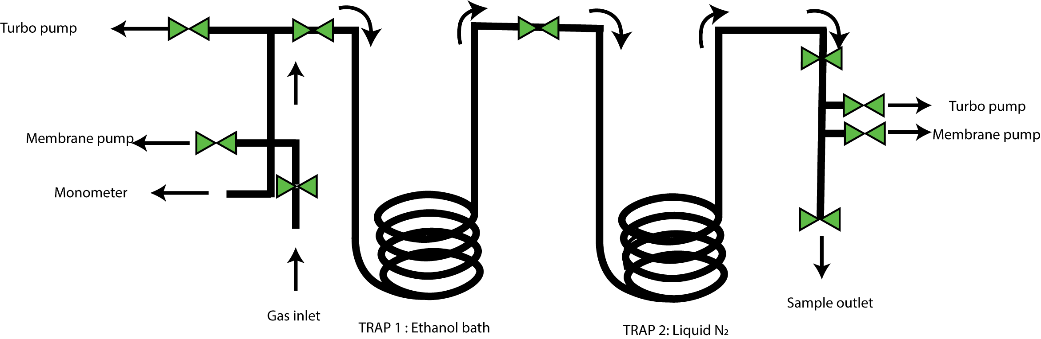
Appendix
Sample preparation unit

