Slide 1




Bulk rock geochemistry of a swarm of orangeite dykes intersecting the Western Limb of the Bushveld Complex
Charlie Compton-Jones^{1*}, Hannah S.R. Hughes^{1,2}, Iain McDonald³, Grant M. Bybee², Judith A. Kinnaird², Jens C.Ø. Andersen¹
¹Camborne School of Mines, University of Exeter, Penryn Campus, Cornwall, UK (*cc715@exeter.ac.uk)
²School of Geosciences, University of the Witwatersrand, Johannesburg, South Africa
³School of Earth & Ocean Sciences, Cardiff University, Cardiff, UK

Slide 2


Home page
1. Introduction
2. Orangeites in South Africa
3. The Bushveld orangeites
4. Major and trace elements
5. Radiogenic isotopes
6. PGE
7. Summary
8. References
Navigation
More information /follow link
Return to home page

Slide 3
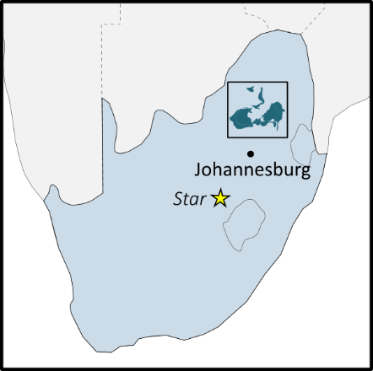
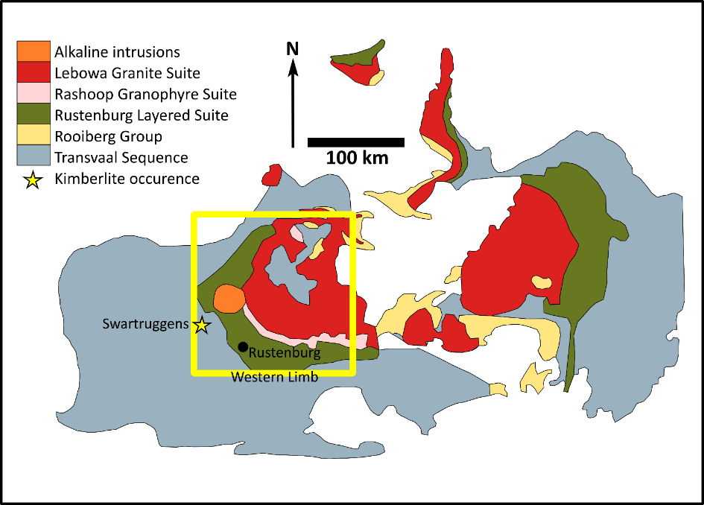
1. Introduction
Recently described swarm of orangeite (formerly Group II kimberlite) dykes observed in underground platinum mines on the western limb of the Bushveld Complex.
We present the first bulk geochemical analyses – including major and trace element abundances, radiogenic isotope compositions and PGE geochemistry.
AIM:
Using the bulk rock geochemistry of the Bushveld orangeites we aim to investigate the mantle source region(s) tapped by the orangeites and place constraints on their petrogenesis.
Notes:
Dykes blind at surface, exposed in underground platinum mines
Intro to sample locality – western limb of BV, where do we observe them, size of swarm, significance etc…
Aims of wider project
Aims of current work (bulk geochemistry)

Slide 4
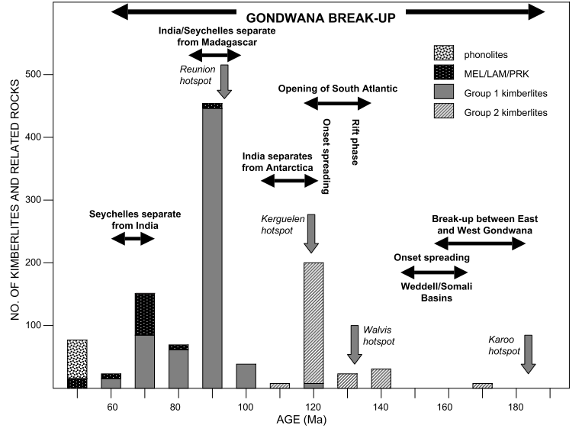
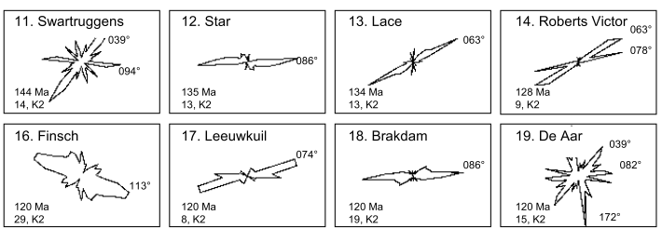
2. Orangeites in South Africa
Bushveld orangeite swarm dated at 177 – 137 Ma (Ar-Ar dating of phlogopite)
180 – 60 Ma - peak in kimberlitic activity across southern Africa (kimberlite and orangeites)
Coincides with break-up of Gondwana and the opening of the South Atlantic Ocean
Jurassic-Cretaceous orangeites form within orientation window approx. 80 – 110° - reflecting transcontinental lithospheric features
177 - 137 Ma
Figures from Jelsma et al. (2004)
Notes:
Orangeite orientation window approx. 70-110, Bushveld orangeites 112 in area show – dykes become more E-W trending where W Limb flattens out to the SE

Slide 5
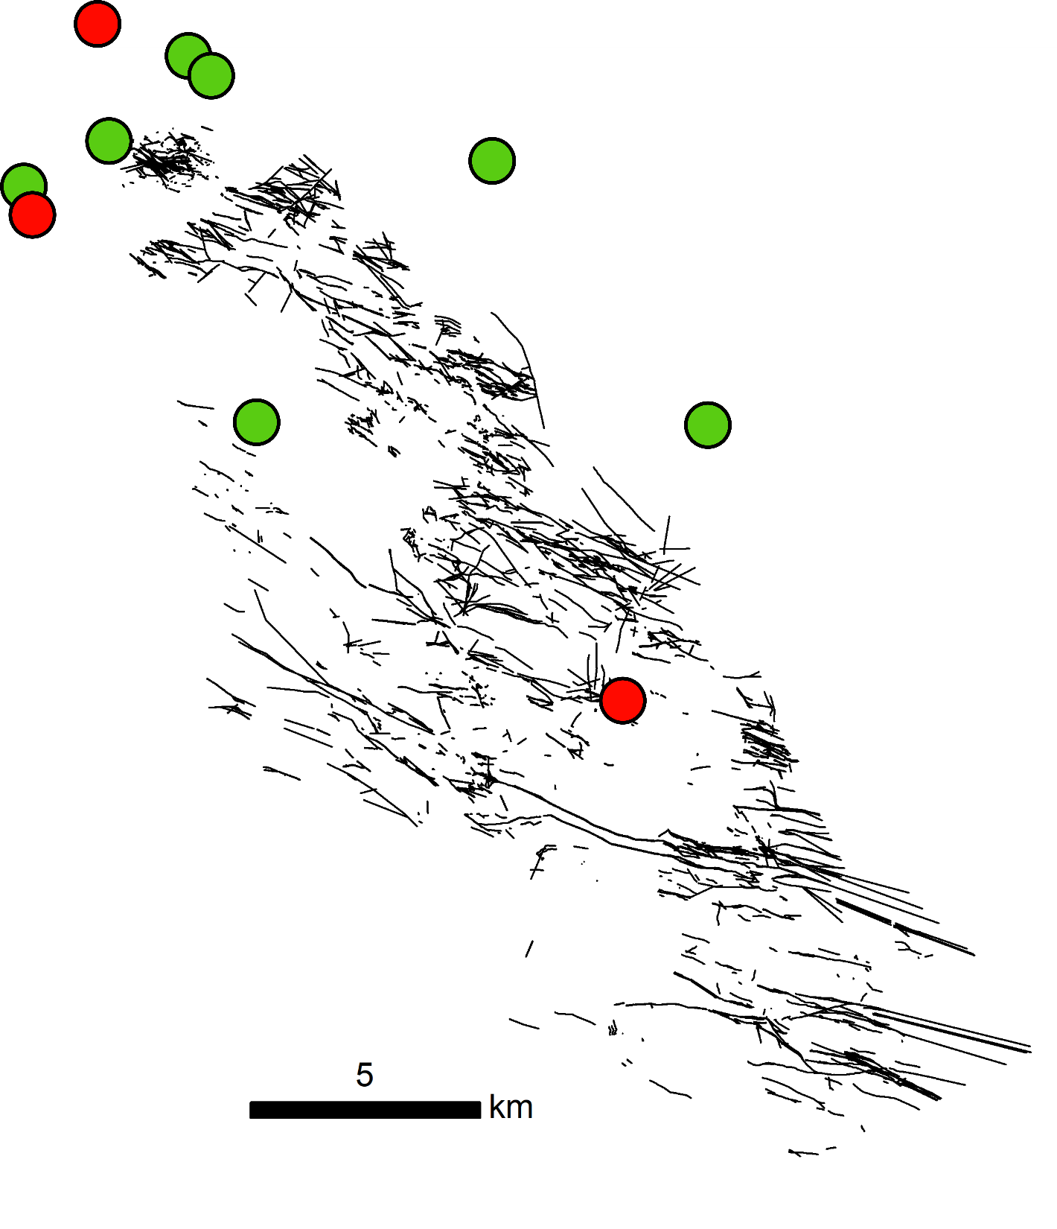


3. The Bushveld orangeites
Age dated orangeites (Ar-Ar):
130 - 140 Ma
140 - 150 Ma
> 150 Ma
\
The dykes are significantly younger (177-137 Ma) than the c. 2.06 Ga Bushveld lithologies they intrude.
Swarm extends > 50 km along strike
Similar age and orientation to Star and Swartruggens orangeite swarms
1
km
~15 km

Slide 6
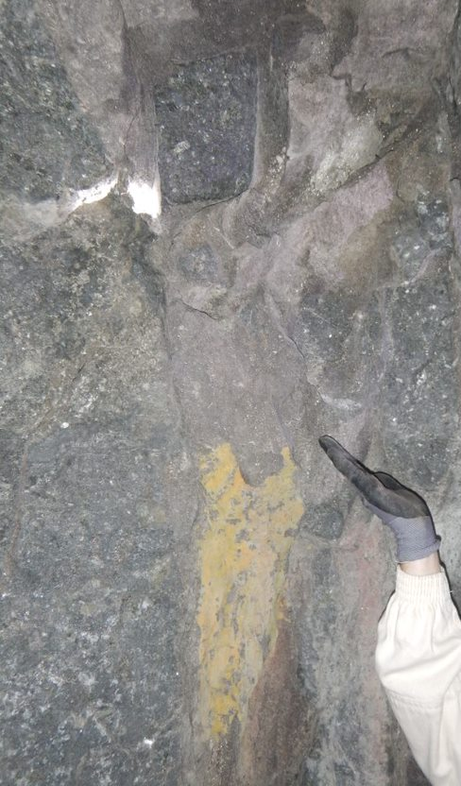
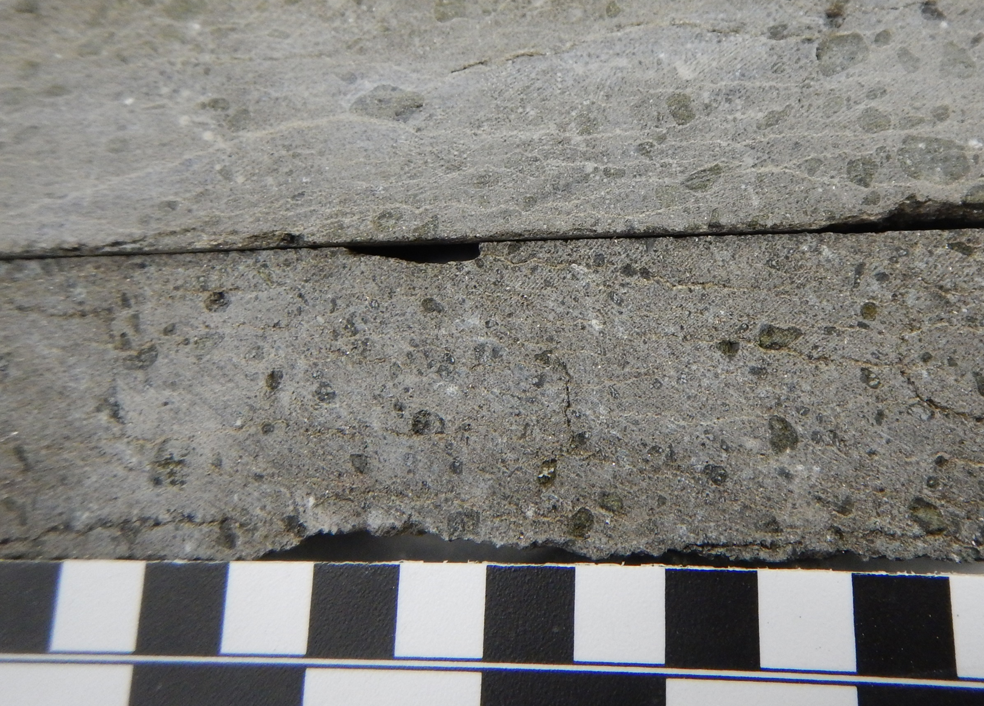
3. Bushveld orangeites: what do they look like?

Slide 7
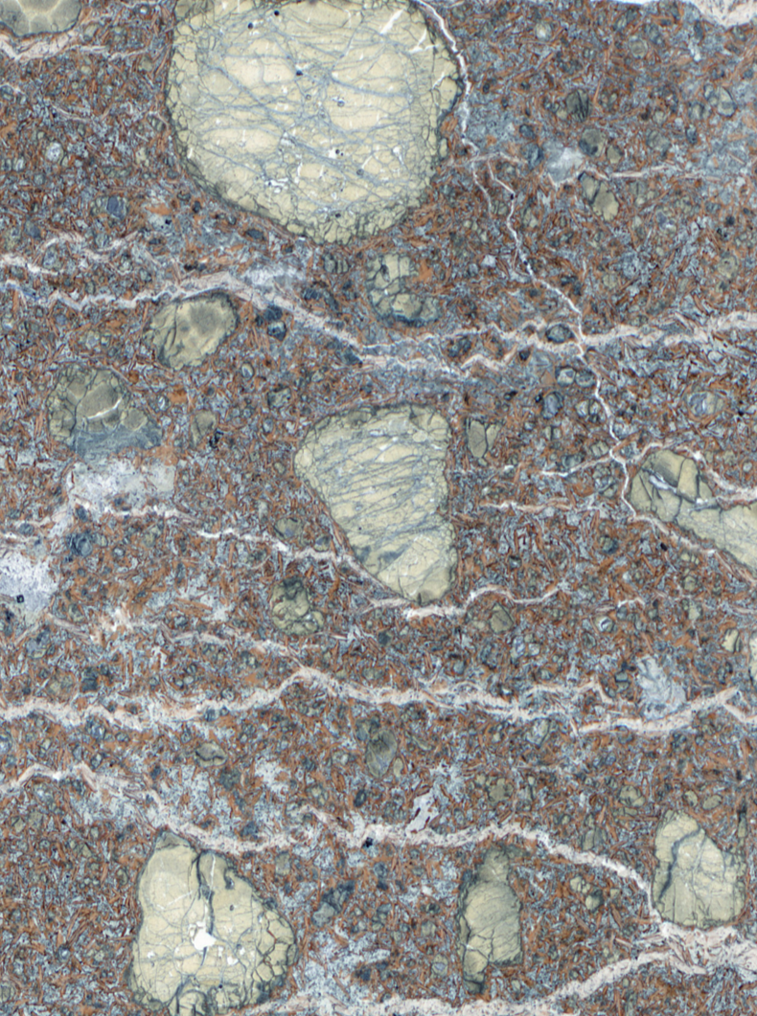
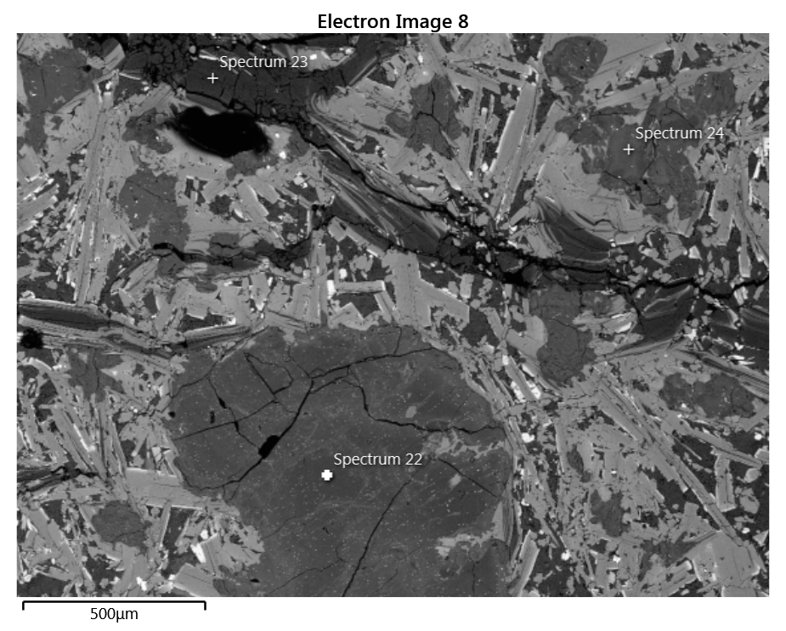
3. Bushveld orangeites: what do they look like?
Return
Macrocrystic orangeite
Olivine macrocrysts (serpentinised) 2 mm – 10 mm
Carbonate (calcite) veining
Groundmass comprises phlogopite, Cr-diopside and augite, apatite, serpentine, calcite
Ol
Serp
Ol
Phl
Ol
4 mm
Notes:
Macrocrystic orangeites – “unevolved” orangeite – serpentinised ol macrocrysts amongst fine grained gm – mostly phl
“glimmerite” – “ “evolved” orangeite – aphanitic, phl microphenocrysts
CPHL – Clinopyroxene-Phlogopite-Halite-Lamprophyre dyke – green augite CPX, brown phl, white halite groundmass
Does the major element geochemistry reflect this? (e.g. evolved has “higher SiO2 and Al2O3 and lower MgO, CaO, and CO2 contents” – Mitchell 1995)

Slide 8
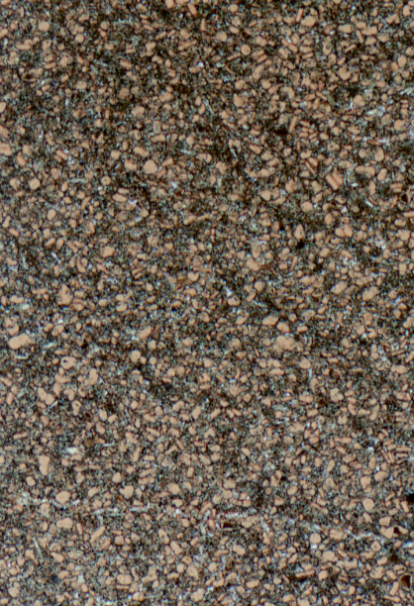
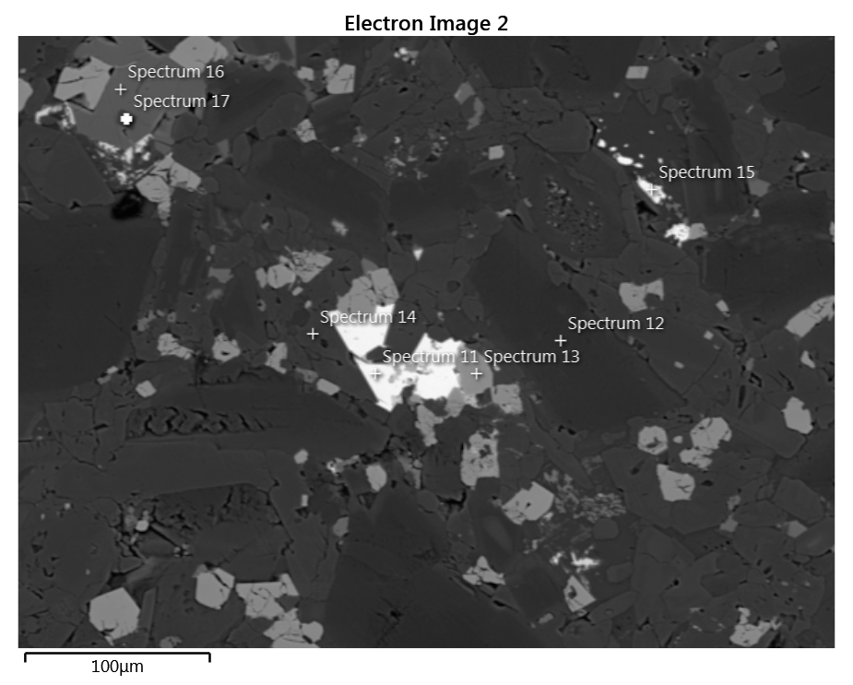
3. Bushveld orangeites: what do they look like?
Return
Macrocrystic-free orangeite
Dominated by phlogopite micro-phenocrysts
Groundmass comprises phlogopite, apatite, serpentine, Ti-magnetite, barite
Ap
Phl
Ba
Ti-Mag
2 mm

Slide 9
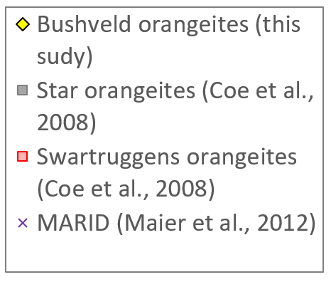


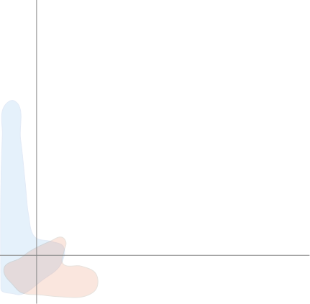
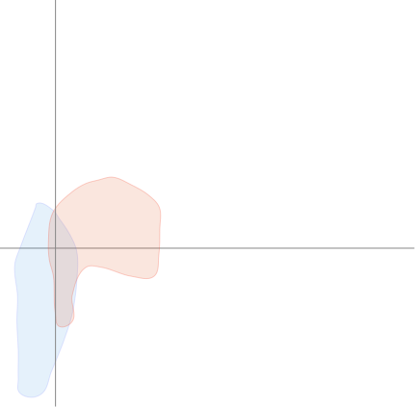
4. Bulk rock geochemistry: major and trace elements
Similar in major and trace element compositions to Kaapvaal orangeites – Significantly the Swartruggens orangeites.
Major elements broadly reflect a combination of ‘primary’ mantle signatures, contamination with mantle macrocrystic olivine (+/- phlogopite), magmatic processes (e.g., fractionation) and the effects of variable crustal contamination and alteration.
Higher Ba/Nb and La/Nb – accounted for by relative depletion in Nb (compared to other orangeites and internally to some elements, e.g. La, Ba).
Kaapvaal orangeites
Kaapvaal kimberlites

Slide 10
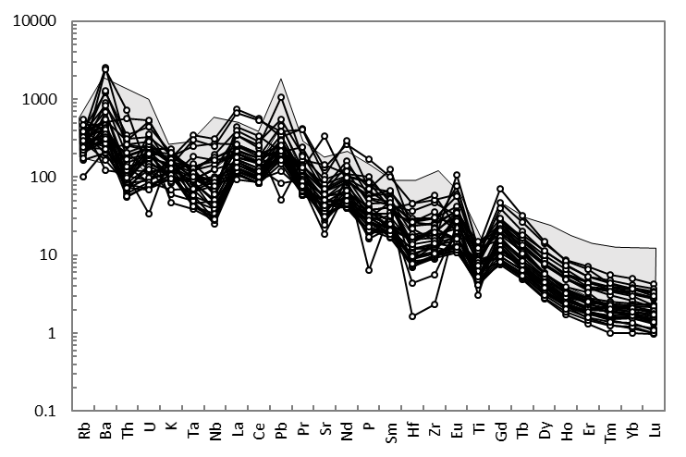

4. Bulk rock geochemistry: major and trace elements
Swartruggens
orangeites
Fairly consistent REE abundances
LREE > HREE – more fractionated than the Swartruggens orangeites.
Highly variable incompatible element abundances
Relatively depleted in Th, U, Nb, Hf, Zr and HREE compared to the Swartruggens orangeites.
Notes:
LREE > HREE
Highlight similarity to Star and Swartruggens

Slide 11
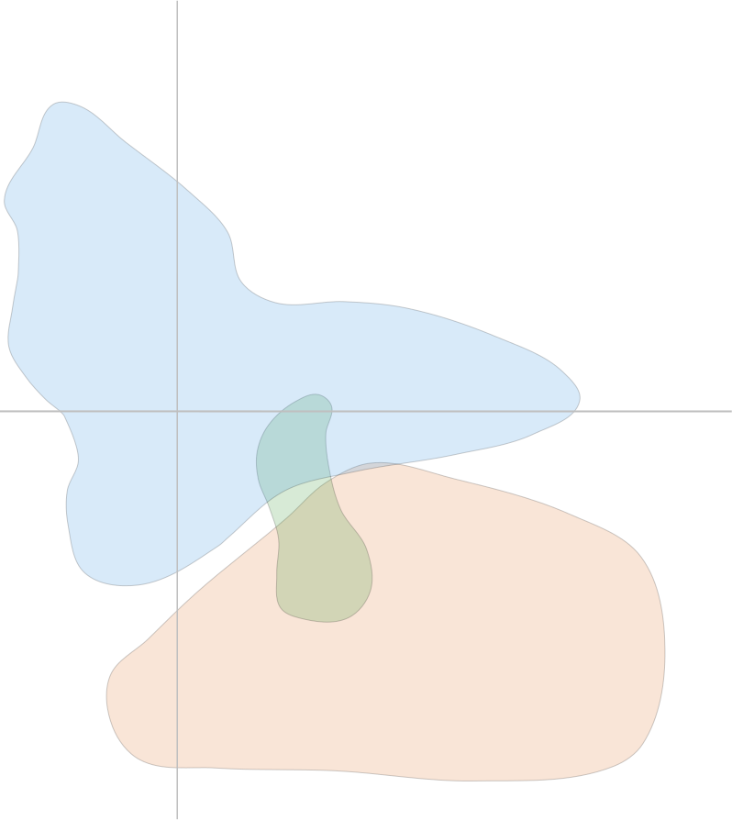
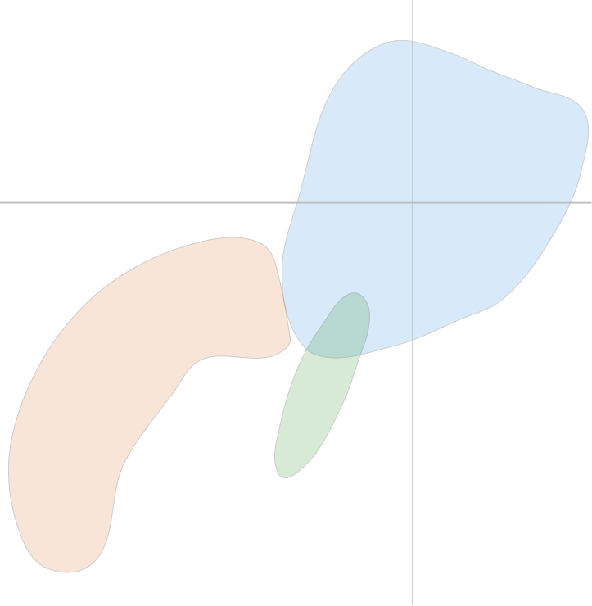

5. Bulk rock geochemistry: radiogenic isotope compositions
Kimberlites
Kimberlites
Transitional kimberlites
Transitional kimberlites
Orangeites
Orangeites
Derivation from an incompatible element enriched, long-lived and isolated lithospheric mantle source
2-3 different isotopic signatures – heterogeneous SCLM beneath the Bushveld Complex?
Notes:
Consistent eNd with variable Sr – alteration and/or contamination
How do the isotope groups relate to trace element groups, age, and location of the dykes?
Do the samples with isotope comps similar to Star or Swartruggens also have similar major and trace element abundances?

Slide 12
6. Bulk rock geochemistry: platinum group elements
Bulk total PGE contents of 1.2 – 8.3 ppb
Pd/Ir of 0.4 – 17 – moderate range in PGE fractionation
Higher total PGE and lower Pd/Ir than expected for such low degree partial melting
Systematic of low degree partial melting in SCLM?
Interaction with high IPGE, low Pd/Ir component in the mantle (e.g. podiform chromitite, mantle peridotite)?
Metal / Chondrite
IPGE
PPGE
Yilgarn orangeites (Choi et al., 2020)
Karelian orangeites (Maier et al., 2017)
Bastar orangeites (Chalapathi Rao et al., 2013)
Kaapvaal orangeites (McDonald et al., 1995)
Notes:
Previous Kaapvaal orangeites PGE analysis (McDonald et al 1995) outdated methods – potentially producing values higher than expected (especially for PPGE) and compared to values of global orangeites and the Bushveld orangites

Slide 13
7. Summary
Vast swarm of orangeite dykes outcropping in underground platinum mines across the Western Limb of the Bushveld Complex with > 100 dykes over ~ 45 km along strike.
Similar major and trace element abundances to the Swartruggens orangeite dyke swarm.
High variability of radiogenic isotope compositions – possibly representing local source heterogeneities?
Similar PGE systematics to orangeites from other cratons – same mechanisms of PGE mobilisation regardless of craton?

Slide 14
8. References
Becker, M., le Roex, A.P., 2006. Geochemistry of South African on- and off-craton, group I and group II kimberlites: Petrogenesis and source region evolution. Journal of Petrology 47, 673–703.
Becker, M., le Roex, A.P., Class, C., 2007. Geochemistry and petrogenesis of South African transitional kimberlites located on and off the Kaapvaal Craton. South African Journal of Geology 110, 631–646.
Chalapathi Rao, N. V., Lehmann, B., Balaram, V., 2014. Platinum-group element (PGE) geochemistry of Deccan orangeites, Bastar craton, central India: Implication for a non-terrestrial origin for iridium enrichment at the K–Pg boundary. Journal of Asian Earth Sciences 84, 24–33.
Choi, E., Fiorentini, M.L., Hughes, H.S. and Giuliani, A., 2020. Platinum-group element and Au geochemistry of Late Archean to Proterozoic calc-alkaline and alkaline magmas in the Yilgarn Craton, Western Australia. Lithos, 374, 105716.
Coe, N., Roex, A., Gurney, J., Pearson, G.D., Nowell, G., 2008. Petrogenesis of the Swartruggens and Star Group II kimberlite dyke swarms, South Africa: Constraints from whole rock geochemistry. Contributions to Mineralogy and Petrology 156, 627–652.
Fitzpayne, A., Giuliani, A., Maas, R., Hergt, J., Janney, P., Phillips, D., 2019. Progressive metasomatism of the mantle by kimberlite melts: Sr–Nd–Hf–Pb isotope compositions of MARID and PIC minerals. Earth and Planetary Science Letters 509, 15–26.
Giuliani, A., Phillips, D., Woodhead, J.D., Kamenetsky, V.S., Fiorentini, M.L., Maas, R., Soltys, A., Armstrong, R.A., 2015. Did diamond-bearing orangeites originate from MARID-veined peridotites in the lithospheric mantle? Nature Communications 6, 1–10.
Griffin, W.L., Batumike, J.M., Greau, Y., Pearson, N.J., Shee, S.R., O’Reilly, S.Y., 2014. Emplacement ages and sources of kimberlites and related rocks in southern Africa: U-Pb ages and Sr-Nd isotopes of groundmass perovskite. Contributions to Mineralogy and Petrology 168, 1–13.
Hughes H.S.R., et al. in prep. A major swarm of orangeite dykes exposed in platinum mines across the Western Bushveld Complex, South Africa. Lithos.
Hughes, H.S.R., Kinnaird, J.A., McDonald, I., Nex, P.A.M., Bybee, G.M., 2016. Lamprophyric dykes in the Bushveld Complex: the lithospheric mantle and its metallogenic bearing on the Bushveld large igneous province. Applied Earth Science 125, 85–86.
Jelsma, H.A., de Wit, M.J., Thiart, C., Dirks, P.H.G.M., Viola, G., Basson, I.J., Anckar, E., 2004. Preferential distribution along transcontinental corridors of kimberlites and related rocks of Southern Africa. South African Journal of Geology 107, 301–324.
Kargin, A. V, Nosova, A.A., Larionova, Y.O., Kononova, V.A., Borisovsky, S.E., Koval, E. V, Griboedova, I.G., 2014. Mesoproterozoic Orangeites ( Kimberlites II ) of West Karelia : Mineralogy , Geochemistry , and Sr – Nd Isotope Composition. Petrology 22, 151–183.
Maier, W.D., O’Brien, H., Peltonen, P., Barnes, S.J., 2017. Platinum-group element contents of Karelian kimberlites: Implications for the PGE budget of the sub-continental lithospheric mantle. Geochimica et Cosmochimica Acta 216, 358–371.
McDonald, I., de Wit, M.J., Smith, C.B., Bizzi, L.A., Viljoen, K.S., 1995. The geochemistry of the platinum-group elements in Brazilian and southern African kimberlites. Geochimica et Cosmochimica Acta 59, 2883–2903.
Nowell, G.M., Pearson, D.G., Bell, D.R., Carlson, R.W., Smith, C.B., Kempton, P.D., Noble, S.R., 2004. Hf isotope systematics of kimberlites and their megacrysts: New constraints on their source regions. Journal of Petrology 45, 1583–1612.
Tappe, S., Stracke, A., van Acken, D., Strauss, H., Luguet, A., 2020. Origins of kimberlites and carbonatites during continental collision – Insights beyond decoupled Nd-Hf isotopes. Earth-Science Reviews 103287.

