Slide 1

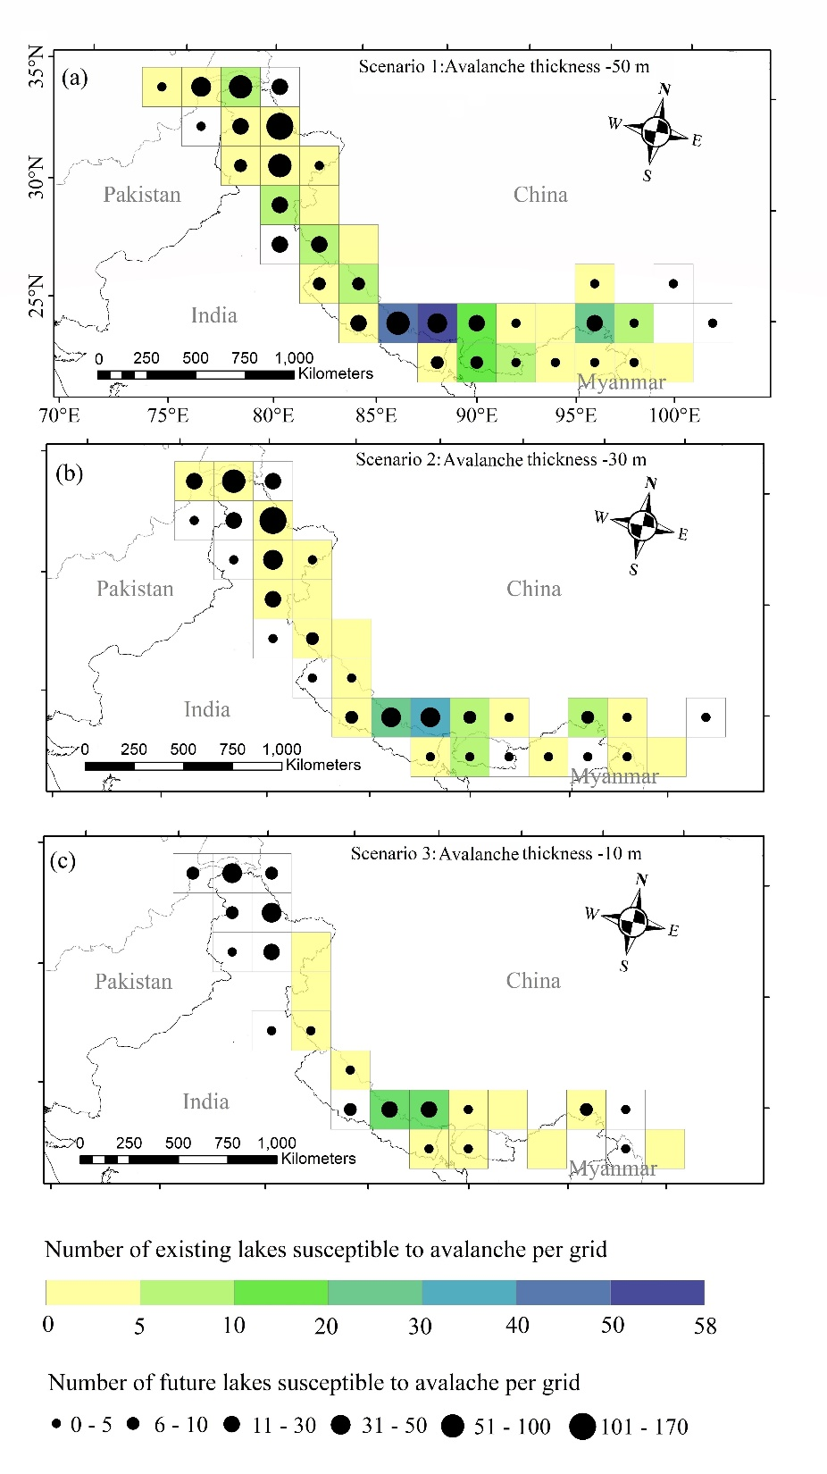
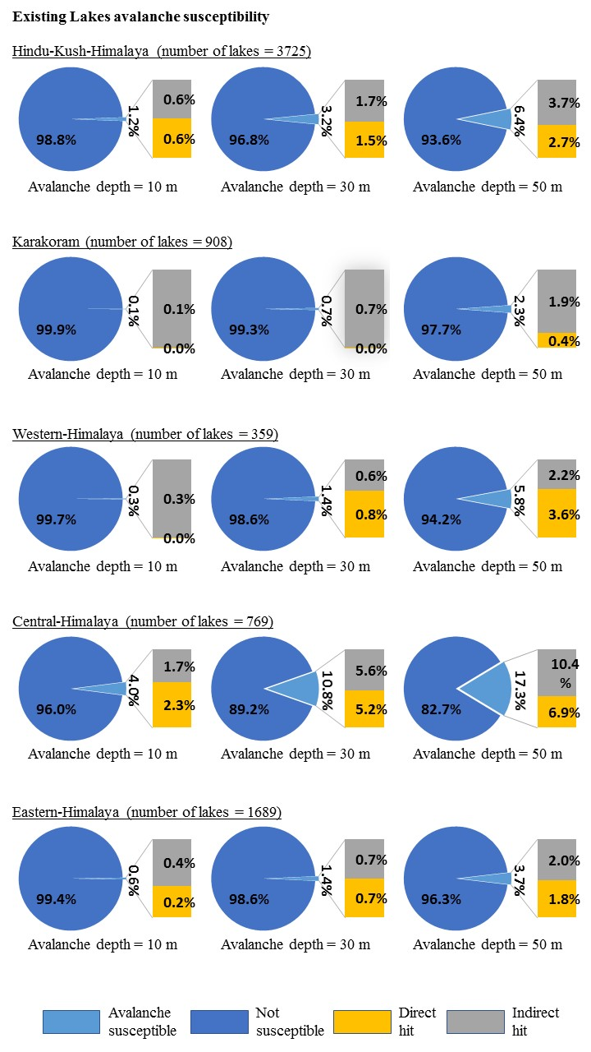
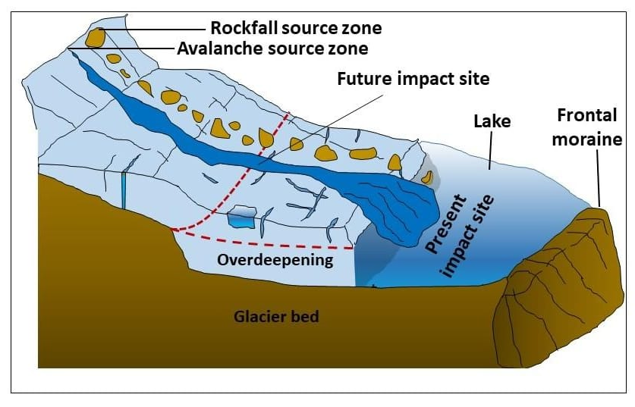
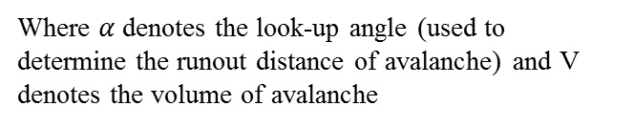

Susceptibility of glacial lakes to avalanche and rockfall in the Hindu-Kush-Himalaya
By-Saket Dubey
Saket Dubey¹, Manish Goyal¹, Ashim Sattar², Umesh Haritashya³, and Simon Allen²
¹Indian Institute of Technology Indore, Indore, India
²University of Zurich, Zurich, Switzerland
³University of Dayton
Correspondance: Saketdubey4@gmail.com
Equation used to determine runout distance for avalanche (Huggel et al. 2004)
$$\tan\left(α\right)=1.11−0.118 log⁡(V)$$
Where $α$ denotes the look-up angle (used to determine the runout distance of avalanche) and V denotes the volume of avalanche

