Slide 1


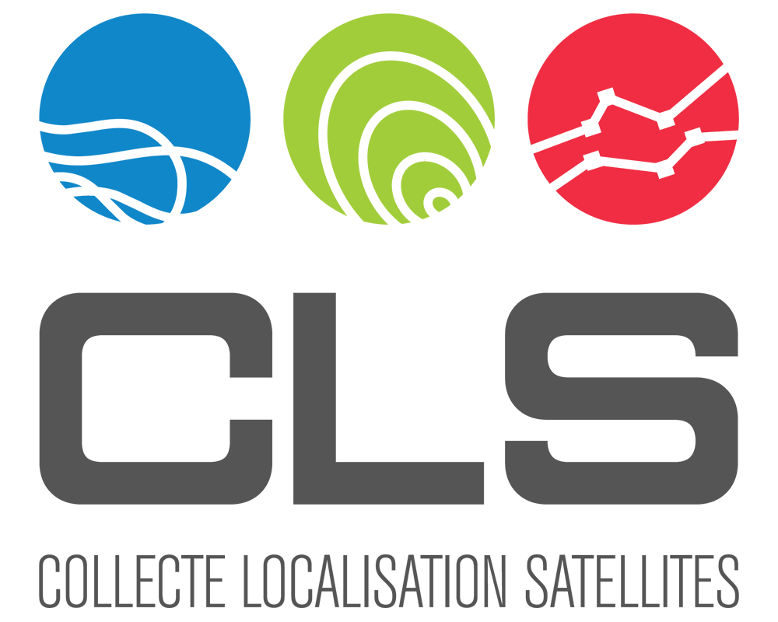

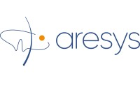




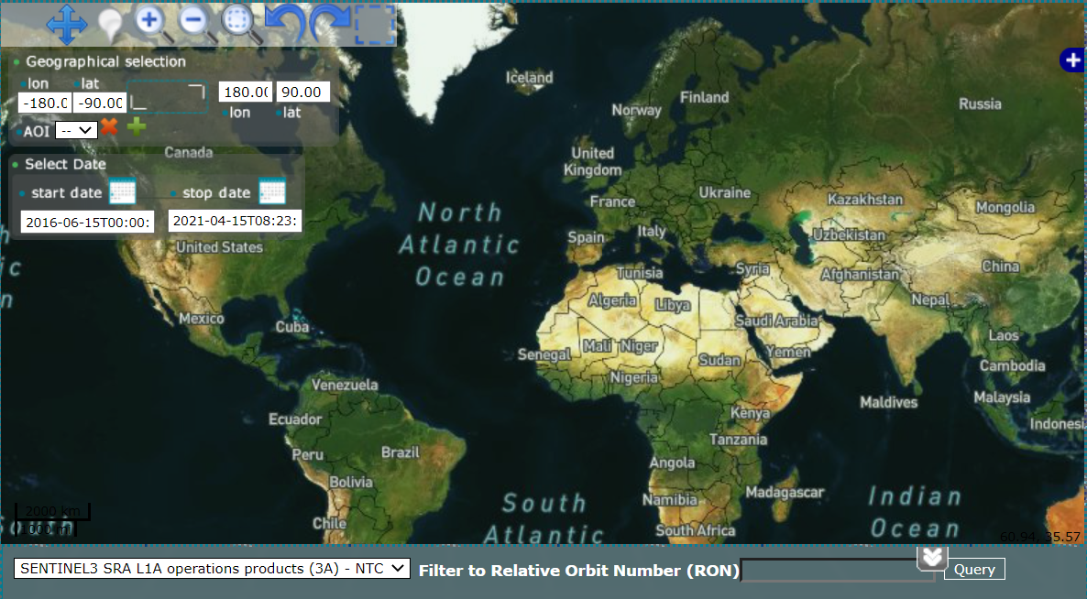
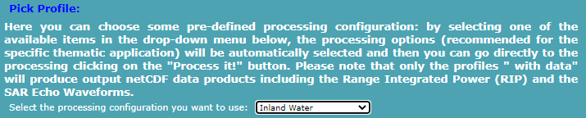
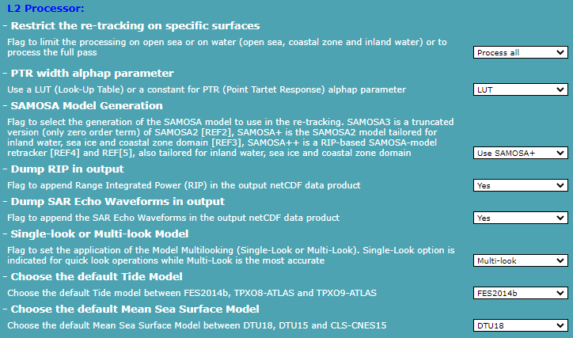
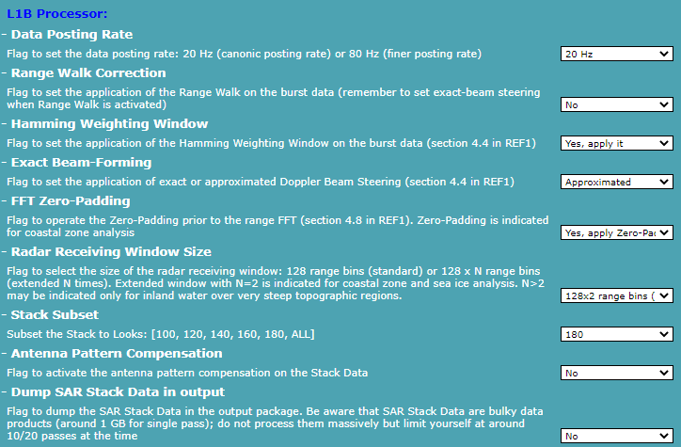
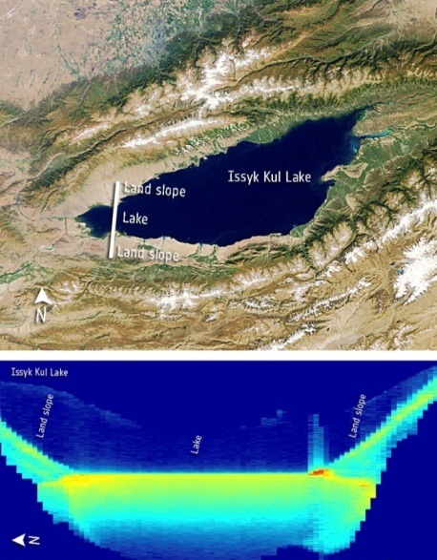
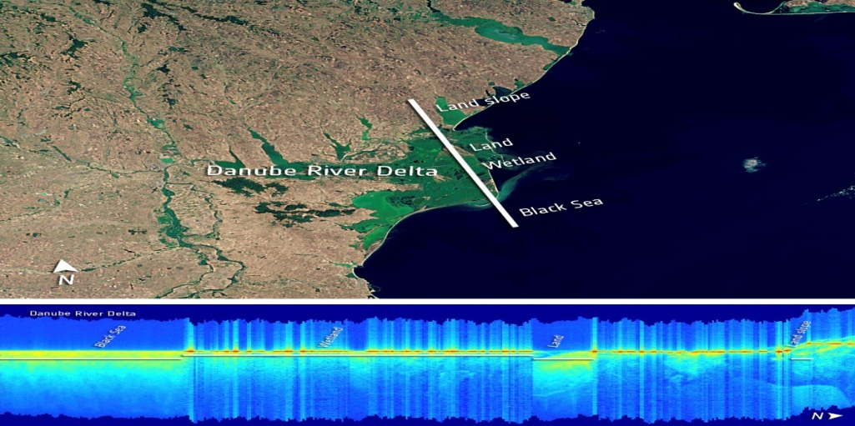
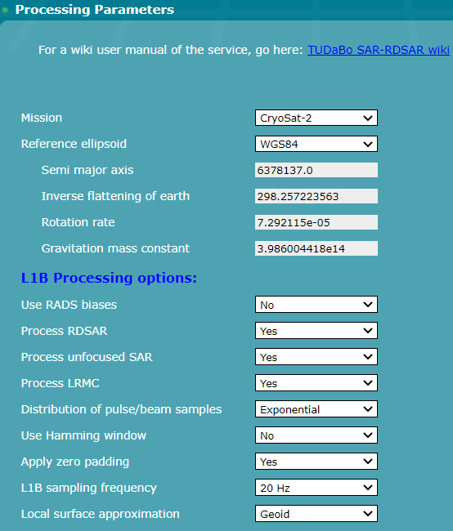
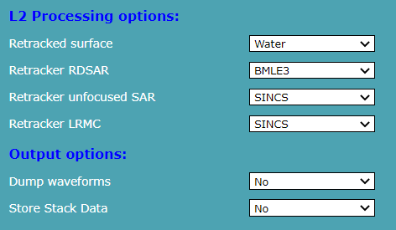
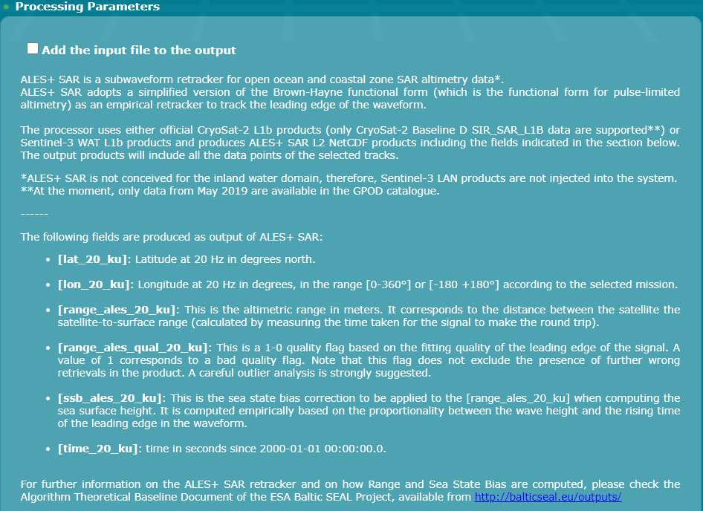
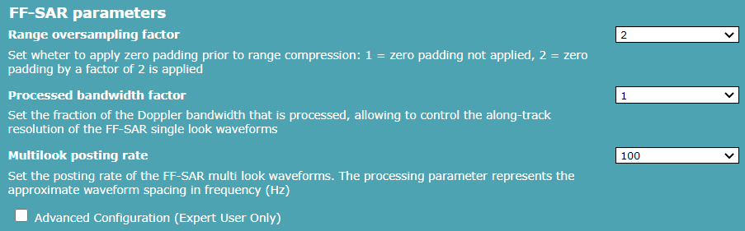
SAR, SARin, RDSAR and FF-SAR Altimetry Processing on Demand for CryoSat-2 and Sentinel-3 at ESA G-POD
Jérôme Benveniste⁽¹⁾, Salvatore Dinardo⁽²⁾, Christopher Buchhaupt⁽³⁾, Michele Scagliola⁽⁴⁾, Marcello Passaro⁽⁵⁾,L. Fenoglio-Marc⁽⁶⁾, Giovanni Sabatino⁽⁷⁾, Beniamino Abis⁽⁷⁾, Marco Restano⁽⁸⁾, Américo Ambrózio⁽⁹⁾,
⁽¹⁾ESA-ESRIN, Largo Galileo Galilei, Frascati, Italy, Email: jerome.benveniste@esa.int
⁽²⁾Collecte Localisation Satellites, Toulouse, France
⁽³⁾University of Maryland, College Park, MD, US
⁽⁴⁾ Aresys, Via Privata Flumendosa 16, 20132 Milano, Italy
⁽⁵⁾ DGFI-TUM, Germany
⁽⁶⁾ Institute of Geodesy and Geoinformation, University of Bonn, Germany
⁽⁷⁾Progressive Systems/ESRIN, Largo Galileo Galilei, Frascati, Italy
⁽⁸⁾ SERCO/ESRIN, Largo Galileo Galilei, Frascati, Italy
⁽⁹⁾ DEIMOS/ESRIN, Largo Galileo Galilei, Frascati, Italy
The scope of this presentation is to feature and provide an update on the ESA G-POD/SARvatore family of altimetry services portfolio for the exploitation of CryoSat-2 and Sentinel-3 data from L1A (FBR) data products up to SAR/SARin Level-2 geophysical data products.
Services are open, free of charge (supported by ESA) for worldwide scientific applications and available, after registration and activation (to be requested for each chosen service to eo-gpod@esa.int), at https://gpod.eo.esa.int.
The G-POD graphical interface allows users to select, in all the services, a geographical area of interest within the time-frame related to the L1A (FBR) & L1b data products availability in the service catalogue. After the task submission, users can follow, in real time, the status of the processing. The output data products are generated in standard NetCDF format, therefore being compatible with the multi-mission “Broadview Radar Altimetry Toolbox” (BRAT, http://www.altimetry.info) and typical tools. At present, the following on-line & on-demand services compose the portfolio:
The SARvatore (SAR Versatile Altimetric TOolkit for Research & Exploitation) for CryoSat-2 and Sentinel-3 services developed by the Altimetry Team in the R&D division at ESA-ESRIN. These processor prototypes are versatile and allow the users to customize and adapt the processing at L1b & L2 according to their specific requirements by setting a list of configurable options. The scope is to provide users with specific processing options not available in the operational processing chains (e.g. range walk correction, stack sub-setting, extended receiving window, zero padding, high-posting rate and burst weighting at L1b & SAMOSA+, SAMOSA++ and ALES+ SAR retrackers at L2). A Join & Share Forum (https://wiki.services.eoportal.org/tiki-custom_home.php) allows users to post questions and report issues. A data repository is also available to the Community to avoid the redundant reprocessing of already processed data (https://wiki.services.eoportal.org/tiki-index.php?page=SARvatore+Data+Repository&highlight=repository).
The TUDaBo SAR-RDSAR (Technical University Darmstadt – University Bonn SAR-Reduced SAR) for CryoSat-2 and Sentinel-3 service. It allows users to generate reduced SAR, unfocused SAR & LRMC data. Several configurable L1b & L2 processing options and retrackers (BMLE3, SINC2, TALES, SINCS) are available. The processor will be extended during an additional activity related to the ESA HYDROCOASTAL Project (https://www.satoc.eu/projects/hydrocoastal/) to account in the open ocean for the vertical motion of the wave particles (VMWP) in unfocused SAR (retracker SINCS-OV) and in a simplified form of the fully focused SAR called here Low Resolution Range Cell Migration Correction-Focused (LRMC-F).
The ALES+ SAR for CryoSat-2 and Sentinel-3 service. It allows users to process official L1b data and produces L2 NetCDF products by applying the empirical ALES+ SAR sub-waveform retracker, including a dedicated SSB solution, developed by DGFI-TUM in the frame of the ESA Sea Level CCI (http://www.esa-sealevel-cci.org/) & BALTIC+ SEAL Projects (http://balticseal.eu/).
The Aresys Fully Focused SAR for CryoSat-2 service. Currently under testing by external power users, it will provide the capability to produce CS-2 FF-SAR L1b products thanks to the Aresys 2D transformed frequency domain AREALT-FF1 processor prototype. Output products will also include geophysical corrections and threshold peak & ALES-like empirical sub-waveform retracker estimates (ALES+FF-SAR)

