Slide 1


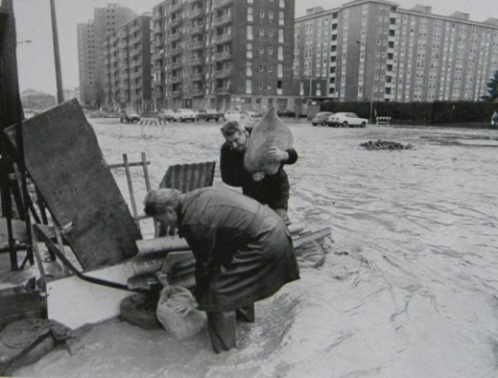
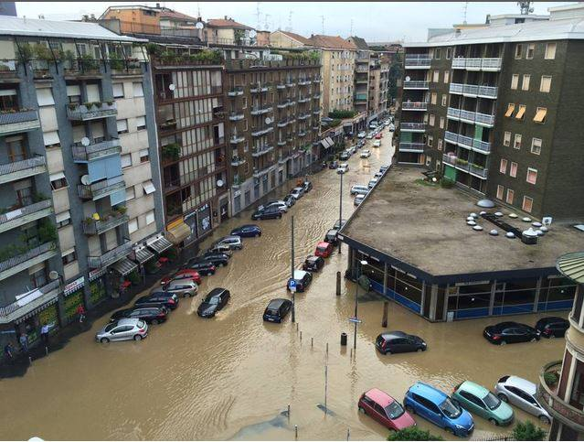
SOL40: forty years of simulations under a climate and land use change scenario
Ceppi A., Gambini E., Lombardi G., Ravazzani G., Mancini M.
Dipartimento di Ingegneria Civile e Ambientale
Politecnico di Milano, Italy
vEGU 2021
26 April 2021
HS 5.1.3
Impacts of land use and land cover changes on hydrological processes and water management

Slide 2
Motivation
In order to assess the impact of anthropogenic development on urban catchment scale hydrology, this study (named as SOL40) analyses 40-years trends of the main hydro-meteorological variables (temperature, precipitation and runoff) over the SOL area, and try to quantify and separate the impact of land use change from the climate change scenario.
A coupled hydro-meteorological system which comprises the physically based rainfall-runoff hydrological model FEST-WB, developed by the Politecnico di Milano and the ERA5-Land hourly dataset from 1981 to 2020 has been built.
Main results are here shown over the Seveso River basin closed at Bovisio gauge section which is upstream the hydraulic structure of the CSNO filling channel.

Slide 3
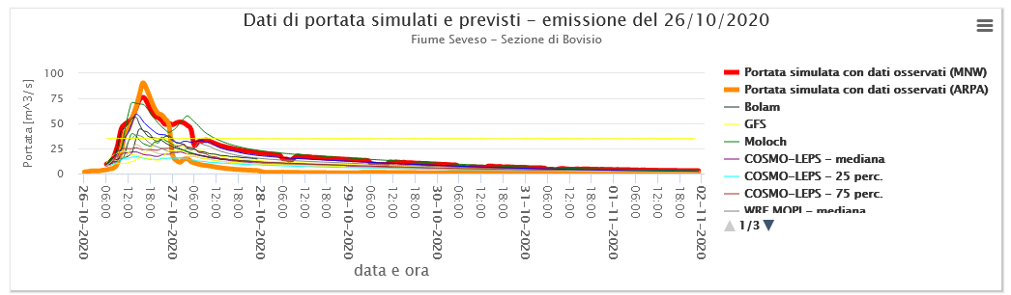
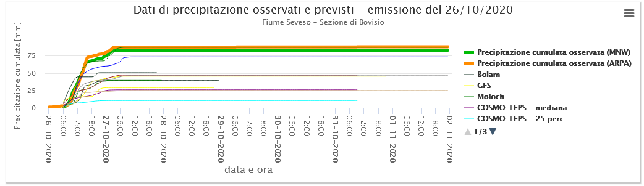

Background: the SOL system
In the last decade the Real Time Hydrology research group of Politecnico di Milano has developed the SOL system: an operative web dashboard for real-time hydro-meteorological forecasts over Milan urban area (northern Italy) and the municipalities along the Seveso, Olona, and Lambro (SOL) rivers.
The main goal is the reduction of flood damages in dense urbanized area through the information and communication of flood hazard, allowing citizens, enterprises and authorities, according to their own responsibility, to activate the preventive protection actions.
Free access: http://padus.dica.polimi.it/Bacini/
Multi-model precipitation forecast
Discharge forecasts & alert thresholds

Slide 4
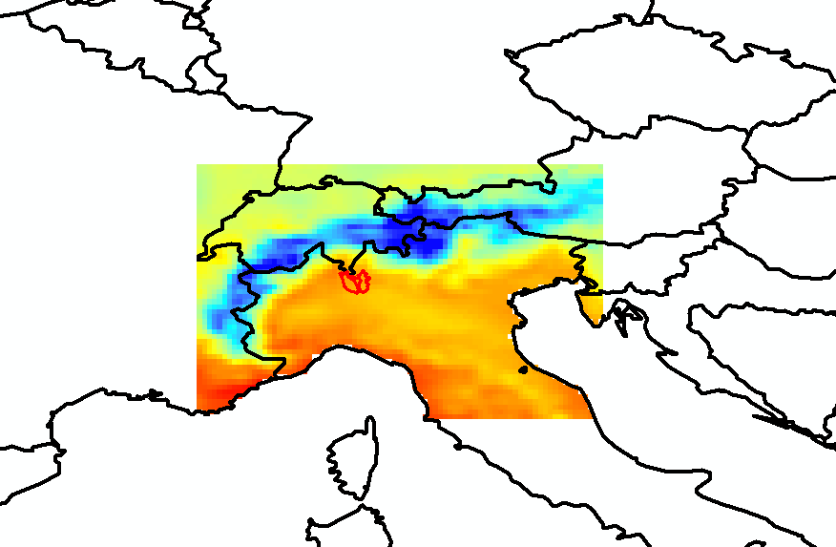
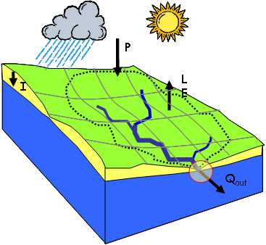

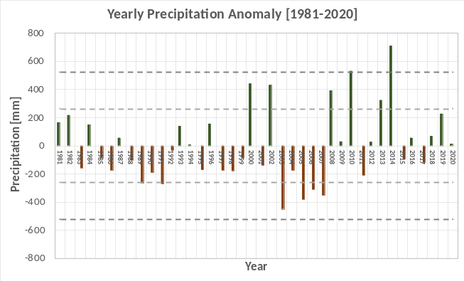
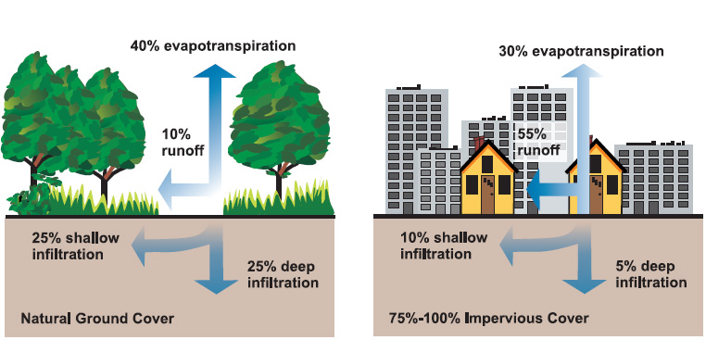
SOL40: aim of the study
The study: after the acquired knowledge in the SOL Project, a reanalysis over the SOL basins has been developed to analyse temperature, precipitation and discharge over the 1981-2020 period coupling the ERA5-Land dataset with the FEST-WB hydrological model.
ERA5-Land Reanalysis
FEST-WB Hydrological model
Goal: which factor has more influence on the increasing frequency of discharge over urban basins: the climate change or the land use change?

Slide 5
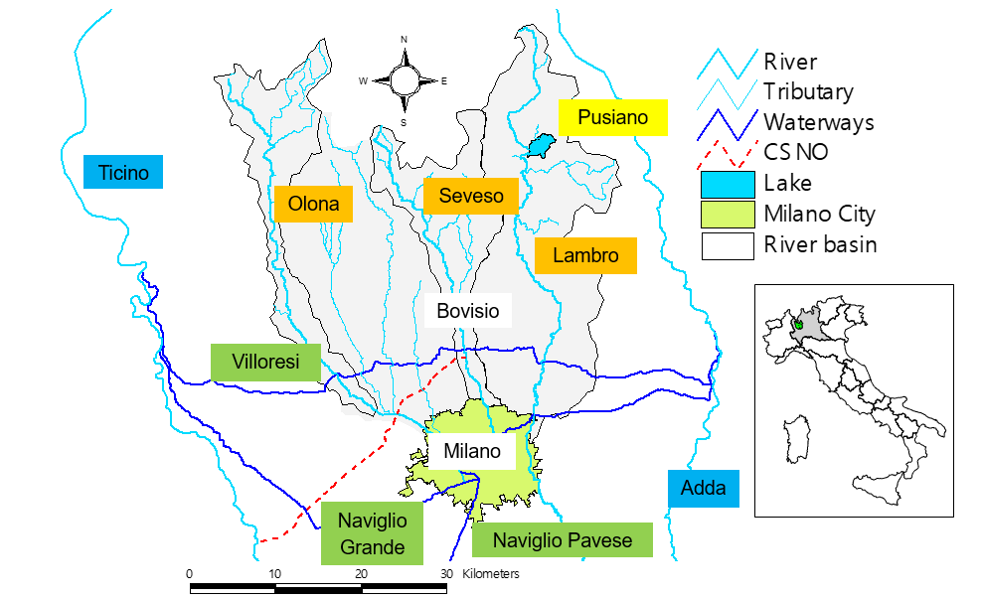
The Milan urban basins: Seveso-Olona-Lambro (SOL)
Area (km²)
Olona = 208
Seveso = 207
Lambro = 500
Total = 1300
Structural measures over the three basins:
Olona → Ponte Gurone dam
Seveso → CSNO filling channel
Lambro → Pusiano Lake regulations

Slide 6
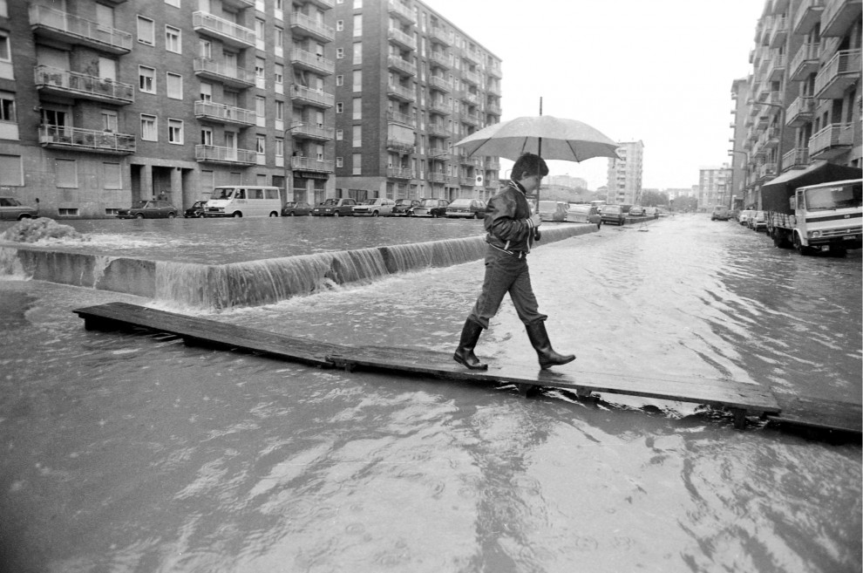
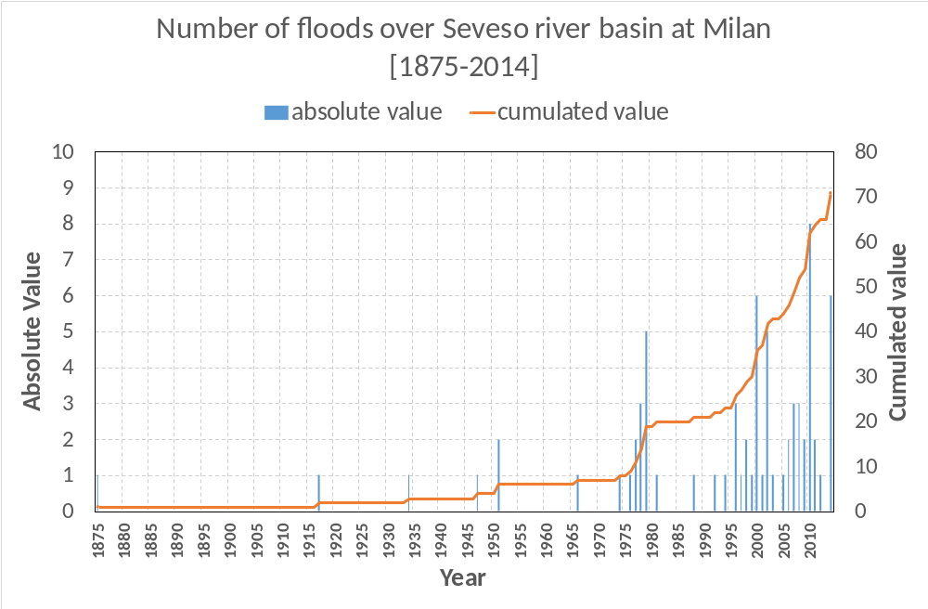

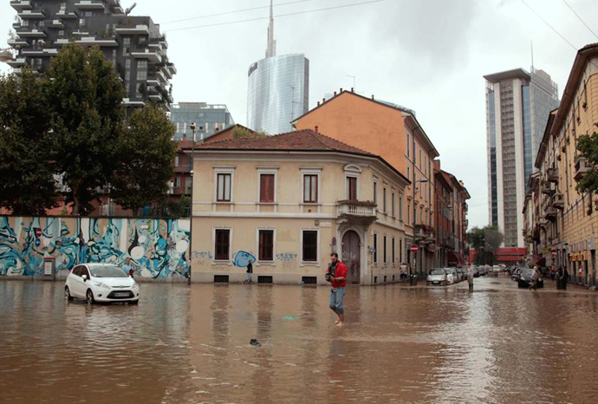
Flood frequency over Seveso river basin at Milan
On average, 2.75 floods per year have been observed between years 2000 and 2014.
End of construction of the CSNO filling channel
Source:
#italiasicura – Progetto Seveso, 2014
Becciu et al. 2017

Slide 7
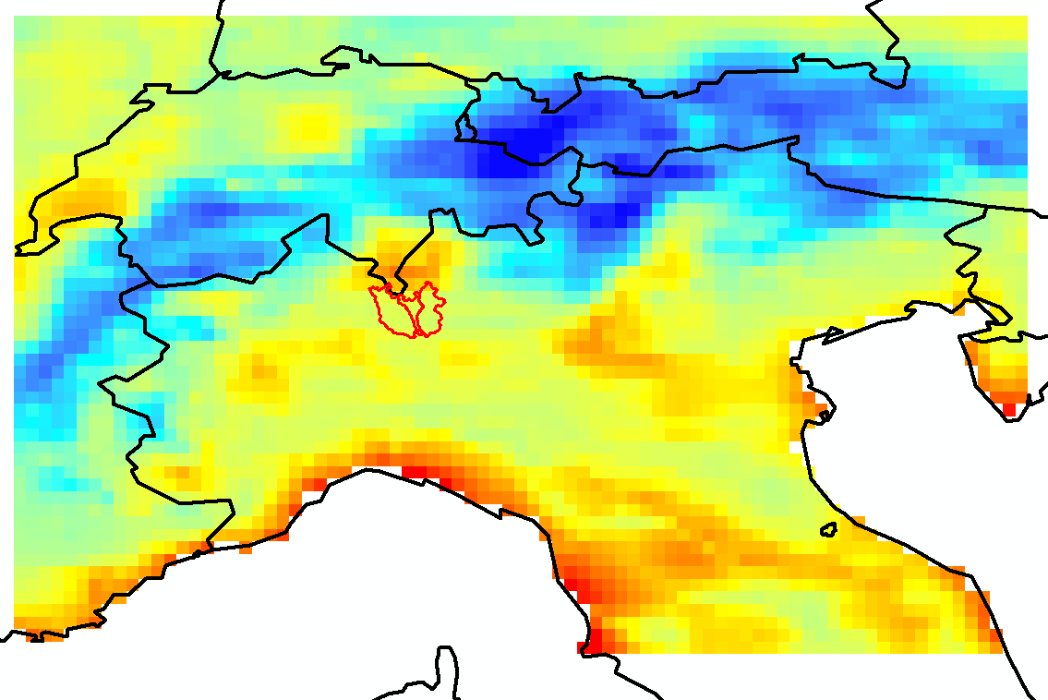
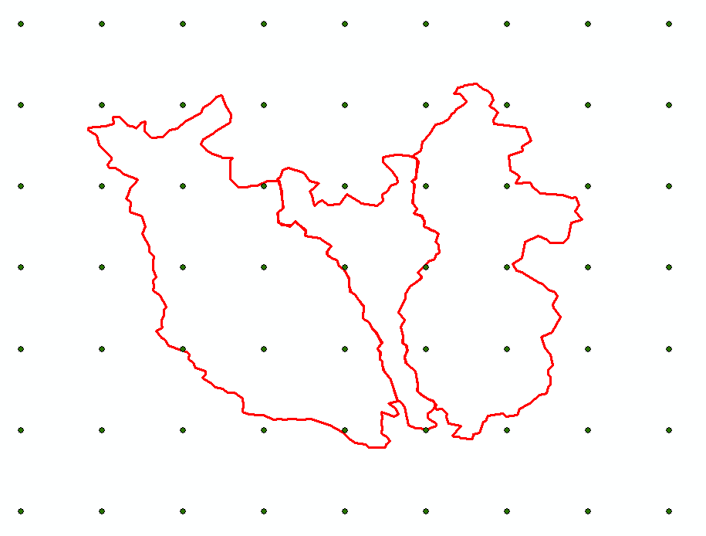


ERA5-Land model
9 km
DATA DESCRIPTION
Data type | Gridded
Projection | Regular latitude-longitude grid
Horizontal coverage | Global
Horizontal resolution | 0.1° x 0.1°; Native resolution is 9 km.
Vertical coverage | From 2 m above the surface level, to a soil depth of 289 cm.
Temporal coverage | January 1981 to December 2020
Temporal resolution | Hourly
File format | GRIB/Netcdf
Source: https://cds.climate.copernicus.eu/cdsapp#!/dataset/reanalysis-era5-land?tab=overview
https://confluence.ecmwf.int/display/CKB/ERA5-Land%3A+data+documentation

Slide 8
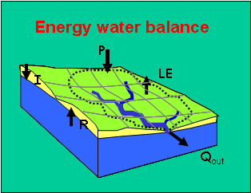
The POLIMI hydrological model: FEST-WB
Meteorological data
FEST-WB: Flash – flood Event – based Spatially – distributed rainfall – runoff Transformation – including Water Balance
Spatial interpolation:
Thiessen, IDW
Soil Parameters
Mancini, 1990: PhD thesis
Ceppi, A., et al. 2013: NHESS, 13(4), 1051-1062.
Ravazzani, G. et al., 2014: Water Resources Management, 28(4), 1033-1044
Corbari, C., Mancini, M., 2014: Hydrological science journal, 59 (10), 1830-1843
Snow
Dynamics
Vegetation
Parameters
LST SM
DEM
Soil Moisture
The routing component
Horizontal resolution
in this study: 200 m
Energy fluxes
Definition of
river network
Percolation
Surface Runoff
LEGEND
Input
Process
Subsurface routing
groundwater
Surface flow routing
Lakes and reservoires
Output
Internal
variable
Hydrograph at any river cross section

Slide 9
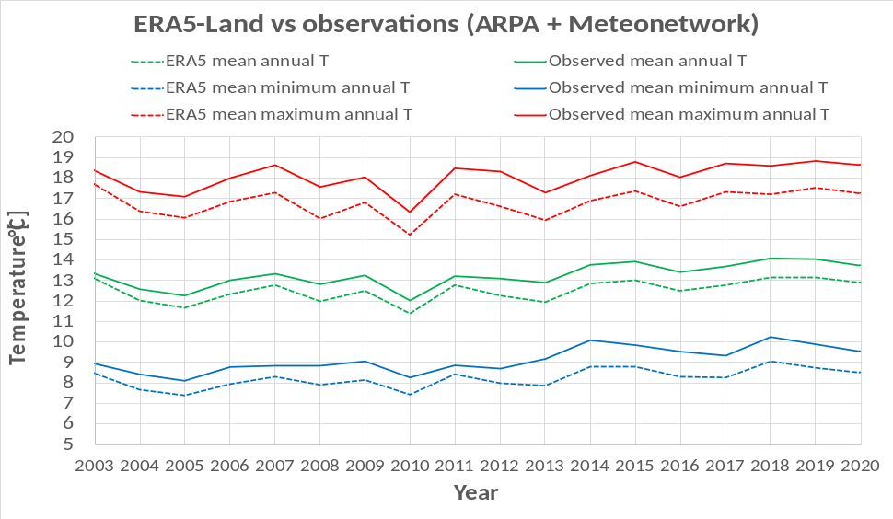
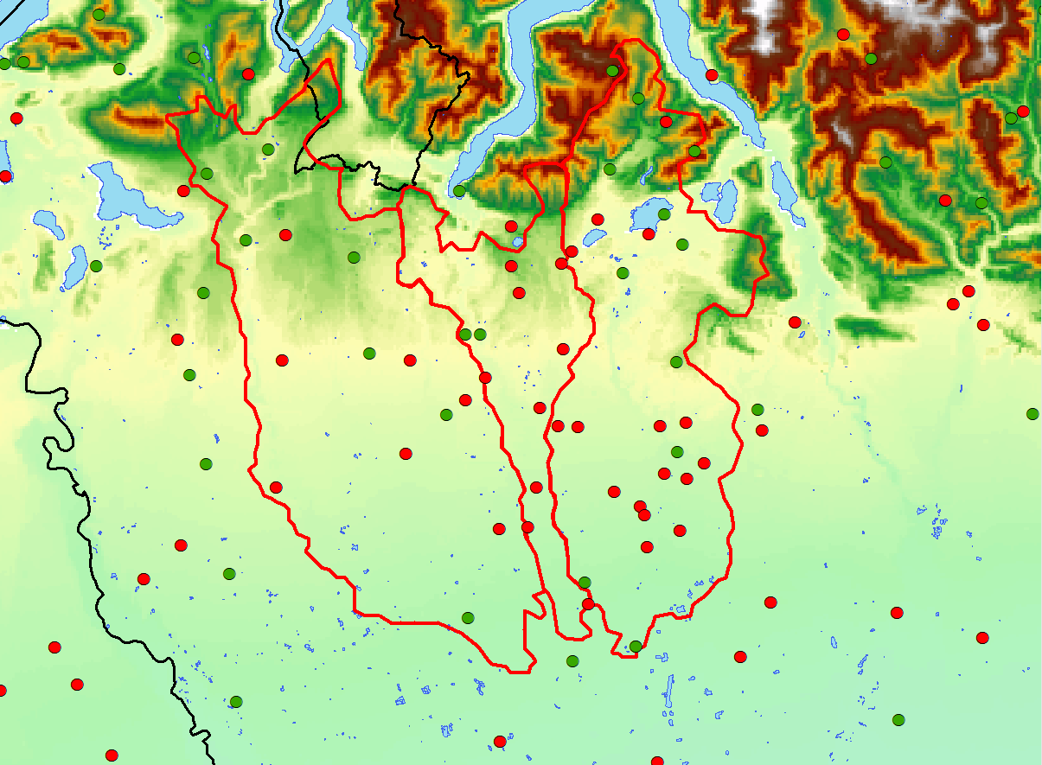
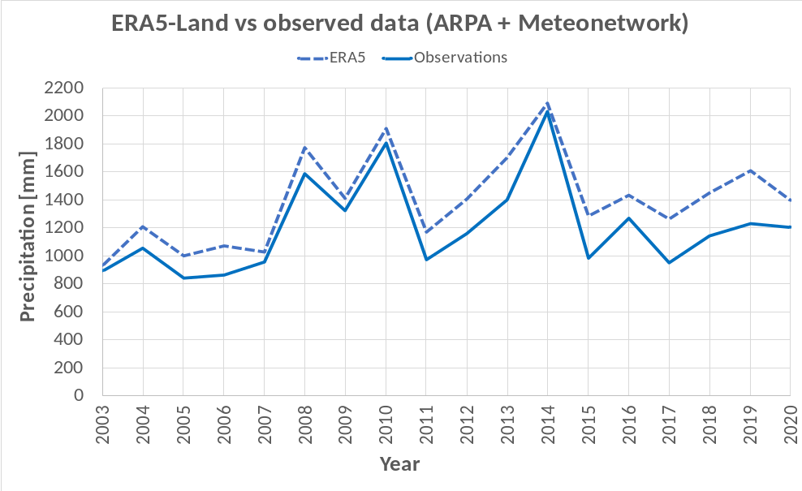


Observed weather data: a comparison with ERA5-Land reanalysis
The comparison between ERA5-Land and observed data has shown very pretty good results in the available overlapping period 2003-2020.
About temperatures:
R² = 0.83 for Tmin, 0.87 for Tmean, and 0.89 for Tmax.
MAE = 0.91°C for Tmin, 0.74°C for Tmean, and 1.28°C for Tmax
About precipitation:
R² = 0.91 and MAE = 193 mm
Arpa
Meteonetwork

Slide 10
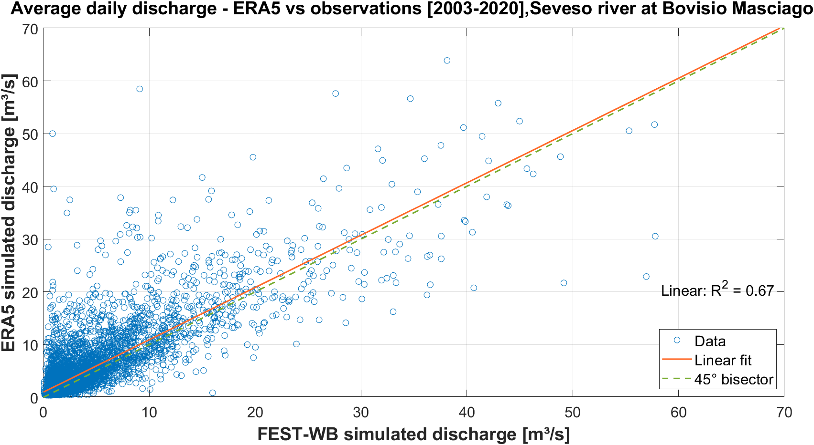
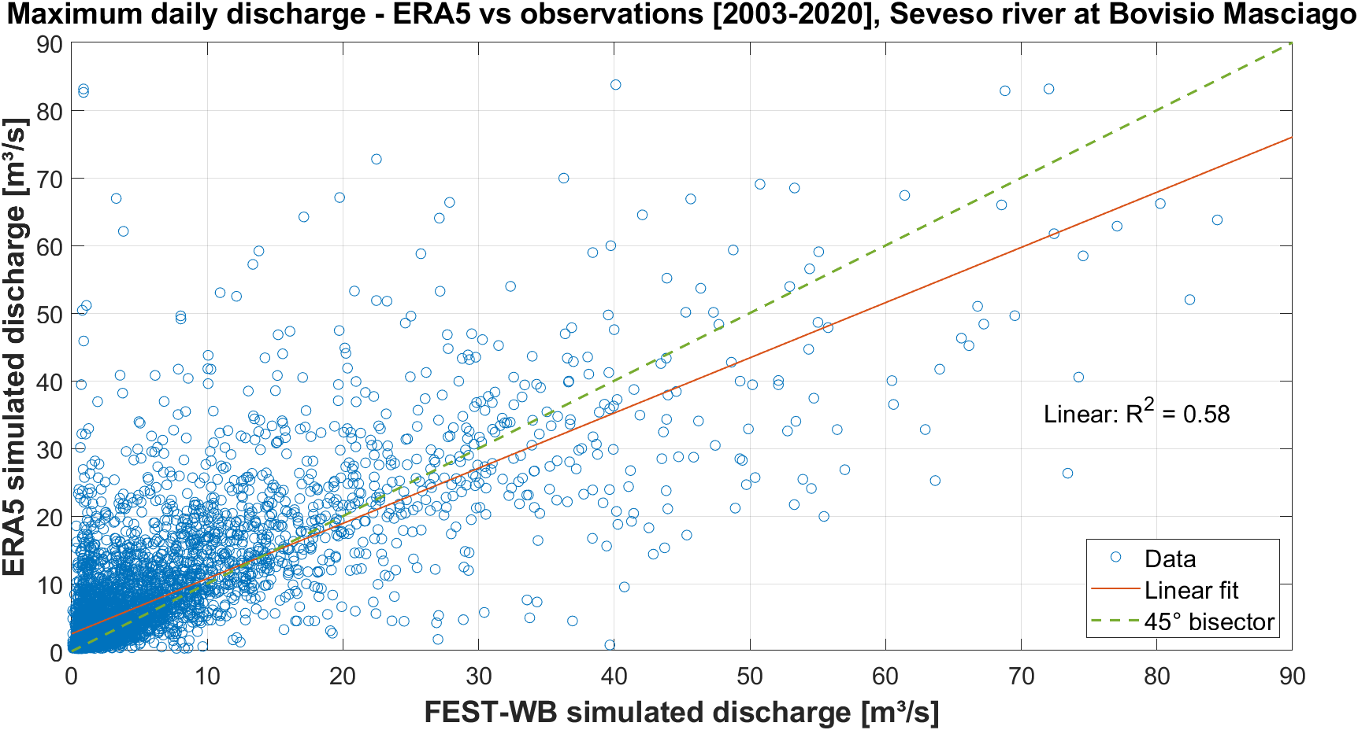
Simulated discharge: a comparison with ERA5-Land reanalysis
Simulated runoff values obtained with the FEST-WB hydrological model forced with observed data coming from the ARPA + Meteonetwork weather stations have shown a good match with the simulated discharges forced with the ERA5-Land reanalysis over the available overlapping period 2003-2020 with a coefficient of determination R² equal to 0.67 for the average daily discharge.
However, simulated discharges forced with ERA5-Land model has a tendency to underestimate the maximum daily discharge, instead, with a coefficient of determination R² equal to 0.58.

Slide 11
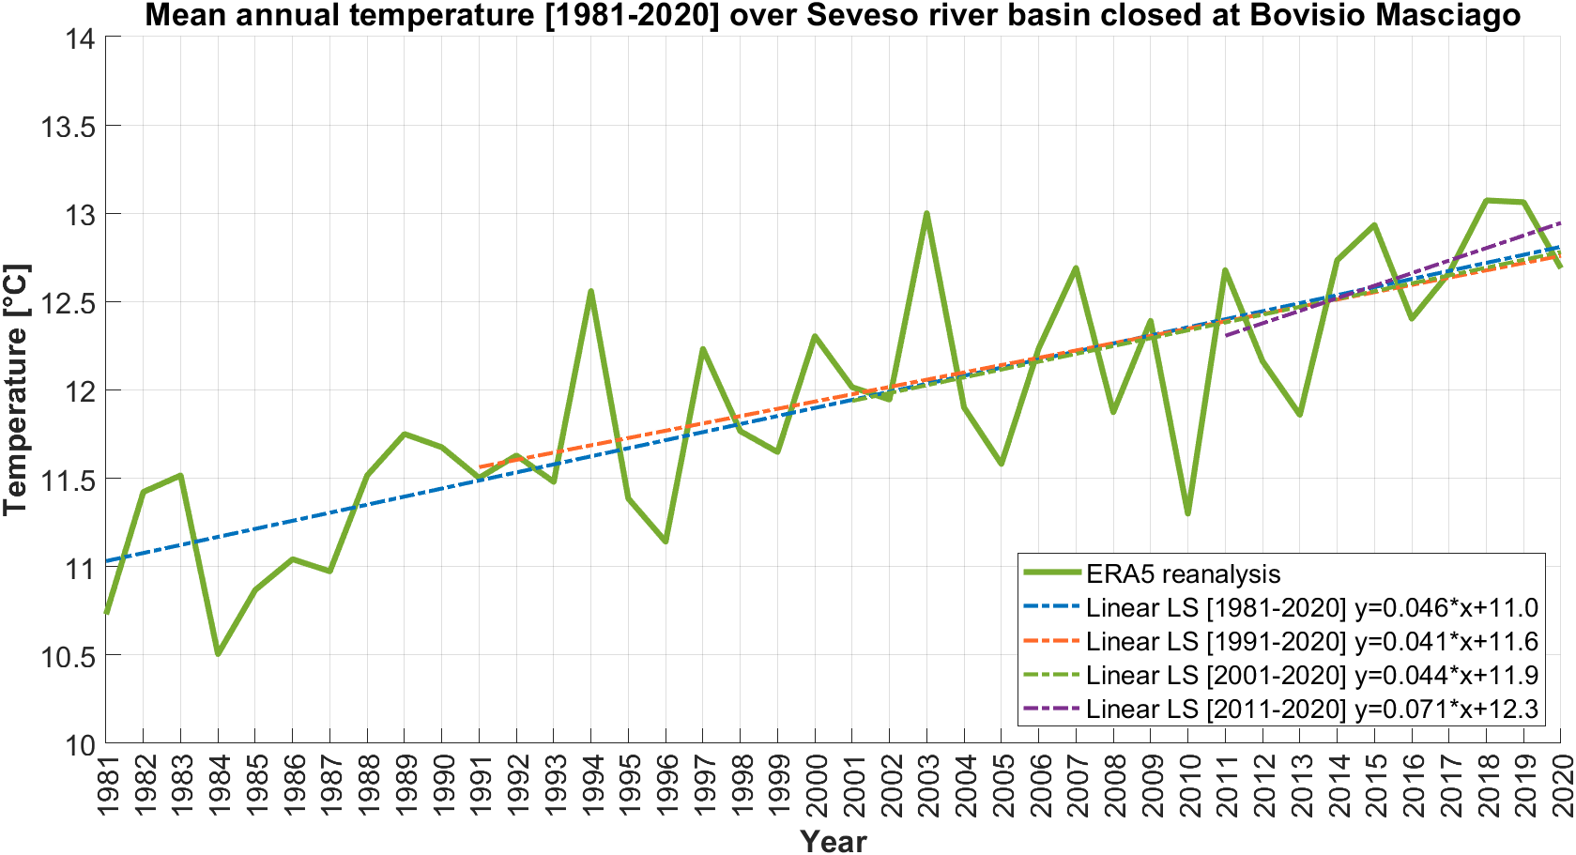
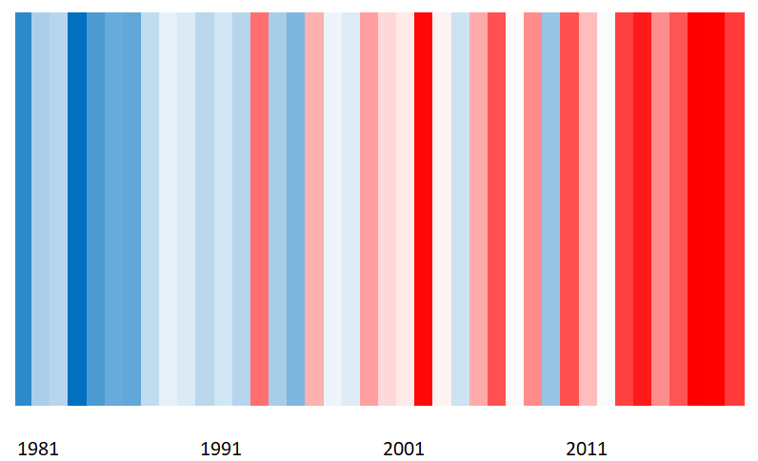
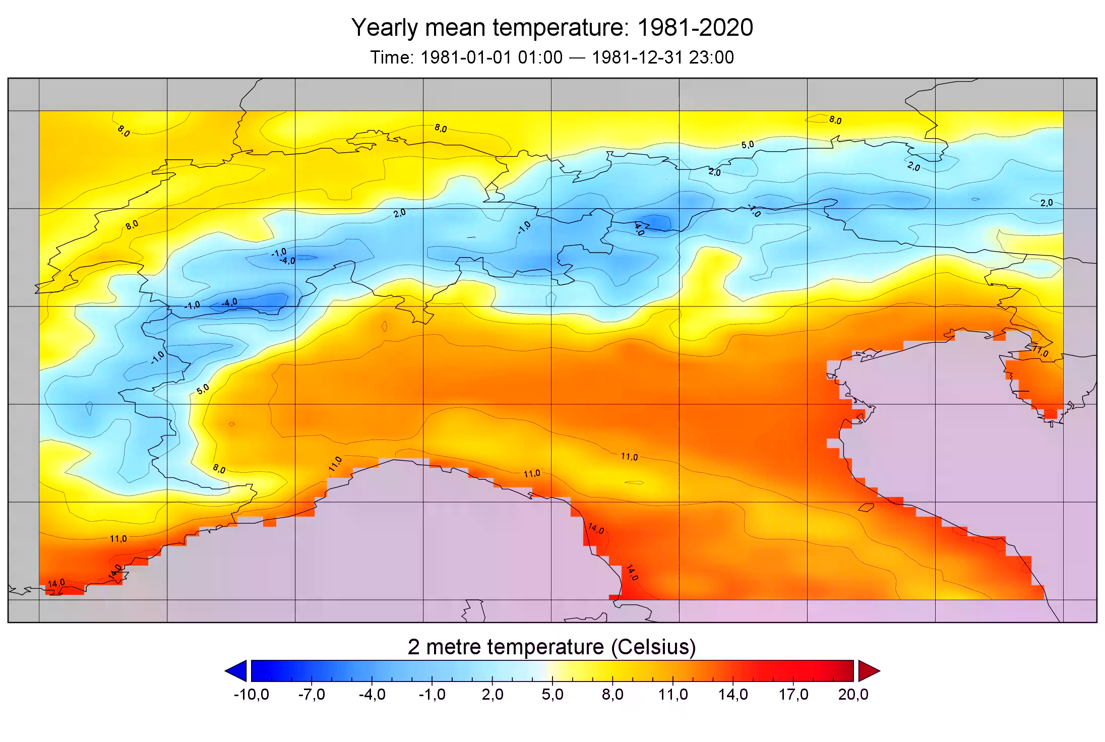
Temperature: the global warming is unequivocal…
…in the last 40 years over the Seveso river basin as well. In particular, it has been calculated an average increasing trend equal to 0.46°C per decade over the whole dataset, while in the last 10 years it has been even more reaching 0.71°C/decade.
Temperature climate stripes [1981-2020]
Much cooler
Much warmer

Slide 12
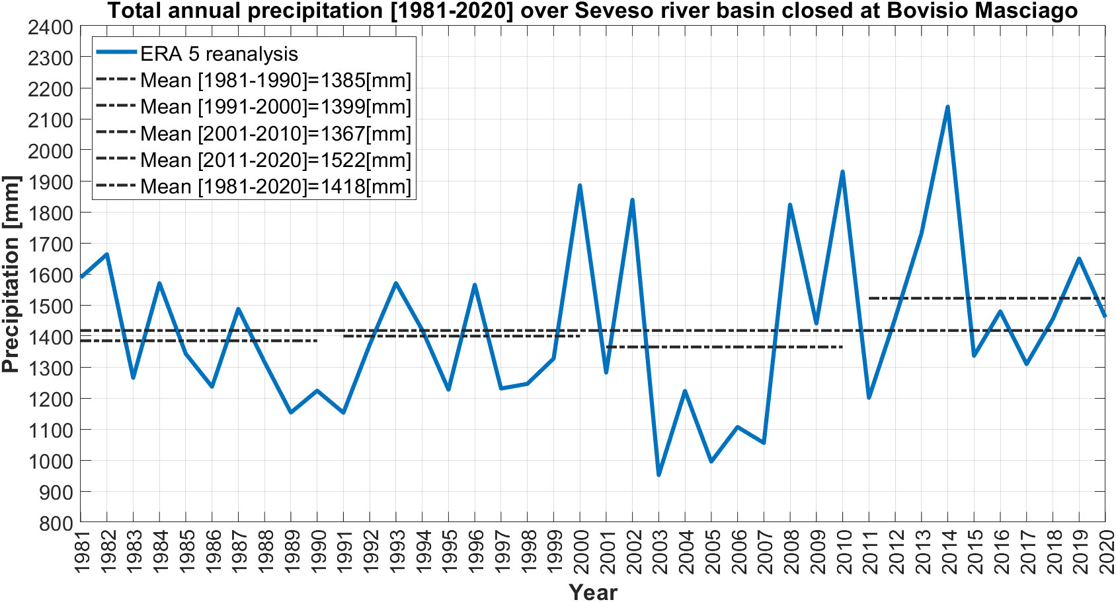
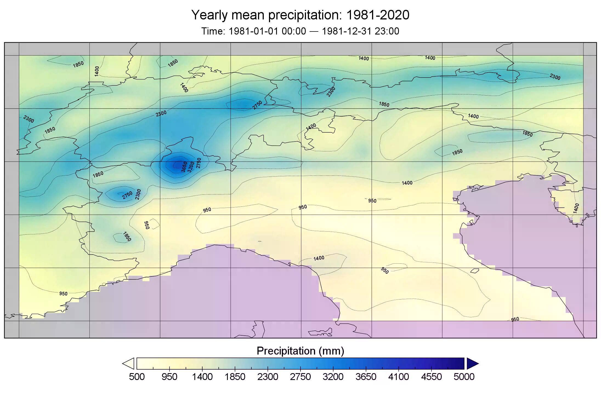
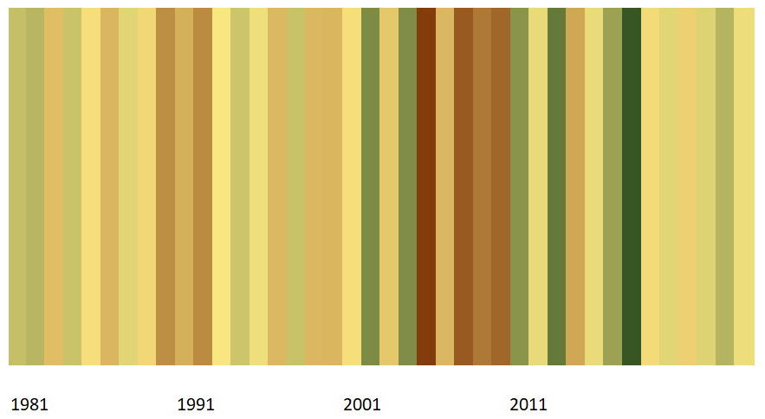
…but, what about precipitation?
The total annual precipitation shows a different behaviour between the first and second time series of the ERA5-Land dataset. In particular, the first twenty years shows a stationary trend, while the last ones highlight very opposite periods: much drier between 2001-2010 and much wetter between 2011-2020, which has turned out to be the rainiest decade.
Precipitation climate stripes [1981-2020]
Much drier
Much wetter

Slide 13
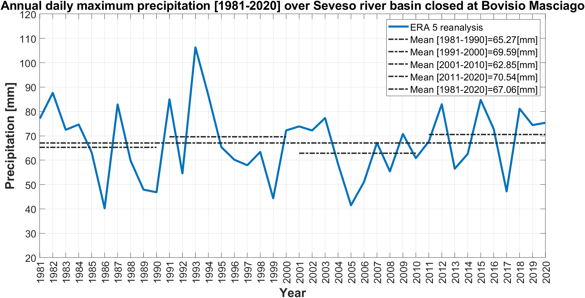
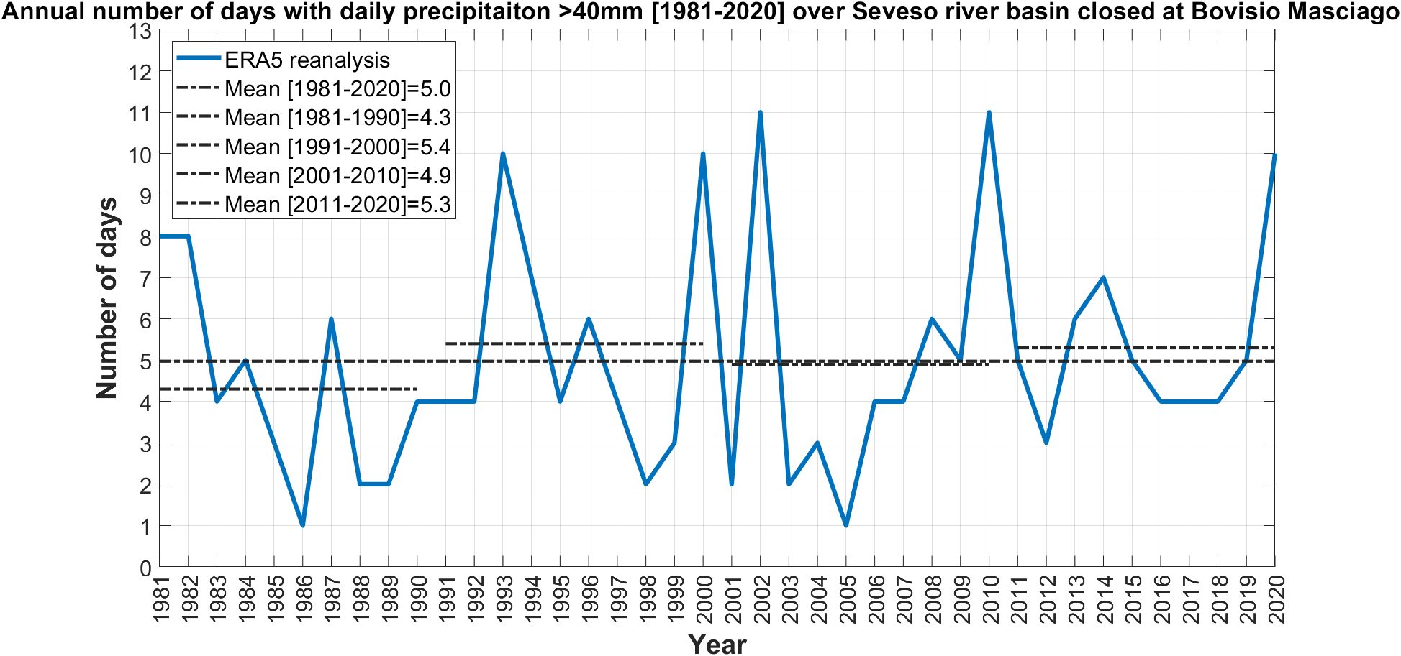
About precipitation: is there a general tendency?
Comparing all four decades, no significant trends are found analysing the annual daily maximum values (top) and the annual number of days with precipitation > 40 mm (bottom) over the Seveso river basin closed at Bovisio.
In particular, similar mean annual values found in the last decade [2011-2020] can be seen in the nineteens [1991-2000].

Slide 14
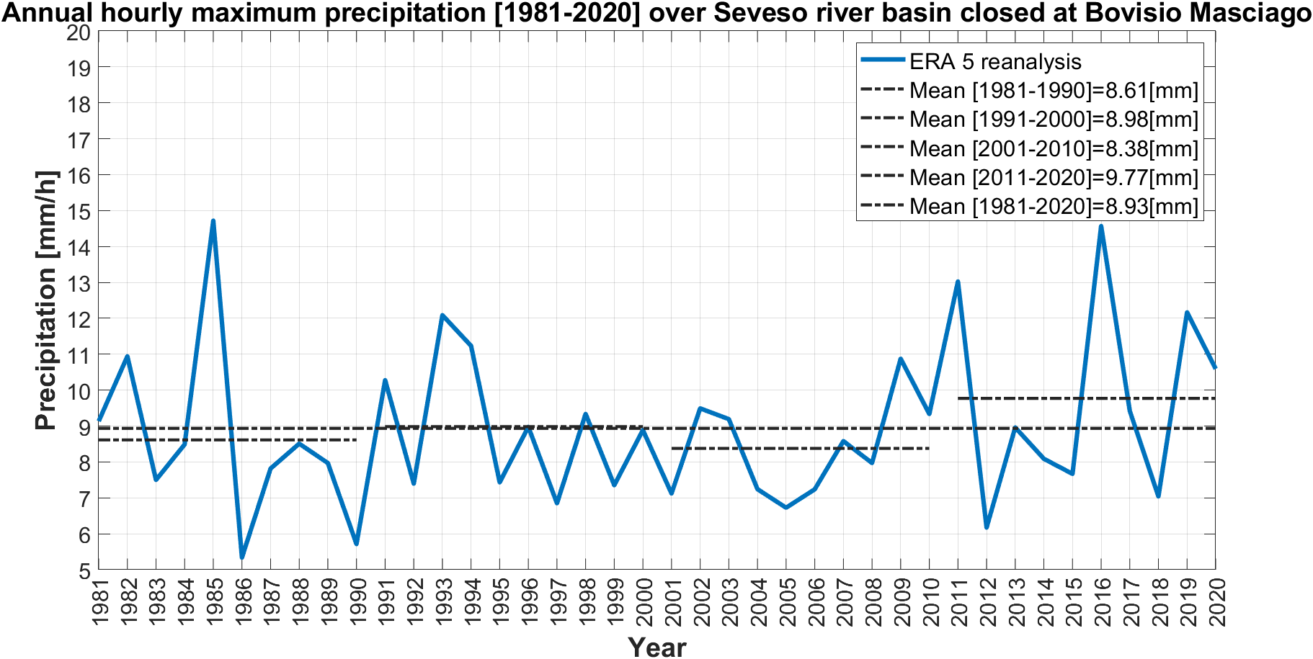
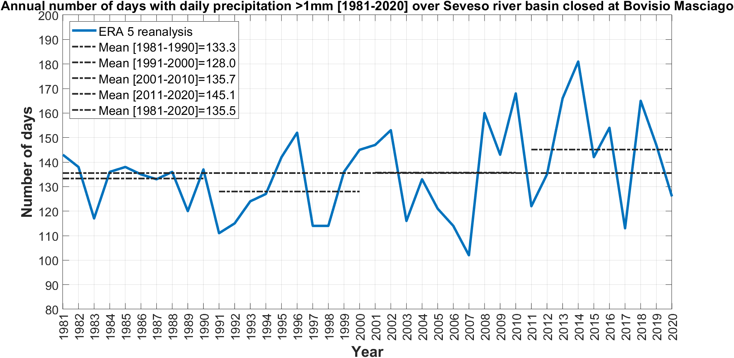
About precipitation: is there a general tendency?
Otherwise, looking at the annual hourly maximum precipitation, the last decade [2011-2020] shows much higher values in comparison with the other periods.
Since these kinds of watersheds have a very fast response in terms of lag time [~ 3 hours], this result has to be taken into account as a relevant issue from a hydrological perspective.
Even the annual number of days with precipitation > 1 mm (considered as wet days according the WMO), shows the highest values in the last period 2011-2020.

Slide 15
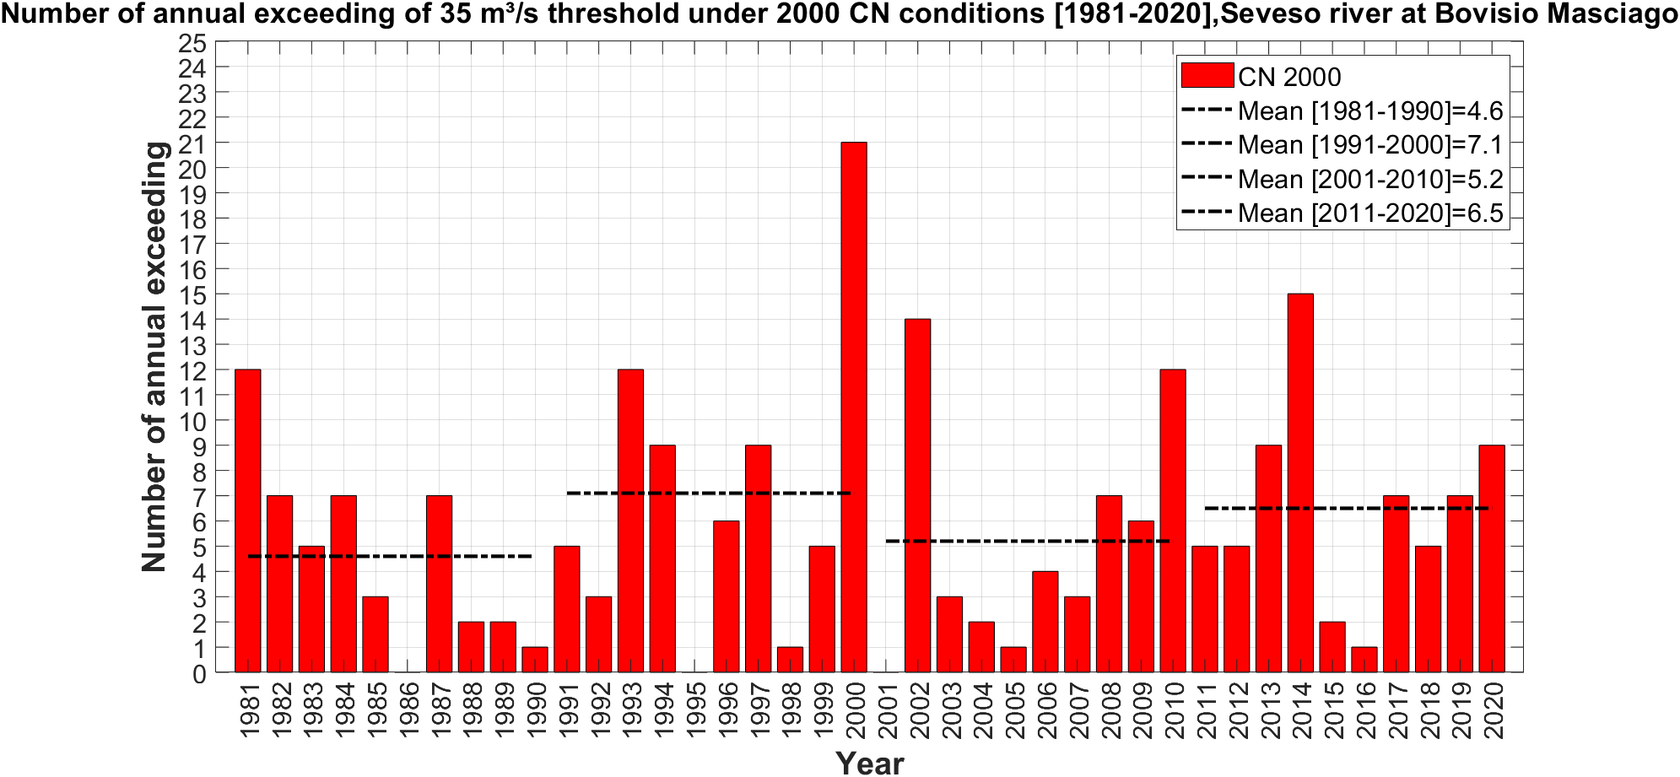
The rainfall-runoff analysis
Therefore, summarizing these main findings, we have seen how the last decade shows the highest values as total annual, hourly maximum precipitation and the number of days with daily precipitation > 1 mm with a relevant increasing trend (top figure) in the last twenty years.
Hence, the question is: how does the analysed precipitation pattern affect the river discharge in the last decades?
Maintaining unchanged the Curve Number (CN) conditions for the entire simulation period [1981-2020], we calculated the number of annual exceeding for the 35m³/s discharge warning threshold (bottom figure).
As it is shown, the effect of «climate change» shows no significant trend on discharge exceeding frequency.

Slide 16
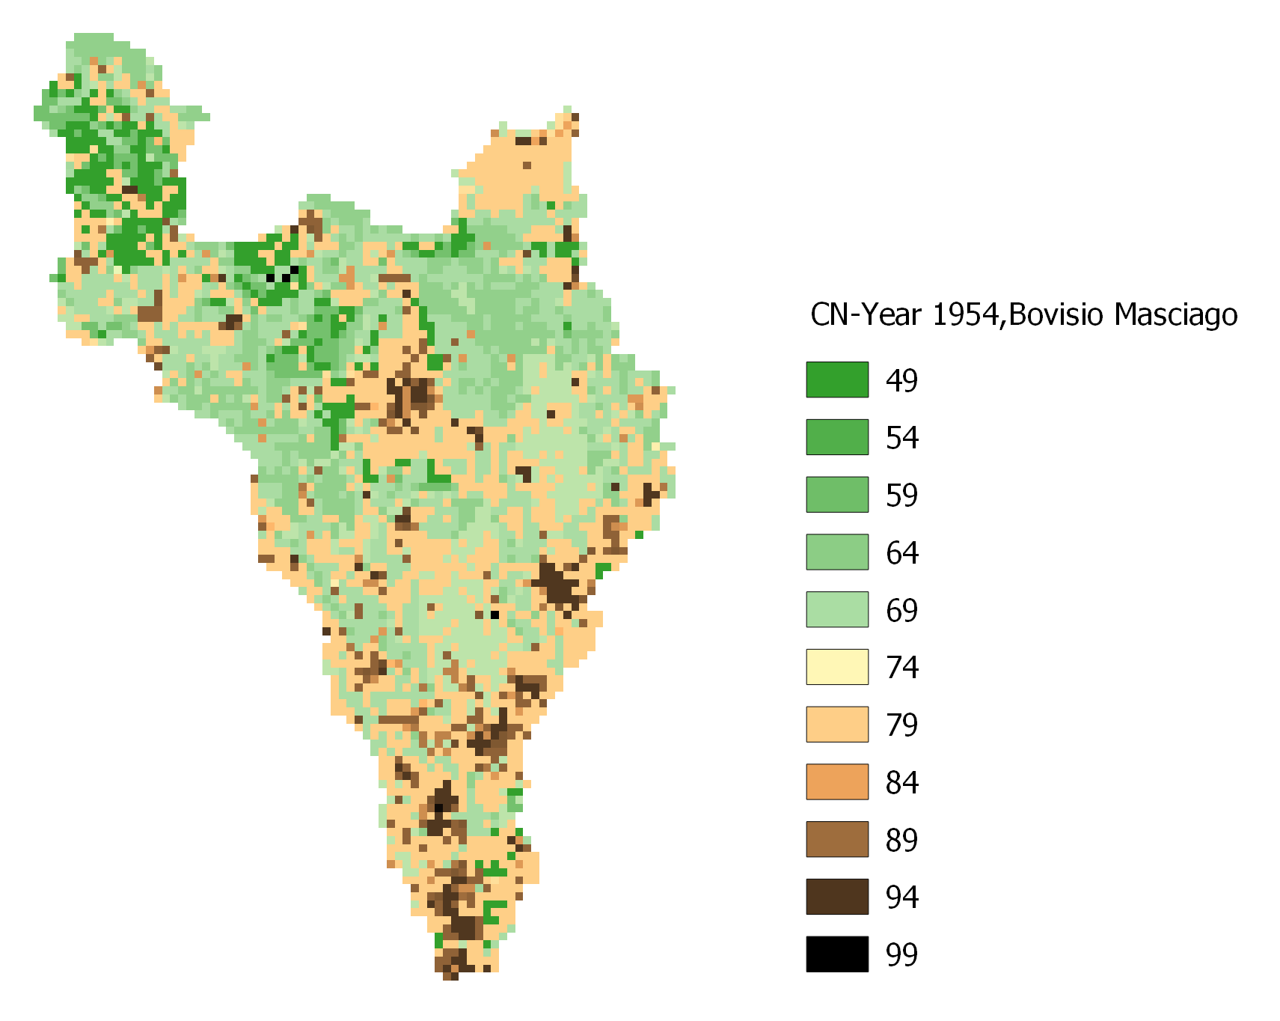
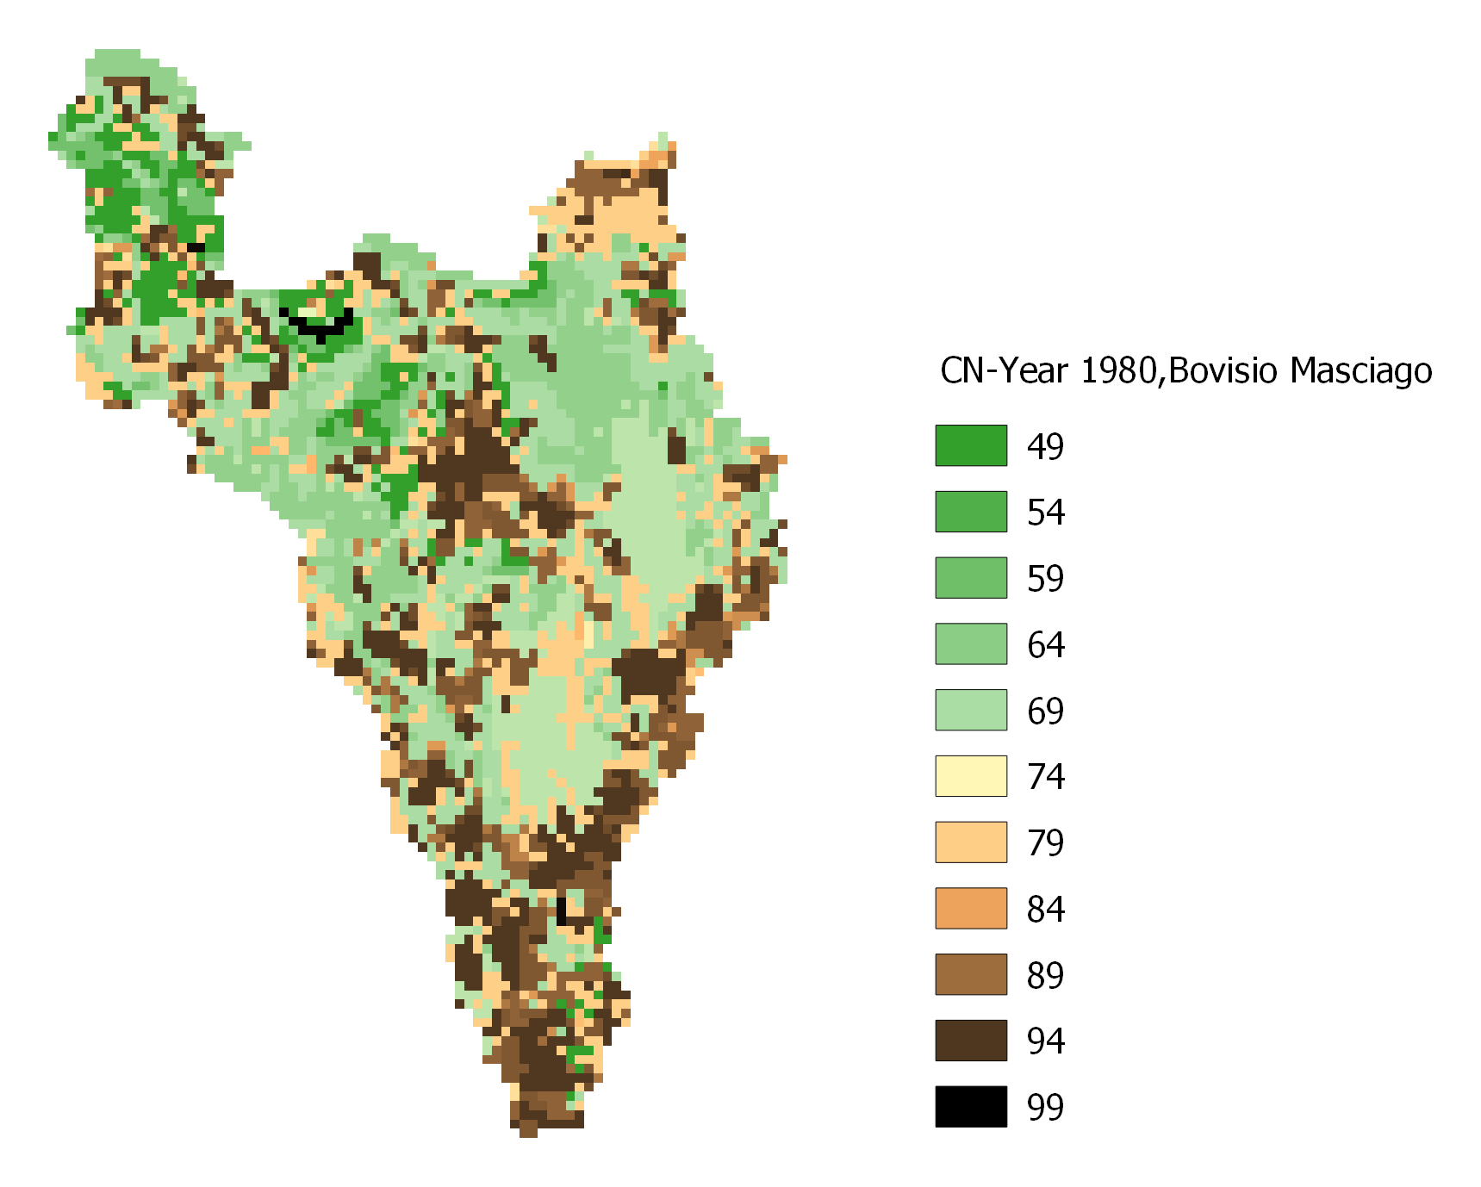
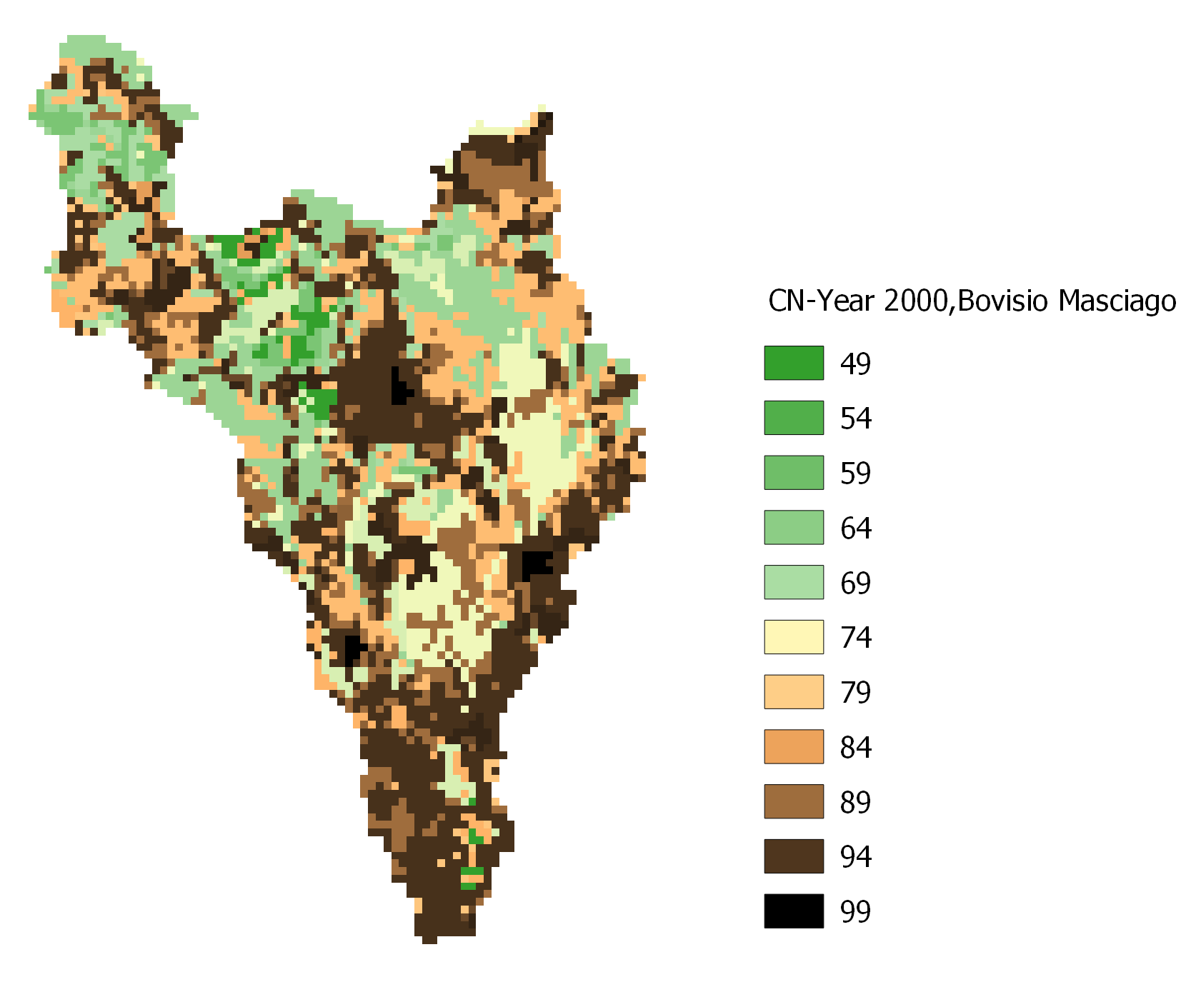
The land use change over Seveso river basin closed at Bovisio
Average CN
1954 =72.5
1980 =75.8
2000 =79.1
The percentage of increasing
Urbanized area
1954 = 8.7%
1980 = 28.7%
2000 =33.6%

Slide 17
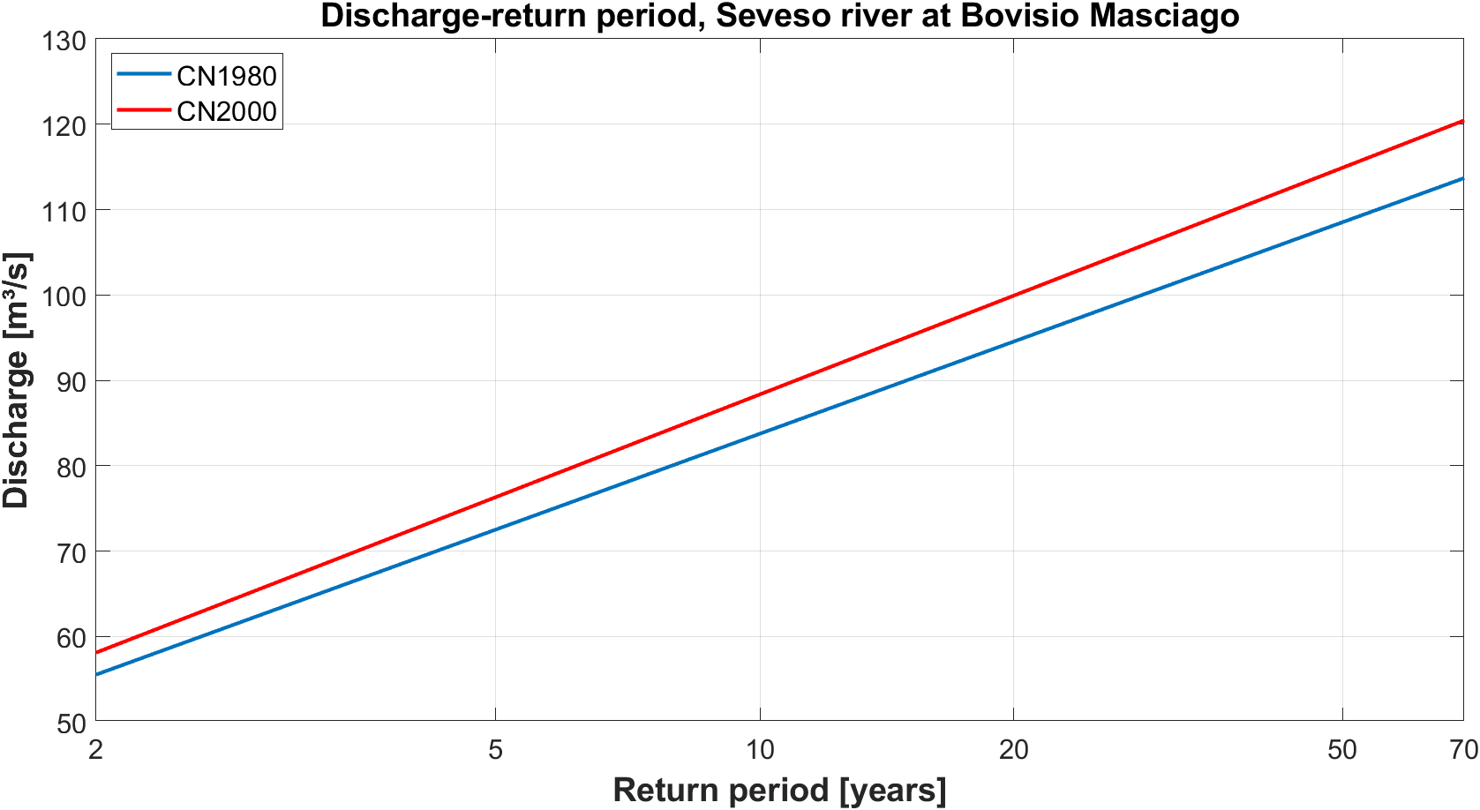
The impact of land use change on discharge/return period relationship
Therefore, what would happen if we modify the land use?
Let try to change the CN conditions!
How much is the effect of CN condition change on the discharge/return period relationship?
On average, the increasing of CN from the year 1980 till 2000 led to diminish the return period of about 7 years.

Slide 18
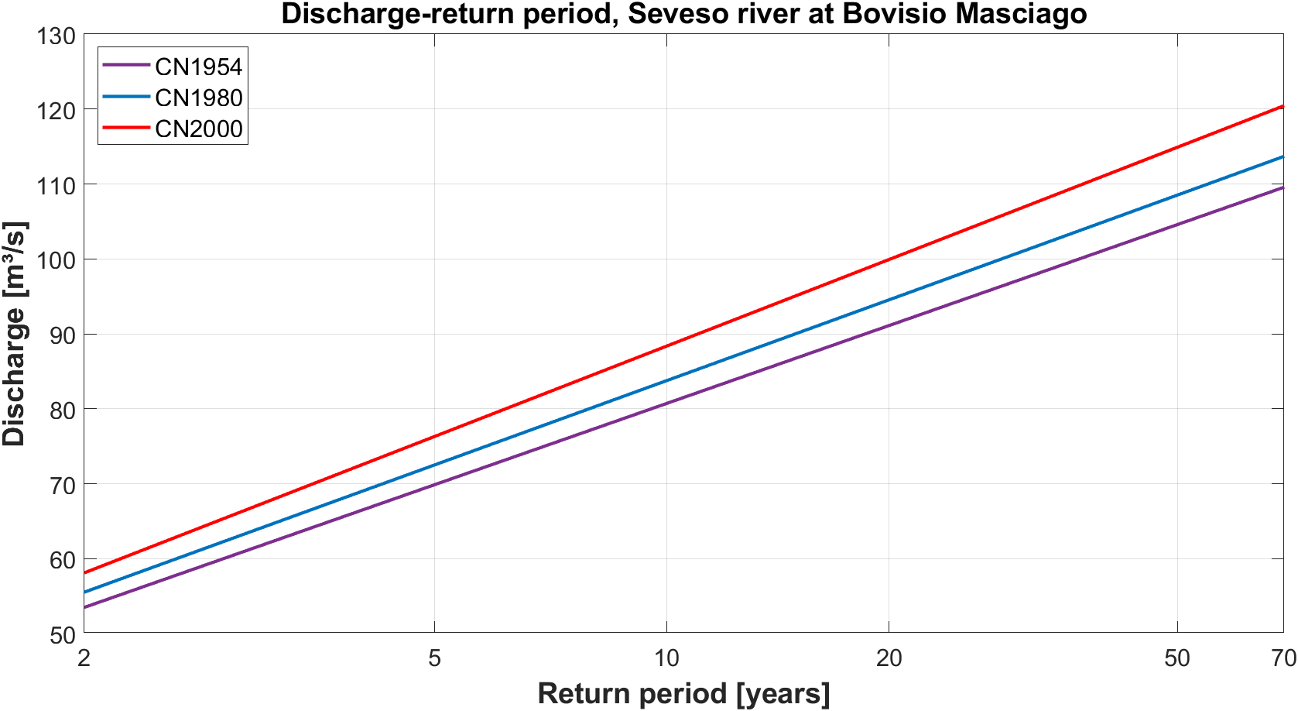
The impact of land use change on discharge/return period relationship
What would have happened with CN conditions of the year 1954?
For instance, the 100m³/s discharge would have had a return period equal to 36.6 years instead of 28.6 and 20.1 years, respectively for CN conditions of 1980 and 2000.
Future CN?
Future developments are ongoing
What should we expect for the future?

Slide 19
Conclusions
A good agreement between ERA5-Land data and observed temperatures and precipitation values coming from ground weather stations is found, and between the discharge simulations forced with two datasets (ERA5-Land vs observation) as well.
The temperature analysis in the 40 years dataset shows an average increasing equal to 1.84°C with a more significant trend in the last decade.
As far as concerning the precipitation pattern, relevant changes are found in the last decade [2011-2020] for the total annual, the hourly maximum values, and the number of days with daily precipitation > 1 mm. However, maintaining CN conditions unchanged, this does not lead to an increasing of exceeding the discharge warning threshold of 35 m³/s.
Otherwise, a significant outcome in the discharge/return period relationship is found once the CN conditions have been modified; on average, there is a diminishing of 7 years as return period with the land use of the year 1980 in regard to the 2000 one.

Slide 20
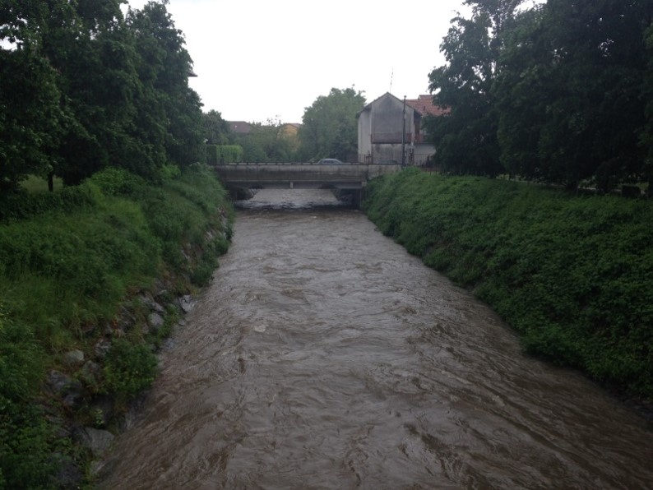
www.fest.polimi.it
alessandro.ceppi@polimi.it
Thank you for your attention

