Slide 1
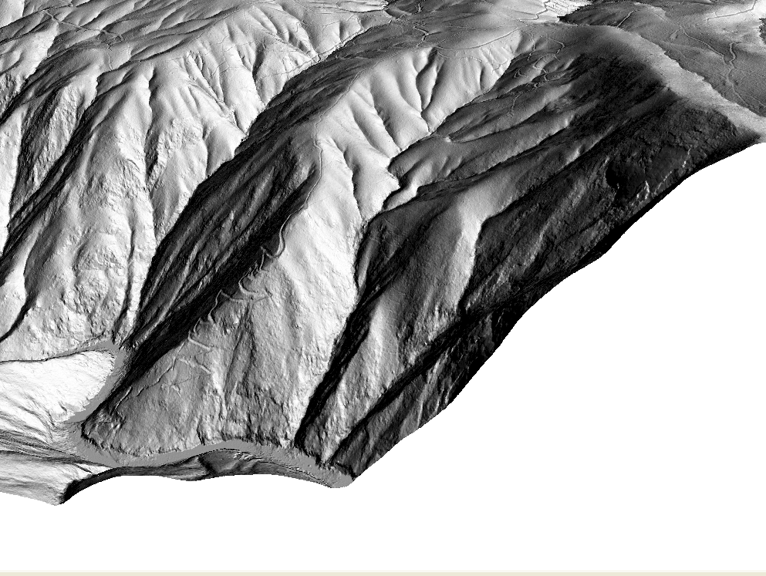






Rapidly eroding hilltops are surprisingly smooth: ridgetop curvature varies with the square root of erosion rate
GM3.17, EGU21-12536
Emmanuel J. Gabet, Simon M. Mudd, Ryan W. Wood, Stuart W. D. Grieve, Steven A. Binnie, and Tibor J. Dunai

Slide 2
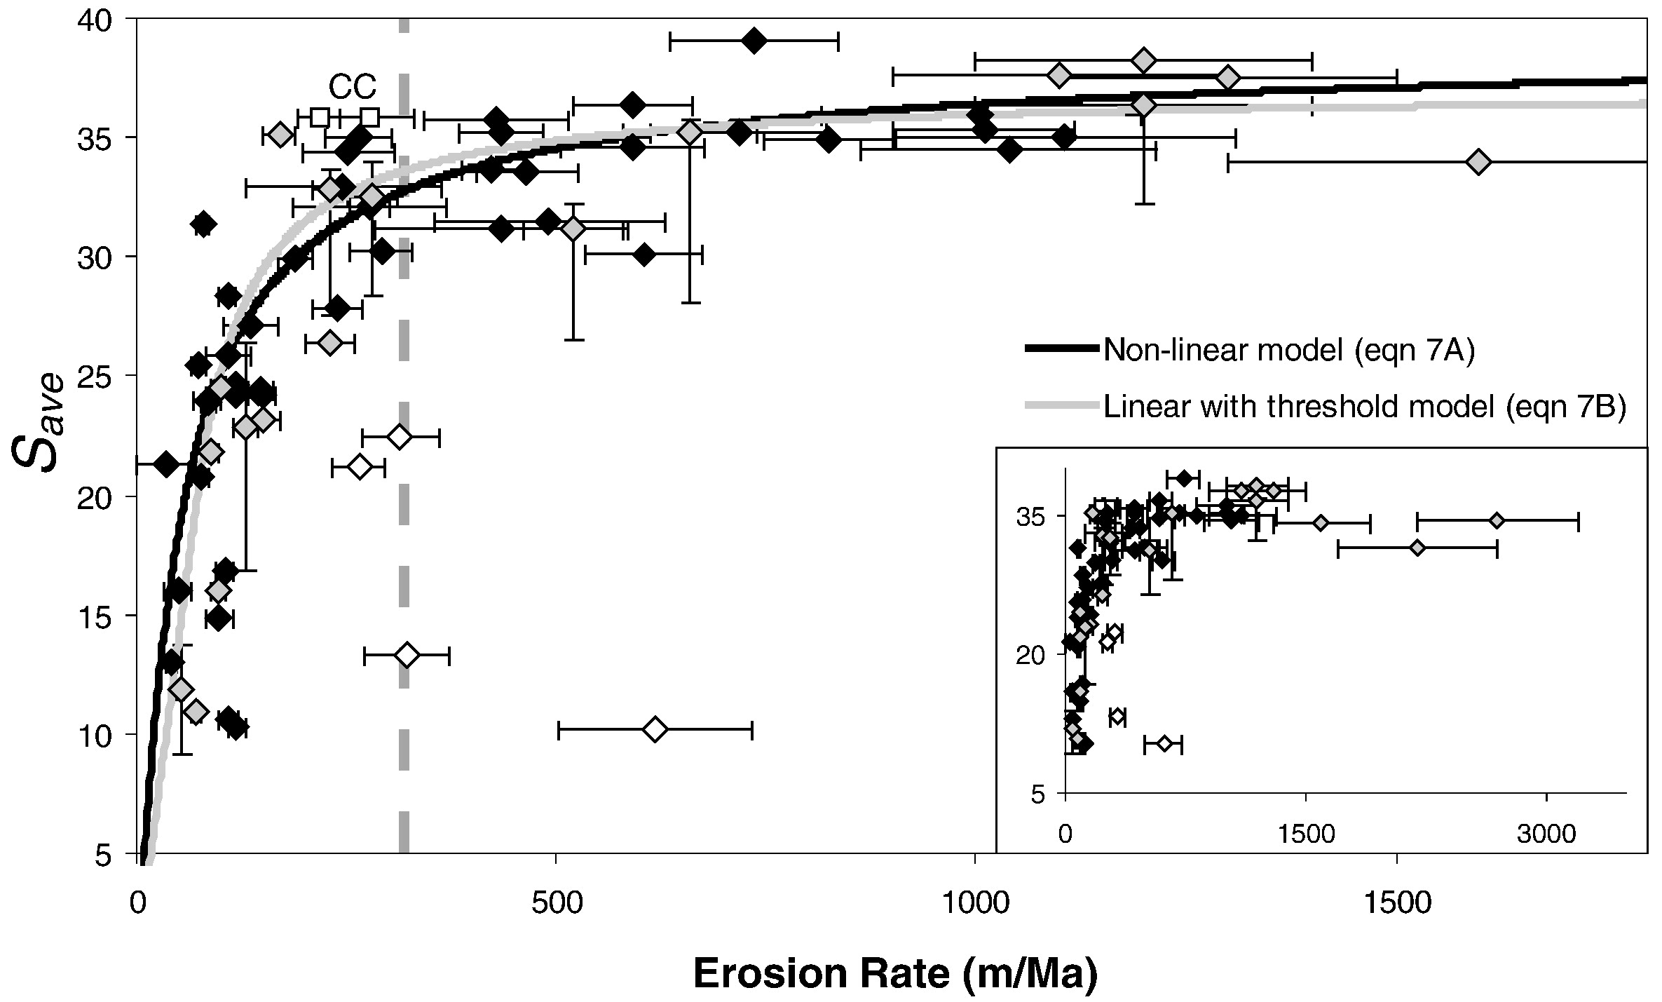
Background
Suppose you want to know millennial scale erosion rates but don’t have the $$ ££ €€ for ¹⁰Be.
In fast eroding landscapes, hillslope gradients are not good for this
DiBiase et al. (2010) ESPL 289(1-2), 134-144

Slide 3
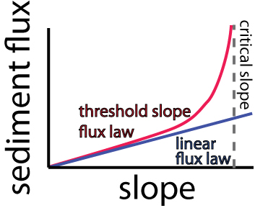
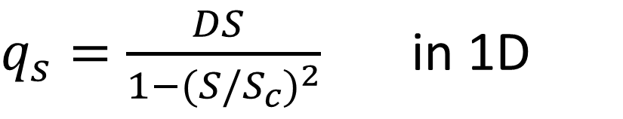
Background
Why?
We think sediment transport gets very efficient as slope approaches a critical value (red line below, and equation).
$q_{s}=\frac{DS }{1−{(S/S_{c})}^{2}}$ in 1D
Andrews, D.J. and Bucknam, R.C., 1987. Journal of Geophysical Research-Solid Earth and Planets, 92(B12): 12857-12867.
Roering, J.J., Kirchner, J.W. and Dietrich, W.E., 1999. Water Resources Research, 35(3): 853-870.
Gabet, E.J., 2003. Sediment transport by dry ravel. Journal of Geophysical Research: Solid Earth 108. https://doi.org/10.1029/2001JB001686

Slide 4
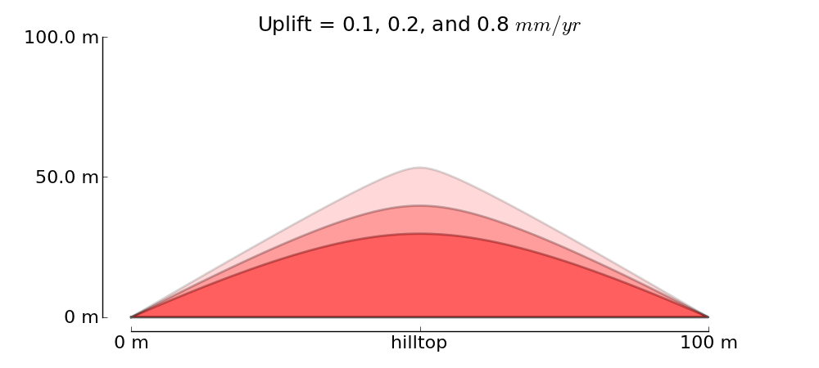
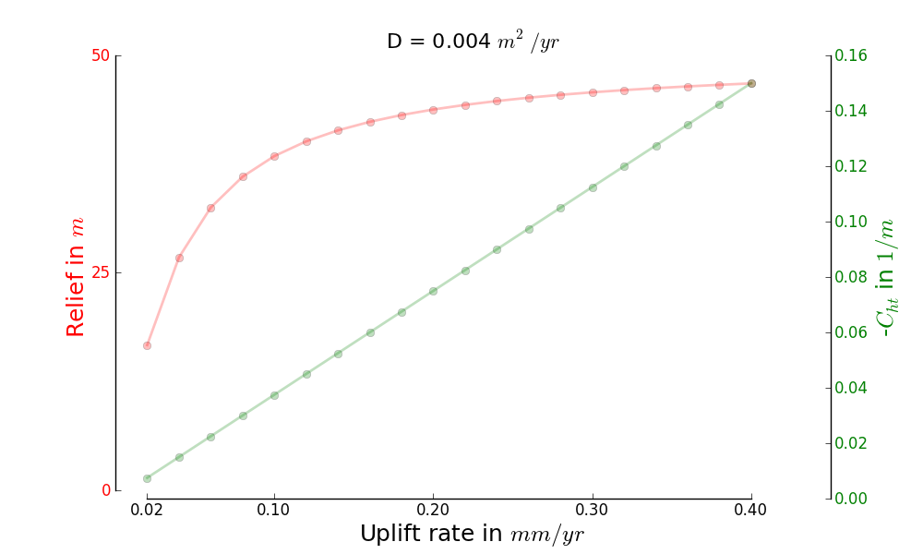
Background
Faster erosion = sharper ridges (greater negative hilltop curvature)
BUT
Theory predicts ridgetop curvature should work
Curvature of the ridgetop is a better indicator of erosion rates!!

Slide 5
Background
Faster erosion = sharper ridges (greater negative hilltop curvature)
Erosion related to curvature by a transport efficiency (sometimes denoted by D)

Slide 6
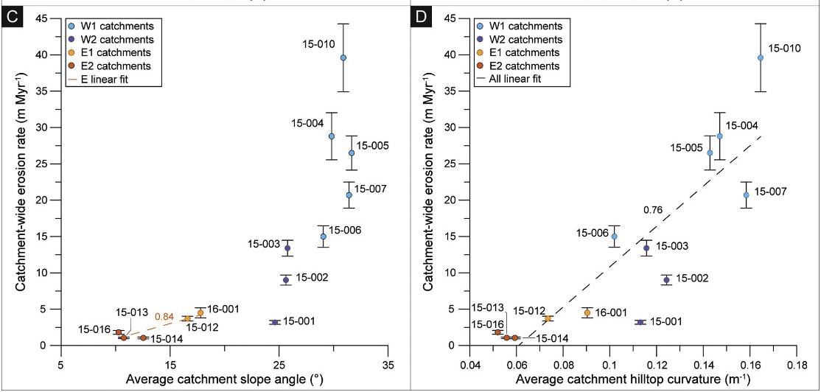
Background
Mohren, J., Binnie, S.A., Ritter, B., Dunai, T.J., 2020. Global and Planetary Change 184, 103068. https://doi.org/10.1016/j.gloplacha.2019.103068
Does it work?

Slide 7
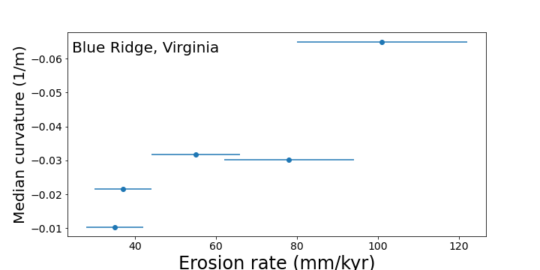
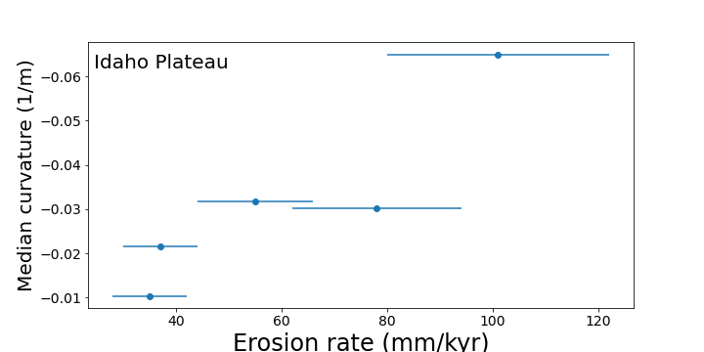
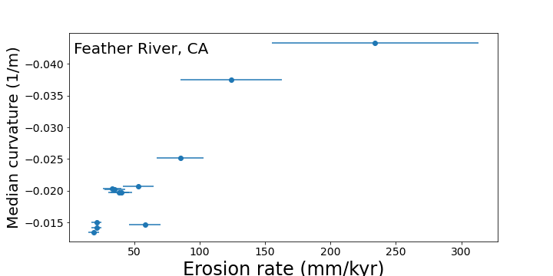
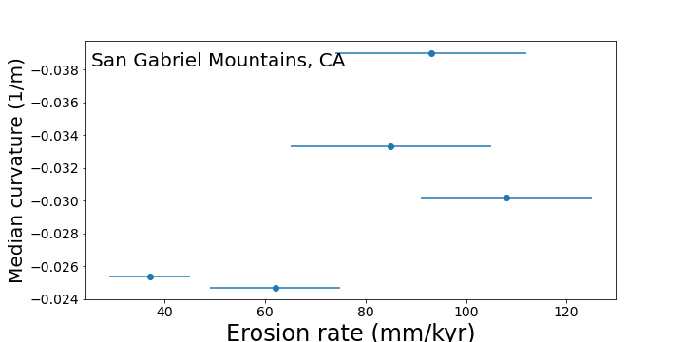
Background
Does it work?

Slide 8
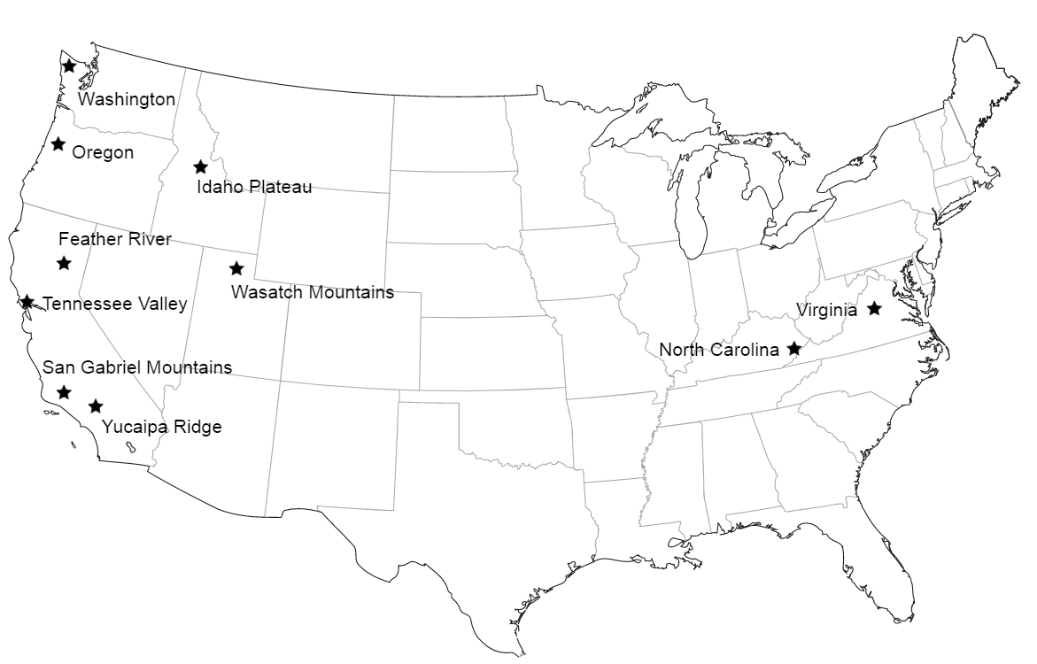
What we did
Gabet, E.J., Mudd, S.M., Wood, R.W., Grieve, S.W.D., Binnie, S.A., Dunai, T.J., (2021) Hilltop Curvature Increases with the Square Root of Erosion Rate. Journal of Geophysical Research: Earth Surface, e2020JF005858. https://doi.org/10.1029/2020JF005858
Found places with lidar and ¹⁰Be erosion rates
Measured curvature.
Stop laughing, this was a lot of work.
Oh actually we sampled and measured 10Be concentration in the Idaho Plateau on a field campaign that used a jetboat. So there.

Slide 9
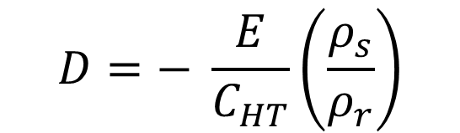
What we hoped to find
Some climate signal?
The sediment transport coefficient (D in dimensions L²/T) should be some function of climate, right?
There is no chance of all the curvature data falling on a similar curve right??????
$$D=− \frac{E}{C_{HT}}\left(\frac{ρ_{s}}{ρ_{r}}\right)$$

Slide 10
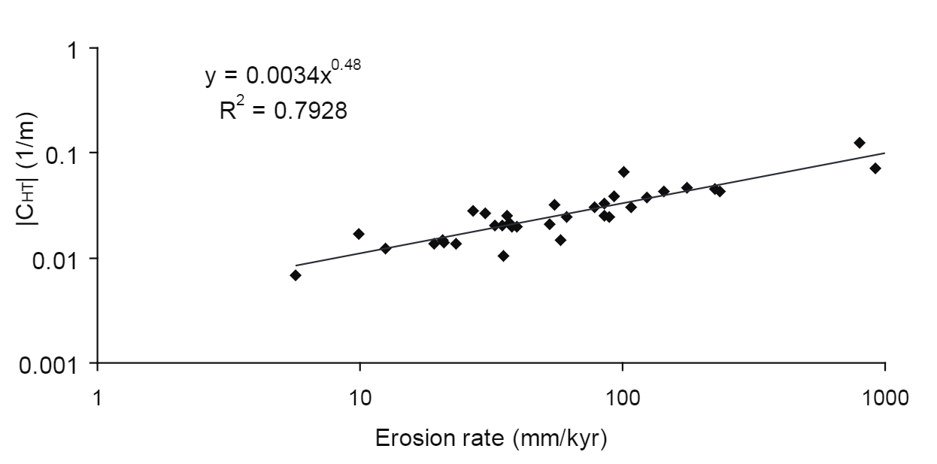
What we did find
Gabet, E.J., Mudd, S.M., Wood, R.W., Grieve, S.W.D., Binnie, S.A., Dunai, T.J., (2021) Hilltop Curvature Increases with the Square Root of Erosion Rate. Journal of Geophysical Research: Earth Surface, e2020JF005858. https://doi.org/10.1029/2020JF005858
Oh. WTF?

Slide 11
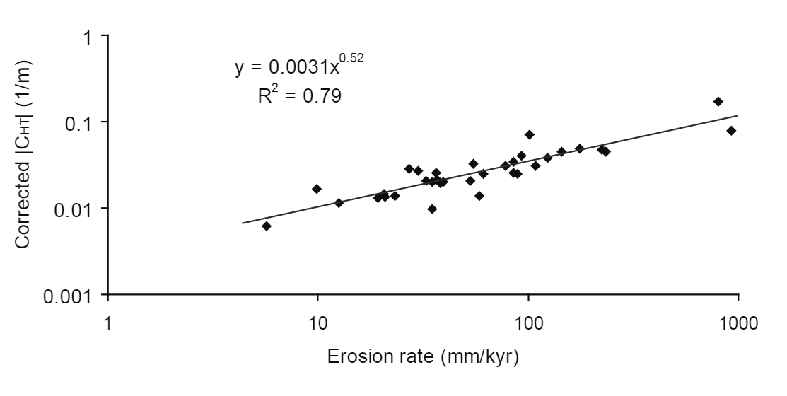
Hey you dummies, maybe you don’t see the signal because of grid scale effects!
Nope. Can’t explain our findings.
Gabet, E.J., Mudd, S.M., Wood, R.W., Grieve, S.W.D., Binnie, S.A., Dunai, T.J., (2021) Hilltop Curvature Increases with the Square Root of Erosion Rate. Journal of Geophysical Research: Earth Surface, e2020JF005858. https://doi.org/10.1029/2020JF005858

Slide 12
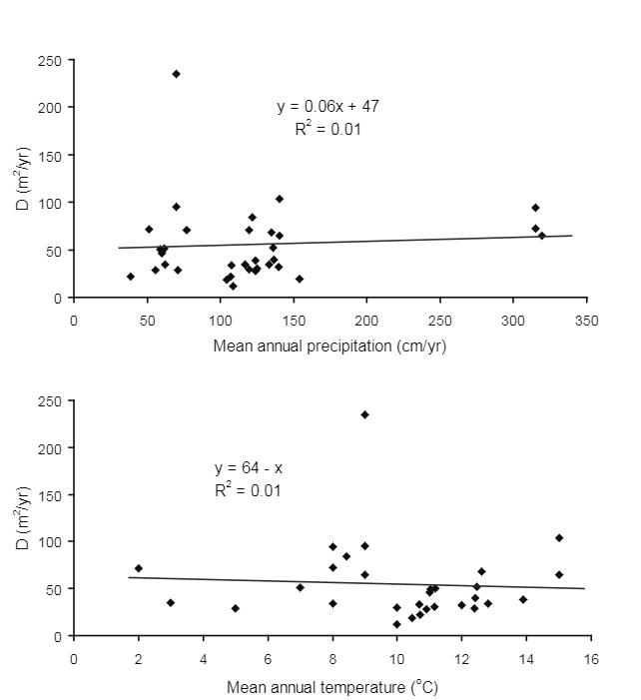
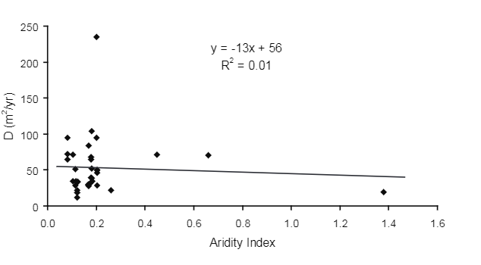
What about the climate signal??
Our data has none. No no no.

Slide 13
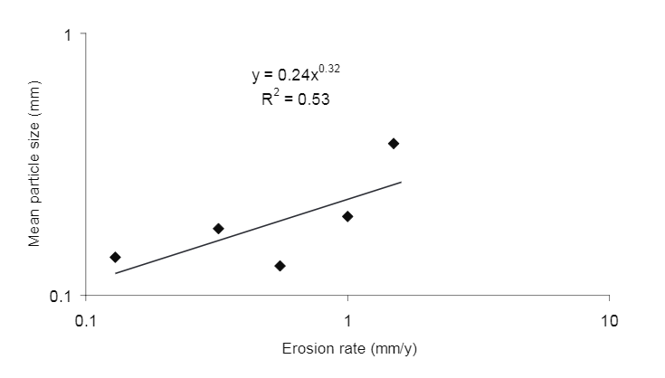
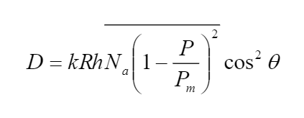
Maybe a particle size effect?
Some speculation that particle size could affect D. From Furbish et al 2009 (R is the particle radius):
Particle size appears to increase with erosion rate.
see also Attal et al. 2015. Earth Surface Dynamics 3, 201–222. https://doi.org/10.5194/esurf-3-201-2015

Slide 14
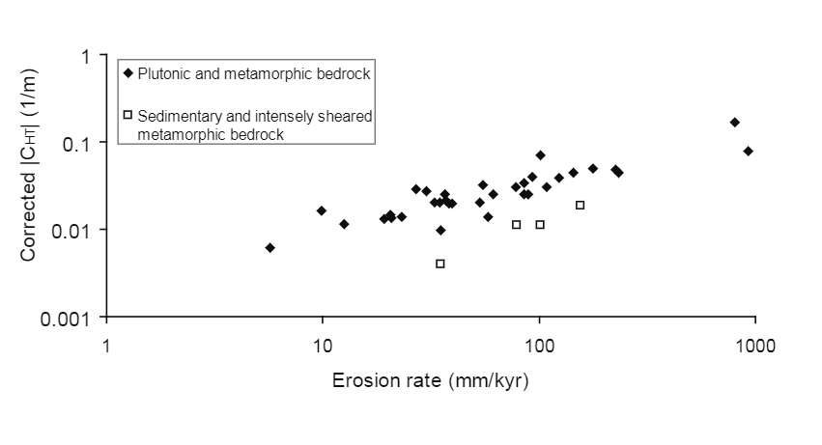
Softer rocks (from Richardson et al., 2019)
Gabet, E.J., Mudd, S.M., Wood, R.W., Grieve, S.W.D., Binnie, S.A., Dunai, T.J., (2021) Hilltop Curvature Increases with the Square Root of Erosion Rate. Journal of Geophysical Research: Earth Surface, e2020JF005858. https://doi.org/10.1029/2020JF005858
Open squares in this figure are from Richardson, P. W., J. T. Perron, and N. D. Schurr (2019), Influences of climate and life on 601hillslope sediment transport, Geology, 47, 423-426.

Slide 15
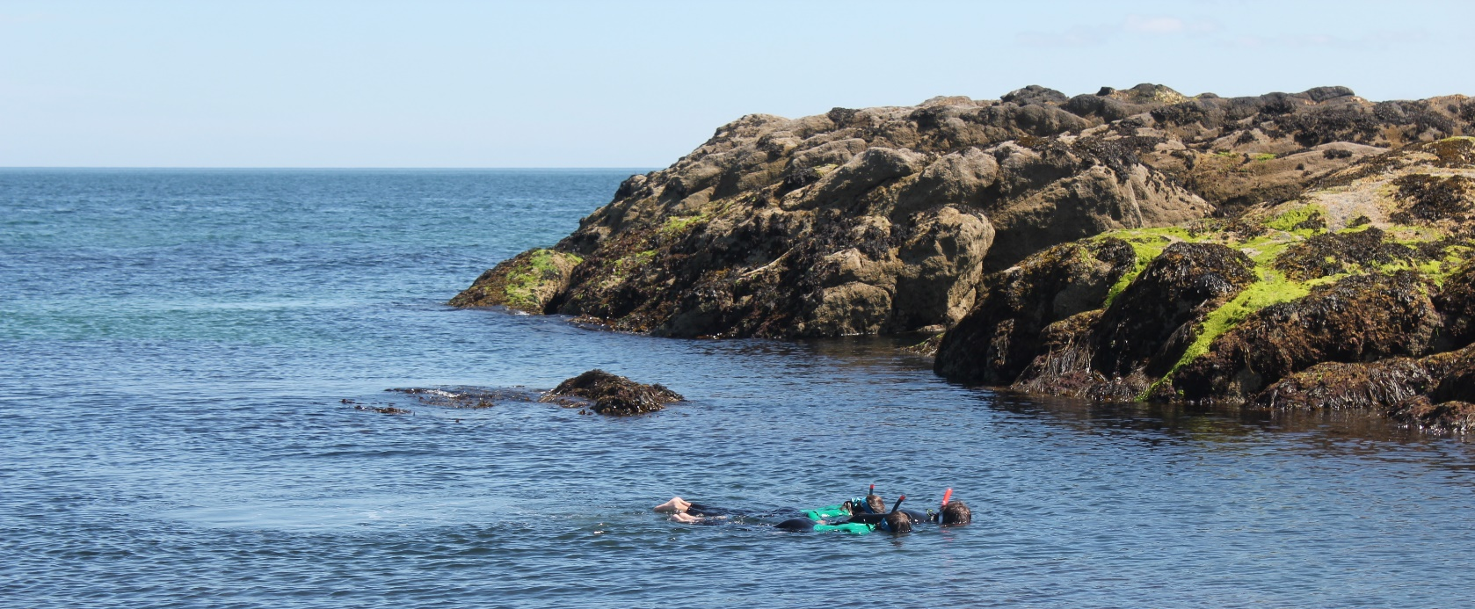
Conclusions
Please try to reproduce and/or explain this.
Read about it here:
  Gabet, et al, (2021) Hilltop Curvature Increases with the Square Root of Erosion Rate. Journal of Geophysical Research: Earth Surface, e2020JF005858. https://doi.org/10.1029/2020JF005858
Here is a picture unrelated to the presentation because people like pictures and the presentation didn’t have any.

