Slide 1



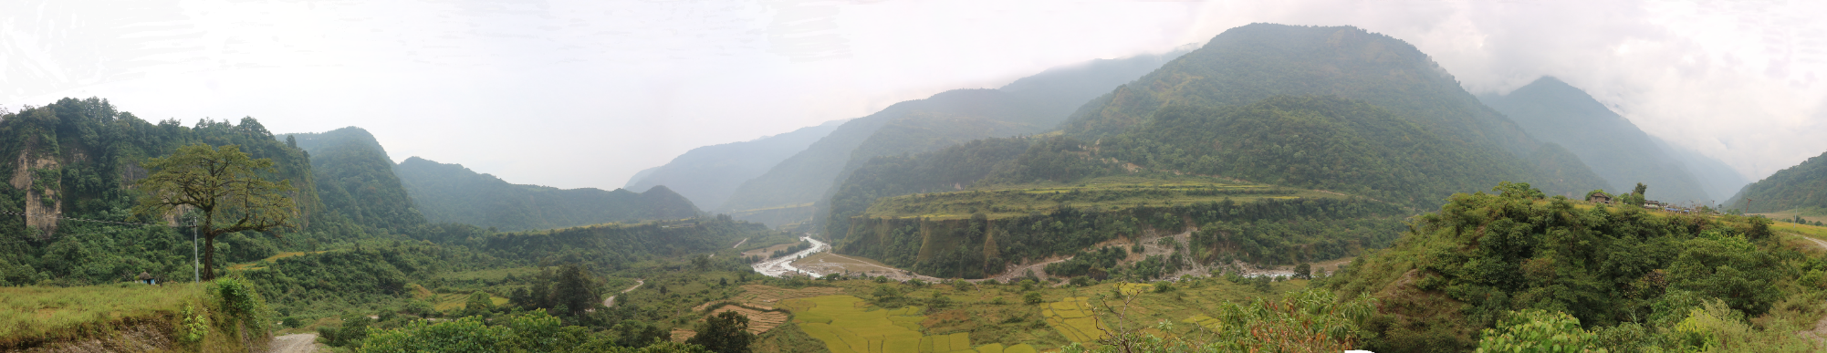
Hydrodynamic modelling of outburst flood hazard in the Pokhara Valley, Nepal
Melanie Fischer¹, Karin Lehnigk², Oliver Korup^{1,3}, Georg Veh¹, and Ariane Walz¹
¹Institute of Environmental Science and Geography, University of Potsdam, Germany
²Department of Geosciences, University of Massachusetts Amherst, United States
³Institute of Geosciences, University of Potsdam, Germany
Correspondence to: Melanie Fischer, melaniefischer@uni-potsdam.de

Slide 2
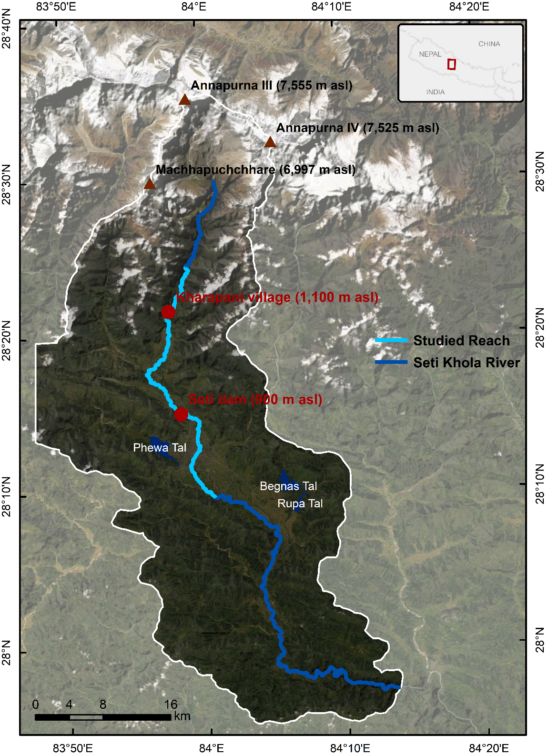
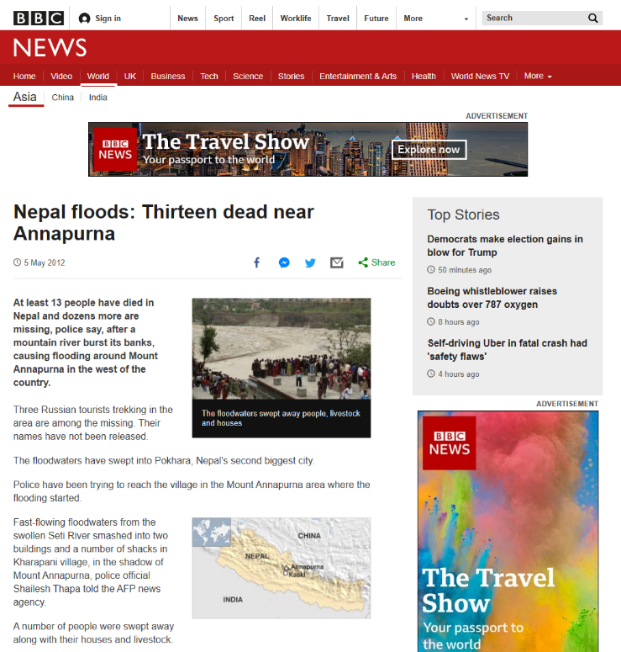
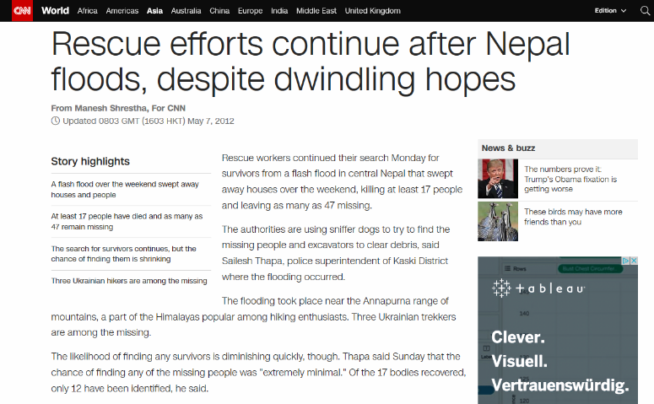
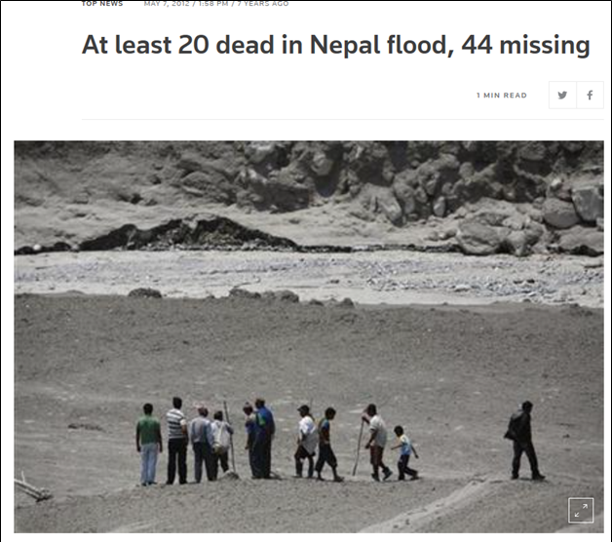
Study Area – Pokhara Valley Overview
1st Objective: Reconstruction of the Seti Khola Flood Disaster (5th May 2012)
72 fatalities, damage to infrastructure (bridges and water supply system), estimated loss of 49.25 million NPR (c. 390,000 €)
Cascading or multihazard event along high topographic gradient
7500 m asl
  Rockslide
  Lake formation
  Ice-rock avalanche
  Hyperconcentrated flood
1100 m asl
Watch video-footage of the event here:
https://www.youtube.com/watch?v=DR4lRcSMKRQ
And post-event footage here: https://www.youtube.com/watch?v=0znR1rm6eK4
International media attention in the days after the event

Slide 3
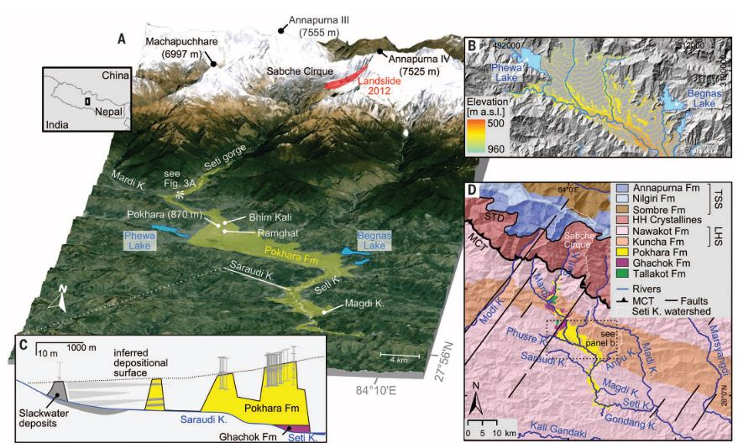
Study Area – Pokhara Valley Overview
2nd Objective: Simulation of potential future events
Informed by widespread fluvial and debris-flow deposits found in the valley‘s recent and geological history
Valley fill records post-glacial to mediaeval events covering hundreds of km² (Tallakot, Ghachok, and Pokhara Formations)
Overview of the Pokhara valley‘s topography and geology. Note the fan-shaped Pokhara Formation, the youngest alluvial depositional unit of the valley‘s sediment fill sequence (Schwanghart et al. 2016).

Slide 4
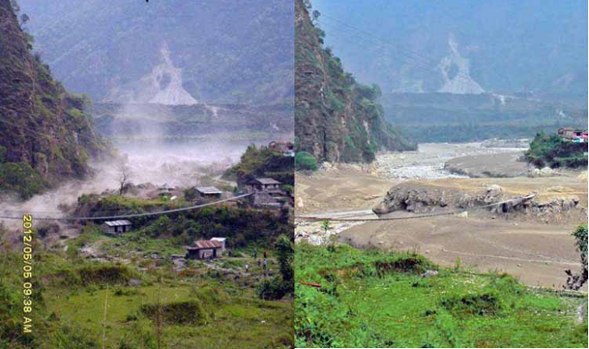
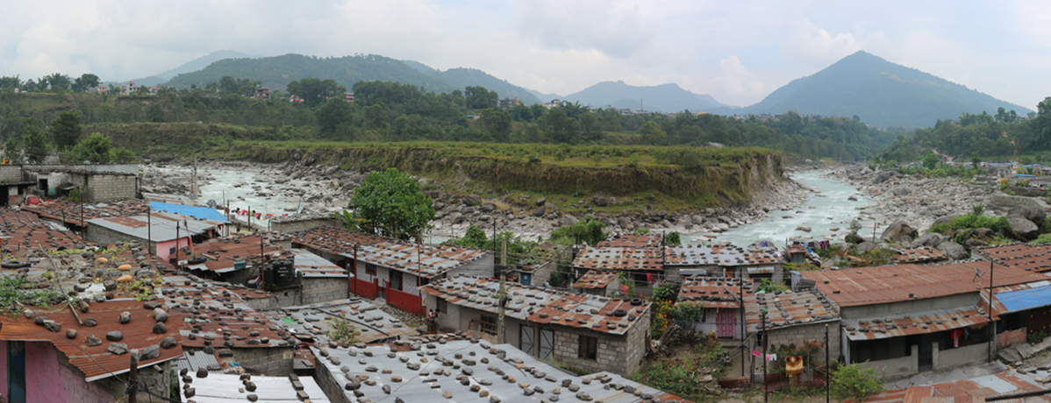
Study Area – Focus Locations
Kharapani village during and after the 2012 flood (modified after Oi et al. 2015)
Kaseri – a settlement of squatters – located directly on the bank of the Seti Khola at the Seti dam location

Slide 5
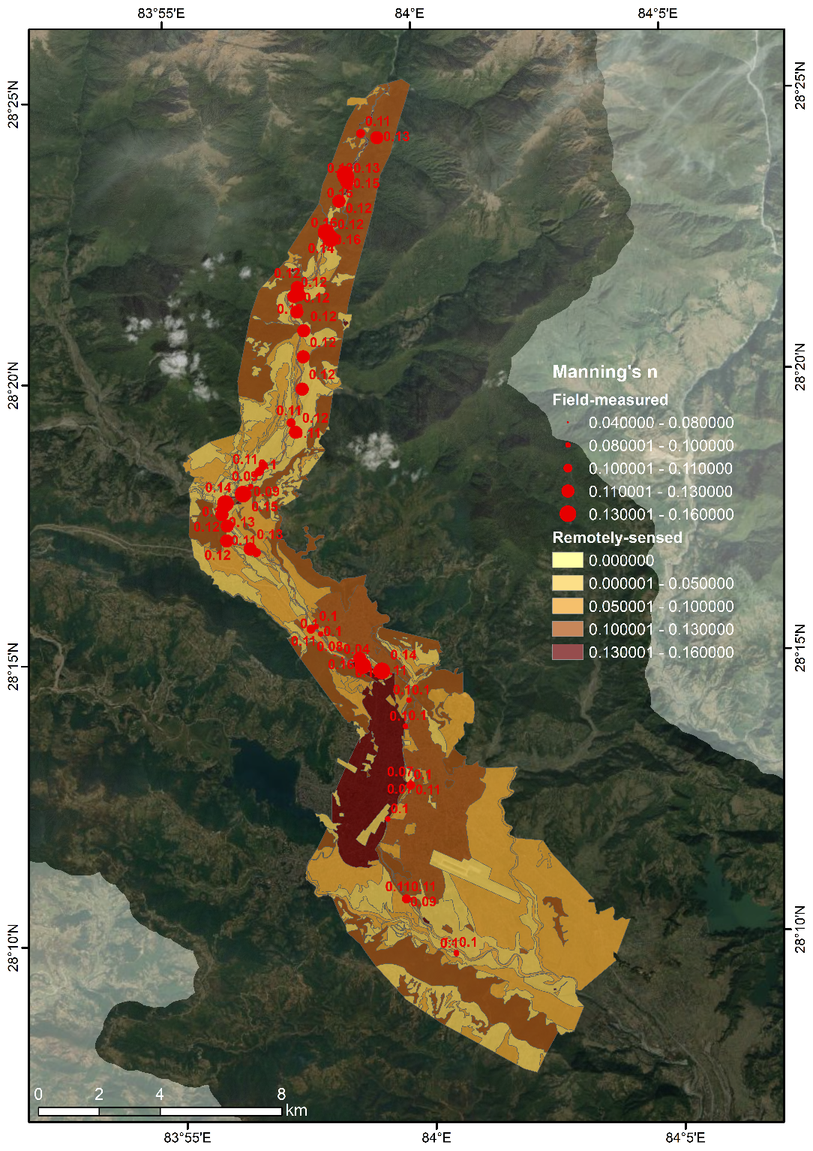
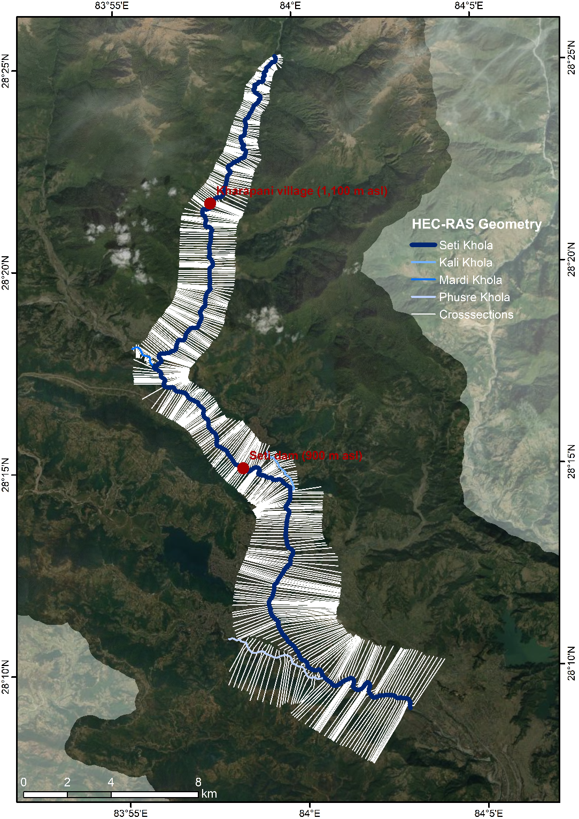
Methods – Hydrodynamic modelling
Steady-state models:
HEC-RAS
  One-dimensional
  25 m² resolution
  Suitable for peak discharges <10,000 m³/s
ANUGA
  Two-dimensional
  2500 m² resolution
  Suitable for peak discharges >10,000 m³/s
Data input:
  ALOS 5 m DEM
  Manning‘s n
  2012-flood-markers
  570 crosssections (field-measured and DEM-derived)
  combination of remote-sensing and field work to minimise modelling uncertainties

Slide 6
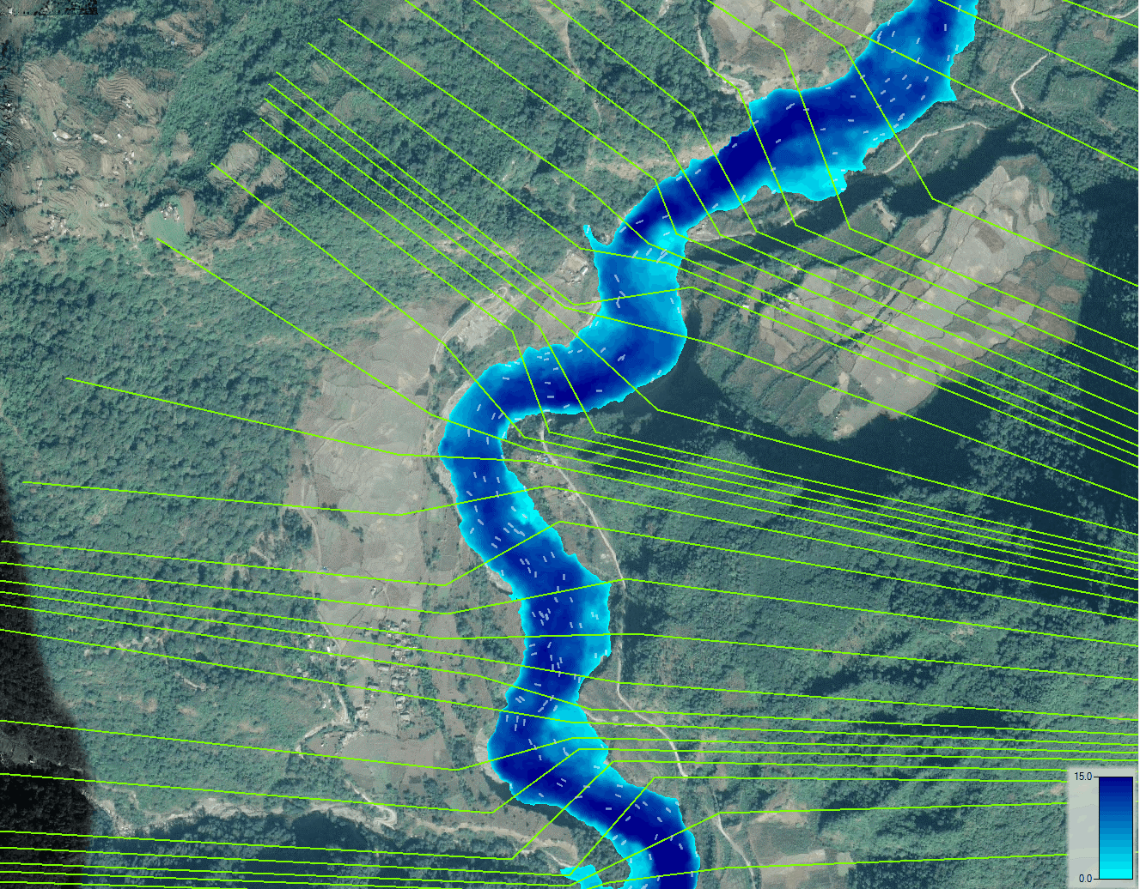

Results – HEC-RAS at Kharapani village location
Location: Kharapani village
Most damages and fatalities in this area
Eyewitnesses reported ice blocks within the flood
Gurung et al. (2015) estimated 8400 m³/s maximum peak discharge
HEC-RAS model:
  1D, steady state in mixed-flow regime
  8400 m³/s as flow boundary condition to test Gurung et al.‘s (2015) estimate
Inundation depth [m]
Click here to start video!

Slide 7
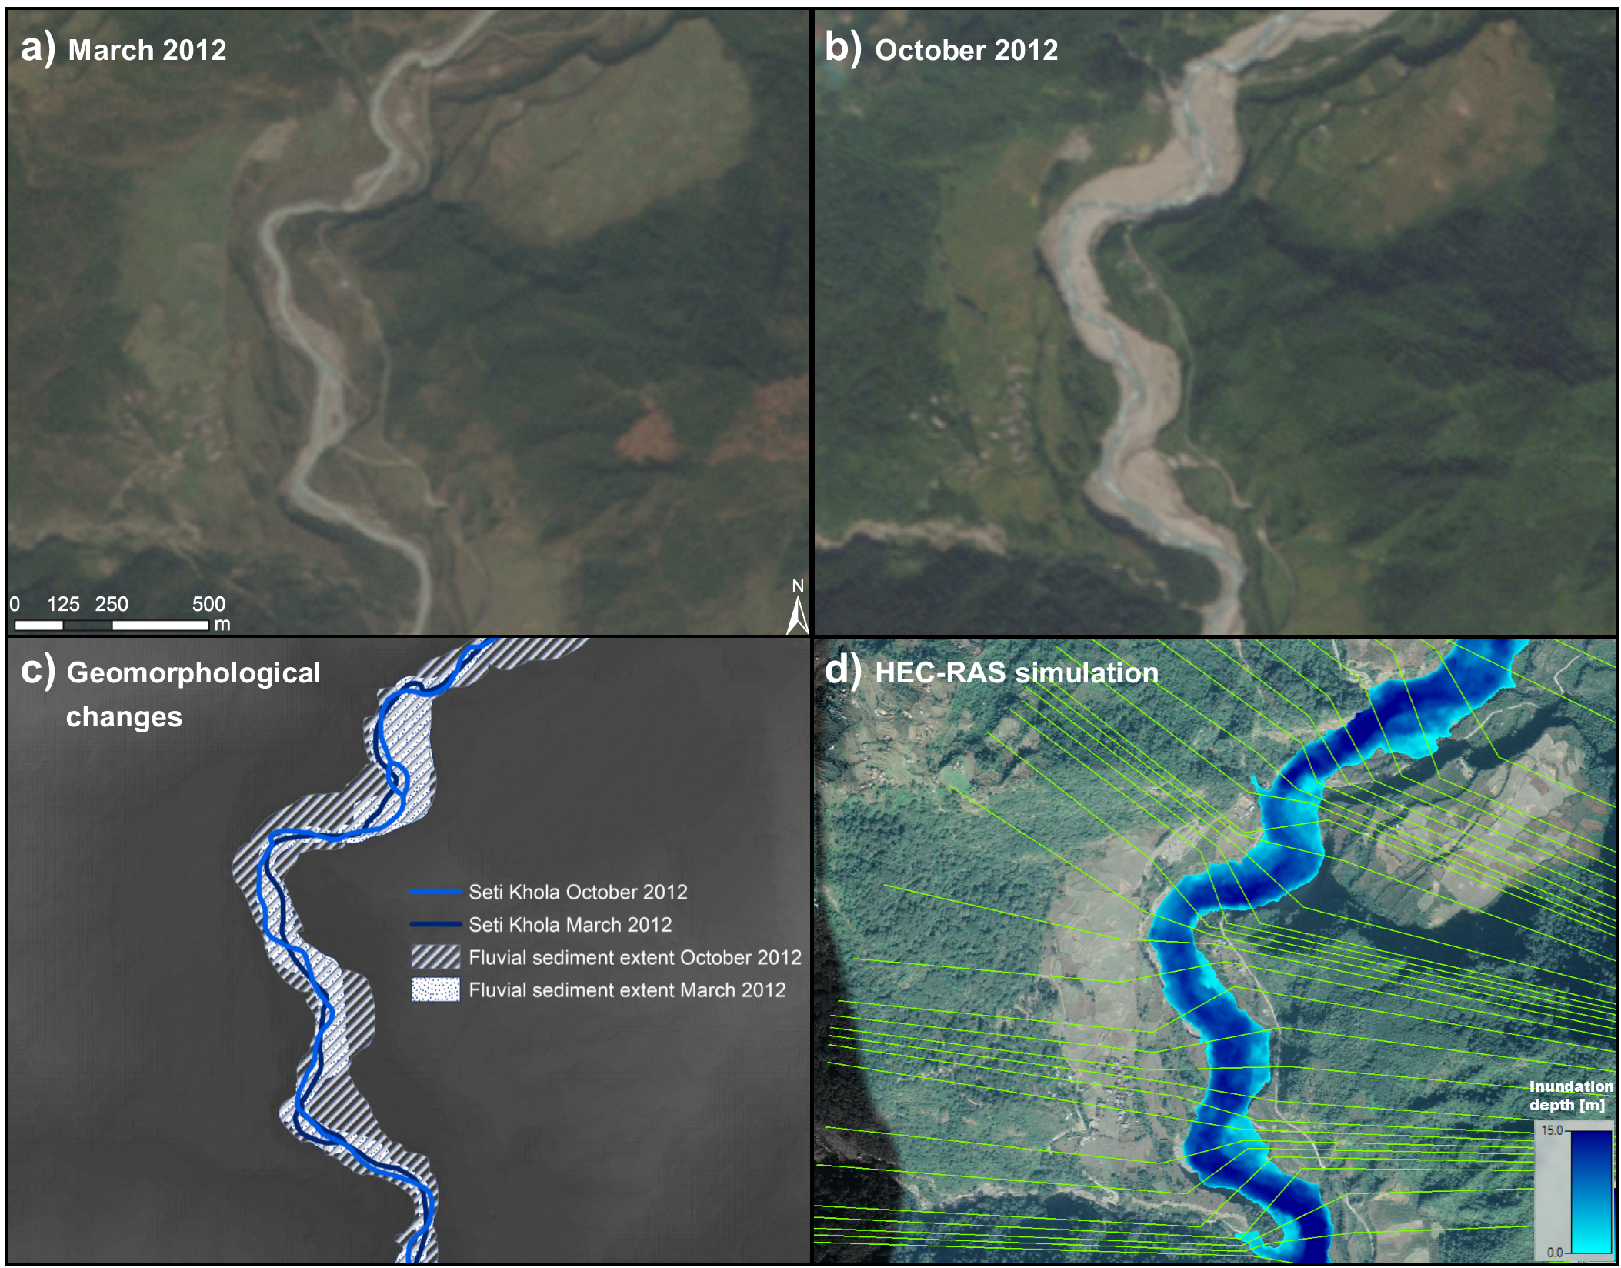
Results – HEC-RAS at Kharapani village location
Location: Kharapani village
Most damages and fatalities in this area
Eyewitnesses report ice blocks within the flood
Gurung et al. (2015) estimated 8400 m³/s maximum peak discharge
HEC-RAS model:
  1D, steady state in mixed-flow regime
  8400 m³/s as flow boundary condition to test Gurung et al.‘s (2015) estimate
  Simulated inundation extents in agreement with field-measured flood markers and remotely-sensed fluvial sediments
RapidEye scenes acquired before (22/03/2012, a) and after (18/10/2012, b) the May 2012 flood at Kharapani; outburst sediment extents and channel changes of the Seti Khola (c); inundation depth for a simulated peak discharge of 8400 m³/s (Gurung et al. 2015) using HEC-RAS (d).

Slide 8
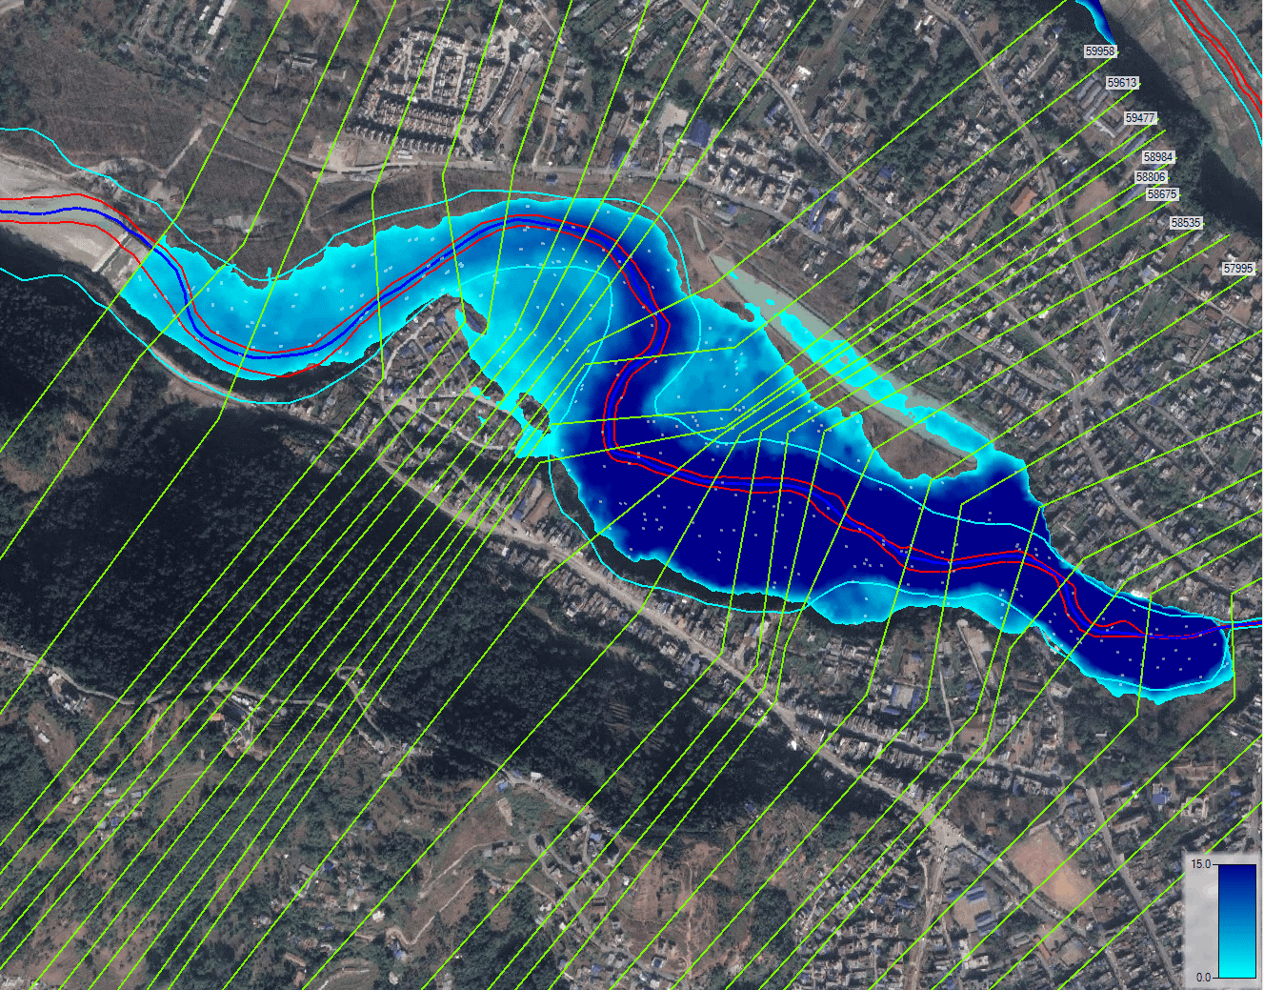

Results – HEC-RAS at Seti dam location
Location: Seti Dam
Densely populated settlement of squatters on lowermost terrace
SANDRP (2014) estimated 935 m³/s peak discharge and 2.15 m water level at dam
HEC-RAS model:
  1D, steady state in subcritical-flow regime
  935 m³/s as flow boundary condition to test SANDRP (2014) estimate
Inundation depth [m]
Click here to start video!

Slide 9
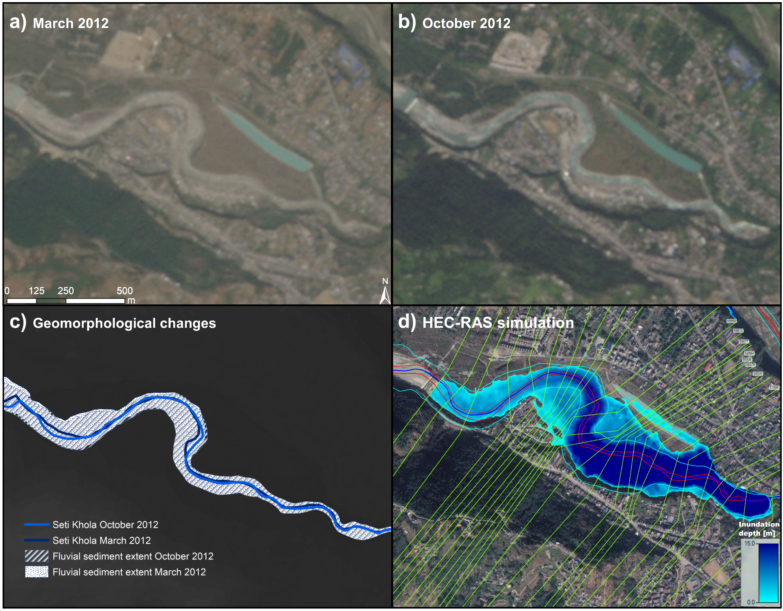
Results – HEC-RAS at Seti dam location
Location: Seti Dam
Densely populated settlement of squatters on lowermost terrace
SANDRP (2014) estimated 935 m³/s peak discharge and 2.15 m water level at dam
HEC-RAS model:
  1D, steady state in subcritical-flow regime
  935 m³/s as flow boundary condition to test SANDRP (2014) estimate
  Simulated inundation extents are inconsistent with remotely-sensed fluvial sediments and reported damage
RapidEye scenes acquired before (22/03/2012, a) and after (18/10/2012, b) the May 2012 flood at the Seti dam; sediment extents and channel changes of the Seti Khola (c); inundation depth for a simulated discharge of 935 m³/s (SANDRP 2014) using HEC-RAS (d).

Slide 10
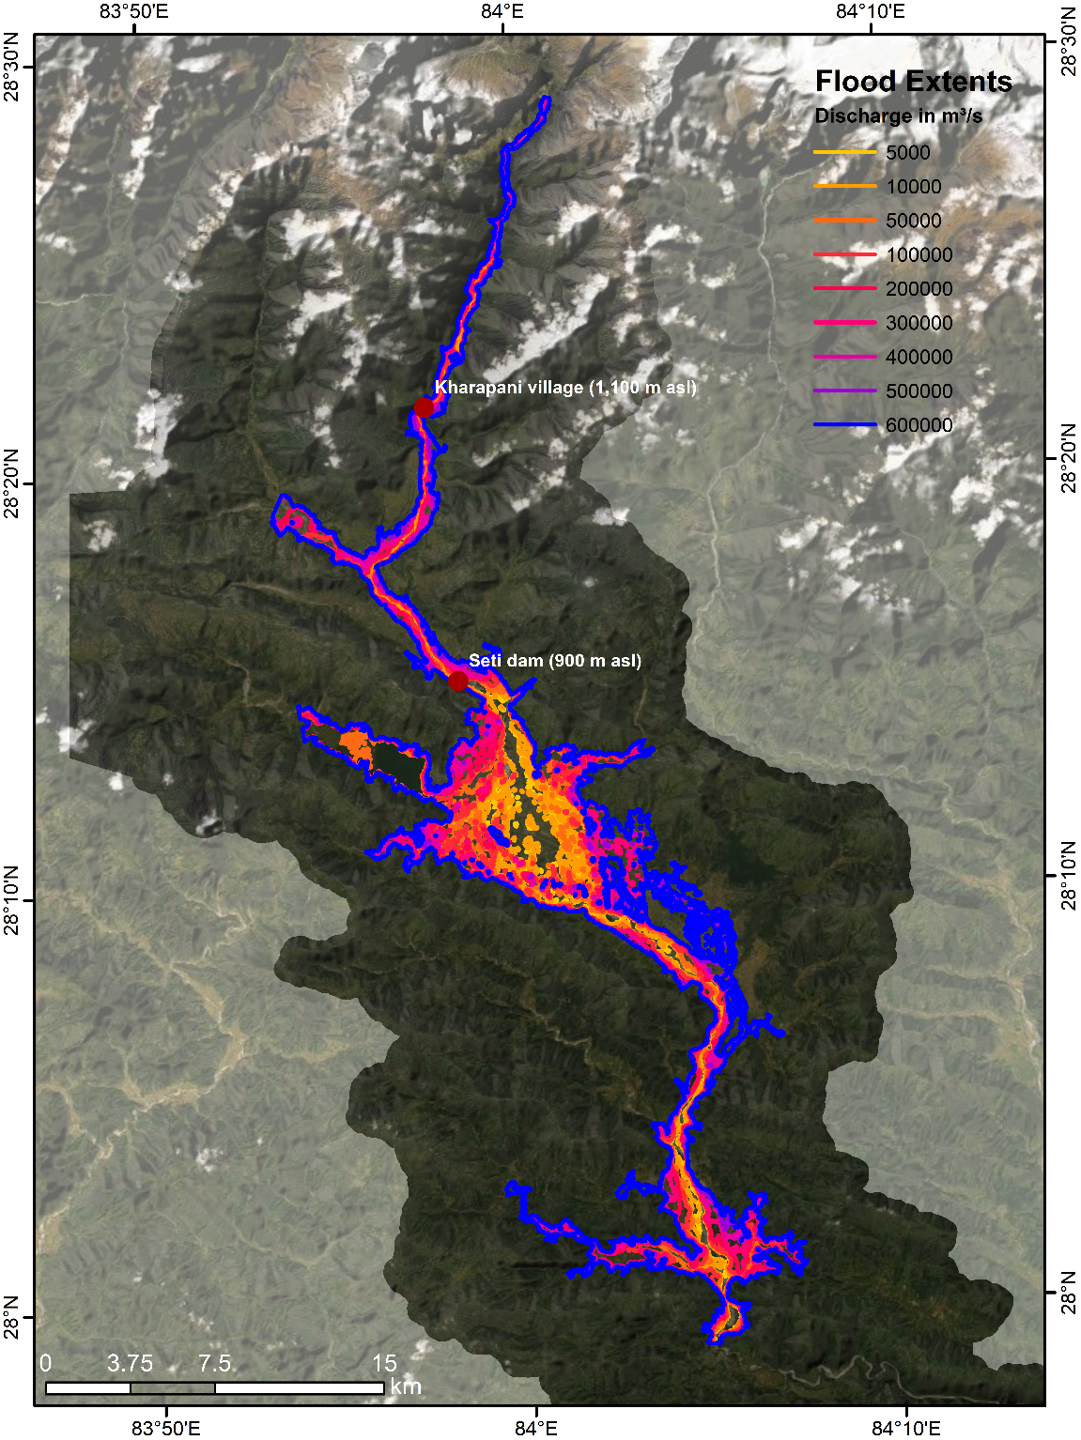
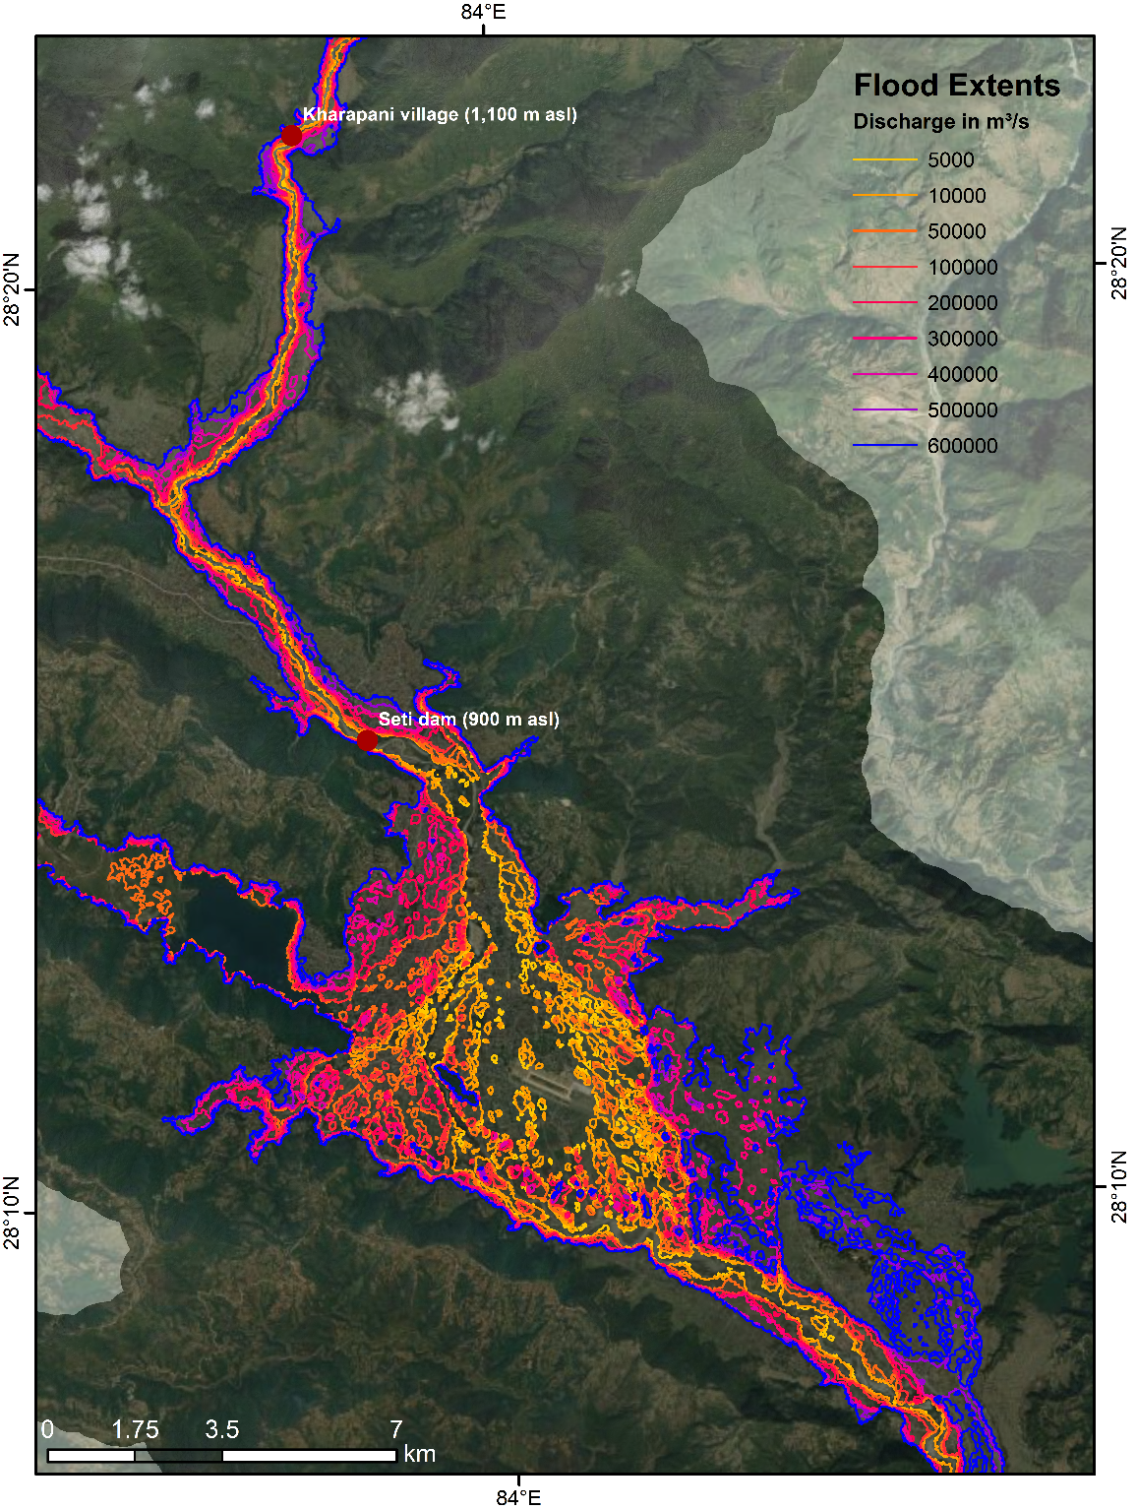
Results - ANUGA models
Simulation of potential future outburst scenarios with a wide range of magnitudes
5,000 to 600,000 m³/s peak discharges
Backwater effect causing extensive flooding in tributary valleys for peak discharges >100,000 m³/s
Alluvial fan deposits may promote lateral spread of overbank flow

Slide 11
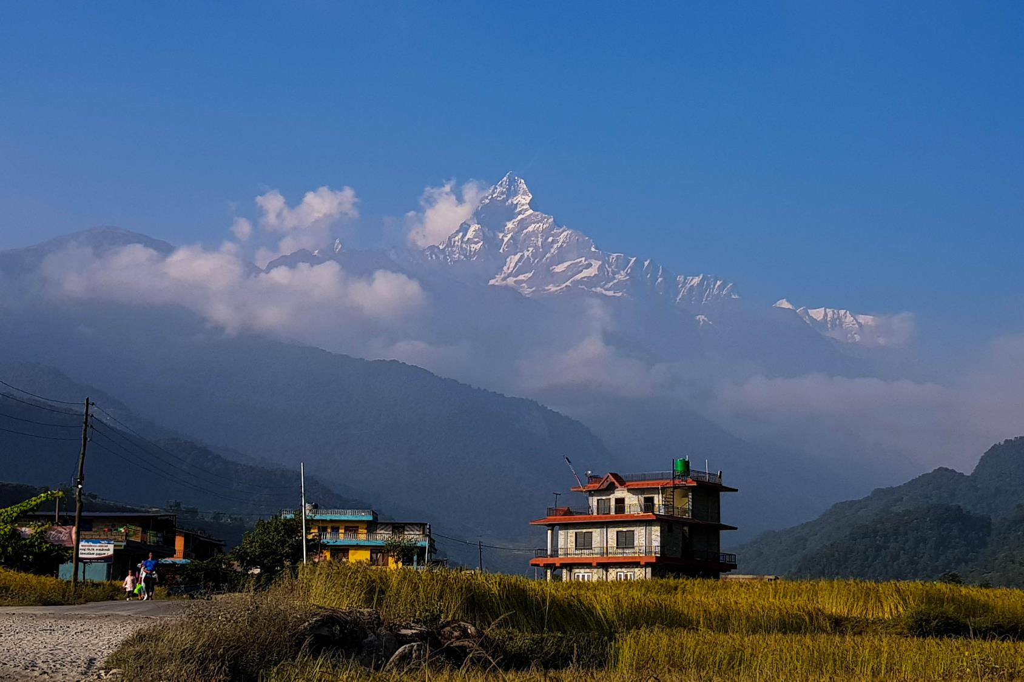
Take Home Message
Pokhara: a fast-growing city located in a valley prone to outburst floods!
HEC-RAS reconstructions: only partially supporting previous (empirical) assessments of the May 2012 Seti Khola Flood Disaster
Backwater effects: large events (>100,000 m³/s) could cause extensive flooding of tributary valleys for several kilometres upstream

Slide 12
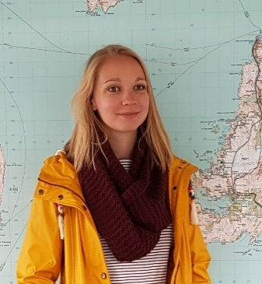



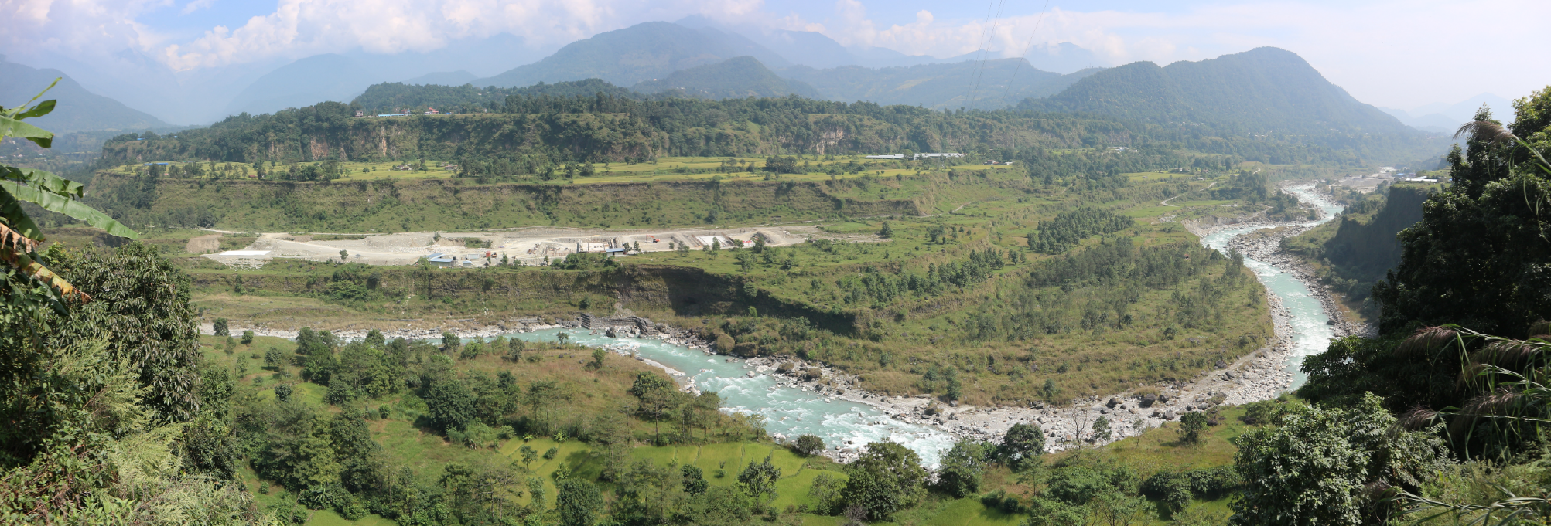
melaniefischer@uni-potsdam.de
@GeoMelFi1
Melanie Fischer
(https://www.researchgate.net/profile/Melanie-Fischer)
Acknowledgements
A big thank you to Elisabeth Schönfeldt, Monique Fort, and Narayan Gurung for their support in the field!
This research is funded by the Deutsche Forschungsgemeinschaft (DFG) via the graduate research training group NatRiskChange (GRK 2043/1, 2043/2) at the University of Potsdam (https://www.natriskchange.de).
Contact me!

