Slide 1



Comparative analysis of global ionospheric models used in GNSS data processing based on selected stations
Paulina Woźniak
pwozniak@cbk.waw.pl
Anna Świątek
ana@cbk.waw.pl
Leszek Jaworski
Space Research Centre
Polish Academy of Sciences
Warsaw, Poland
European Geosciences Union General Assembly
vEGU21: Gather Online | 19-30 April 2021

Slide 2


Table of contents
Basics & data
  theoretical introduction
  motivation
  considered data
Results
  NeQuick vs IONEX – global TEC maps
  NeQuick vs IONEX – month statistics for selected stations
  station coordinates
Summary
Comparative analysis of global ionospheric models used in GNSS data processing based on selected stations | Table of contents
P. Woźniak, A. Świątek, L. Jaworski

Slide 3
Basics & data
Comparative analysis of global ionospheric models used in GNSS data processing based on selected stations | Table of contents
P. Woźniak, A. Świątek, L. Jaworski

Slide 4
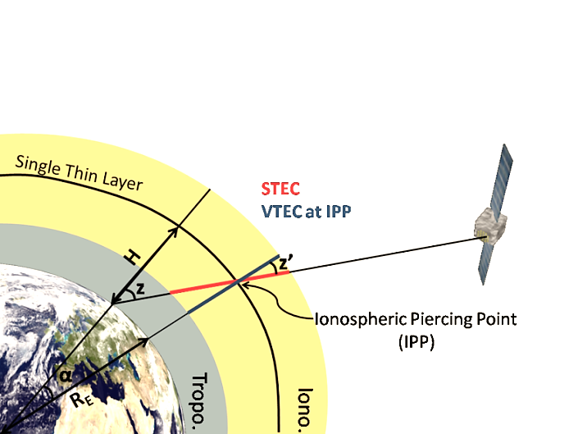
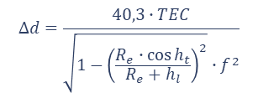
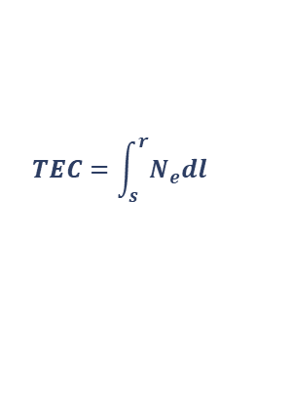

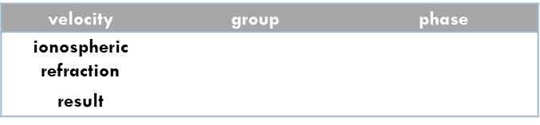
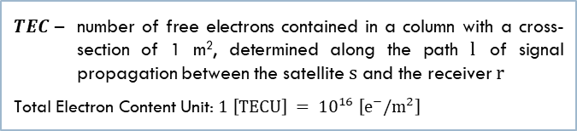

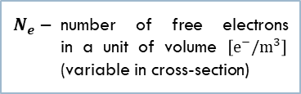
Ionosphere impact on GNSS observations
Number of e⁻
Total Electron Content
$N_{e}$ – number of free electrons
in a unit of volume $\left[e^{−}/m^{3}\right]$
(variable in cross-section)
$$TEC=\int_{s}^{r}{N_{e}dl}$$
$TEC$ – number of free electrons contained in a column with a cross- section of 1 m², determined along the path $l$ of signal propagation between the satellite $s$ and the receiver $r$
Total Electron Content Unit: $1 \left[TECU\right] = {10}^{16} \left[e^{−}/m^{2}\right]$
$$M\left(z\right)=\frac{1}{\cos{z′}}$$
$$∆d=\frac{40,3∙TEC}{\sqrt{1−{\left(\frac{R_{e}∙\cos{h_{t}}}{R_{e}+h_{l}}\right)}^{2}}∙f^{2}}$$
velocity | group | phase
ionospheric refraction | $${δI}_{gr}=+\frac{40,3 TEC}{f^{2}}$$ | $${δI}_{ph}=−\frac{40,3 TEC}{f^{2}}$$
result
VTEC – vertical TEC
STEC – slant TEC
$$\sin{z′}=\frac{R_{E}}{R_{E}+H}\sin{z}$$
Single Layer Model
Ionospheric Pierce Point
SLM – in the GNSS data processing, a constant value of the maximum
electron concentration height
for the entire globe; commonly determined altitude of 450 km
IPP – intersection of the ionosphere by the satellite signal
in an approximated single layer located at the average height of the maximum electron concentration
Credit: Royal Observatory
of Belgium GNSS Research Group (http://gnss.be/ionosphere_tutorial.php)
Comparative analysis of global ionospheric models used in GNSS data processing based on selected stations | Table of contents
P. Woźniak, A. Świątek, L. Jaworski

Slide 5
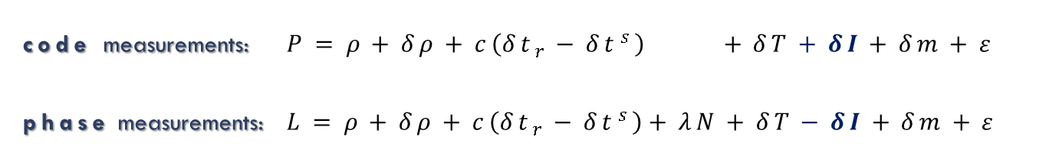
GNSS positioning – observational equations
geometric distance
between the satellite
and the receiver
ionospheric refraction
satellite and receiver
clock errors
receiver noise
observed pseudorange
code measurements: $P=ρ+δρ+c\left({δt}_{r}−{δt}^{s}\right) +δT+δI+δm+ε$
phase measurements: $L=ρ+δρ+c\left({δt}_{r}−{δt}^{s}\right)+λN+δT−δI+δm+ε$
carrier
wavelength
observed
carrier phase
multipath
orbital errors
carrier phase ambiguity
tropospheric refraction
Comparative analysis of global ionospheric models used in GNSS data processing based on selected stations | Table of contents
P. Woźniak, A. Świątek, L. Jaworski

Slide 6
Motivation
Grounds
Actions
the ionosphere is an important factor in GNSS positioning
in the case of single-frequency measurements,
the influence of the ionosphere is compensated
on the basis of ionospheric models
NeQuick model has significantly different characteristic than various solutions provided by IGS
despite the fact that the NeQuick model is dedicated
to the Galileo system, it can be used for other GNSS
comparison of gobal TEC map for the NeQuick
and IGS solution
examination of the NeQuick model for stations
in equatorial localizations
analysis of the relationship between the K-index and the level of the TEC parameter
comparison of station positioning results using single-frequency GPS observations
and various TEC maps
Objectives
compliance verification of the NeQuick model with IGS solution in low latitudes
determining the influence of the choice of ionospheric refraction compensation method on the GNSS positioning results
Comparative analysis of global ionospheric models used in GNSS data processing based on selected stations | Table of contents
P. Woźniak, A. Świątek, L. Jaworski

Slide 7
Considered data – TEC maps
model | IGS (International GNSS Service) | NeQuick-G
institution | AIUB (Astronomical Institute of the University of Bern) | ICTP (Abdus Salam International Center of Theoretical Physics) University of Graz ESA (European Space Agency)
area | global | global
spatial resolution | 2.5° x 5.0° | 2.5° x 5.0°
time resolution | 1 h | 1 h
source | CDDIS FTP (Crustal Dynamics Data Information System) | dedicated application by European Space Agency
Comparative analysis of global ionospheric models used in GNSS data processing based on selected stations | Table of contents
P. Woźniak, A. Świątek, L. Jaworski

Slide 8
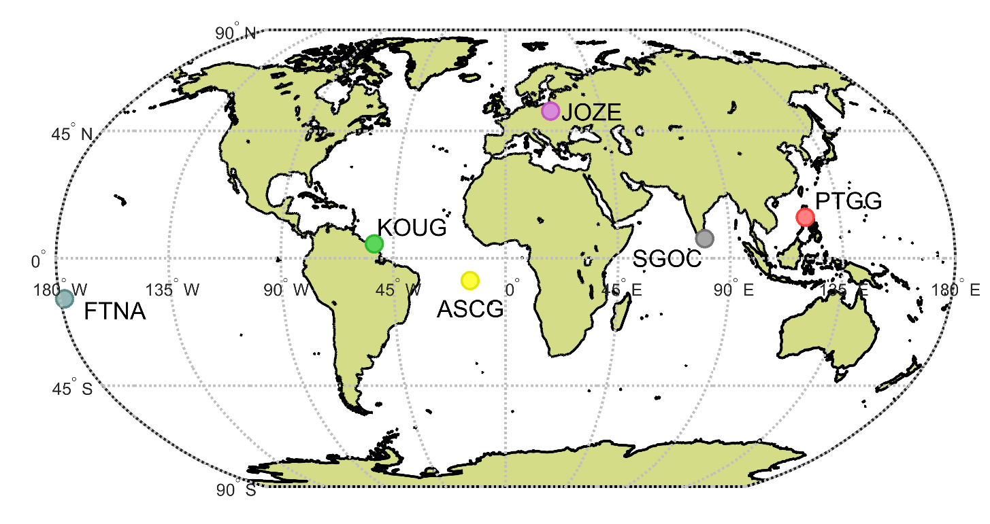
Considered data – GNSS files and stations map
GPS observational data (final, 30 s)
precise satellite clock data (5 s)
precise satellite ephemeris
computation approaches:
  single-frequency (L1) observations
  + TEC map (NeQuick)
  single-frequency (L1) observations
  + TEC map (IGS\AIUB)
  iono-free combination (L3)
software: RTKLIB ver. 2.4.2
Comparative analysis of global ionospheric models used in GNSS data processing based on selected stations | Table of contents
P. Woźniak, A. Świątek, L. Jaworski

Slide 9
Considered data – GNSS stations
station | city | country | latitude [deg] | longitude [deg] | height [m]
ASCG | Ascension Island | Saint Helena, Ascension and Tristan Da Cunha | -7.916 | -14.333 | 37.953
FTNA | Maopo'opo | French Polynesia | -14.308 | -178.121 | 84.859
CBKA | Warsaw | Poland | 52.215 | 21.068 | 125.194
JOZE |  |  | 52.097 | 21.032 | 141.400
KOUG | Kourou | French Guiana | 5.098 | -52.640 | 107.248
PTGG | Taguig City | Philippines | 14.535 | 121.041 | 86.944
SGOC | Narahenpita, Colombo | Sri Lanka | 6.892 | 79.874 | -78.500
Comparative analysis of global ionospheric models used in GNSS data processing based on selected stations | Table of contents
P. Woźniak, A. Świątek, L. Jaworski

Slide 10
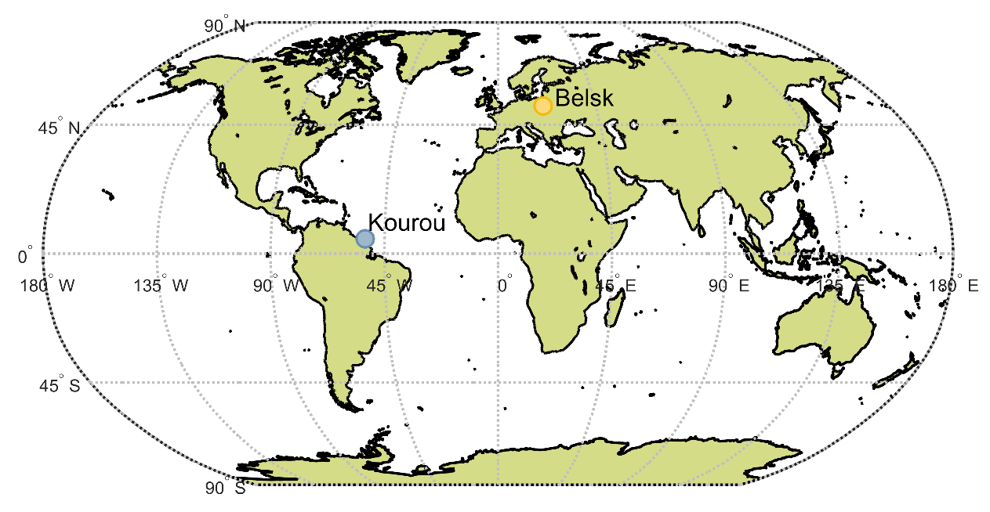
Considered data – K-index
K-index:
used to characterize the magnitude
of geomagnetic storms
quantifies disturbances in the horizontal component of Earth's magnetic field with an integer in the range 0–9
  1 – calm
  5 or more – geomagnetic storm
derived from the maximum fluctuations of horizontal components observed
on a magnetometer during a three-hour interval
Comparative analysis of global ionospheric models used in GNSS data processing based on selected stations | Table of contents
P. Woźniak, A. Świątek, L. Jaworski

Slide 11
Results
NeQuick vs IGS\AIUB – global TEC maps
Comparative analysis of global ionospheric models used in GNSS data processing based on selected stations | Table of contents
P. Woźniak, A. Świątek, L. Jaworski

Slide 12
Introduction – global TEC maps
in the presented research stage, the TEC maps for NeQuick and AIUB models were prepared
and the differences between them were determined
for each day of 2019, visualizations and lists of statistical parameters were generated
the presented maps contain examples of results for selected dates:
  3 June, when the ionosphere was quiet and the TEC parameter was at a low level all day long
  and did not exceed 30 TECU
  29 October, when the ionospheric conditions were disturbed and the TEC parameter
  reached the level of 45 TECU
Comparative analysis of global ionospheric models used in GNSS data processing based on selected stations | Table of contents
P. Woźniak, A. Świątek, L. Jaworski

Slide 13
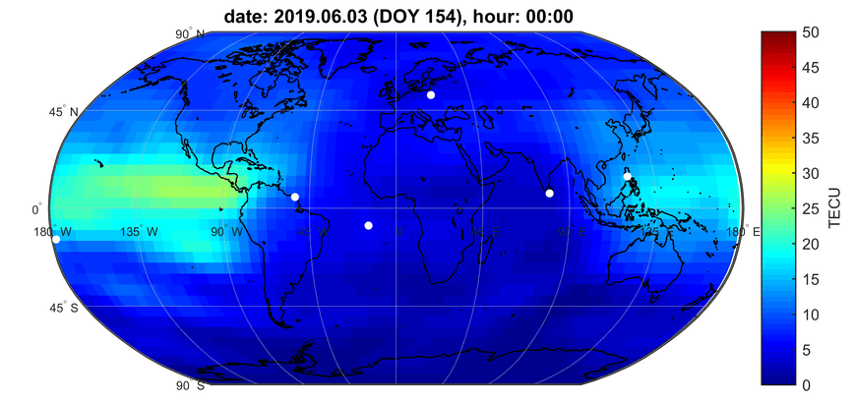
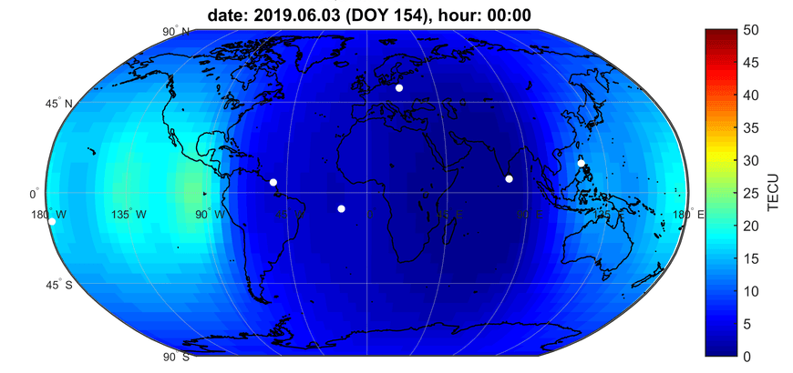
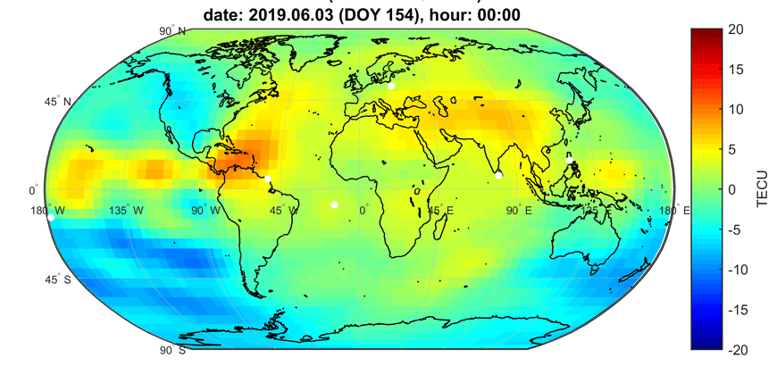
3 June 2019 – quiet ionospheric conditions
AIUB
NeQuick
CBKA
CBKA
KOUG
SGOC
PTGG
KOUG
SGOC
PTGG
FTNA
ASCG
FTNA
ASCG
differences
CBKA
KOUG
SGOC
PTGG
FTNA
ASCG
Comparative analysis of global ionospheric models used in GNSS data processing based on selected stations | Table of contents
P. Woźniak, A. Świątek, L. Jaworski

Slide 14
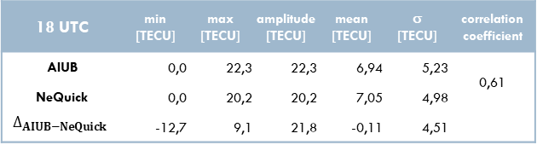
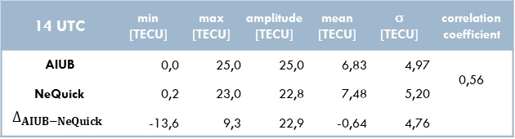
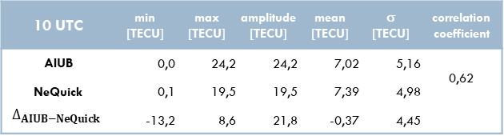
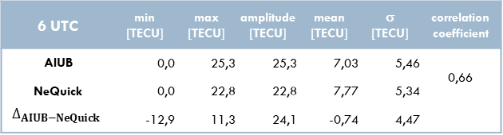
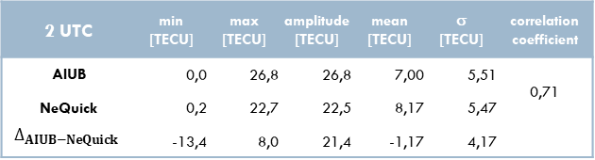
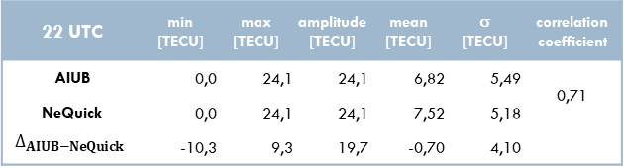
3 June 2019 – statistical parameters
2 UTC | min [TECU] | max [TECU] | amplitude [TECU] | mean [TECU] | σ [TECU] | correlation coefficient
AIUB | 0,0 | 26,8 | 26,8 | 7,00 | 5,51 | 0,71
NeQuick | 0,2 | 22,7 | 22,5 | 8,17 | 5,47
$$∆_{AIUB−NeQuick}$$ | -13,4 | 8,0 | 21,4 | -1,17 | 4,17
6 UTC | min [TECU] | max [TECU] | amplitude [TECU] | mean [TECU] | σ [TECU] | correlation coefficient
AIUB | 0,0 | 25,3 | 25,3 | 7,03 | 5,46 | 0,66
NeQuick | 0,0 | 22,8 | 22,8 | 7,77 | 5,34
$$∆_{AIUB−NeQuick}$$ | -12,9 | 11,3 | 24,1 | -0,74 | 4,47
10 UTC | min [TECU] | max [TECU] | amplitude [TECU] | mean [TECU] | σ [TECU] | correlation coefficient
AIUB | 0,0 | 24,2 | 24,2 | 7,02 | 5,16 | 0,62
NeQuick | 0,1 | 19,5 | 19,5 | 7,39 | 4,98
$$∆_{AIUB−NeQuick}$$ | -13,2 | 8,6 | 21,8 | -0,37 | 4,45
14 UTC | min [TECU] | max [TECU] | amplitude [TECU] | mean [TECU] | σ [TECU] | correlation coefficient
AIUB | 0,0 | 25,0 | 25,0 | 6,83 | 4,97 | 0,56
NeQuick | 0,2 | 23,0 | 22,8 | 7,48 | 5,20
$$∆_{AIUB−NeQuick}$$ | -13,6 | 9,3 | 22,9 | -0,64 | 4,76
18 UTC | min [TECU] | max [TECU] | amplitude [TECU] | mean [TECU] | σ [TECU] | correlation coefficient
AIUB | 0,0 | 22,3 | 22,3 | 6,94 | 5,23 | 0,61
NeQuick | 0,0 | 20,2 | 20,2 | 7,05 | 4,98
$$∆_{AIUB−NeQuick}$$ | -12,7 | 9,1 | 21,8 | -0,11 | 4,51
22 UTC | min [TECU] | max [TECU] | amplitude [TECU] | mean [TECU] | σ [TECU] | correlation coefficient
AIUB | 0,0 | 24,1 | 24,1 | 6,82 | 5,49 | 0,71
NeQuick | 0,0 | 24,1 | 24,1 | 7,52 | 5,18
$$∆_{AIUB−NeQuick}$$ | -10,3 | 9,3 | 19,7 | -0,70 | 4,10
Comparative analysis of global ionospheric models used in GNSS data processing based on selected stations | Table of contents
P. Woźniak, A. Świątek, L. Jaworski

Slide 15
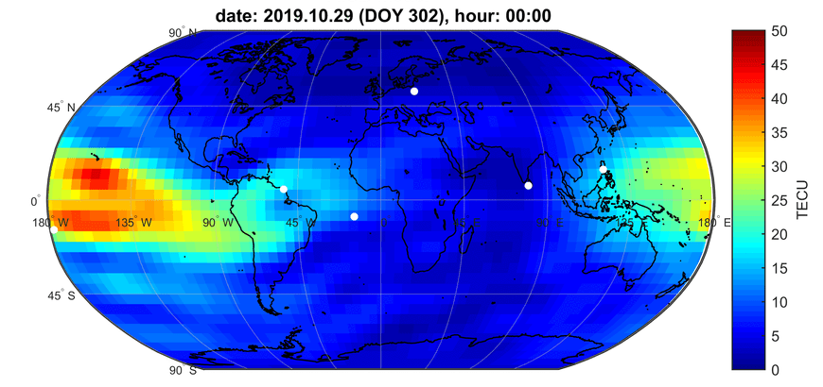
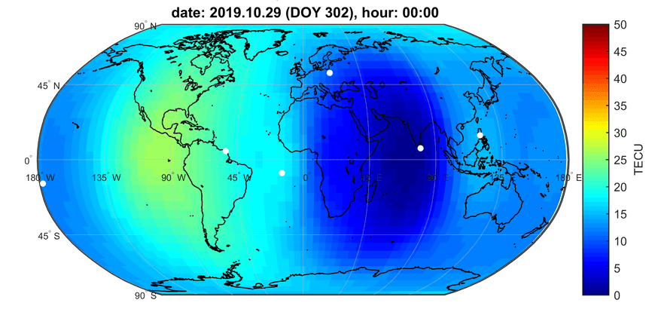
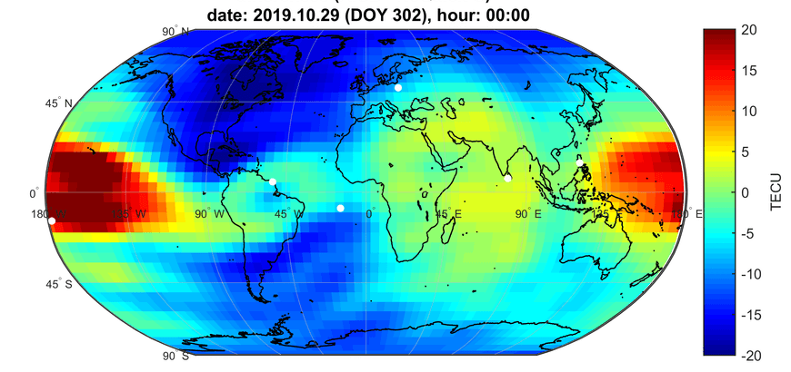
29 October 2019 – disturbed ionospheric conditions
AIUB
NeQuick
CBKA
CBKA
KOUG
SGOC
PTGG
KOUG
SGOC
PTGG
FTNA
ASCG
FTNA
ASCG
differences
CBKA
KOUG
SGOC
PTGG
FTNA
ASCG
Comparative analysis of global ionospheric models used in GNSS data processing based on selected stations | Table of contents
P. Woźniak, A. Świątek, L. Jaworski

Slide 16
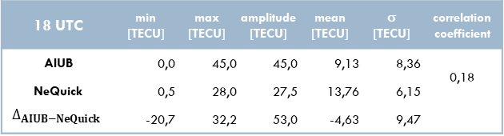
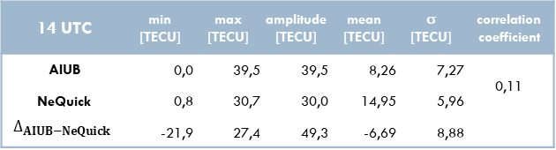
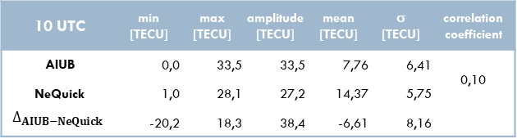
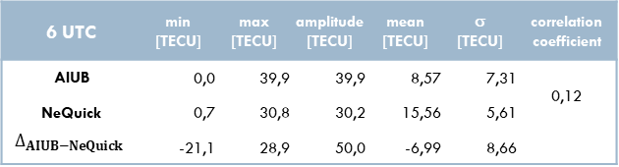

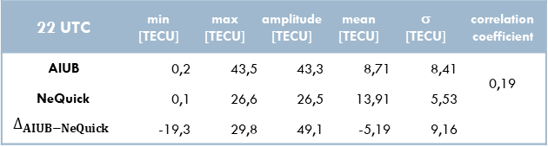
29 October 2019 – statistical parameters
2 UTC | min [TECU] | max [TECU] | amplitude [TECU] | mean [TECU] | σ [TECU] | correlation coefficient
AIUB | 0,5 | 37,0 | 36,5 | 8,46 | 7,35 | 0,13
NeQuick | 0,9 | 29,3 | 28,4 | 15,23 | 5,90
$$∆_{AIUB−NeQuick}$$ | -22,6 | 21,5 | 44,0 | -6,76 | 8,81
6 UTC | min [TECU] | max [TECU] | amplitude [TECU] | mean [TECU] | σ [TECU] | correlation coefficient
AIUB | 0,0 | 39,9 | 39,9 | 8,57 | 7,31 | 0,12
NeQuick | 0,7 | 30,8 | 30,2 | 15,56 | 5,61
$$∆_{AIUB−NeQuick}$$ | -21,1 | 28,9 | 50,0 | -6,99 | 8,66
10 UTC | min [TECU] | max [TECU] | amplitude [TECU] | mean [TECU] | σ [TECU] | correlation coefficient
AIUB | 0,0 | 33,5 | 33,5 | 7,76 | 6,41 | 0,10
NeQuick | 1,0 | 28,1 | 27,2 | 14,37 | 5,75
$$∆_{AIUB−NeQuick}$$ | -20,2 | 18,3 | 38,4 | -6,61 | 8,16
14 UTC | min [TECU] | max [TECU] | amplitude [TECU] | mean [TECU] | σ [TECU] | correlation coefficient
AIUB | 0,0 | 39,5 | 39,5 | 8,26 | 7,27 | 0,11
NeQuick | 0,8 | 30,7 | 30,0 | 14,95 | 5,96
$$∆_{AIUB−NeQuick}$$ | -21,9 | 27,4 | 49,3 | -6,69 | 8,88
18 UTC | min [TECU] | max [TECU] | amplitude [TECU] | mean [TECU] | σ [TECU] | correlation coefficient
AIUB | 0,0 | 45,0 | 45,0 | 9,13 | 8,36 | 0,18
NeQuick | 0,5 | 28,0 | 27,5 | 13,76 | 6,15
$$∆_{AIUB−NeQuick}$$ | -20,7 | 32,2 | 53,0 | -4,63 | 9,47
22 UTC | min [TECU] | max [TECU] | amplitude [TECU] | mean [TECU] | σ [TECU] | correlation coefficient
AIUB | 0,2 | 43,5 | 43,3 | 8,71 | 8,41 | 0,19
NeQuick | 0,1 | 26,6 | 26,5 | 13,91 | 5,53
$$∆_{AIUB−NeQuick}$$ | -19,3 | 29,8 | 49,1 | -5,19 | 9,16
Comparative analysis of global ionospheric models used in GNSS data processing based on selected stations | Table of contents
P. Woźniak, A. Świątek, L. Jaworski

Slide 17
Conclusions – global TEC maps
there is a noticeable relationship between the compatibility of both models and local time;
while the differences are not large at night, during the day (approx. 14 LT) they reach a dozen of TECU during the quiet day, and during disturbed conditions – exceed 30 TECU
it can be noticed that the area of the highest TEC values in the equatorial areas in a given day
in the case of the NeQuick model occurs later than in the IGS model
correlation coefficients for a quiet and disturbed day are highly diverse – in the first case they reach 0.7, while in the second – they do not exceed 0.2 (at night) and amount to slightly over 0.1 during the day
Comparative analysis of global ionospheric models used in GNSS data processing based on selected stations | Table of contents
P. Woźniak, A. Świątek, L. Jaworski

Slide 18
Results
NeQuick vs IGS\AIUB – month statistics
for selected stations
Comparative analysis of global ionospheric models used in GNSS data processing based on selected stations | Table of contents
P. Woźniak, A. Świątek, L. Jaworski

Slide 19
Introduction – month statistic for selected stations
the presented results refer to statistical parameters calculated for the following hours of the day,
independently for each month
for each month of 2019, charts of mean values and standard deviation for both subject models
as well as for the differences between them were generated; they refer to the locations
of the selected GNSS stations
the presented bar graphs include exemplary results for selected months:
  June, when the TEC values are relatively low
  October, when the considered statistical parameters reach their highest values throughout the year
as the stations are located in different longitudes, the local noon is marked on each graph (vertical line)
Comparative analysis of global ionospheric models used in GNSS data processing based on selected stations | Table of contents
P. Woźniak, A. Świątek, L. Jaworski

Slide 20
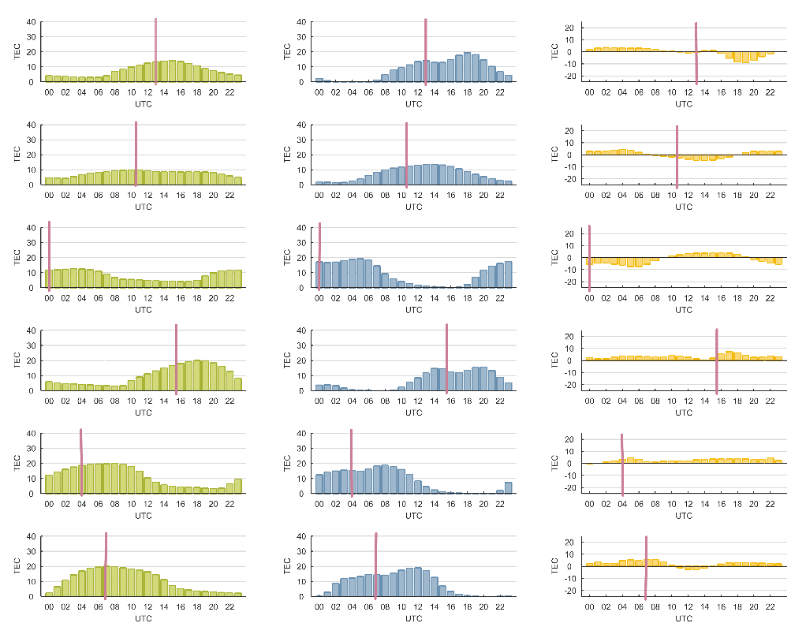
June 2019 – mean TEC for individual hours of the day and sample map
AIUB
NeQuick
differences
CBKA
ASCG
PTGG
AIUB
KOUG
SGOC
FTNA
ASCG
CBKA
FTNA
CBKA
NeQuick
KOUG
SGOC
PTGG
FTNA
ASCG
KOUG
PTGG
CBKA
KOUG
SGOC
PTGG
differences
SGOC
FTNA
ASCG
Comparative analysis of global ionospheric models used in GNSS data processing based on selected stations | Table of contents
P. Woźniak, A. Świątek, L. Jaworski

Slide 21
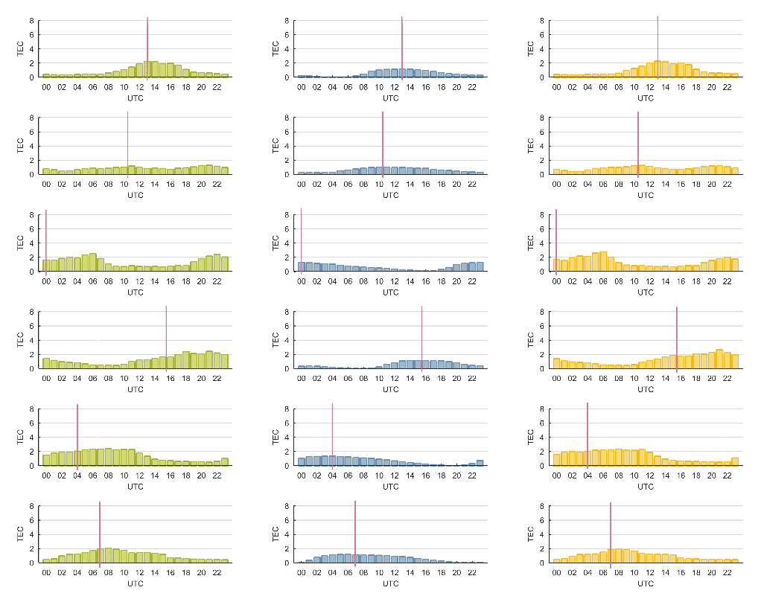
June 2019 – TEC standard deviation for individual hours of the day and statistical parameters
AIUB
NeQuick
differences
station | model | min [TECU] | max [TECU] | amplitude [TECU] | mean [TECU] | σ [TECU] | correlation coefficient
ASCG | AIUB | 1,9 | 22,6 | 7,8 | 7,1 | 4,1 | 0,82
 | NeQuick | 0,0 | 21,3 | 8,3 | 8,6 | 6,5
 | delta | -10,8 | 9,0 | -0,4 | 0,5 | 3,9
CBKA | AIUB | 3,1 | 12,7 | 7,7 | 8,1 | 2,0 | 0,79
 | NeQuick | 1,2 | 16,6 | 7,5 | 7,5 | 4,5
 | delta | -6,9 | 6,6 | 0,2 | 0,9 | 3,2
FTNA | AIUB | 2,9 | 20,6 | 8,4 | 7,9 | 3,6 | 0,90
 | NeQuick | 0,1 | 22,1 | 9,8 | 10,4 | 7,3
 | delta | -12,0 | 6,4 | -1,4 | -1,5 | 4,4
KOUG | AIUB | 1,8 | 26,5 | 10,2 | 8,8 | 6,3 | 0,94
 | NeQuick | 0,0 | 18,6 | 7,0 | 5,2 | 5,8
 | delta | -3,6 | 12,7 | 3,2 | 3,1 | 2,1
PTGG | AIUB | 1,9 | 25,1 | 11,6 | 11,2 | 6,6 | 0,96
 | NeQuick | 0,0 | 22,4 | 9,0 | 10,8 | 7,1
 | delta | -4,3 | 8,7 | 2,6 | 3,0 | 2,1
SGOC | AIUB | 1,3 | 25,7 | 10,8 | 10,9 | 7,0 | 0,93
 | NeQuick | 0,0 | 21,9 | 8,6 | 10,6 | 7,1
 | delta | -6,1 | 11,1 | 2,3 | 2,6 | 2,6
ASCG
CBKA
FTNA
KOUG
PTGG
SGOC
Comparative analysis of global ionospheric models used in GNSS data processing based on selected stations | Table of contents
P. Woźniak, A. Świątek, L. Jaworski

Slide 22
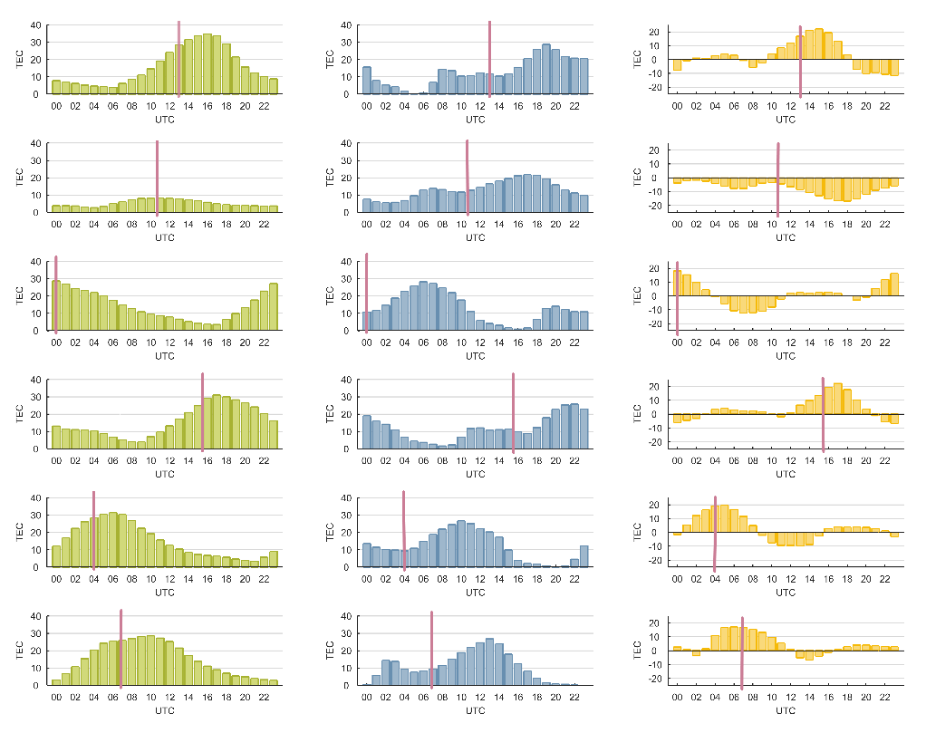
October 2019 – mean TEC for individual hours of the day and sample map
AIUB
NeQuick
differences
CBKA
ASCG
PTGG
AIUB
KOUG
SGOC
FTNA
ASCG
CBKA
FTNA
CBKA
KOUG
SGOC
PTGG
NeQuick
FTNA
ASCG
KOUG
PTGG
CBKA
KOUG
SGOC
PTGG
differences
SGOC
FTNA
ASCG
Comparative analysis of global ionospheric models used in GNSS data processing based on selected stations | Table of contents
P. Woźniak, A. Świątek, L. Jaworski

Slide 23
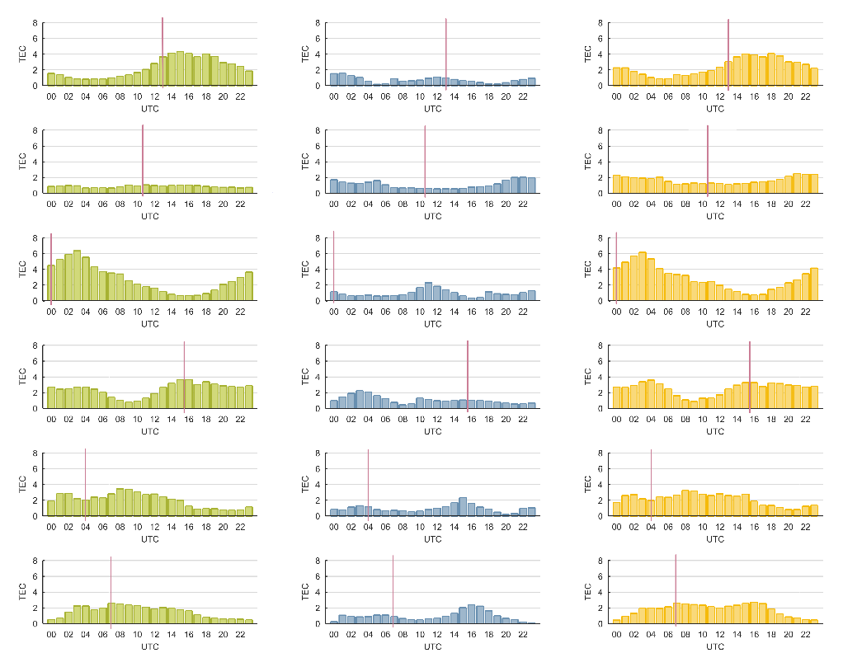
October 2019 – TEC standard deviation for individual hours of the day and statistical parameters
AIUB
NeQuick
differences
station | model | min [TECU] | max [TECU] | amplitude [TECU] | mean [TECU] | σ [TECU] | correlation coefficient
ASCG | AIUB | 1,9 | 43,8 | 15,9 | 11,6 | 11,0 | 0,42
 | NeQuick | 0,1 | 29,2 | 13,2 | 12,1 | 7,9
 | delta | -18,2 | 31,7 | 2,7 | 1,9 | 10,5
CBKA | AIUB | 1,3 | 10,6 | 5,3 | 5,0 | 2,0 | 0,30
 | NeQuick | 3,9 | 24,1 | 13,3 | 12,9 | 5,1
 | delta | -20,0 | 1,5 | -8,0 | -7,1 | 4,9
FTNA | AIUB | 1,7 | 42,1 | 14,5 | 12,7 | 8,8 | 0,43
 | NeQuick | 0,4 | 30,0 | 13,3 | 12,2 | 8,4
 | delta | -17,6 | 27,2 | 1,2 | 1,4 | 9,2
KOUG | AIUB | 2,3 | 37,8 | 16,0 | 13,9 | 9,1 | 0,50
 | NeQuick | 1,1 | 27,4 | 12,2 | 11,2 | 7,2
 | delta | -12,1 | 28,6 | 3,9 | 2,3 | 8,3
PTGG | AIUB | 1,1 | 36,4 | 15,3 | 12,3 | 9,8 | 0,49
 | NeQuick | 0,0 | 28,6 | 12,2 | 11,4 | 8,3
 | delta | -13,6 | 25,4 | 3,1 | 3,1 | 9,2
SGOC | AIUB | 2,0 | 34,4 | 15,4 | 14,2 | 9,5 | 0,67
 | NeQuick | 0,0 | 29,4 | 10,8 | 9,6 | 8,3
 | delta | -11,4 | 23,2 | 4,6 | 3,1 | 7,2
ASCG
CBKA
FTNA
KOUG
PTGG
SGOC
Comparative analysis of global ionospheric models used in GNSS data processing based on selected stations | Table of contents
P. Woźniak, A. Świątek, L. Jaworski

Slide 24
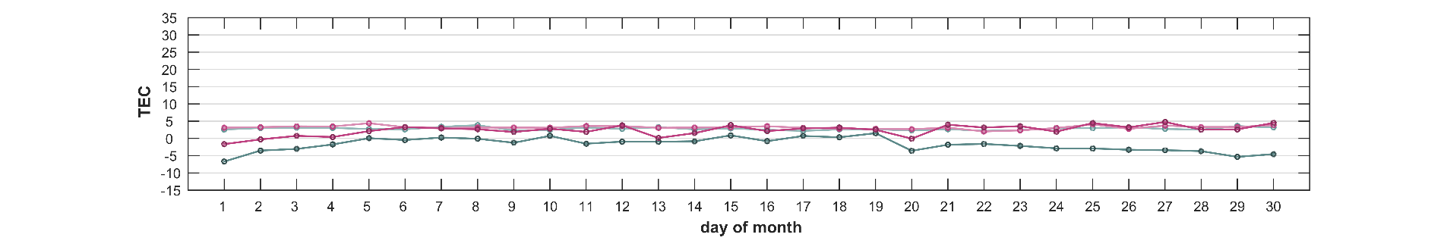
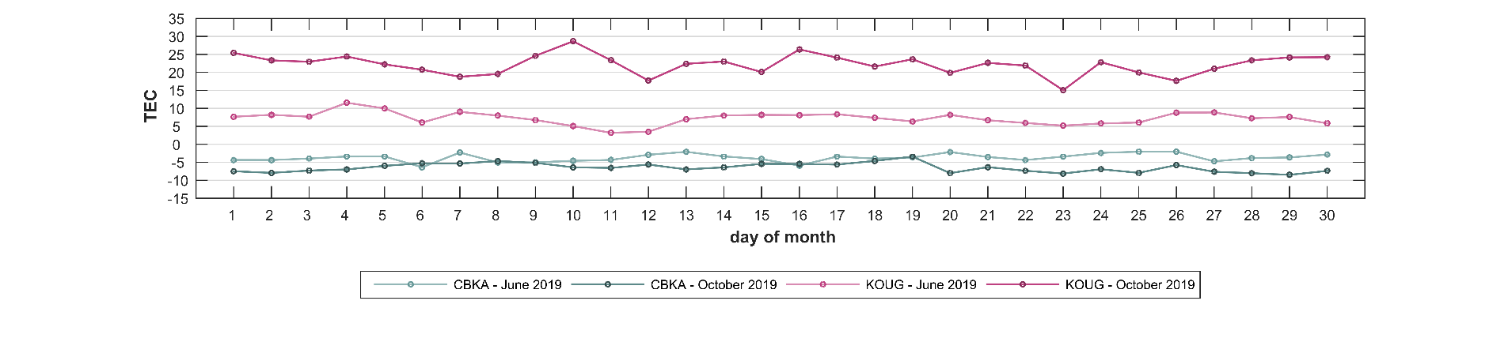
Mean TEC differences between NeQuick and IGS\AIUB models for CBKA and KOUG in 4 and 14 hour of local time
4 local time
14 local time
Comparative analysis of global ionospheric models used in GNSS data processing based on selected stations | Table of contents
P. Woźniak, A. Świątek, L. Jaworski

Slide 25
Conclusions – month statistic for selected stations
for the quiet month – June – the differences in mean TEC values for all stations are small
considering the month of higher ionospheric activity – October – and taking into account the local time, it can be noticed
that for all equatorial stations the difference in mean values is positive during the daytime (TEC values for AIUB model
are higher than for NeQuick model), however after sunset there is a sharp decrease in this parameter
and the difference takes a negative sign
it is different in the case of the European station (CBKA), for which the differences are negative the whole day,
so the NeQuick TEC values exceed the AIUB values
correlation coefficients for a quiet and disturbed month are at different level – in the first case this parameter values
are close to unity for low latitude stations, and for October they are between 0.4 and 0.7;
in both cases the results for the European station are lower (0.8 and 0.3, respectively)
nevertheless, considering the time series showing the differences between the subject models for 4 and 14 hour of local time on the consecutive days of a given month (stations in Warsaw and Kourou), the relationship between the compatibility
of the models and the time of day and the general ionospheric conditions in a given period becomes visible
Comparative analysis of global ionospheric models used in GNSS data processing based on selected stations | Table of contents
P. Woźniak, A. Świątek, L. Jaworski

Slide 26
Results
station coordinates
Comparative analysis of global ionospheric models used in GNSS data processing based on selected stations | Table of contents
P. Woźniak, A. Świątek, L. Jaworski

Slide 27
Introduction – station coordinates
based on the K-index data from stations in Belsk and Kourou, dates were selected for which the coordinates
of the considered GNSS stations were calculated
the dates considered include both days with a calm ionosphere and with the possibility of a magnetic storm
the following approaches were implemented to compensate for the influence of ionospheric refraction on satellite observations:
  single-frequency (L1) observations + TEC map (NeQuick)
  single-frequency (L1) observations + TEC map (IGS\AIUB)
  iono-free combination (L3)
time series of horizontal and vertical coordinates were generated for stations, independently for each of the
above-mentioned approaches to develop GPS observation; similarly, the differences in the resulting coordinates were determined for each pair of computation approaches (sample resulting set was presented for 27 February 2019)
as the topic of this presentation is the difference between the solution obtained with use of the NeQuick and AIUB models, in the case of further dates presented, the focus was on this element
Comparative analysis of global ionospheric models used in GNSS data processing based on selected stations | Table of contents
P. Woźniak, A. Świątek, L. Jaworski

Slide 28
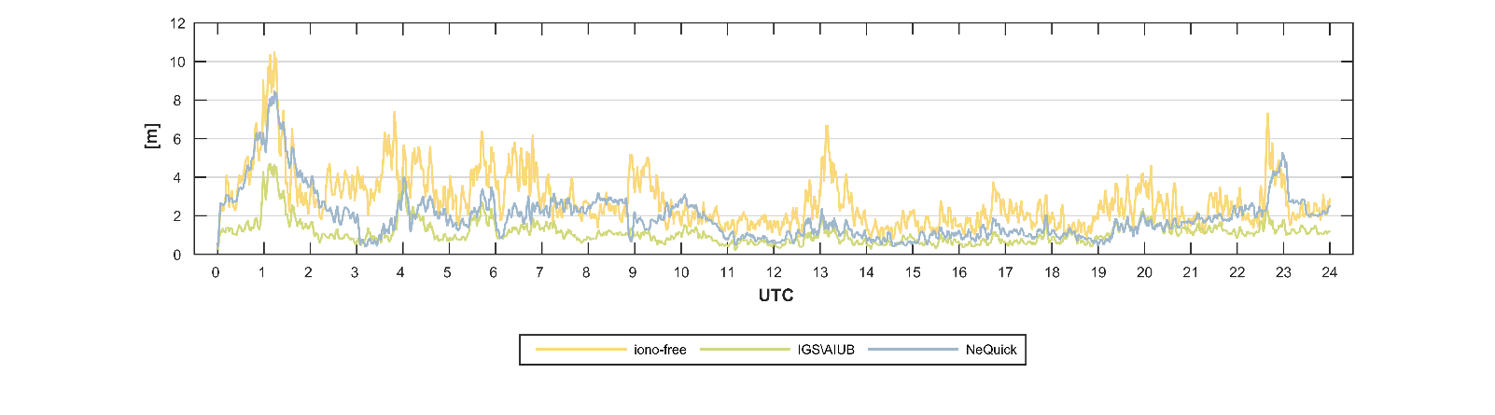
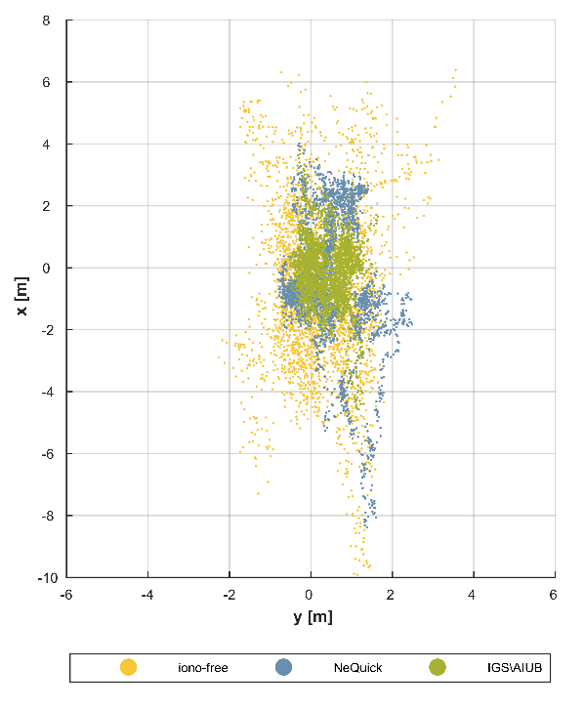
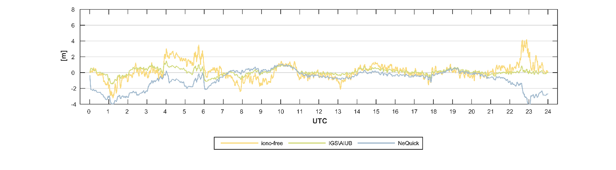
Result set for a sample day and station date: 27 February 2019, station: FTNA
xy scatter
xy coordinates
z coordinate
Comparative analysis of global ionospheric models used in GNSS data processing based on selected stations | Table of contents
P. Woźniak, A. Świątek, L. Jaworski

Slide 29
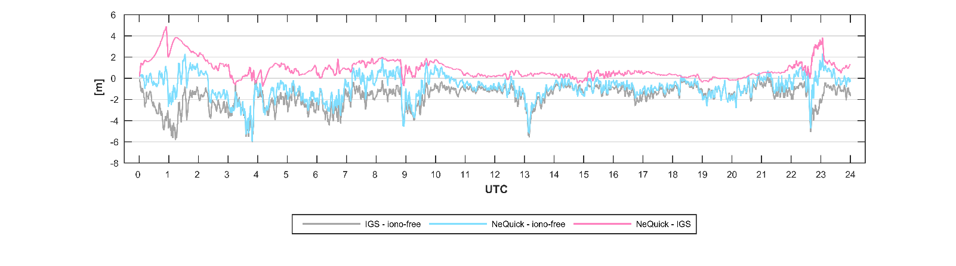
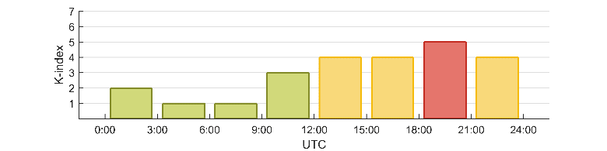
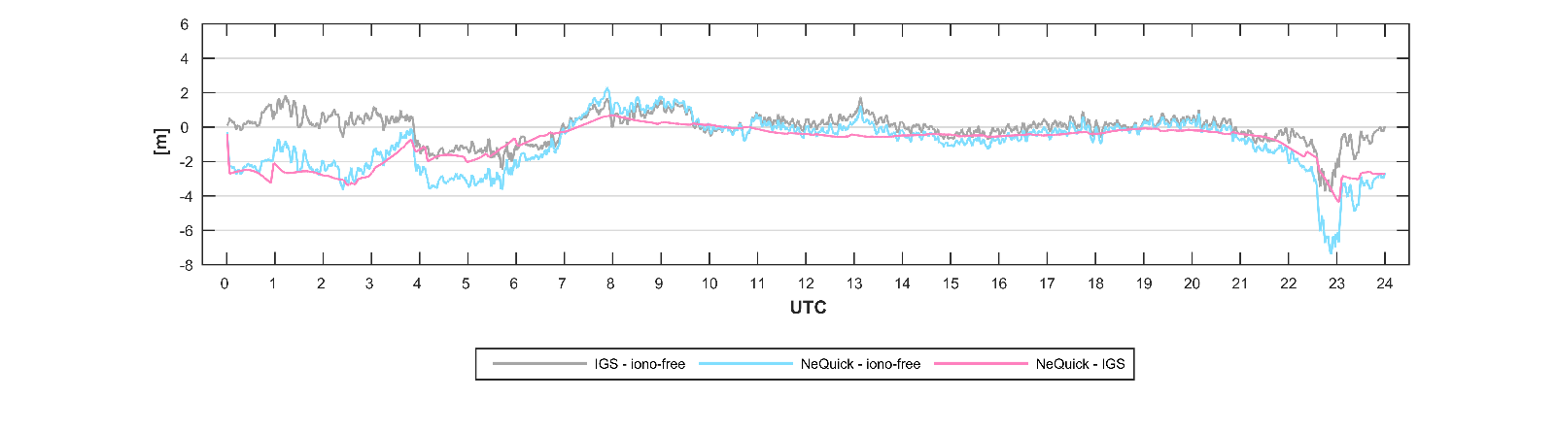
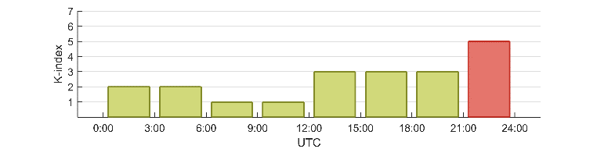
Result set for a sample day and station date: 27 February 2019, station: FTNA
K-index - Belsk
xy differences
K-index - Kourou
z differences
Comparative analysis of global ionospheric models used in GNSS data processing based on selected stations | Table of contents
P. Woźniak, A. Świątek, L. Jaworski

Slide 30
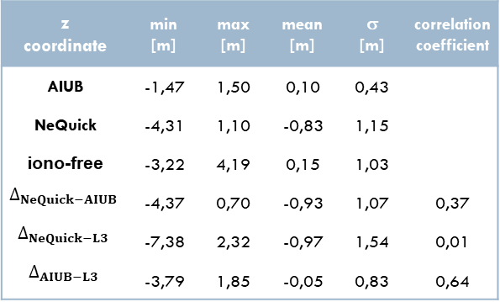
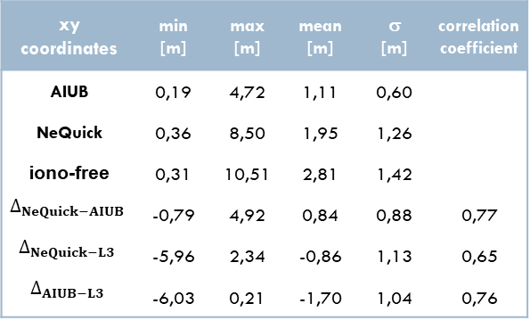
Result set for a sample day and station date: 27 February 2019, station: FTNA
xy coordinates | min [m] | max [m] | mean [m] | σ [m] | correlation coefficient
AIUB | 0,19 | 4,72 | 1,11 | 0,60
NeQuick | 0,36 | 8,50 | 1,95 | 1,26
iono-free | 0,31 | 10,51 | 2,81 | 1,42
$$∆_{NeQuick−AIUB}$$ | -0,79 | 4,92 | 0,84 | 0,88 | 0,77
$$∆_{NeQuick−L3}$$ | -5,96 | 2,34 | -0,86 | 1,13 | 0,65
$$∆_{AIUB−L3}$$ | -6,03 | 0,21 | -1,70 | 1,04 | 0,76
z coordinate | min [m] | max [m] | mean [m] | σ [m] | correlation coefficient
AIUB | -1,47 | 1,50 | 0,10 | 0,43
NeQuick | -4,31 | 1,10 | -0,83 | 1,15
iono-free | -3,22 | 4,19 | 0,15 | 1,03
$$∆_{NeQuick−AIUB}$$ | -4,37 | 0,70 | -0,93 | 1,07 | 0,37
$$∆_{NeQuick−L3}$$ | -7,38 | 2,32 | -0,97 | 1,54 | 0,01
$$∆_{AIUB−L3}$$ | -3,79 | 1,85 | -0,05 | 0,83 | 0,64
Comparative analysis of global ionospheric models used in GNSS data processing based on selected stations | Table of contents
P. Woźniak, A. Świątek, L. Jaworski

Slide 31
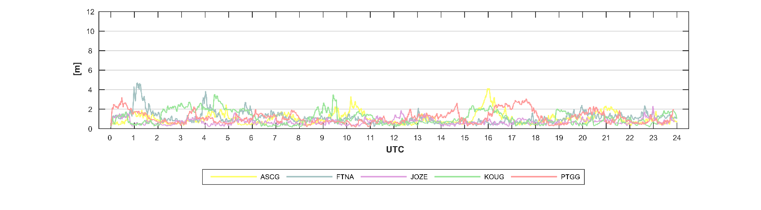
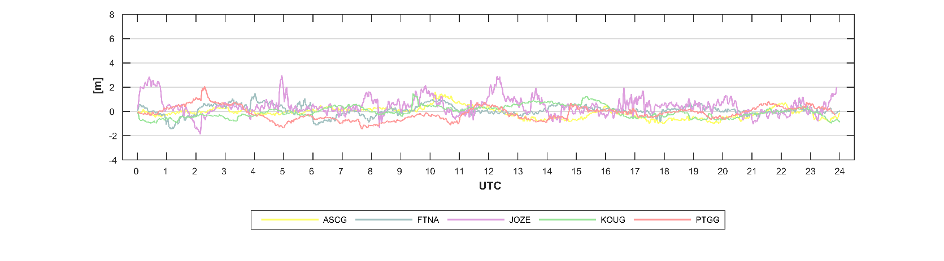
Time series – 27 February 2019, TEC map: AIUB
xy coordinates
z coordinate
Comparative analysis of global ionospheric models used in GNSS data processing based on selected stations | Table of contents
P. Woźniak, A. Świątek, L. Jaworski

Slide 32
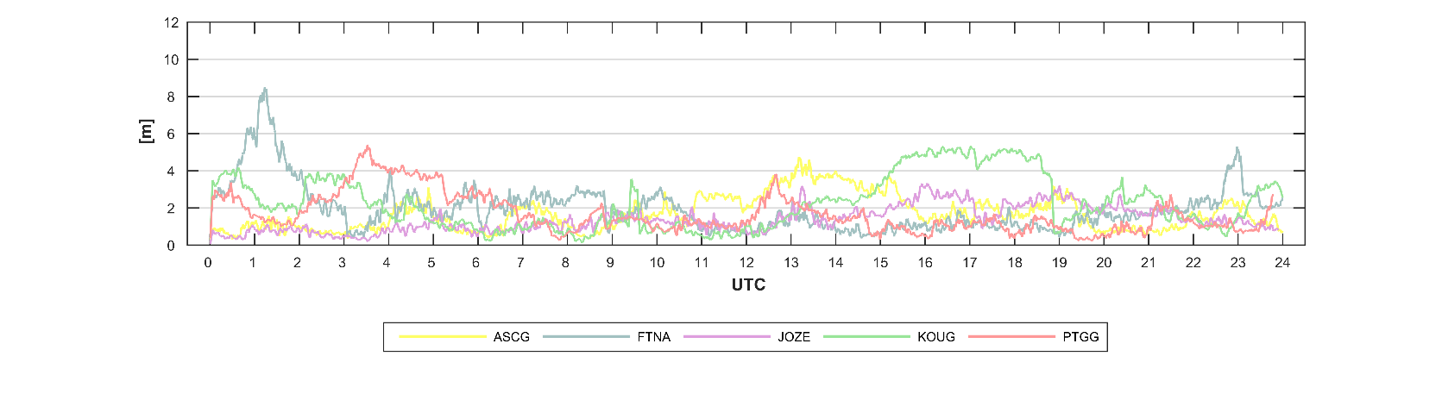
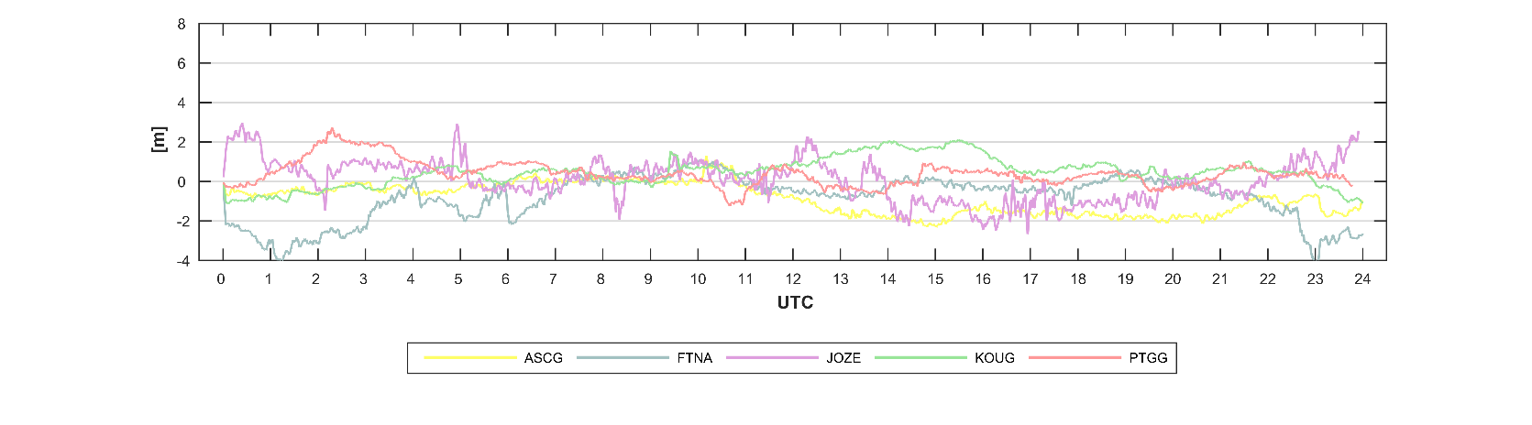
Time series – 27 February 2019, TEC map: NeQuick
xy coordinates
z coordinate
Comparative analysis of global ionospheric models used in GNSS data processing based on selected stations | Table of contents
P. Woźniak, A. Świątek, L. Jaworski

Slide 33
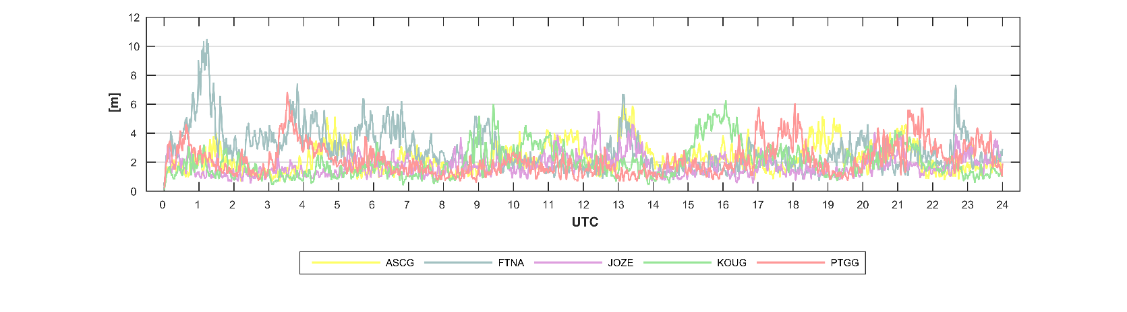
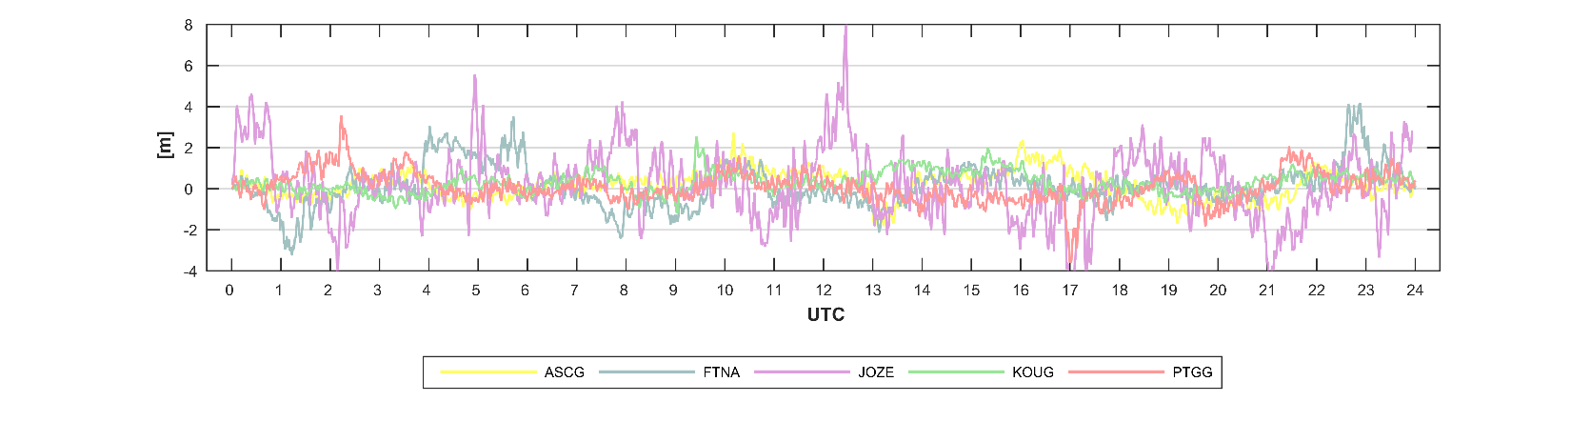
Time series – 27 February 2019, iono-free combination
xy coordinates
z coordinate
Comparative analysis of global ionospheric models used in GNSS data processing based on selected stations | Table of contents
P. Woźniak, A. Świątek, L. Jaworski

Slide 34
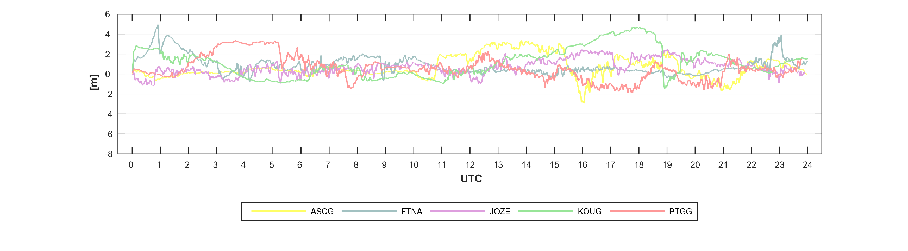
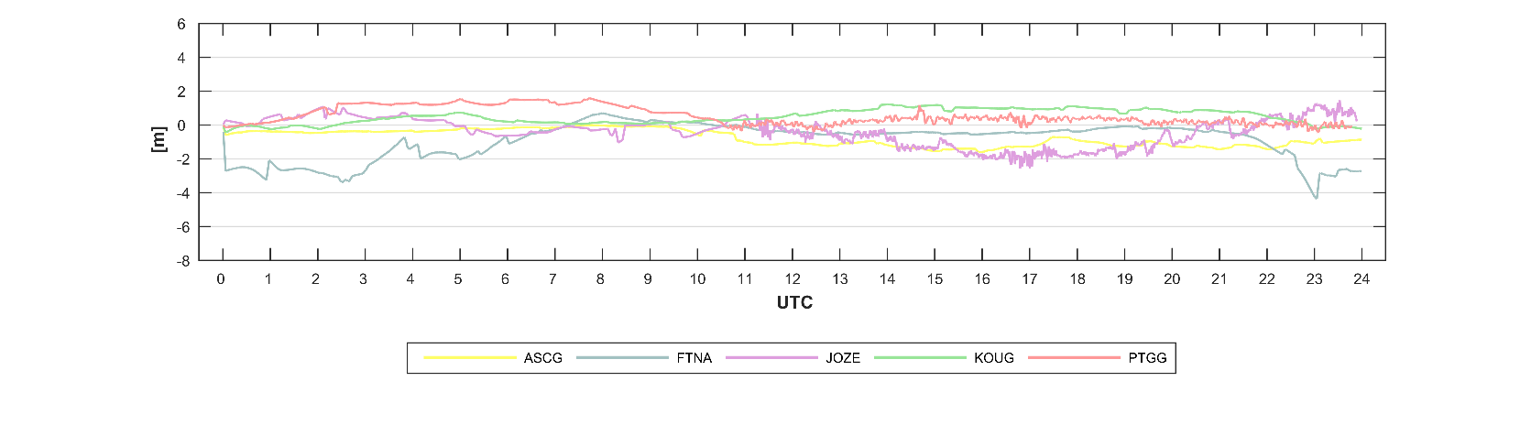
Time series – 27 February 2019, differences: (NeQuick – AIUB)
xy differences
z differences
Comparative analysis of global ionospheric models used in GNSS data processing based on selected stations | Table of contents
P. Woźniak, A. Świątek, L. Jaworski

Slide 35
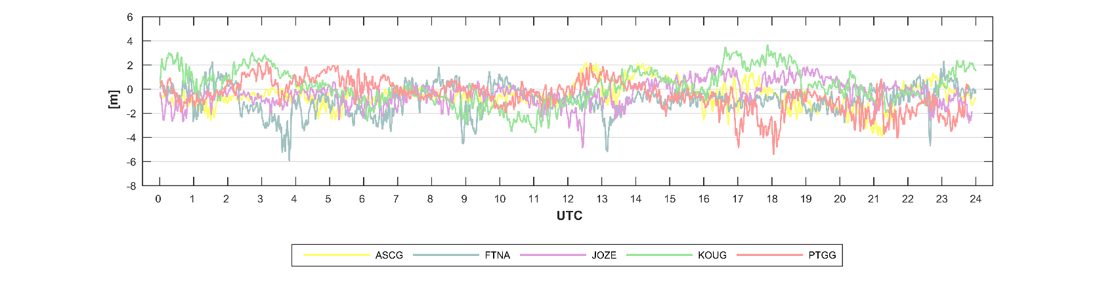

Time series – 27 February 2019, differences: (NeQuick – iono-free)
xy differences
z differences
Comparative analysis of global ionospheric models used in GNSS data processing based on selected stations | Table of contents
P. Woźniak, A. Świątek, L. Jaworski

Slide 36


Time series – 27 February 2019, differences: (AIUB – iono-free)
xy differences
z differences
Comparative analysis of global ionospheric models used in GNSS data processing based on selected stations | Table of contents
P. Woźniak, A. Świątek, L. Jaworski

Slide 37




K-index and time series – 23 February 2019 differences: (NeQuick – AIUB)
K-index - Belsk
xy differences
K-index - Kourou
z differences
Comparative analysis of global ionospheric models used in GNSS data processing based on selected stations | Table of contents
P. Woźniak, A. Świątek, L. Jaworski

Slide 38




K-index and time series – 8 July 2019 differences: (NeQuick – AIUB)
K-index - Belsk
xy differences
K-index - Kourou
z differences
Comparative analysis of global ionospheric models used in GNSS data processing based on selected stations | Table of contents
P. Woźniak, A. Świątek, L. Jaworski

Slide 39




K-index and time series – 24 July 2019 differences: (NeQuick – AIUB)
K-index - Belsk
xy differences
K-index - Kourou
z differences
Comparative analysis of global ionospheric models used in GNSS data processing based on selected stations | Table of contents
P. Woźniak, A. Świątek, L. Jaworski

Slide 40




K-index and time series – 31 August 2019 differences: (NeQuick – AIUB)
K-index - Belsk
xy differences
K-index - Kourou
z differences
Comparative analysis of global ionospheric models used in GNSS data processing based on selected stations | Table of contents
P. Woźniak, A. Świątek, L. Jaworski

Slide 41
Conclusions – station coordinates
looking at the presented graphs for FTNA station, the increase in coordinate changes for all options is clearly visible
after crossing the local noon (around 1 UTC);
similarly, large changes occur after 22 UTC, which is a few hours before noon the next day; moreover, a high K-index
was recorded at that time
comparing the solutions with the use of the two subject ionospheric models, the results for AIUB are characterized
by a lower variation in time, this can be seen both in the time series of the horizontal and vertical component;
the same trend is shown in the scatter of the points recorded for the whole day: Nequick's results have a larger spread
finally, the differences in the AIUB and NeQuick solutions for 27 February 2019 reach almost 5 m around the local noon
for xy coordinates, in the case of the vertical component – at the same time the differences exceed 4 m
in the nighttime the difference for the z coordinate oscillates close to zero, while the horizontal coordinates differences
are changing in the range from 0 to about 2 m
Comparative analysis of global ionospheric models used in GNSS data processing based on selected stations | Table of contents
P. Woźniak, A. Świątek, L. Jaworski

Slide 42
Conclusions – station coordinates
considering the exemplary statements for all stations on a common time series for the three considered computational approaches, it can be seen that:
  the AIUB solution gives the most stable result
  in the case of the NeQuick model, significant increases appear, in particular related to the local noon
  of individual equatorial stations
  the iono-free combination result is the most diversified between the successive measurement epochs
confirmation is shown by the statements for the differences between the considered calculation methods; importantly,
all equatorial stations in the vicinity of the local noon record several meters differentiation between solution obtained
with the use of NeQuick and AIUB TEC maps, especially in the case of the horizontal component
similar trends (although with varying intensity) can be observed for the following days presented
Comparative analysis of global ionospheric models used in GNSS data processing based on selected stations | Table of contents
P. Woźniak, A. Świątek, L. Jaworski

Slide 43
Summary
Comparative analysis of global ionospheric models used in GNSS data processing based on selected stations | Table of contents
P. Woźniak, A. Świątek, L. Jaworski

Slide 44
Summary
compared to the IGS ionospheric products, the NeQuick model has different diurnal course across the globe
the zone of increased TEC value, which moves consistently with the position of the Earth in relation to the Sun, in the case of the NeQuick model is blurred latitudinally, in contrast to the IGS model, for which the mentioned zone extends along the meridians
this causes an underestimation of the TEC parameter at low latitudes, in particular during days with high geomagnetic activity and under storm conditions; on the other hand - for mid-latitude locations - the NeQuick result exceeds the values
of the IGS model, which was proved in the presented research results, concerning the comparison of models in a global aspect and a detailed analysis of statistical parameters based on selected stations localized in equatorial region
as the main goal of the considerations is to study ionospheric models in the context of GNSS data processing,
both models were examined and applied in the course of the discussed stations position computation
the results presented in the last part illustrate the differences between the coordinates determined on the basis
of both models; in particular, a pattern of increasing divergence is seen during the daytime and around the local noon
in conclusion, it seems that the NeQuick model needs improvement in the equatorial region; so far, in the case of single-frequency data processing a better quality GNSS positioning can be obtained with the use of IGS products, e.g. by AIUB
Comparative analysis of global ionospheric models used in GNSS data processing based on selected stations | Table of contents
P. Woźniak, A. Świątek, L. Jaworski

Slide 45
Comparative analysis of global ionospheric models used in GNSS data processing based on selected stations
Paulina Woźniak
pwozniak@cbk.waw.pl
Anna Świątek
ana@cbk.waw.pl
Leszek Jaworski
Space Research Centre
Polish Academy of Sciences
Warsaw, Poland
Thank you!
European Geosciences Union General Assembly
vEGU21: Gather Online | 19-30 April 2021

