Slide 1
VERIFICATION AND COMMUNICATION OF THE SCIENTIFIC QUALITY OF OPERATIONAL OCEANOGRAPHY PRODUCTS OF THE COPERNICUS MARINE SERVICE
Supporting information
Isabel Garcia Hermosa¹, Charly Régnier¹, Marie Drevillon¹, Marcos Garcia sotillo², and Camille Szczypta³
¹Mercator Ocean International, France
²Puertos del Estado, Spain
³CELAD, France
Session OS4.6 - 09:31am CEST, EGU, April 28th 2021

Slide 2
Abstract
Verification and communication of the scientific quality of operational oceanography products of the Copernicus Marine Service
Isabel Garcia Hermosa¹, Charly Régnier¹, Marie Drevillon¹, Marcos Garcia sotillo², and Camille Sczcypta³.
¹Mercator Ocean International, France (igarciahermosa@mercator-ocean.fr).
²Puertos del Estado, Spain.
³CELAD, France.
The Copernicus Marine Environment Monitoring Service (CMEMS) is delivering ocean satellite observations, in situ observations, together with ocean model reanalyzes, analyzes and forecasts from a unique web portal (Le Traon et al, 2019, https://doi.org/10.3389/fmars.2019.00234). Each one of these products is evaluated before its entry into service, and its quality is documented in a Quality Information Document (QUID). This information is complemented by regular quality metrics updates on the CMEMS website. Due to a relatively sparse observation network, in particular in subsurface, it is still a challenge to propose meaningful uncertainty estimates and forecast skills to the operational oceanography user’s community. In order to improve, and better target the scientific quality information provided to the various types of CMEMS users, several developments are ongoing which will be described in this presentation.
Notes:
PQ: Product quality
PC: production centres, i.e. data producers for CMEMS. Contracted to provide satellite or in situ observations (TACs), or forecast / reanalysis (MFCs).
TAC: Thematic Assembly Centre (observations). SL: Sea level; OC: Ocean colour; OSI: Sea ice, surface wind and sea surface temperature; INS: In situ.
MFC: Monitoring and Forecasting Centre (forecasts or reanalisys). GLO: Gobal; ARC: Arctic; BAL: Baltic Sea; NWS: North west shelf; IBI: Iberia-Biscay-Ireland; MED: Mediterranean Sea; and BS: Black Sea.
QUID: Quality information document
SE: Service evolution program; a series of contracts to provide the improvements to future systems by including (e.g.) missing or poorly described processes, or by applying innovative techniques or analysis. It is a tier 2 contract which lasts typically 2 years and the third one the findings are implemented into the service. It is guided by the CMEMS R&D roadmap.

Slide 3
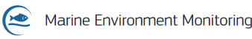

The Copernicus Marine Environment Monitoring Service (CMEMS)& its ecosystem
ESA AND EUMETSAT
EEA, EUROGOOS, EMODNET…
Marine Environment Monitoring
SCIENTIFIC AND TECHNICAL ADVISORY COMMITTEE
OTHER COPERNICUS SERVICES
Entrusted entity:
CHAMPION USERS
ADVISORY COMMITTEE
CROSS-CUTTING COORDINATION
CENTRAL USER SERVICE
System
Service
Outreach
Science
CMEMS OPERATIONS
PRODUCTION AND SERVICE
Service operations - Central Information System
Monitoring and Forecasting Centres (Models)
Thematic Assembly Centres (Obs)
CMEMS EVOLUTIONS &
USER UPTAKE
Additional activities complementing CMEMS operations
ARC
BAL
BS
IBI
MED
NWS
GLO
SERVICE EVOLUTION
USER UPTAKE
INS
MOB
OC
SI
SL
SST
WAV
WIND
Notes:
PQ: Product quality
PC: production centres, i.e. data producers for CMEMS. Contracted to provide satellite or in situ observations (TACs), or forecast / reanalysis (MFCs).
TAC: Thematic Assembly Centre (observations). SL: Sea level; OC: Ocean colour; OSI: Sea ice, surface wind and sea surface temperature; INS: In situ.
MFC: Monitoring and Forecasting Centre (forecasts or reanalisys). GLO: Gobal; ARC: Arctic; BAL: Baltic Sea; NWS: North west shelf; IBI: Iberia-Biscay-Ireland; MED: Mediterranean Sea; and BS: Black Sea.
QUID: Quality information document
SE: Service evolution program; a series of contracts to provide the improvements to future systems by including (e.g.) missing or poorly described processes, or by applying innovative techniques or analysis. It is a tier 2 contract which lasts typically 2 years and the third one the findings are implemented into the service. It is guided by the CMEMS R&D roadmap.

Slide 4
CMEMS Product Quality activities
..
..
..
..
Peer-reviewed
Sci. publications
R&D Projects
exchanges
CMEMS PQ
Dashboard
(www)
Validation in support of Service Desk
Planned evolution
Pre- operational qualification
Operational Routine verification
Delayed time verification
CMEMS PQ Documentation
Internal PQ Docs:
End-User Docs (for each product):
described in
PQ-MP
PQ-MP: PQ Management Plan
PQ-SP: Strategic Plan
CMEMS PQ
Processes
(along Product Lifecycle)
Linked to CMEMS releases
ScQP: Scientific Qualification Plan
ScVP: Scientific Validation Plan
ScMYVP: Sci. Multi Year Val. Plan
described in
ScVP, ScMYVP
Producers’
Specific Websites
(optional; mostly for
internal use)
QuID: Quality Information Doc
SQO: Synthesis Quality Overview
(New!)
described in
ScVP
End-user PQ Documentation
(QUIDs/SQOs)
described in
ScQP
Notes:
PQ: Product quality
PC: production centres, i.e. data producers for CMEMS. Contracted to provide satellite or in situ observations (TACs), or forecast / reanalysis (MFCs).
TAC: Thematic Assembly Centre (observations). SL: Sea level; OC: Ocean colour; OSI: Sea ice, surface wind and sea surface temperature; INS: In situ.
MFC: Monitoring and Forecasting Centre (forecasts or reanalisys). GLO: Gobal; ARC: Arctic; BAL: Baltic Sea; NWS: North west shelf; IBI: Iberia-Biscay-Ireland; MED: Mediterranean Sea; and BS: Black Sea.
QUID: Quality information document
SE: Service evolution program; a series of contracts to provide the improvements to future systems by including (e.g.) missing or poorly described processes, or by applying innovative techniques or analysis. It is a tier 2 contract which lasts typically 2 years and the third one the findings are implemented into the service. It is guided by the CMEMS R&D roadmap.

Slide 5
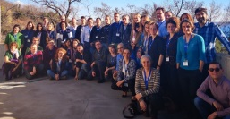
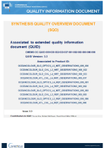
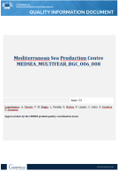
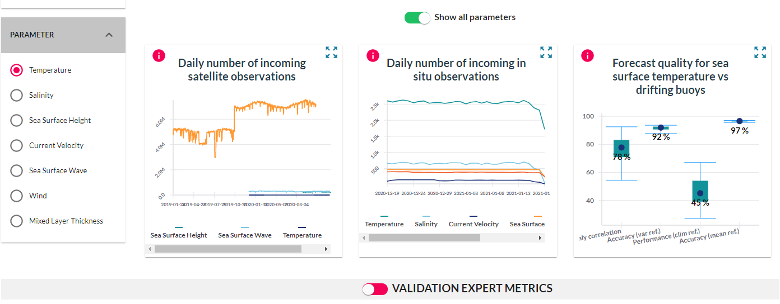
+
VERIFICATION & COMMUNICATION OF THE SCIENTIFIC QUALITY OF OPERATIONAL OCEANOGRAPHY PRODUCTS OF THE COPERNICUS MARINE SERVICE
A multi-disciplinary team
(1)
Production product quality info
CMEMS PQ Coordination Team (MOi)
CMEMS PQ Working Group
>50 Sci. experts; Obs & model
Blue, Green, White
All regions covered
Pre-op Qualification
PQ Teams
(@ CMEMS
producers)
(2)
Op. generation of Assessment & metrics
(3)
Op. Evaluation of PQ
Op validation
CMEMS PQ Docs
Scientific expert knowledge
CMEMS Internal PQ Plans: ScVP, ScQP, ScMYVP
Driven by end users
Delivery External PQ Docs: QUIDs, SQOs
Regular dissemination of quality information (metrics/ reports)
(4)
CMEMS PQ WWWs
Operational delivery
@ CMEMS PQ-Dashboard (monthly/ daily)
(5)
END USERS
Scientific community, private/ public, gvt. advisors/ policy makers
Operational delivery @ CMEMS PQ webpage (internal/optional)
https://marine.copernicus.eu/
PQ dashboard https://pqd.mercator-ocean.fr/?pk_vid=5688911fd2e6aba41618843139d0ce1a
Notes:
PQ: Product quality
PC: production centres, i.e. data producers for CMEMS. Contracted to provide satellite or in situ observations (TACs), or forecast / reanalysis (MFCs).
TAC: Thematic Assembly Centre (observations). SL: Sea level; OC: Ocean colour; OSI: Sea ice, surface wind and sea surface temperature; INS: In situ.
MFC: Monitoring and Forecasting Centre (forecasts or reanalisys). GLO: Gobal; ARC: Arctic; BAL: Baltic Sea; NWS: North west shelf; IBI: Iberia-Biscay-Ireland; MED: Mediterranean Sea; and BS: Black Sea.
QUID: Quality information document
SE: Service evolution program; a series of contracts to provide the improvements to future systems by including (e.g.) missing or poorly described processes, or by applying innovative techniques or analysis. It is a tier 2 contract which lasts typically 2 years and the third one the findings are implemented into the service. It is guided by the CMEMS R&D roadmap.

Slide 6
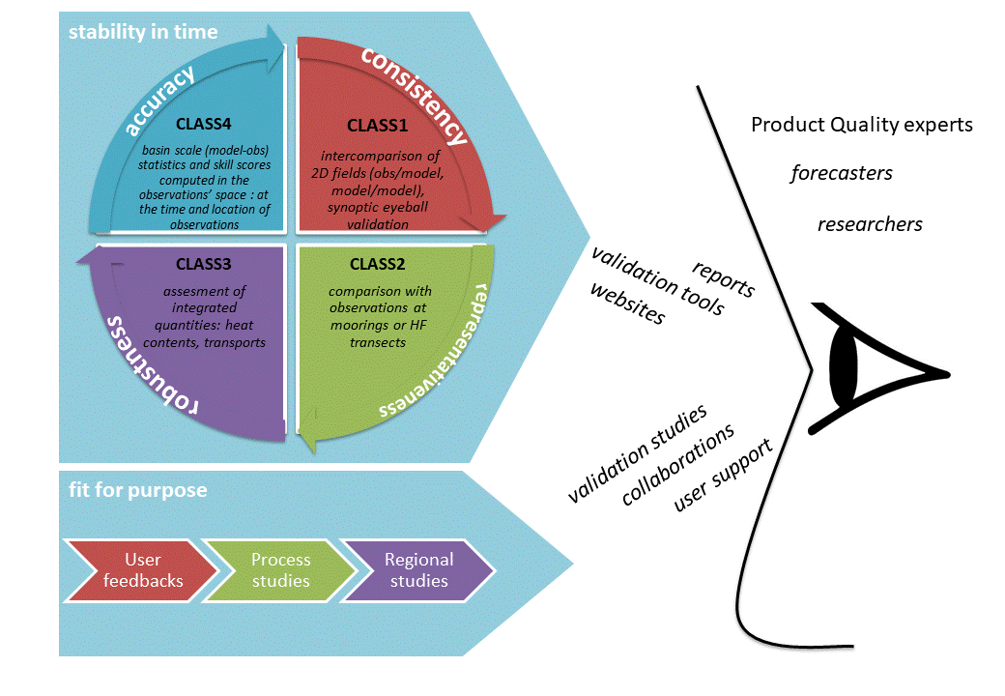
How to measure product quality?
metrics
following GODAE international standards
Achieved regular delivery of PQ metrics
  - CLASS4 & CLASS2
feedback
via service desk
via scientific collaborations
human expertise
In all production centres
Feedback from users
Notes:
How to evaluate and measure the quality of the products

Slide 7
THE COMPLEXITY OF THE CROSS-CUTTING INTERACTIONS & CONNECTIONS
CMEMS PQ Cross-cutting Activity
CMEMS PQ Working Group
All MFC/TACs represented
(>50 Sci. PQ experts)
All products (Blue, Green, White); Obs & model; All regions covered
Facilitation
Top-Down & Bottom-Up exchanges
CMEMS PQ Coordination Team
CMEMS PQ Docs
Management
Agreements on standards
& evolutions
CMEMS PQ Strategy
PQ Management Plan
Approval
implementation
Participation
& expertise
Acceptance
Management
Internal PQ Docs:
ScVP, ScQP, ScMYVP
Coordination
implementation
Inputs
PQ Docs: QUIDs, SQOs (reviewed)
Qualification New products
OR
Major updates (change release)
CMEMS PQ WWWs
PQ team
@ CMEMS
Production centres
(MFC/TAC)
CMEMS
PQ-Dashboard
PQ metrics (Daily/Monthly) Metrics delivery
Dissemination
PQ activity
CMEMS element
PQ webpage (optional)
Inputs
Validation
Approved Products
(In Ops)
Dissemination
CMEMS PQ Communication
Notes:
PQ: Product quality
PC: production centres, i.e. data producers for CMEMS. Contracted to provide satellite or in situ observations (TACs), or forecast / reanalysis (MFCs).
TAC: Thematic Assembly Centre (observations). SL: Sea level; OC: Ocean colour; OSI: Sea ice, surface wind and sea surface temperature; INS: In situ.
MFC: Monitoring and Forecasting Centre (forecasts or reanalisys). GLO: Gobal; ARC: Arctic; BAL: Baltic Sea; NWS: North west shelf; IBI: Iberia-Biscay-Ireland; MED: Mediterranean Sea; and BS: Black Sea.
QUID: Quality information document
SE: Service evolution program; a series of contracts to provide the improvements to future systems by including (e.g.) missing or poorly described processes, or by applying innovative techniques or analysis. It is a tier 2 contract which lasts typically 2 years and the third one the findings are implemented into the service. It is guided by the CMEMS R&D roadmap.
EAN: Estimated accuracy numbers, metrics present and tabulated in the CMEMS PQ documents (QUID)

Slide 8
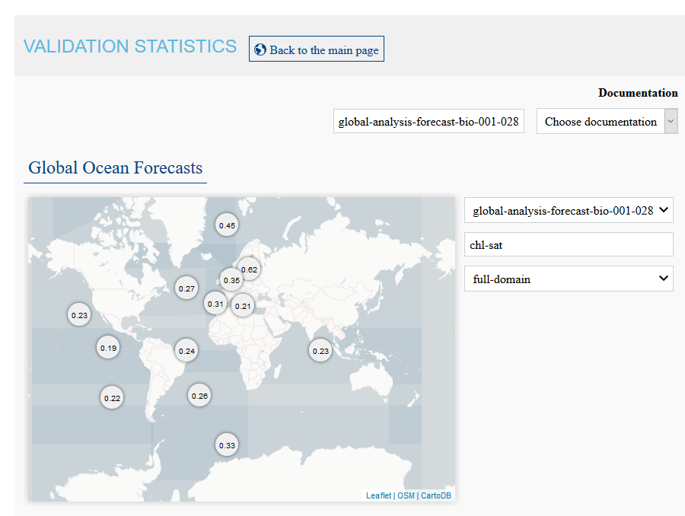
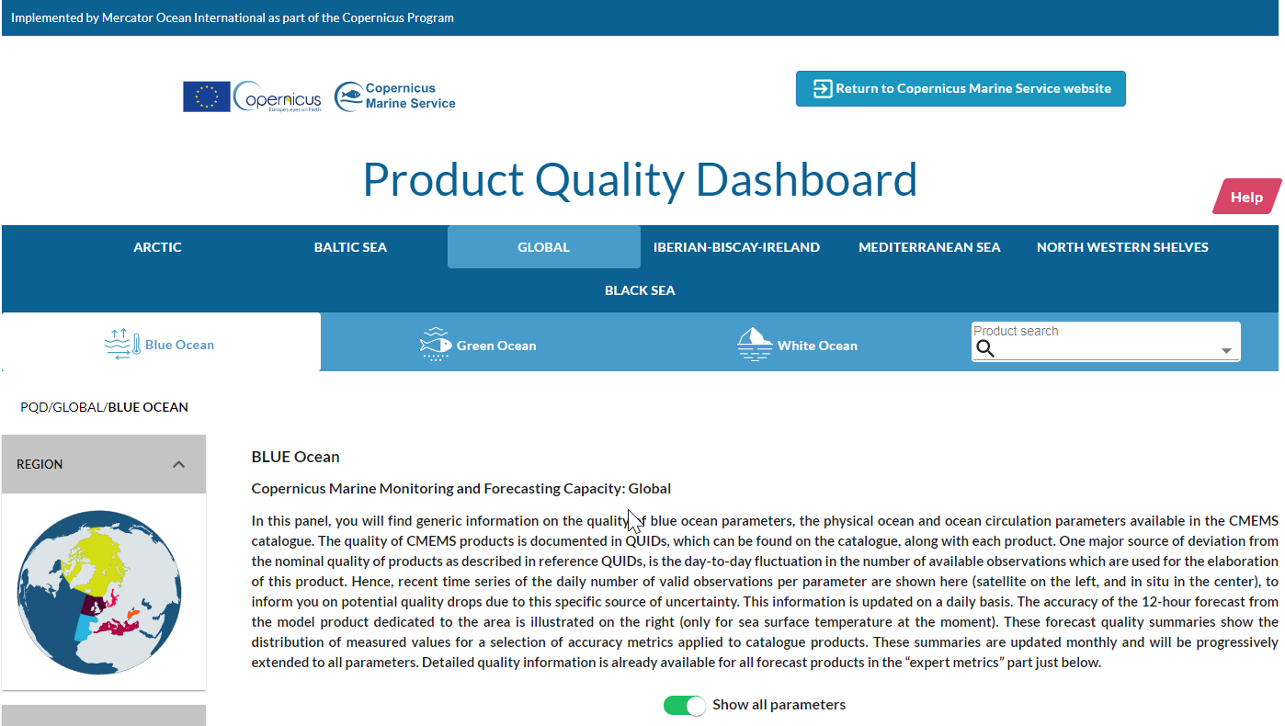
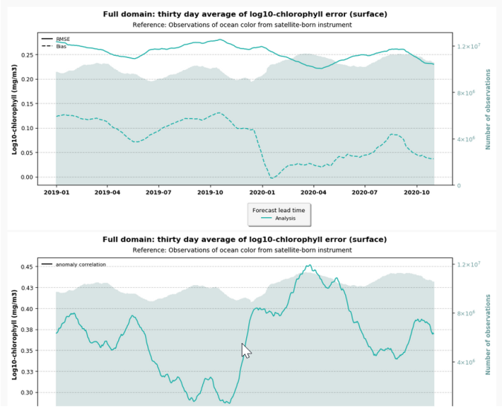
The CMEMS PQ-Dasboard
VERSION 2015
VERSION 2020
You can access it in:
https://pqd.mercator-ocean.fr/?pk_vid=5688911fd2e6aba41618843139d0ce1a
Notes:
PQ: Product quality
PC: production centres, i.e. data producers for CMEMS. Contracted to provide satellite or in situ observations (TACs), or forecast / reanalysis (MFCs).
TAC: Thematic Assembly Centre (observations). SL: Sea level; OC: Ocean colour; OSI: Sea ice, surface wind and sea surface temperature; INS: In situ.
MFC: Monitoring and Forecasting Centre (forecasts or reanalisys). GLO: Gobal; ARC: Arctic; BAL: Baltic Sea; NWS: North west shelf; IBI: Iberia-Biscay-Ireland; MED: Mediterranean Sea; and BS: Black Sea.
QUID: Quality information document
SE: Service evolution program; a series of contracts to provide the improvements to future systems by including (e.g.) missing or poorly described processes, or by applying innovative techniques or analysis. It is a tier 2 contract which lasts typically 2 years and the third one the findings are implemented into the service. It is guided by the CMEMS R&D roadmap.

Slide 9
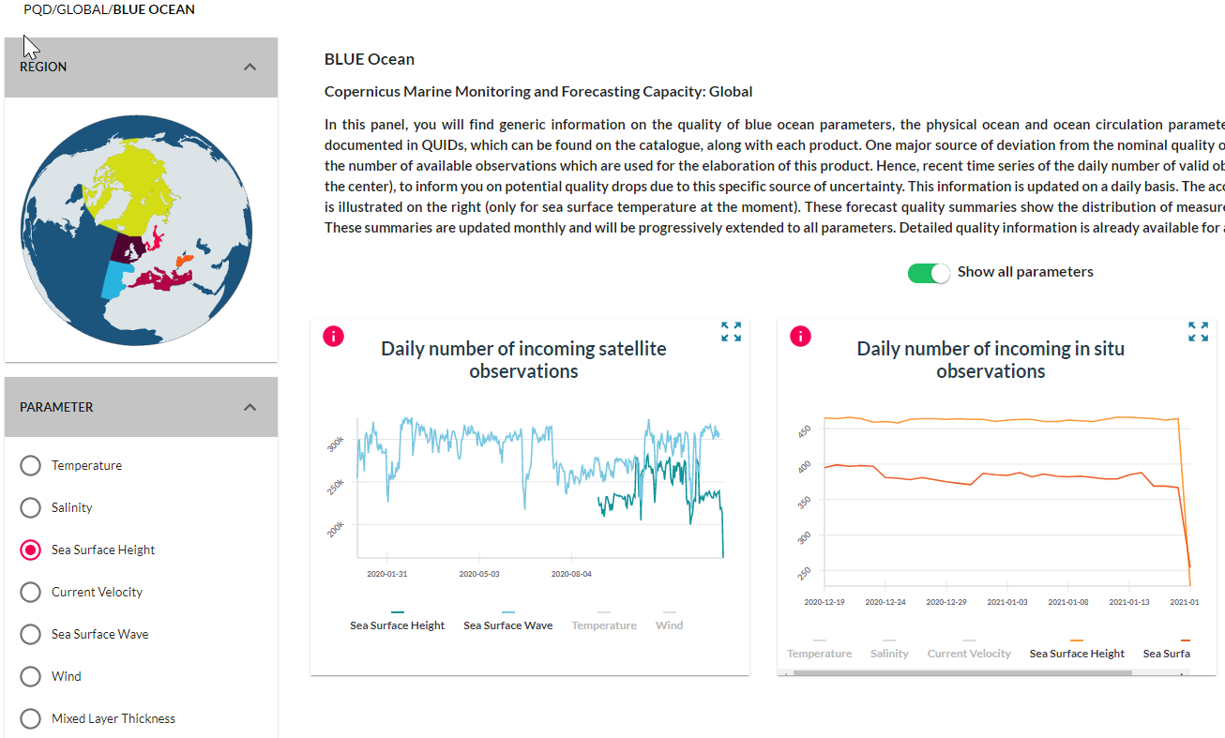
The CMEMS PQ-Dasboard
Number of observations updated daily -> a drop in obs coverage induces a drop in quality.
Valid points in one L3 per parameter.
Missing information -> regular updates are planned.
Per area and Blue/White/Green.
Notes:
PQ: Product quality
PC: production centres, i.e. data producers for CMEMS. Contracted to provide satellite or in situ observations (TACs), or forecast / reanalysis (MFCs).
TAC: Thematic Assembly Centre (observations). SL: Sea level; OC: Ocean colour; OSI: Sea ice, surface wind and sea surface temperature; INS: In situ.
MFC: Monitoring and Forecasting Centre (forecasts or reanalisys). GLO: Gobal; ARC: Arctic; BAL: Baltic Sea; NWS: North west shelf; IBI: Iberia-Biscay-Ireland; MED: Mediterranean Sea; and BS: Black Sea.
QUID: Quality information document
SE: Service evolution program; a series of contracts to provide the improvements to future systems by including (e.g.) missing or poorly described processes, or by applying innovative techniques or analysis. It is a tier 2 contract which lasts typically 2 years and the third one the findings are implemented into the service. It is guided by the CMEMS R&D roadmap.

Slide 10
CMEMS, answering user needs on PQ
New PQ-Dashboard in 2020
Produce synthetic overview of PQ (for each product)
Produce user friendly scores
Higher resolution for error estimates
More information on quality flags
Add number of (good) observations
Explain why some products/datasets may be « less » validated
Add online technical lectures
Provide error estimates as dataset
Continuous enhancement of PQ metrics
Evolution of PQ QUID docs in 2020
Continuous improvement of training material
Continuous improvement of catalogue
Main PQ working lines
Notes:
PQ: Product quality
PC: production centres, i.e. data producers for CMEMS. Contracted to provide satellite or in situ observations (TACs), or forecast / reanalysis (MFCs).
TAC: Thematic Assembly Centre (observations). SL: Sea level; OC: Ocean colour; OSI: Sea ice, surface wind and sea surface temperature; INS: In situ.
MFC: Monitoring and Forecasting Centre (forecasts or reanalisys). GLO: Gobal; ARC: Arctic; BAL: Baltic Sea; NWS: North west shelf; IBI: Iberia-Biscay-Ireland; MED: Mediterranean Sea; and BS: Black Sea.
QUID: Quality information document
SE: Service evolution program; a series of contracts to provide the improvements to future systems by including (e.g.) missing or poorly described processes, or by applying innovative techniques or analysis. It is a tier 2 contract which lasts typically 2 years and the third one the findings are implemented into the service. It is guided by the CMEMS R&D roadmap.

Slide 11
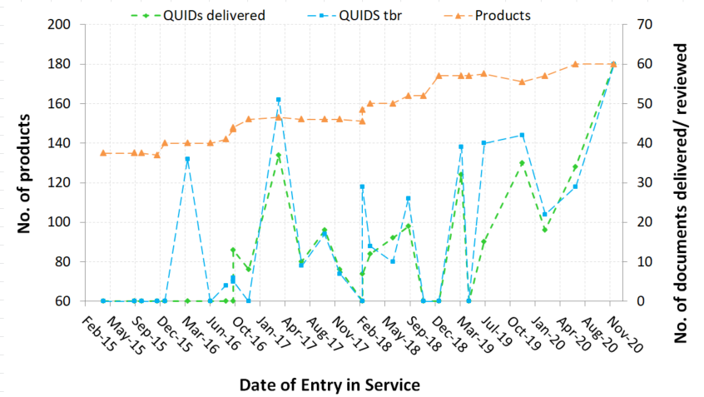
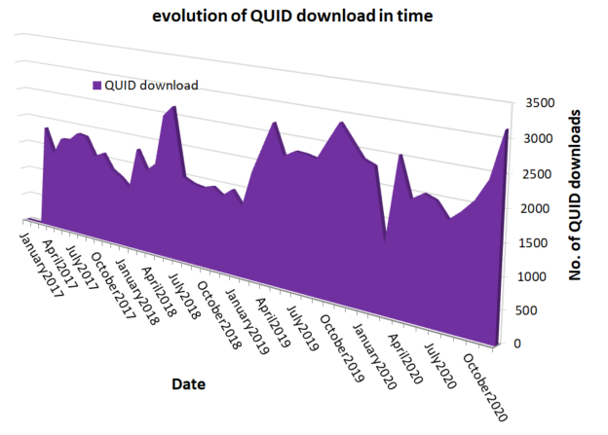
PQ – product information doc
QUality Information Documentation
Quality information document (QUID):
Detailed description of product + scientific assessment + extended validation with all metrics + references.
Quality Information Documents reviewed internally:
Achieved increased maturity of procedures and documents are fit-for-purpose (user oriented);
More homogeneous and standardised;
> Will become producers’ reference reports in Copernicus 2, peer review process under evaluation.
> Will increase consistency with other Copernicus services;
Quality Information Documents are downloaded alongside products:
Working on a lighter document which evolves with the product “Synthesis Quality Overview”.
Notes:
PQ: Product quality
PC: production centres, i.e. data producers for CMEMS. Contracted to provide satellite or in situ observations (TACs), or forecast / reanalysis (MFCs).
TAC: Thematic Assembly Centre (observations). SL: Sea level; OC: Ocean colour; OSI: Sea ice, surface wind and sea surface temperature; INS: In situ.
MFC: Monitoring and Forecasting Centre (forecasts or reanalisys). GLO: Gobal; ARC: Arctic; BAL: Baltic Sea; NWS: North west shelf; IBI: Iberia-Biscay-Ireland; MED: Mediterranean Sea; and BS: Black Sea.
QUID: Quality information document
SE: Service evolution program; a series of contracts to provide the improvements to future systems by including (e.g.) missing or poorly described processes, or by applying innovative techniques or analysis. It is a tier 2 contract which lasts typically 2 years and the third one the findings are implemented into the service. It is guided by the CMEMS R&D roadmap.

Slide 12

The PQ-Working Group (WG)
A key CMEMS element
A WG of ~55 ocean sci. experts:
Meet on a yearly basis to agree
on PQ actions.
We exchange regularly on:
Upgrade of validation standards
Evolution of PQ documentation
Development of PQ-Dashboard
2019 PQ-WG Meeting (OGS; Trieste)
42 Attendees
The last PQ-WG Meeting (2020, Irish Marine Institute)
> on-line < due to covid19
CMEMS PQ main topics (definition of actions)
Novelties on reference obs (i.e. S-3, BGC-Argo)
Scientific issues…
Notes:
PQ: Product quality
PC: production centres, i.e. data producers for CMEMS. Contracted to provide satellite or in situ observations (TACs), or forecast / reanalysis (MFCs).
TAC: Thematic Assembly Centre (observations). SL: Sea level; OC: Ocean colour; OSI: Sea ice, surface wind and sea surface temperature; INS: In situ.
MFC: Monitoring and Forecasting Centre (forecasts or reanalisys). GLO: Gobal; ARC: Arctic; BAL: Baltic Sea; NWS: North west shelf; IBI: Iberia-Biscay-Ireland; MED: Mediterranean Sea; and BS: Black Sea.
QUID: Quality information document
SE: Service evolution program; a series of contracts to provide the improvements to future systems by including (e.g.) missing or poorly described processes, or by applying innovative techniques or analysis. It is a tier 2 contract which lasts typically 2 years and the third one the findings are implemented into the service. It is guided by the CMEMS R&D roadmap.

Slide 13
Questions
https://pqd.mercator-ocean.fr/?pk_vid=5688911fd2e6aba41618843139d0ce1a
https://marine.copernicus.eu/
Contact us in:
valid.cmems@mercator-ocean.fr

