Slide 1
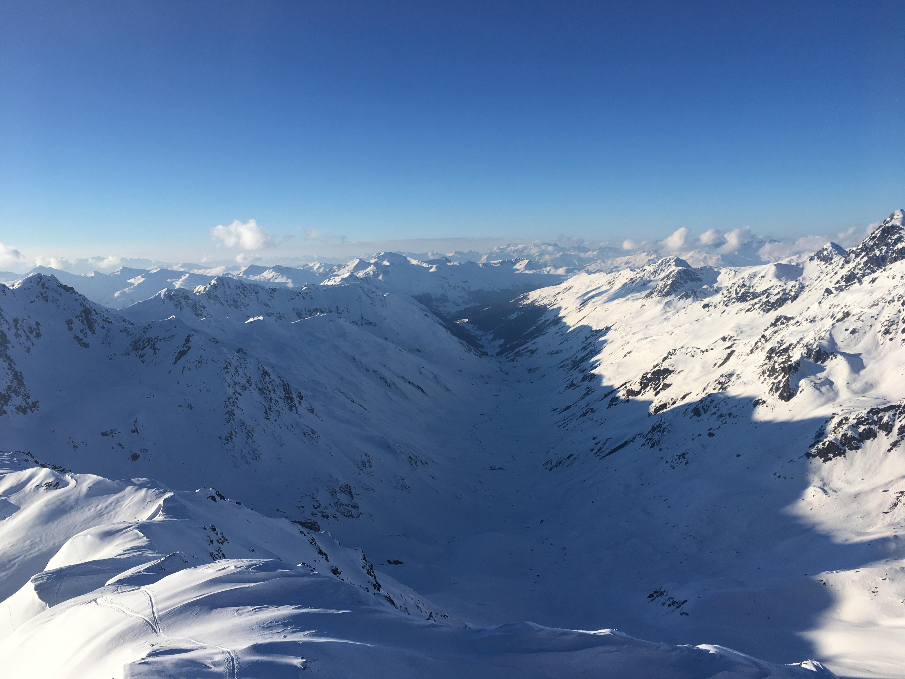
High-resolution wind fields in complex terrain for snow-atmosphere interactions
Dylan Reynolds^{1,2}, Bert Kruyt¹, Ethan D. Gutmann³,
Michael Lehning^{1,2}, Tobias Jonas¹, Rebecca Mott¹
¹WSL Institute for Snow and Avalanche Research, SLF ; ²École polytechnique fédérale de Lausanne, EPFL ; ³National Center for Atmospheric Research, NCAR

Slide 2
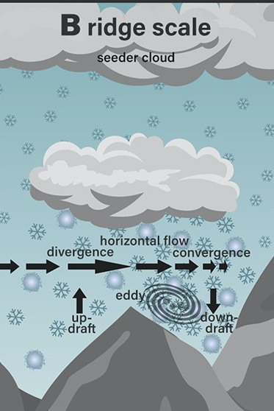
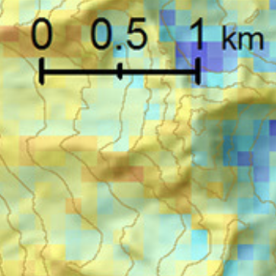
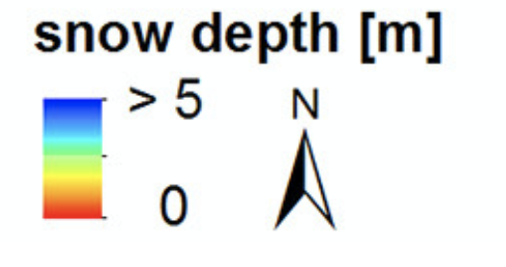
Motivation
(Mott et al. 2018)
Represent ridge-scale deposition patterns in modeled precipitation used as input to a snow model
Deposition processes depend on winds, which can vary significantly between scale regimes (1 km vs. 50m)
Dynamic downscaling required
Observed Snow Depth
“NWP Modeled Snowfall”
Downscaling
1.5 km
1.5 km
(Mott et al. 2018)
Notes:
Measurement of Winter snow depth – mainly caused by deposition patterns
Discuss dynamic downscaling right-off-the-bat
-dynmaical downscaling allows you to account for inter-varaible consistency
-explain the processes involved in preferential deposition
-Leeward snow loading caused by speed up and eddies

Slide 3
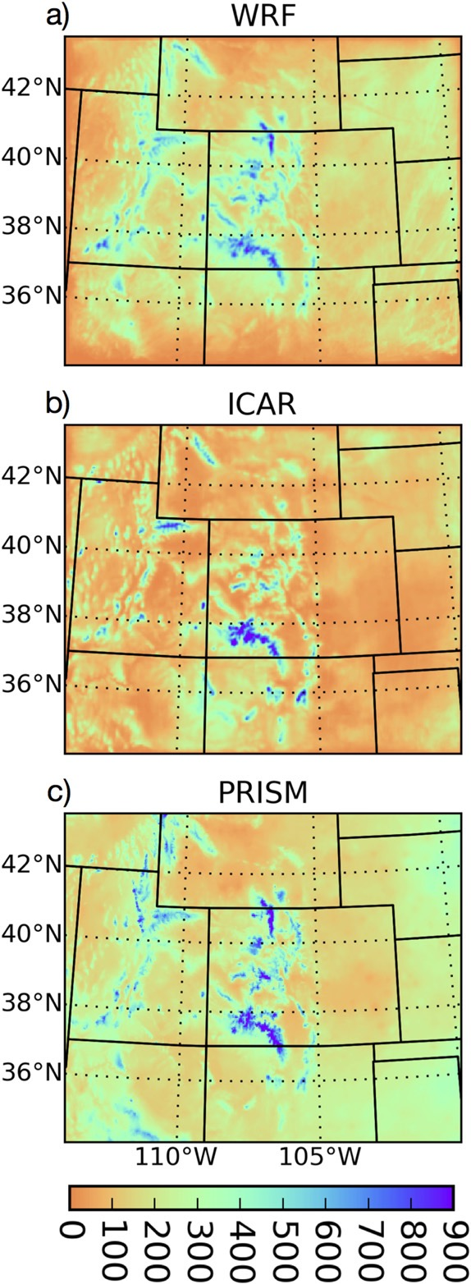
Dynamic downscaling with ICAR
Intermediate Complexity Atmospheric Research model
3D atmospheric model, no Navier-Stokes Equations
Run at grid sizes ~= 4km (Horak et al. 2019, Gutmann et al. 2016)
Overall good agreement with more complex atmospheric models
Snow-atmosphere feedbacks
Michi Haugeneder -- HS2.1.7/CR7.3
(Gutmann et al. 2016)
Notes:
It could be worth mentioning that the driving model ICAR usually downscales has a grid spacing of ~25-250km, and that it makes sense to apply linear mountain wave theory in that context.

Slide 4
Difference of Scales
Prior Studies
Forcing Data Resolution
ICAR Resolution
Gutmann et al. 2016
36 x 36 km
4 x 4 km
Horak et al. 2019
81 x 110 km
4 x 4 km
Preferential deposition occurs at scales <= 50m (Gerber et al. 2019)
Wind dynamics in this scale range, especially in complex terrain, necessitates a new dynamical core
This has lead to “HICAR”, the High-resolution variant of ICAR
This Setup
1 km x 1 km
50 x 50 m
GCM/ Reanalysis Data
Atmospheric Models
Snow Models
~100-10 km
~10-1 km
~100-10 m

Slide 5
HICAR Setup
Input: 1-km COSMO Forcing data
Grid:
50m horizontal resolution
~ 30 x 30 km area [555 x 615] cells
60 vertical levels, dz = 20m at surface
Model top ~7-km above surface
Notes:
-COSMO – NWP model. Used operationally over Switzerland, input provided at 1 km resolution
-2 resolutions of ICAR runs, for now we will just discuss 250m
-Varying vertical resolution, extent up to 7km

Slide 6
Changes to wind field for complex terrain
Base interaction of winds with terrain on atmospheric conditions (stability, wind speed)
Use pre-computed terrain descriptors to keep model complexity low
Winstral et al. 2017 found success downscaling COSMO-2km to meteorological stations using the terrain-descriptors:
TPI
Sx
(Winstral et al. 2017)
Notes:
Prior studies have notted resolutions of 50m may be necessary to resolve pref dep
We are using TPI and Sx since they were used to great benefit by Winstral et al. 2017

Slide 7
TPI – A tale of two mountains
50 m
Forcing Data: 1 km
D = 1km
+ TPI
TPI is the difference between local elevation and the mean elevation within a search window
If the search window distance is the same as the forcing data resolution, TPI is a proxy for the error between forcing DEM and high-resolution DEM
Areas with TPI > 0 are sharp terrain features which are smoothed in the forcing DEM

Slide 8
Sx Parameter – Maximum Upwind Slope
Wind Direction
Elevation
-
+
-
Notes:
TPI – Topographic position index: A measure of our difference from terrain represented at forcing data resolution
Sx – Maximum upwind slope

Slide 9
3-D Sx Sheltering
Wind Direction
Elevation
Notes:
If we have flow separation, sheltering will extend above the surface as well

Slide 10
3-D Sx Sheltering
Wind Direction
Elevation
Notes:
We calculate Sx for model grid cells above surface as well

Slide 11
3-D Sx Sheltering
Wind Direction
Elevation
Step up vertically from surface until Sx is found to be negative. Now the Sx of the whole sheltered region is calculated
Notes:
…stepping up until we find that we are no longer sheltered

Slide 12
3-D Sx Exposure
Wind Direction
Elevation
Notes:
Similarly, for exposed grid cells, we calculate exposure vertically. This is done since there should exist some speed up as we move away from the surface friction

Slide 13
3-D Sx Exposure
Wind Direction
Elevation
For exposed grid cells,
there should be some additional speed up, extending slightly above surface
Notes:
Currently, this is done for an arbitrary number of cells above the surface

Slide 14
Sx + TPI
At 1km, COSMO captures some speed up/sheltering effects
We only want to apply adjustment where high-elevation, high-resolution terrain features are not represented by low-resolution DEM: where TPI > 0
Only apply sheltering where TPI of sheltering element > 0
Only speed up winds where TPI > 0
High-peak
Low-hill
TPI
-
+
0

Slide 15
Stability-dependent sheltering
Menke et al. 2019, Gerber et al. 2017 characterize flow separation as a function of terrain, Richardson’s Number (Ri), wind speed (WS)
Define angle ϴ, which is the threshold Sx angle for sheltering to occur
ϴ
ϴ = fn(Ri,WS)
Ri <= 0
-and/or-
WS >> 0
Ri >> 0
-and/or-
WS ~ 0
Area of separation/sheltering
No separation/sheltering

Slide 16
Stability-dependent divergence splitting
Forcing data from a compressible atmospheric model and terrain-adjustments introduce divergence to wind field
Final wind field must be 0-divergence for mass-consistency
Existing divergence is removed by adjusting vertical or horizontal motion, depending on local Froude number (Fr)
Very unstable (Fr >> 1)
Very stable (Fr ~ 0)
Hill
Hill

Slide 17
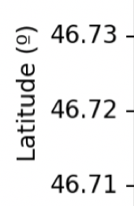
Case study: 28/10/2015, Dischma valley
Observational wind LiDAR data from Gerber et al. 2017
Observed lee-side eddy formation in complex terrain
DEM
2900
Elevation (m)
2000
Field of view shown by angle to the right

Slide 18
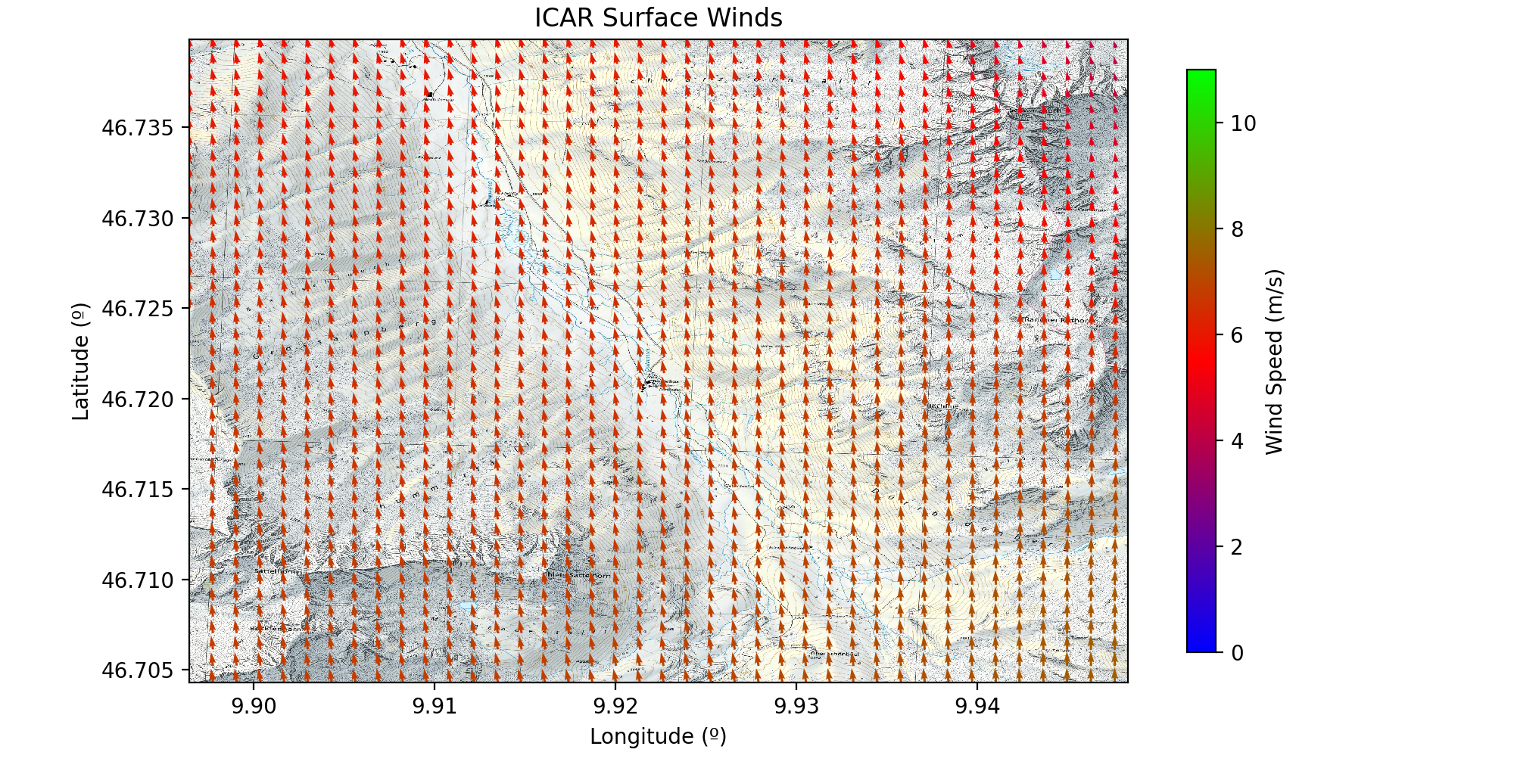
Model without modifications:

Slide 19
Model with modifications:

Slide 20
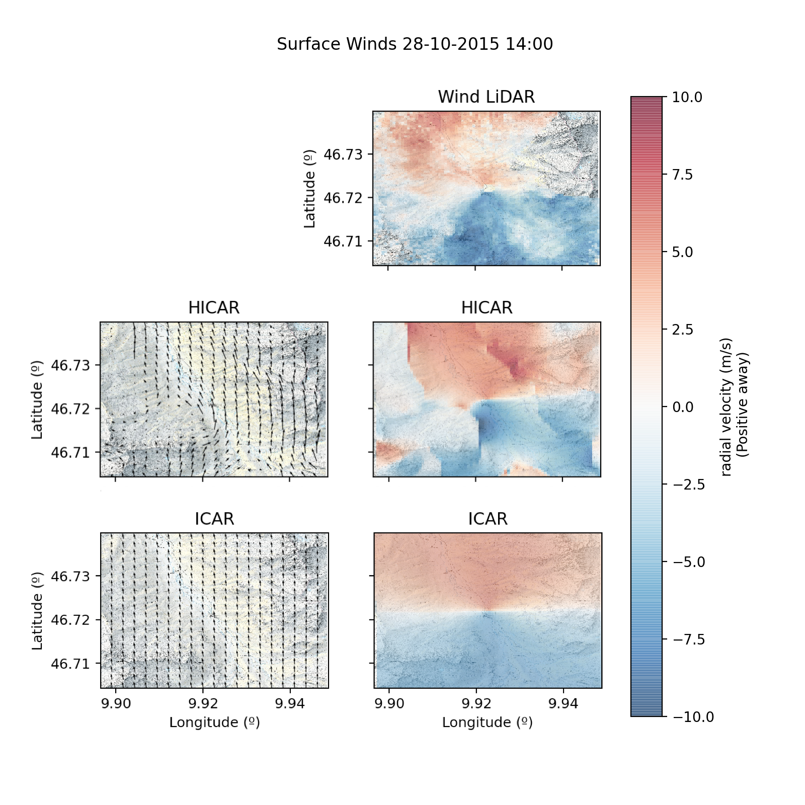
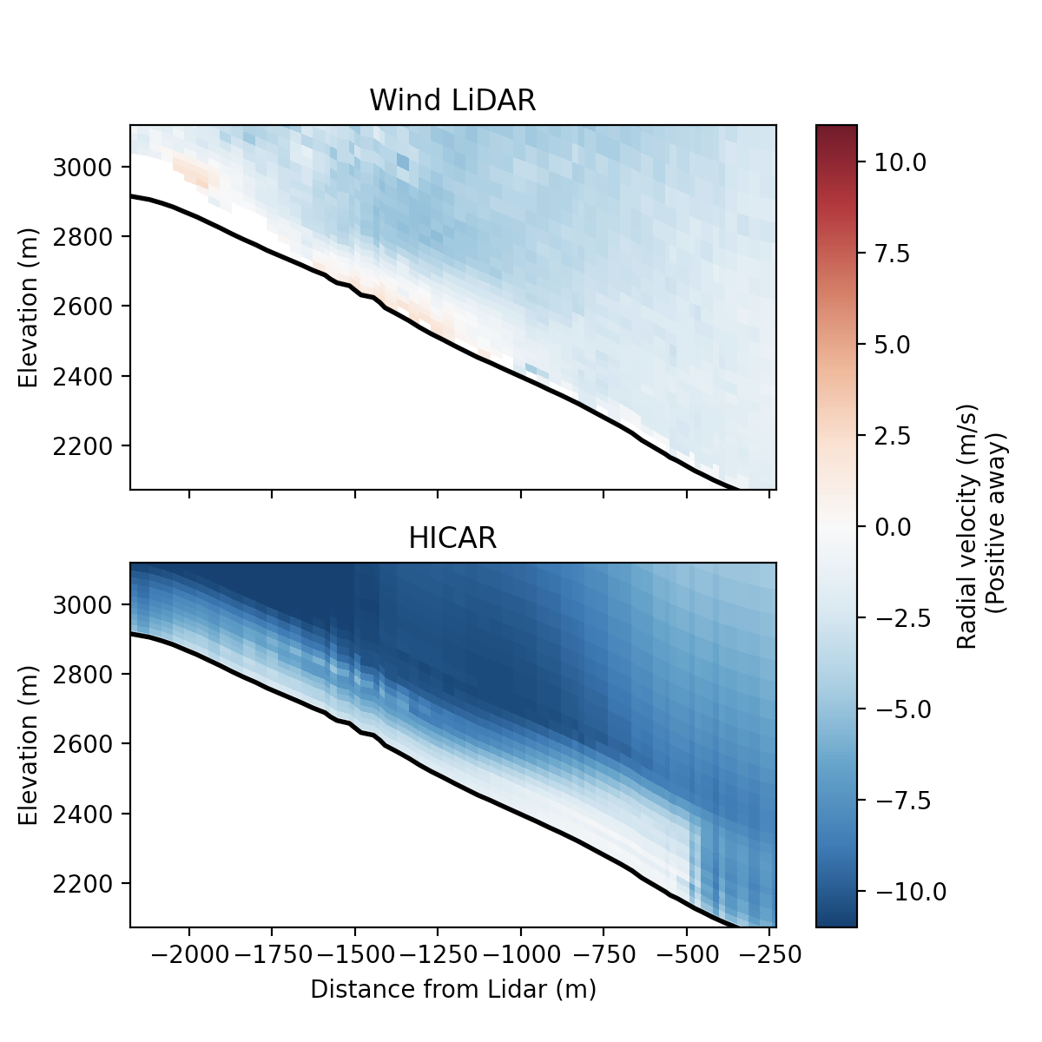
Comparison to wind LiDAR
PPI Scan
= wind LiDAR location
Presence of lee-side eddy, important for preferential distribution (Gerber et al. 2017, 2019)
captured by HICAR
Red line corresponds to vertical transect below
DEM
2900
Elevation (m)
2000

Slide 21
Advantages of approach
Sx and TPI are computed once on model initialization
Sheltering/exposure adjustments are local, linear operations
Stability is parameterized through divergence splitting, only additional calculation is of Froude Number
Hourly time-step of HICAR is 5% increase over ICAR

Slide 22
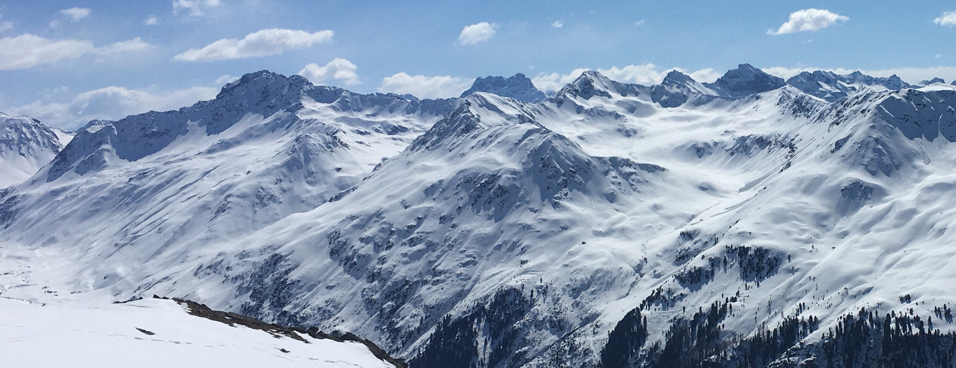
Future work
Calibration of stability-dependent corrections using observational wind LiDAR data from Winter 2020/2021
Analysis of modeled snow deposition patterns at the ridge scale when compared to observations

