Slide 1
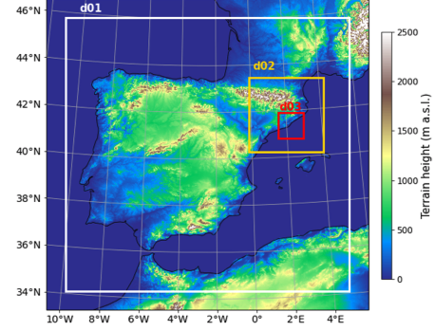
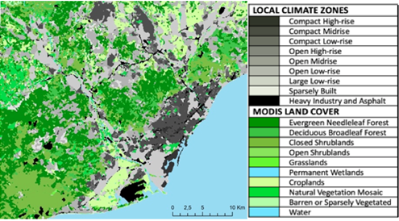
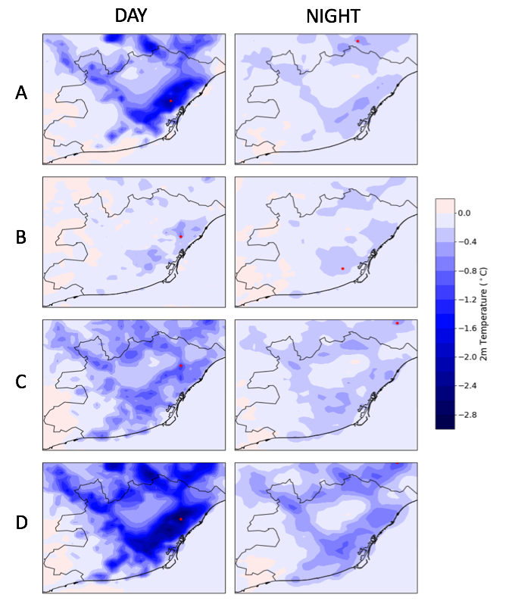
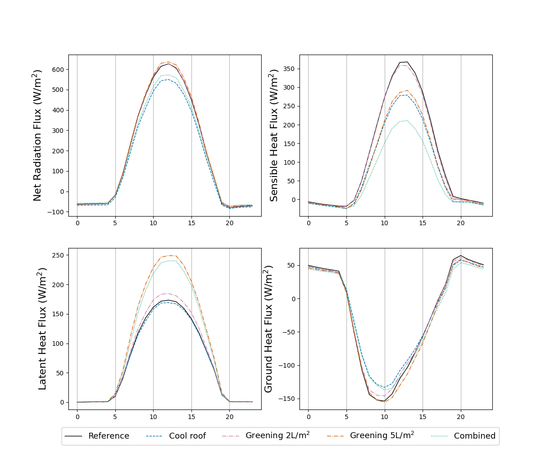

Assessing heat wave mitigation strategies in a Mediterranean coastal city: how effective are cool roofs and urban green?
Sergi Ventura, Alba Badia, Ricard Segura, Joan Gilabert, Carme Llasat, Alberto Martilli and Gara Villalba
Three nested domains used to run WRF
A: Cool roof: Albedo up to 0.85
B: Greening with increased irrigation to 2L/m²day
C: Greening
with increased irrigation to 5L/m²day
D: Combined cool roofs & greening with 5L/m²day
irrigation
Metropolitan Area of Barcelona with each MODIS Land Cover and Local Climate Zone
- WRF with the urban scheme BEP+BEM including 11 urban classes, urban surfaces in three dimensions, energy budget and heat fluxes.
- Heat wave occurred in August 2015.
- Four mitigation scenarios:
A: -0.67°C / B: -0.15°C
C: -0.61°C/ D: -1.26°C

Slide 2
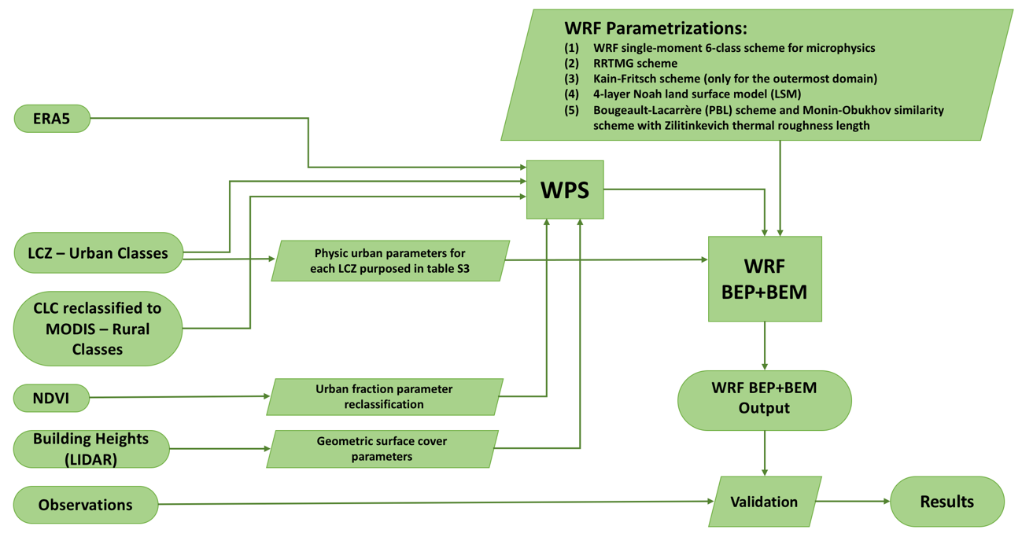
Assessing heat wave mitigation strategies in a Mediterranean coastal city: how effective are cool roofs and urban green?
Sergi Ventura, Alba Badia, Ricard Segura, Joan Gilabert, Carme Llasat, Alberto Martilli and Gara Villalba
Methods
A flowchart depicting the roadmap of the study as well as the interactions between different physical parameterizations in the modeling process.

Slide 3
Assessing heat wave mitigation strategies in a Mediterranean coastal city: how effective are cool roofs and urban green?
Sergi Ventura, Alba Badia, Ricard Segura, Joan Gilabert, Carme Llasat, Alberto Martilli and Gara Villalba
Scenario 1: Increasing cool roofs
-The “cool roof” scenario increments the albedo of certain rooftops to 0.85 by painting them white. Albedo implemented for LCZ’s 1, 2, 4, 5 and 8. These LCZ have mostly accessible flat roofs.
Sharma, A., Conry, P., Fernando, H.J.S., Hamlet, A.F., Hellmann, J.J., Chen, F., 2016. Green and cool roofs to mitigate urban heat island effects in the Chicago metropolitan area: Evaluation with a regional climate model. Environ. Res. Lett. 11. https://doi.org/10.1088/1748-9326/11/6/064004

Slide 4
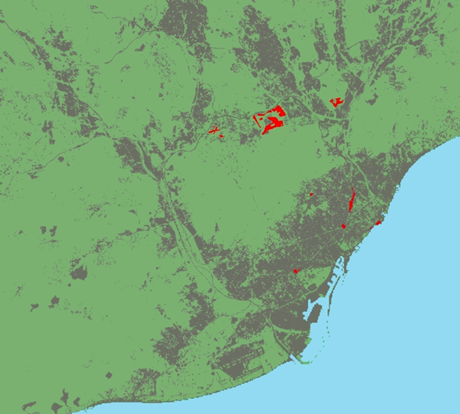
Assessing heat wave mitigation strategies in a Mediterranean coastal city: how effective are cool roofs and urban green?
Sergi Ventura, Alba Badia, Ricard Segura, Joan Gilabert, Carme Llasat, Alberto Martilli and Gara Villalba
Scenarios 2 and 3: Greening
Scenario 4: Combined
-Urban green areas increased according to the targets set by the Urban Master Plan (PDU) of the AMB. Addition of 6 urban parks and green areas with a total of 255.64 ha by 2030.
-Vegetation fraction increases from 32.54 to 35.92
-Urban fraction decreases from 53.04 to 48.68
-Daily irrigation of 2L/m² and 5L/m² respectively from 4:00 to 5:00 UTC (Ajuntament de Barcelona)
-Combination of the cool roofs and the additional urban green space, with 5L/m² irrigation.

Slide 5
Assessing heat wave mitigation strategies in a Mediterranean coastal city: how effective are cool roofs and urban green?
Sergi Ventura, Alba Badia, Ricard Segura, Joan Gilabert, Carme Llasat, Alberto Martilli and Gara Villalba
Results
A: Cool roof: Albedo up to 0.85
B: Greening with increased irrigation to 2L/m²day
C: Greening
with increased irrigation to 5L/m²day
D: Combined cool roofs & greening with 5L/m²day
irrigation
A: -0.41°C
Highest reduction of 3.83°C at day (15:00 local time) and 1.63°C at night (7:00 local time)
B: -0.14°C
Highest reduction of 1.7°C at day (13:00 local time) and 1.24°C at night (5:00 local time)
C: -0.41°C
Highest reduction of 2.46°C at day (17:00 local time) and 1.44°C at night (3:00 local time)
D: -0.8°C
Highest reduction of 4.73°C at day (15:00 local time) and 1.88°C at night (21:00 local time)

Slide 6
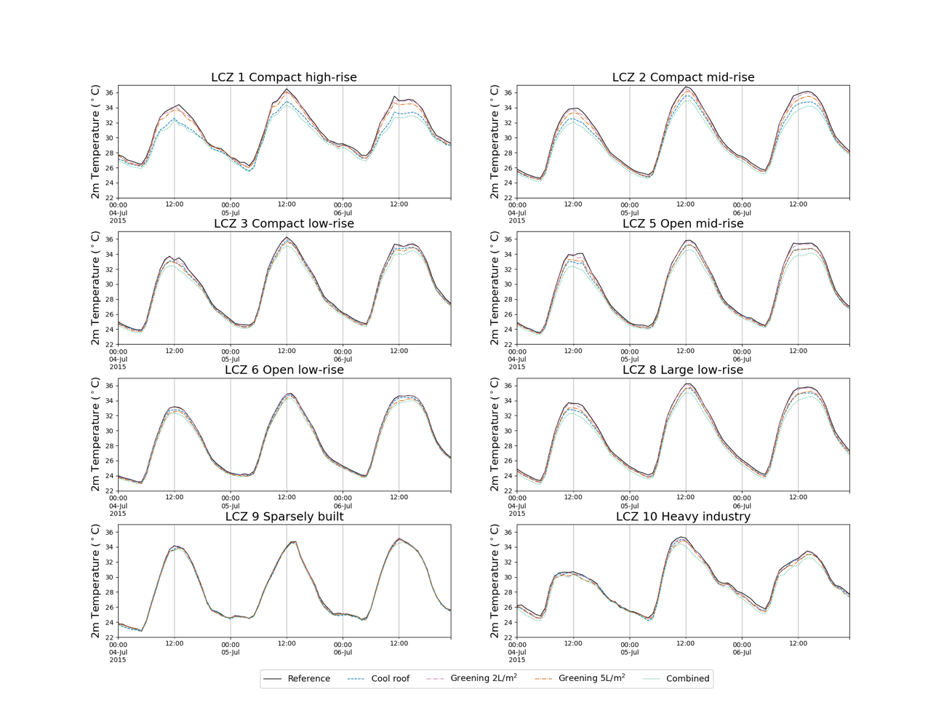
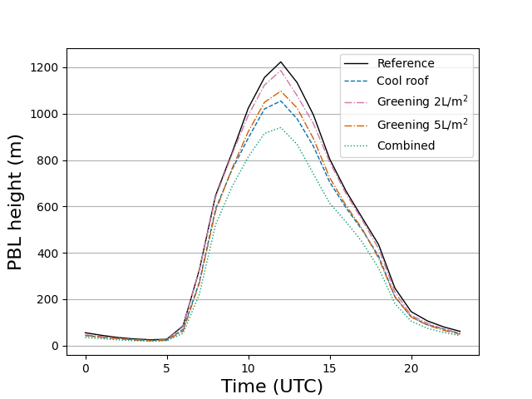
Assessing heat wave mitigation strategies in a Mediterranean coastal city: how effective are cool roofs and urban green?
Sergi Ventura, Alba Badia, Ricard Segura, Joan Gilabert, Carme Llasat, Alberto Martilli and Gara Villalba
2m temperature profile of various LCZ’s for the three scenarios during the three hottest days of the simulation
Urban boundary layer height for the different scenarios

