Slide 1
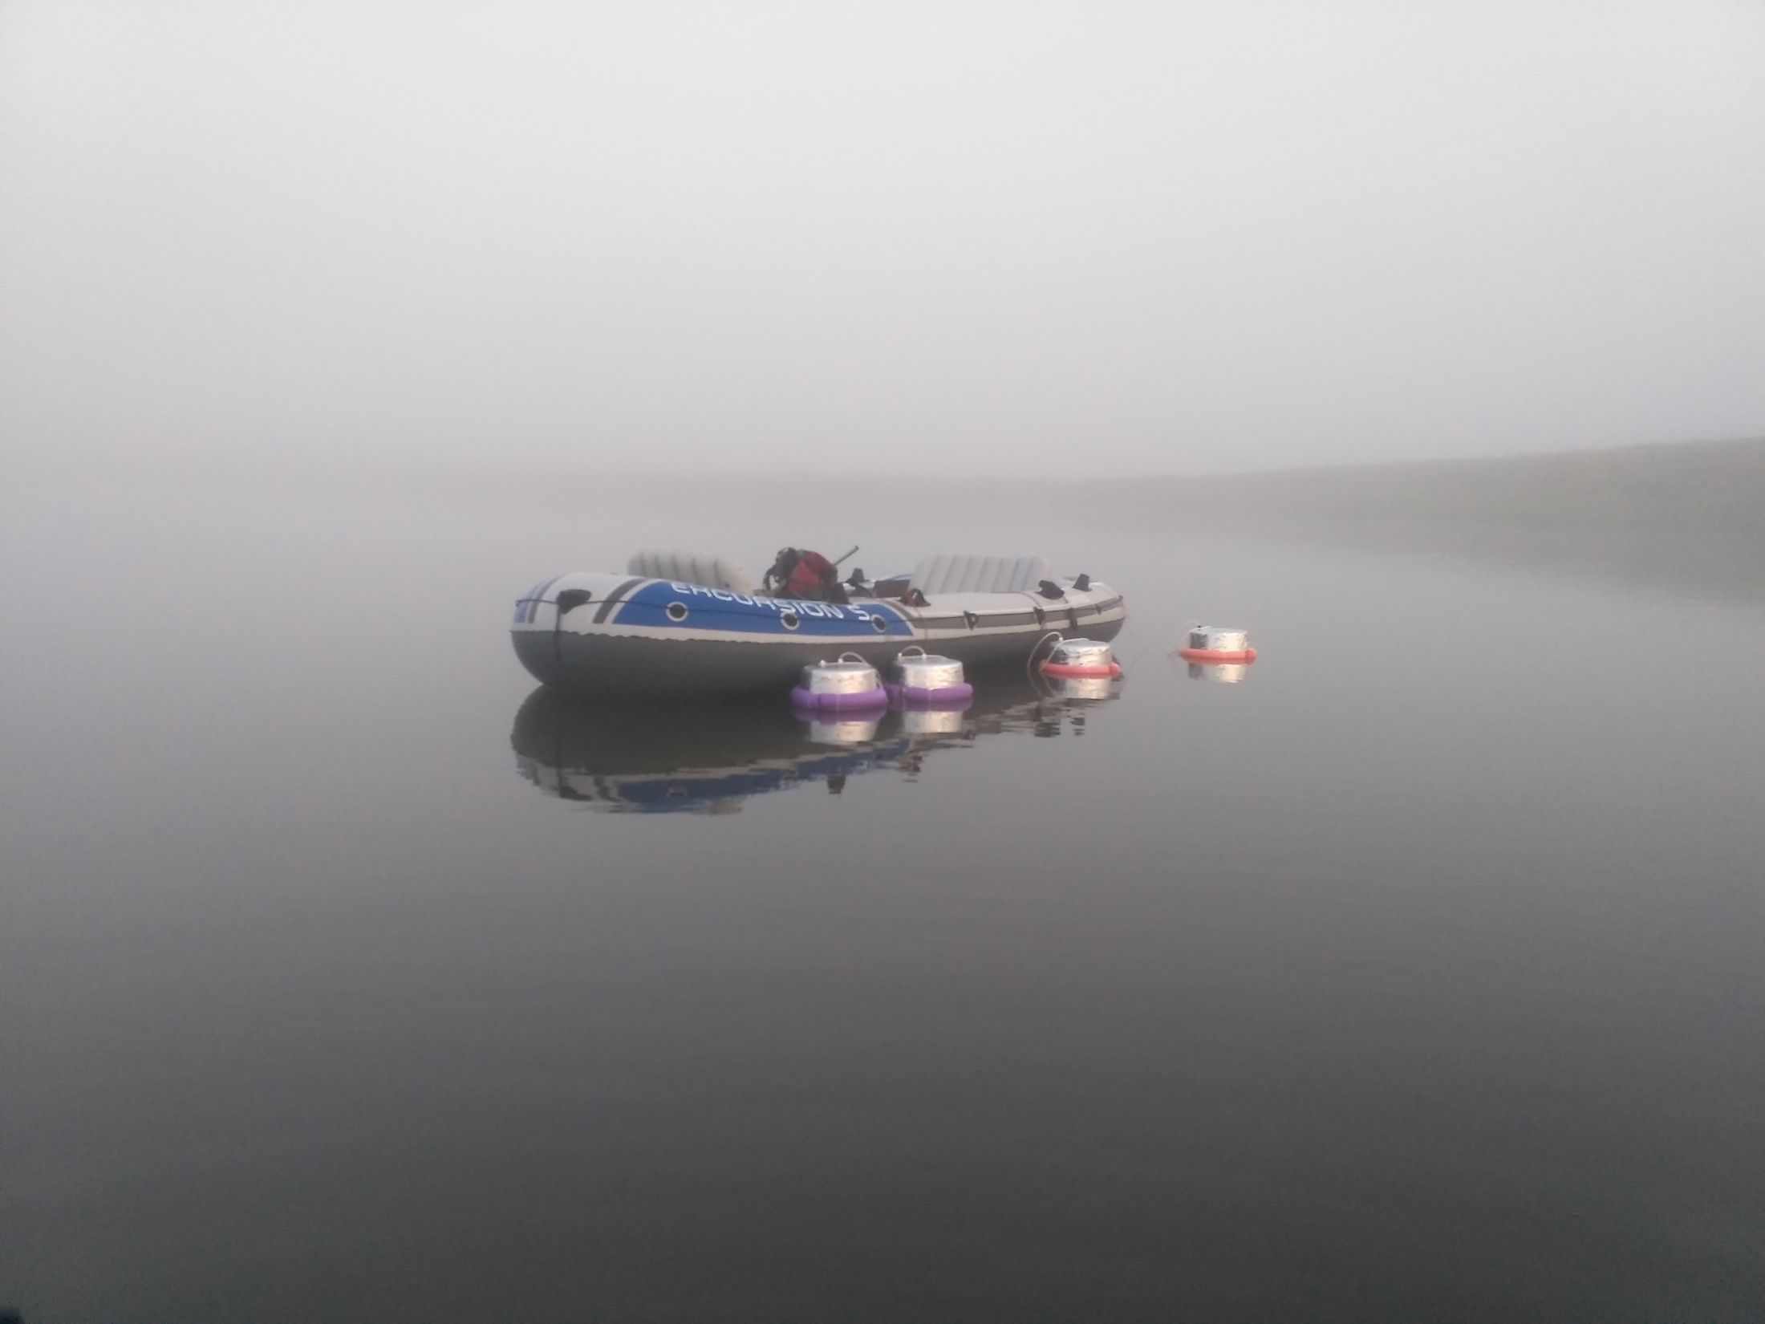


Features of the diffusive CH₄ emission measurements on lakes by chamber method
Liudmila Krivenok (krivenok@ifaran.ru) and Vladimir Kazantsev
A.M. Obukhov Institute of Atmospheric Physics RAS, Moscow, Russia

Slide 2
Methane emission from lakes
Methane is one of the main greenhouse gases in the atmosphere. Lakes are the third-largest natural source of methane on a global scale [Kirschke et al., 2013].
[Anderson et al., 2010]

Slide 3
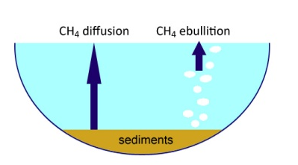
Methane emission from lakes during open-water period
Chamber method is quite often applied in the GHG emission measurements from freshwater ecosystems.
In such cases it is important to divide diffusive and bubble pathways of CH₄ emission.
Customary floating chambers with plastic shields underside are not blocking diffusive transfer but preventing gas bubbles from entering into the chamber.

Slide 4
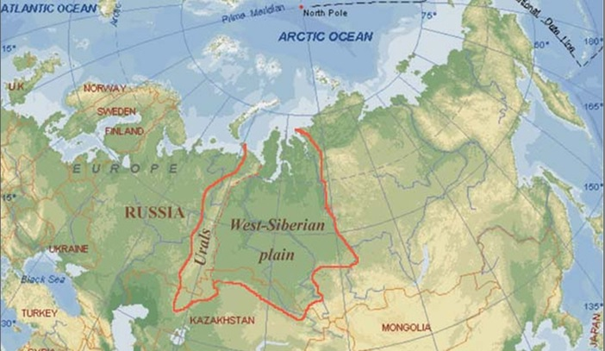
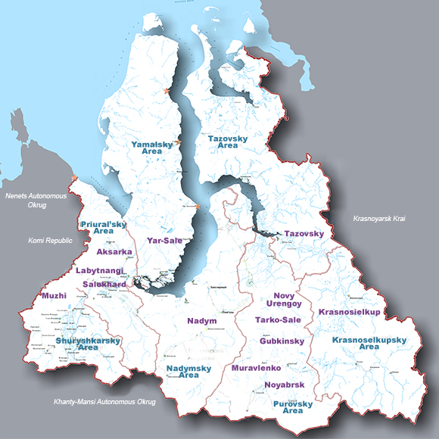
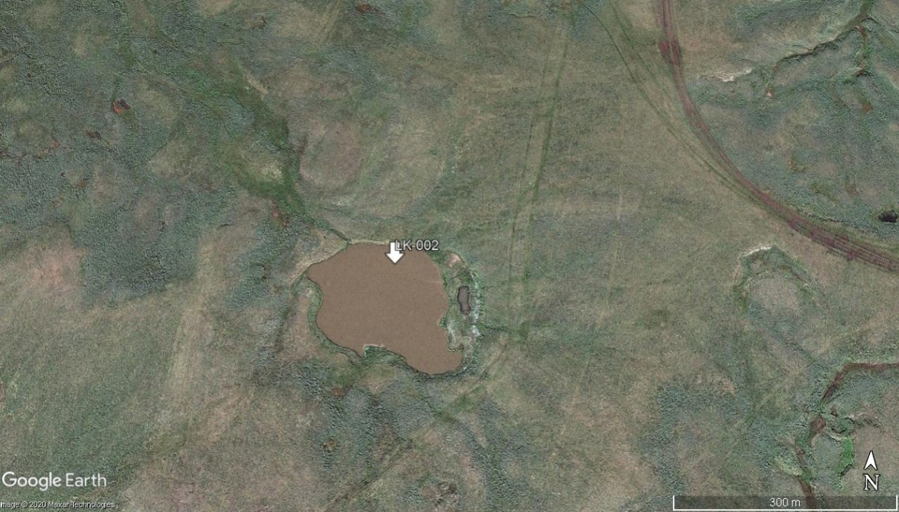
Study object
Vaskiny Dachi field station (68.8663° N, 70.3040° E, Central Yamal, Western Siberia, Russia).
Measurements were conducted 19-20 August 2019.
Average lake depth 2 m, at the measurement point 1.6 m.
Lake size: 280х210 m.
thermokarst lake LK-005

Slide 5
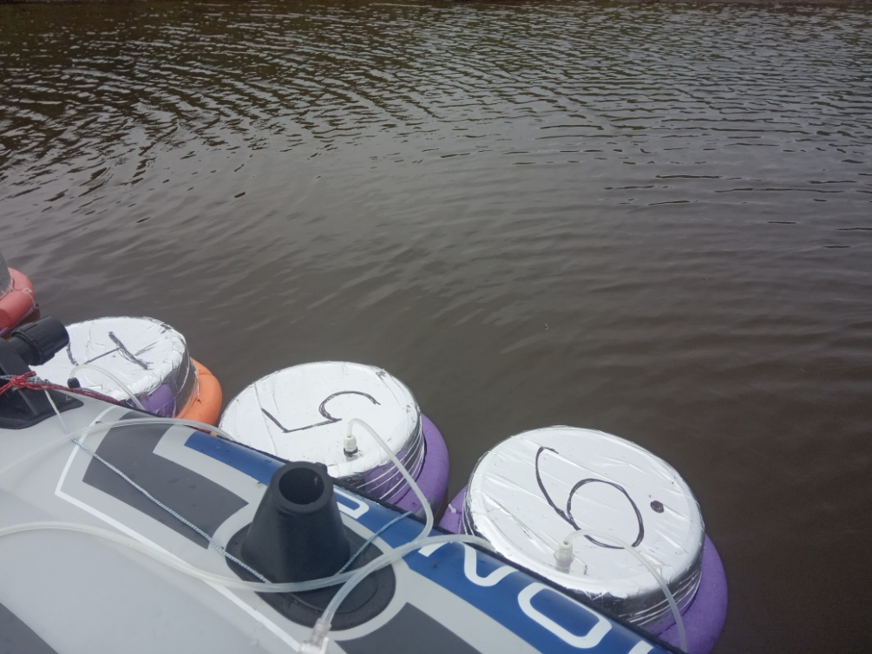
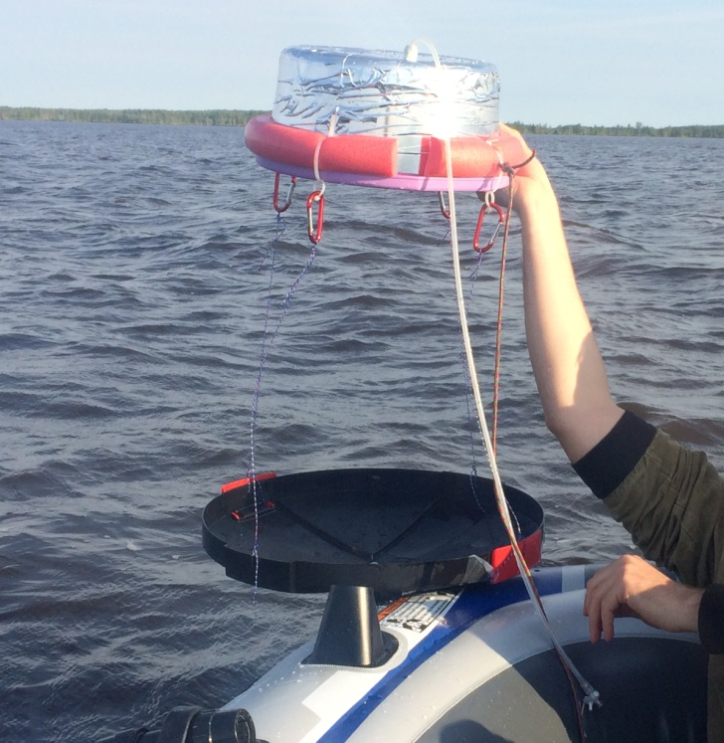
Field methods
To compare results of customary and modified chambers, samples were taken in parallel from chambers with and without shields (two chambers of each type) every two hours during the day with the exposure time of 30 min for single flux. Sampling was conducted according to [Bastviken et al., 2010].
Additional parameters were measured: bottom and surface water temperature, EC, pH, air temperature, wind velocity, atmospheric pressure.

Slide 6
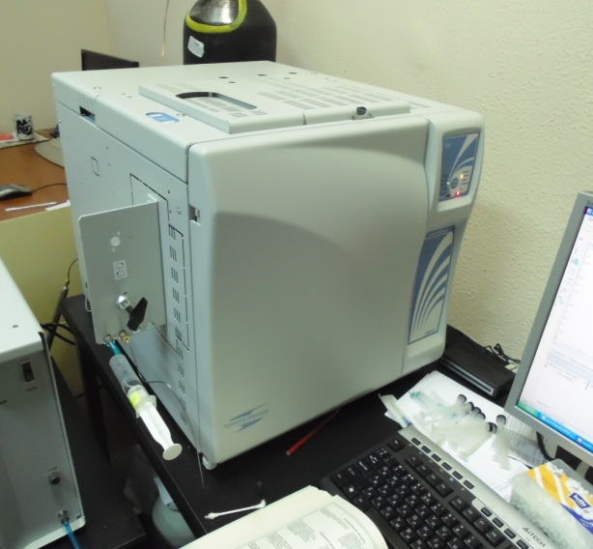
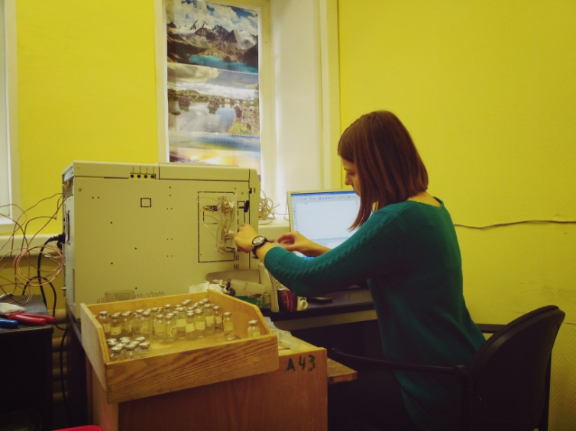
Laboratory methods
The methane concentrations in samples were determined in the laboratory by a Crystal 5000.2 gas chromatograph with a flame ionization detector. Fluxes were calculated according to [Bastviken et al., 2010] using the coefficient of gas exchange between water and atmosphere.

Slide 7
Results
Diurnal dynamics of the CH₄ fluxes (chamber with shield)
• measured
• modeled
Diurnal dynamics of the CH₄ fluxes (chamber without shield)

Slide 8
Results
Diurnal dynamics of the CH₄ fluxes (chamber with shield)
• measured
• modeled
According to the sign test for the 0.05 p-level, methane fluxes measured using chambers with and without shields differ statistically significant considering their diurnal dynamics. At the same time, within the group of fluxes measured by the same type of chambers, no statistically significant differences were found, and mean and median flux values are higher for chambers without shields.
Diurnal dynamics of the CH₄ fluxes (chamber without shield)

Slide 9
Results
Diurnal dynamics of the CH₄ fluxes (chamber with shield)
• measured
• modeled
running hour
F=(0.048±0.005)+(0.003±0.0004)*T_{air}*sin(2π*((-3.041±0.567)-h)*24⁻¹),
F – methane flux, mgC m⁻² h⁻¹;
T_{air} – air temperature, °C;
π ≈ 3.1416;
h – running hour, h;
U – Theil coefficient. U=0.10 (rather good approximation quality)
Average fluxes varies from 0.02 to 0.12 mgC m⁻² h⁻¹.

Slide 10
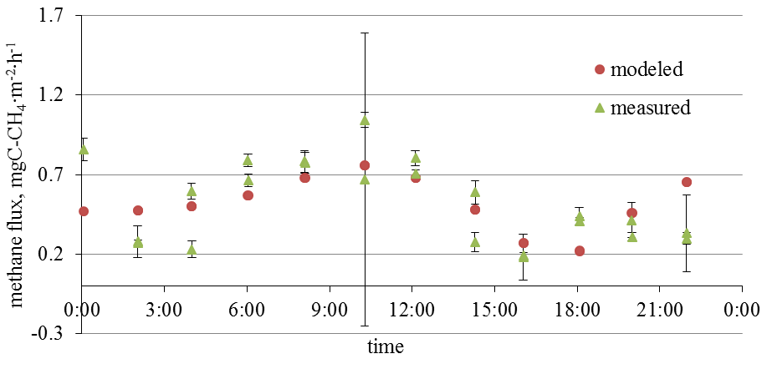
Results of 2016: diurnal dynamic of CH₄ fluxes for thermokarst lake
F=(0.47±0.01)+(0.012±0.001)∙T_{air}∙sin([𝝅∙(1.14±0.11-h)/24]²)
F – methane flux, mgC m⁻² h⁻¹;
T_{air} – air temperature, °C;
π ≈ 3.1416;
h – running hour, h;
U – Theil coefficient. Coefficient of approximation quality. U=0.03
T_{air} [14.4; 24.9], p< 0.05.
[Kazantsev et al., 2018]

Slide 11
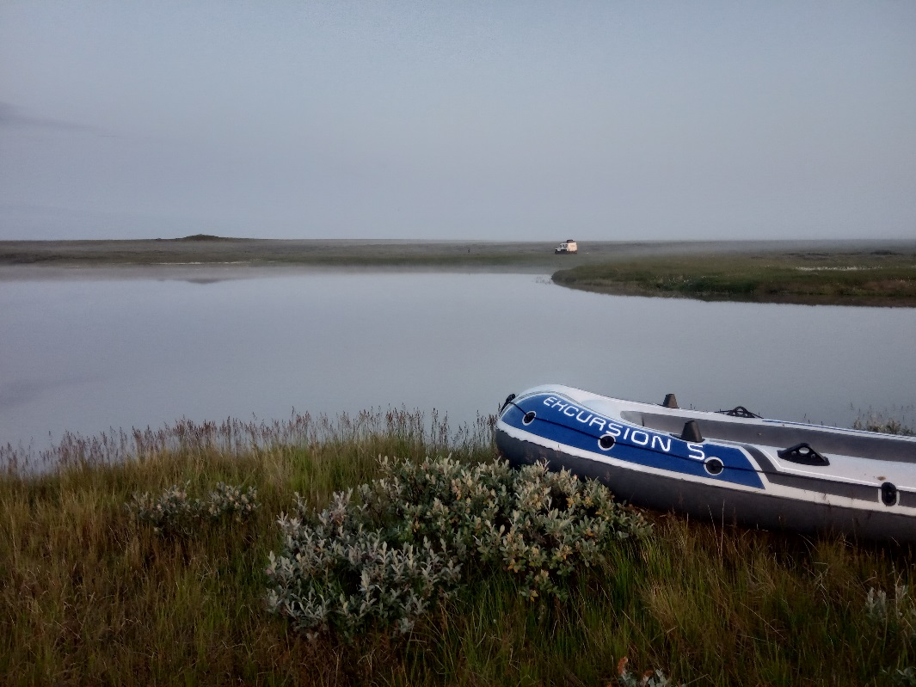
To sum up:
Methane fluxes measured using chambers with and without shields differ statistically significant considering their diurnal dynamics. Observed differences are not due to natural variability, but due to the contribution of bubble component to the fluxes measured by chambers without shields.
The diurnal dynamic of CH₄ fluxes from thermokarst lakes is important to make representative assessments and can be described by the harmonic regression on air temperature and running hour.

