Slide 1


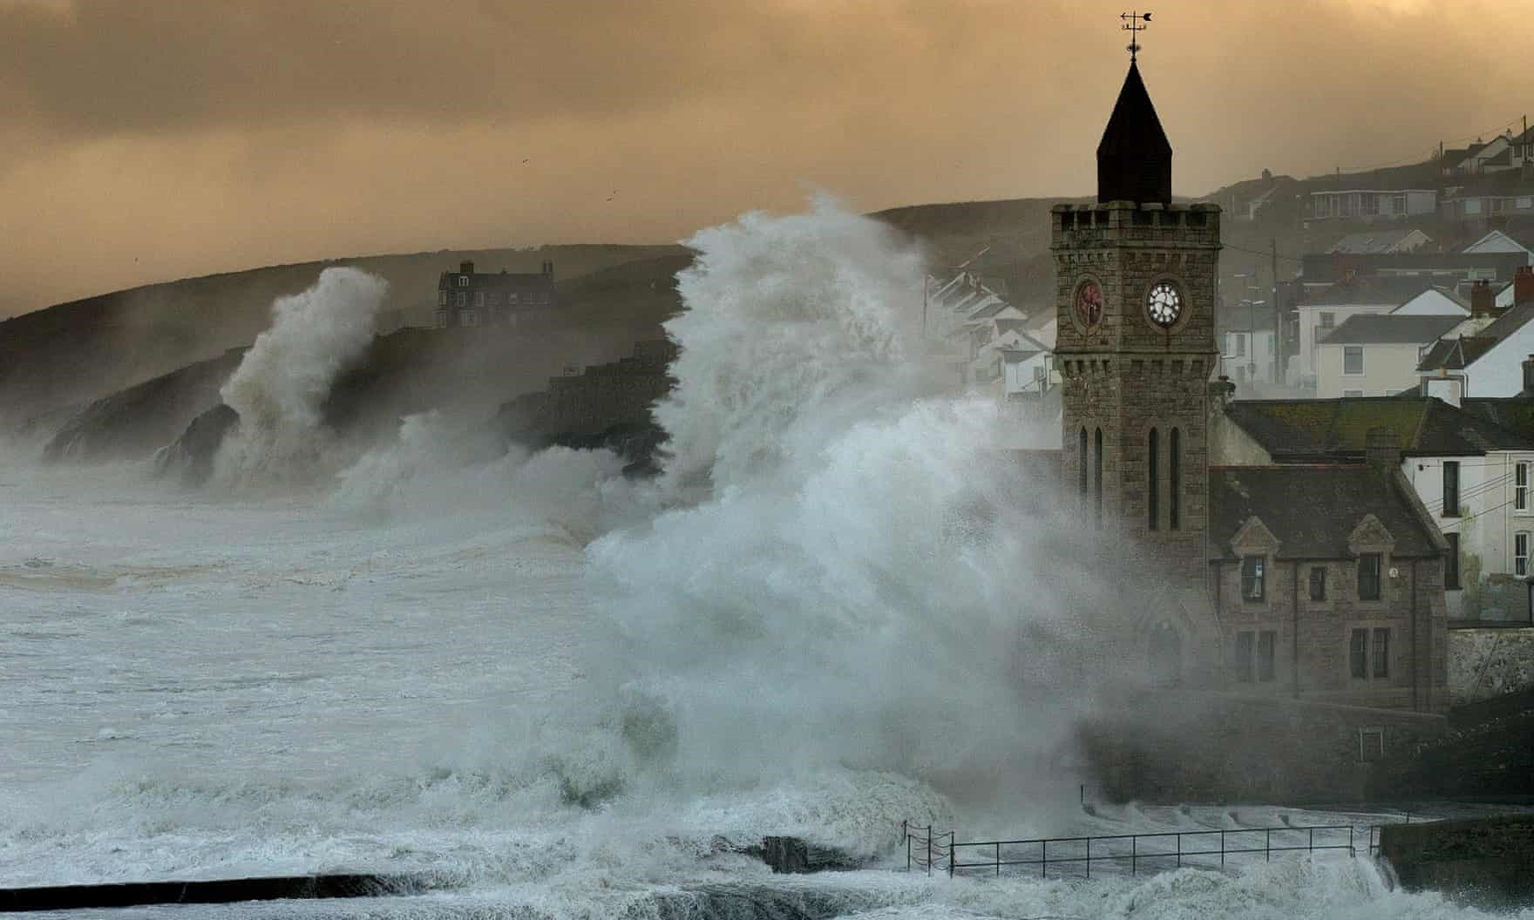
Department of Meteorology, 26 April
The impact of atmosphere-ocean-wave on extreme
surface wind forecasts
COUPLED SYSTEM
MODELLING FRAMEWORK
BACKGROUND
IMPACT ON FORECAST BIAS
CASE STUDY OF SEVERE STORMS
IMPACT OF COUPLING
CONCLUSIONS
CONCLUSIONS
Emanuele Silvio Gentile
Supervised by:
Prof. Suzanne Gray, Prof. Janet Barlow, Dr John Edwards and Dr Huw Lewis

Slide 2
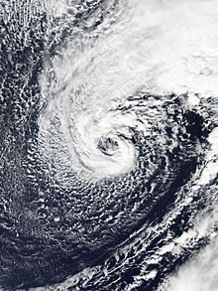


MENU
Every year several
extra-tropical cyclones (ETCs) cross the British Isles, bringing extreme surface wind speeds that cause widespread damage of varying harshness to lives
and livelihoods.
BACKGROUND
The severity of the resulting damage can be estimated using the storm index first introduced by Klawa and Ulbrich (2003), which is proportional to the cube of exceedances of the local 98th percentile of wind speeds.
Skillful forecasts of
extreme surface wind speeds associated with ETCs are critical to providing actionable information to first-line responders as a basis for preparedness to act.

Slide 3
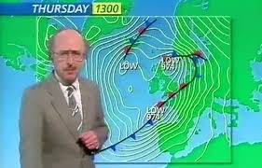
MENU
Because the weather is a chaotic system, small errors in the atmospheric state describing the initial conditions (IC) for the NWP forecast, and small errors in the NWP model physics approximations of atmospheric processes can grow exponentially over time, leading to large uncertainty in the location and strength of ETC mesoscale weather features such as localised strong winds.
A way to sample and provide guidance on the forecast uncertainty from IC and model errors is to generate probabilistic realizations of ETC events using ensemble prediction systems (EPS). Model errors arising from approximations of unresolved atmospheric processes can be amplified during the course of the forecast as their impact upscales to larger resolved scales of motion. Correct estimation of model errors in EPS represent a much greater challenge than correct estimation of IC errors.
A potentially important source of model errors of ETC forecasts are the sea-state independent NWP model parametrizations of air-sea momentum, heat, and moisture fluxes that control, at convective-scale, ETC wind speeds timing and magnitude near the ocean surface.
BACKGROUND
“Well if you are watching there isn’t!”
Michael Fish missed forecast of the 1987 Great Storm

Slide 4
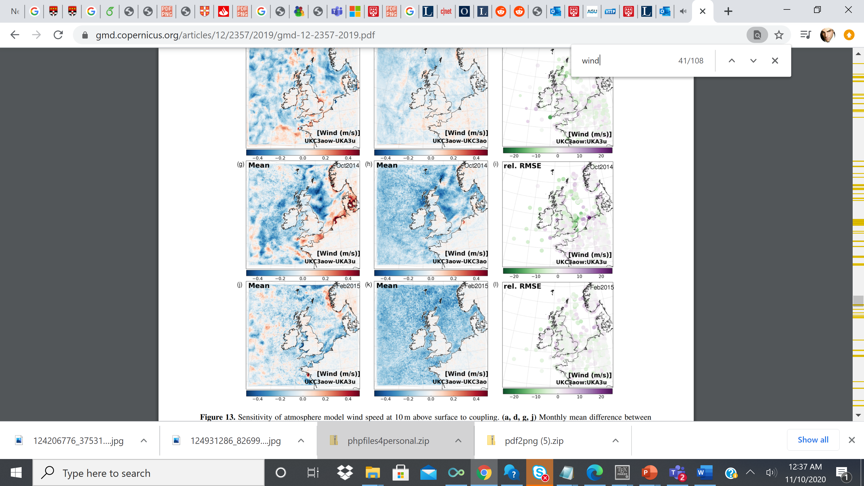
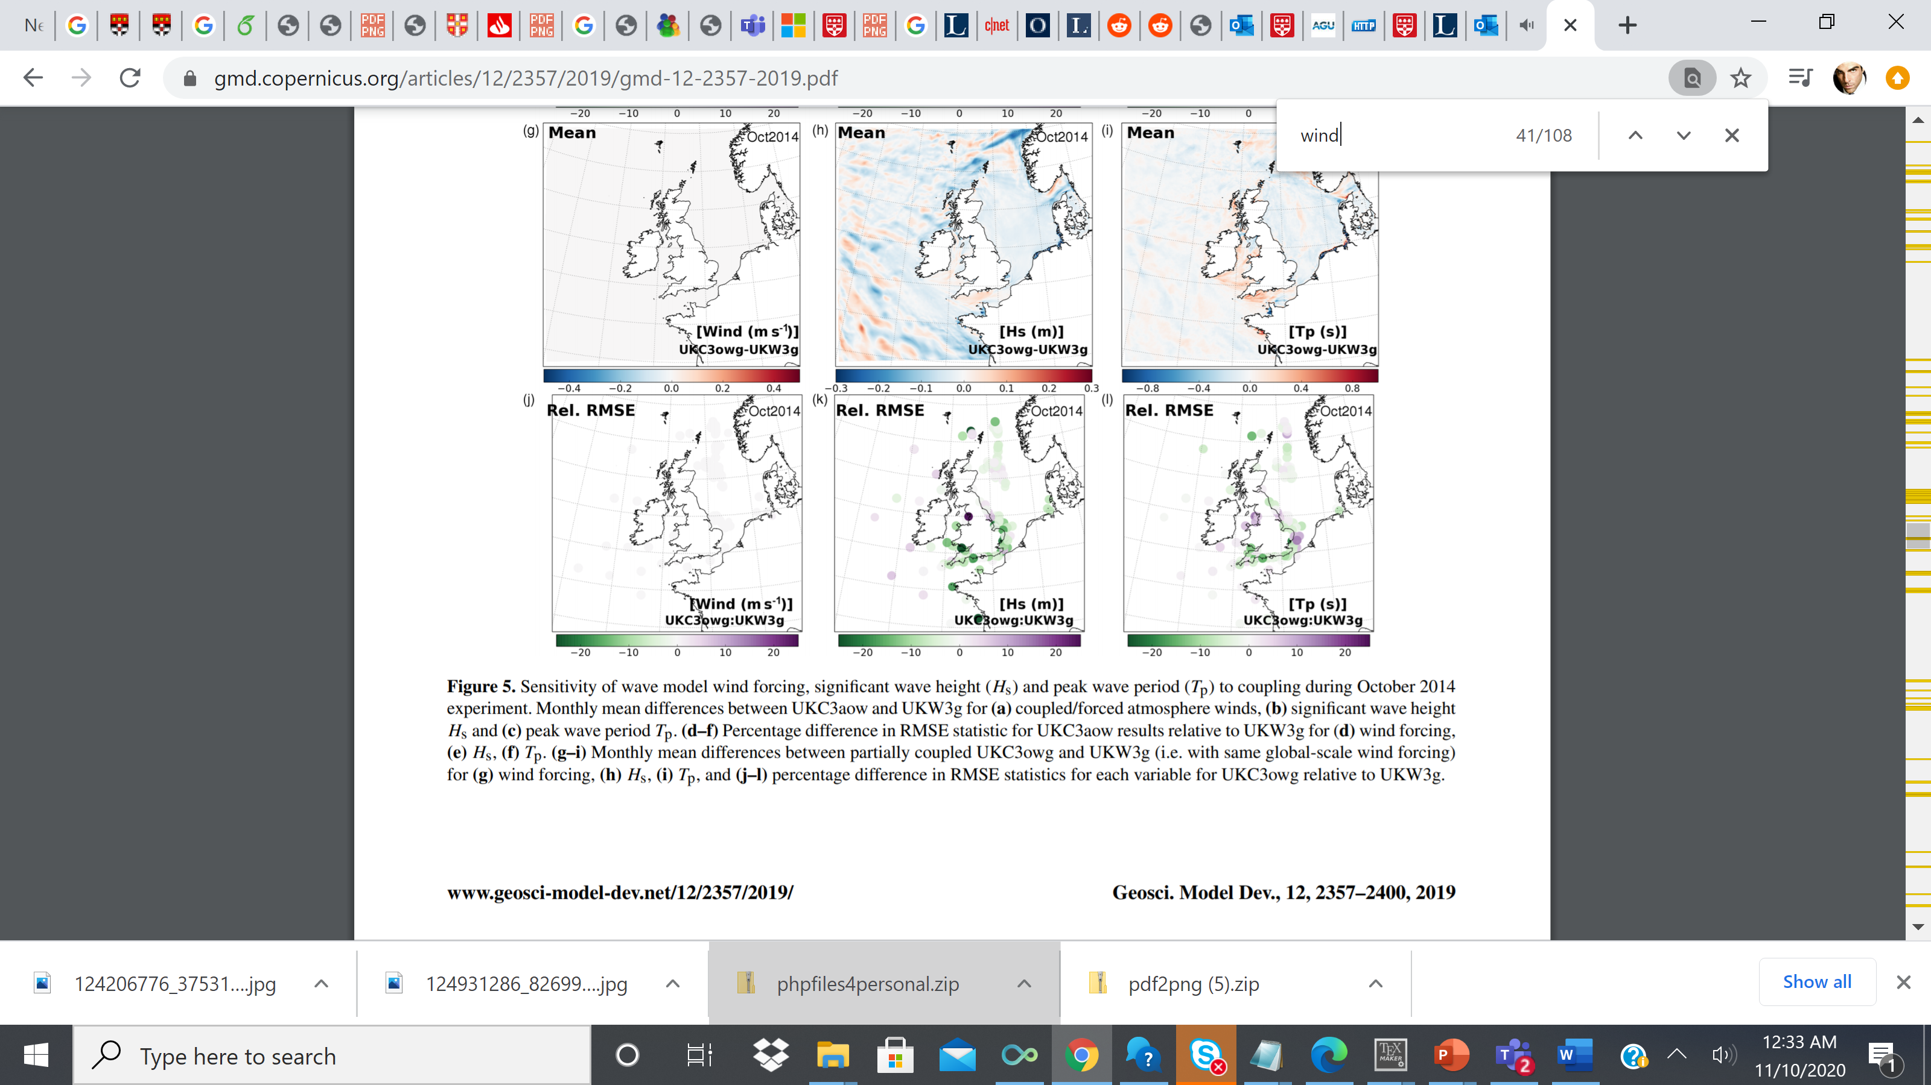
MENU
Over the last decade, a number of coupled multi-model simulation systems have been developed to directly integrate the feedbacks between the ocean and wave single-component models and the atmosphere-only models. These systems have shown potential for more accurate predictions of severe weather events, such as extreme surface wind speeds .
Lewis et al (2019) results
BACKGROUND
Lewis et al (2019) demonstrated that coupling achieves up to 20% forecast skill improvement in windspeeds and wave heights.
Wahle et al. (2017) simulated a historical series of winter storms that cross the southern North Sea, demonstrating that coupling to wave reduced wave heights and wind speeds by up to 8% and 3%, respectively, with associated improvements in the forecast skill of the wind speed and wave height.

Slide 5
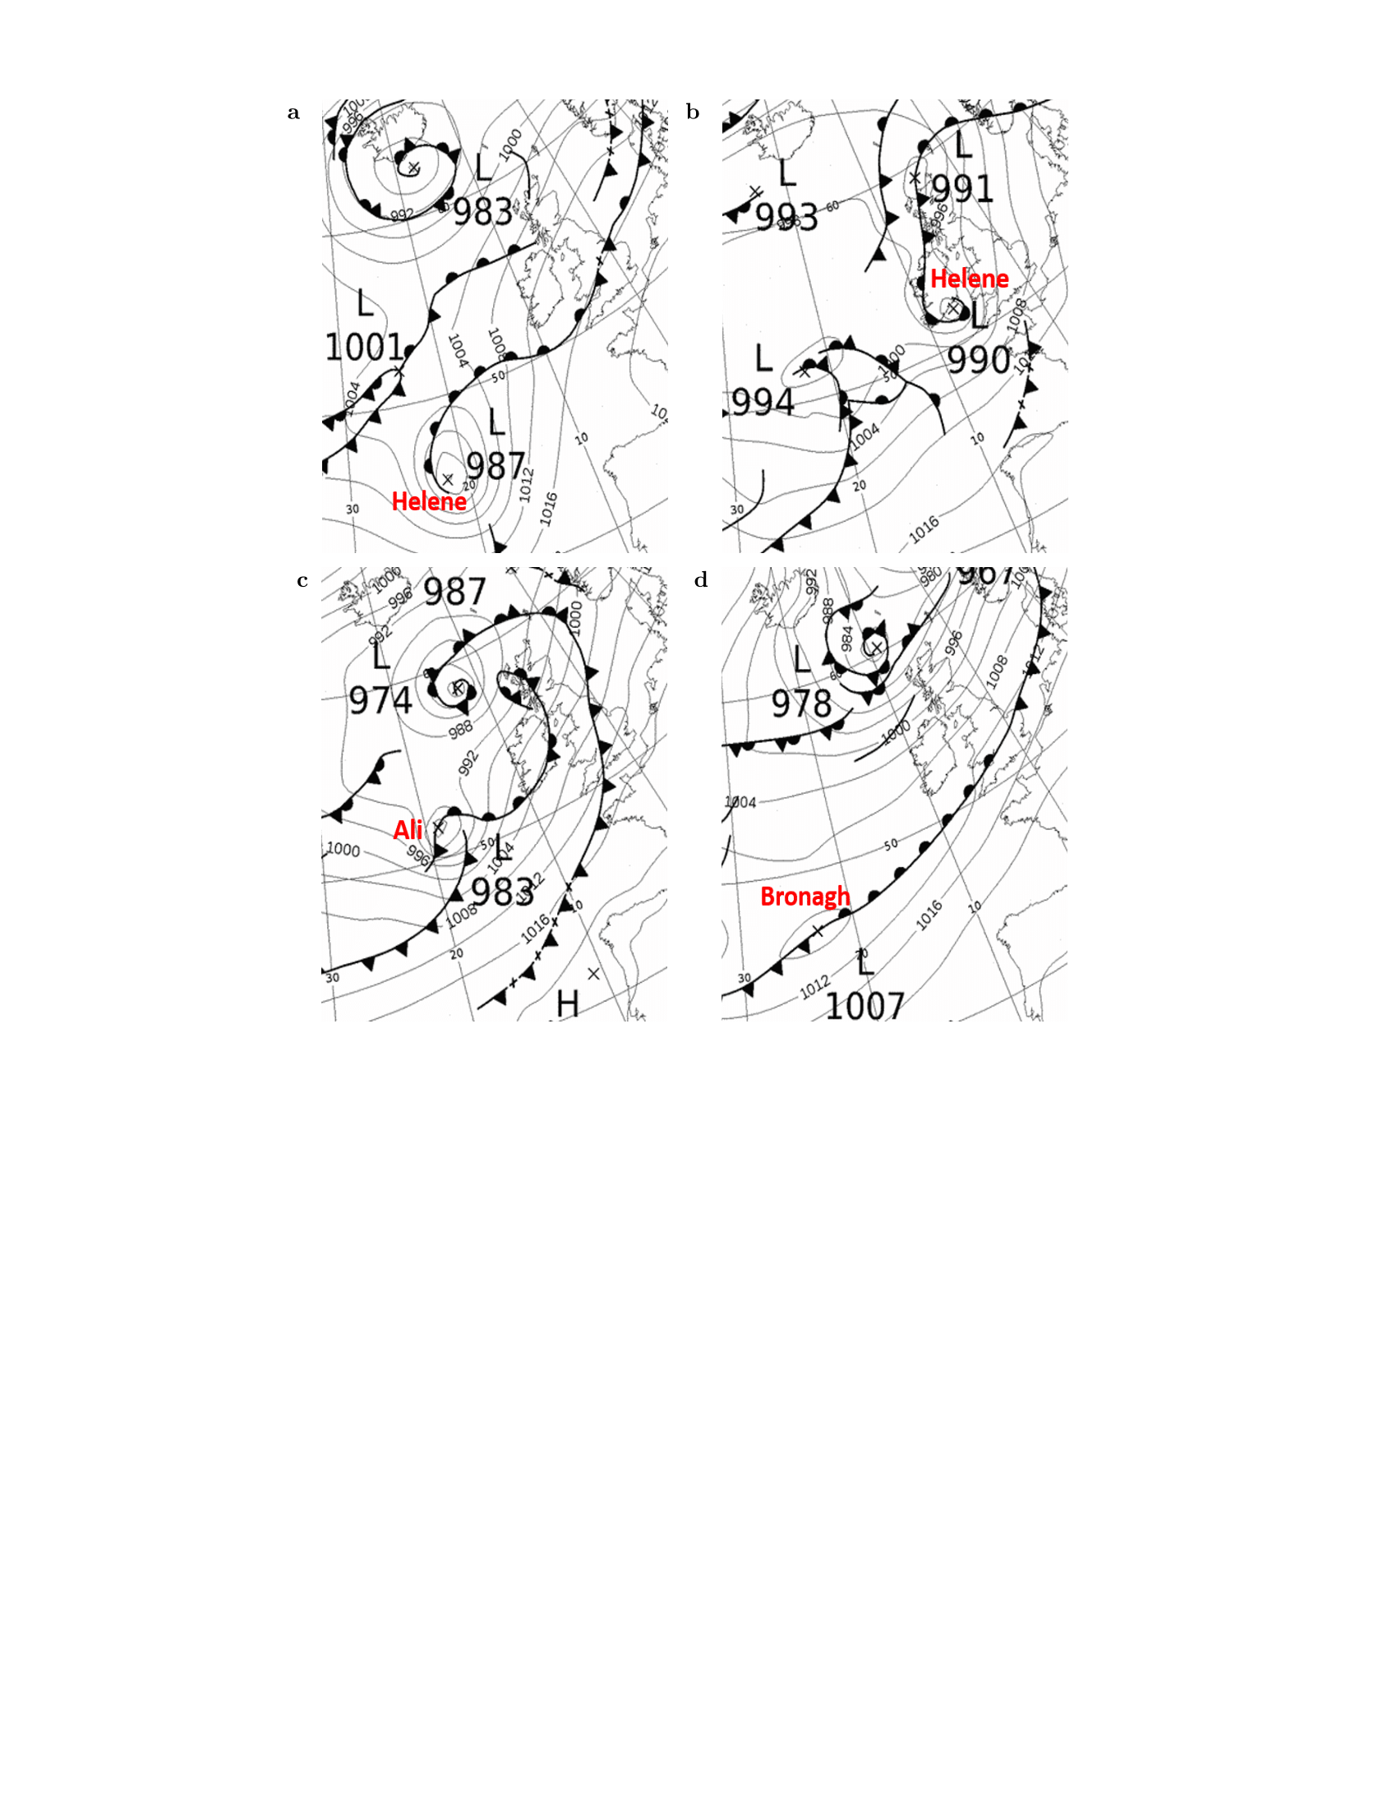
MENU
CASE STUDY OF SEVER STORMS
The sensitivity of extreme surface wind speeds to air–sea surface exchange is investigated in the extreme weather conditions brought by Helene, Ali, and Bronagh as they crossed the UK from 17–20 September 2018.
Of the three ETCs, Ali had the lowest central mean sea level pressure of 969 hPa over the North Sea at 1800 UTC 19 September (not shown), with maximum gusts peaking at 36 m s−1 over the North of the UK.

Slide 6
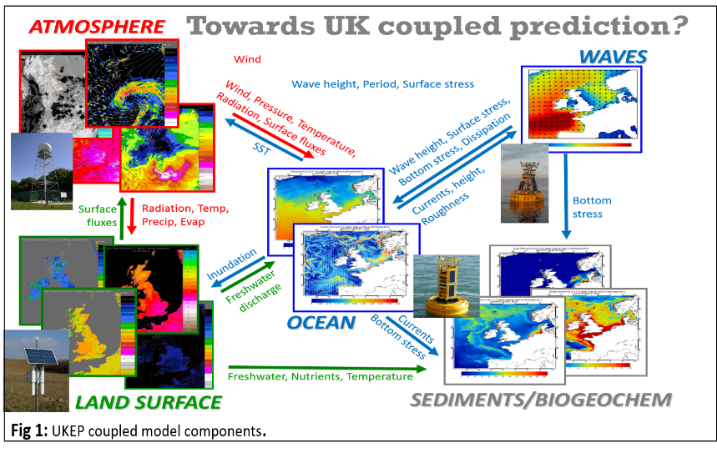
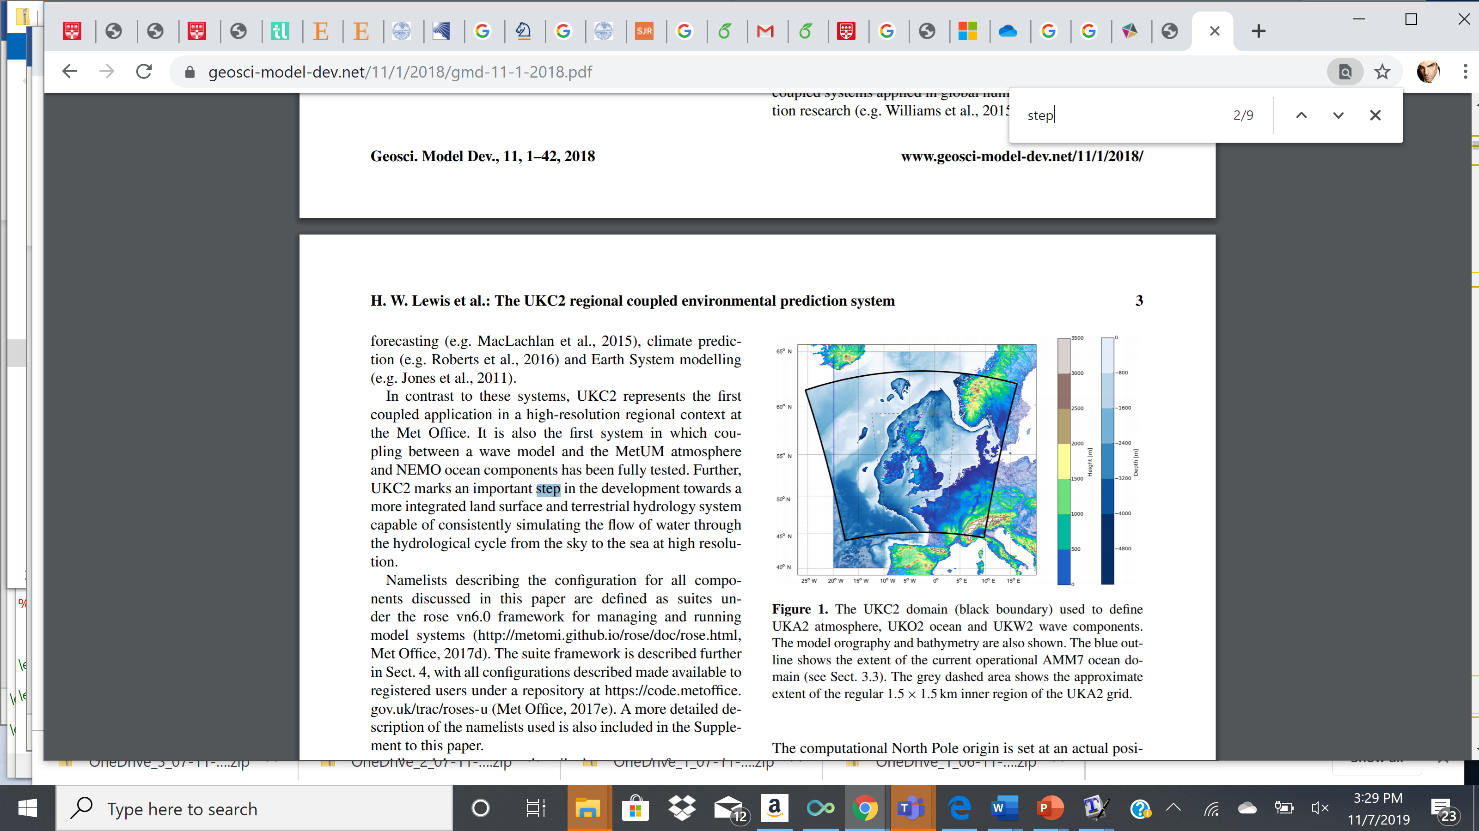
MENU
  SET UP
  CASE STUDY PERIOD: 16--20 of Sept 2018
  MODEL: UKC4 SYSTEM by Met Office
  START TIME: 0000 UTC 16/09/2018
  MODEL RESOLUTION: 1.5km x 1.5km
  MODEL TIME STEP: 60s
  COUPLING FREQUENCY: hourly
Configuration | Components | Node hr
Adrag1 | Atmosphere-only with UKV drag parametrization | 35
Adrag2 | Atmosphere-Only with new drag parametrization: COARE4.0 for moderate winds and Donelan (2018) cap and decrease at high winds | 35
A-O | Atmosphere-ocean | 38
A-O-W | Atmosphere-Ocean-Wave | 43
COUPLED SYSTEM FRAMEOWRK
UKC4 DOMAIN

Slide 7
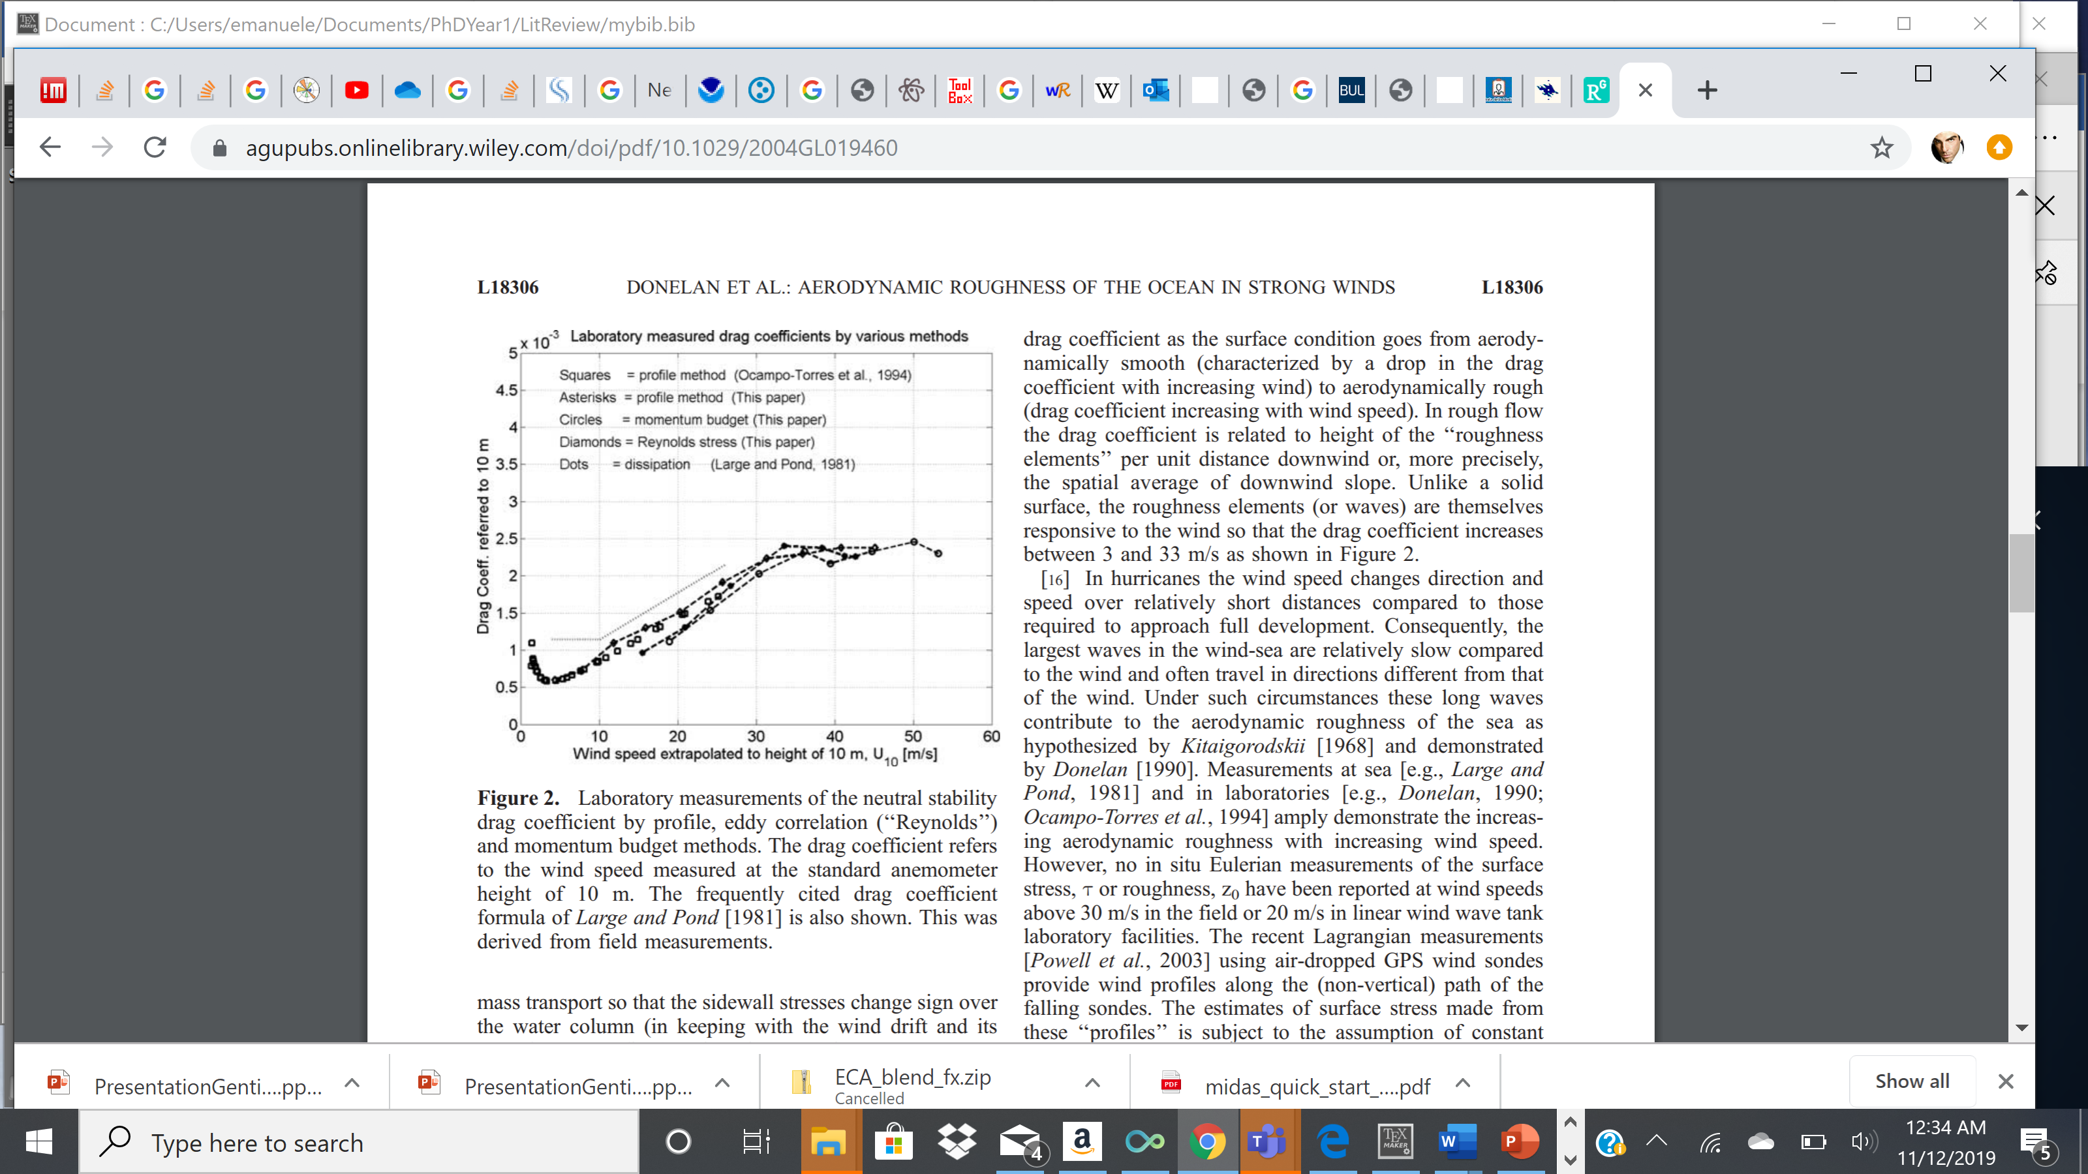
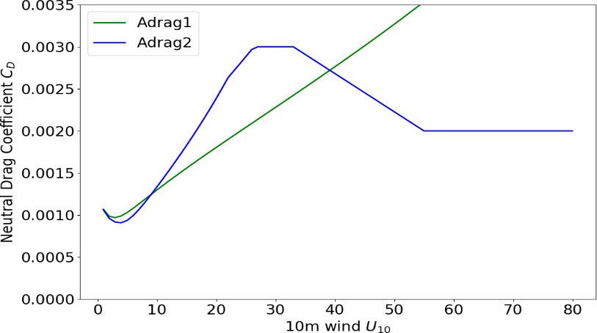
MENU
Neutral Drag Coefficient dependence on 10-m wind speed
Laboratory results
Donelan (2002)
HIGH WINDS, LARGE WAVES
COUPLED SYSTEM FRAMEOWRK
MODERATE WINDS, GROWING WAVES CATCHING UP WITH THE WIND
LOW WINDS, CALM SEA STATE
UKC4 parameterizations
Hsu et al (2017) plateau value
27 m/s
Donelan (2018) cap and decrease
COARE4.0

Slide 8
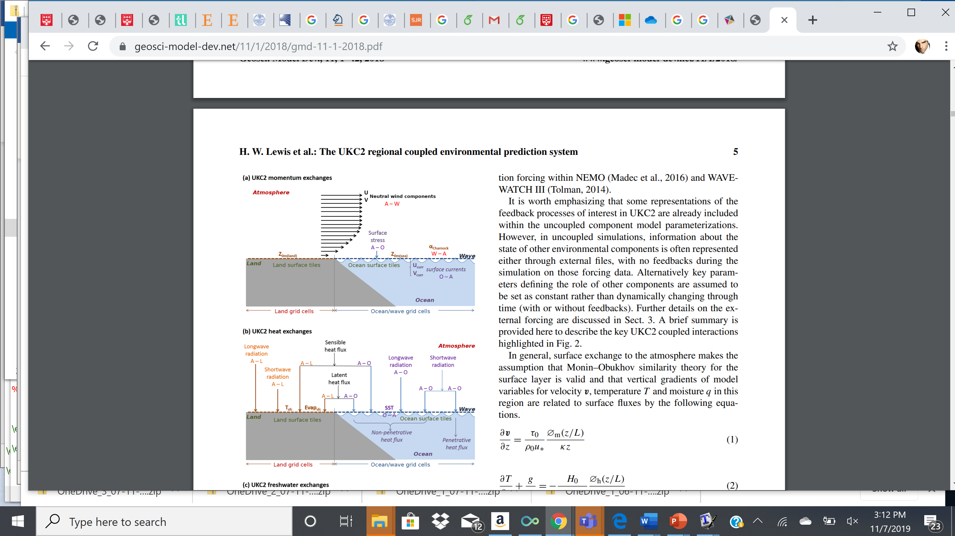
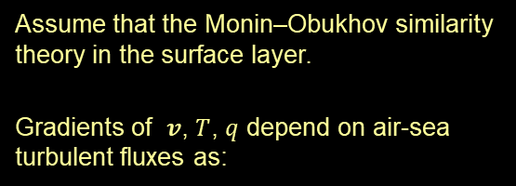



MENU
Assume that the Monin–Obukhov similarity theory in the surface layer.
Gradients of $v$, $T$, $q$ depend on air-sea turbulent fluxes as:
Momentum exchange
Heat and moisture exchange
COUPLED SYSTEM FRAMEOWRK
$$\frac{∂v}{∂z}= \frac{τ_{0}}{ρ_{0}u_{∗}}\frac{φ_{m}(z/L)}{kz}$$
$$\frac{∂T}{∂z}+\frac{g}{c_{p}}=−\frac{H_{0}}{{c_{p}ρ}_{0}u_{∗}}\frac{φ_{h}(z/L)}{kz}$$
$$\frac{∂q}{∂z}=−\frac{E_{0}}{ρ_{0}u_{∗}}\frac{φ_{h}(z/L)}{kz}$$

Slide 9

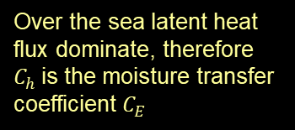

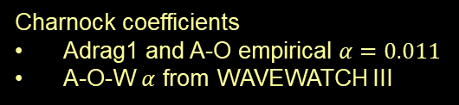
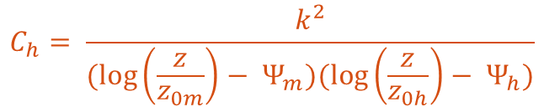
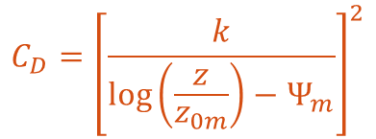
MENU
Wind speed
Momentum roughness length
Momentum transfer coefficient
$$U= \frac{u_{∗}}{k}\left[\log\left(\frac{z}{z_{0m}}\right)−Ψ_{m}\right]$$
Used to calculate the 10-m wind speed
Charnock coefficients
Adrag1 and A-O empirical $α=0.011$
A-O-W $α$ from WAVEWATCH III
$$z_{0m}(sea)= \frac{0.11ν}{u_{∗}}+ \frac{α}{g}u_{∗}^{2}$$
COUPLED SYSTEM FRAMEOWRK
$$C_{D}={\left[\frac{k}{\log\left(\frac{z}{z_{0m}}\right)−Ψ_{m}}\right]}^{2}$$
Over the sea latent heat flux dominate, therefore $C_{h}$is the moisture transfer coefficient $C_{E}$
Scalar transfer Coefficient
$$C_{h}= \frac{k^{2}}{(\log\left(\frac{z}{z_{0m}}\right)− Ψ_{m})(\log\left(\frac{z}{z_{0h}}\right)− Ψ_{h})}$$

Slide 10
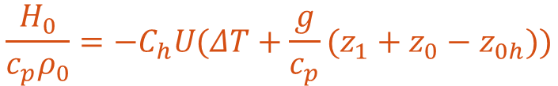




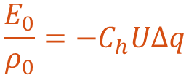
MENU
Parametrize momentum, heat and moisture turbulent fluxes as
$${|Δv|}^{2}≈ U_{10}^{2}$$
Under strong winds conditions surface currents negligible
$$\frac{τ_{0}}{ρ_{0}}= C_{D}{|Δv|}^{2}$$
COUPLED SYSTEM FRAMEOWRK
Persisted SST
Dynamic SST
$$ΔT= T_{1} − T_{0}$$
$$\frac{H_{0}}{c_{p}ρ_{0}}=−C_{h}U(ΔT+\frac{g}{c_{p}}(z_{1}+z_{0}−z_{0h}))$$
$$ΔT= T_{1} −T(t)$$
$$\frac{E_{0}}{ρ_{0}}=−C_{h}UΔq$$
Buoyancy flux accounts for moisture and heat flux via virtual potential temperature
Dictates overlying BL stability

Slide 11
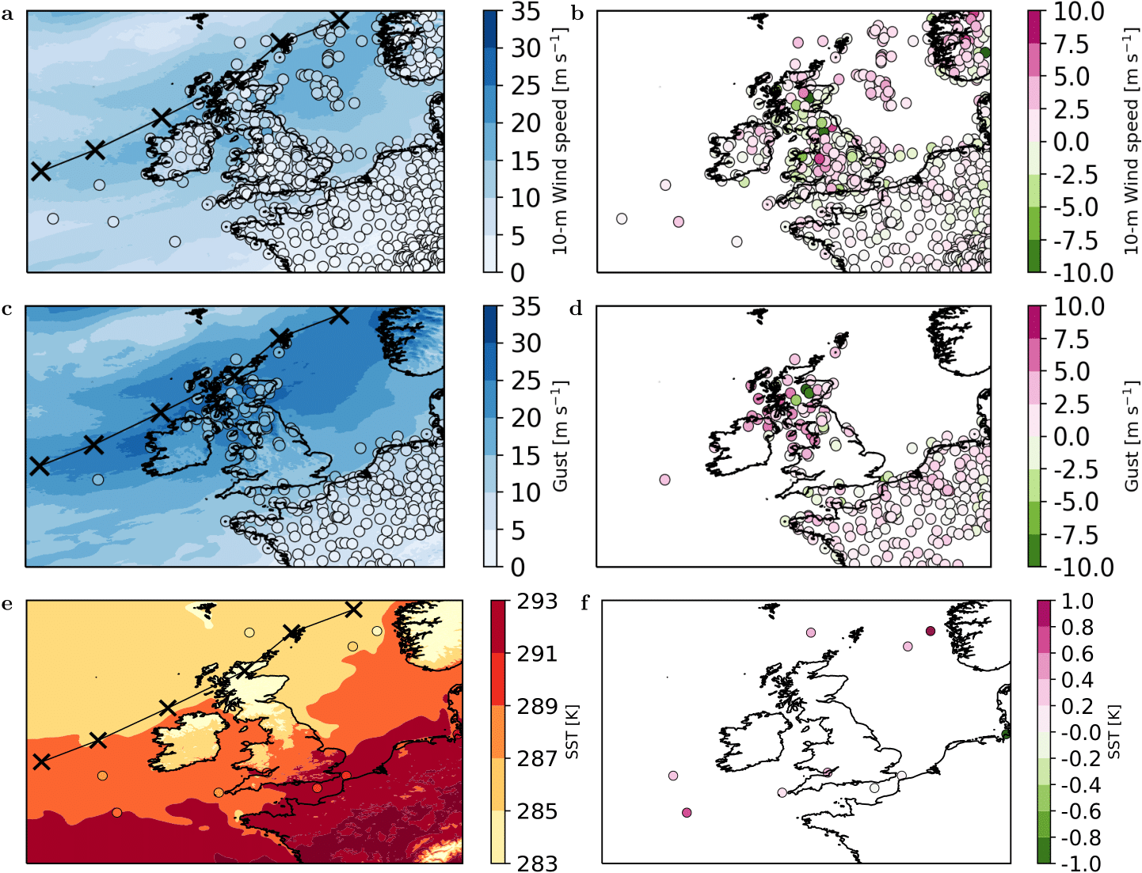
MENU
In-situ 10m Winds, Gusts, SSTs overlaid on corresponding model variables averaged on 19 September 2018
Adrag1 configuration overestimates 10-m wind, gust, and SST, at most of the observation sites. 10-m wind speeds are overestimated by up to 5 m/s while SST values are overestimated by up to 1.5 K.
IMPACT OF COUPLING
The biases are consistent with Lewis et al. (2019), who reported results over a longer time period relative to a month-long autumn case study. The size of the bias across the domain suggests that the atmosphere-only Adrag1 forecast may not provide a satisfactory representation of the air–sea interactions at high wind speeds.

Slide 12
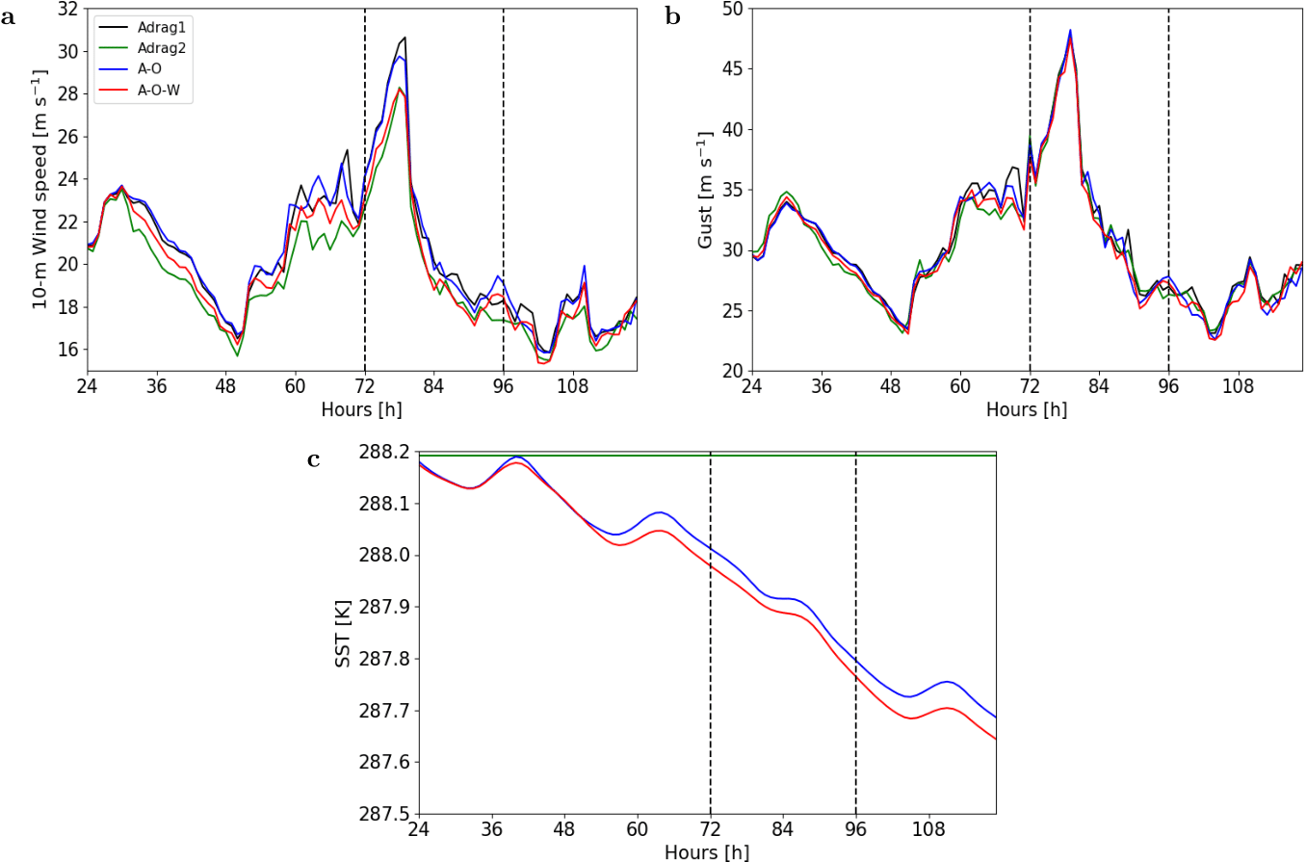
MENU
Timeseries of 98th percentile of 10m winds, gusts and mean SST 17 – 20 September 2018
The 98th percentile of the A–O–W and Adrag2 10-m wind speeds are consistently lower than those simulated by Adrag1 and A–O with maximum differences of up to 2 m/s at peak time. Helene, Ali, and Bronagh extreme surface wind speeds are equally sensitive to the Adrag2 new drag parametrization and to coupling to waves.
IMPACT OF COUPLING
the slight reduction of 0.5ms−1 in 98th percentile of the A–O–W and Adrag2 simulated gusts could be accounted for by the reduction of 10-m wind speed upon coupling to waves and change in the drag parametrization.
The SSTs in the A–O and A–O–W simulations generally decrease with time by more than 0.5 K over the five days (Fig. 5c). The SST changes are primarily a consequence of the ocean coupling rather than the additional wave coupling.

Slide 13
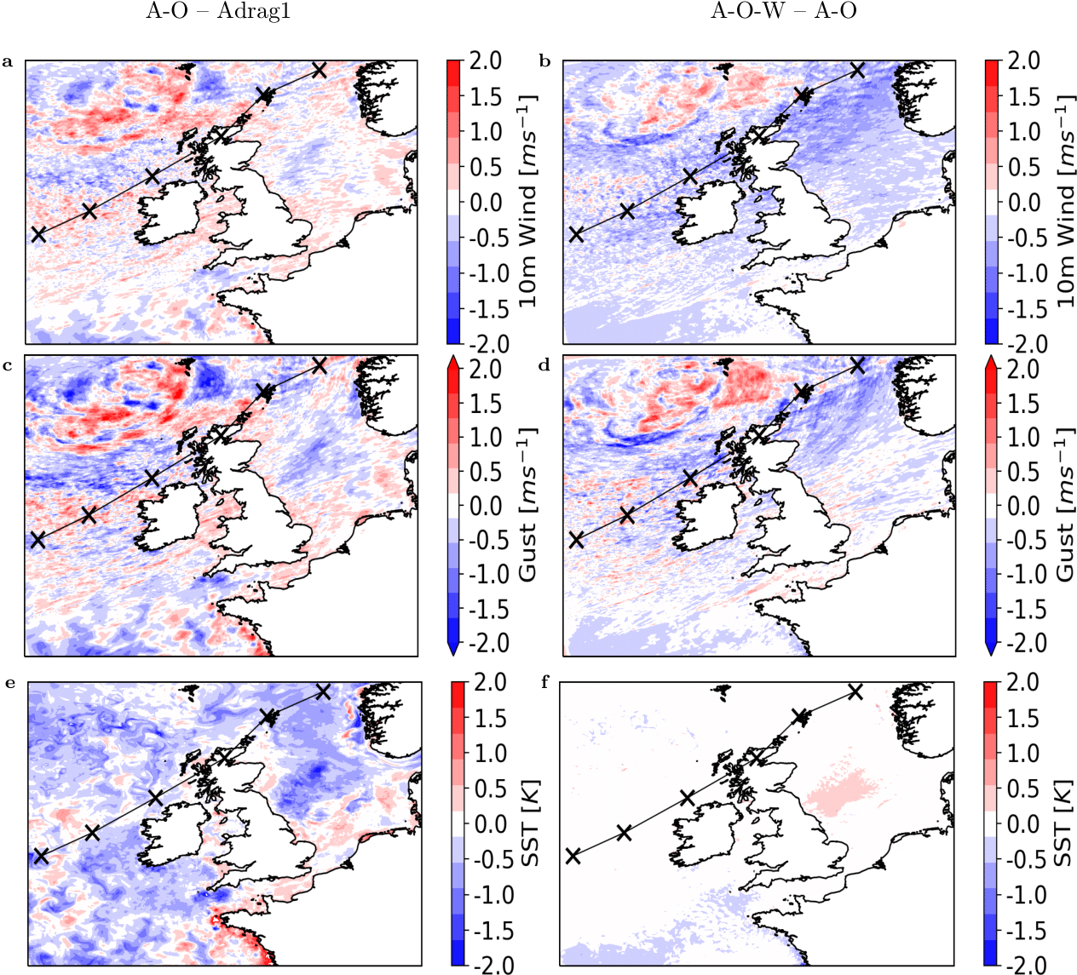
MENU
Mean 10m winds, gusts and SSTs averaged over 19 September 2018.
The largest magnitude for the 10-m wind-speed differences between the A–O and Adrag1 simulations are found to the north of Ali’s track, possibly associated with slightly different positioning of the bent-back front (i.e. different frontal structure) in the two simulations. However, the overall lack of coherency of the wind-speed differences is consistent with the negligible impact of ocean coupling seen in the domain-average time series.
IMPACT OF COUPLING
In contrast, compared with the 10-m wind speed in the partially coupled A–O simulation, the fully coupled A–O–W 10-m wind speeds are consistently decreased, by up to 2 m s−1, in the high-wind-speed region extending south of the track of Ali. Also, gusts are generally decreased by coupling to both the ocean and additionally to waves south of Ali’s track, particularly in the North Sea, although only by up to 1 m/s. The dominant impact of coupling on SSTs is the result of coupling to the ocean component with reductions across most of the ocean regions peaking at ≈2.2 K. Coupling to waves impact is smaller and localized with a 0.5-K increase in the Dogger Bank region, characterized by shallow bathymetry. The Ocean stratified after surface heating through summer so oceanic mixing implies surface cooling.

Slide 14
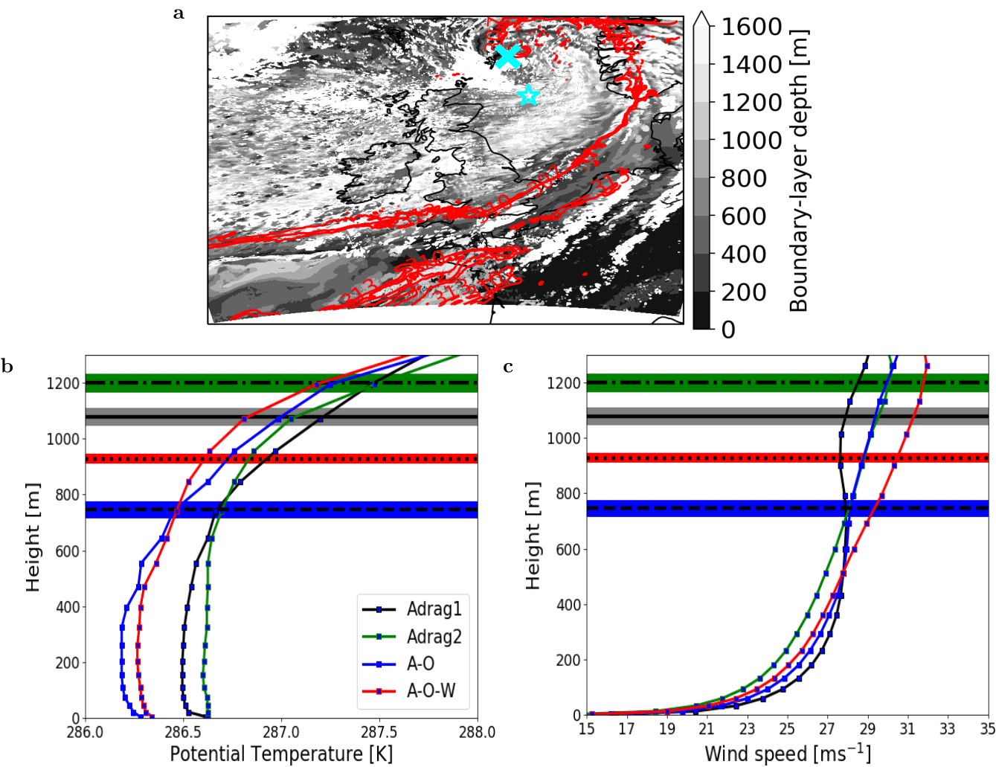
MENU
1800 UTC 19 September 2018
The MABL simulated by Adrag1 is unstable at this point and time, being characterized by a negative near-surface gradient of potential temperature and a strong wind shear.
The A–O configuration yields a weaker near-surface gradient of potential temperature than that simulated by the Adrag1 configuration, leading to a MABL height of 780 m, reduced from the 1100 m diagnosed in the Adrag1 simulation. The decreased MABL instability simulated by the A–O configuration is most likely caused by the reduction of SST in the region of the North Sea located underneath the cold sector.
Point within Ali’s cold sector
IMPACT OF COUPLING
Coupling to the wave model and changing the atmospheric drag parametrization both reduce the potential temperature gradients near the surface, leading to a small reduction in instability (comparing A–O to A–O–W) and a larger change from an unstable (Adrag1) to a neutral (Adrag2) surface layer, as inferred from the vertical potential temperature gradients. These changes are associated with similar magnitude increases in the wind-shear turbulence and hence with diagnosed MABL height. The increased turbulent eddies likely enhance momentum transfer from the air to the sea, leading to the noted reduction in near-surface wind speed.

Slide 15
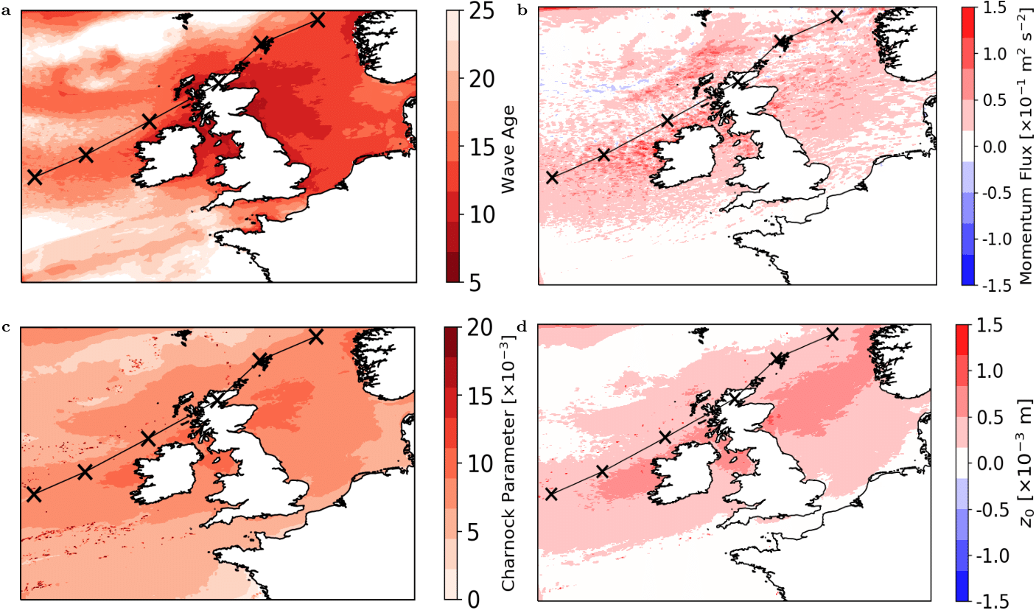
MENU
Mean A-O-W Wave Age and A-O-W – A-O Charnock, momentum flux, momentum roughness length averaged over 19 September 2018.
Coupling to waves enhances momentum fluxes in the whole region extending south of the track of Ali, where reductions in the range of moderate to extreme 10-m wind speeds occur.
The young wave ages, corresponding to cp/u∗ values less than 20, indicate that the sea is covered by young growing waves that enhance the Charnock coefficients by up to 0.02 , which means that the Charnock coefficients increase nearly three times from the constant value α = 0.011 used by the Adrag1 and A–O simulations to α = 0.031, with corresponding enhancements in the roughness length z0 by up to 1.5 × 10−3 m.
IMPACT OF COUPLING ON
The increase in the z0 is associated with a larger momentum loss at the air–sea interface compared with the A–O simulation, resulting in lower wind speeds. This suggests that the waves give rise to a force proportional to the wave-induced stress, which effectively acts as frictional drag at the air–sea interface.

Slide 16
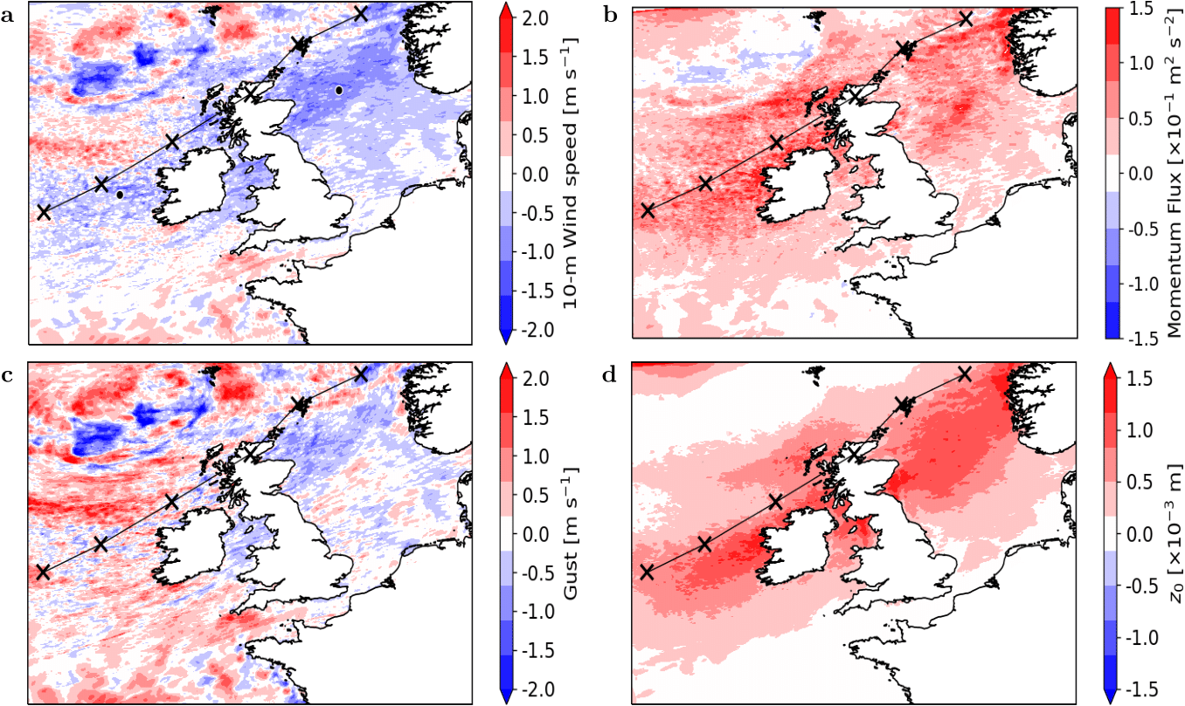
MENU
Adrag2 – A-O 10m Wind, gusts, momentum flux, momentum surface roughness length over 19 September 2018
The new drag parametrization used in the Adrag2 simulation enhances the momentum fluxes in the whole region south of the track of Ali compared with those in the A–O simulation, leading to a reduction in the moderate to extreme surface wind speeds, which is similar to that found by comparing the A–O–W and the A–O simulations. The new drag parametrization must produce a frictional surface stress at the air–sea interface, which is comparable in size to that induced by the growing young waves in the A–O–W simulation.
IMPACT OF COUPLING
Compared with the impacts on the 10-m wind speed, both coupling to waves and using the Adrag2 new drag parametrization reduces the gusts less in the regions contiguous with the track of Ali. In these regions, the balancing effects of reduction of 10m winds and enhanced gustiness.

Slide 17
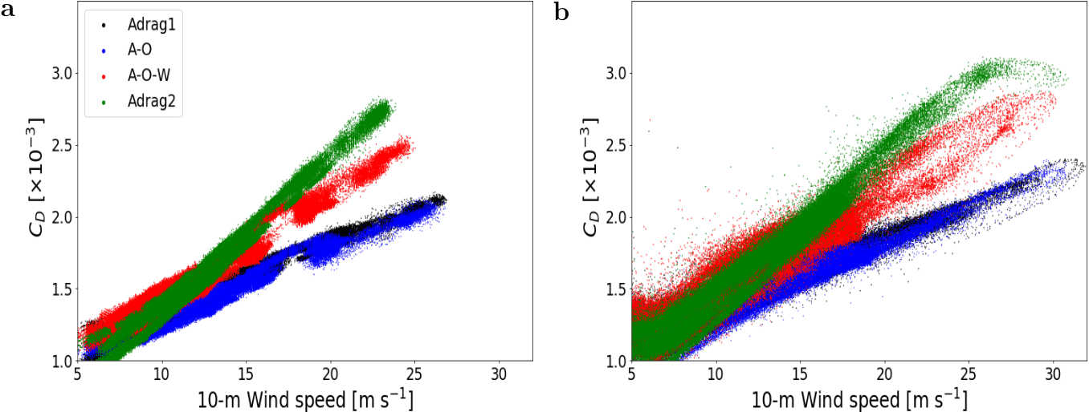
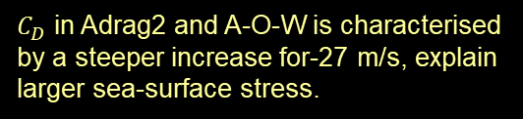

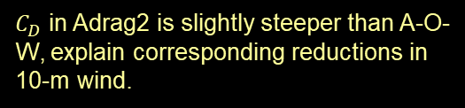
MENU
Drag coefficient dependence on 10m wind speed for a point in the North Sea and in the North Atlantic
$C_{D}$ in Adrag2 and A-O-W is characterised by a steeper increase for-27 m/s, explain larger sea-surface stress.
$C_{D}$ in Adrag2 is slightly steeper than A-O-W, explain corresponding reductions in 10-m wind.
IMPACT OF COUPLING ON
It is not possible to quantify impact of Adrag2 cap due to same reductions in 10-m wind speed.
$C_{D}$ in A-O-W plateau above 27 m s-1, though slightly lower than Adrag2.
Adrag2 likely capable of mimicking physics of A-O-W coupling for simulated wind speeds.

Slide 18
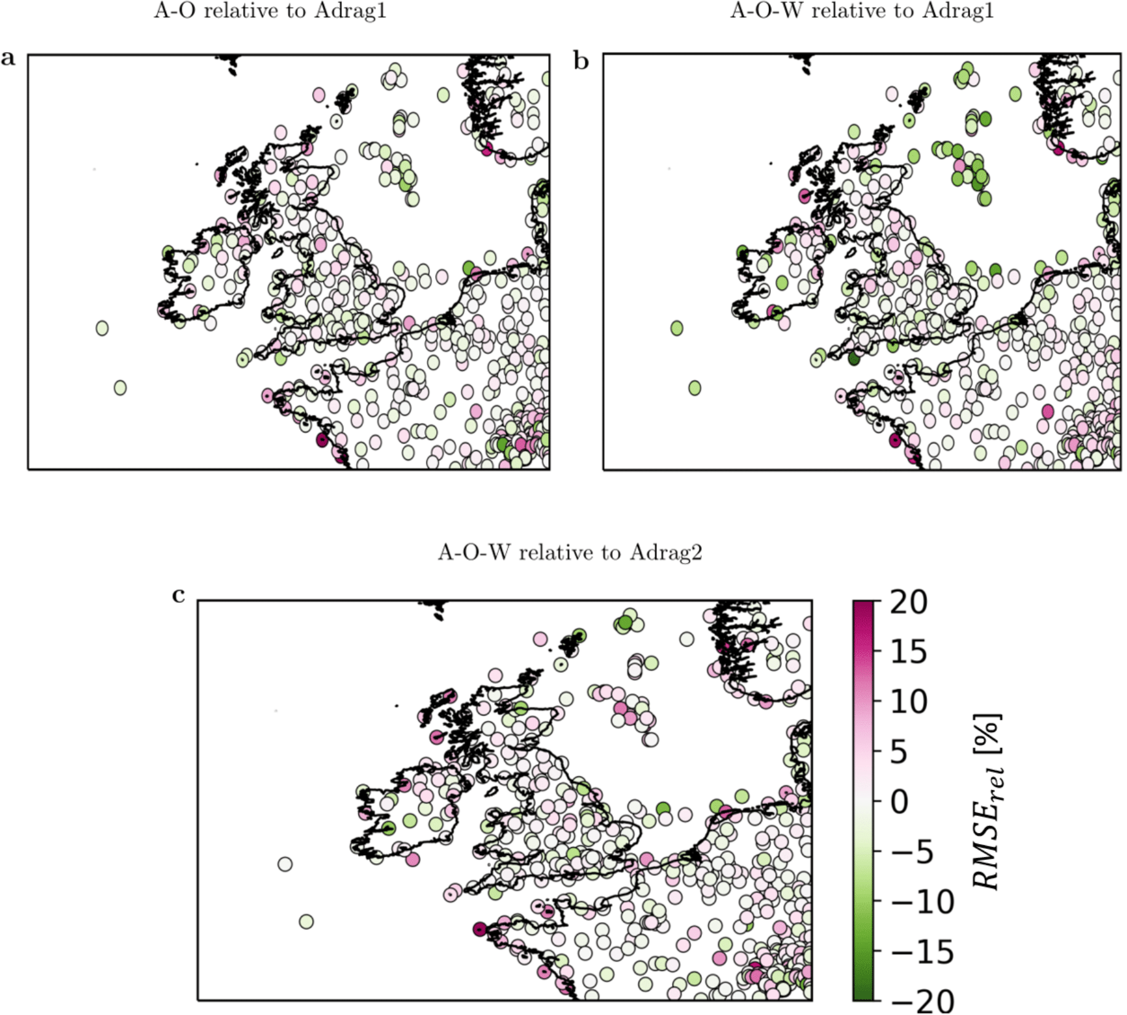
MENU
Percentage difference in 10m wind RMSE statistic
The prevalence of light over dark coloured dots in Fig. a, suggests that partially coupling to ocean neither appreciably improves nor degrades the 10-m wind-speed forecast compared with the atmosphere-only configuration.
In contrast, the prevalence of dark green dots over the North Sea in Fig. b highlights that coupling to waves improves the 10-m wind-speed-forecast skill by up to 20% over the ocean-grid cells (comparing the A–O–W and A–O simulations).
IMPACT ON FORECAST BIAS
For most of the observation sites, the atmosphere-only Adrag2 simulation with the new drag parametrization is able to achieve the same improvement in 10-m wind-speed-forecast skill as that obtained from fully coupling the atmosphere to ocean and waves (A–O–W) with the benefit of saving 25% of the computational cost.

Slide 19
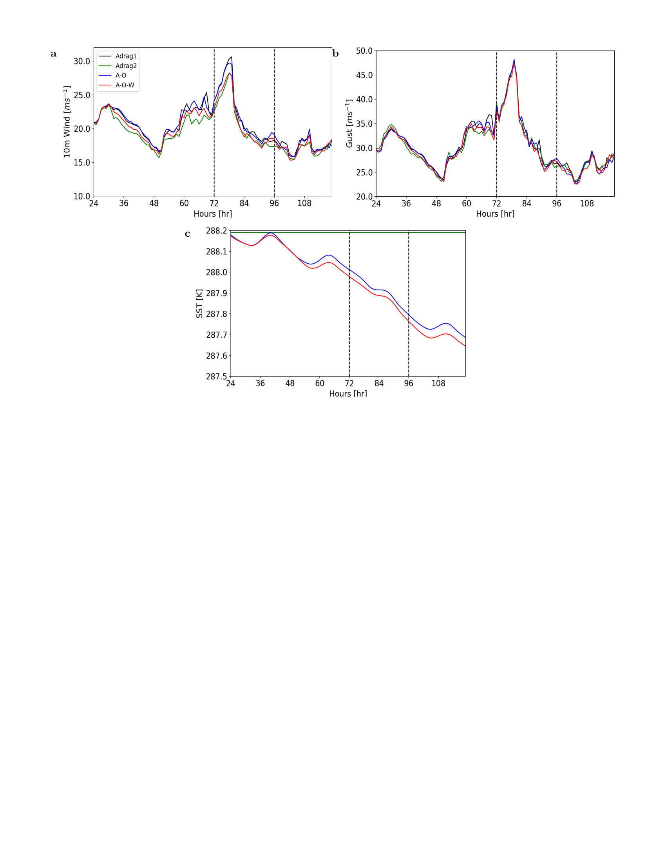
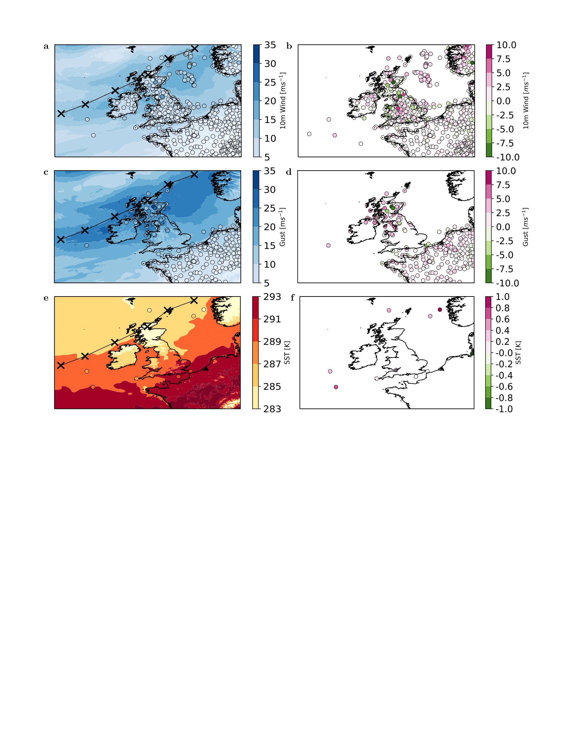
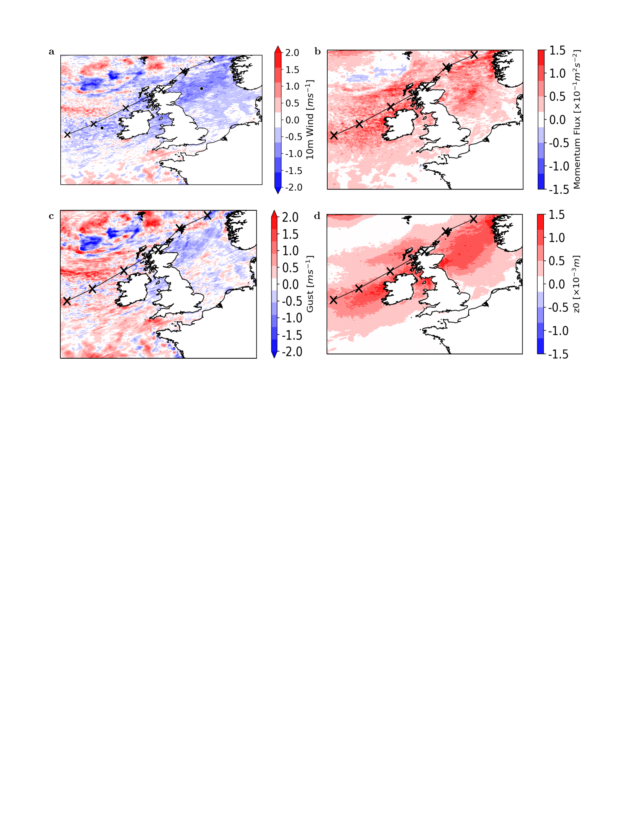
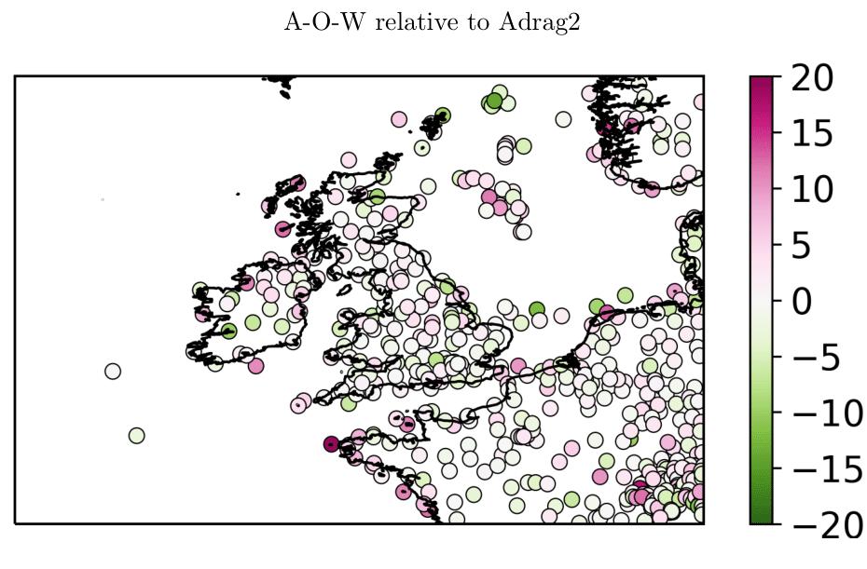
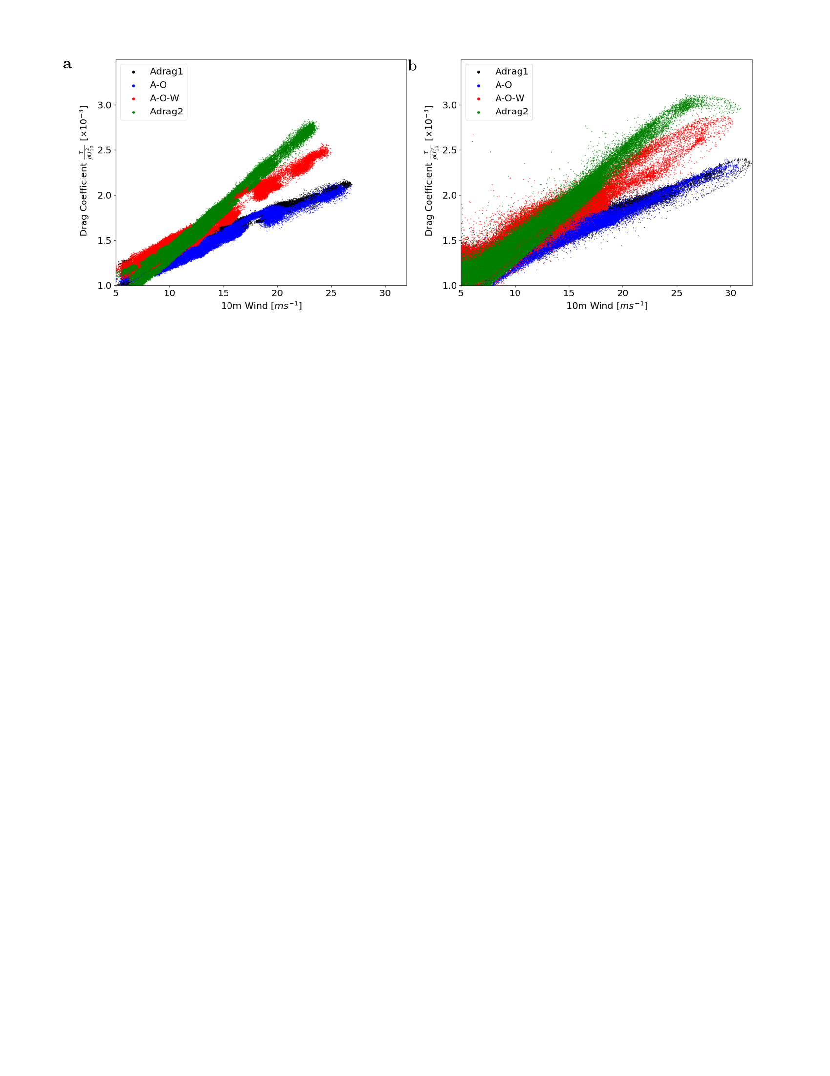
MENU
There is a positive bias for winds, gusts and SSTs in ETC weather conditions.
Atmosphere-only Adrag1 produces an unsatisfactory representation of the atmospheric state.
A-O reduces SST up to 0.5 K.
A-O-W reduces extreme 10m wind up to 3 m/s.
Adrag2 impact on 10m winds ~ A-O-W.
CONCLUSIONS
A-O-W ~ 20% 10m winds RMSE improvement compared to A-O.
Adrag2 ~ A-O-W , test for operational implementation.
Small improvements relative to overall bias.
A-O-W and Adrag2 enhanced drag + enhanced air-sea momentum flux reduces 10m wind values.
Adrag2 captures A-O-W physics saving 20% computational cost.

