Slide 1
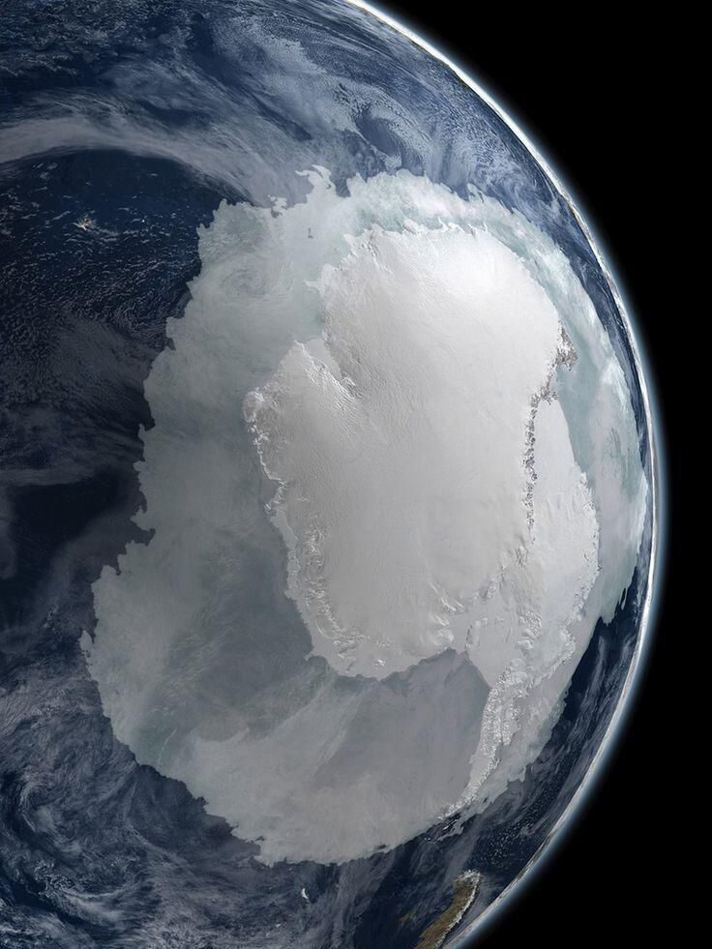
Toward an improved characterisation of climate and environmental changes during warm periods of the past
First results from the MOPGA HOTCLIM project
Etienne Legrain, Emilie Capron, Frédéric Parrenin
Université Grenoble Alpes, CNRS, IRD, IGE, Grenoble, France
EGU 2021 (2021/04/30)

Slide 2
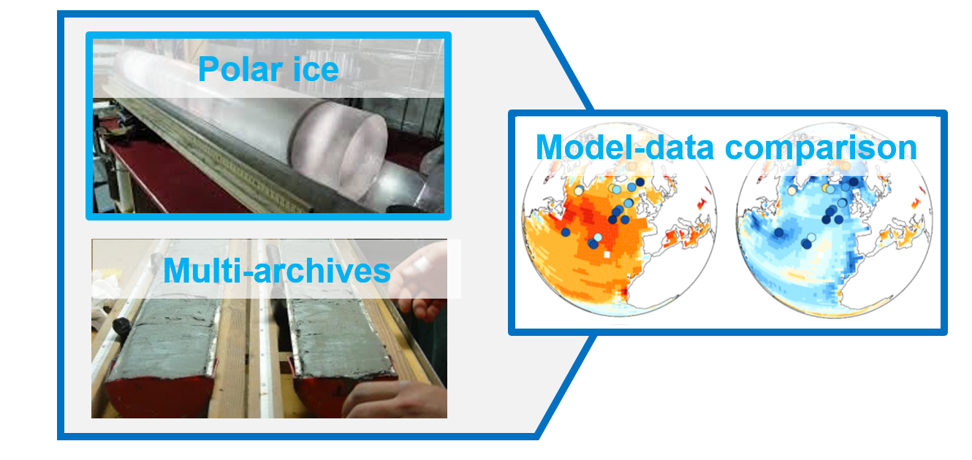
CHaracterisation & Dynamics Of PasT Warm CLIMates
Anthropogenic-induced warming ➔ Polar ice melting / global sea level rise / ocean circulation changes
Understand climate – cryosphere – carbon cycle during warm period
Multi-tool approach:
Analyses on the air trapped in Antarctic ice core
Synthesis of climate data from various archives (ice core, marine sediment, speleothems)
Data comparison with climate model simulations
1

Slide 3
CHaracterisation & Dynamics Of PasT Warm CLIMates
Anthropogenic-induced warming ➔ Polar ice melting / global sea level rise / ocean circulation changes
Understand climate – cryosphere – carbon cycle during warm period
What can we learn about current and future global warming and its impact on polar ice-sheet melting and oceanic circulation from past warm periods?
Multi-tool approach:
Analyses on the air trapped in Antarctic ice core
Synthesis of climate data from various archives (ice core, marine sediment, speleothems)
Data comparison with climate model simulations
1

Slide 4
Climate variability over the last 800 ka in Antarctica
RCP 8.5
RCP 2.6
time
Alternance between hot periods (interglacial) and cold periods (glacial) for at least 800 ka
2

Slide 5
Climate variability over the last 800 ka in Antarctica
Present
RCP 8.5
RCP 2.6
time
Alternance between hot periods (interglacial) and cold periods (glacial) for at least 800 ka
Nowadays, we are currently in an interglacial. Our aim is to study another hot period of the past
2

Slide 6
Climate variability over the last 800 ka in Antarctica
Present
RCP 8.5
RCP 2.6
time
Alternance between hot periods (interglacial) and cold periods (glacial) for at least 800 ka
Nowadays, we are currently in an interglacial. Our aim is to study another hot period of the past
2

Slide 7
Climate variability over the last 800 ka in Antarctica
Present
RCP 8.5
RCP 2.6
time
Alternance between hot periods (interglacial) and cold periods (glacial) for at least 800 ka
Nowadays, we are currently in an interglacial. Our aim is to study another hot period of the past
2

Slide 8
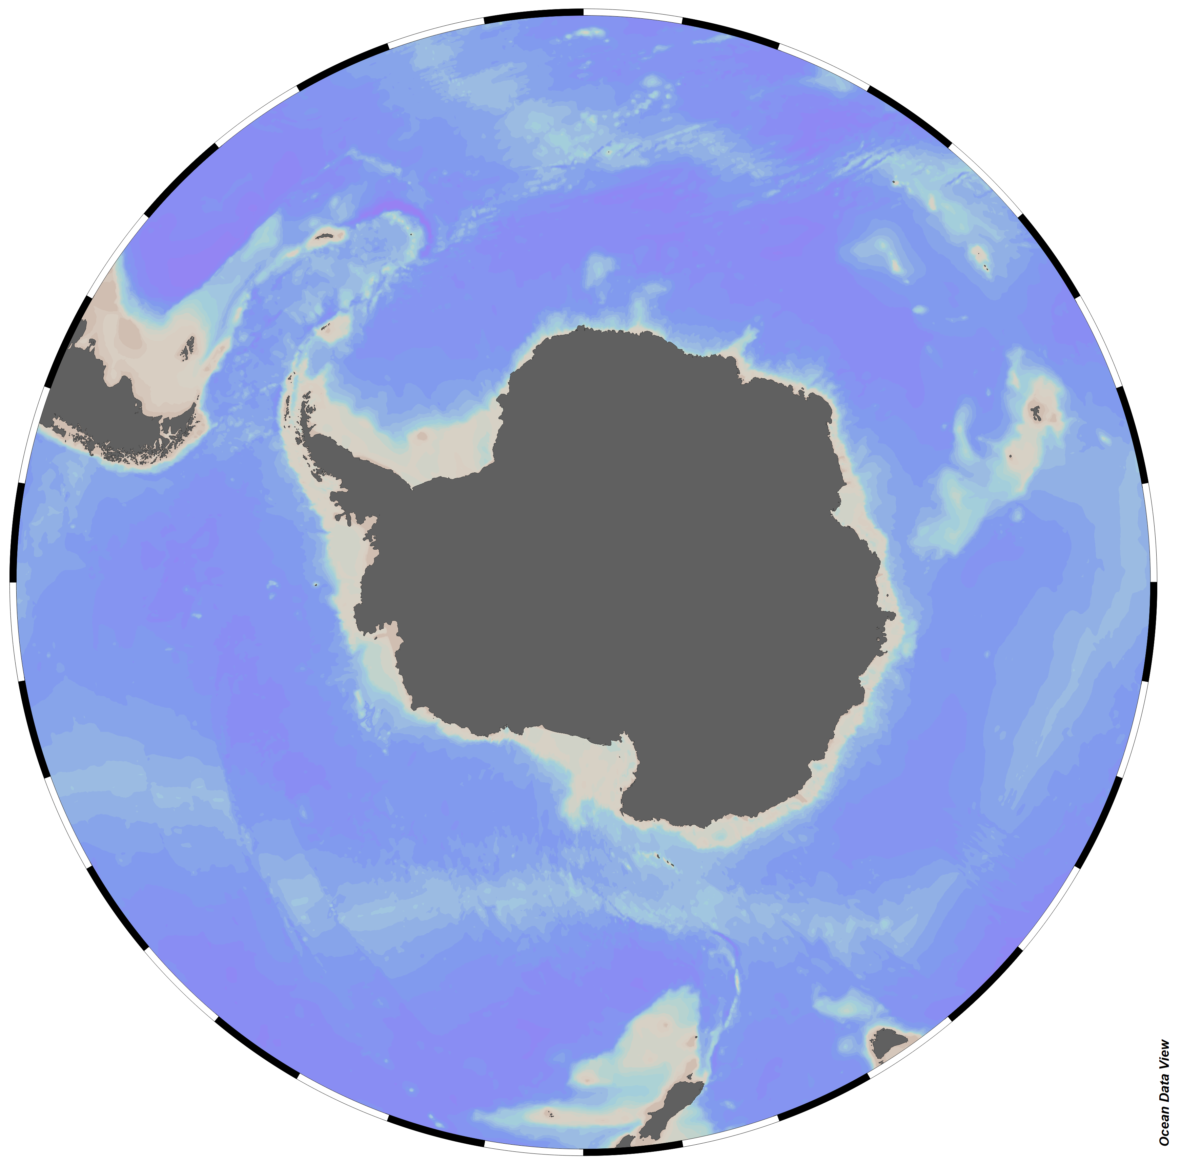
Climate variability over the last 800 ka in Antarctica
Present
RCP 8.5
RCP 2.6
time
Alternance between hot periods (interglacial) and cold periods (glacial) for at least 800 ka
Nowadays, we are currently in an interglacial. Our aim is to study another hot period of the past
2

Slide 9
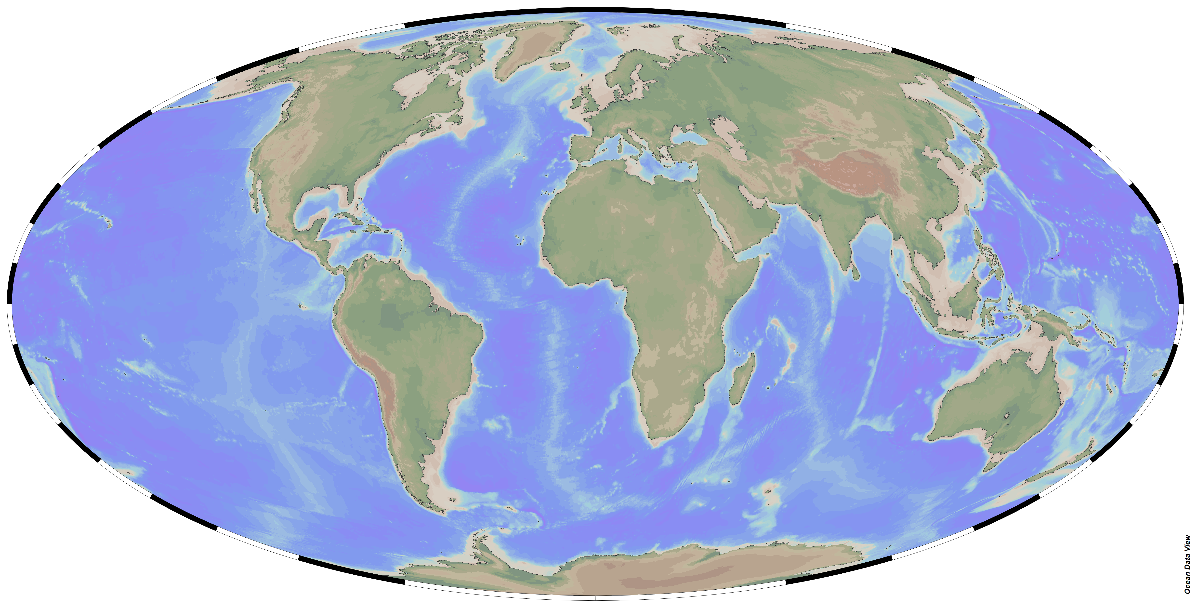
Climate variability over the last 800 ka in Antarctica
Present
RCP 8.5
RCP 2.6
time
Alternance between hot periods (interglacial) and cold periods (glacial) for at least 800 ka
Nowadays, we are currently in an interglacial. Our aim is to study another hot period of the past
?
Need to characterize the spatial pattern of Earth Warming
2

Slide 10
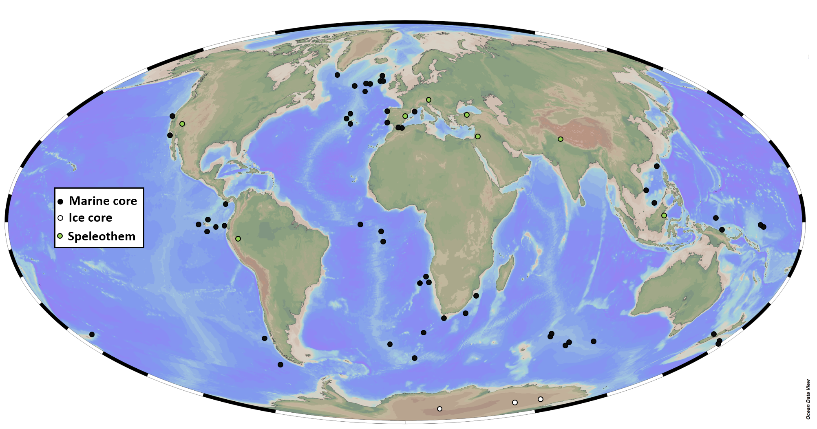
Multi-archive synthesis : building a common temporal framework
52 marine sediment cores
9 speleothems
3 ice cores
4

Slide 11
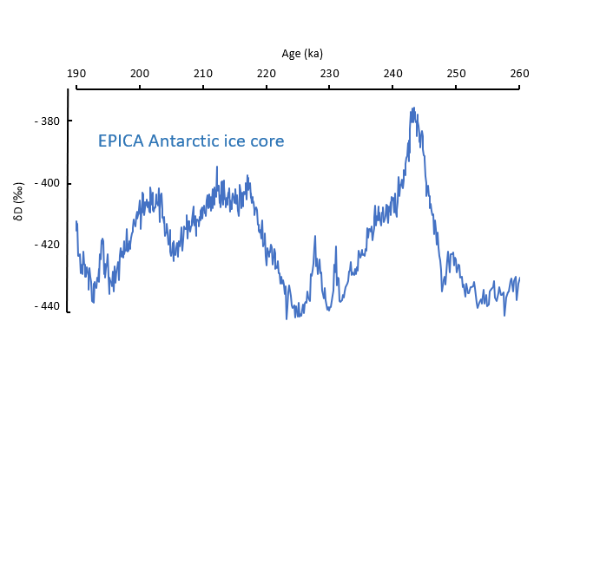
Multi-archive synthesis : building a common temporal framework
Step 1 : Select a chronology of reference
ODP 1293 marine core
MD07-2120 marine core
reference
EPICA Antarctic ice core
1
5

Slide 12
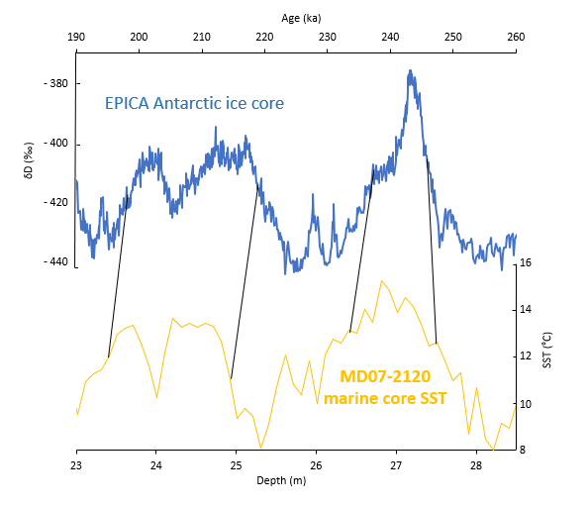
Multi-archive synthesis : building a common temporal framework
Step 1 : Select a chronology of reference
Step 2a : Propagate to high-latitude records
ODP 1293 marine core
MD07-2120 marine core
reference
2
reference
EPICA Antarctic ice core
1
5

Slide 13
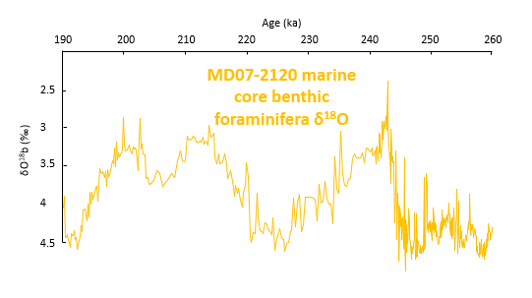
Multi-archive synthesis : building a common temporal framework
Step 1 : Select a chronology of reference
Step 2a : Propagate to high-latitude records
Step 2b : Create a new age model
ODP 1293 marine core
MD07-2120 marine core
reference
2
EPICA Antarctic ice core
1
5

Slide 14
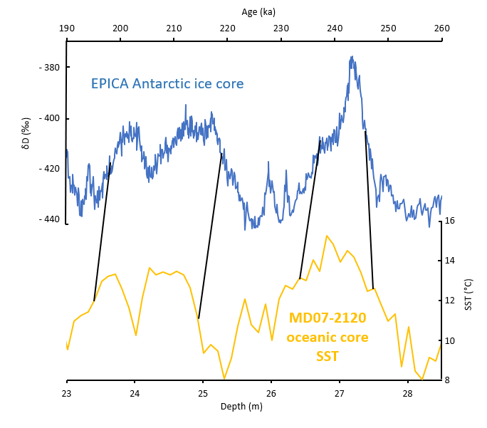
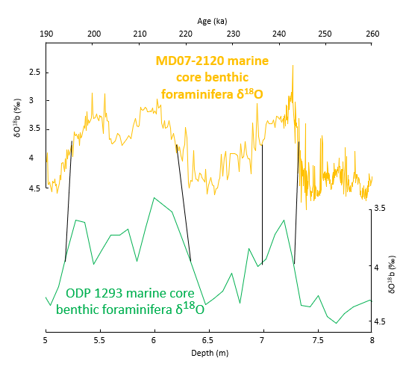
Multi-archive synthesis : building a common temporal framework
Step 1 : Select a chronology of reference
Step 2a : Propagate to high-latitude records
Step 2b : Create a new age model
Step 3 : Propagate to low-latitude records
ODP 1293 marine core
3
MD07-2120 marine core
reference
2
reference
EPICA Antarctic ice core
1
5

Slide 15
Multi-archive synthesis : first results
NH Timing = 220.0 ka
High-latitude North (NH)
SST(°C)
Age (ka)
SST(°C)
6

Slide 16
Multi-archive synthesis : first results
High-latitude North (NH)
SST(°C)
Age (ka)
SST(°C)
High-latitude South (SH)
SST(°C)
Age (ka)
6

Slide 17
Multi-archive synthesis : first results
NH Timing = 220.0 ka
High-latitude North (NH)
SST(°C)
Age (ka)
SST(°C)
Timing findings
- SH warm up before NH
High-latitude South (SH)
SST(°C)
Age (ka)
6

Slide 18
Multi-archive synthesis : first results
NH Timing = 220.0 ka
High-latitude North (NH)
SST(°C)
Age (ka)
SST(°C)
Timing findings
- SH warm up before NH
SH Timing = 222.3 ka
High-latitude South (SH)
SST(°C)
Age (ka)
6

Slide 19
Multi-archive synthesis : first results
High-latitude North (NH)
SST(°C)
Age (ka)
SST(°C)
Timing findings
Amplitude findings
- SH warm up before NH
- 1st warming is more intense than 2nd warming in SH
High-latitude South (SH)
SST(°C)
Age (ka)
6

Slide 20
Multi-archive synthesis : first results
High-latitude North (NH)
SST(°C)
Age (ka)
SST(°C)
Timing findings
Amplitude findings
- SH warm up before NH
- 1st warming is more intense than 2nd warming in SH
High-latitude South (SH)
SST(°C)
Age (ka)
6

Slide 21
Multi-archive synthesis : first results
High-latitude North (NH)
SST(°C)
Age (ka)
SST(°C)
Timing findings
Amplitude findings
Better characterization of spatial and temporal pattern of climate changes during warm periods
- SH warm up before NH
- 1st warming is more intense than 2nd warming in SH
High-latitude South (SH)
SST(°C)
Age (ka)
6

Slide 22
Thank you for your attention !

