Slide 1
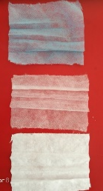
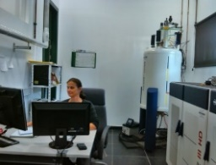
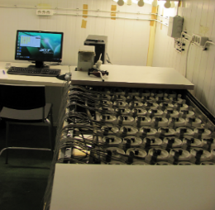
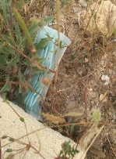
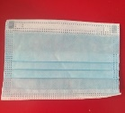
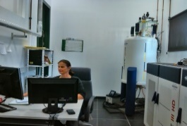
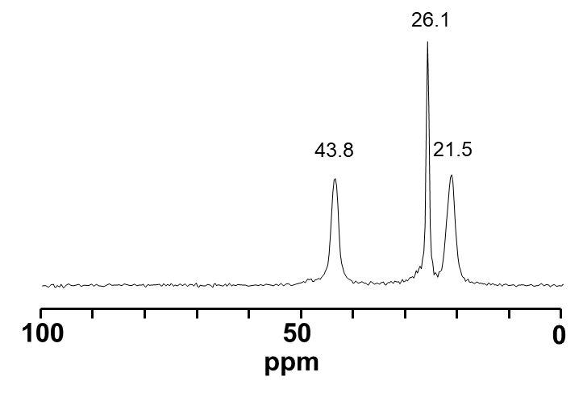
Biodegradability of single-use polypropylene-based face masks, littered during the COVID-19 pandemic
– a first approach
Heike Knicker and Marta Velasco-Morena
Solid-state NMR Service Unit, IRNAS-CSIC, Sevilla, Spain (e-mail: knicker@irnase.csic.es)
Reasoning
Approach
6 months
Outer (blue)
Threats:
Human health
Animals (unintentional feeding)
nano/microplastics in soil
Transport to rivers/ oceans
Solid-state ¹³C NMR
129 billion masks / month (worldwide)
Additional plastic deposal:
5.2 * 10⁴ / month
Mask + soil
Center (filter)
CO₂-C production (mg)
Soil
Mask
Respirometry
Inner layer
Isotactic polypropylene
Degradation time
soil+mask cuts (75 % WHC)
21.5 ppm
CH₃
43.8 ppm
disposal
of 1%
Total mask
CH₃
H
H
CH₃
H
COVID 19
C
C
C
C
C
C
H
H
H
H
H
H
Statistical Analysis: ANOVA
26.1 ppm
What happens to masks after their disposal to soil?
Differences indicating degradation?
Results
All layers have the same chem. composition
No indication for oxidation
Center mask is the most chemically affected but:
it is protected if it stays in the “complete” mask
Very fast pool: 4-5%
MRT_{slow}: 7 to 31 years
“Free” center mask has MRT_{slow} = 7 yrs
Cut of “complete” propylene unit
C-loss per C-group for single (S) / complete (C) masks after 1 / 6 months (t1, t6) of degradation
CO₂
 | A_{fast} | MRT_{fast} | A_{slow} | MRT_{slow} | R²
 | % | years | % | years
soil | 5.2 | 0.114 | 97.1 | 6 | 0.999
outer | 4.6 | 0.008 | 94.9 | 18 | 0.947
center | 3.8 | 0.008 | 95.7 | 7 | 0.981
inner | 4.7 | 0.008 | 94.7 | 31 | 0.780
complete | 4.3 | 0.022 | 96.3 | 21 | 0.946
Fresh mask
Degraded mask
CH₃
CH₃
CH₃
H
H
H
C
Outer
Carbonyl C
C
C
C
C
H
+
H
C
H
H
H
H
H
H
Center
21.5 ppm
43.8 ppm
CH₃
H
CH₃
H
CH₃
H
Inner
C
C
C
C
C
C
H
H
H
H
H
H
A: Pool size; MRT: Mean Residence Time
100
50
ppm
0
200
100
0
26.1 ppm

