Slide 1
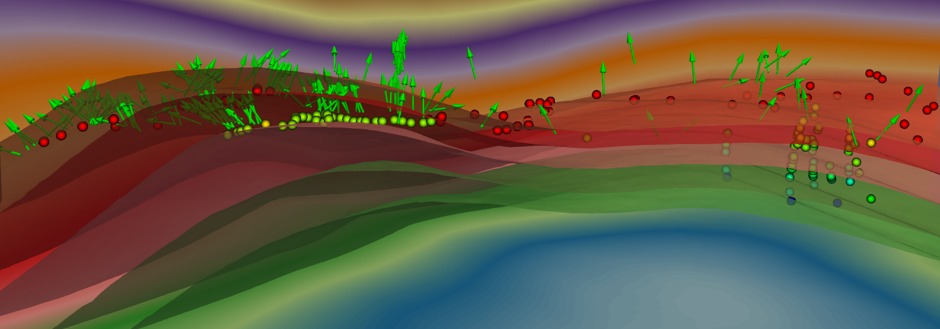

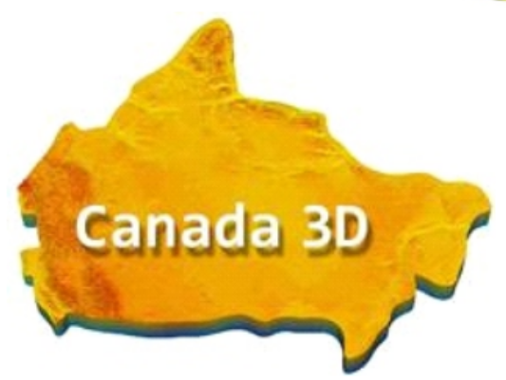
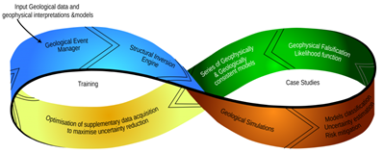

Using Graph Neural Networks for 3-D Structural Geological Modelling
Michael Hillier, Florian Wellmann, Boyan Brodaric, Eric de Kemp, and Ernst Schetselaar
Notes:
Today I will talk about machine learning methods for 3D geological model construction.

Slide 2
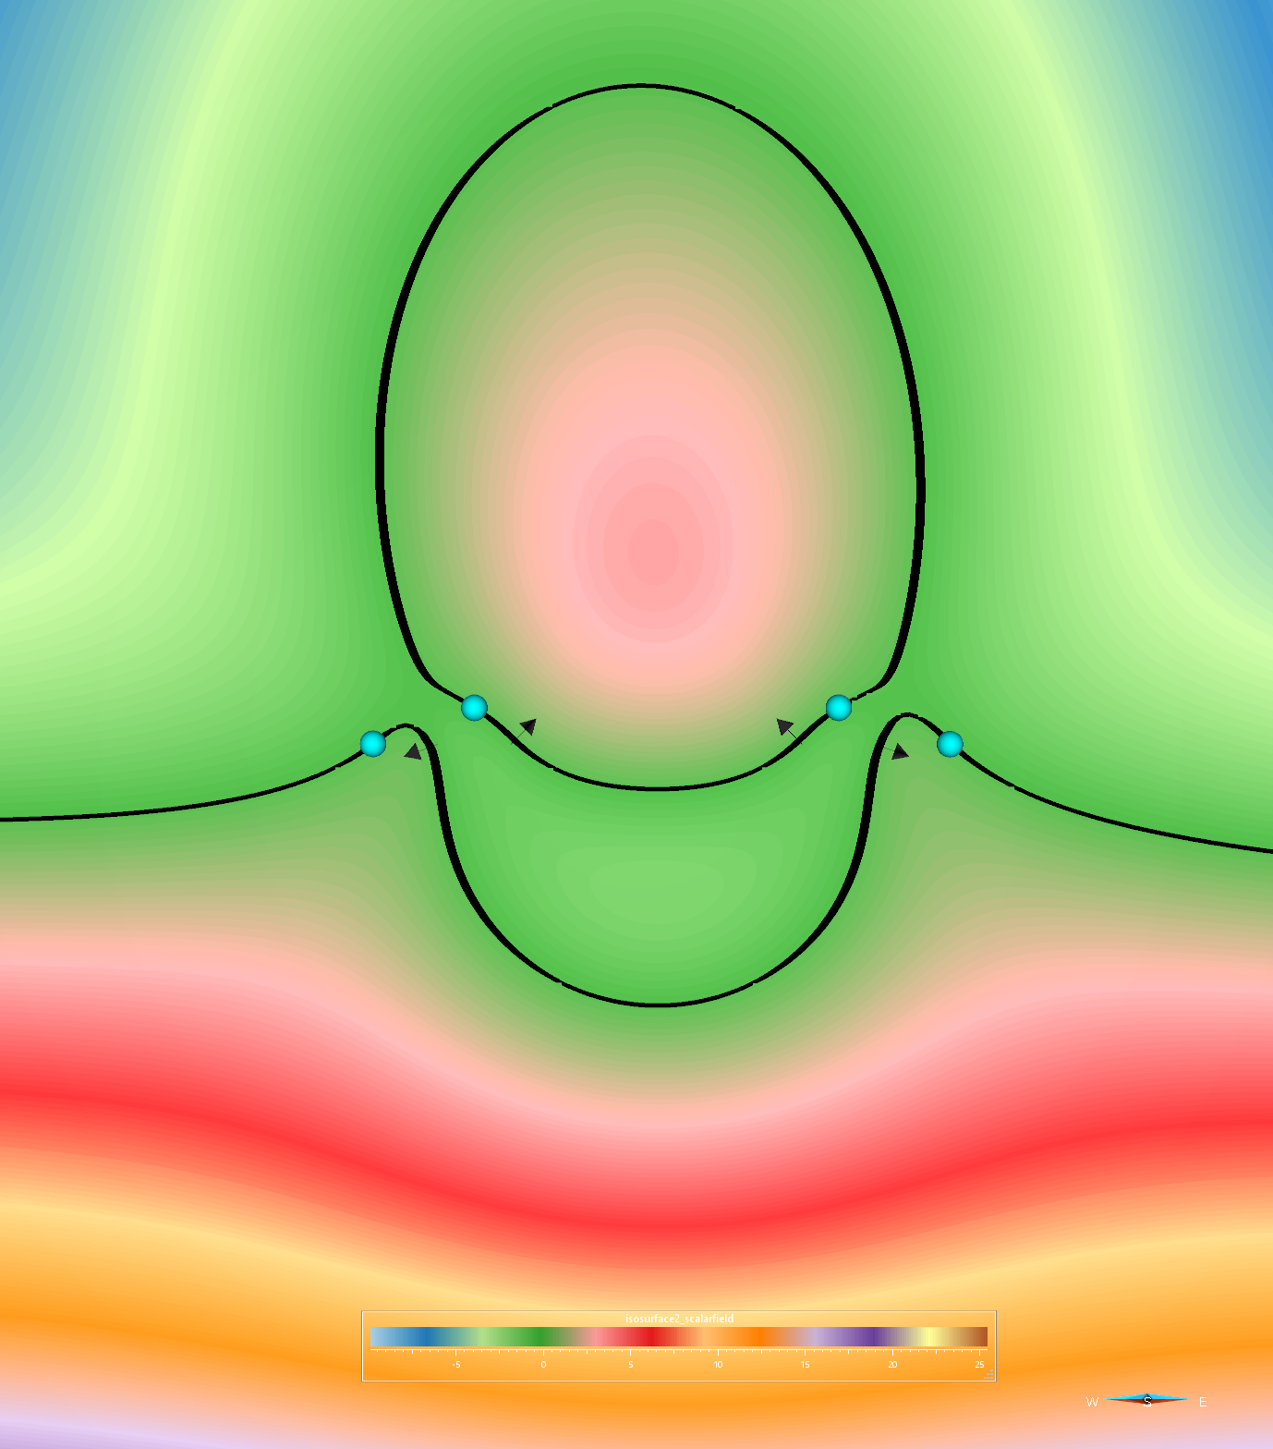


Implicit Approaches: Limitations
Implicit-based approaches are the most widely used method for producing 3D geological models
In complex settings, resultant models are not geologically plausible
  Geological inconsistences
Related to restrictions on the types of data and knowledge constraints that can be incorporated in modelling
Challenges with scaling (e.g. big data)
Mathematically valid
Geologically valid

Slide 3
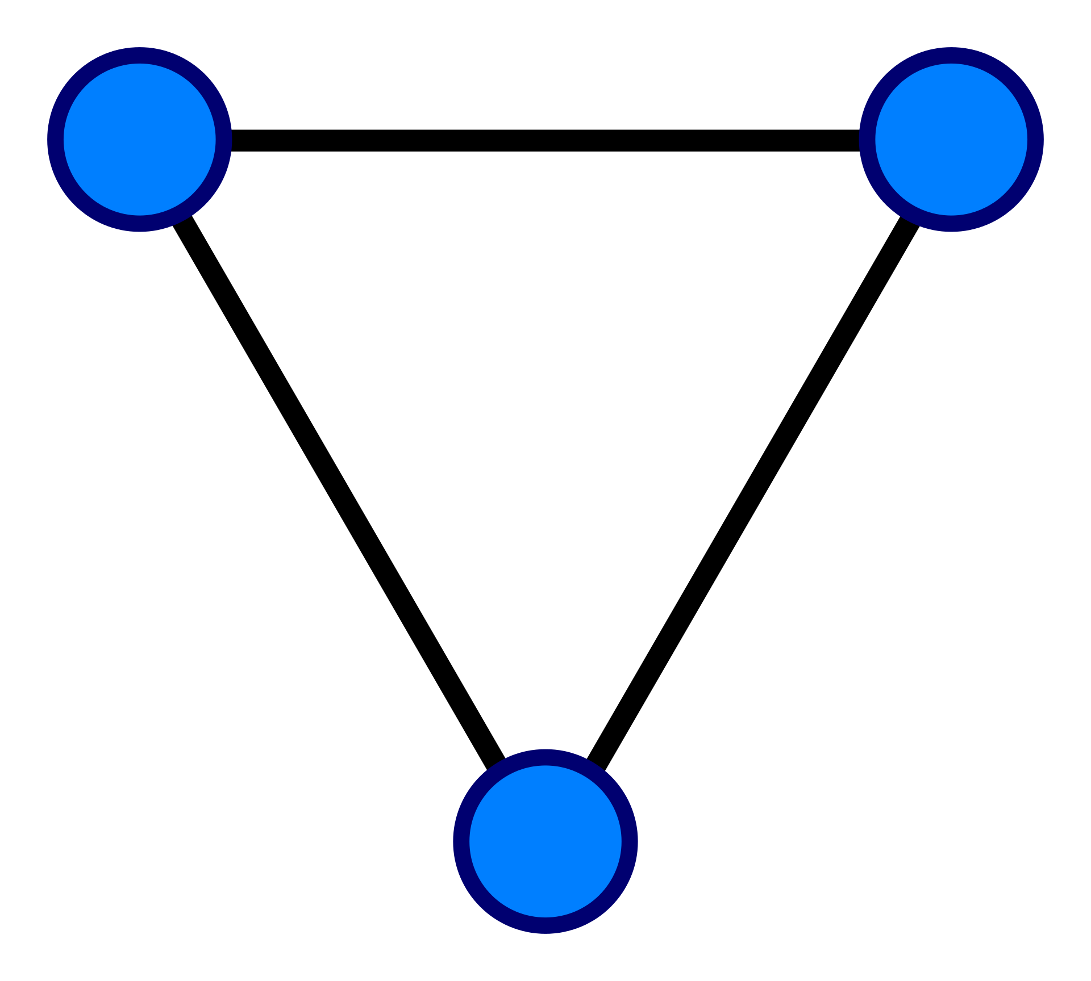
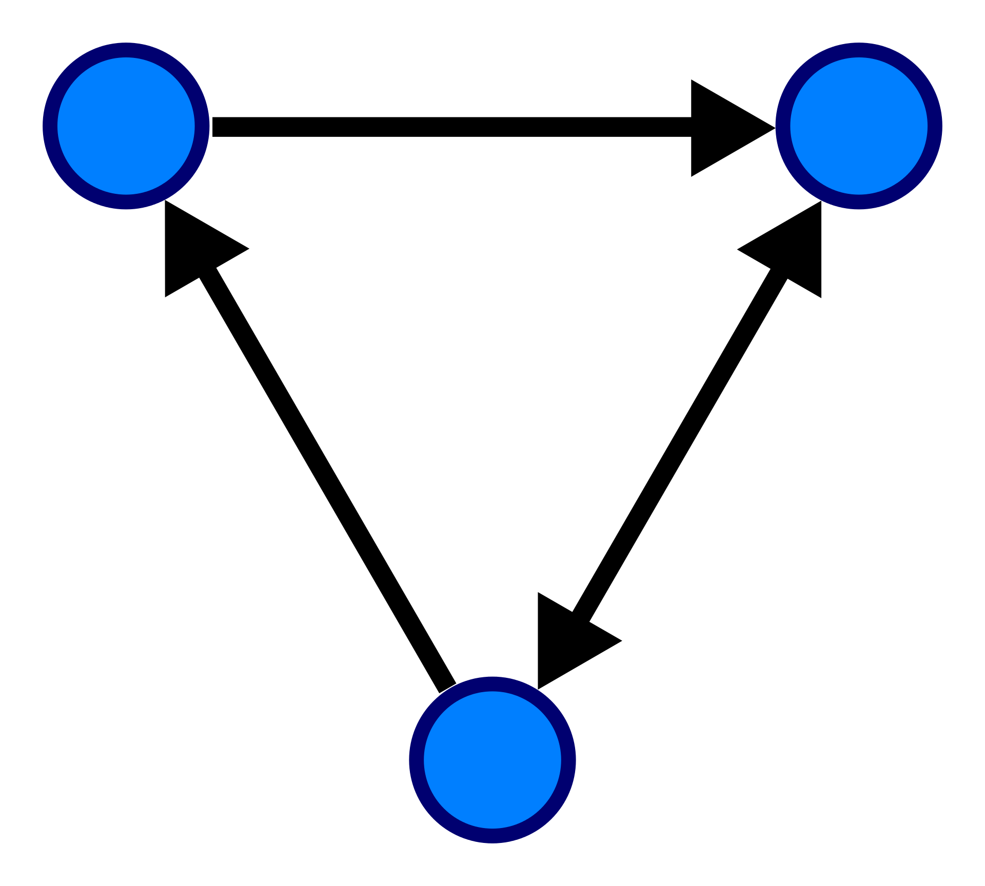
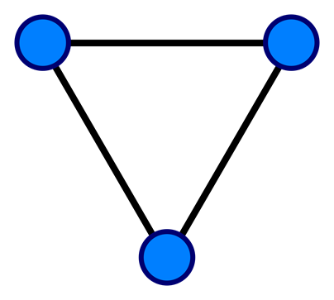
Graph Structured Data
Graphs are a collection of nodes connected by a set of edges
3
1
4.5
Undirected
Directed
Weighted

Slide 4
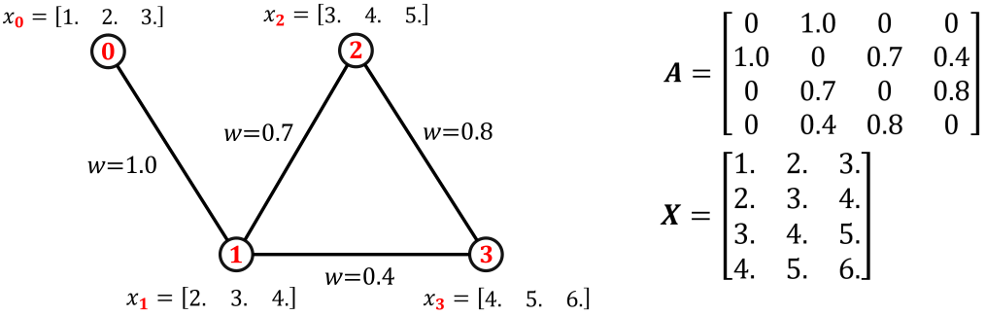
Graph Structured Data
Adjacency Matrix
Node Feature Matrix

Slide 5
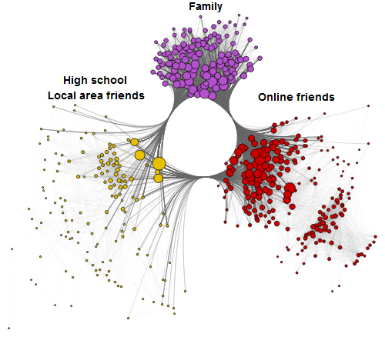
Graph Neural Network Applications:
Recommender Systems
Social Networks
Recommender System ↔ Link Prediction
  Predicting edges between nodes
Recommendation of
  Friends
  Products
  Movies
  Interests
https://neptune.ai/blog/graph-neural-network-and-some-of-gnn-applications

Slide 6
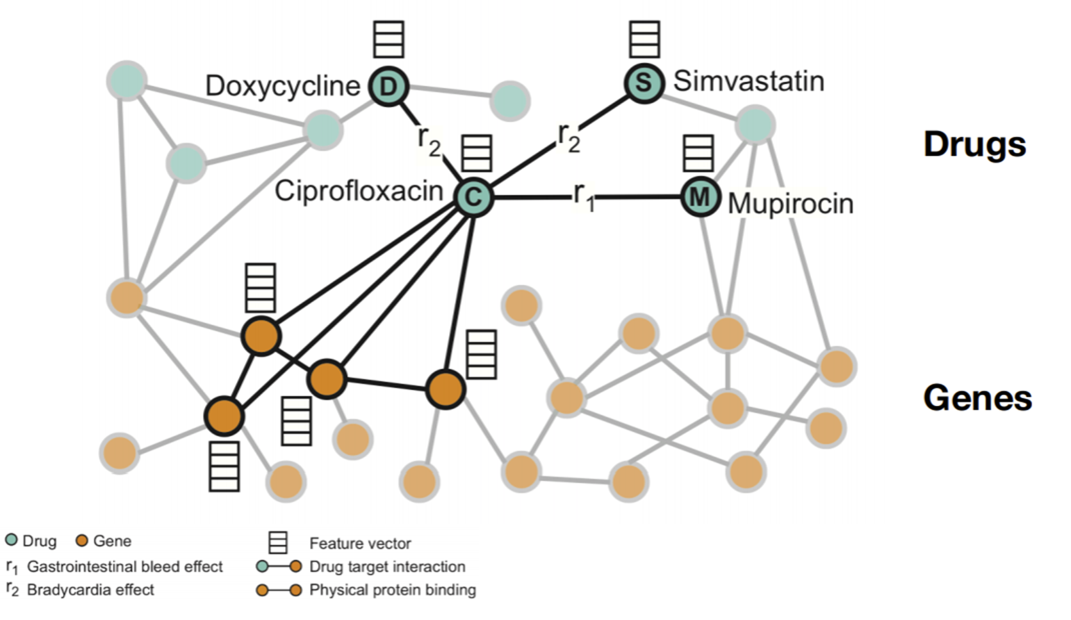
Graph Neural Network Applications:
Polypharmacy Side Affects
Zitnik et al. 2018

Slide 7
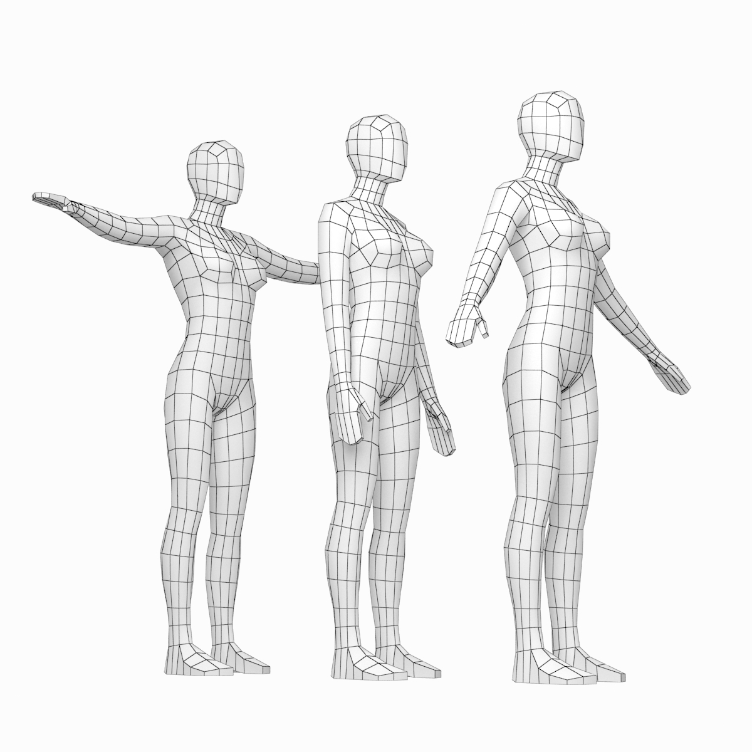
Graph Neural Network Applications:
Geometric Deep Learning
Bronstein et al. 2017
Shape Correspondence

Slide 8







Graph Neural Network Model
$$h_{2}$$
$$h_{4}$$
$$h_{0}$$
Message passing network
Generate abstract representations (embeddings) of nodes and edges which will be used for various learning tasks
Representations updated in every layer of the network using a node’s neighborhood
2
4
0
6
3
5
$$h_{6}$$
1
$$h_{3}$$
$$h_{5}$$
$$h_{1}$$

Slide 9


Node Embeddings
Encapsulate the topological structure, structural roles, relevant property information in a compressed form (e.g. low-d vector)
Final layer in network will transform embeddings into predictions using simple linear operations
DNA sequence
Graph Node Embedding
Visual Representation of Embedding
1.1
0
1.7
6.2
4.9
0
3.2
2.6
Vector representation of Embedding

Slide 10
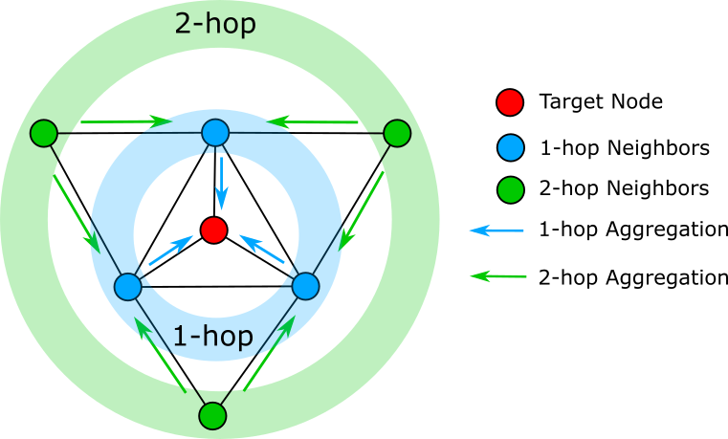
Generation of Node Embeddings
Application of recursive graph convolutions.
Graph convolution is an operation that aggregates/combines the representations (e.g. embeddings) of neighbouring nodes
The deeper the network, the further information is being propagated
At the start of the algorithm, the node embeddings are initialized to the node features (input data).

Slide 11
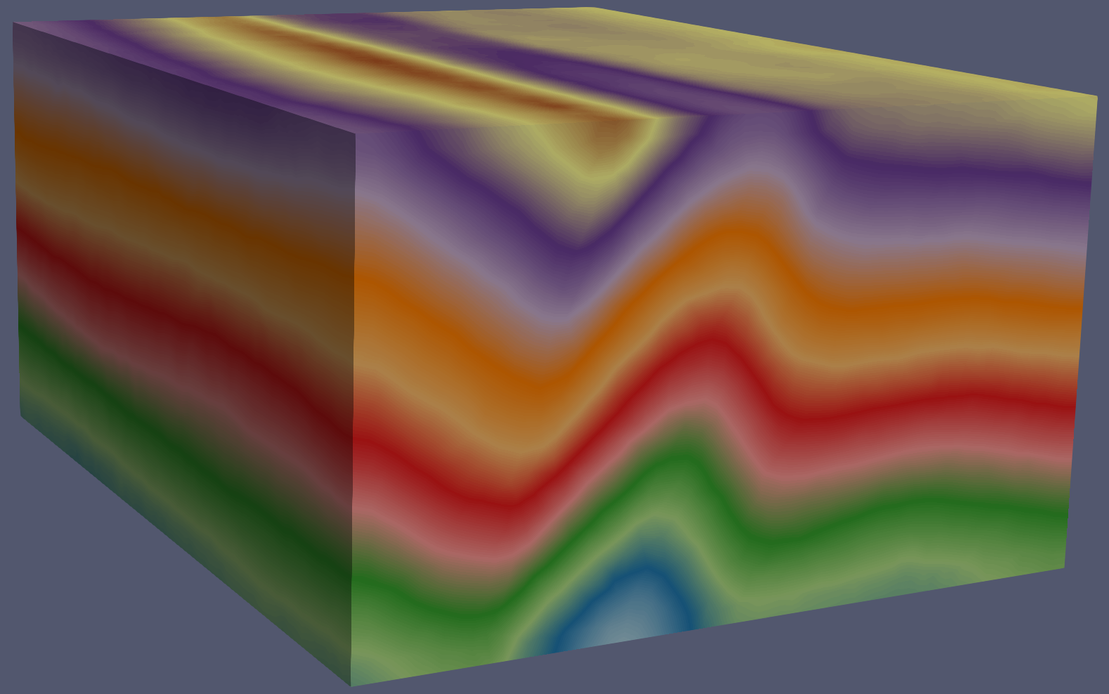
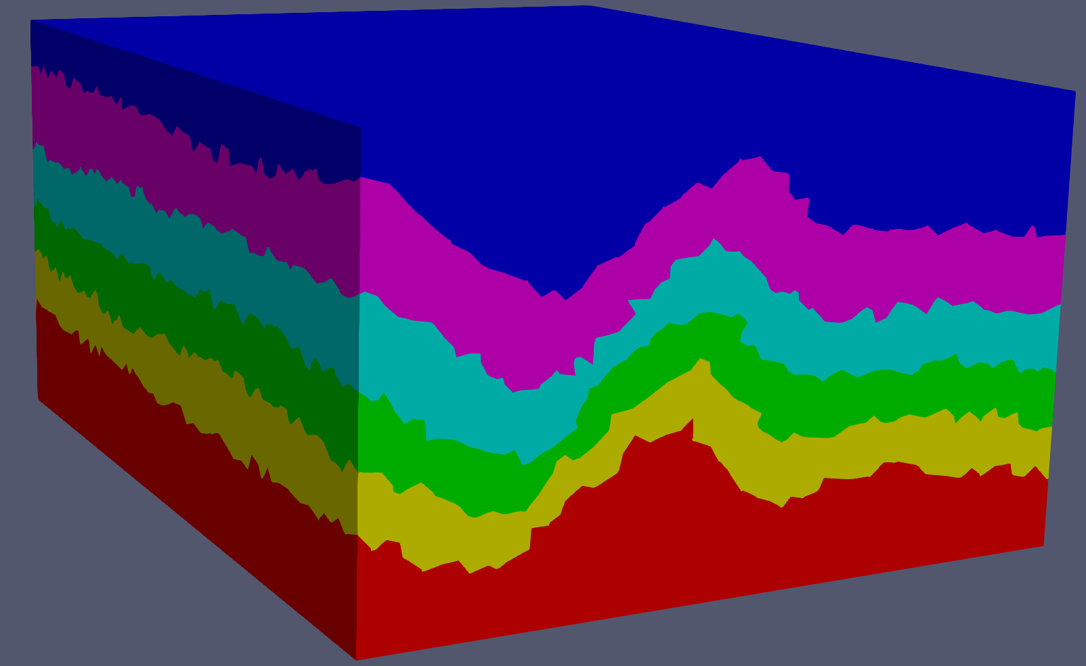
Graph Neural Network Applications:
Three-dimensional Geologic Modelling
Benefits
Model both continuous (implicit scalar fields) and discrete (lithostratigraphic) features simultaneously
No requirement to solve large interpolation matrices
Provides an expressive framework for incorporating constraints through loss functions
Ability to scale for massive and complex modelling

Slide 12
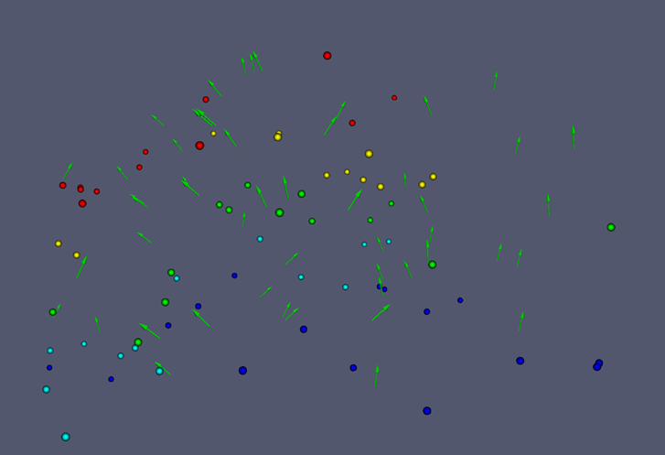
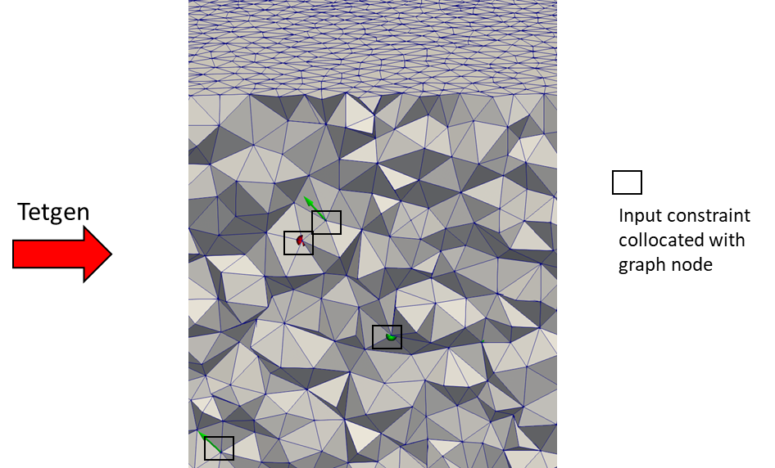

Graph Neural Network Applications:
Three-dimensional Geologic Modelling
Layer 0’s embedding (e.g. input layer)
$h^{0}=$ node embeddings e.g. $\left[x,y,z\right]$

Slide 13
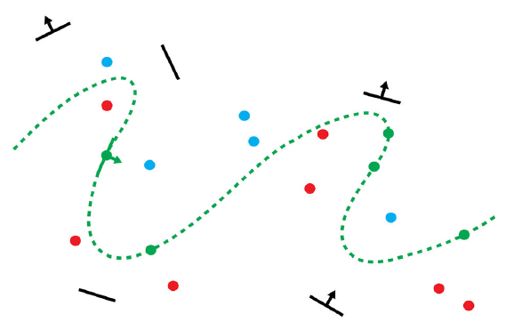



Geological Constraints
Stratigraphic Data Stratigraphic Point
Constraint
Younger
Rock Unit A
Rock Unit B
Rock Unit C
Orientation Data Orientation Point
Constraint
Planar Orientation
(has polarity)
Linear Orientation
Modified from Hillier et al. 2014

Slide 14
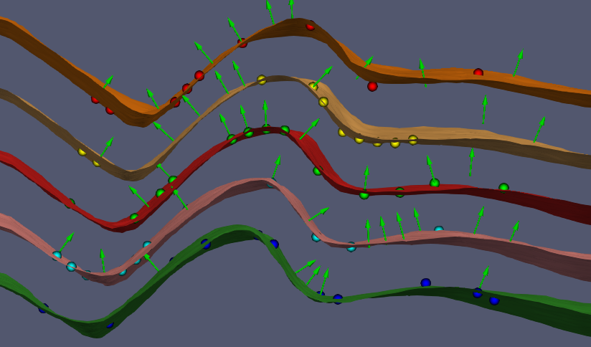
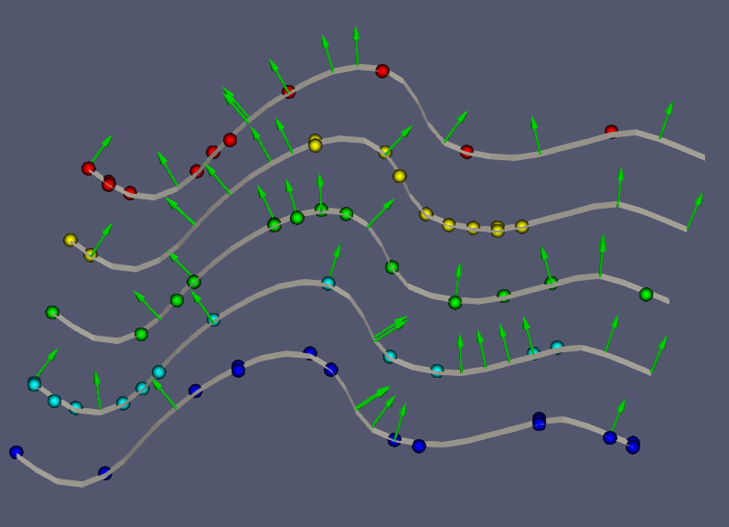
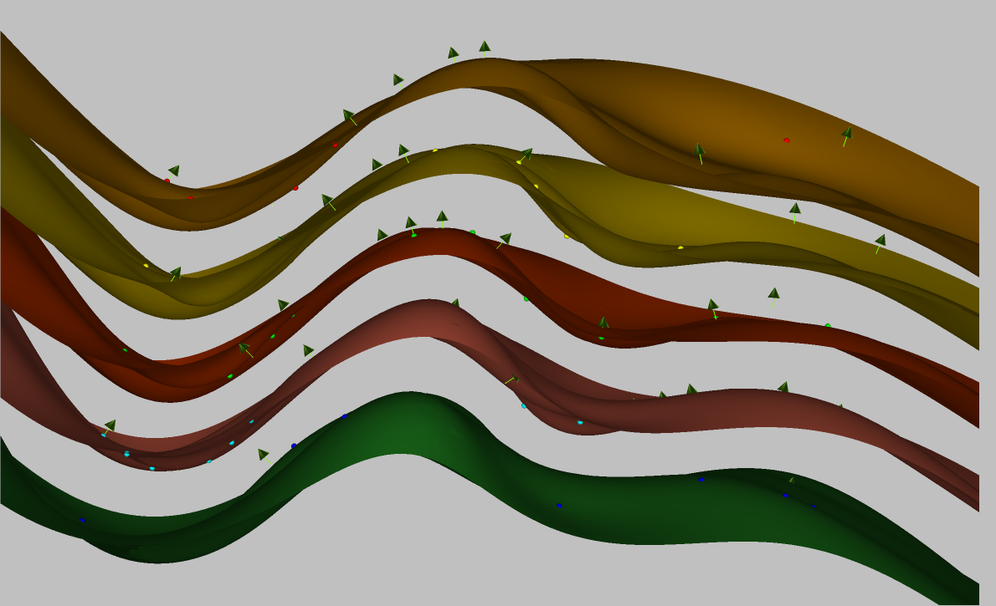
Modelling Results
GNN
RBF
Synthetic Model

Slide 15
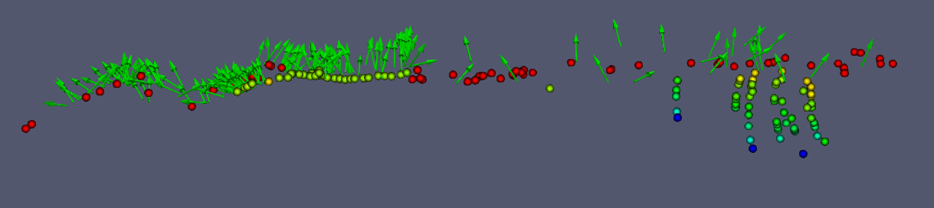
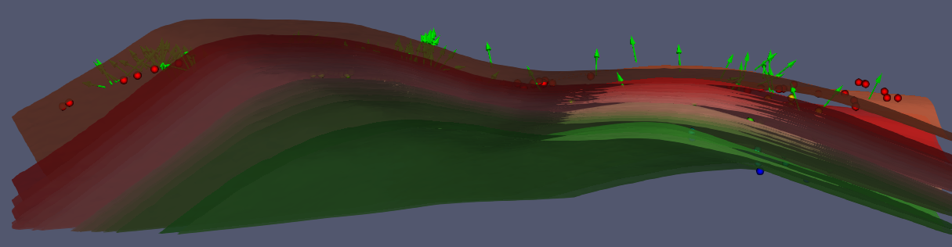
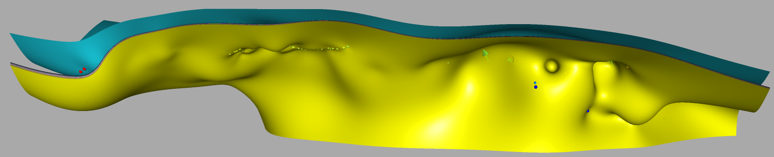
Modelling Results
Real World Dataset
GNN
RBF

Slide 16


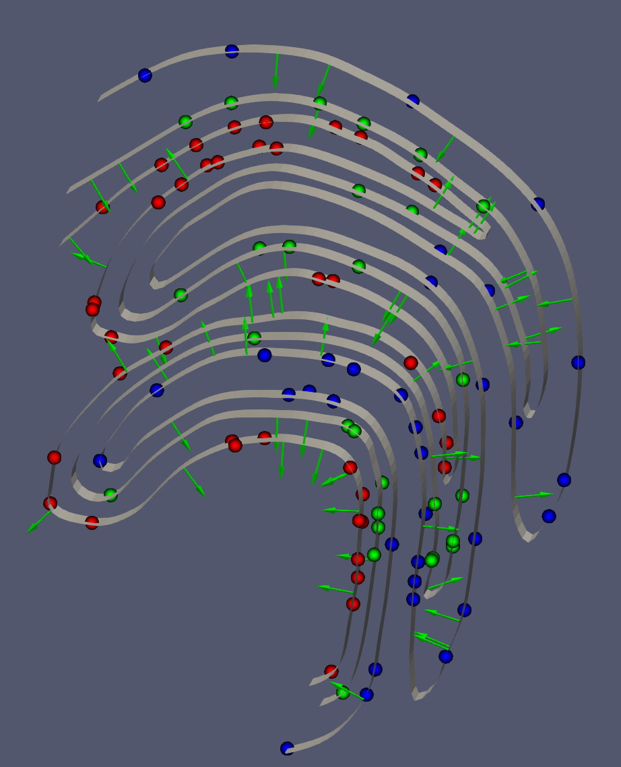
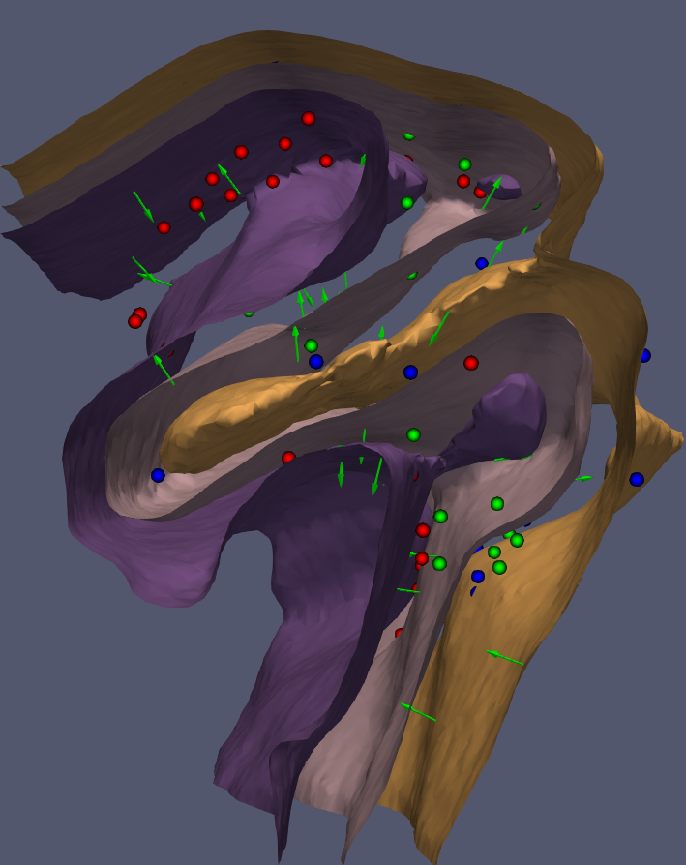
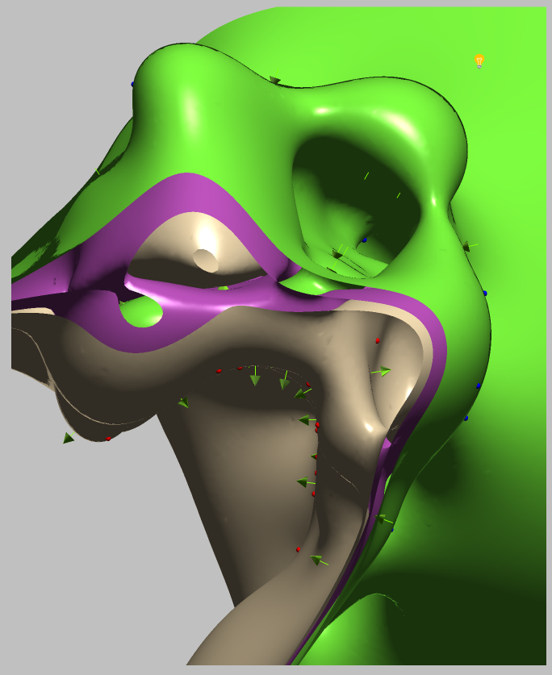
Modelling Results
Synthetic Model

Slide 17
Conclusions
GNN models provide promising framework for constraining 3D geological models
  Manuscript in accepted, subject to minor revisions
Expressive framework made possible by incorporating constraints through loss functions
  Only requirement is geological property/feature must be computable on the model
Provides a foundation for knowledge constraints expressible as a graph for future work.
  Topology, knowledge graphs
Leverage cloud computing infrastructure using big data

Slide 18
References
Thiele ST, Jessel MW, Lindsay M, Ogarko V, Wellmann F, Pakyuz-Charrier E (2016) The topology of geology 1: Topological analysis. J Struct Geo 91:27-38
Zitnik M, Agrawal M, Leskovec J (2018) Modeling polypharmacy side effects with graph convolutional networks. Bioinformatics 34(13):i457-i466
Bronstein MM, Bruna J, LeCun Y, Szlam A, Vandergheynst P (2017) Geometric deep learning: going beyond Euclidean data. IEEE Signal Process Mag 34 (4):18-42
Hillier MJ, Schetselaar EM, de Kemp EA, Perron G (2014) Three-Dimensional Modelling of Geological Surfaces Using Generalized Interpolation with Radial Basis Functions. Math Geosci 46(8): 931-953

