Slide 1

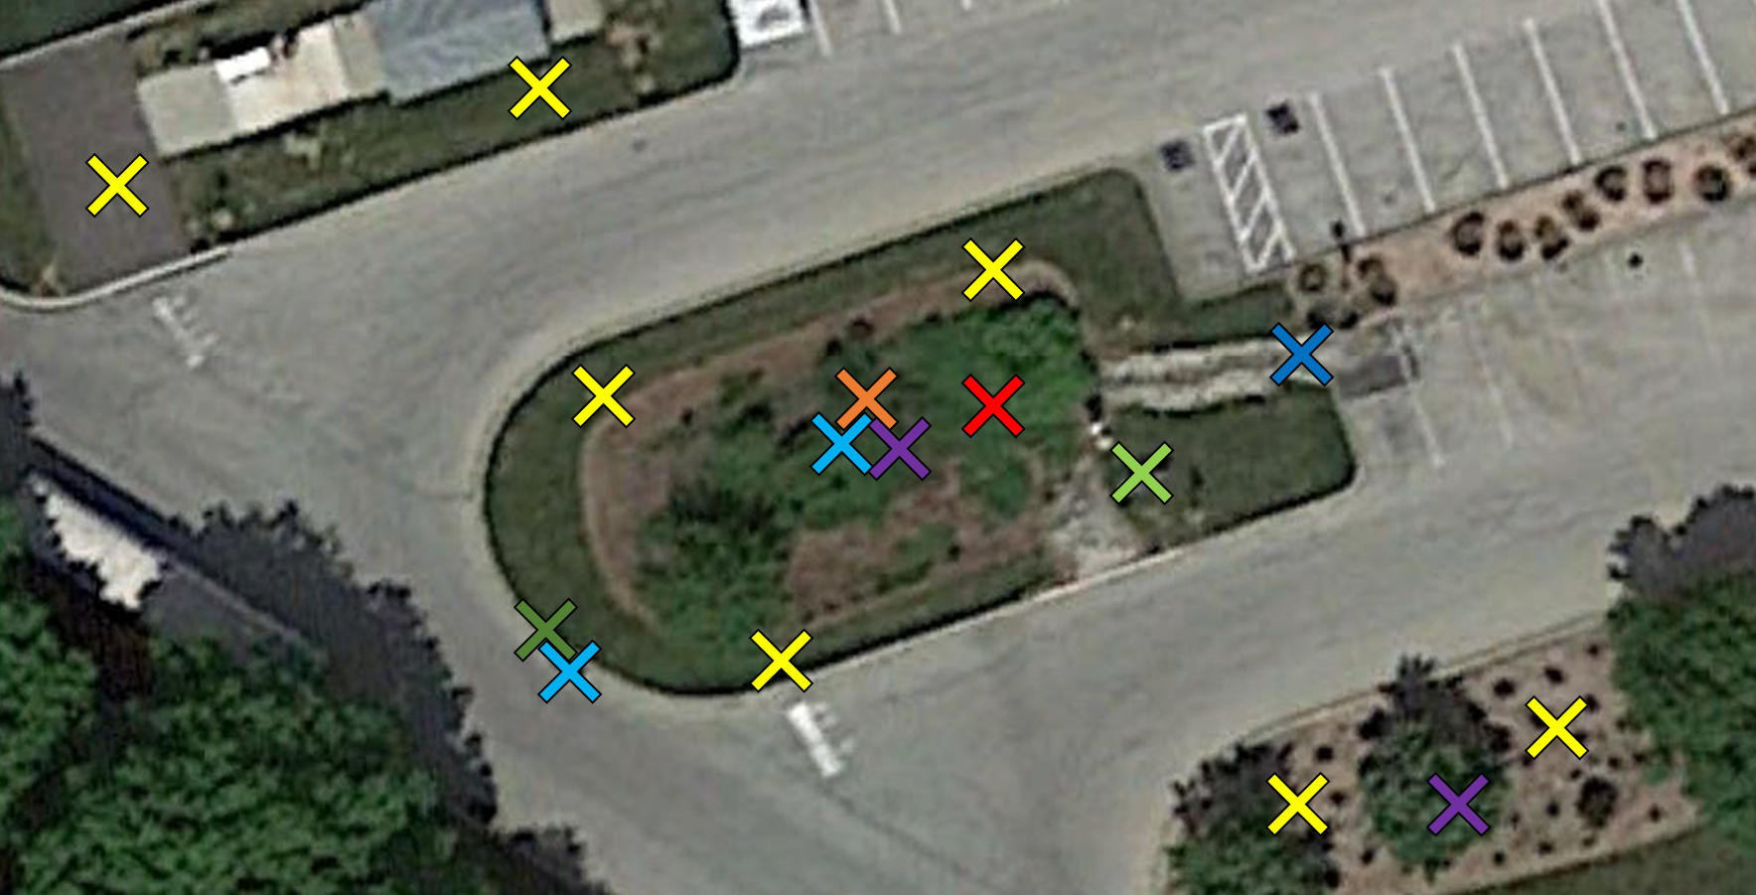
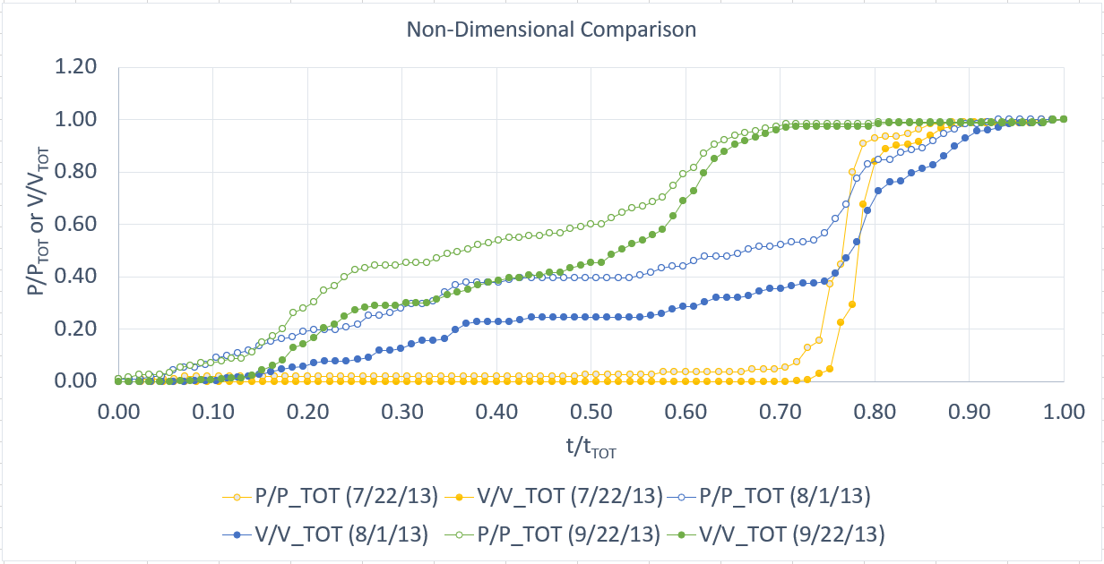
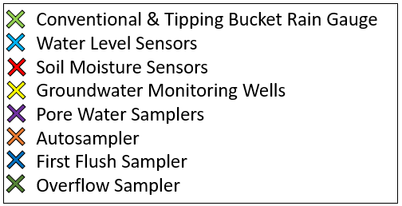
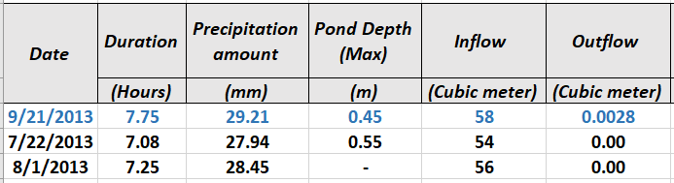
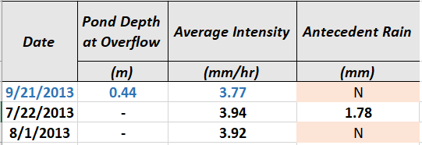
Analyzing the performance of a rain garden over
15 years
Achira Amur, PhD candidate; Bridget Wadzuk, PhD; Robert Traver, PhD
Department of Civil & Environmental Engineering, Villanova University
Data Collection at the BTI:
Non-Dimensional Comparison:
Water Quantity: Rain Gauge, sensors & monitoring wells
Water Quality: Samplers
The plot above shows the Non-Dimensional Comparison for each of the storms discretized in the bin of 6-8 hours, 27.94-30.48 mm
The open dots depict the rainfall patterns and the filled in dots show the inflow patterns for the storms
Out of the three plot lines, the green line (event that overflowed) shows a gradual increase over the course of the storm with the other two plot lines showing an abrupt increase towards the end of the storm
The inflow plot lines follow the same shape as the rainfall plot lines but are dampened due to their initial interaction with the drainage area
Comparison within a bin:
Key Takeaways:
(Past 72-hour period)
The BTI does not respond similarly to characteristically similar storms (storms with similar precipitation amounts and event durations)
Only one of the three storms discretized in the same bin overflowed
The rainfall-runoff patterns for the three storms vary significantly
The BTI produces a set of hydrographs for a bin with characteristically similar storms rather than one characteristic response
The storm highlighted in blue in the table above depicts the storm that overflowed.

