Slide 1
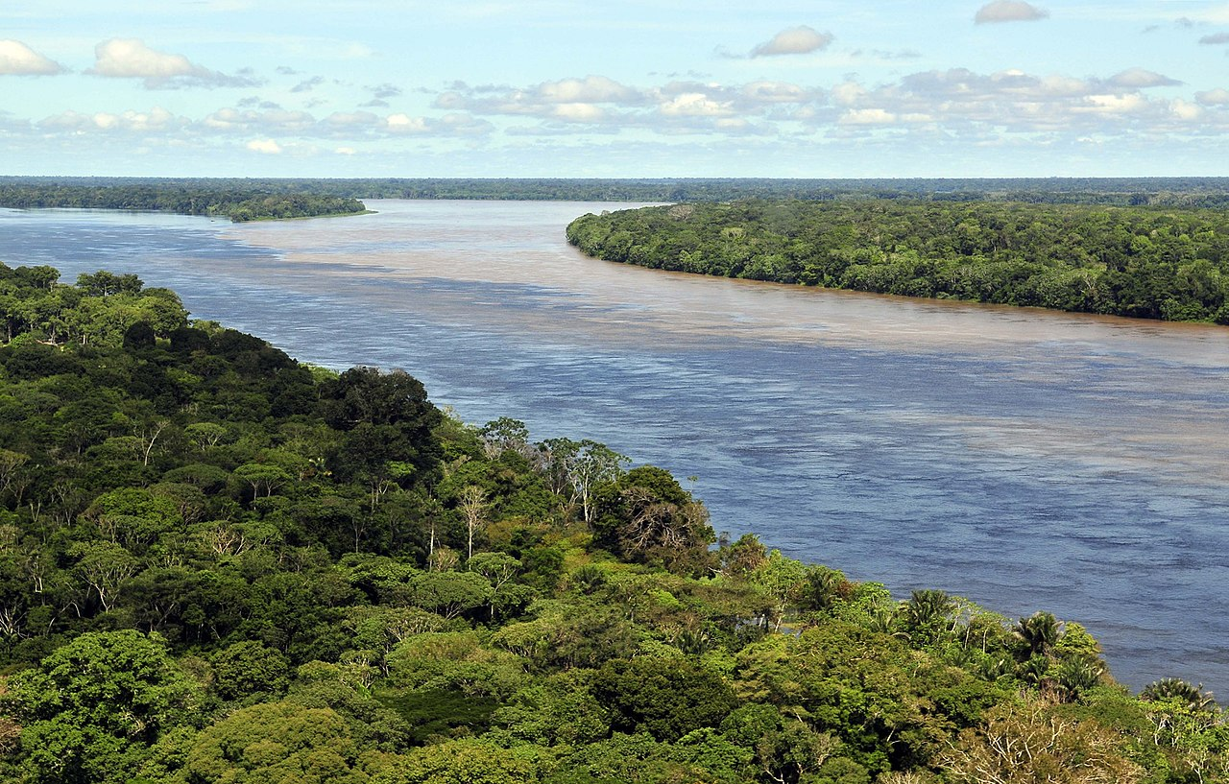






High-resolution mapping of floodplain vegetation changes in large tropical rivers
Source: Wikipedia.com
Salerno, L. ª; Moreno-Martínez, Á. ^{b}; Izquierdo-Verdiguier, E. ^{c}; Clinton, N. ^{d}; Siviglia, A. ^{e} and Camporeale, C. ª.
ª Department of Environment, Land and Infrastructure Engineering, Politecnico di Torino, Italy
^{b} Image Processing Laboratory (IPL), Universitat de València, València, Spain
^{c} Institute of Geomatics, University of Natural Resources and Life Science (BOKU), Wien, Austria
^{d} Google, Inc., Mountain View, CA, USA
^{e} Department of Civil, Environmental and Mechanical Engineering, Università degli studi di Trento, Italy
Corresponding: luca.salerno@polito.it

Slide 2
Tropical floodplains vegetation: a pulsing system
Terrestrial phase
Aquatic phase
River Morphodynamic
Vegetation regeneration
FLOOD PULSE
Main driver of ecological and biogeochemical processes in floodplain vegetation
(Junk, 1989; Lewis et al., 2000, de Resende, A. F., et al. 2019).
Anatomical, morphological, physiological, and biochemical trees adaptations to survive in this seasonal environment
(De Simone et al., 2003; Ferreira and Parolin, 2011; Junk, 1989; Parolin et al., 2004).

Slide 3
Disturbances
Large Dams and resevoirs:
- Break sediment-load river dynamic nexus.
- Disturbe flood-pulse and impact on riparian vegetation [1]
Climate change:
- Hydro-climatic anomalies [2]
- Extended drought: direct vegetation stress and fire vulnerability. [3]
- Multiannual period of uninterrupted flooding and tree mortaliy [1]
Land-cover change:
- Agriculture use of wetlands
[*]
[*]
[*]
[1] de Resende, A. F., et al.(2019).
[2] Poveda, G., & Salazar, L. F. (2004).
[3] Aragão, L. E., et al., 2018
[*] Source: Wikipedia.com

Slide 4
Vegetation Mapping and Monitoring
LandSat
(30 m)
HISTARFM ^{[4]}
High resolution
Gap-filled reflectance (30 m)
Modis
(500 m)
Vegetation Index and uncertainties
(NDVI)
Vegetation Mapping and Monitoring
Antropological effects
Global Water Surface Data ^{[5]}
Hydrological regime
transition zones
[4] Moreno-Martínez, A. et al.(2020). Remote Sensing of Environment, 247, 111901.
[5] Pekel, J. F., et al. (2016). Nature, 540(7633), 418-422.

Slide 5
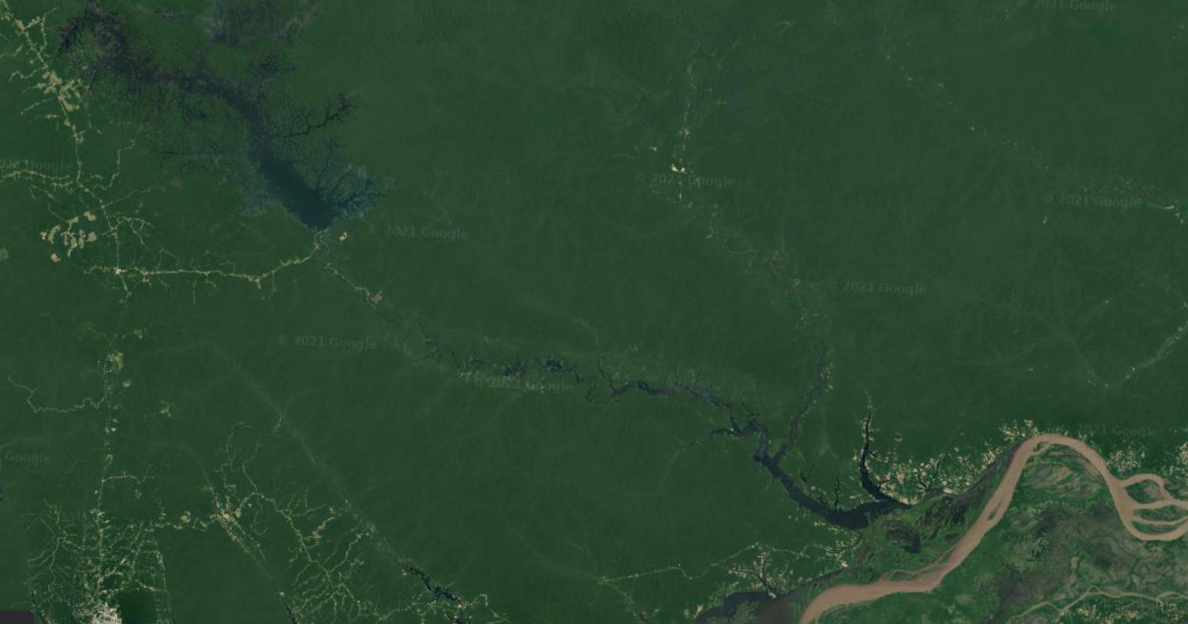
A case study: Uatuma River
Balbina Dam (1987)
Analysis of
vegetation
alteration
due to dam
construction
between 2001-2019
[*]
[*] Source: Google Earth

Slide 6
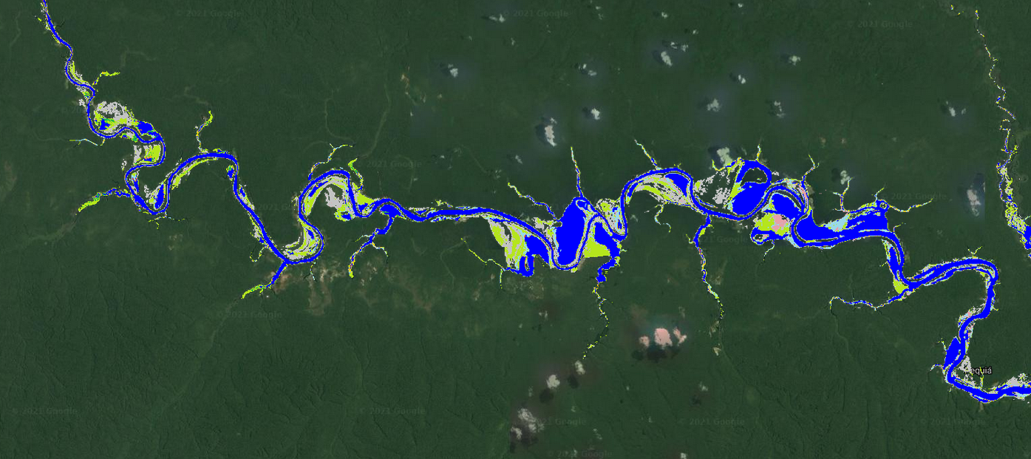
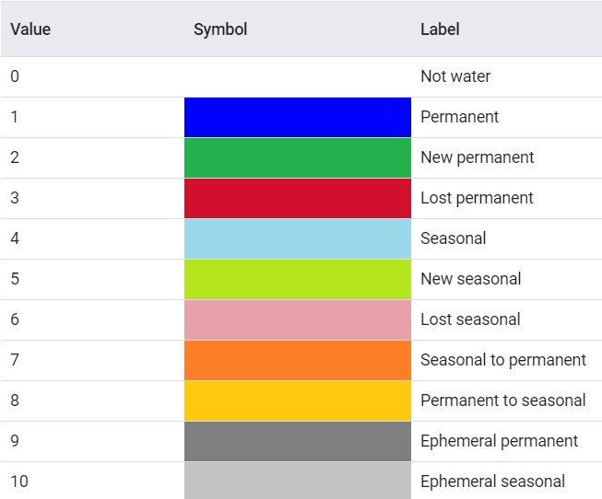
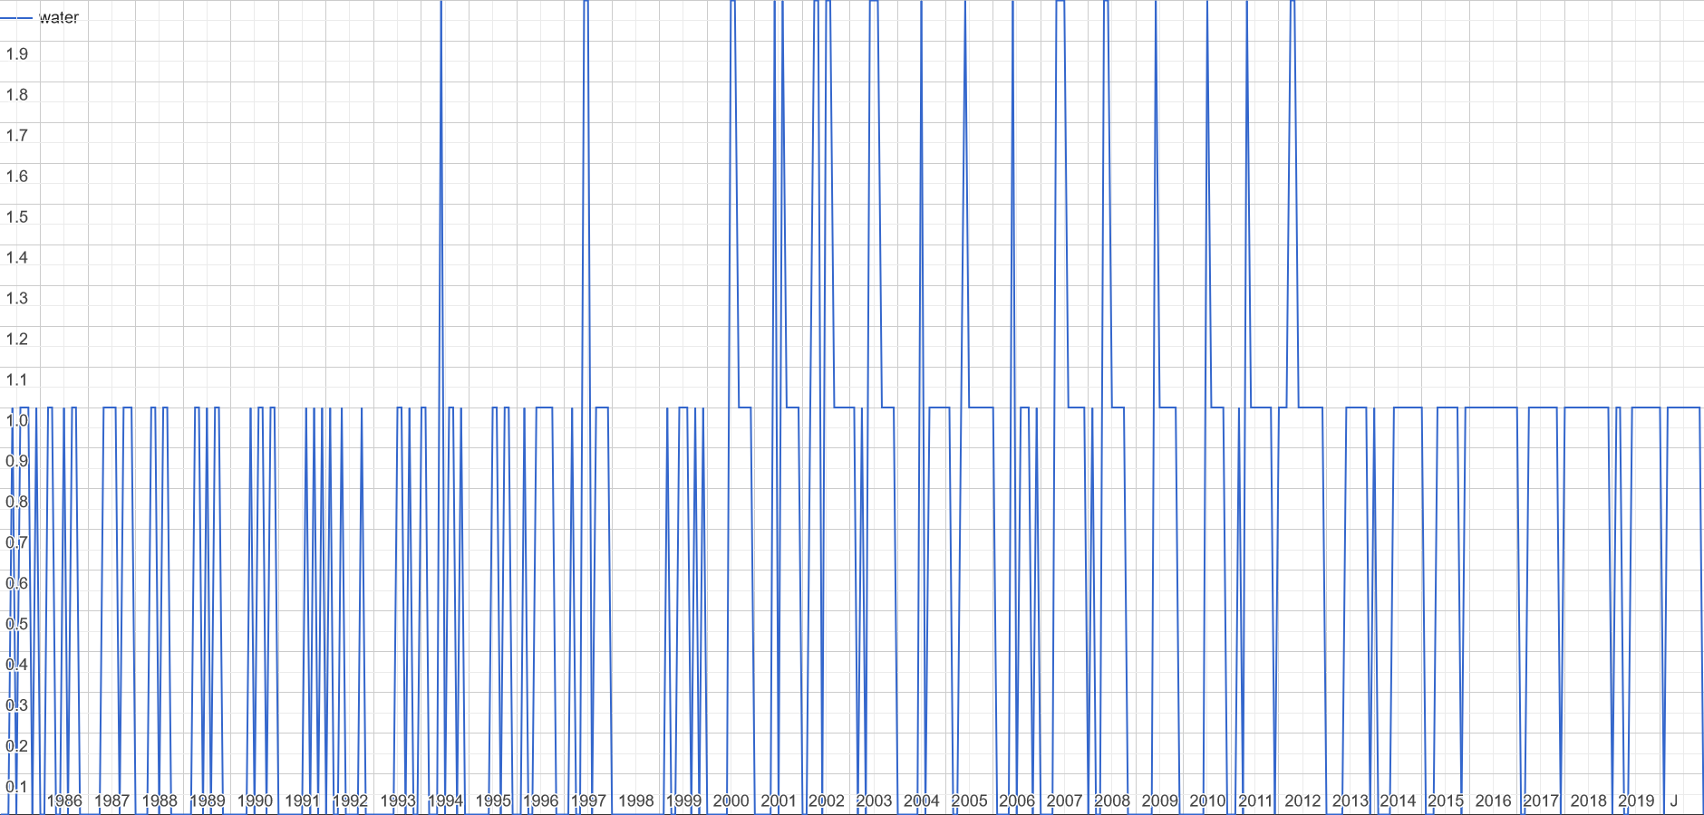
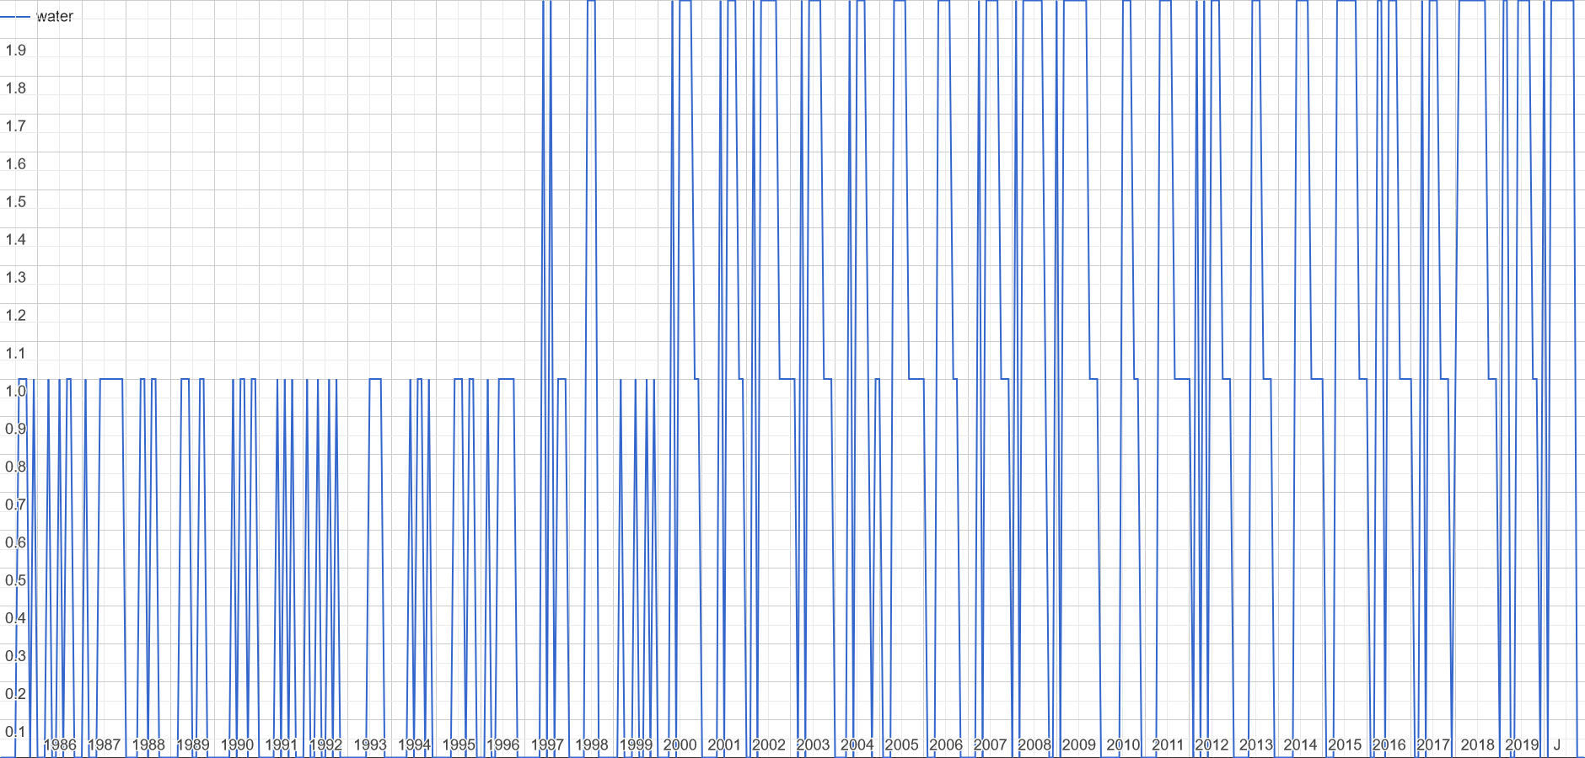

$${\text{Water} \text{transition} \text{map}}^{[5]}$$
[5]
Ephemeral seasonal
New seasonal
Water
No- water
No-Data
[5] Pekel, J. F., Cottam, A., Gorelick, N., & Belward, A. S. (2016). High-resolution mapping of global surface water and its long-term changes. Nature, 540, 418-422.

Slide 7
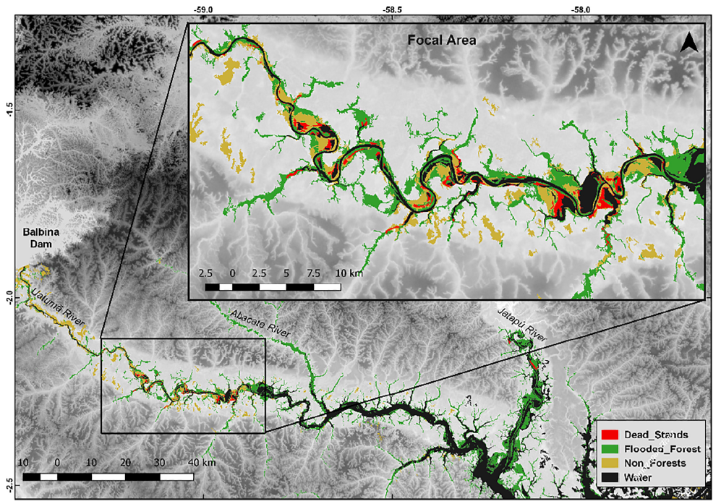
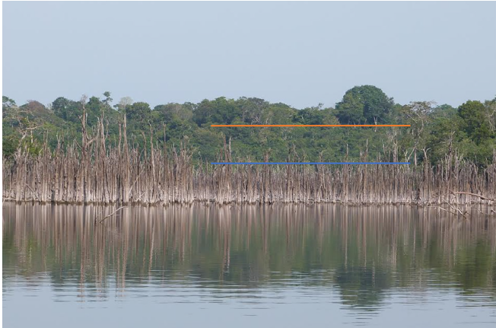
Massive trees mortality [1]
[1]
[1]
[1] de Resende et al. 2019

Slide 8
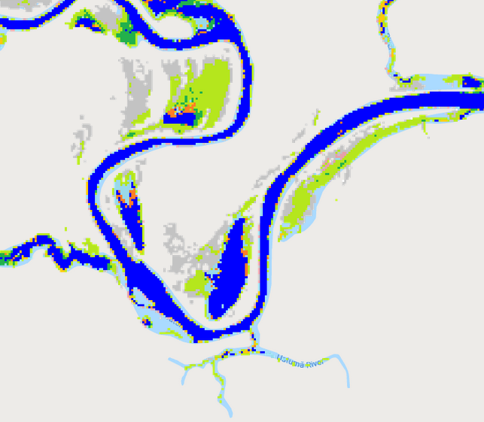
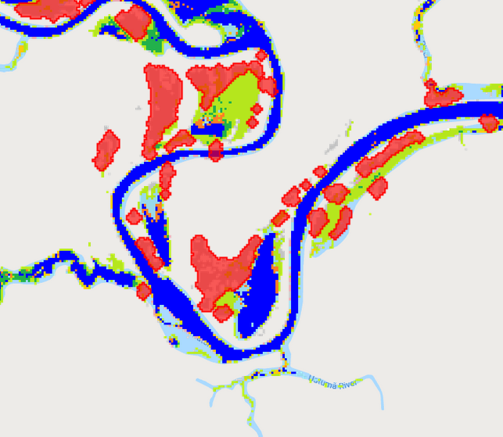
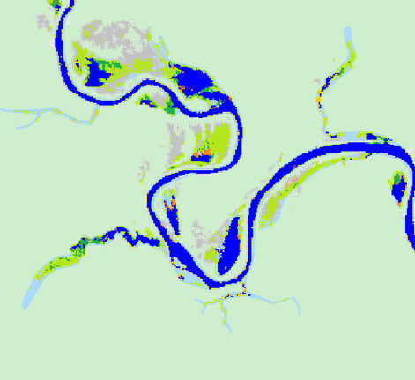
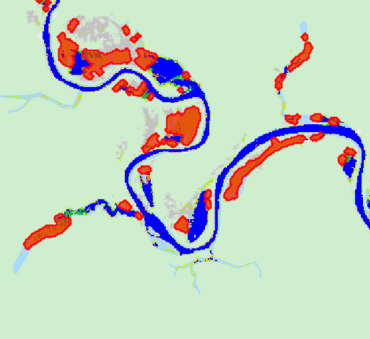
Region of interest definition

Slide 9
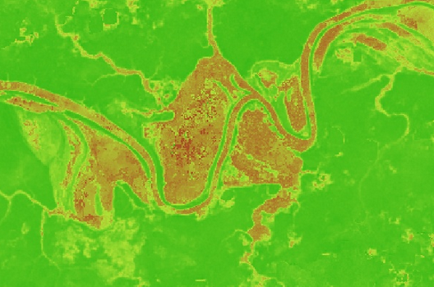
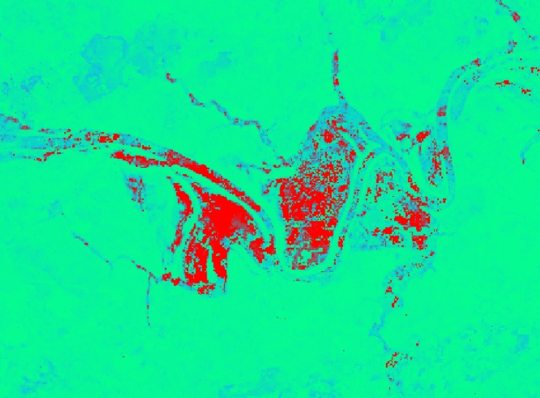
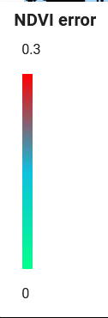

NDVI and NDVI uncertainties
NDVI ERROR
0.3
0.1
NDVI
0.9
0.1

Slide 10
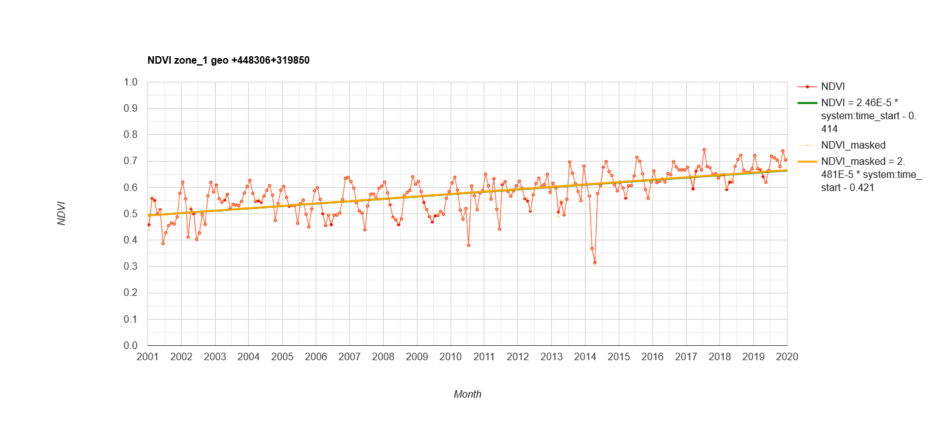
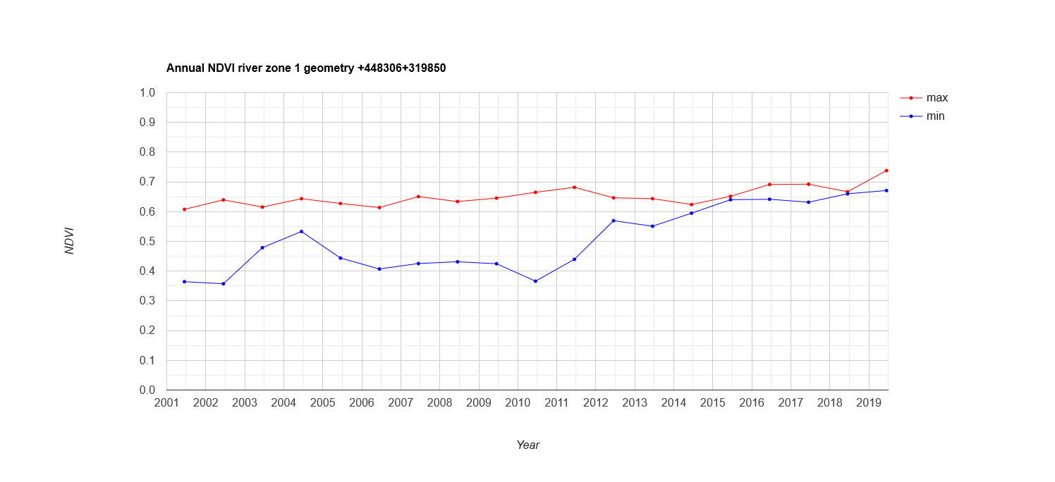
NDVI trend
Change in phenology

Slide 11
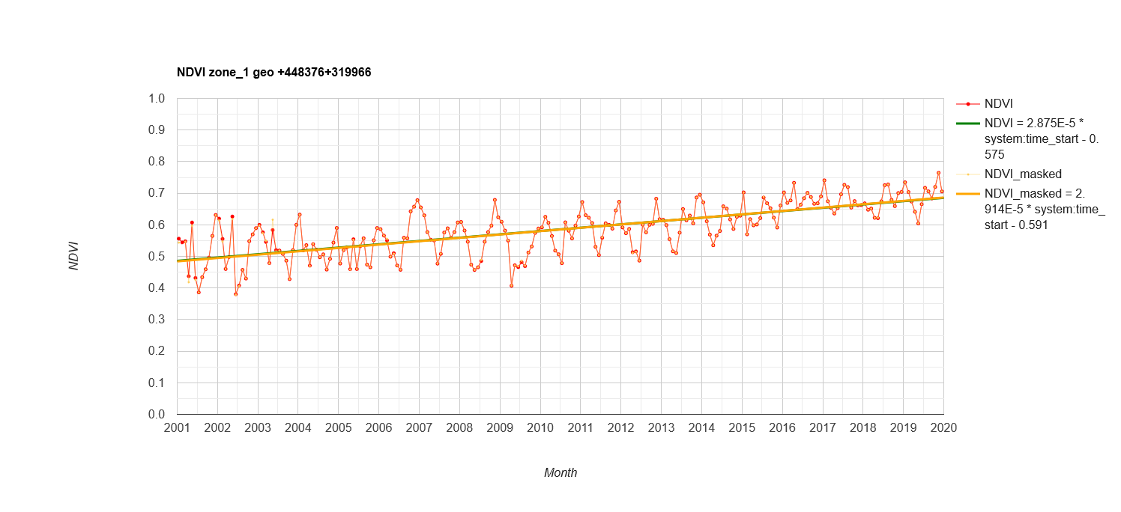
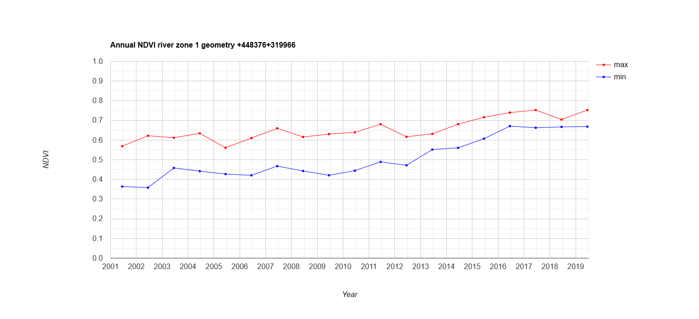
NDVI trend

Slide 12
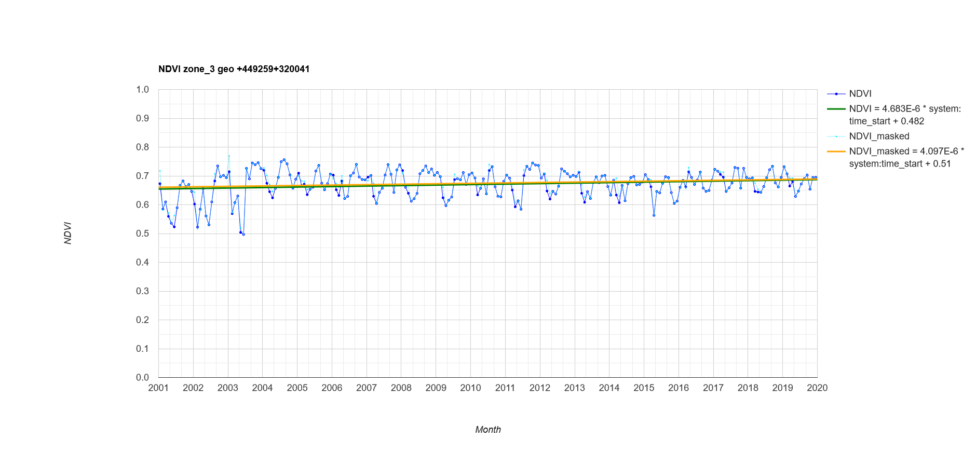
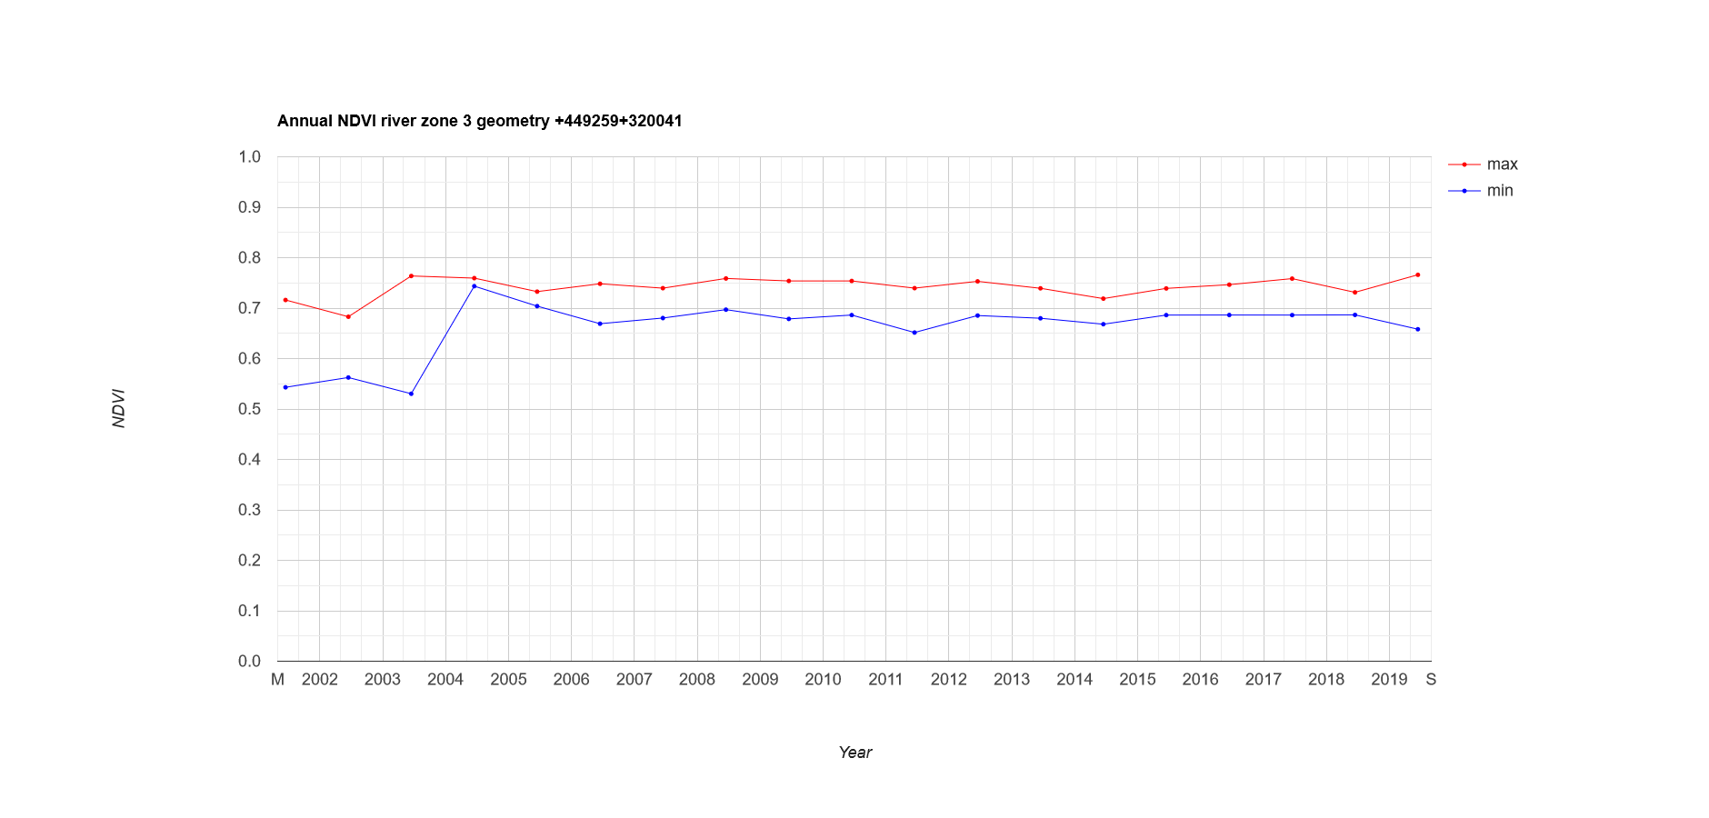
NDVI trend

Slide 13
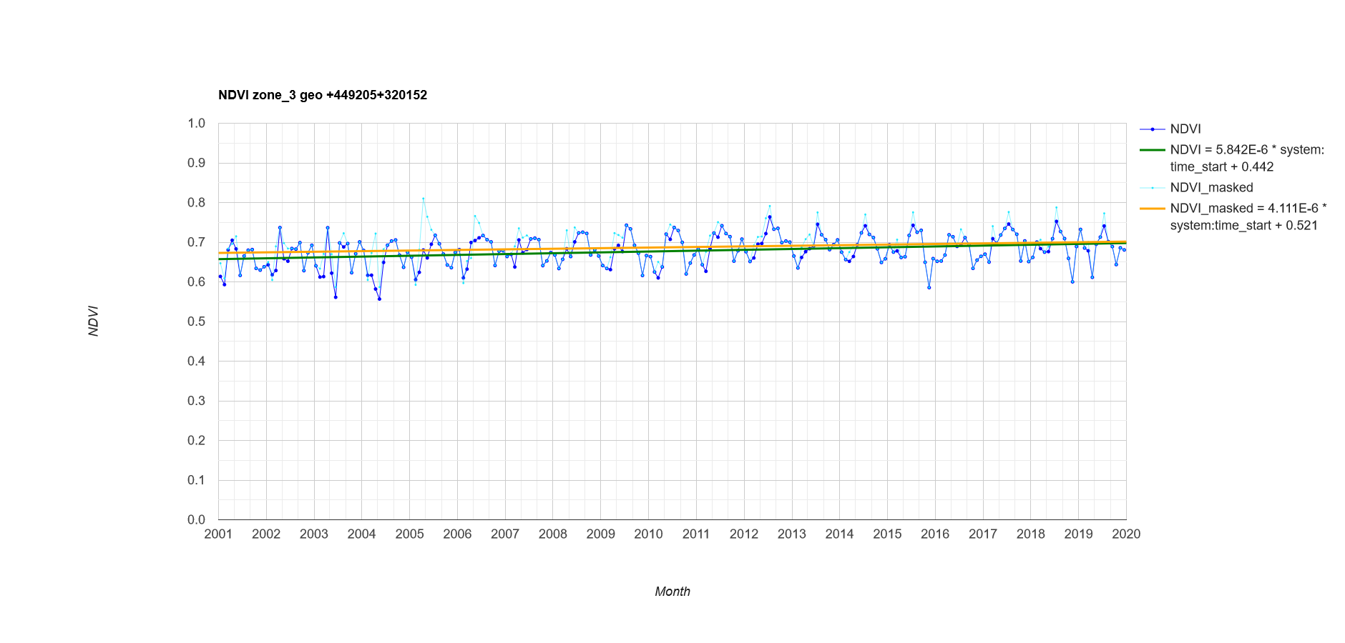
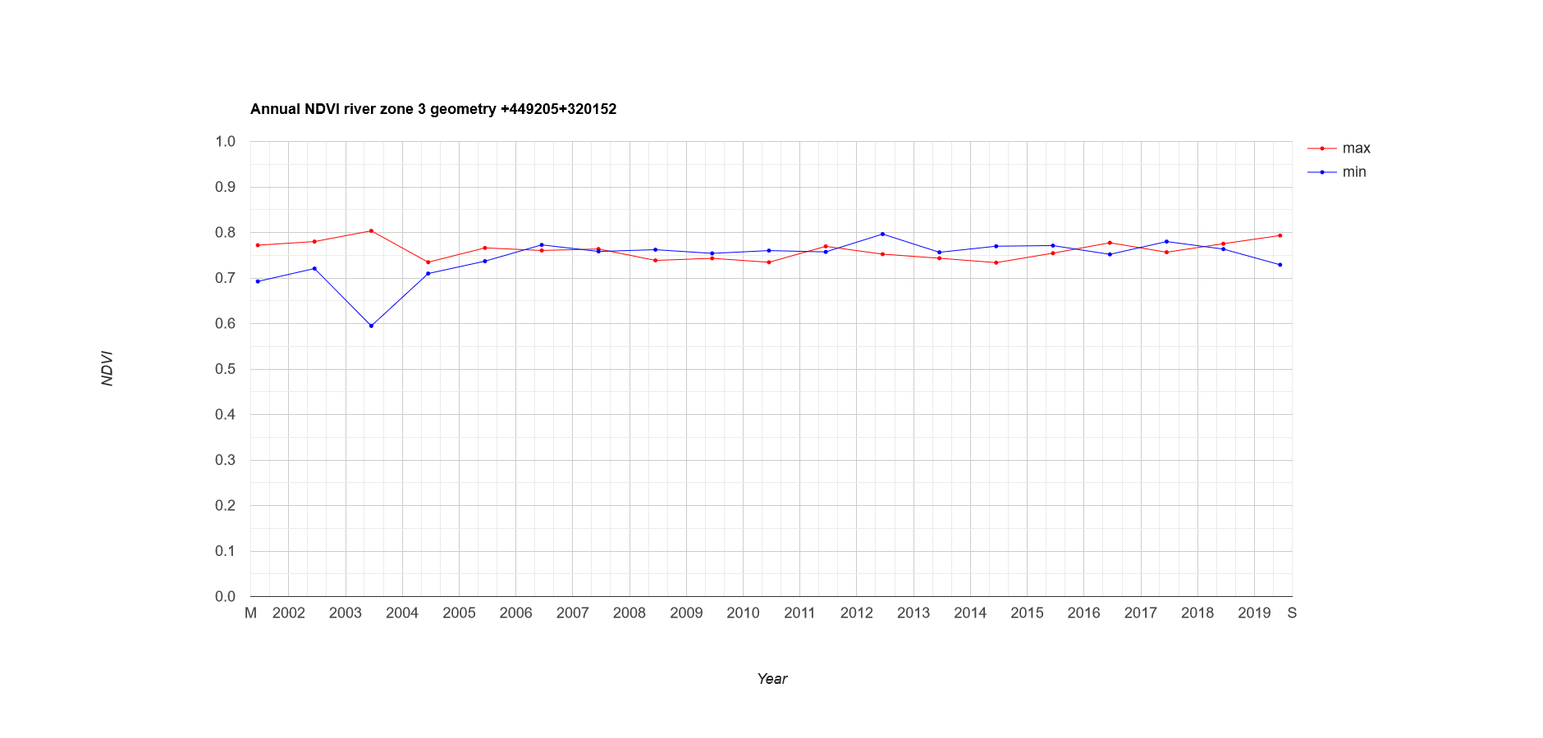
NDVI trend

Slide 14
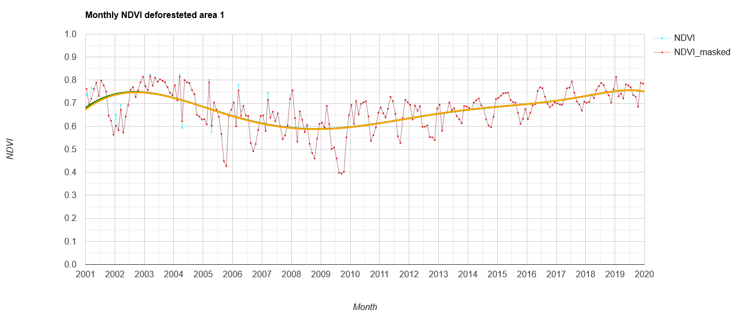
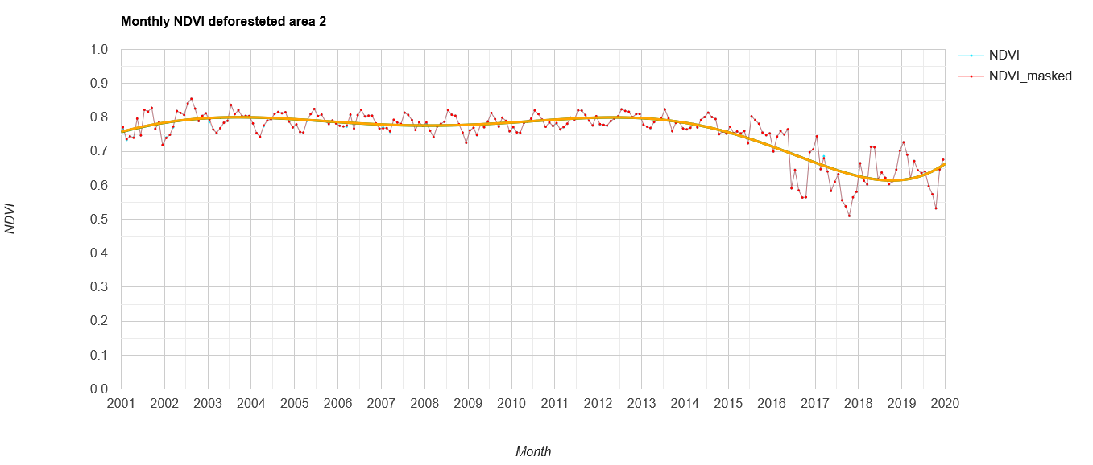
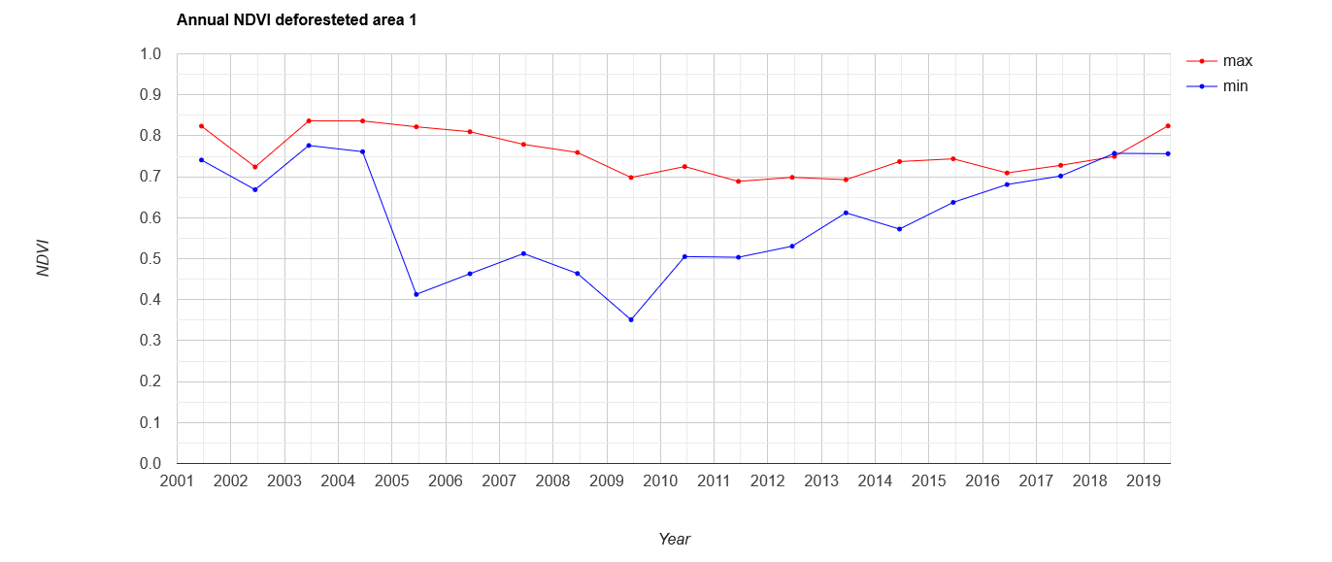
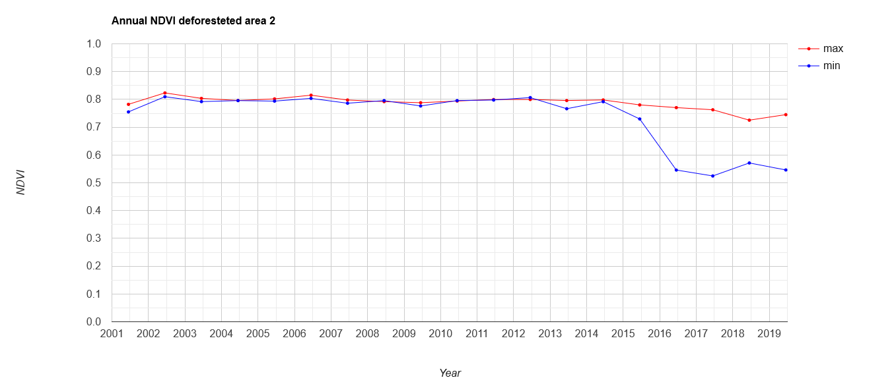
Deforestated ROIs

Slide 15
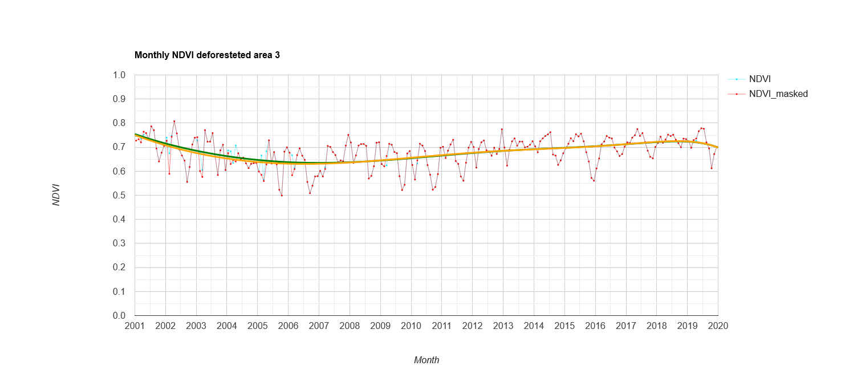
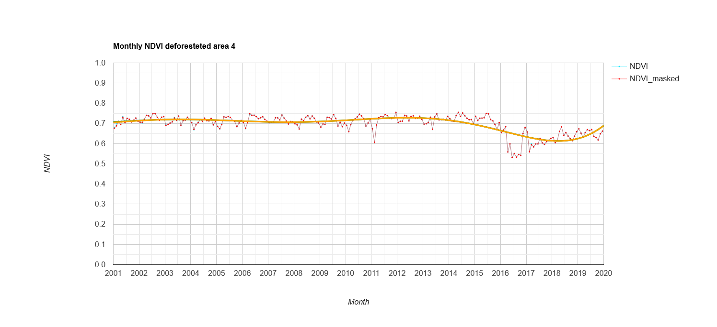
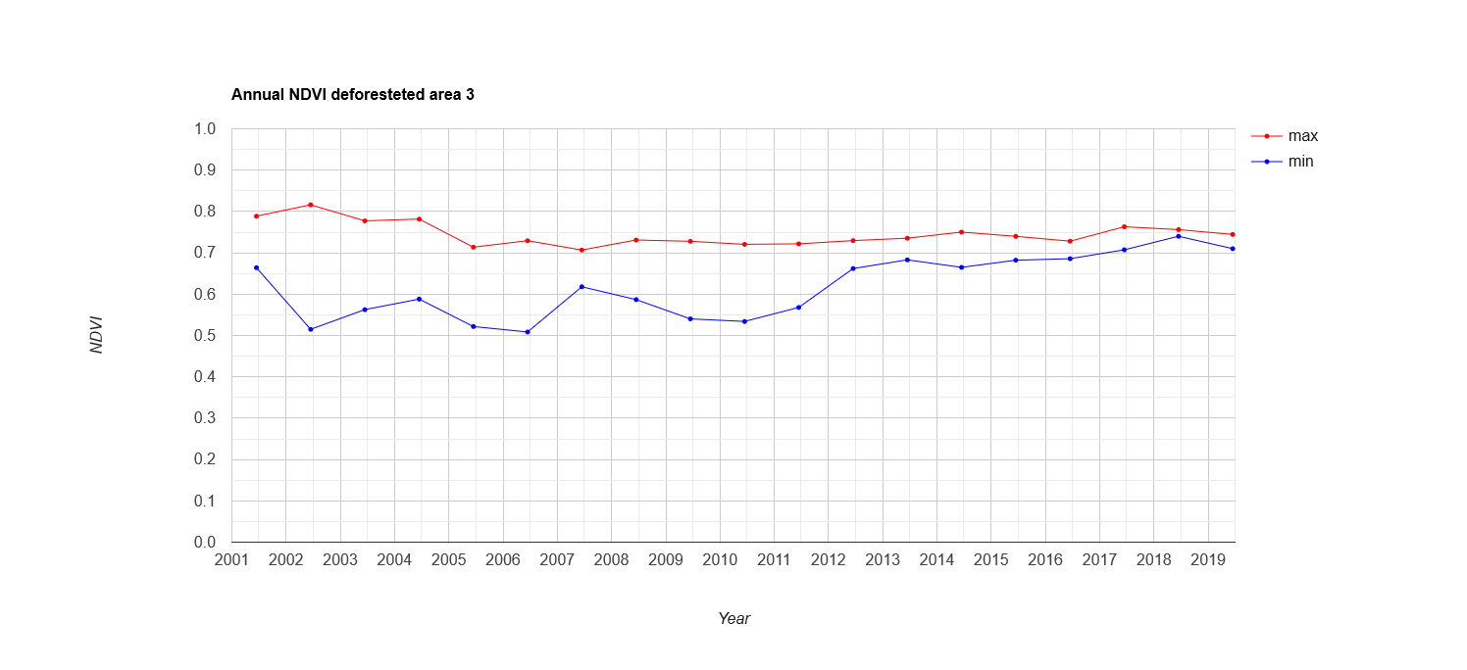
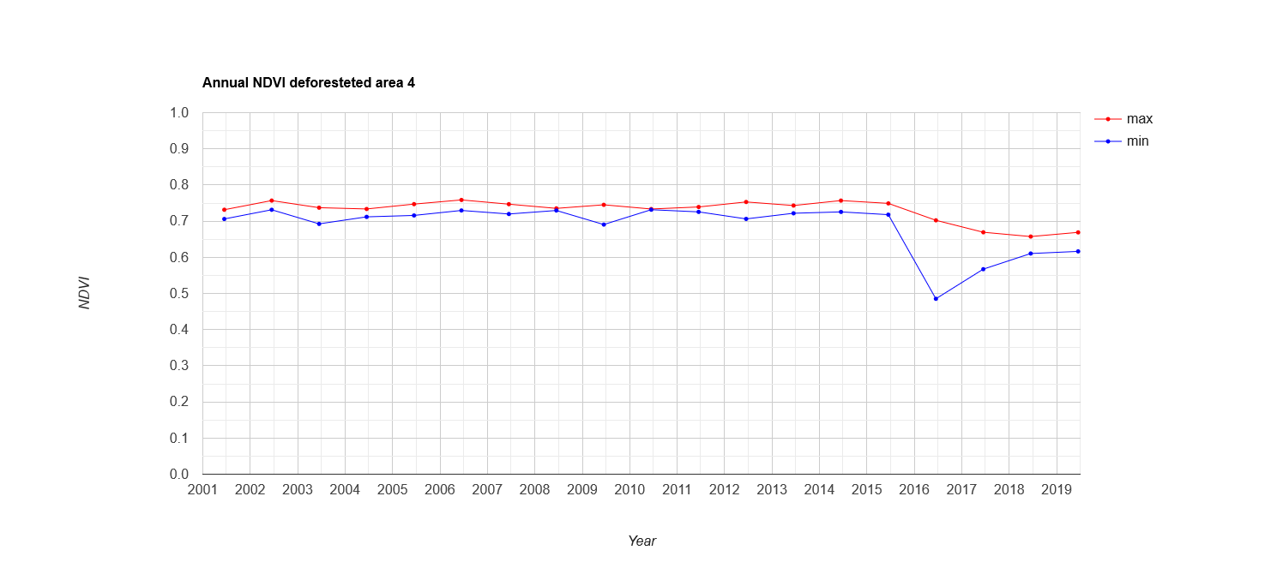

Slide 16
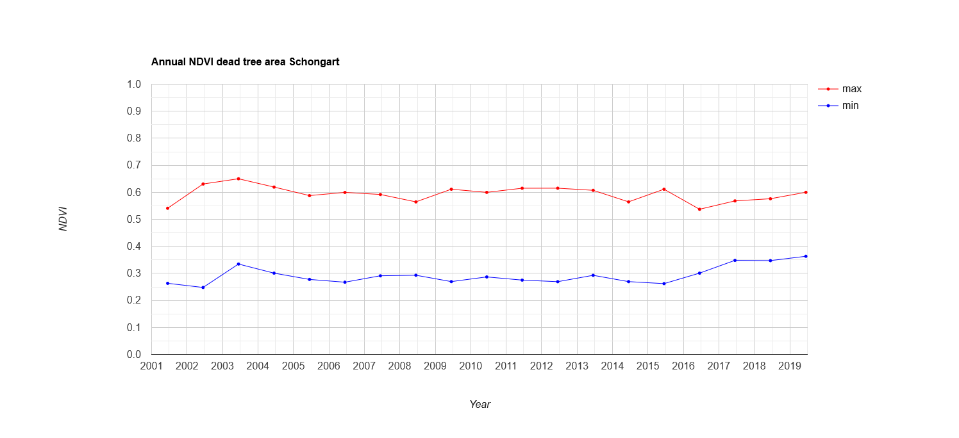
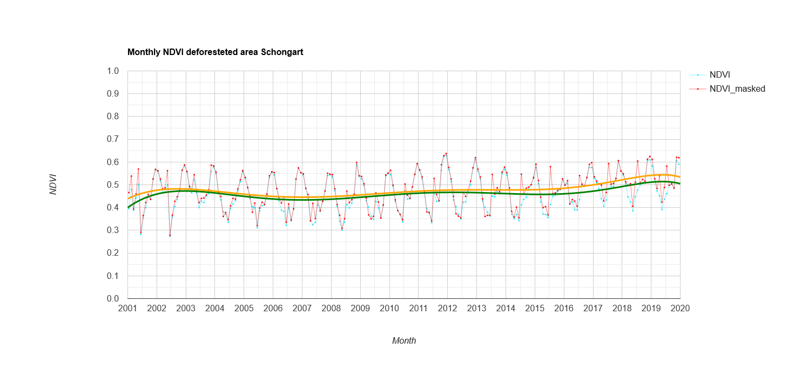
Dead stands
[1]
[6] [6]
[6]
[1] de Resende et al. 2019

Slide 17
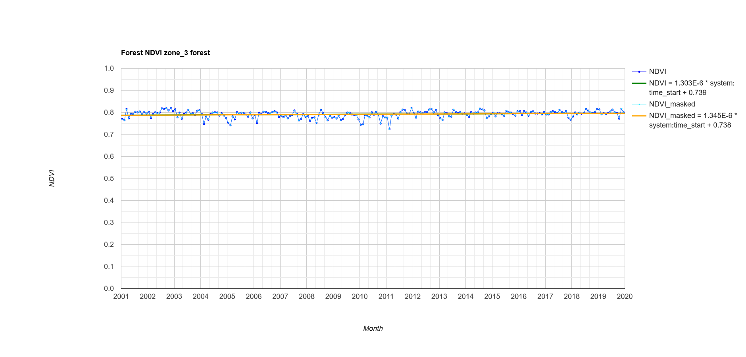
Unperturbed floodplain forest

Slide 18
Thank you

Slide 19
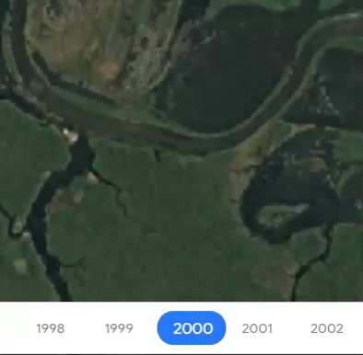
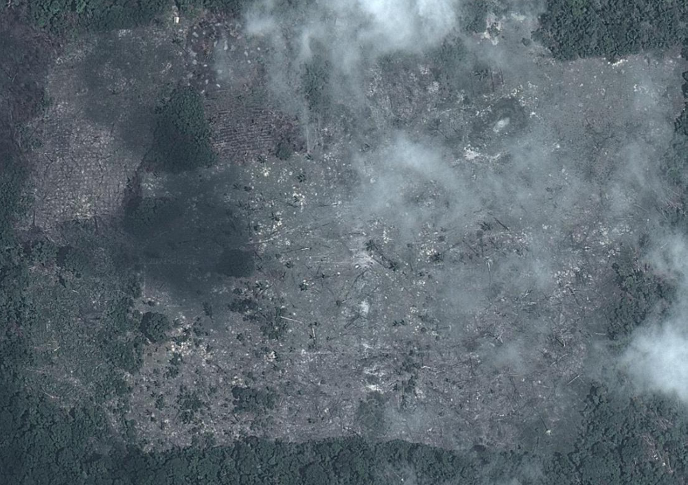
[*]
[*] Google Earth Engine: Time-lapse

Slide 20
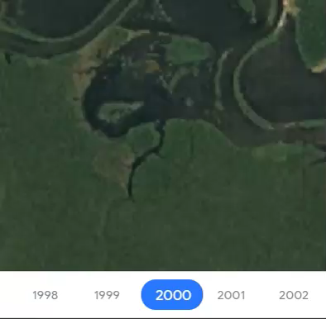
[*]
[*] Google Earth Engine: Time-lapse

Slide 21
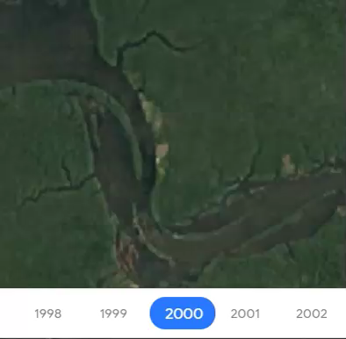
[*]
[*] Google Earth Engine: Time-lapse

Slide 22
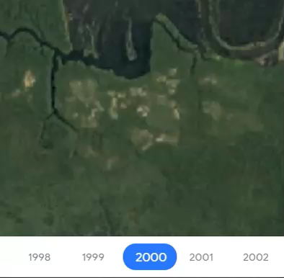
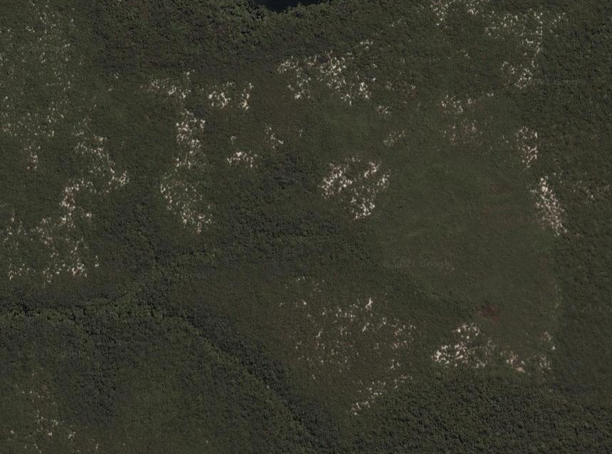
[*]
[*] Google Earth Engine: Time-lapse

