Slide 1


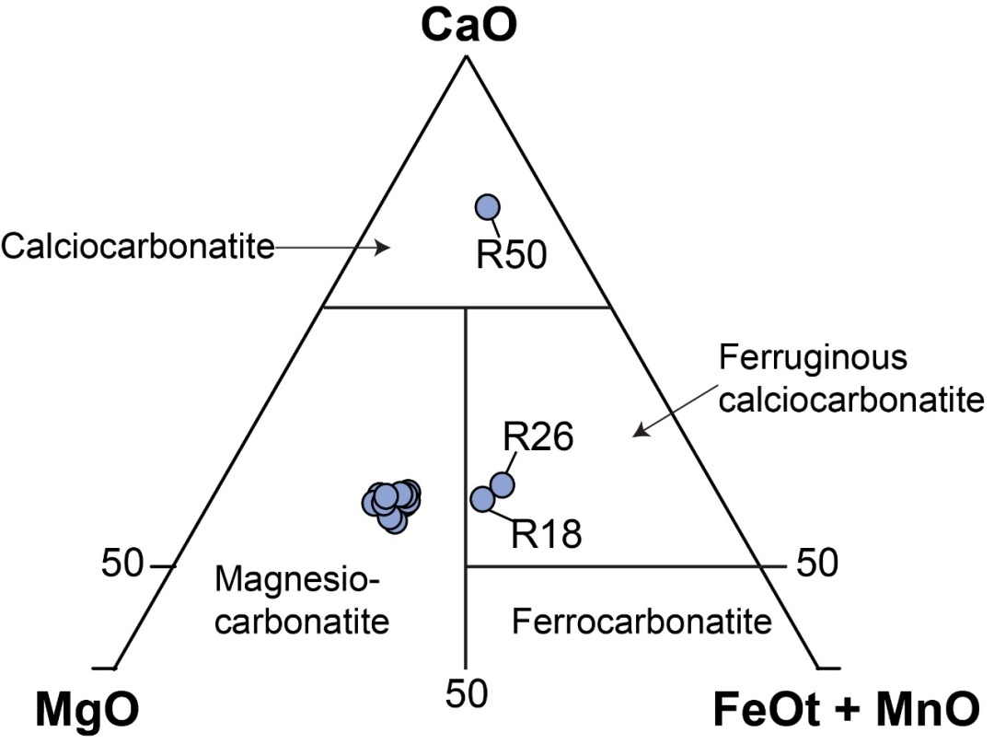
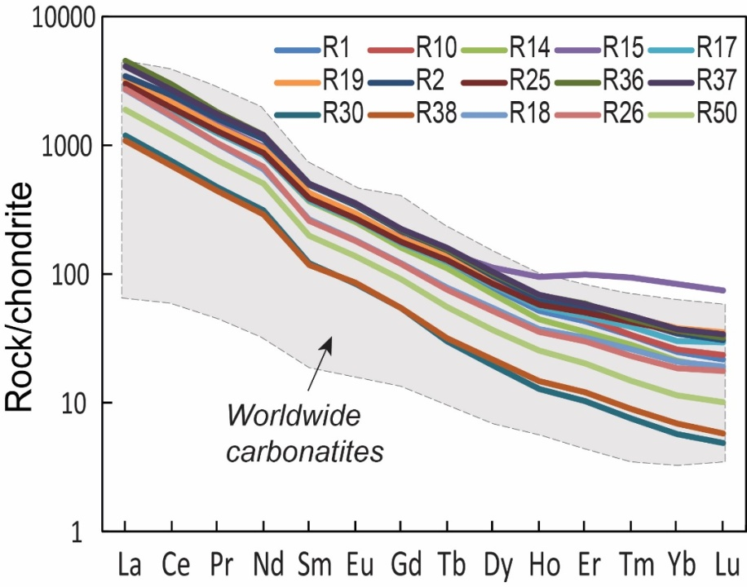
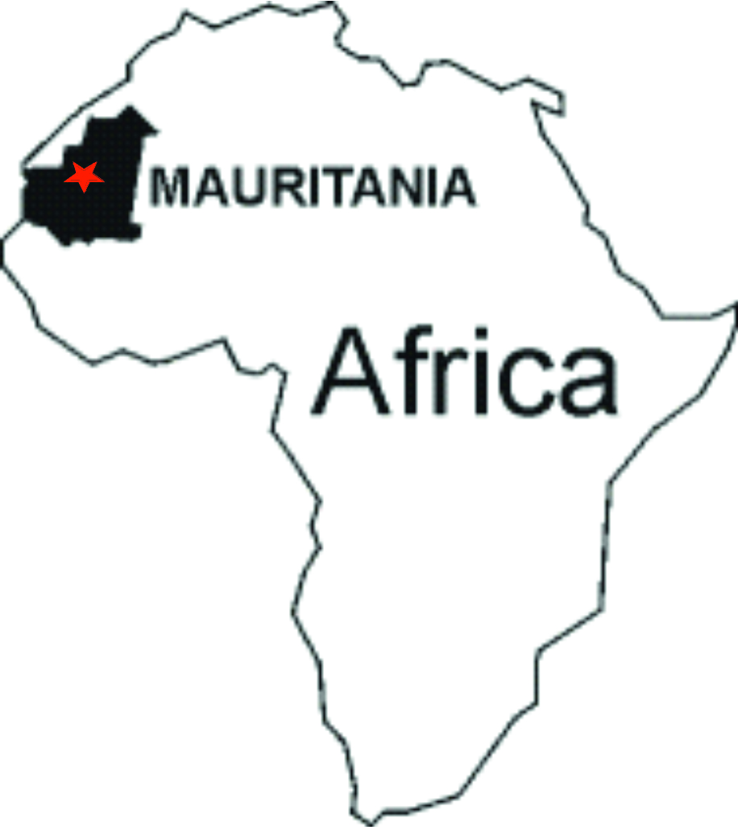
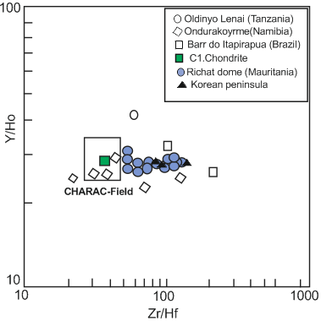
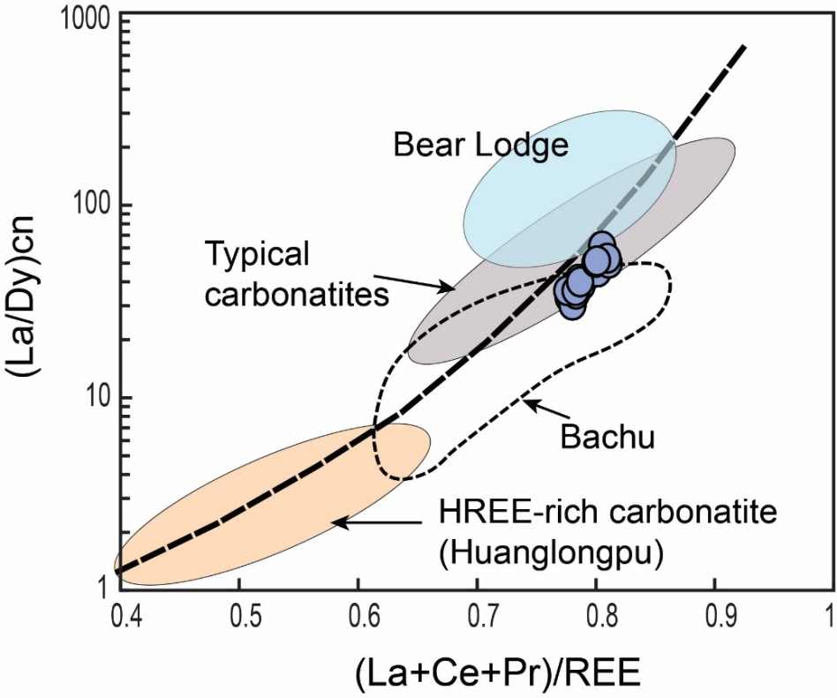
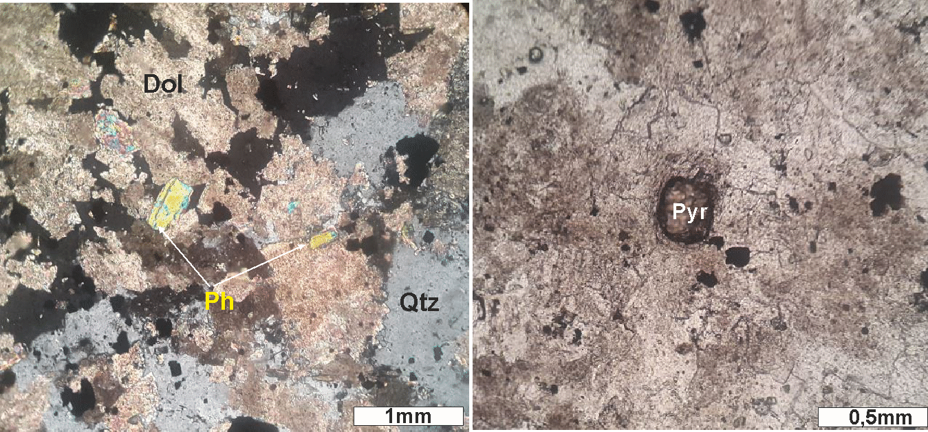
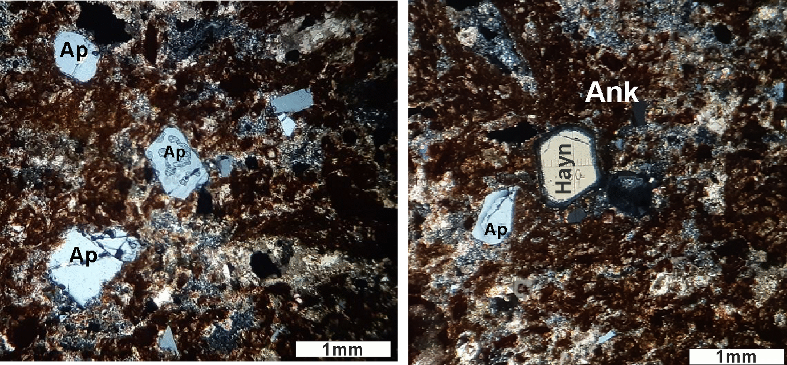
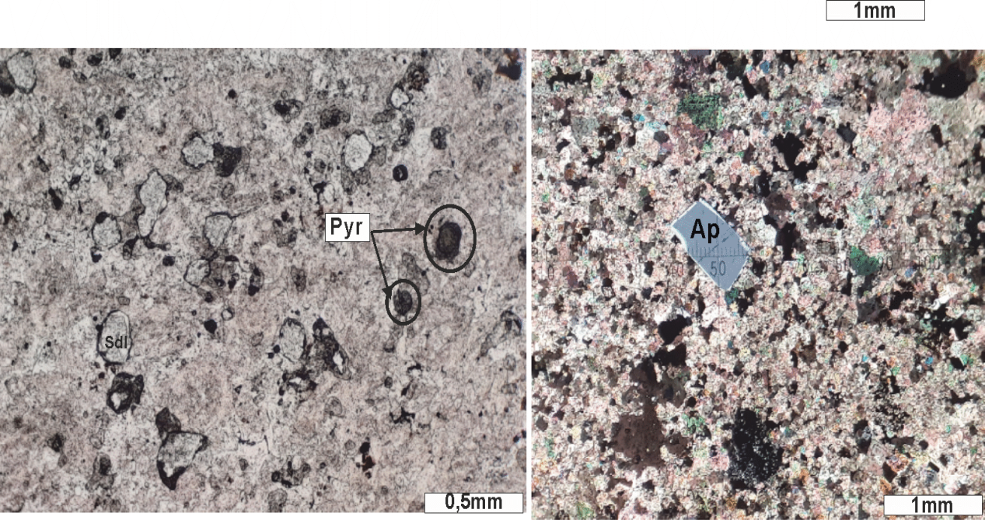
Contribution to the study of carbonatite complex of the Richat Dome (Mauritania)
Maham Eboubekrine Sedigh¹, Houssa Ouali¹, Michel Jébrak², Muhammad Ouabid^{3,4}
¹ Département de Géologie, Faculté des Sciences, Université Moulay Ismail, P.O. 11201 Zitoune, Meknès, Maroc; ² Department of Earth and Atmospheric Sciences, Université du Québec à Montréal, Canada; ³ Geology & Sustainable Mining, Mohammed VI Polytechnic University, Plot 660, Hay Moulay Rachid, 43150, Benguerir, Morocco; ⁴ Instituto Andaluz de Ciencias de la Tierra (IACT), CSIC–UGR, Granada, Spain
GEOLOGICAL SETTING & MAPPING
GEOCHIMISTRY
Magnesiocarbonatite (dominant), ferruginous calciocarbonatite, calciocarbonatite (rare)
Hydrothermal fluid contribution
Similar to other worldwide carbonatites in termes of REE abondances
Gittins &
Harmer (1997)
Adapted from Matton & Jébrak 2014
( Bau, 1996 ;Andrade et al., 1999 ; Bühn, 2008).
After Vrublevskii et al. (2019)
Richat
PETROGRAPHY OF ALKALINE ROCKS
R37
R37
R26
R26
R1
R1
Mineral assemblage: Carbonates [dolomite (Dol), Ankerite (Ank), rare calcite], quartz (Qtz), phlogopite (Ph), pyrochlore (Pyr), apatite (Ap), Hauyine (Hayn), Sodalite (Sdl)
REFERENCES
Andrade, F.R.D., M€oller, P., Lüders, V., Gilg, H.A., 1999. Hydrothermal rare elements mineralization in the Barra do Itapirapu~a carbonatite, southern Brazil: behavior of selected/trace elements and stable isotopes (C, O). Chem. Geol. 155, 91–113.*-*Bau, M., 1996. Controls on the fractionation of isovalent trace elements in magmatic and aqueous systems: evidence from Y/Ho, Zr/Hf, and lanthanide tetrad effect. Contrib. Mineral. Petrol. 123, 323–333.*-*Bühn, B., 2008. The role of the volatile phase for REE and Y fractionation in low-silica carbonate magmas: implications from national carbonatites, Namibia. Mineral. Petrol. 192, 453–470.*-* G. Matton, M. Jébrak 2014.The ‘‘eye of Africa’’ (Richat dome, Mauritania): An isolated Cretaceous alkaline–hydrothermal complex. Journal of African Earth Sciences 97 (2014) 109–124.*-*Gittins, J.; Harmer, R.E. What Is Ferrocarbonatite? A Revised Classification. J. Afr. Earth Sci. 1997, 25, 159–168.*-*-Vrublevskii, V. V., Bukharova, O. V., Nebera, T. S., & Sveshnikova, V. L. (2019). Composition and origin of rare-metal (Nb–Ta, REE) and sulfide mineralization in magnesiocarbonatites from the Yenisei Ridge, Central Siberia. Ore Geology Reviews, 111, 102949.

