Slide 1
Artificial neural networks in the problem of determining the position and size of the solar disk in wide-angle photographs of the sky
Mikhail Borisov, Mikhail Krinitskiy

Slide 2
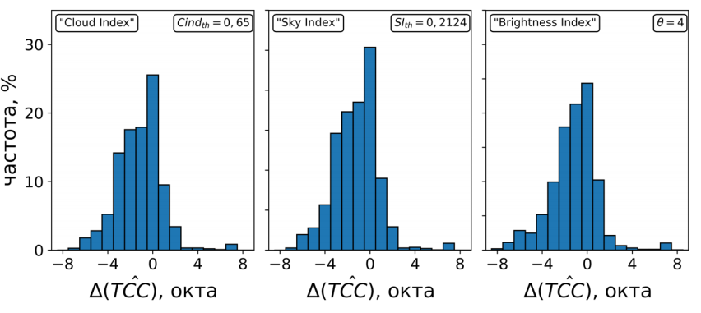
Introduction
The most famous algorithms for calculating the total cloudiness score are "Cloud Index", "Sky Index", "Brightness Index“
  disadvantages of these algorithms:
    1. the sun is identified as a cloud
    2. these algorithms do not know how to determine the position and size of the solar disk, or determine in a limited set of cases(research Yang et al.)
Frequency, %
octo
octo
octo

Slide 3
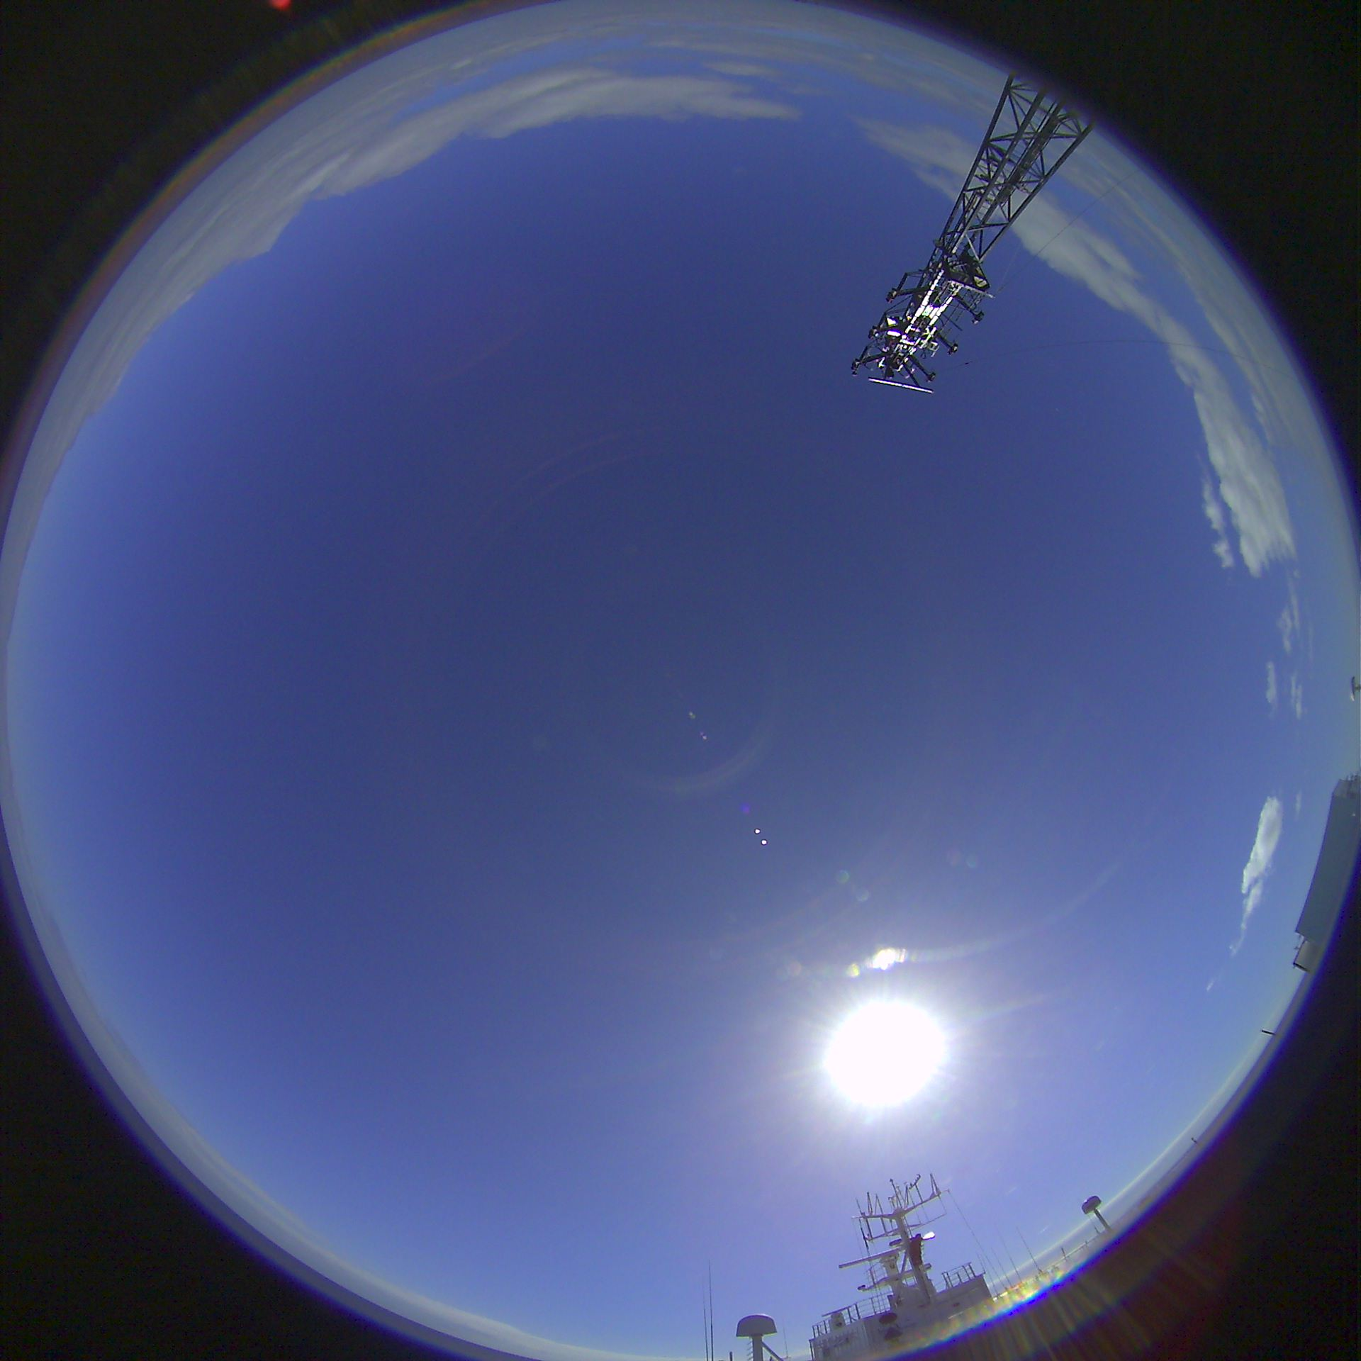
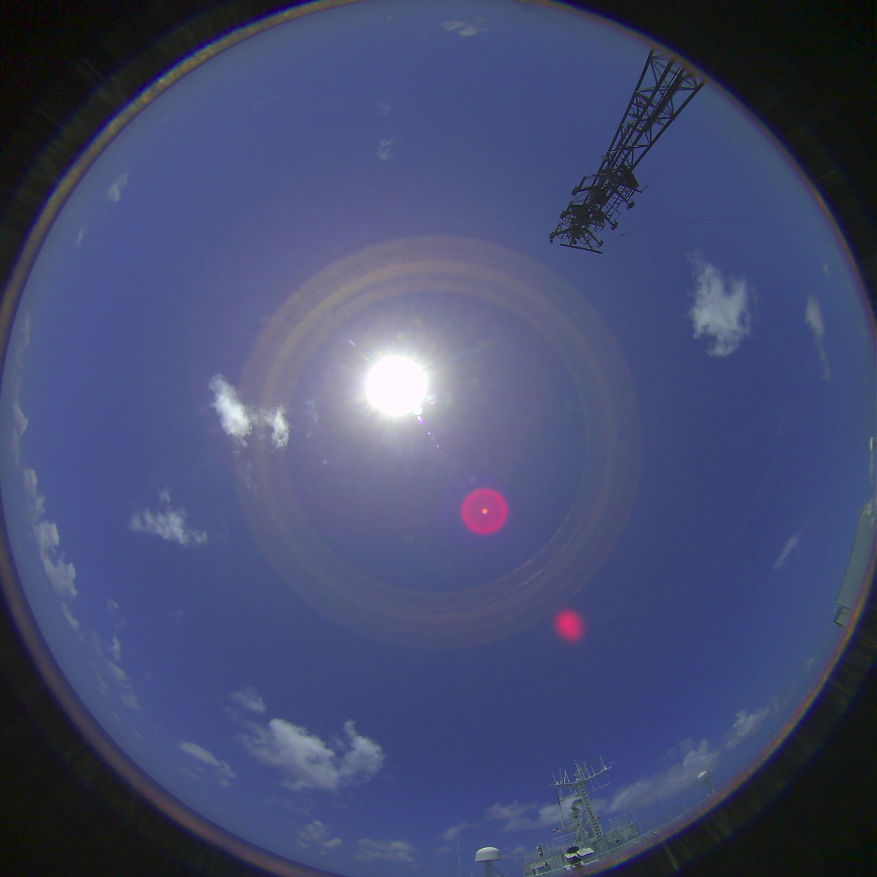
Introduction
The location of the sun is necessary to filter out distortions caused by Mi scattering.
  Then, knowing the coordinates of the sun, we will exclude it from the composition of the clouds and help algorithms to filter Mi scatter

Slide 4
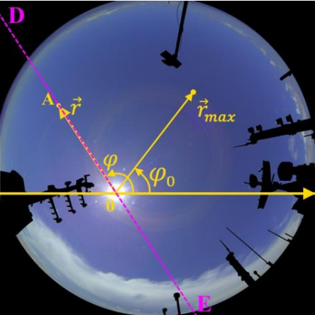
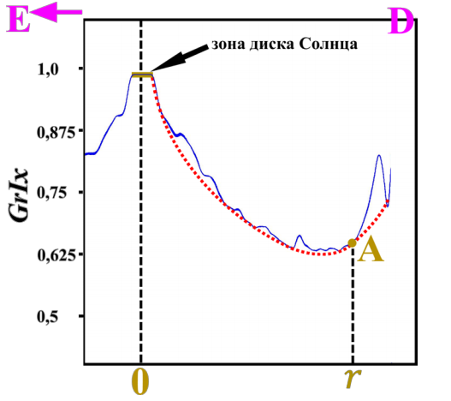
Mi scattering
sun disk zone

Slide 5
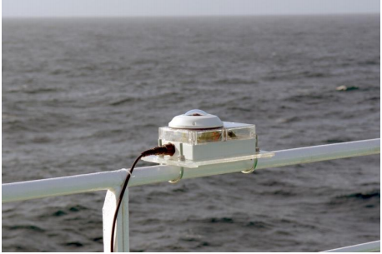
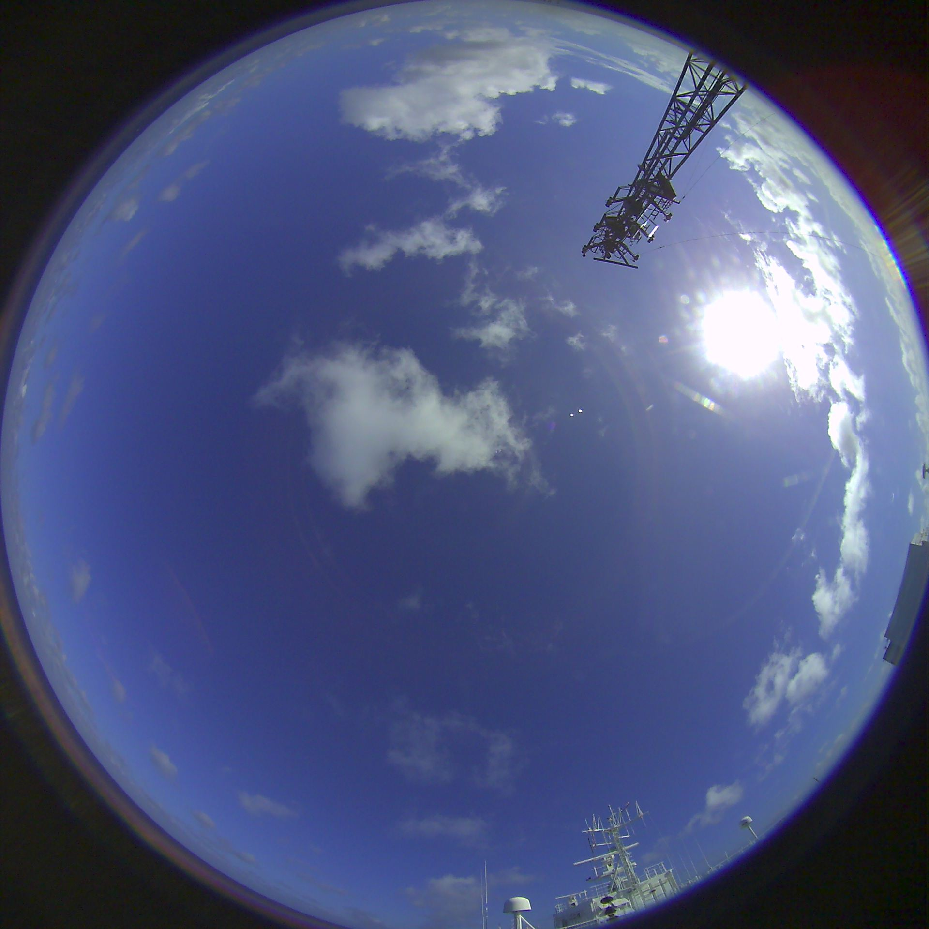
Data collection system «SAIL cloud v.2»
Using this system, 1200 thousand photographs were collected

Slide 6
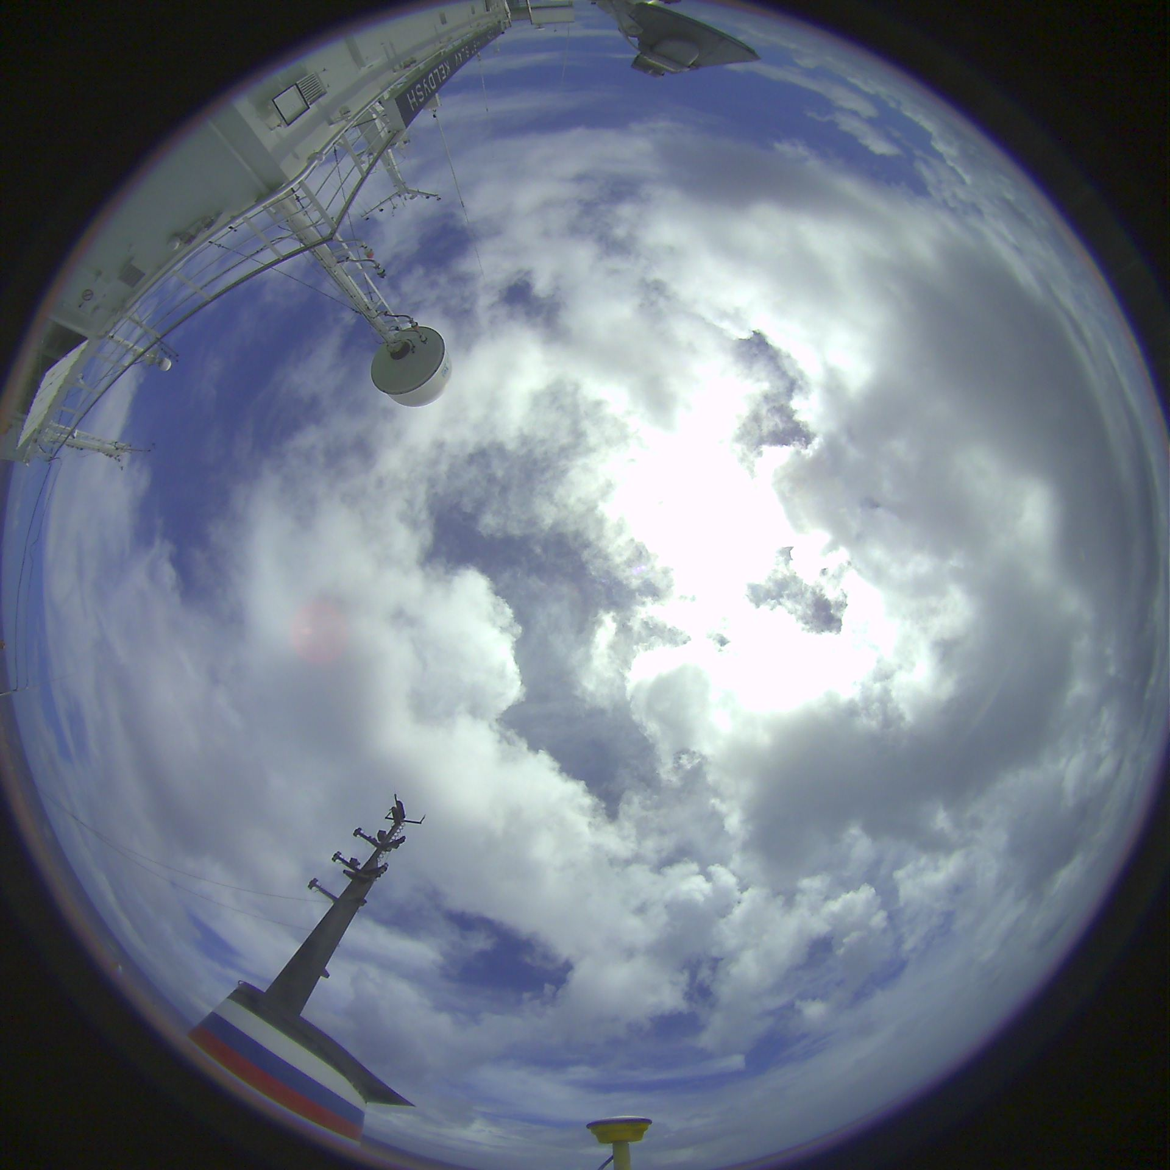
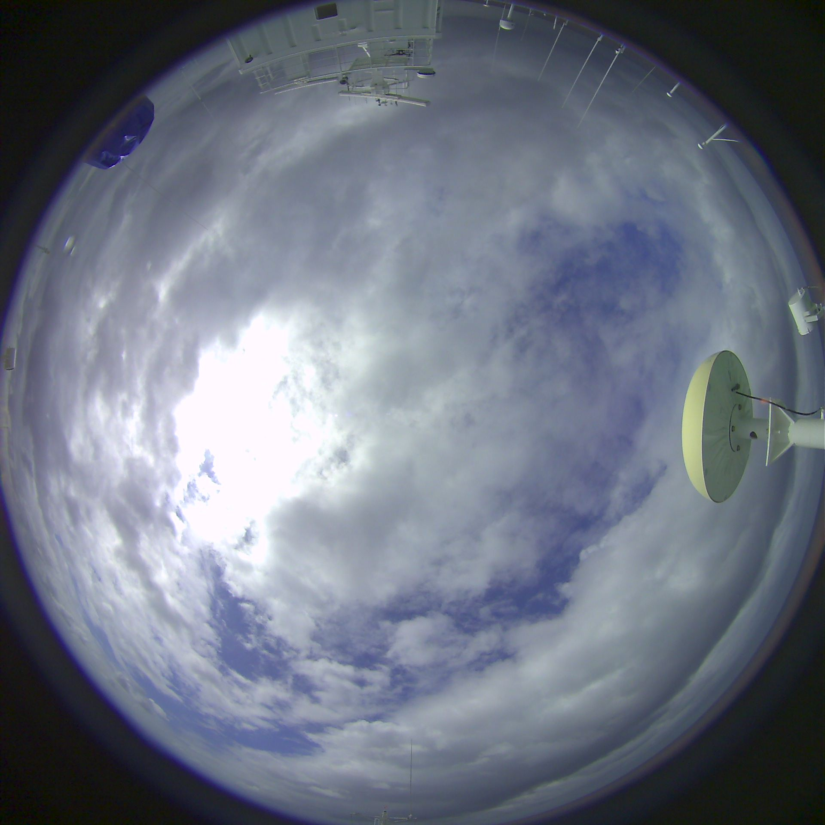
Sample photos of sky

Slide 7
Scientific missions resulting in the Dataset of All-Sky Imagery
 | Departure | Destination | Route
AI-45 | 17 September 2014 Reykjavik, Iceland | 25 September 2014 Rotterdam, Netherlands | Northern Atlantic
AI-49 | 12 June 2015 Gdansk, Poland | 2 July 2015 Halifax, Canada | Northern Atlantic
ANS-31 | 16 December 2015 Colombo, Sri Lanka | 19 January 2016 Kaliningrad, Russia | Indian ocean, Red sea, Mediterranean sea, Atlantic ocean
AI-52 | 30 September 2016 Gdansk, Poland | 3 November 2016 Ushuaia, Argentina | Atlantic ocean
ABP-42 | 21 January 2017 Singapore | 25 March 2018 Kaliningrad, Russia | Indian ocean, Red sea, Mediterranean sea, Atlantic ocean
AMK-70 | 5 October 2017 Arkhangelsk, Russia | 13 October 2017 Kaliningrad, Russia | Northern Atlantic, Arctic
AMK-71 | 24 June 2018 Kaliningrad, Russia | 13 August 2018 Arkhangelsk, Russia | Northern Atlantic, Arctic
AMK-79 | 13 October 2019 Kaliningrad, Russia | 5 January 2020 Montevideo, Uruguay | Northern Atlantic, Arctic

Slide 8
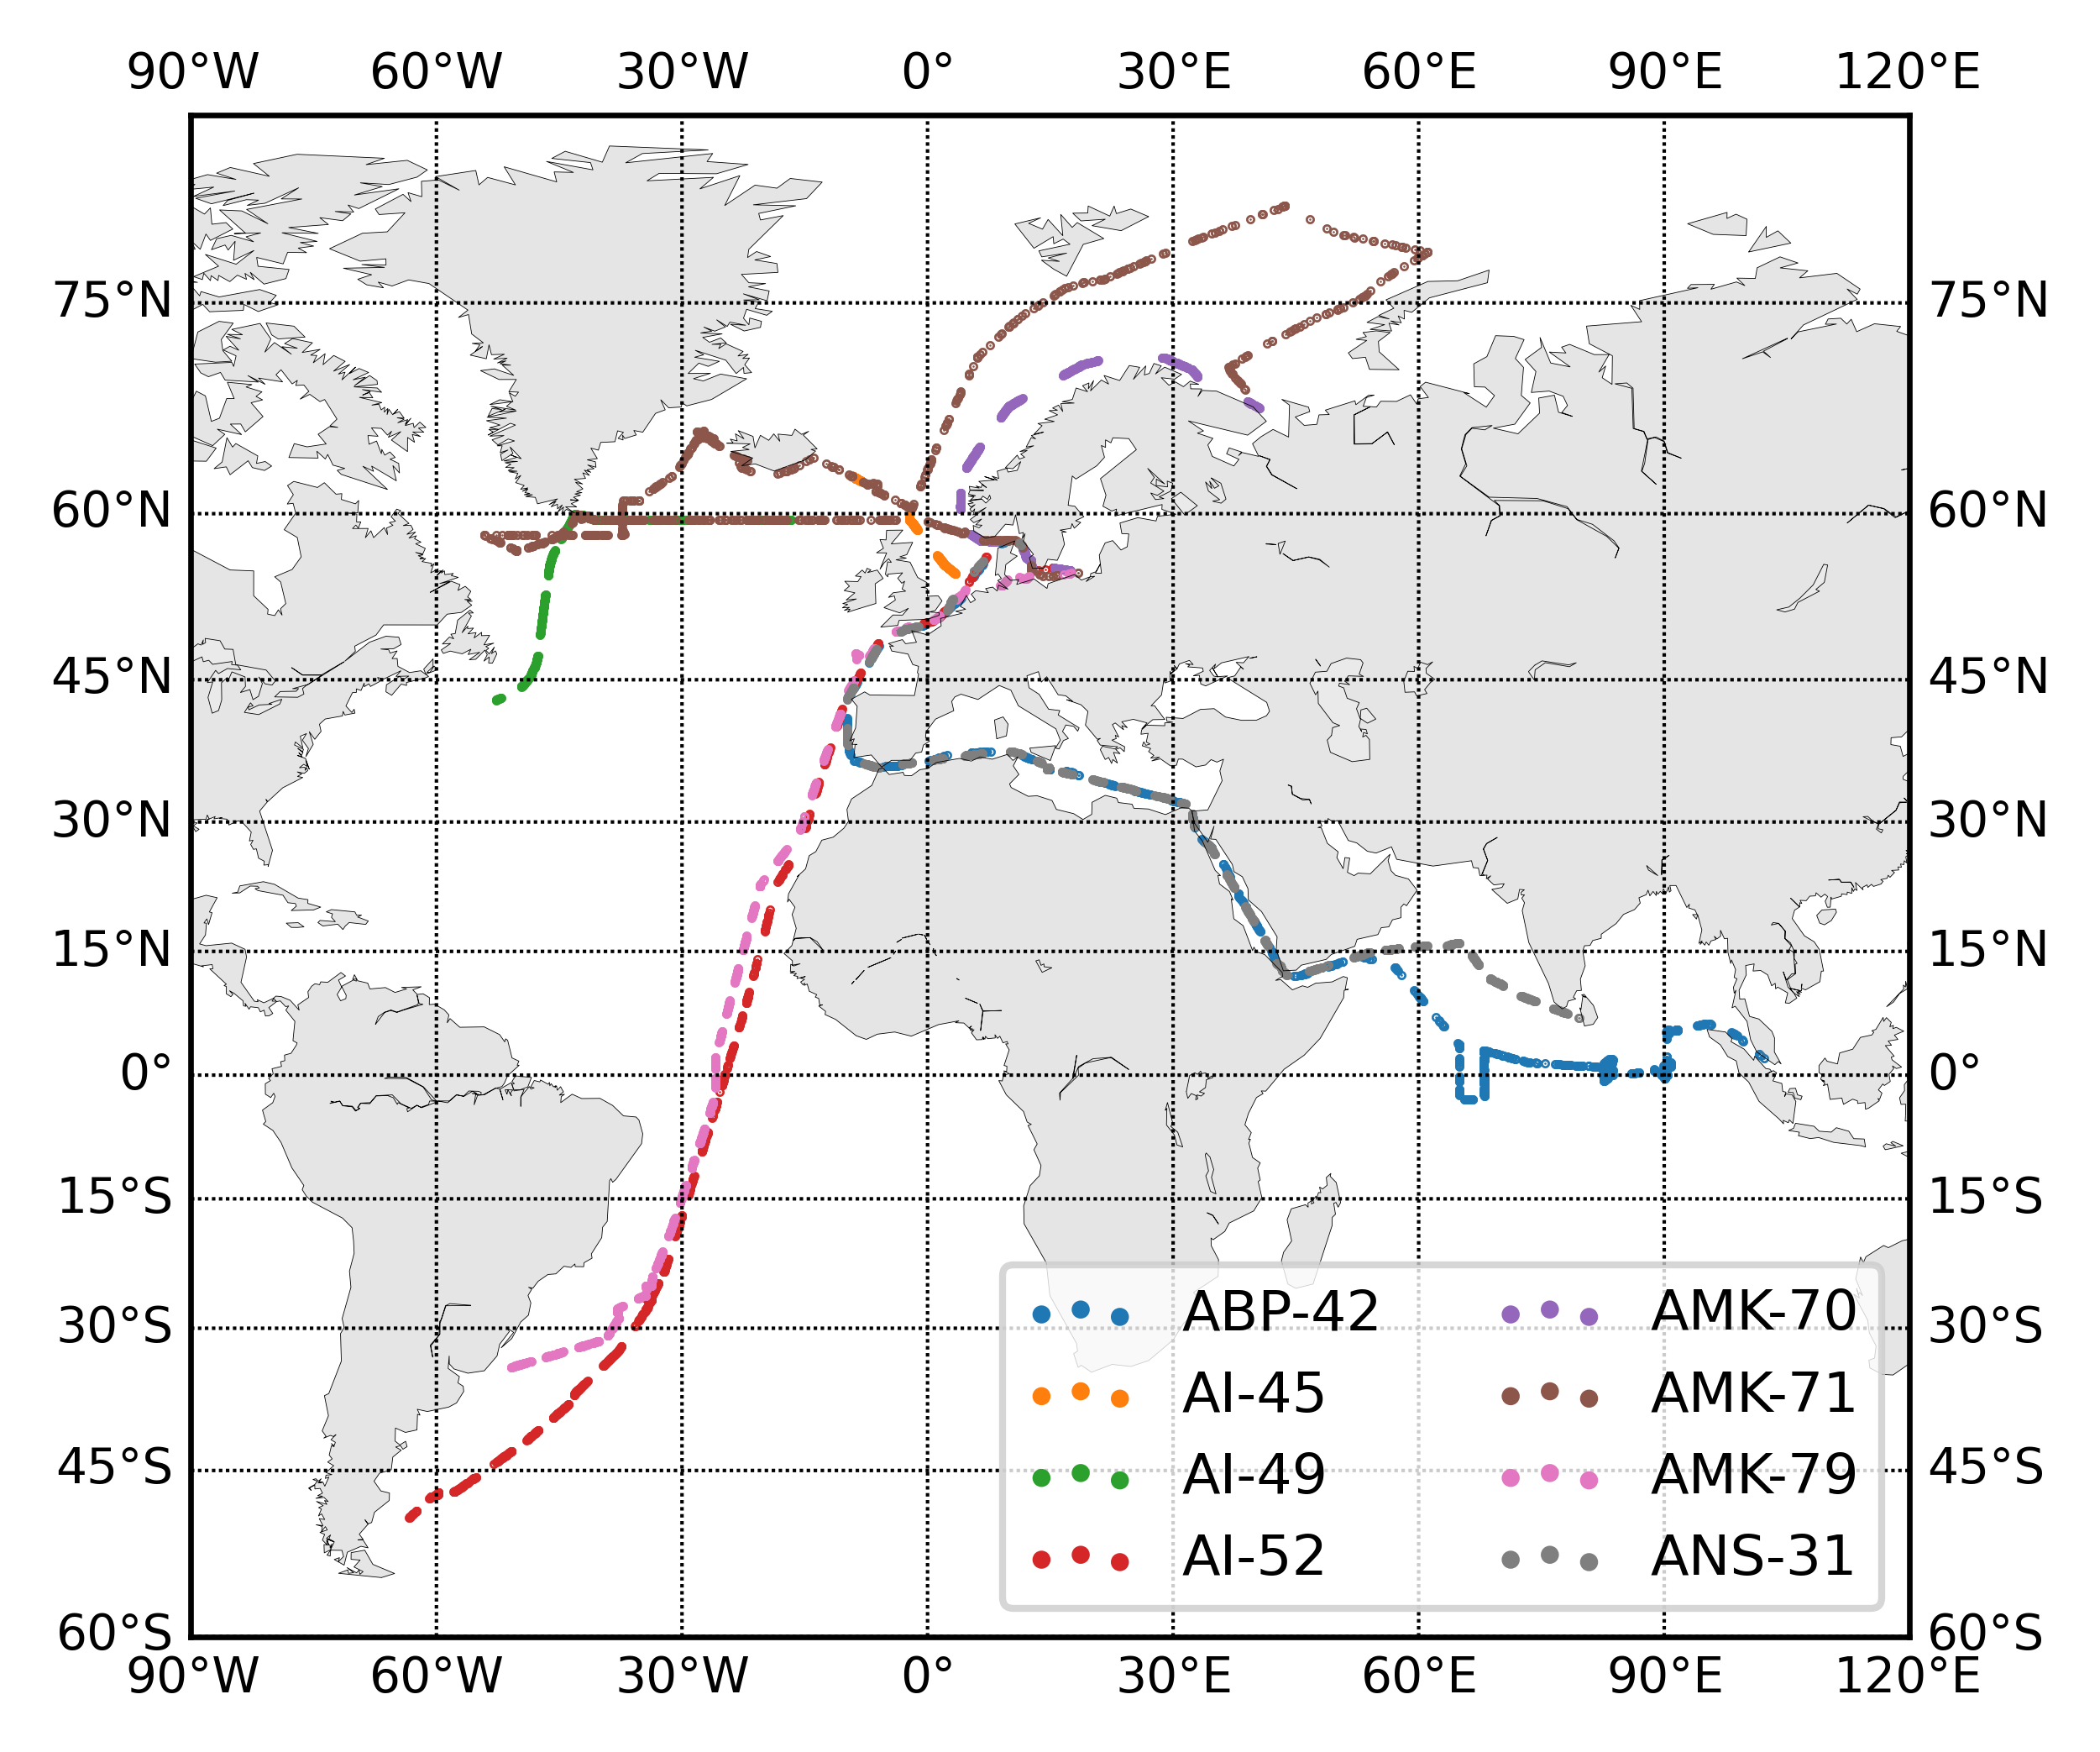
Research expeditions routes

Slide 9
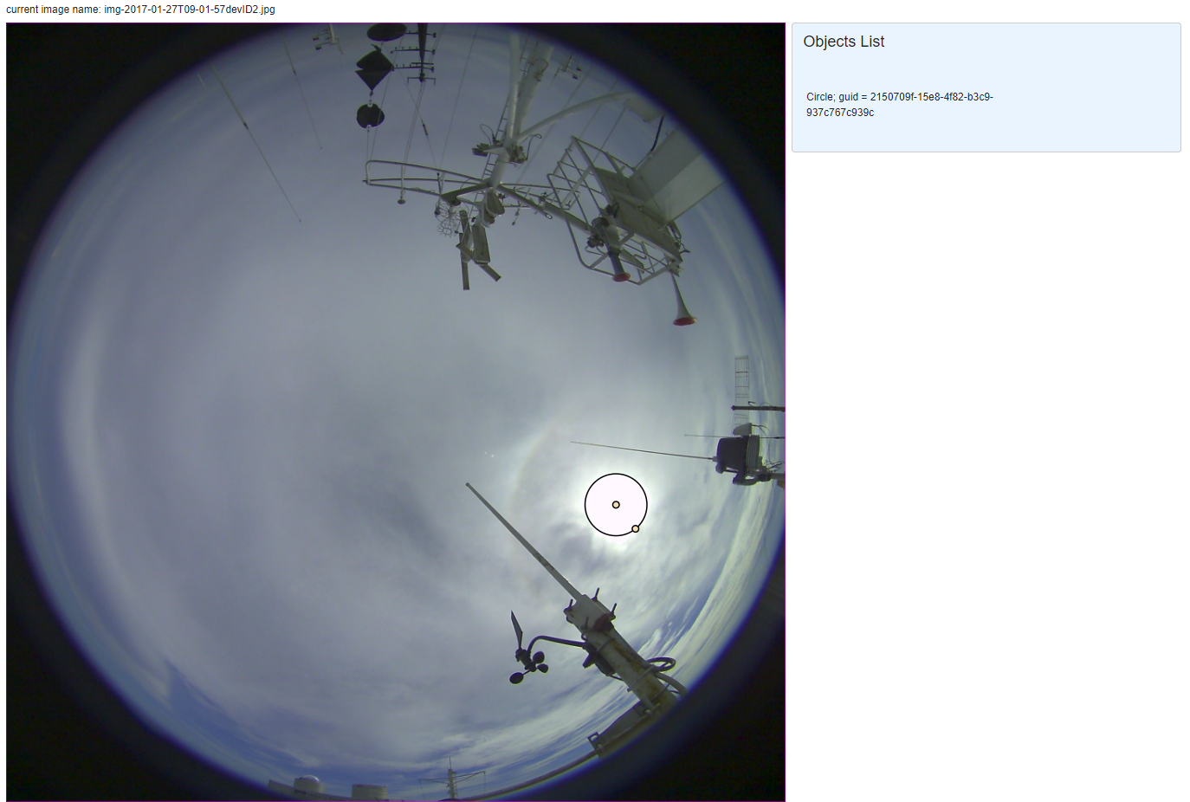
Photo markup process
Client-server application for marking up photos
(backend: Python; frontend: Blazor C#) Mikhail Krinitskiy
Thus, 2677 photos were marked up, which participated in the training and testing of the neural network.

Slide 10
Approach to solving the problem
This task uses a convolutional neural network trained on labeled data
  Additional approaches to improve the convergence and generalization of the network:
    Transfer learning
    method CoordConv, allowing to refine the approximation of the coordinates of individual objects.
    Cosine Learning Step Schedule, optimizator ADAM
    Artificial data augmentation
Libraries and tools to accomplish the task
  ImageAug uses for artificial data augmentation
  PyTorch for building and training a neural network
  Computing resources LOAICL Shirshov Institute of Oceanology
  Client-server application for marking up photos
    (backend: Python; frontend: Blazor C#) Mikhail Krinitskiy

Slide 11
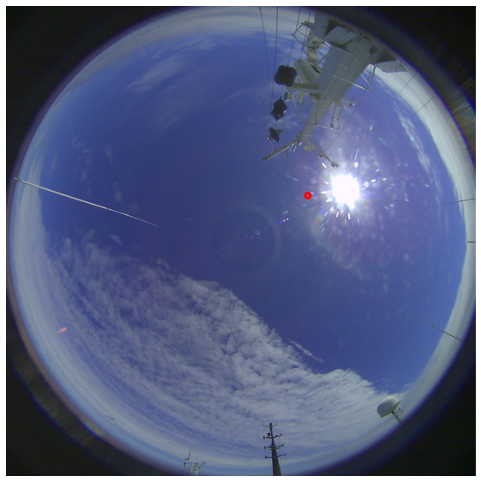
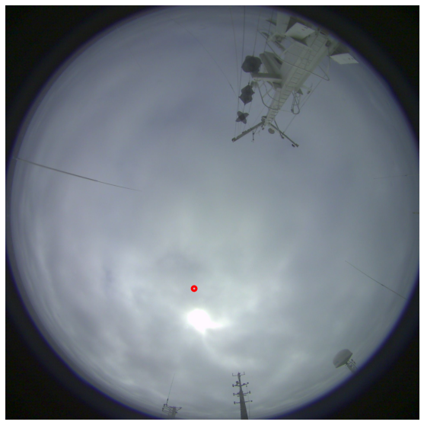
Results

Slide 12
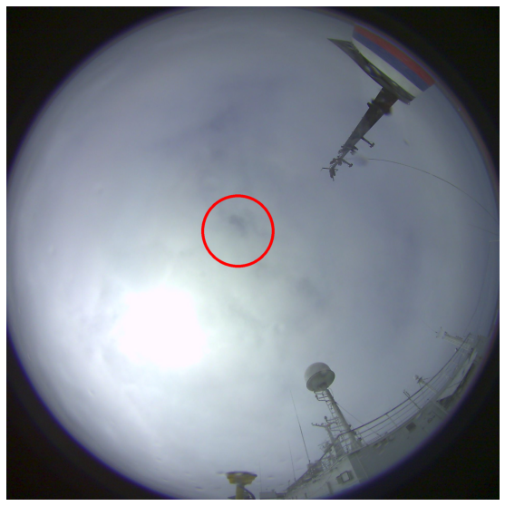
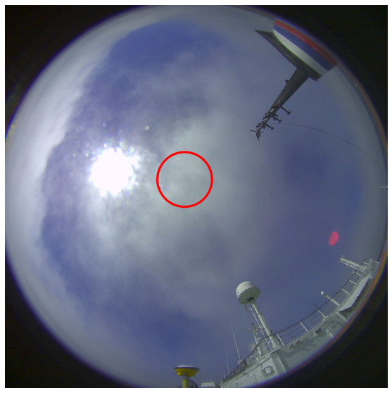
Radius determination

Slide 13
conclusions
Created a tagged dataset showing the position and size of the sun disk in wide-angle photographs of the sky
Created and trained a convolutional neural network to determine the position and size of the sun disk in wide-angle photographs of the sky
The accuracy of the trained model is still insufficient for further use in the algorithms for assessing the total cloudiness score.
Further development of work:
  Refinement of the model
  Investigation of alternative problem formulations

