Slide 1




Using 2D long-streamer seismic waveform tomography to decipher sedimentary processes surrounding a forearc fault offshore Alaska
Kahrizi, A¹., Delescluse, M¹., Rodriguez, M¹., Roche, P.-H¹., Bécel, A². , Nedimović, M. R³., Shillington, D. J⁴., Pubellier, M¹., Chamot-Rooke., N¹
Ecole Normale Supérieure, UMR 8538, PSL Research University, 75231 Paris, France
Lamont-Doherty Earth Observatory of Columbia University, Palisades, New York 10964, USA
Dalhousie University, Halifax, Nova Scotia B3H 4R2, Canada
Northern Arizona University, Flagstaff, Arizona 86011, USA

Slide 2
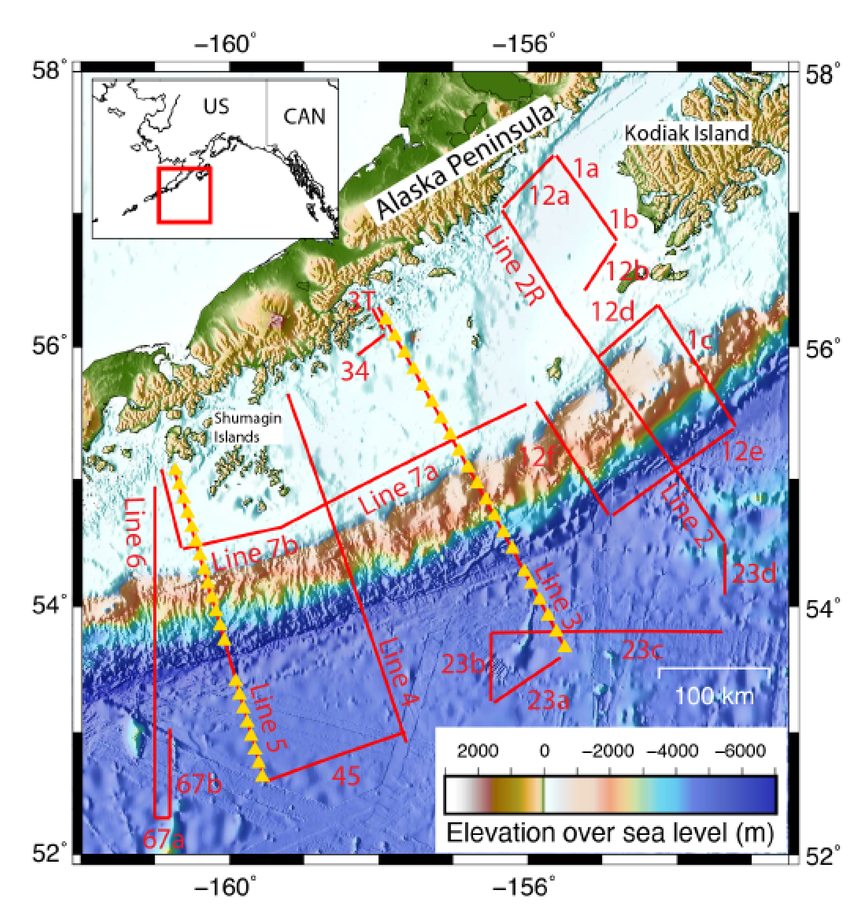
Introduction
The 2011 ALEUT program acquired 3500 km of multichannel seismic (MCS) data along a part of the western Alaska subduction zone, from the freely slipping Shumagin Seismic Gap to the locked regions in the Semidi segment and the western Kodiak asperity (e.g. Li & Freymueller, 2018). The primary goal was to characterize variations in the geometry and properties of the megathrust and the downgoing plate and relate them to downdip and along-strike changes in slip behavior and seismogenesis (Li et al., 2015 ; Shillington et al., 2015 ; Bécel et al., 2017 ; Kuehn, 2019)
Modern multichannel seismic (MCS) reflection data acquisition now have long offsets which allow imaging deep reflectivity as well as recording shallow refracted waves. The turning waves can constrain high resolution Full Waveform Inversion (FWI)-derived subsurface velocities at a significant enough depth to image sedimentary basins.
Map of the subduction zone off the Alaska Peninsula; Red lines indicate MCS profiles from the ALEUT project. Line 5 and 6 is used for this research.

Slide 3
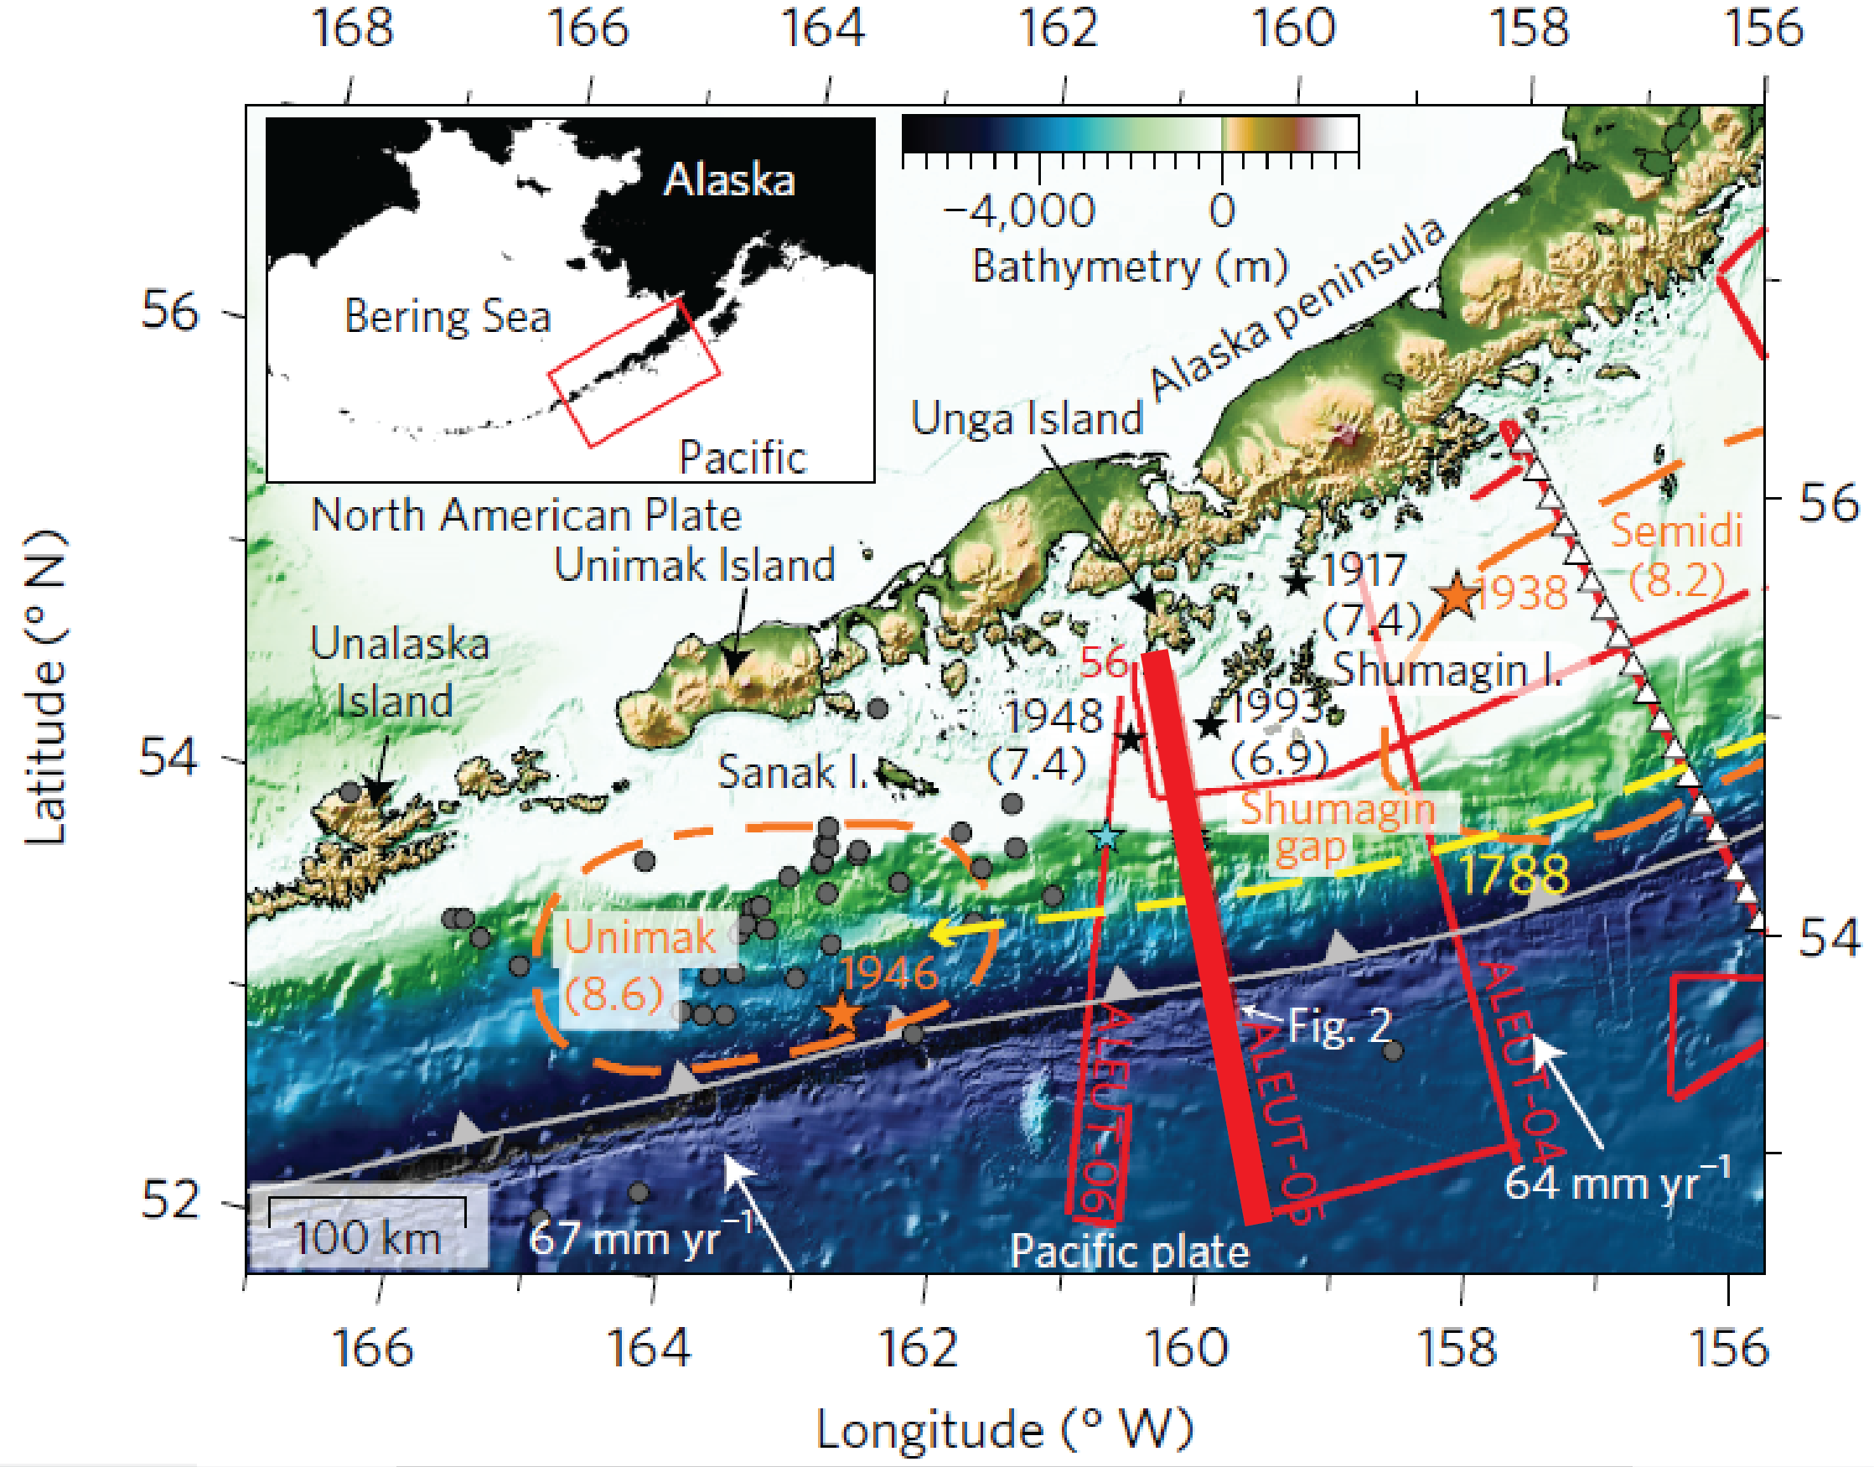
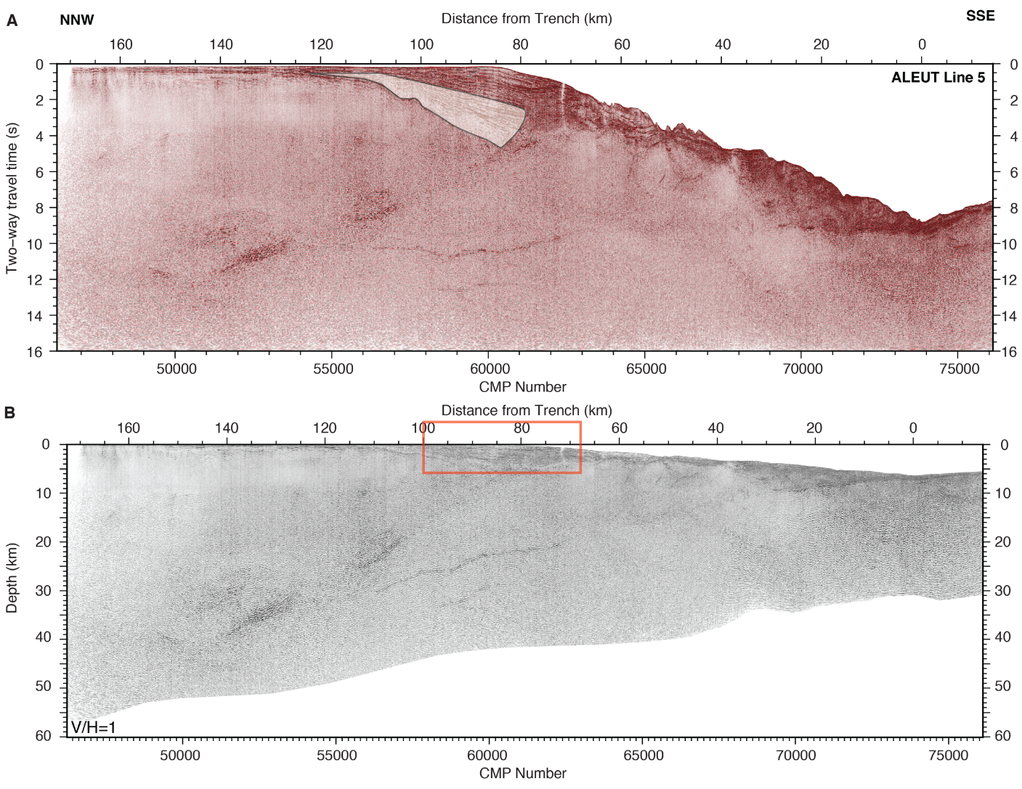
The Sanak basin and the Landward Dipping Reflector (LDR)
Miocene synrift wedge
The ALEUT Line 5 (thick line on the map) image captures the targeted megathrust reflectivity and shows reflections arising from a major reflector in the overriding plate within the Shumagin Seismic Gap located ~75 km from the trench, which can be followed from the seafloor to the megathrust (Bécel et al., 2017). The imaged reflector bounds the seaward end of the Cenozoic Sanak Basin. Onlaps indicate normal faulting on the LDR during Miocene (Bruns, et al., 1987).
This structural configuration has been linked to shallow rupture of the megathrust (Bécel et al, 2017), also in the case of the Tohoku area (Tsuji et al., 2011 ; McKenzie and Jackson, 2012).
ALEUT seismic profile illustrates the structural configuration of Shumagin Gap, along profile 5 (Bécel et al., 2017) . The red rectangle indicates the targeted area where MCS waveform tomography is applicable (A) Two-way time seismic section, (B) Depth converted seismic section.

Slide 4
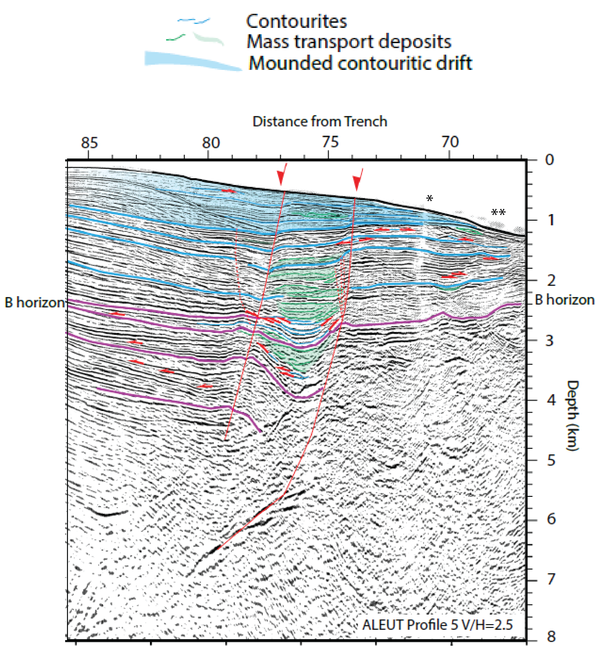
A complex sedimentary record around the Sanak fault.
The active fault scarp captures an oceanic bottom current till late Miocene (horizon B). Chaotic facies show a succession of episodes of moat infill by mass wasting processes (green).
After Miocene, the fault scarp is no longer marked enough to further control the pathways of the bottom currents that appear less localized. It is difficult to quantify the activity of the fault as reflectors cannot be recognized easily across it.
One possible interpretation involves mostly sedimentary processes and limited to no recent tectonic activity.
The complex sedimentary processes make this profile interesting to test whether FWI can help us better understand the recent sedimentary record through a high resolution velocity field.
* A Mw 6 earthquake during acquision led to the deletion of corresponding CDPs.
** Suggested present-day location of the bottom current

Slide 5

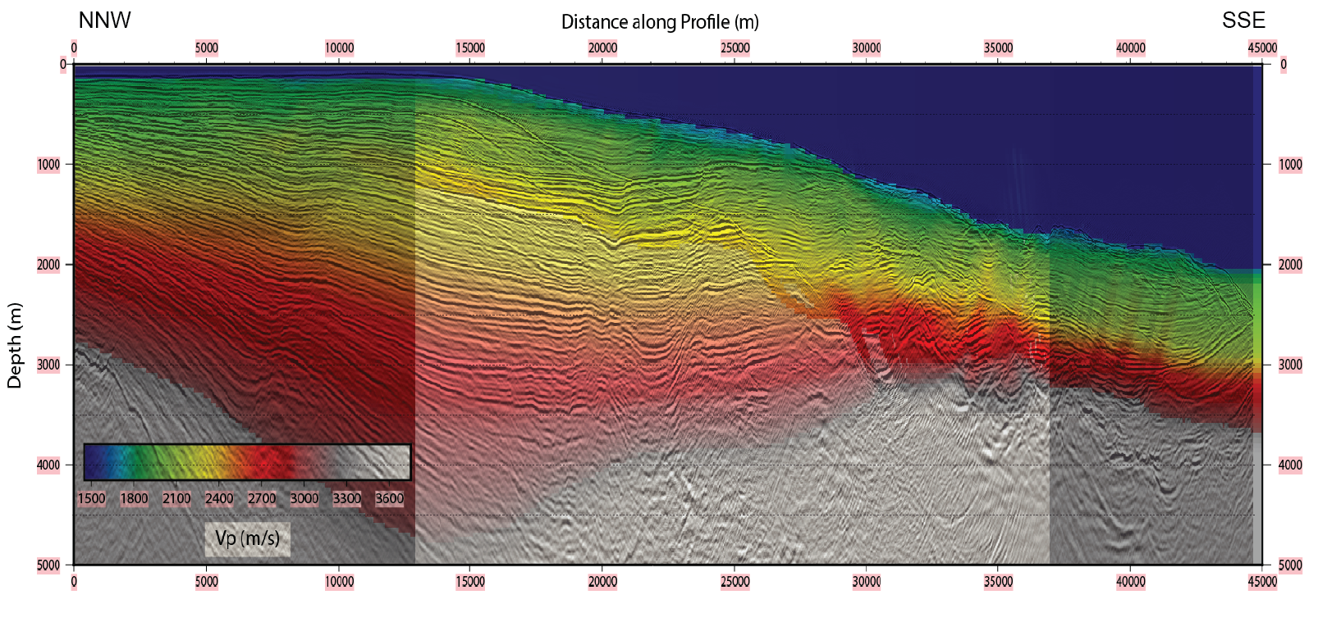
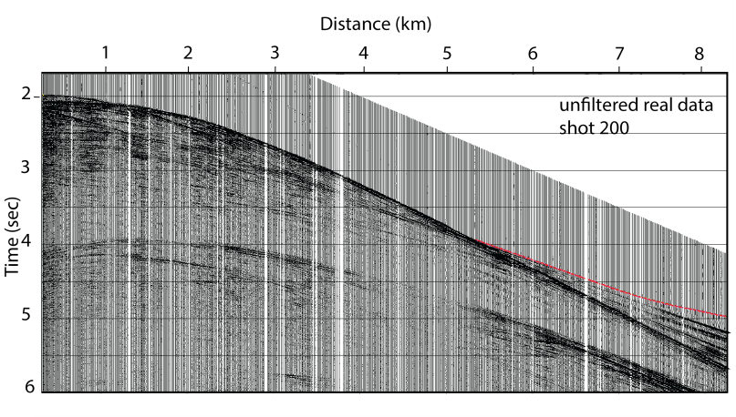
Traveltime tomography model of line 5 (modified FAST) (Canales et al., 2008)
+ overlapping PSDM
Forward grid cell : 25m – Inverse grid cell : 50m.
Initial model for TT tomo is a layered model with linear velocity gradients
Limited refraction arrivals catch the basement down-slope
Waves are turning 1-2 km below seafloor (shading mask in the Figure below)
Picking uncertainty is 10 ms
First shot
Shot 200
Last shot
Notes:
5

Slide 6
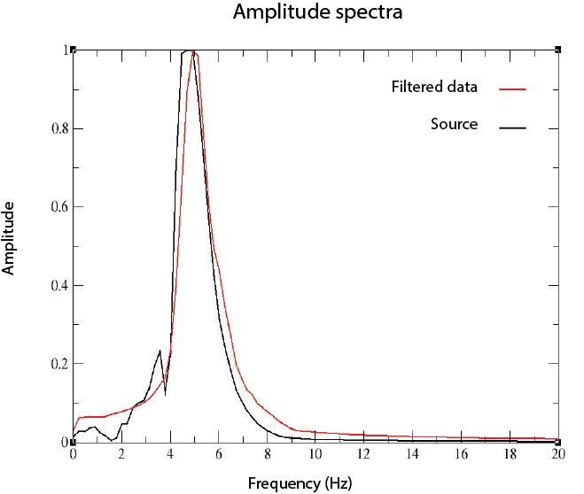
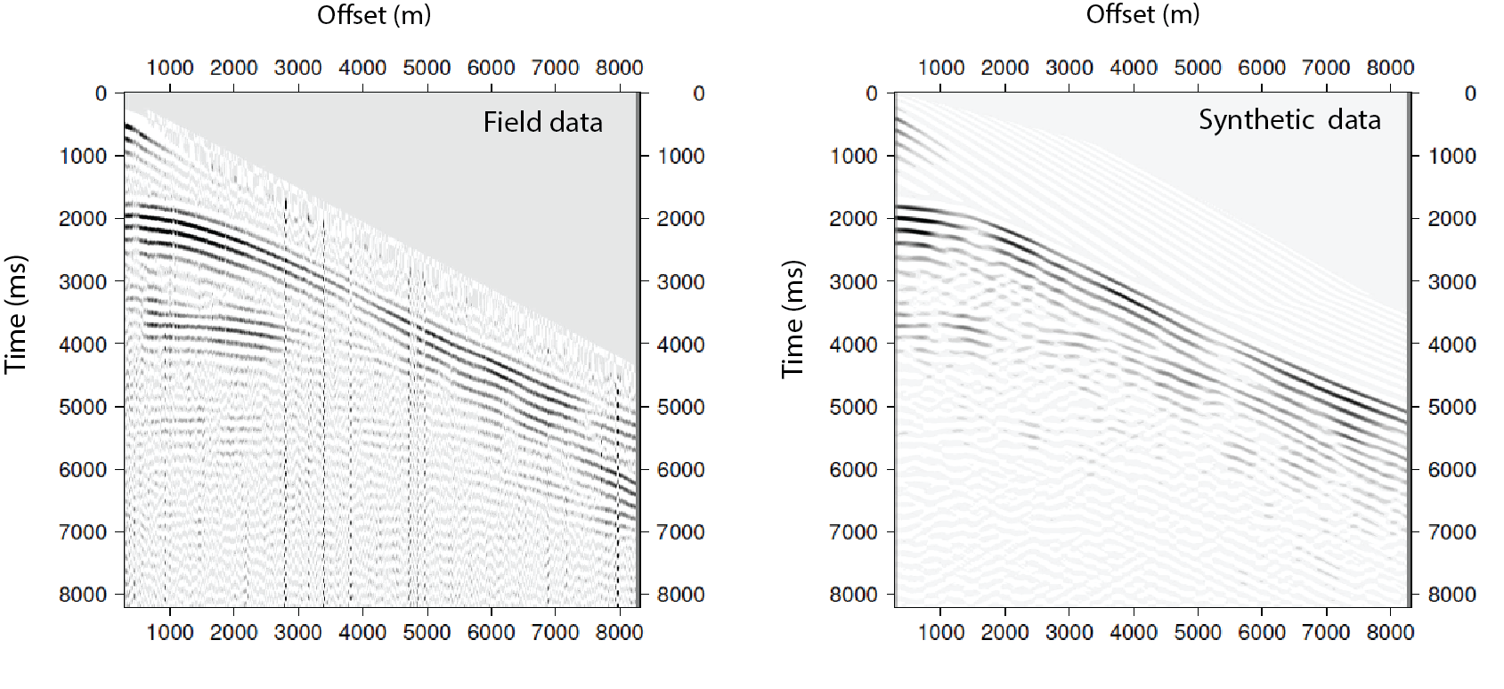
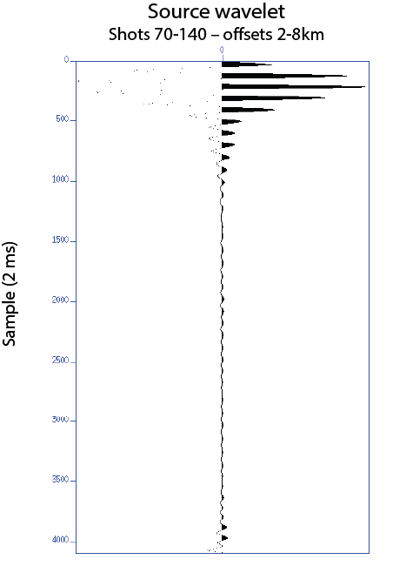
Source inversion using TT tomo model
Data filtered using a Butterworth filter (subfilt) minimum phase High cut pass 4Hz High cut stop 6Hz.
Amplitudes are multiplied by sqrt(t).
We use the Toyxdac acoustic time domain FWI code from the Seiscope consortium
(e.g. Yang et al., 2016).
The grid is 50m; dominent frequency is ~5Hz; we use a density model based on Gardner’s
equation (Gardner et al., 1974).
The first step is the frequency domain source inversion for the lowest frequencies (Pratt, 1999).
Source inversion needs an accurate seafloor depth and water-column velocity (quite a challenge). The source must be stable along the profile and at all offsets
Shot 180
The synthetic data is modeled using the traveltime tomography velocity model.

Slide 7

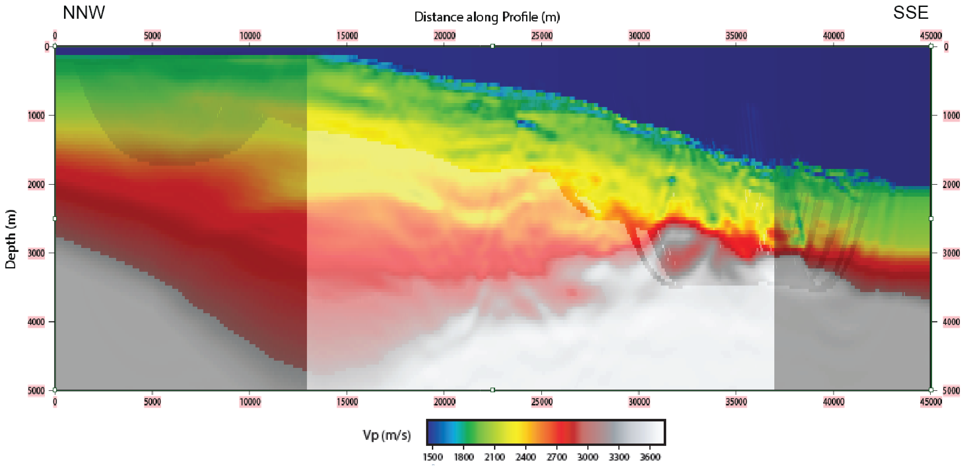
INVERSION STRATEGY
- 275 shots spaced 125m, trace length 8s TWT, 4 ms sampling
- 636 receivers for each shot spaced 12.5 m (max. 8 km offset)
- model size is 45x6 km with a 50m grid
- 10 iterations with the lowest frequency band (4-6Hz)
- Data filtering up to 8 Hz
- New estimation of the source
- 10 iterations with frequencies 4-8Hz
- One iteration takes ~15 minutes on 16 cores@3Ghz, using ~60GB RAM
Shot 140
Shot 200

Slide 8
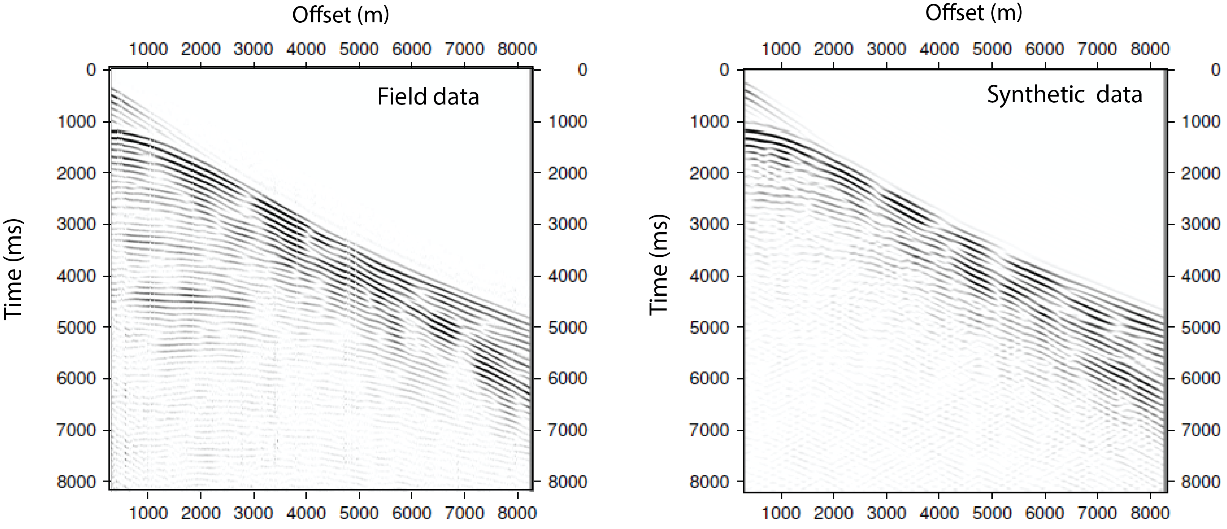
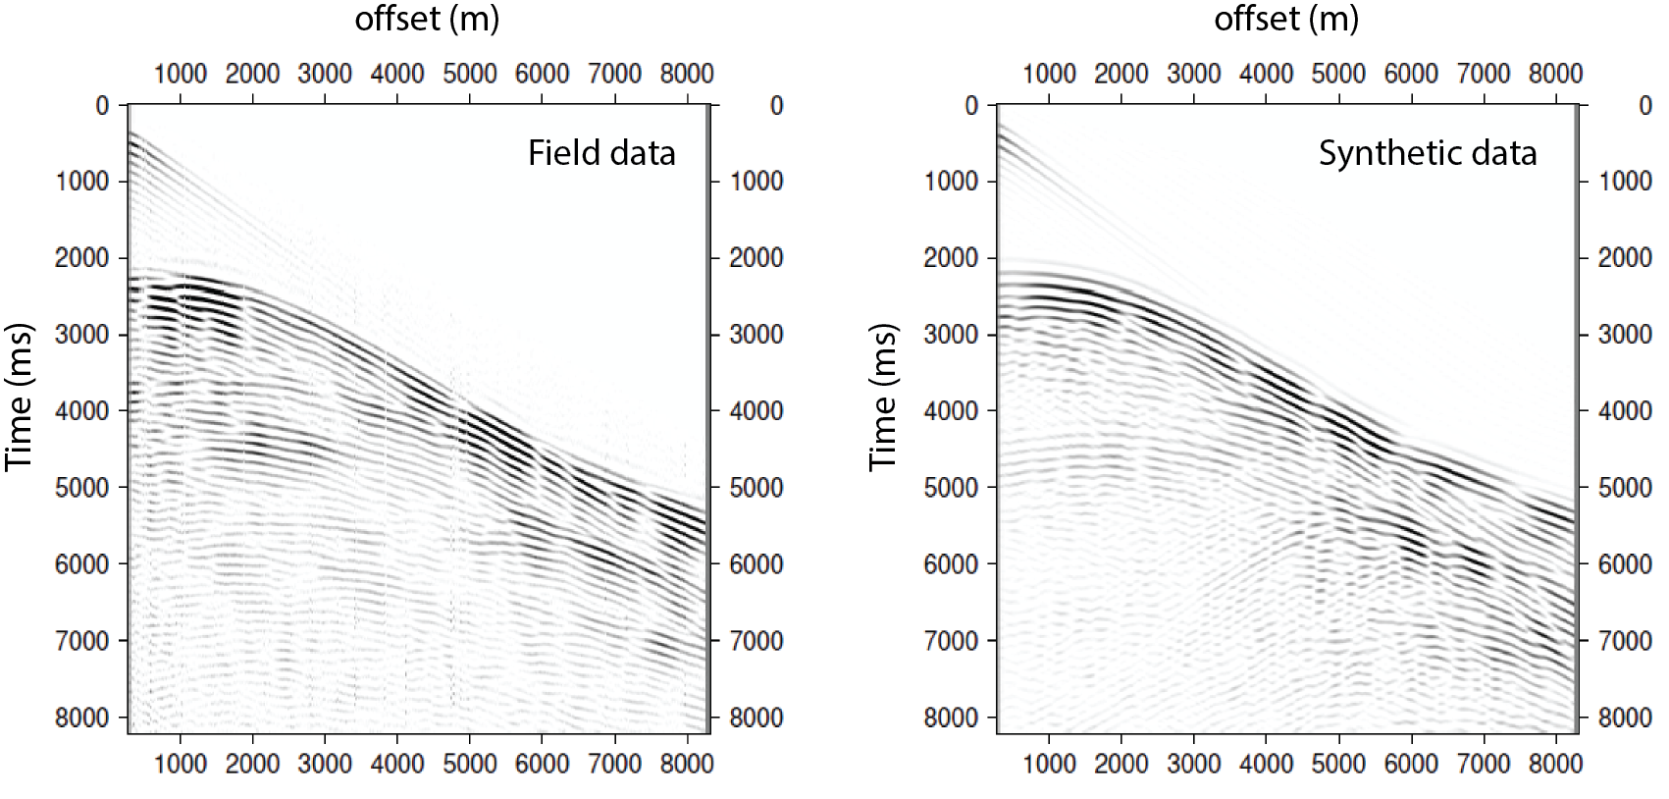
Comparison of field and synthetic data; (synthetic data is modeled via FWI model).
The first two kilometers is not used for inversion
Shot 140
Shot 200

Slide 9
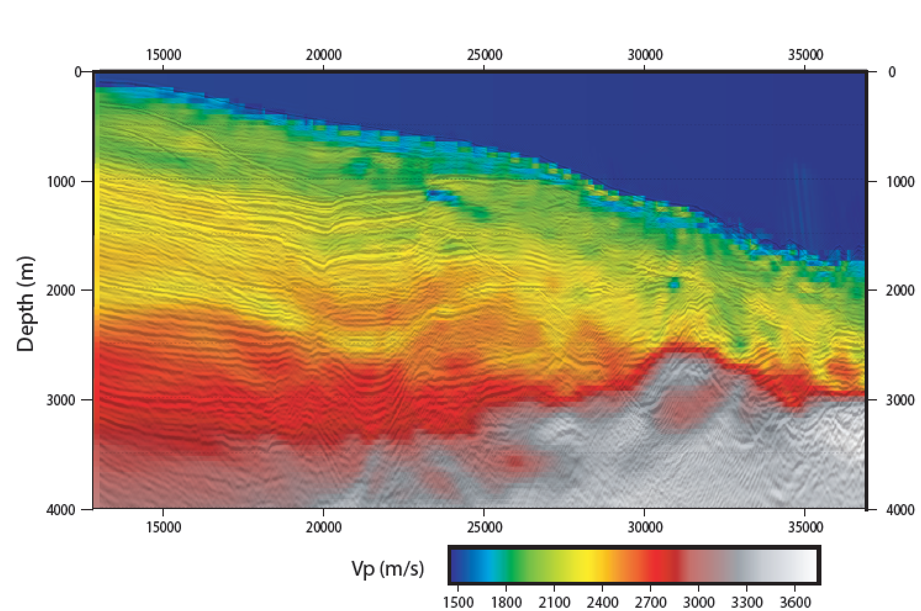
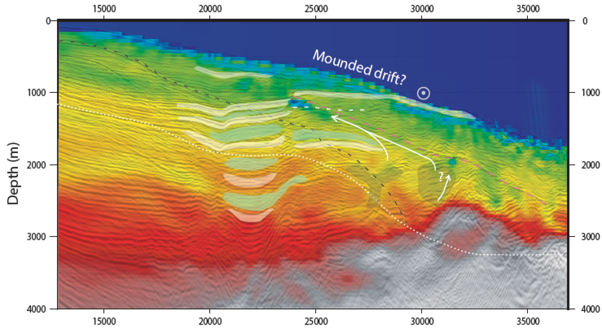

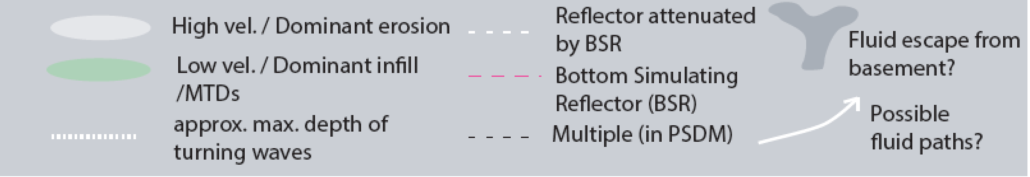
Full waveform tomography velocity model of line 5 + PSDM
Alternating low and high velocities correspond to the previously interpreted erosive and infill phases. The images demonstrate a velocity inversion oblique to the sedimentary horizons in consistency with a bottom simulating reflector (BSR), which is only partially visible in the reflection image. Very low velocity associated to trapped fluid/gas appears to stop at the main fault.

Slide 10
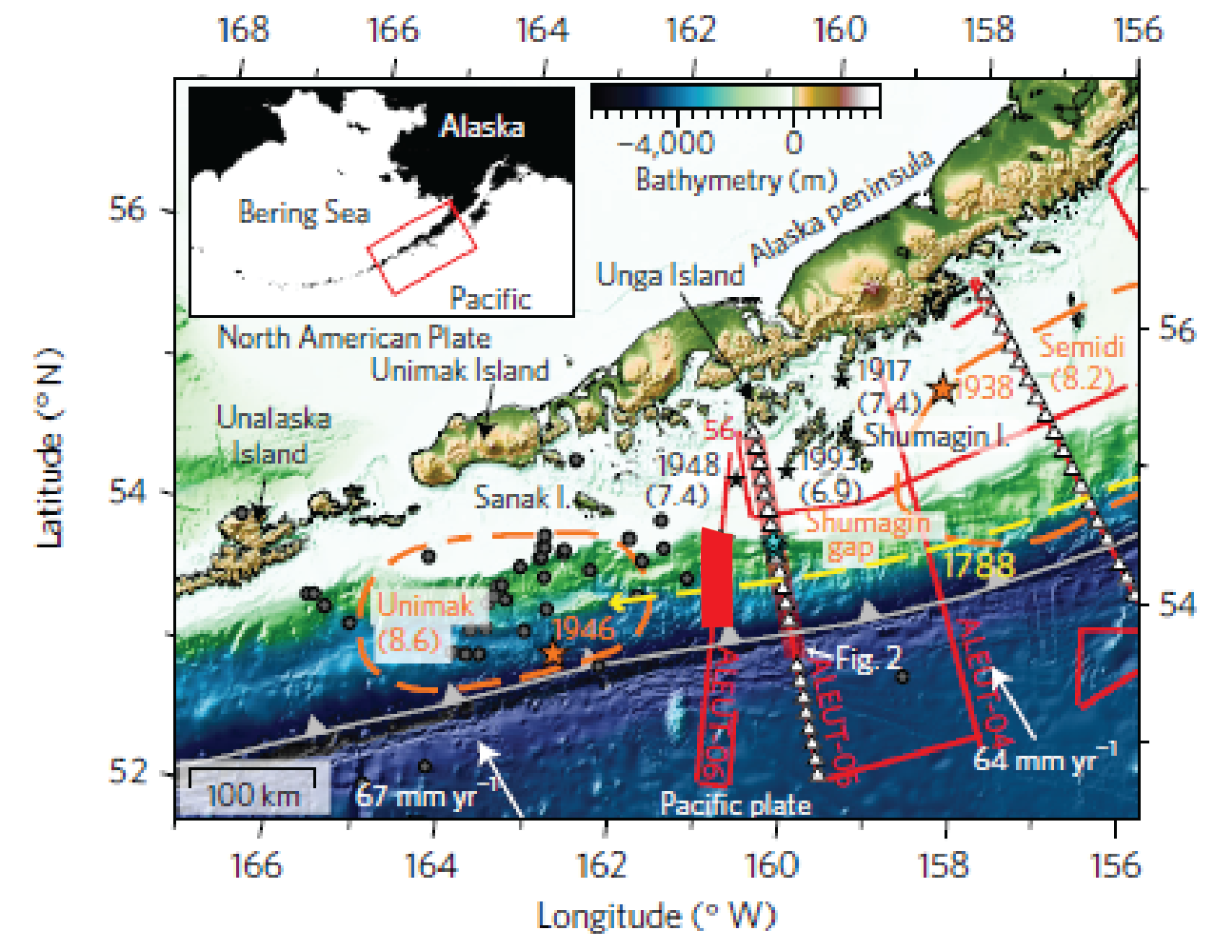
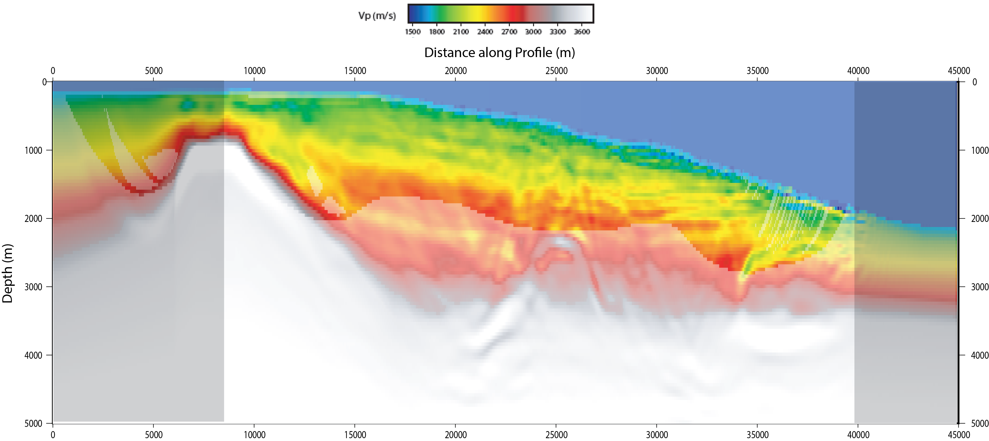
Full waveform tomography velocity model of line 6
The velocity model of the ALEUT Line 5, is compared with nearby ALEUT line 6 (thick line on the map). We compare similar structure on line 6; and we realize that the velocity model of line 6 does not show strong discontinuity through the faults.
However , there are low velocities above the basement highs (indicated by circle on the figure below) at the both sides of the model that could be interpreted as fluid escape.
PS: the inversion strategy that has been discussed for line 5, is also used for line 6.

Slide 11
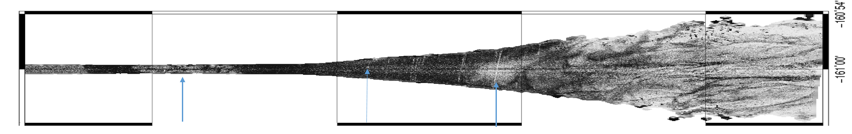
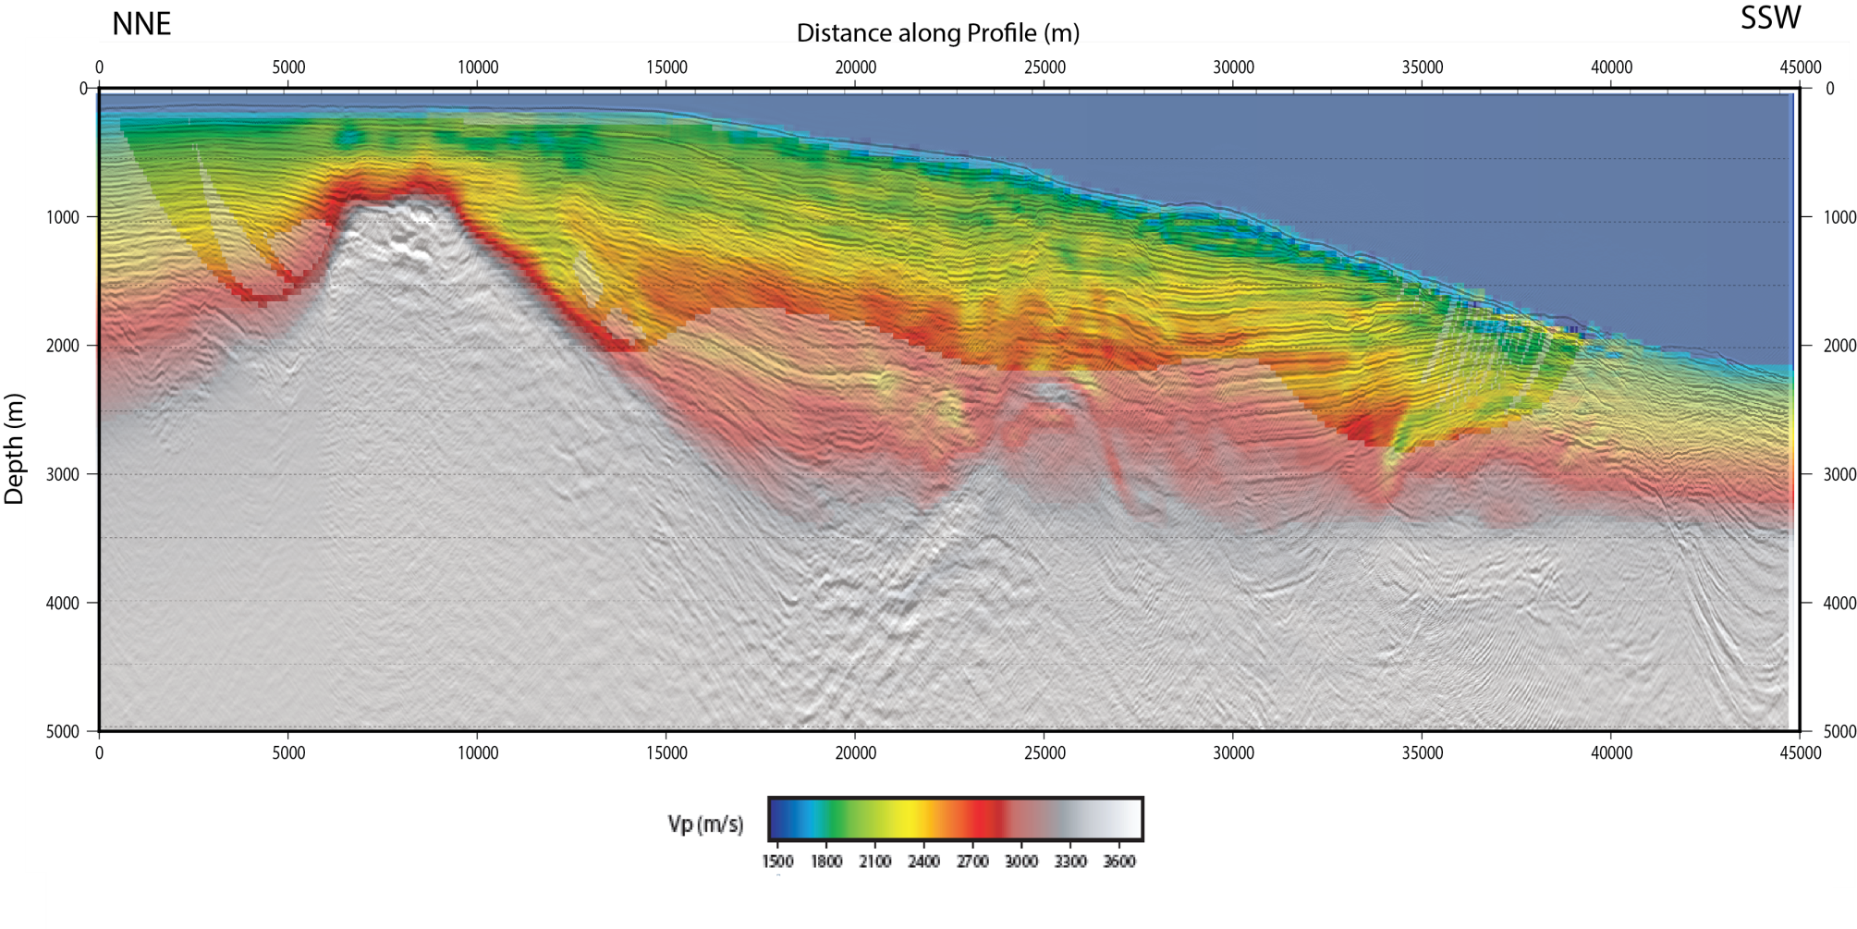
Full waveform tomography velocity model of line 6 + PSDM
Low velocity in the shallow shelf sediments above the basement high (indicated by ellipse) correlates well with low multibeam reflectivity; the arrows show places of low reflectivity (white) on multibeam reflectivity.

Slide 12
Conclusion
Two 40-kilometer-long sections of the ALEUT lines crossing the Sanak Basin were subjected to 2D time-domain acoustic waveform tomography. Our results are currently only qualitatively confirmed by comparisons of synthetic and observable data sets as well as comparison of waveform tomography velocity model with the migrated image. Main results:
Erosion an infill due to water bottom currents seem to affect the velocities.
We detect a velocity inversion in continuity to a bottom simulating reflector (BSR) only partially visible in the reflection image of line 5.
The BSR velocity anomaly disappears suddenly across the main normal fault, implying an impermeability of the fault on line 5, which proves its existence in shallow sediments.
On line 5, the velocity contours more or less follow the reflective horizons landward of the fault whereas the contours do not follow reflectivity seaward of the fault, highlighting fluid effects.
On both sides of the line 6 model, low velocities above the basement highs can be observed, which may mean fluid escape, but there is no significant discontinuity of the velocities across the main faults
Perspective
We need to focus on more quantitative model validation.
To get more details, higher frequencies are needed (and a finer grid)
Further interpretation in the local and regional framework will be performed to understand the meaning of the fault system activity.

Slide 13
Acknowledgment
We thank Romain Brossier and Ludovic Métivier from Seiscope for allowing us to use the Toyxdac software
References
Bécel, A., Shillington, D.J., Delescluse, M., Nedimović, M.R., Abers, G.A., Saffer, D.M., Webb, S.C., Keranen, K.M., Roche, P.-H., Li, J., and Kuehn, H., 2017, Tsunamigenic structures in a creeping section of the Alaska subduction zone: Nature Geoscience, v. 10, p. 609–613.
Bruns, T. R., von Huene, R., & Culotta, R. C. (1987). Geology and petroleum potential of the Shumagin margin, Alaska. In D. W., Scholl, A., Grantz, & J. G., Vedder, eds., Geology and resource potential of the continental margin of western North America and adjacent ocean basins—Beaufort Sea to Baja California: Houston, Texas, Circum-Pacific Councilfor Energy and Mineral Resources, Earth Science Series, v. 6, pp. 157–190.
Canales, J. P., B. E. Tucholke, M. Xu, J. A. Collins, and D. DuBois, 2008, Seismic evidence for large-scale compositional heterogeneity of oceanic core complexes: Geochemistry, Geophysics, Geosystems, 9, Q08002.
Kuehn, H., 2019, Along-trench segmentation and down-dip limit of the seismogenic zone at the eastern Alaska-Aleutian subduction zone, PhD thesis, Dalhousie University, Halifax, Nova Scotia.
Li, J., Shillington, D.J., Bécel, A., Nedimović, M.R., Webb, S.C., Saffer, D.M., Keranen, K.M., Kuehn, H., 2015, Downdip variations in seismic reflection character: Implications for fault structure and seismogenic behavior in the Alaska subduction zone, 120, 7883-7904.
Li, S., Freymueller, J,T., 2018, Spatial variation of slip behavior beneath the Alaska Peninsula along Alaska-Aleutian subduction zone, Geophysical Research Letters, 45, 3453-3460.
McKenzie, D., Jackson, J., 2012, Tsunami earthquake generation by the release of gravitational potential energy, Earth and Planetary Science Letters, 345, 1-8.
Pratt, R. G., 1999, Seismic waveform inversion in the frequency domain, Part 1: Theory and verification in a physical scale model: Geophysics, 64, 888–901
Shillington, D. J., A. Becel, M. R. Nedimovic, S. C. Webb, H. Kuehn, G. A. Abers, K. M. Keranen, J. Li, M. Delecluse, and G. A. Mattei-Salicrup , 2015, Link between plate fabric, hydration and subduction zone seismicity in Alaska, Nat. Geosci., 8, 961–964.
Tsuji, T., Ito, Y., Kido, M., Osada, Y., Fujimoto, H., Ashi, J., Kinoshita, M., Matsuoka, T., 2011, Potential tsunamigenic faults of the 2011 off the Pacific coast of Tohoku Earthquake, Earth, planets and space, 63, 831-834.
Yang, P., Brossier, R., Métivier, L., Virieux, J., 2016, A review on the systematic formulation of 3-D multiparameter full waveform inversion in viscoelastic medium. Geophysical Journal International, 207, 129-149.

