Slide 1

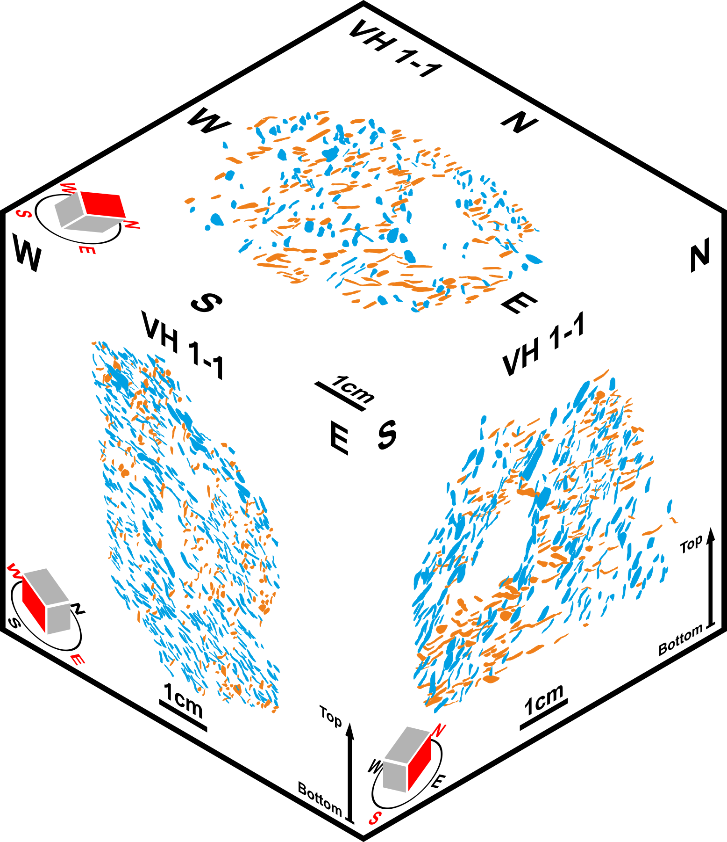
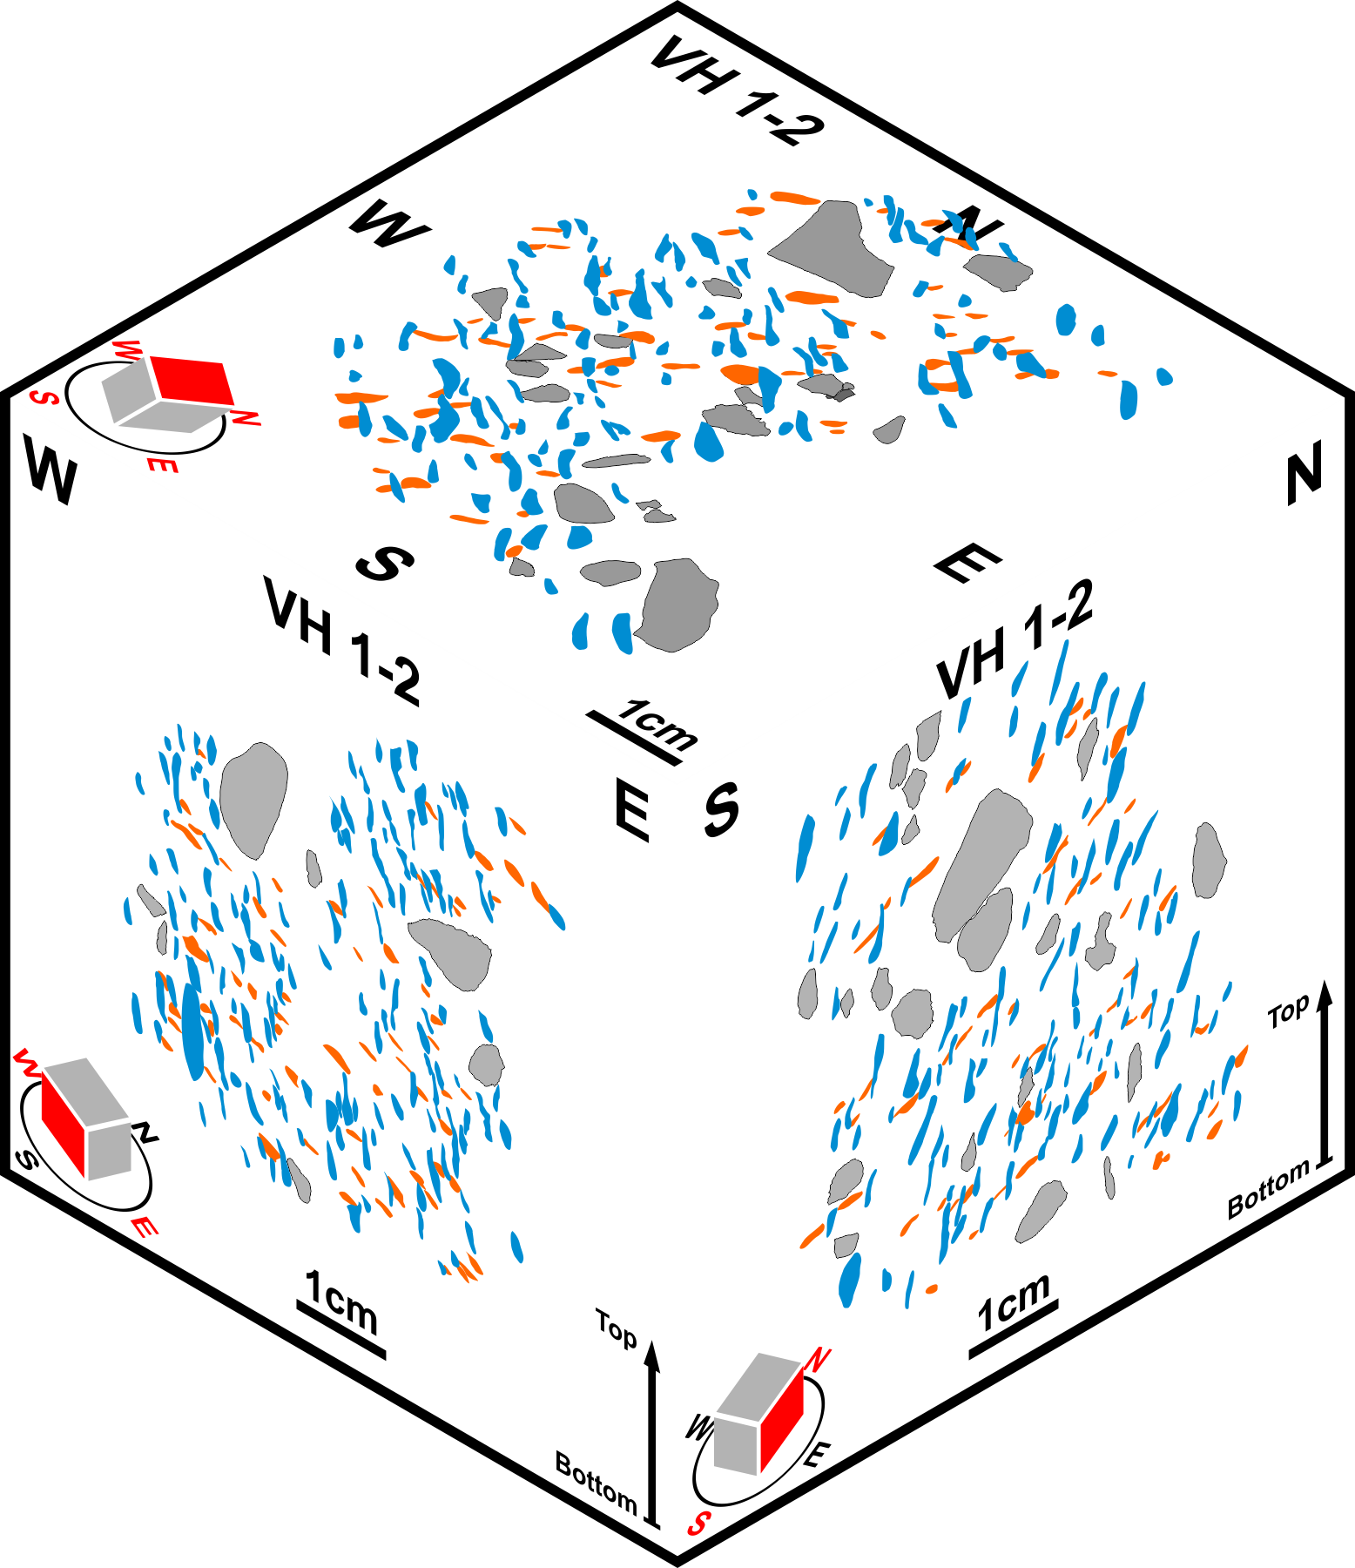
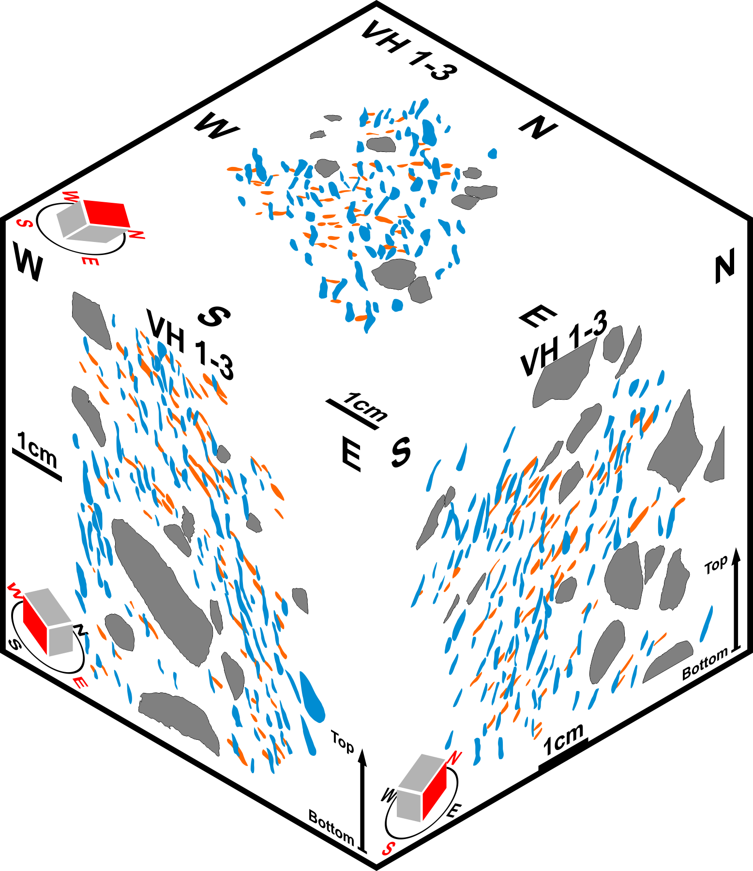
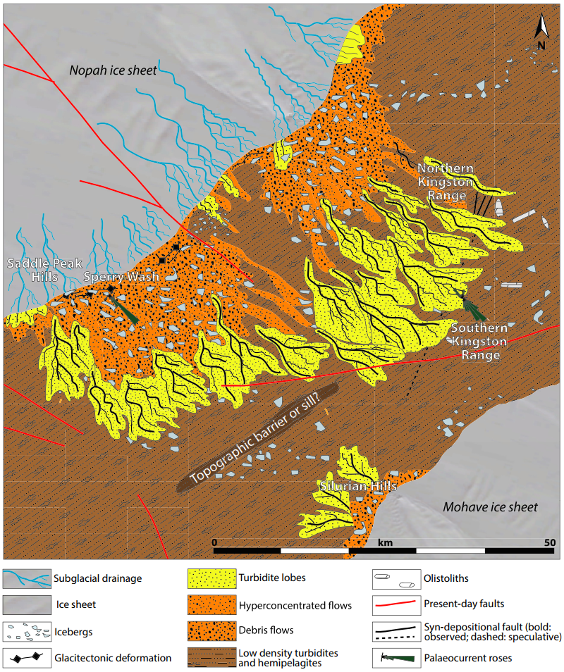
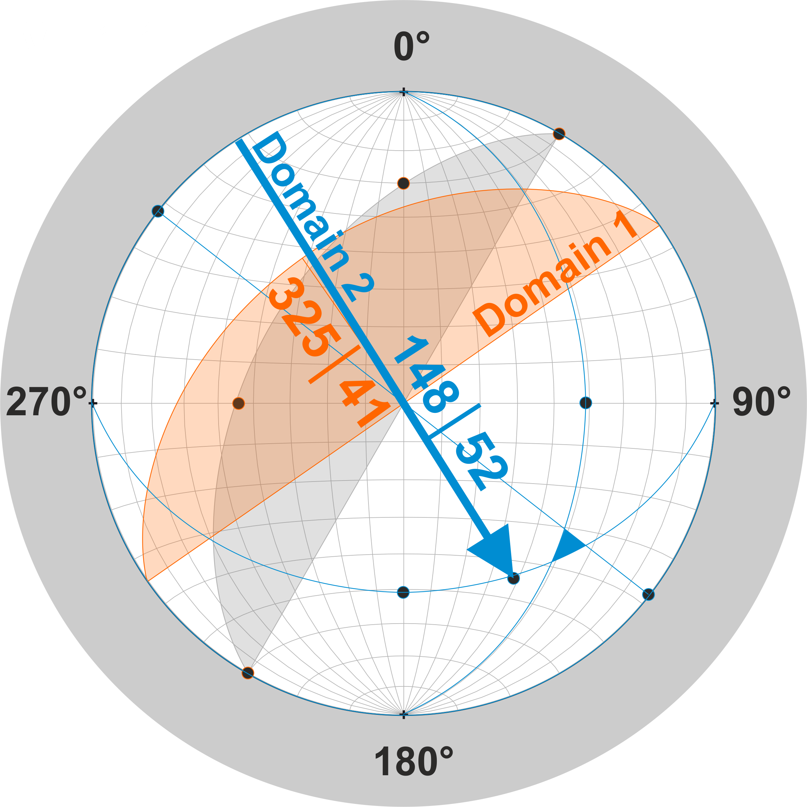
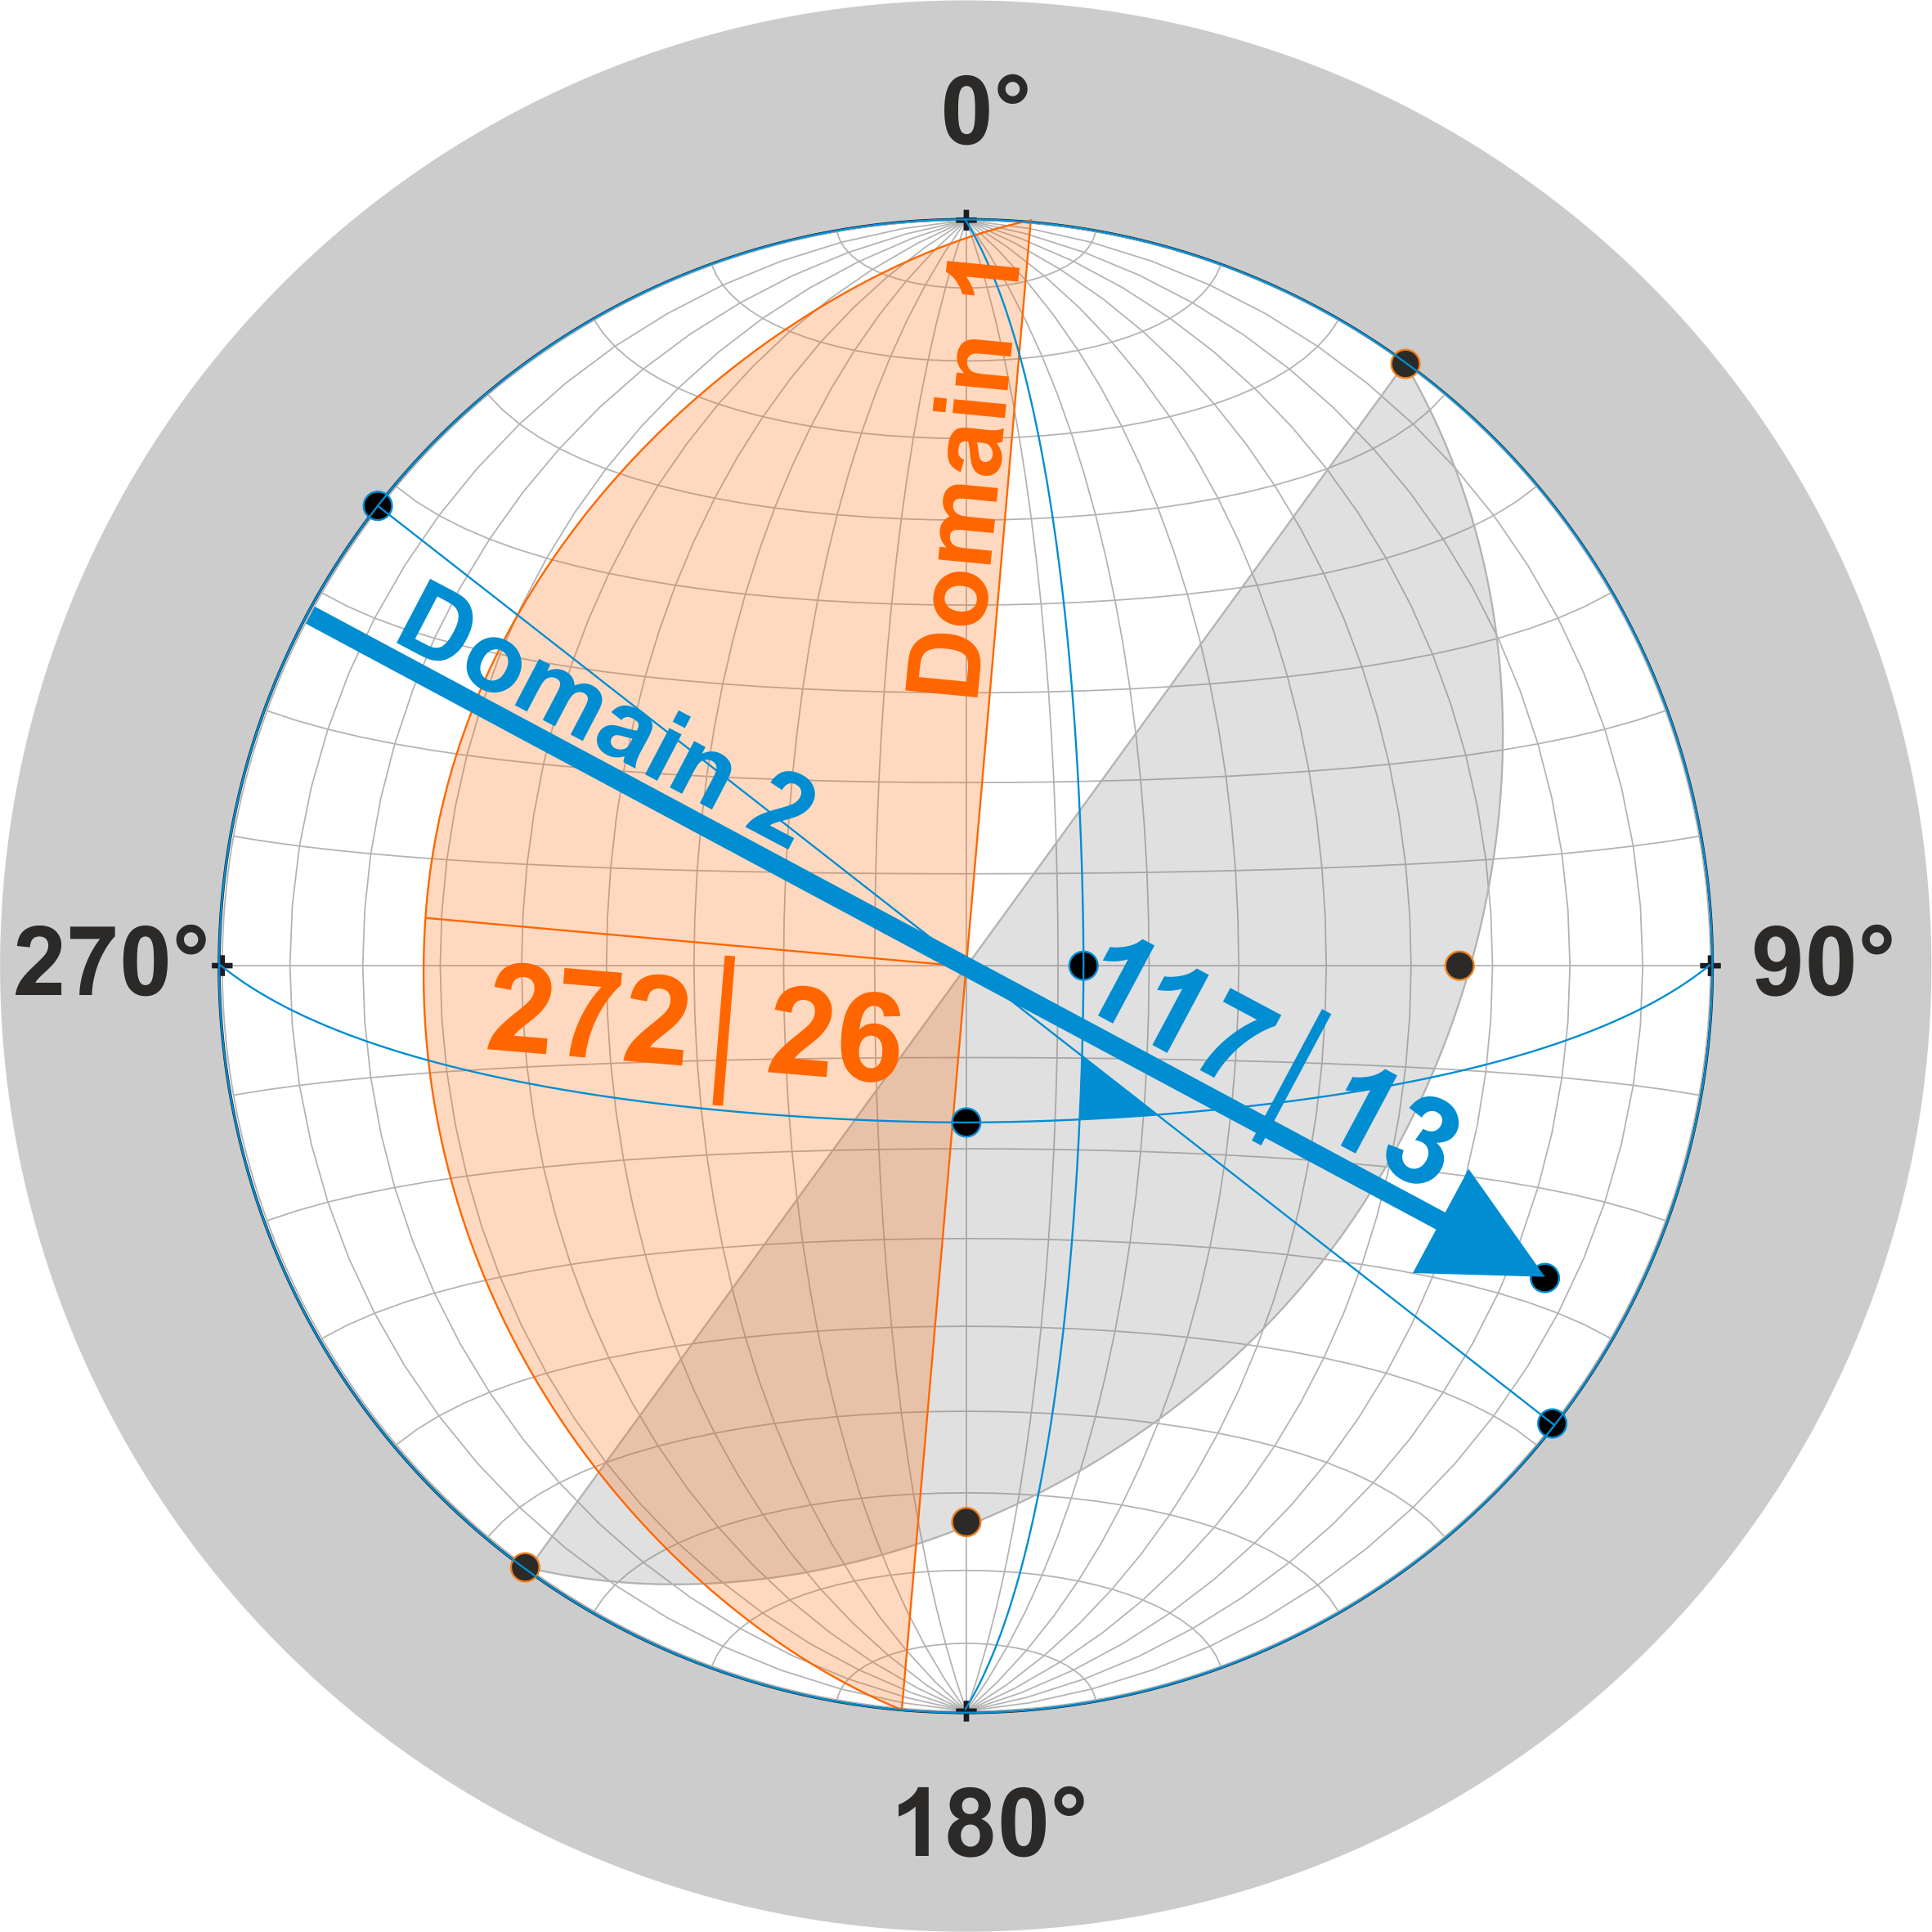
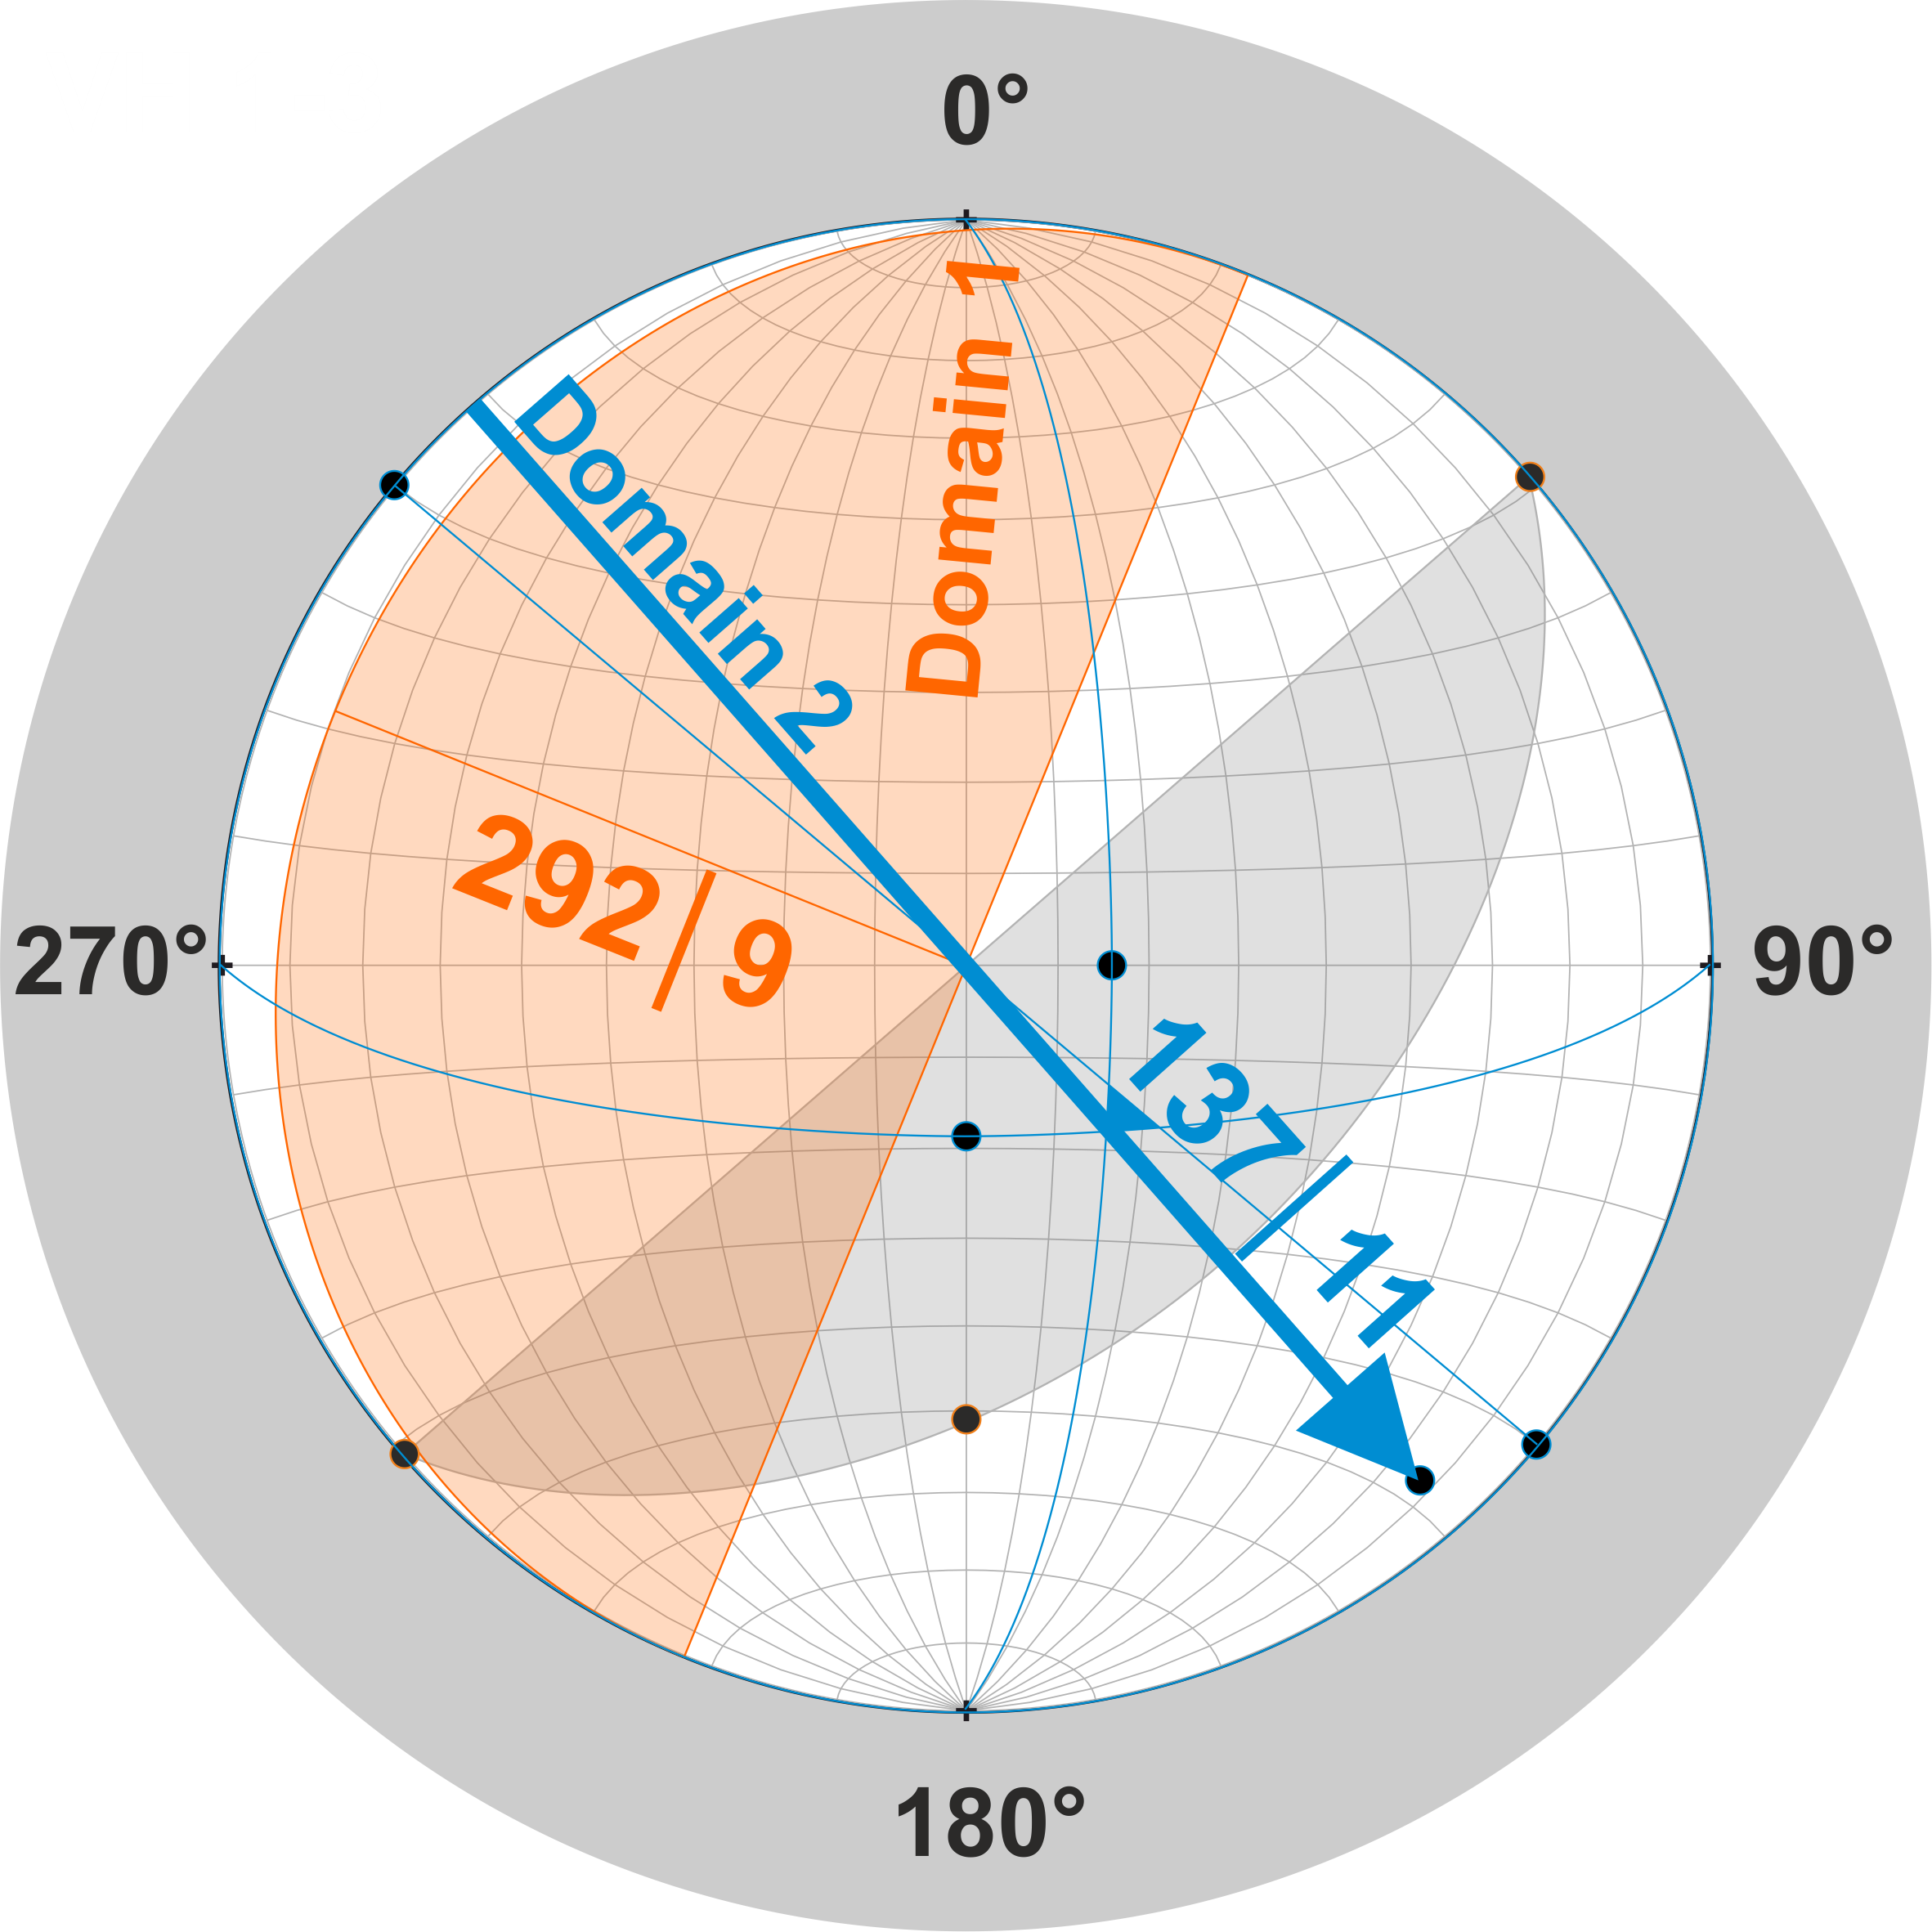
3D-Microfabric reconstruction of Neoproterozoic diamictites from the Valjean Hills, California (USA)
(sub)glacial origin is indicated by fabrics and microstructural elements
during the Sturtian Ice Age in this area wet - based glaciation
three advances or oscillations?
subsequent overprinting of older diamictites?
Palaeogeographic map
(Le Heron & Busfield 2016)
Christoph Kettler, Katarina Pichler, Daniel Smirzka, Thomas Vandyk, and Daniel Le Heron

