Slide 1


Release of Bioavailable Dissolved Organic Matter into the Arctic Coastal Zone: Simulating Coastal Permafrost Soil Erosion
Anders Dalhoff Bruhn¹, Colin A. Stedmon¹, Jérôme Comte², Atsushi Matsuoka^{3,4},
Niek Jesse Speetjens⁵, George Tanski^{5,6}, Jorien E. Vonk⁵ and Johanna Sjöstedt^{1,7}
1 Technical University of Denmark, Lyngby, Denmark,
2 Institut National de la Recherche Scientifique, Québec, QC, Canada,
3 Takuvik (CNRS-ULaval), Québec, Canada,
4 University of New Hampshire, Durham, NH, United States,
5 Vrije Universiteit Amsterdam, Amsterdam, Netherlands,
6 Alfred Wegener Institute Helmholtz Centre for Polar and Marine Research, Potsdam, Germany,
7 Lund University, Lund, Sweden
www.nunataryuk.org

Slide 2
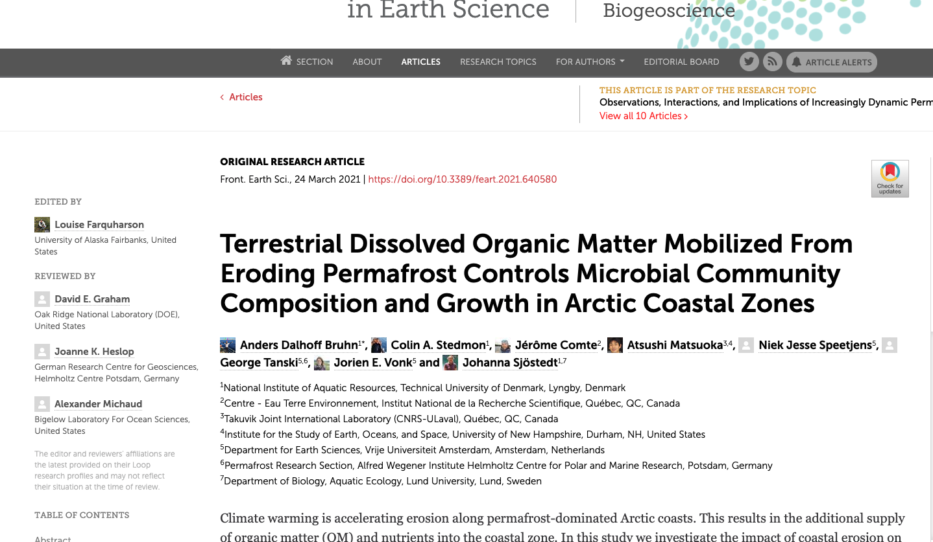
Just out….

Slide 3
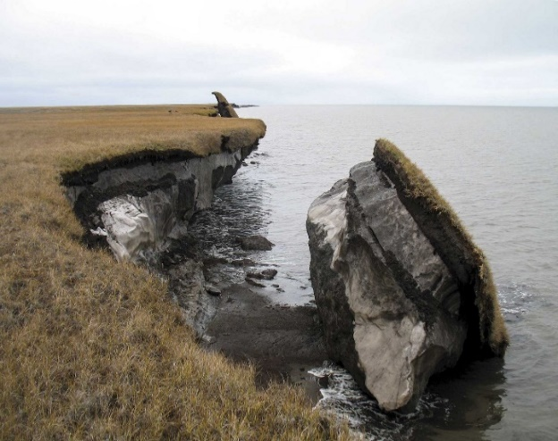
Motivation
Permafrost soils along the Arctic coasts destabilize and erode directly into the Arctic coastal zone.
Dissolved organic matter (DOM) derived from permafrost soils has shown to be highly biodegradable.
However, post-glacial landscape processes potentially lead to different DOM quality between glacial deposit types.
CO₂
DOM
Food web
Exported DOM
https://frontierscientists.com/2014/04/ground-changing-underfoot-thermokarsts/
Notes:
As climate change leads to warming and loss of ice, permafrost soils along the Arctic coasts destabilize and erode directly into the Arctic coastal zone.
When the eroded permafrost soil is dissolved into the coastal water, part of the organic matter will be released as dissolved organic matter (referred to as DOM for the rest of the presentation).
For DOM derived from permafrost, it has been previously shown that a fraction is biodegradable and readily used by microbes.
In this study we wanted to examine the fate of permafrost derived DOM in coastal waters.
Is it mineralized to CO2? Turned into bacterial biomass and potentially channelled into the foodweb? Or does it resist degradation and become exported off shore.
We were in particular interested to see if different permafrost soil types influenced the balance between these processes.

Slide 4
Experimental idea
Pump
Pump
Permafrost
DOM
Marine bacteria
Outflow
Purpose of chemostat:
To achieve steady-state.
Mimic natural conditions
Notes:
To examine this, we chose to use a chemostat approach where we could culture a bacterial community from Arctic seawater.
The benefit of this approach is that we can study the performance of a stable living community rather than a boom bust situation which is normal for bottle experiments.
The downside is that it is a much more elaborate experiment to perform.
The chemostat setup basically consists of three compartments.
Medium, in this case permafrost DOM dissolved in artificial seawater.
Culture, in this case marine bacteria, sampled from coastal waters.
Outflow, which contains the culture and media that is flushed from the system.
Peristaltic pumps provides a stable dilution rate of the culture with the soil medium.
The purpose of the chemostat is to achieve steady-state condition, with a stable bacterial community supported by the media.
It allows us to easily see how they modify DOM and mimics natural conditions where there is a constant supply from eroding permafrost soils.

Slide 5
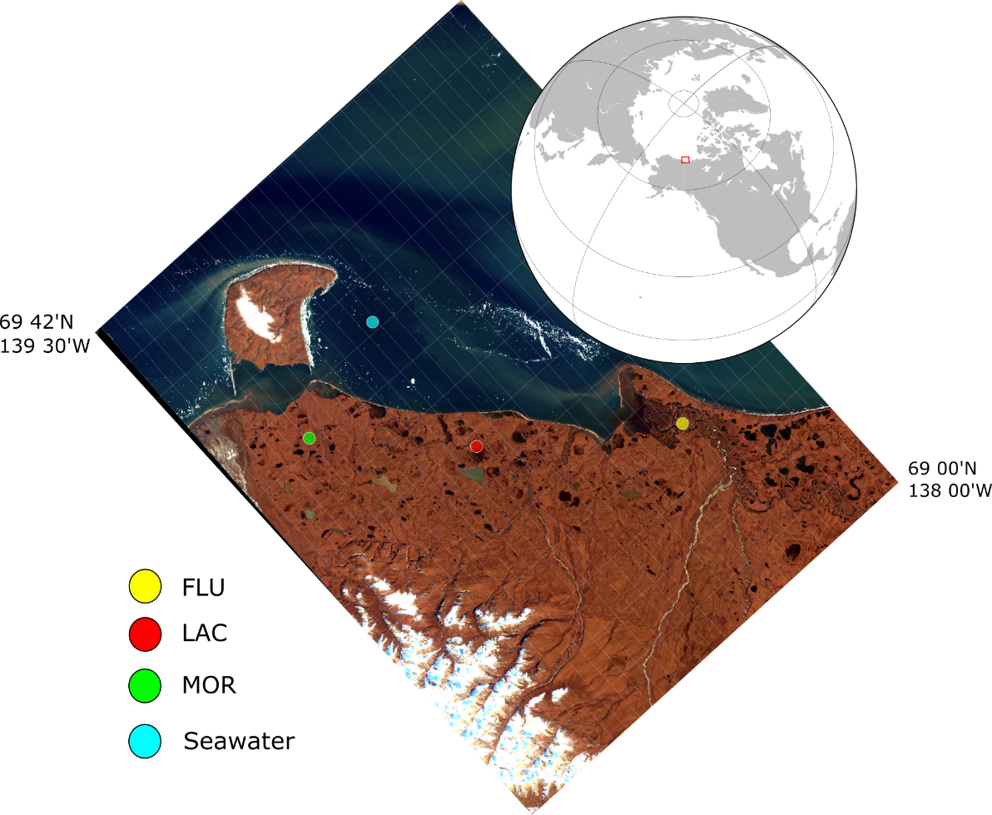
Sampling area
Fluvial/deltaic (FLU, river deposits)
Lacustrine (LAC, lake deposits)
Moraine (MOR, drained deposits)
Soil cores were taken from active and permfrost layer.
Water sample for cultivation of marine bacterial community.
Boosted with the later produced soil media (next slide)
Notes:
We sampled the permafrost soils in the Yukon Coastal Plains in Northern Canada, where coastal erosion is occurring at a high level (should I find value??).
The three different types, fluvial, Lacustrine and moraine, differ from their post-glacial genesis and OC storage.
Soil cores were taken from both the active and the frozen permafrost layer.
To cultivate marine bacterial communities, we sampled water in the Herschel Basin.
Before the experiment, the indigenous marine bacteria were “boosted” with soil medium to prepare them for the chemostat experiment.
EXTRA KNOWLEDGE:
Fluvial:
Poorly-drained floodplains
Fine-grained sediments
Lacustrine:
Sediments accumulated with lake formation
Fine-grained composition with peat layers present
Moraine:
Ice-rich and surfaces usually well drained
Finer sediments washed away by melt water

Slide 6
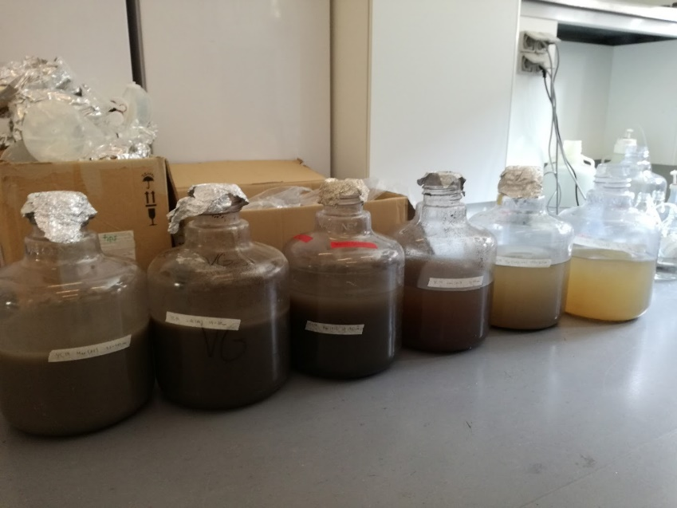
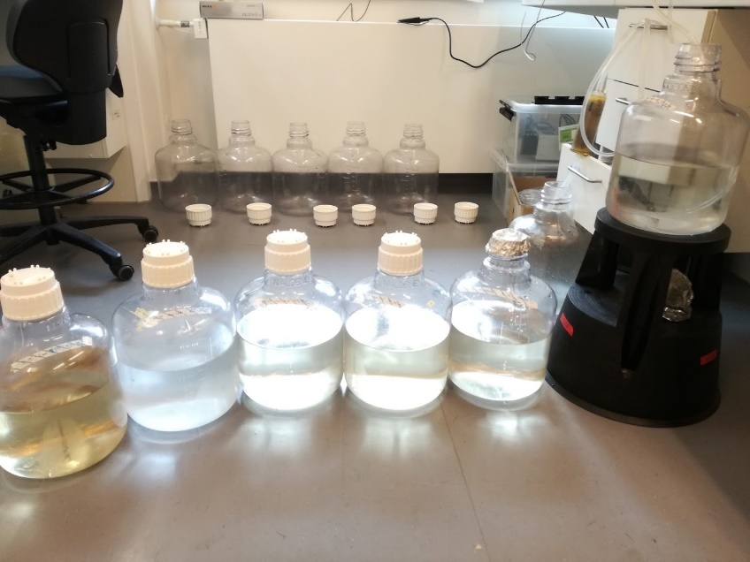
Preparation of soil media
Soil cores were dissolved in artificial seawater and filtered.
Before filtration
After filtration
The layers were then mixed and autoclaved twice. Later on used as media in the chemostat setup.
Notes:
Soil cores were dissolved in artificial seawater.
After mixing overnight, we filtered the samples.
We then mixed the active and permafrost layer.
Filtration and autoclaving was performed twice to ensure sterile media.

Slide 7
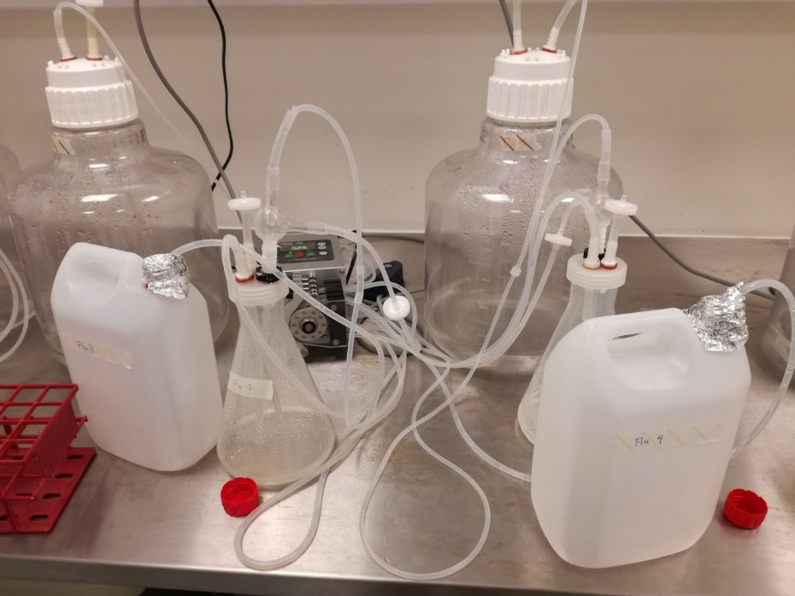
Actual chemostat setup
Experimental setup:
14 days running
4 replicates per deposit type
Room temperature in the dark.
Culture dilution of 1 per day
Notes:
This photo shows the actual chemostat setup that we had.
So we ran the experiment for 14 days.
For each soil type we used 4 replicate chemostat setups.
The chemostat experiment was performed at room temperature in the dark.

Slide 8
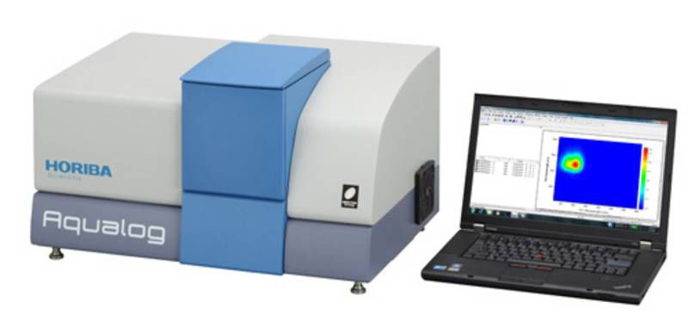
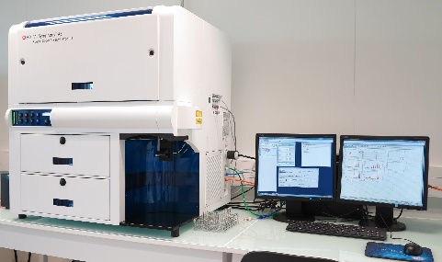
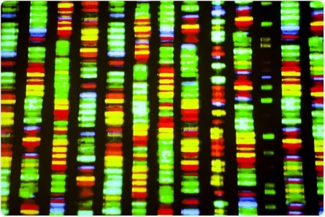
Analytical measurements
DOM quality (soil medium):
DOC
CDOM (coloured dissolved organic matter)
FDOM (fluorescent dissolved organic matter)
Carbon processing (outflow):
DOC
Bacterial abundance (flow cytometer)
BOD (Biological oxygen demand) (NB! performed separately)
Microbial community assessment (outflow):
Illumina sequencing (16S rRNA gene)
Data presentation:
From steady-state period (days 7-13).
Notes:
To investigate differences in DOM quality we measured DOC, absorbance and fluorescence on the soil media.
To study the carbon processing by the bacteria, we looked at DOC and bacterial abundance in the ouflow, together with BOD.
Finally we performed DNA sequencing, to see how the community composition was affected by the differences in DOM quality.
The data I will show you now represents the steady state period (second week of the expeirment).

Slide 9
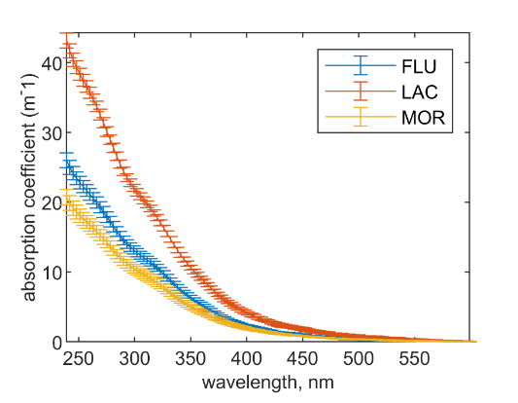
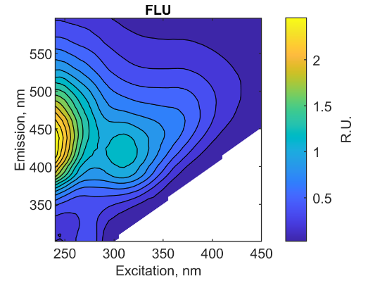
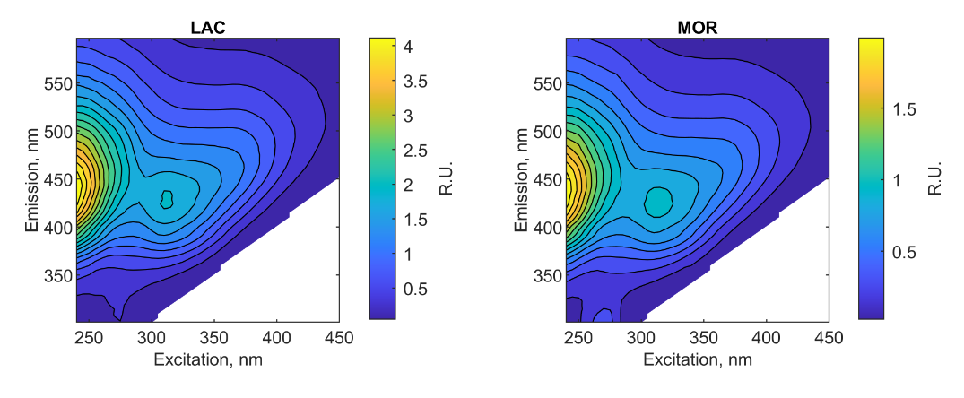
DOM composition of soil media
DOC:
FLU: 526 uM
LAC: 632 uM
MOR: 543 uM
Notes:
The soil DOM extracts differed in DOC and spectral properties.
The DOC concentations were…
Lacustrine was significantly higher than moraine and fluvial, which did not really differ in concentrations.
The optical measurements (absorption and fluorescence) also revealed that there were subtle differences in DOM character and concentrations.
The highest absorption and fluorescence was in the lacustrine samples, which showed to be the most humic-like of three soil types.
Moraine on the other hand, had the lowest values of absorption and fluorescence.
Fluvial DOM, compared to lacustrine, showed a greater proportion of UVA fluorescence (amino-acid like) relative to the visible wavelength fluorescence (humic-like) .
EXTRA:
The slope ratio is an proxy for average molecular weight and origin of DOM.
The slope ratio is calculated as (275–295 nm)/(350–400 nm).
SUVA value, which is the UV254 absorbance over the DOC concentration.

Slide 10
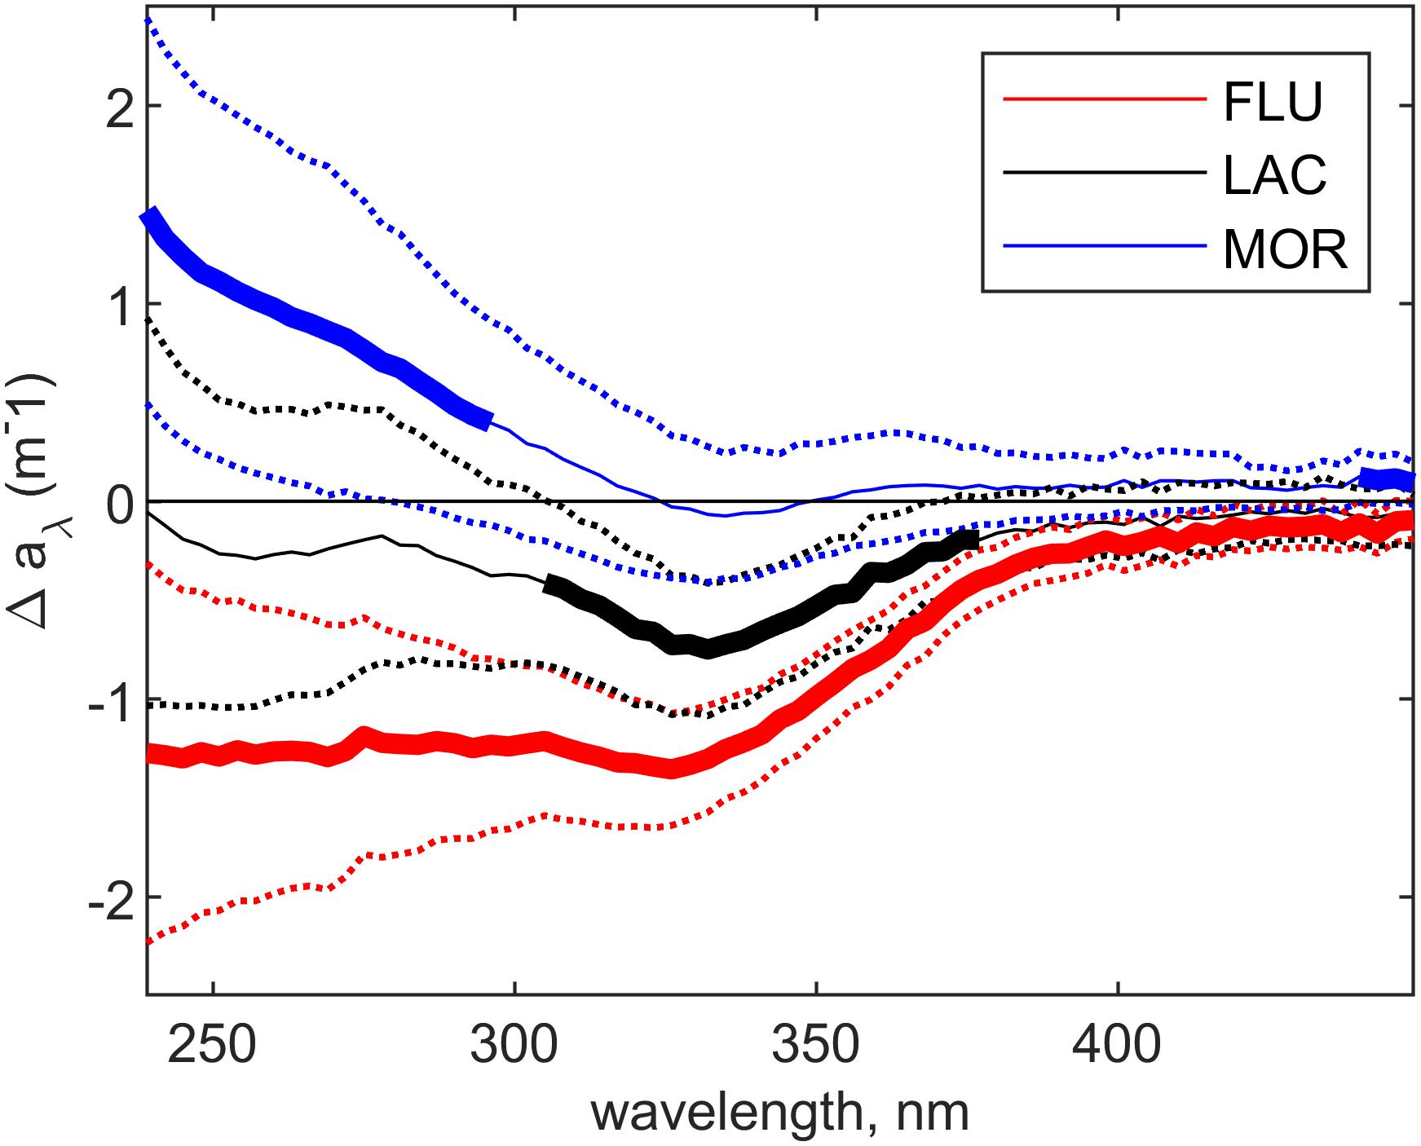
Effects of DOM degradation on absorption
Notes:
Here the change in the absorption properties, as an affect of microbial interaction of the DOM, are shown.
The bold lines indicate where significant changes were identified, between the soil medium and the culture outflow.
Similar results were also found for the fluorescence properties.
The result show that the coloured DOM was significantly removed in the fluvial treatment, only slightly in the lacuerstrine and actual produced in case of the moraine DOM (in the deep UV).

Slide 11
Carbon processing
Glacial deposit type | Respiration (µM O₂ d⁻¹) | Bacterial carbon production (µM C d⁻¹) | DOC uptake (µM C d⁻¹) | BGE (%)
FLU | 90 (± 12) | 16 (± 13) | 132 (± 50) | 13 (± 12)
LAC | 57 (± 20) | 48 (± 37) | 160 (± 46) | 28 (± 20)
MOR | 111 (± 17) | 105 (± 58) | 158 (± 48) | 66 (± 42)
Moraine DOM had the highest bacterial growth efficiency (BGE) (%).
Fluvial DOM has the lowest BGE, where most of the carbon processed went to respiration.
NB! Most of the DOC was actually not taken up by the microbial communities in any of the soil treatments and will eventually be exported to the ocean.
Notes:
To look at carbon processing we calcualted
-respiration (from short term BOD incubations),
-bacterial prodcuction and
-DOC uptake,.
From these values we then calculated the bacterial growth efficiency, which says how high percentage of DOC consumed, that is incorporated into biomass.
The BGE value was found to be highest for MOR and as high as 66%.
LAC and FLU had much lower BGE values.
So, DOM from MOR was therefore found to be much more labile with more of carbon incoporated into bacterial biomass.
FLU showed the lowest BGE value, where most of the carbon processed actual went to respiration.
Note here, that compared to the start DOC values, that we saw two slides ago, most of the DOC released from coastal erosion was not taken up by the microbes and will therefore probably be exported off-shore.

Slide 12
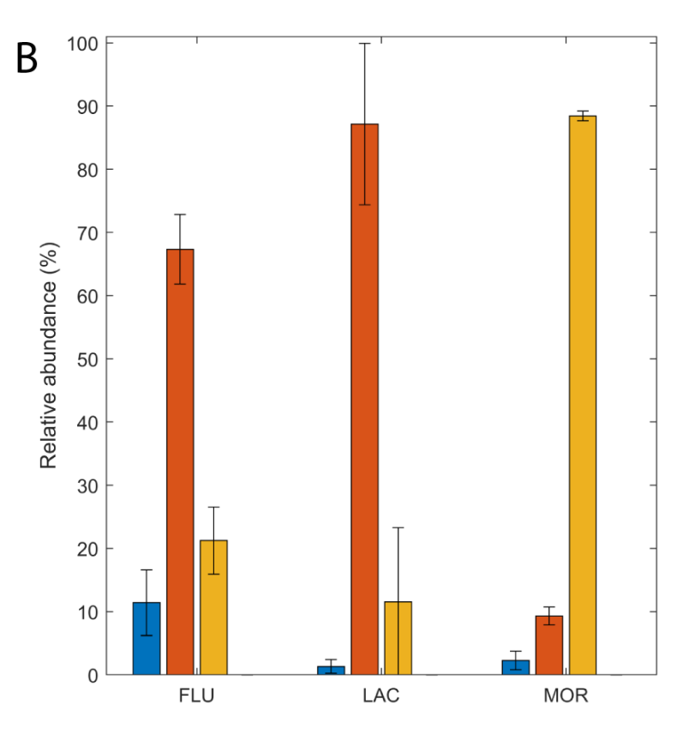
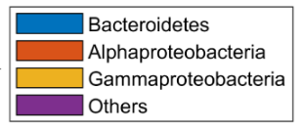
Effect of DOM quality on microbial community composition
Notes:
Finally, we also followed the establishment of the microbial community in each of the chemostat cultures.
This NMDS plots indicate how similar the community composition in each of the treatments were, based on relative abundances obtained from the DNA sequencing.
A point on the graph to the left, essential represent a community of one replicate in the steady state period.
If the points are closer together the community in the samples are more similar (less dissimilar).
From the plot we can conclude two things,
First, we see that the communities established differ between the soil types.
Secondly the cluster of points also show similarity of communities between replictae chemostats within each soil type. With other words, good reproducebility.
On the right you can see how the relative bacterial community compositon, on class level, during steady state differed between the soil types. The moraine treatment were dominated by Gammaproteobacteria, while lacuestrine dominaetd by Alphapoteobacteria and fluvial DOM with a larger contribution from all three groups.
EXTRA:
NMDS:
Non-metric multidimensional scaling
NMDS ordination randomly places your data in 2D space, but then iteratively improves their ordinational distancing (spacing) to more closely represent their distance in the dissimilarity index. The axis are essentially arbitrary, but display your data in a way which best represents their dissimilarity. Points on the graph that are closer together are more similar (less dissimilar).
Normalized data (relative abundances) of ASVs obtained from sequencing of the 16S rRNA gene.
Vector length and direction reflects strength and direction of correlation
between the DOM characteristics and community composition.
The BCC in the LAC culture was positively correlated to peak A and peak C but also to peak M and SUVA254.
The BCC in the FLU culture was positively correlated to peak B and negatively correlated to DOC concentration and Sr.
BCC in the MOR culture was not positively correlated to any of the included DOM characteristics but negatively correlated to peak T.
Relative abundances:
Alphaproteobacteria:
Rhodobacterales was the dominant order within Alphaproteobacteria within all glacial deposit types and contributed to between 79 and 98% of the
Alphaproteobacterial reads.
Other orders contributing to at least 1% of the reads in at least one of the glacial deposit types wereSphingomonadales, Caulobacterales and Rhizobiales
Gammeproteobacteria:
Within Gammaproteobacteria, Oceanospirillales was the dominant order in the cultures from all glacial deposit types and contributed to between 79 and 99% of the Gammaproteobacterial reads.
In the FLU and LAC cultures the abundance of Nitrosococcales was 14% and 13% of the reads, respectively.
Other orders with an abundance above 1% in at least one of the glacial deposit types were Alteromonadales and Cellvibrionales.
Based on the top 10 ASVs there was a significant
higher abundance of ASVs belonging to the genus Sulfitobacter in
the FLU cultures compared to both the LAC and MOR cultures
(Supplementary Tables 2, 3). In the LAC culture several of
the ASVs with significantly higher abundance compared to the
FLU and MOR cultures belonged to the genus Pacificibacter and
Polaribacter (Supplementary Tables 3, 4). Whereas in the MOR
culture several of the ASVs belonged to the genus Amphritea and
Marinomonas (Supplementary Tables 2, 4).

Slide 13
Conclusions
DOM released from permafrost soils only slightly differs in character based on the optical characteristics
Moraine soils supported highest bacterial growth and resulted in a net production of coloured DOM.
  Likely an indication of presence of labile (colourless) DOM converted to coloured DOM by the culture.
Lacustrine and fluvial soil DOM less bioavailable and bacterial growth is supported by coloured DOM.
  Possibly due to previous exposure of these soils to degradation (waterlogged in the Holocene)
Subtle differences in substrate composition are enough to lead to significant (reproducible) differences in the microbial communities that developed.
  Erosion of different soil types will alter microbial community composition and result in differing fate of soil organic C (biomass vs CO2 vs offshore export)
Notes:
So the conclusion from the study is therefore, that DOM released from permafrost soils only slightly differs in character based on the absorbance and fluorescence.
DOM from moraine soil supported the highest bacterial growth with a net production of coloured DOM.
The high lability of this DOM could be an indication of colourless DOM, converted into coloured DOM by the microbial community.
Both lacustrine and fluvial DOM seemed to be less bioavaible, probably because bacterial growth was supported by coloured DOM.
Colourless labile DOM in these soil types could have been exposed to degradation during the Holocene, where they were waterlogged.
This devolpment of three distinct microbial communities showed that subtle difference in DOM composition can lead to significant changes – so substrate driven.
Finally, we found out that coastal erosion of different permafrost soil types will lead to differ processing of the carbon.

Slide 14
Thank your for the attention!
Please contact me on:
adbj@aqua.dtu.dk
Notes:
Thank you for the attention.
If you have any questions later on, do not hestitate to contact me on this email.
Also, dont forget to go and check out the paper. You will be able to find more details on the microbial devolopments.

