Slide 1

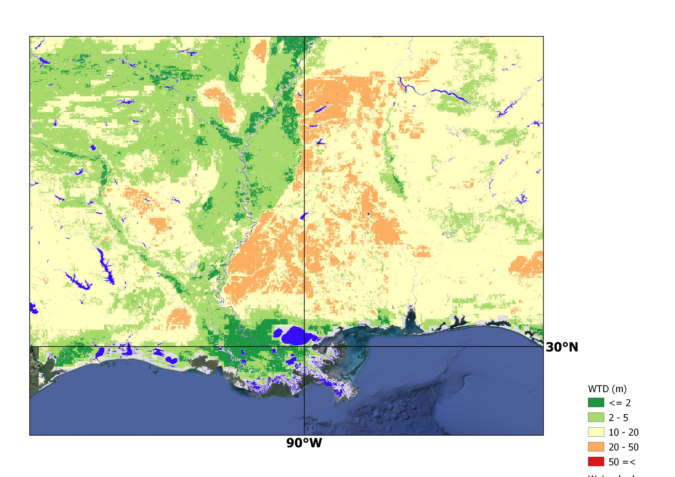
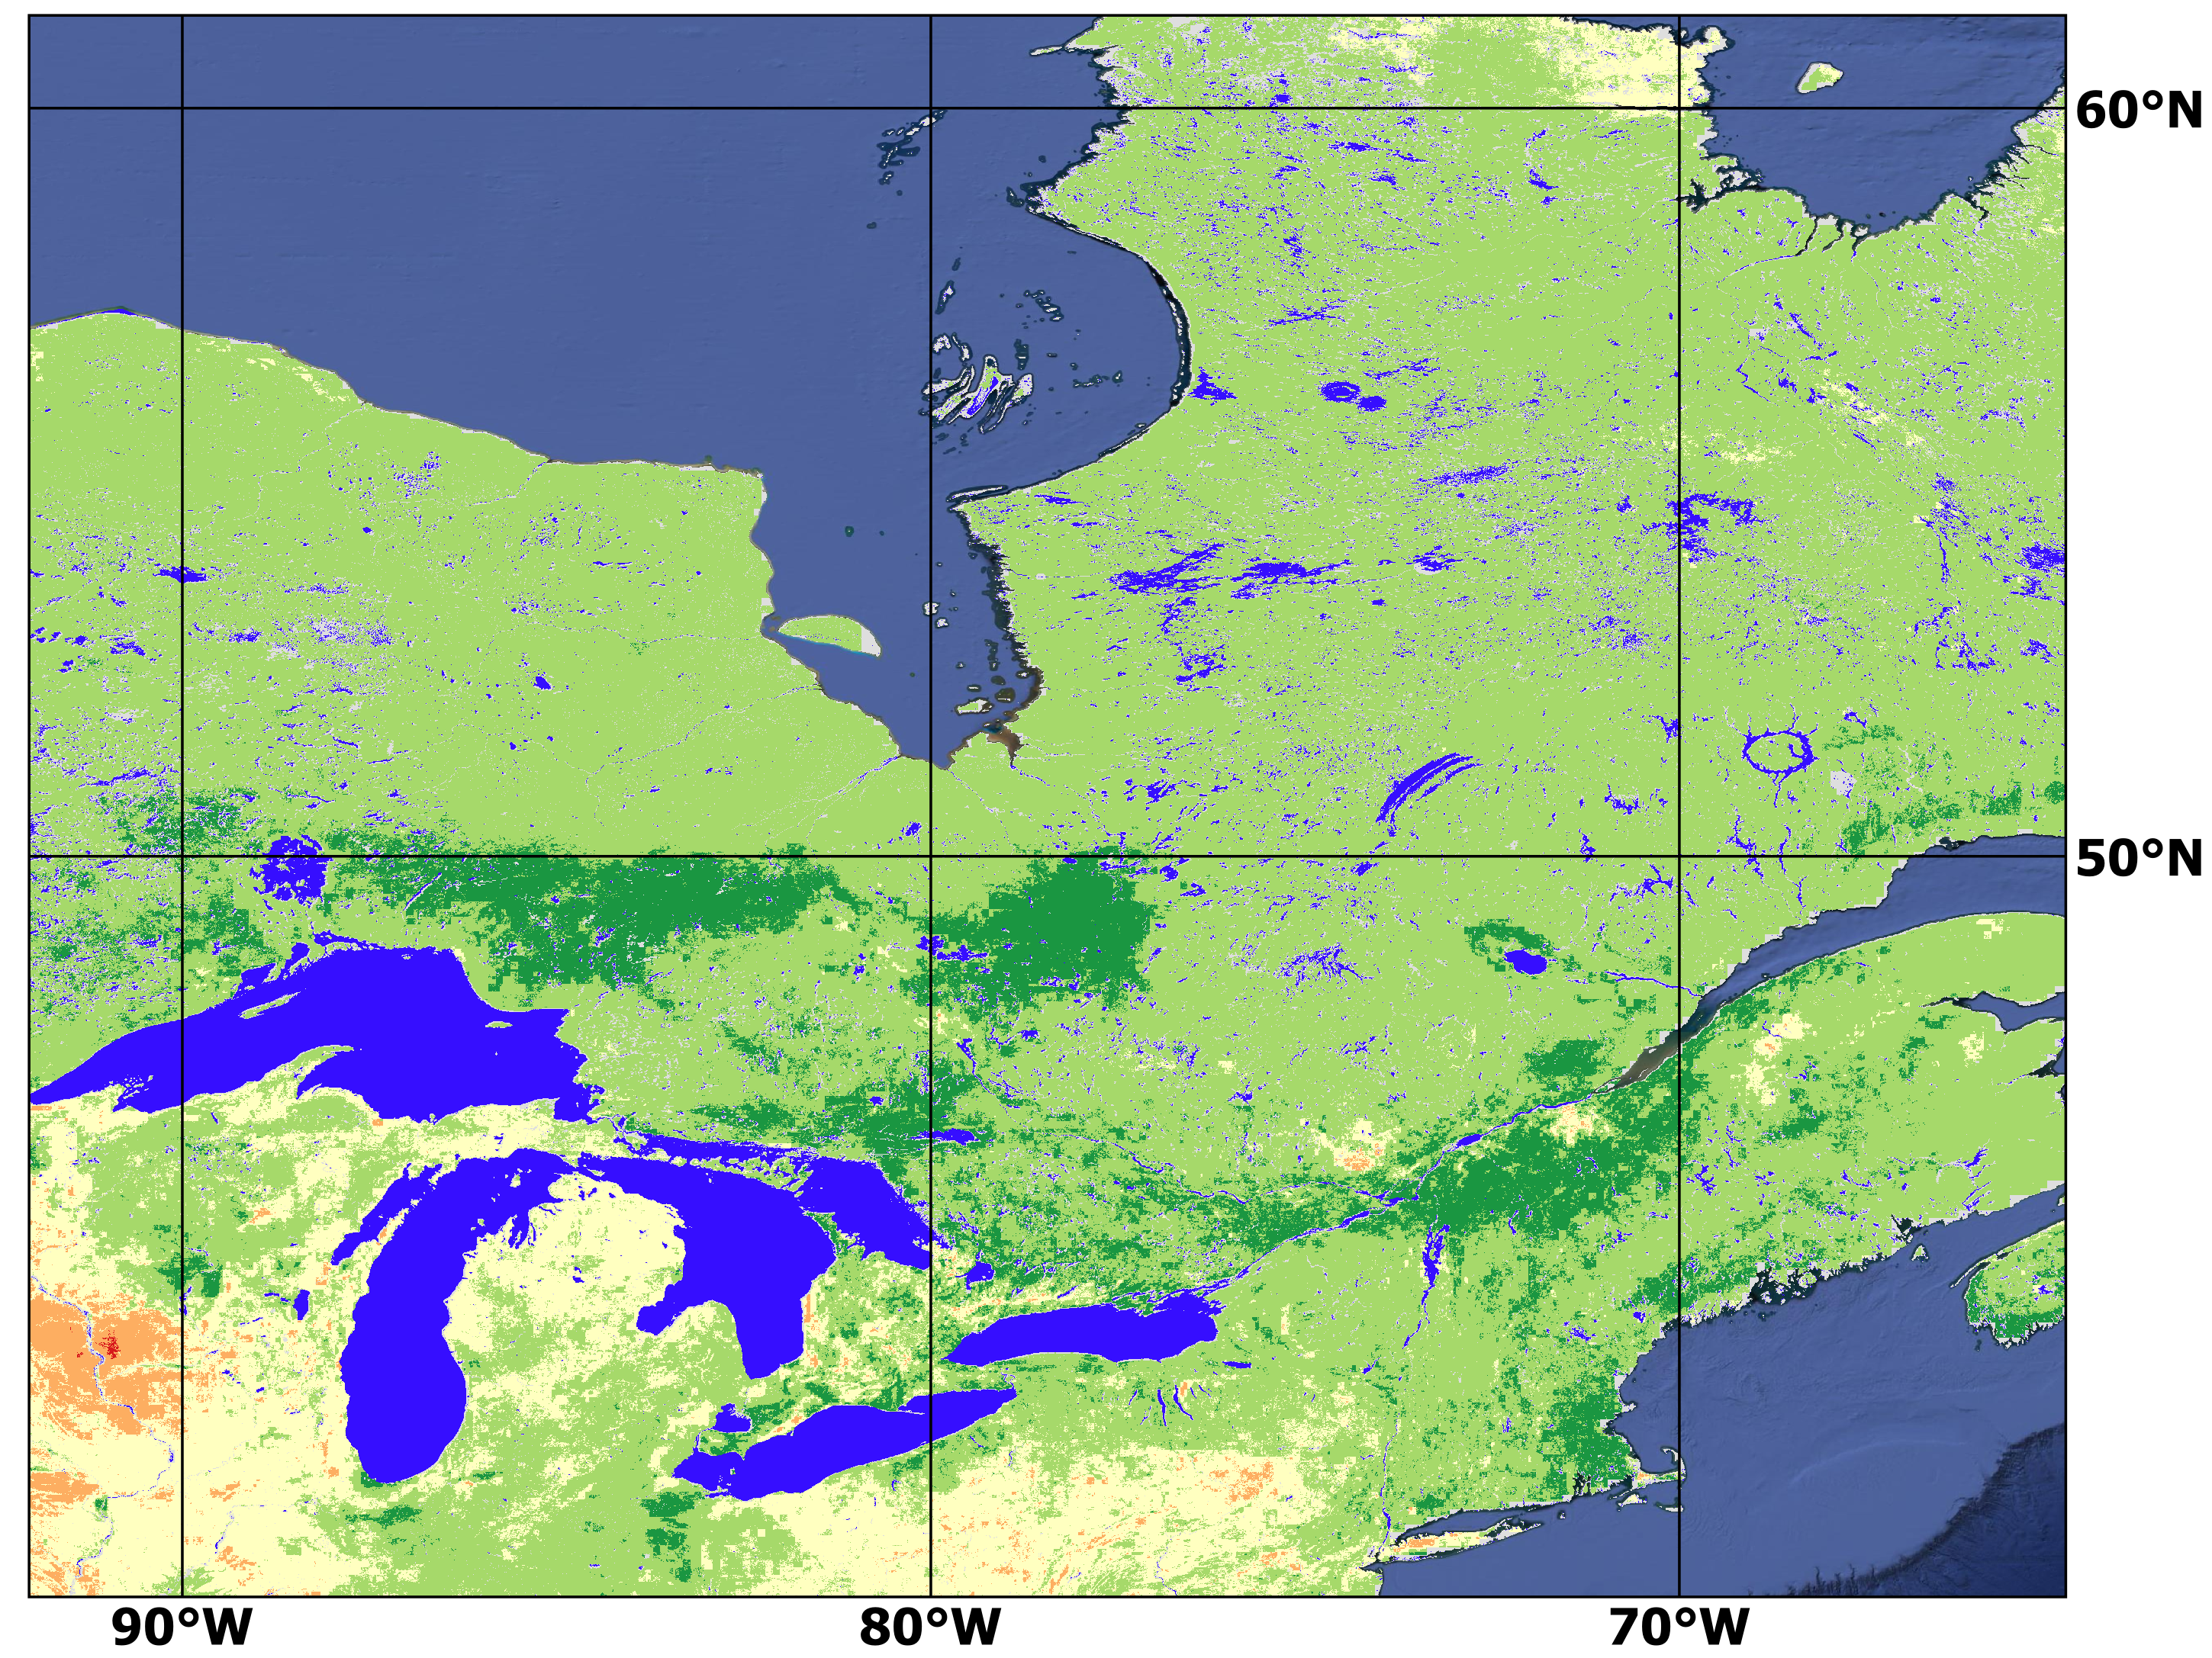
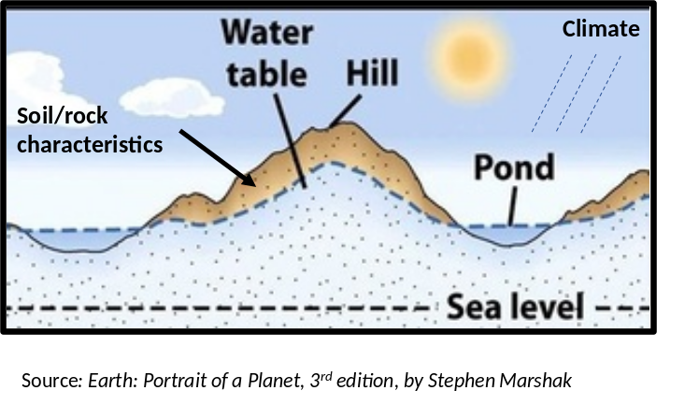



Functional Topographic, Lithology, and Climatic Indices to Define Shallow Groundwater Systems in (Un)Gauged Basin
Ardalan Tootchi; Joseph Janssen; Ali Ameli EGU Meeting April 2021
Why map groundwater?
Method:
Regional to local management:
Locating flood prone zones
Freshwater sources in arid areas
Forestry and natural resource management
Large-scale modelling:
Explicitly integrate groundwater to Land Surface Models
Interaction between climate and GW
Carbon absorption/emission
Goal: Predict WTD and estimate its uncertainty across North America using the indicators of:
Climate (e.g. Rain, Snow, Temp)
Topography
Land Cover
Subsurface properties
Model: Bias Corrected Random Forests
Train/Validate: Against 1.3 million WTD observations across the USA & Canada
Mississippi Floodplain
Results:
Performance in the validation phase:
OOB R²=0.54
MPCV R²=0.47 (Training with 20% data only)
Prediction uncertainty:
Relatively higher over arid zones such as the North American Deserts
Hudson Bay Lowlands
With Financial Support From:
Great Lakes

