Slide 1



Multi-hazard interactions to inform disaster risk reduction in Istanbul
EGU General Assembly 2021
Ekbal Hussain^{1*}, Eser Cakti², Bruce Malamud³, Aslihan Yolcu², Joel Gill¹, Robert Trogrlic³
1. British Geological Survey, UK
2. Kandilli Observatory, Turkey
3. Kings College London, UK
* ekhuss@bgs.ac.uk

Slide 2
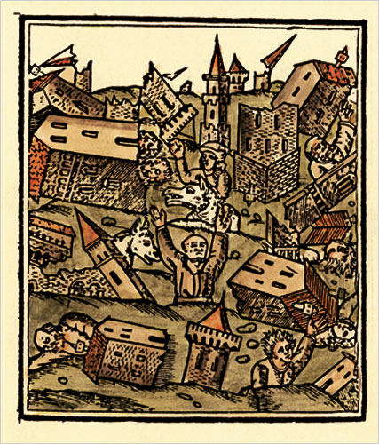
Overview
Aims and Objectives
Data Sources
Overview of single natural hazards in Istanbul
Hazard interrelationships in Istanbul
Multi-hazard scenarios
Summary
Appendix. Hazard Definitions
The Lesser Judgment Day
Ambraseys and Finkel. 'The Marmara Sea Earthquake of 1509’
Click on boxes below to navigate to a specific section of this presentation
Aims
Data Sources
Single Hazards
Interrelations
Scenarios
Summary
Definitions

Slide 3
Aims and Objectives
Main aim: To better understand the natural hazard landscape of Istanbul and the interrelationships between these hazards.
  Objective 1. To produce a coarse overview of the natural hazards that have occurred or have the potential to occur in or near Istanbul. Collecting evidence from peer reviewed and grey literature as well as social media.
  Objective 2. To collect evidence of hazard interrelationships and build a hazard interaction matrix.
  Objective 3. Develop multi-hazard scenarios to explore dynamic risk.
Click on boxes below to navigate to a specific section of this presentation
Aims
Data Sources
Single Hazards
Interrelations
Scenarios
Summary
Definitions

Slide 4
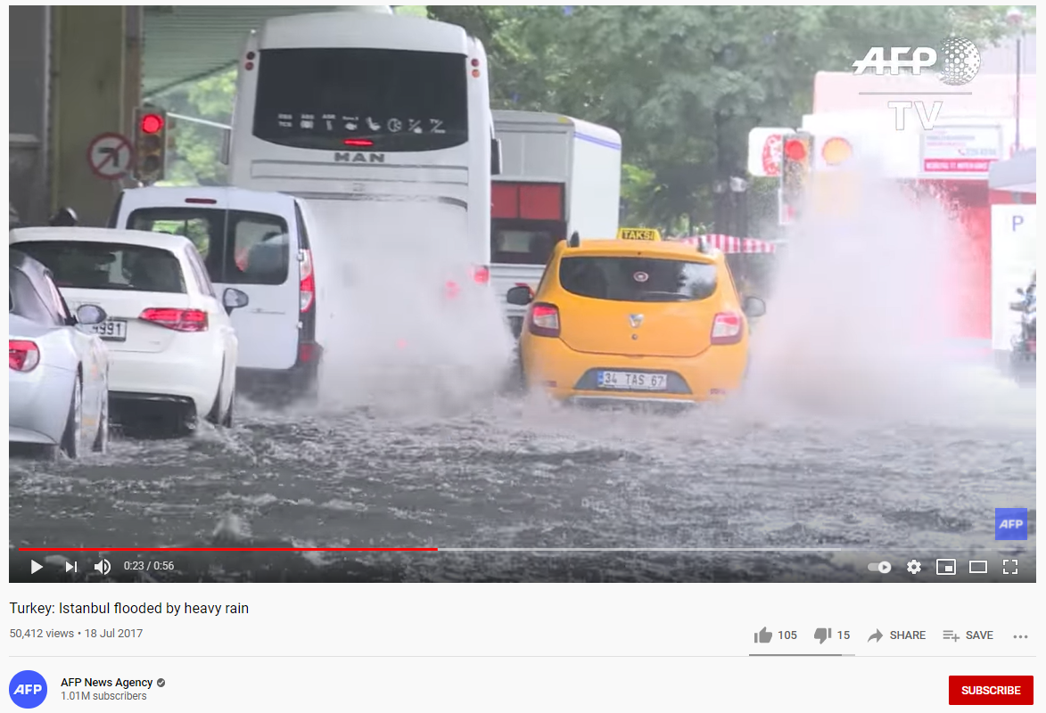

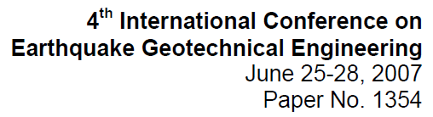



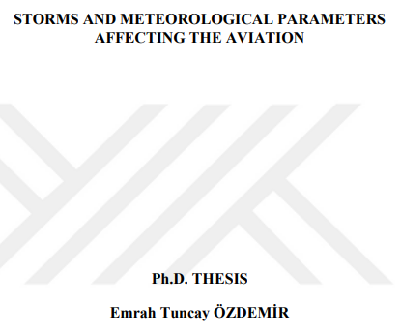

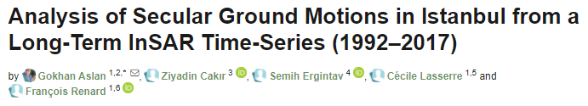
B. Data Sources
The overview of single natural hazards and hazard interactions are based on evidence collected from:
Peer-reviewed literature (where possible we used review papers)
Grey literature (Government/NGO reports, research grant reports)
National/International hazard databases (AFAD, EM-DAT)
Media/news reports
Social media (YouTube)
Examples of data sources used to collect evidence for
natural hazard occurrence and their interactions
Click on boxes below to navigate to a specific section of this presentation
Aims
Data Sources
Single Hazards
Interrelations
Scenarios
Summary
Definitions

Slide 5
HAZARD GROUP | HAZARD | COMPONENT HAZARDS
GEOPHYSICAL | Earthquake | Ground Shaking and Rupture; Liquefaction; Co-Seismic Subsidence; Co-Seismic Uplift
 | Tsunami | Marine Tsunami; Freshwater Tsunami
 | Volcanic Activity or Eruption | Volcanic Explosions; Volcanic Ash or Tephra Ejection; Volcanic Gas or Aerosol Emission; Pyroclastic Density Current; Lava flow; (for Lahar - see Landslide)
 | Landslide | Submarine Landslide; Subaerial Rockfall; Subaerial Rotational/Translational Landslide; Subaerial Debris Flow; Lahar
 | Snow Avalanche
HYDROLOGICAL | Flood | Pluvial Flood (incl. flash floods, urban ponding); Fluvial Flood; Groundwater Flood; Coastal Flood (incl. storm surge)
 | Seiche
 | Drought | Meteorological Drought; Agricultural Drought; Hydrological Drought
SHALLOW EARTH PROCESSES | Regional Subsidence | Tectonic Subsidence
 | Ground Collapse | Karst/Evaporite Collapse (sinkhole); Piping Collapse; Metastable Soils
 | Soil (Local) Subsidence | Soil Shrinkage; Consolidation or Settlement
 | Ground Heave | Tectonic Uplift; Soil Expansion (Swelling)
ATMOSPHERIC | Storm | Heavy rain; strong winds; Tropical Cyclone, Hurricane; Typhoon; Mid-Latitude Storm; Windstorms; Dust storms
 | Fog
 | Tornado
 | Hail
 | Snow | Snowstorm; Blizzard
 | Lightning
 | Extreme Temperature (Hot) | Heat Wave; Climatic Change
 | Extreme Temperature (Cold) | Cold Wave; Frost; Climatic Change
BIOPHYSICAL | Wildfire
SPACE | Space Weather | Geomagnetic Storm
 | Impact Event | Asteroid; Meteorite
C. Coarse overview of single natural hazards in Istanbul
Natural hazard classification:
5 main hazard groups
23 natural hazards
Some natural hazards consist of numerous component hazards
For example: Earthquake includes Ground shaking and Liquefaction
(Click on each Hazard Group to see the definition of the Hazards)
Adapted from Gill and Malamud (2014) Rev. of Geophys.
Click on boxes below to navigate to a specific section of this presentation
Aims
Data Sources
Single Hazards
Interrelations
Scenarios
Summary
Definitions

Slide 6

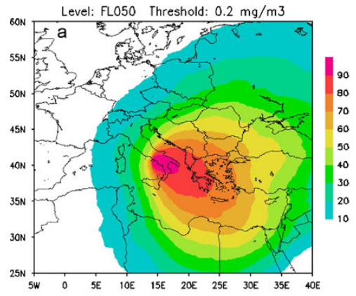
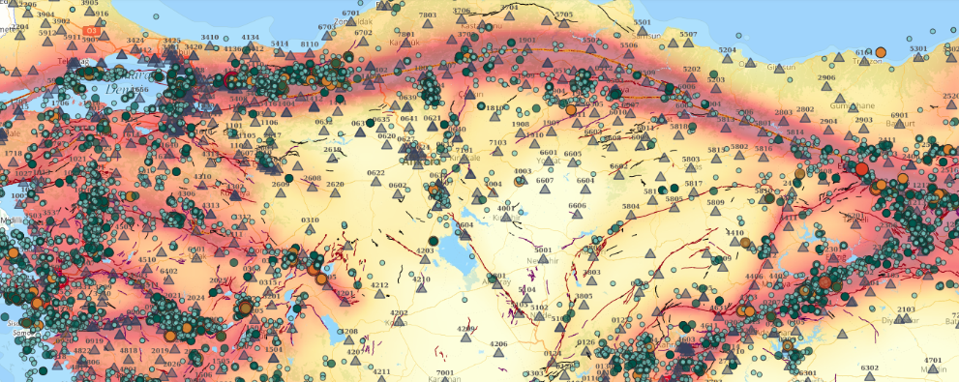
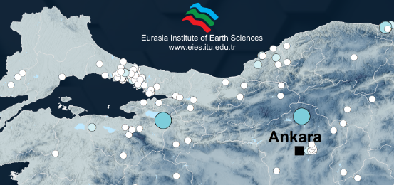
HAZARD GROUP | HAZARD | CODE | ISTANBUL?
GEOPHYSICAL | Earthquake | EQ | Y
 | Tsunami | TS | Y
 | Volcanic Activity or Eruption | VO | Y
 | Landslide | LA | Y
 | Snow Avalanche | AV | N
HYDROLOGICAL | Flood | FL | Y
 | Seiche | SE | Y
 | Drought | DR | Y
SHALLOW EARTH PROCESSES | Regional Subsidence | RS | Y
 | Ground Collapse | GC | Y
 | Soil (Local) Subsidence | SS | Y
 | Ground Heave | GH | Y
ATMOSPHERIC | Storm | ST | Y
 | Fog | FO | Y
 | Tornado | TO | Y
 | Hail | HA | Y
 | Snow | SN | Y
 | Lightning | LN | Y
 | Extreme Temperature (Hot) | ET (H) | Y
 | Extreme Temperature (Cold) | ET (C) | Y
BIOPHYSICAL | Wildfire | WF | Y
SPACE | Space Weather | SW | Y
 | Impact Event | IM | Y
C. Overview of single natural hazards in Istanbul
Of the 23 natural hazards in our hazard classification, we found evidence for 22 of these to have the potential to occur in Istanbul.
Examples of evidence:
Large volcanic eruptions in the Mediterranean (e.g. Vesuvius) can result in ash dispersal as far as Istanbul.
Geophysical Hazards
Sulpizio et al. (2012)
AFAD
Seismic hazard map of Turkey showing
high hazard near Istanbul.
Database of fatal landslides in Turkey
Shows a cluster of fatalities in Istanbul.
Y | Potential for hazard to occur in Istanbul
N | No evidence for hazard occurrence in Istanbul
FatalDot
Görüm and Fidan (2021)
Click on boxes below to navigate to a specific section of this presentation
Aims
Data Sources
Single Hazards
Interrelations
Scenarios
Summary
Definitions

Slide 7

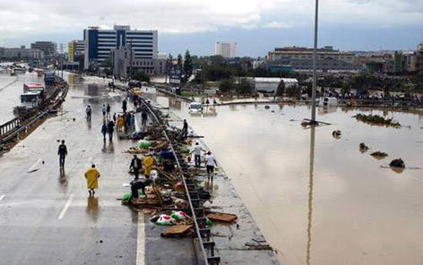
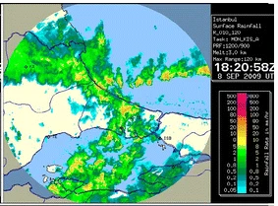
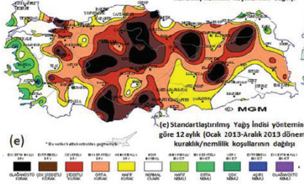
HAZARD GROUP | HAZARD | CODE | ISTANBUL?
GEOPHYSICAL | Earthquake | EQ | Y
 | Tsunami | TS | Y
 | Volcanic Activity or Eruption | VO | Y
 | Landslide | LA | Y
 | Snow Avalanche | AV | N
HYDROLOGICAL | Flood | FL | Y
 | Seiche | SE | Y
 | Drought | DR | Y
SHALLOW EARTH PROCESSES | Regional Subsidence | RS | Y
 | Ground Collapse | GC | Y
 | Soil (Local) Subsidence | SS | Y
 | Ground Heave | GH | Y
ATMOSPHERIC | Storm | ST | Y
 | Fog | FO | Y
 | Tornado | TO | Y
 | Hail | HA | Y
 | Snow | SN | Y
 | Lightning | LN | Y
 | Extreme Temperature (Hot) | ET (H) | Y
 | Extreme Temperature (Cold) | ET (C) | Y
BIOPHYSICAL | Wildfire | WF | Y
SPACE | Space Weather | SW | Y
 | Impact Event | IM | Y
C. Overview of single natural hazards in Istanbul
Examples of evidence:
Hydrological Hazards
Floods are a common hazard in Turkey. Record rainfall across the Marmara region in 2009 resulted in flash floods causing 32 deaths in Istanbul.
Kömüşacü et al. (2013)
Detailed review of droughts in Turkey and impacts on water supply to Istanbul in a policy brief by Kurnaz (2014).
“2007-2008 meteorological drought led to agricultural, hydrological, and socioeconomic droughts.”
Y | Potential for hazard to occur in Istanbul
N | No evidence for hazard occurrence in Istanbul
Click on boxes below to navigate to a specific section of this presentation
Aims
Data Sources
Single Hazards
Interrelations
Scenarios
Summary
Definitions

Slide 8
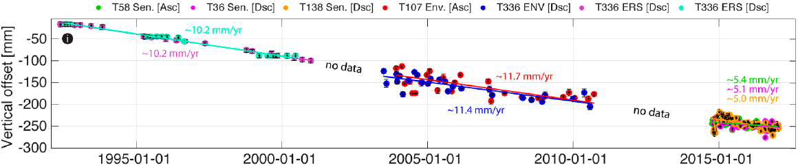
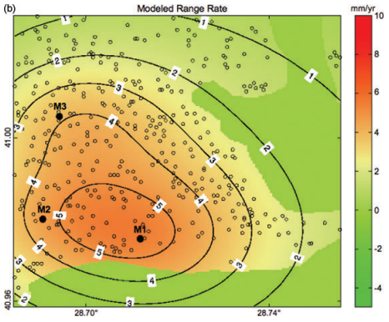
HAZARD GROUP | HAZARD | CODE | ISTANBUL?
GEOPHYSICAL | Earthquake | EQ | Y
 | Tsunami | TS | Y
 | Volcanic Activity or Eruption | VO | Y
 | Landslide | LA | Y
 | Snow Avalanche | AV | N
HYDROLOGICAL | Flood | FL | Y
 | Seiche | SE | Y
 | Drought | DR | Y
SHALLOW EARTH PROCESSES | Regional Subsidence | RS | Y
 | Ground Collapse | GC | Y
 | Soil (Local) Subsidence | SS | Y
 | Ground Heave | GH | Y
ATMOSPHERIC | Storm | ST | Y
 | Fog | FO | Y
 | Tornado | TO | Y
 | Hail | HA | Y
 | Snow | SN | Y
 | Lightning | LN | Y
 | Extreme Temperature (Hot) | ET (H) | Y
 | Extreme Temperature (Cold) | ET (C) | Y
BIOPHYSICAL | Wildfire | WF | Y
SPACE | Space Weather | SW | Y
 | Impact Event | IM | Y
C. Overview of single natural hazards in Istanbul
Examples of evidence:
Shallow Earth Processes
Reclaimed lands along the coast of Istanbul underwent subsidence of up to 8±1.3 mm/year between 1992-2017.
Aslan et al. (2018)
Maximum subsidence rate of 6 mm/year in Avcilar district measured between 1992-1999 with satellite observations. This area was damaged by the 1999 earthquake.
Y | Potential for hazard to occur in Istanbul
N | No evidence for hazard occurrence in Istanbul
Akarvardar et al. (2009)
Click on boxes below to navigate to a specific section of this presentation
Aims
Data Sources
Single Hazards
Interrelations
Scenarios
Summary
Definitions

Slide 9
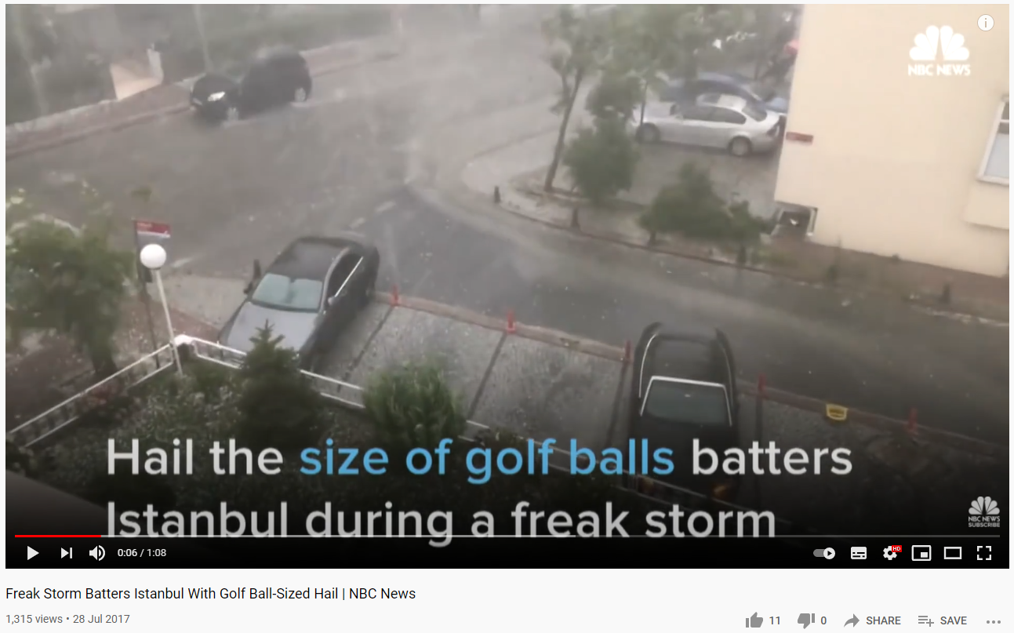
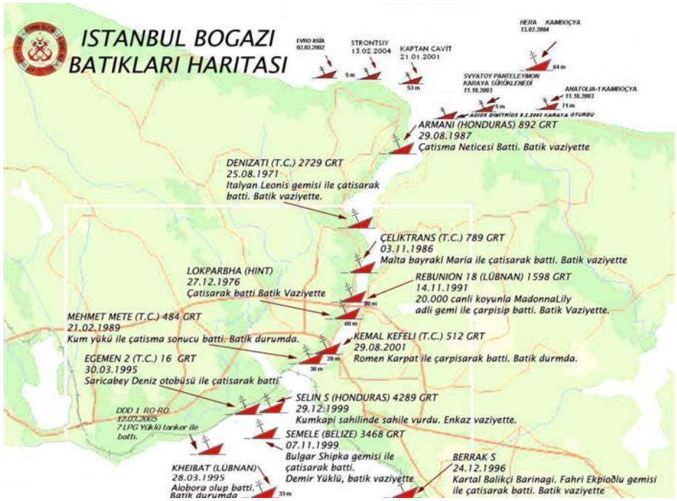
HAZARD GROUP | HAZARD | CODE | ISTANBUL?
GEOPHYSICAL | Earthquake | EQ | Y
 | Tsunami | TS | Y
 | Volcanic Activity or Eruption | VO | Y
 | Landslide | LA | Y
 | Snow Avalanche | AV | N
HYDROLOGICAL | Flood | FL | Y
 | Seiche | SE | Y
 | Drought | DR | Y
SHALLOW EARTH PROCESSES | Regional Subsidence | RS | Y
 | Ground Collapse | GC | Y
 | Soil (Local) Subsidence | SS | Y
 | Ground Heave | GH | Y
ATMOSPHERIC | Storm | ST | Y
 | Fog | FO | Y
 | Tornado | TO | Y
 | Hail | HA | Y
 | Snow | SN | Y
 | Lightning | LN | Y
 | Extreme Temperature (Hot) | ET (H) | Y
 | Extreme Temperature (Cold) | ET (C) | Y
BIOPHYSICAL | Wildfire | WF | Y
SPACE | Space Weather | SW | Y
 | Impact Event | IM | Y
C. Overview of single natural hazards in Istanbul
Examples of evidence:
A hailstorm in 2017 produced ‘golf ball’ size hail. (NBC News, YouTube)
Atmospheric Hazards
A review of shipping accidents in the Istanbul Straits between 2001-2008 found that most of the 170 recorded events occurred due to reduced visibility due to fog, snow or heavy rain.
Y | Potential for hazard to occur in Istanbul
N | No evidence for hazard occurrence in Istanbul
Bayar et al. (2017)
Click on boxes below to navigate to a specific section of this presentation
Aims
Data Sources
Single Hazards
Interrelations
Scenarios
Summary
Definitions

Slide 10
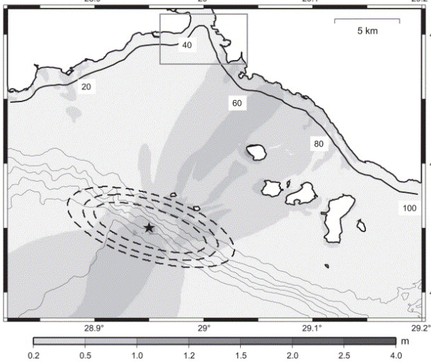
D. Hazard interrelationships in Istanbul
Hazard interrelationship: Primary hazard directly triggers or changes the probability of occurrence of a secondary hazard.
For example: An earthquake can directly trigger landslides
We also know that after a big earthquake the probability of a landslide happening in the near future increases, e.g. Marc et al., 2015.
We collected evidence of these relationships
for the hazards identified for Istanbul.
E.g. A modelling study of the tsunami hazard in Istanbul showed that landslide triggered tsunamis have the potential to cause more damage to the city than those produced by an earthquake.
Hébert et al. (2005)
Click on boxes below to navigate to a specific section of this presentation
Aims
Data Sources
Single Hazards
Interrelations
Scenarios
Summary
Definitions

Slide 11
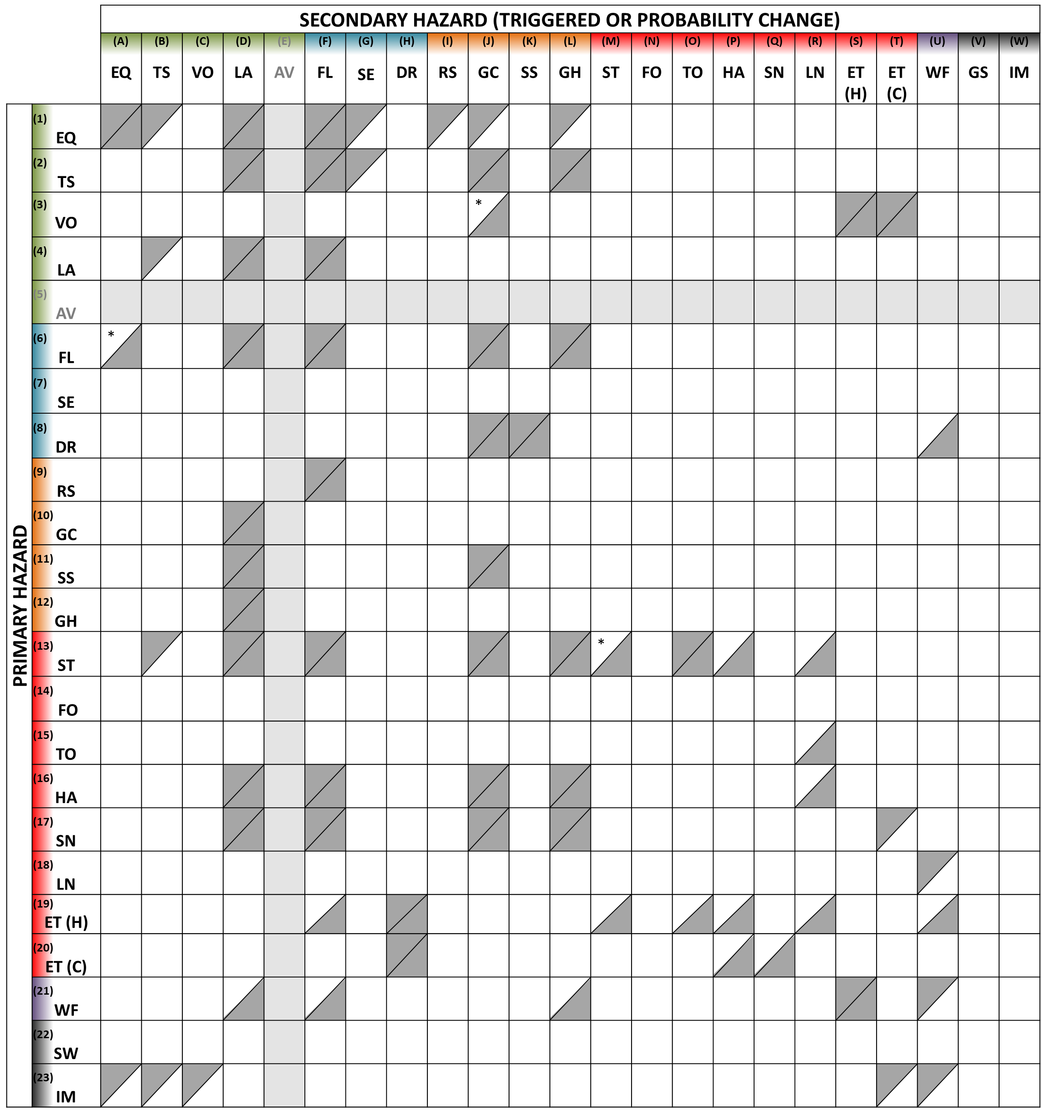
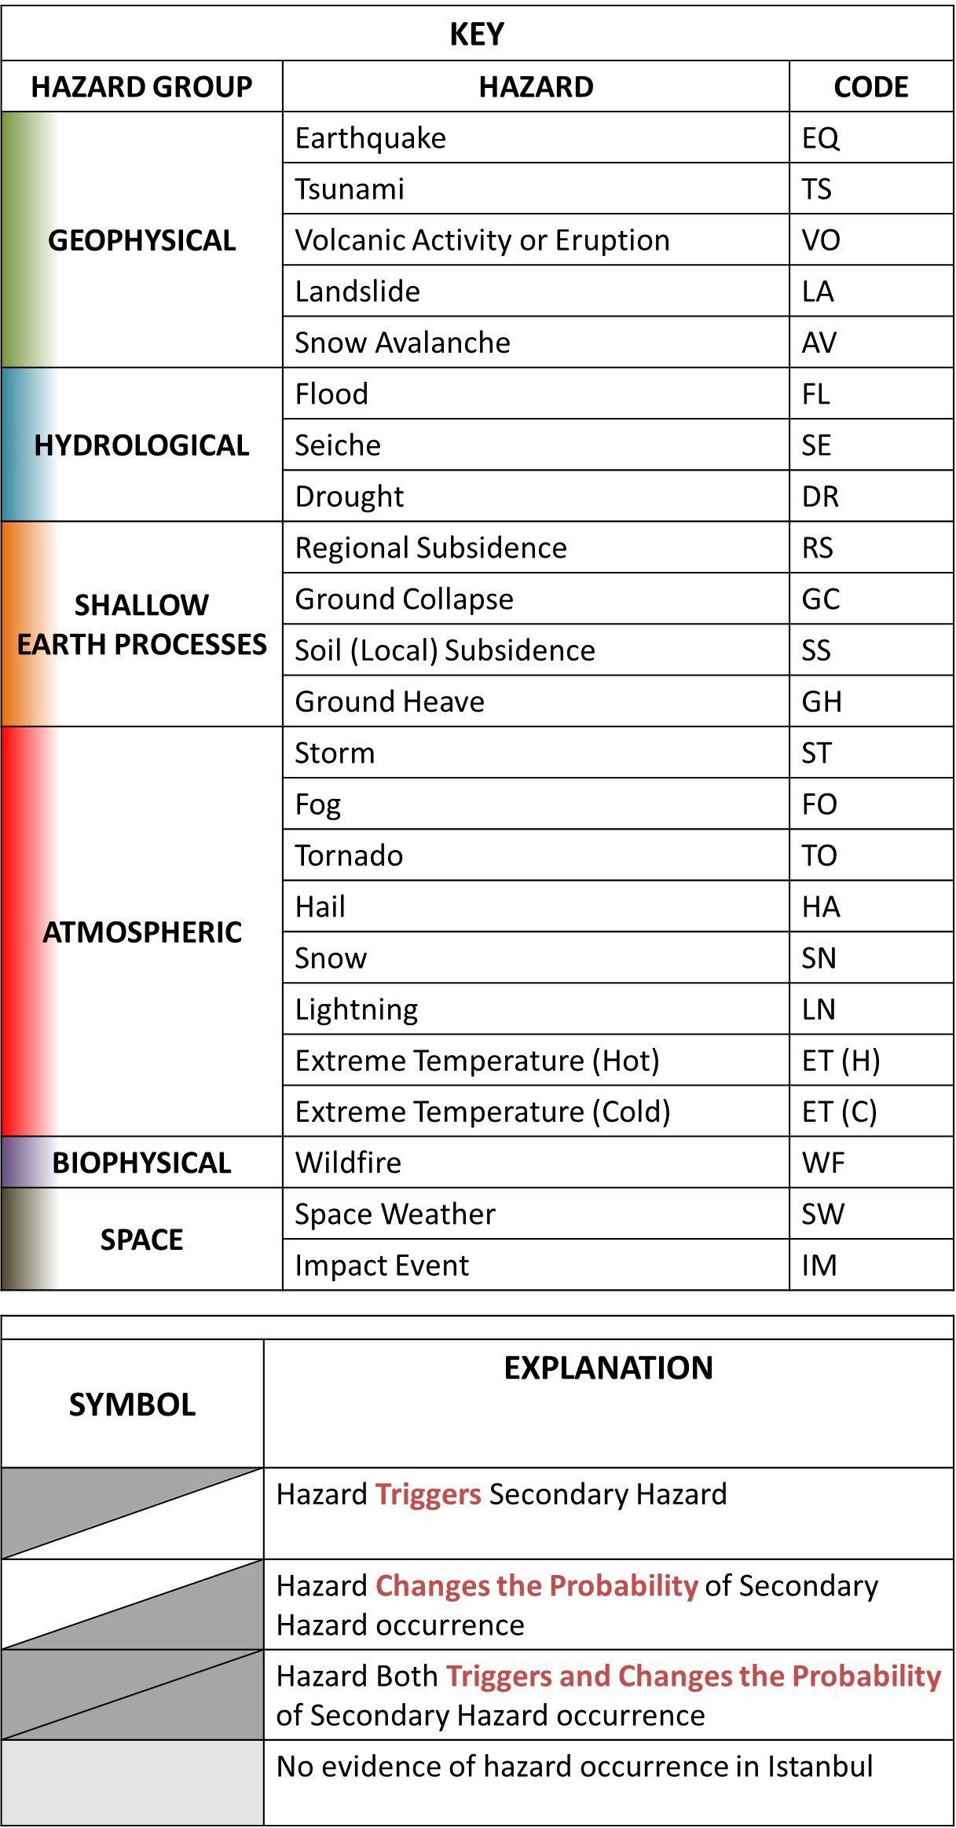
D. Hazard interrelationships
in Istanbul
25 examples of hazard interactions found in Istanbul
Supplement with the global hazard interactions of Gill and Malamud (2014)
In total 73 potential hazard interactions relevant to Istanbul
Adapted from
Gill and Malamud (2014)
Click on boxes below to navigate to a specific section of this presentation
Aims
Data Sources
Single Hazards
Interrelations
Scenarios
Summary
Definitions

Slide 12
D. Hazard interrelationships
in Istanbul
Example interactions:
Storms can trigger or change the probability of occurrence of landslides
Landslides can trigger tsunamis
Storm (ST)
Landslide (LA)
Tsunami (TS)
Adapted from
Gill and Malamud (2014)
Click on boxes below to navigate to a specific section of this presentation
Aims
Data Sources
Single Hazards
Interrelations
Scenarios
Summary
Definitions

Slide 13
E. Multi-hazard scenarios for Istanbul
Secondary Hazard
Using this hazard interaction matrix we can now develop plausible multi-hazard scenarios that could impact Istanbul.
For example:
1
2b
2a
2a
Tsunami
1
Triggers
Earthquake
Primary Hazard
2b
Increases
probability
3
3
Triggers
Landslide
Flooding
Blocked
rivers
Extract from multi-hazard matrix. Clipped for clarity
Click on boxes below to navigate to a specific section of this presentation
Aims
Data Sources
Single Hazards
Interrelations
Scenarios
Summary
Definitions

Slide 14
E. Multi-hazard scenarios for Istanbul
Using this hazard interaction matrix we can now develop plausible multi-hazard scenarios that could impact Istanbul.
For example:
3a
3a
3b
Increases
probability
Local Soil Subsidence
1
2
Triggers
Heatwave
Drought
3b
Increases
probability
Wildfire
1
2
Click on boxes below to navigate to a specific section of this presentation
Aims
Data Sources
Single Hazards
Interrelations
Scenarios
Summary
Definitions

Slide 15
E. Multi-hazard scenarios for Istanbul – Anthropogenic Processes
Multi-hazard scenarios allow us to explore how anthropogenic processes might influence hazard interactions.
For example, some anthropogenic processes that might influence landslide occurrence after an earthquake ([1] -> [2b]) are:
Deforestation
Aggressive farming practices on hillslopes
Roads undercut into hillsides
Each of these increase the chance of an
earthquake triggered landslide.
2a
Tsunami
1
Triggers
Earthquake
Increases
probability
2b
3
Triggers
Landslide
Flooding
Blocked
rivers
In this example, the development of preventative measures to reduce the susceptibility of earthquake triggered landslides also reduces the potential for flooding due to blocked rivers.
Click on boxes below to navigate to a specific section of this presentation
Aims
Data Sources
Single Hazards
Interrelations
Scenarios
Summary
Definitions

Slide 16
E. Multi-hazard scenarios for Istanbul – Exposure and Vulnerability
Additionally these scenarios allow us to explore how exposure and vulnerability might change during the scenario.
For example:
After an earthquake people relocate outside, which increases their exposure to a tsunami.
People with disabilities who are outside are also
more vulnerable to a tsunami.
People camping on hillslopes in
temporary structures (e.g. tents) are
more exposed and more vulnerable to
landslides that often occur after
earthquakes.
2a
Tsunami
1
Triggers
Earthquake
Increases
probability
2b
3
Triggers
Landslide
Flooding
Blocked
rivers
We need to ensure that disaster response strategies and planning encompass the dynamic nature of exposure and vulnerability. Response to one hazard should not increase the risk to the next.
Click on boxes below to navigate to a specific section of this presentation
Aims
Data Sources
Single Hazards
Interrelations
Scenarios
Summary
Definitions

Slide 17
F. Summary
Istanbul is exposed to 22 of the 23 major natural hazards identified in this study.
There are 73 potential hazard interactions relevant to Istanbul in terms of one natural hazard triggering another natural hazard or a hazard changing the probability of occurrence of a second hazard.
Our hazard interaction matrix enables the production of multi-hazard scenarios.
These scenarios can be used to explore how anthropogenic processes influence hazard interactions.
Multi-hazard scenarios can also be used to understand dynamic risk by exploring how exposure and vulnerability changes during a scenario.
Click on boxes below to navigate to a specific section of this presentation
Aims
Data Sources
Single Hazards
Interrelations
Scenarios
Summary
Definitions

Slide 18
Appendix. Hazard Definitions
HAZARD GROUP | HAZARD | CODE | DEFINITION
GEOPHYSICAL | Earthquake | EQ | The sudden release of stored elastic energy in the Earth’s lithosphere, caused by its abrupt movement or fracturing along zones of pre-existing geological weakness, and resulting in the generation of seismic waves [Smith and Petley, 2009].
 | Tsunami | TS | The displacement of a significant volume of water, generating a series of waves with large wavelengths and low amplitudes [Alexander, 1993]. As the waves approach shallow water, their amplitude increases through wave shoaling.
 | Volcanic Activity or Eruption | VO | The subterranean movement of magma and its eruption and ejection from volcanic systems under the influence of its confining pressure and superheated steam and gases [Alexander, 1993], together with associated tephra, ash and gas.
 | Landslide | LA | The down-slope displacement of surface materials (predominantly rock and soil) under gravitational forces [Smith and Petley, 2009].
 | Snow Avalanche | AV | The down-slope displacement of surface materials (predominantly ice and snow) under gravitational forces [Smith and Petley, 2009].
Click on boxes below to navigate to a specific section of this presentation
Aims
Data Sources
Single Hazards
Interrelations
Scenarios
Summary
Definitions

Slide 19
Appendix. Hazard Definitions
HAZARD GROUP | HAZARD | CODE | DEFINITION
HYDROLOGICAL | Flood | FL | The inundation of typically dry land with water.
 | Seiche | SE | A standing wave in an enclosed or partially enclosed body of water.
 | Drought | DR | A prolonged period with lower than expected precipitation [Smith and Petley, 2009] resulting in a serious hydrological imbalance [Alexander, 1993], or the removal of once existent and persistent water through poor agricultural practice or water diversion.
SHALLOW EARTH PROCESSES | Regional Subsidence | RS | The sudden or gradual, downward vertical movement of the ground surface over a regional spatial extent.
 | Ground Collapse | GC | The rapid, downward vertical movement of the ground surface into a void.
 | Soil (Local) Subsidence | SS | The gradual, downward vertical movement of the ground surface over a localized spatial extent.
 | Ground Heave | GH | The sudden or gradual, upward vertical movement of the ground surface.
Click on boxes below to navigate to a specific section of this presentation
Aims
Data Sources
Single Hazards
Interrelations
Scenarios
Summary
Definitions

Slide 20
Appendix. Hazard Definitions
HAZARD GROUP | HAZARD | CODE | DEFINITION
ATMOSPHERIC | Storm | ST | A significant perturbation of the atmospheric system, often involving heavy precipitation and violent winds.
 | Fog | FO | A cloud on the ground that has formed through a cooling or modification process [Croft et al, 1997]. It occurs when water droplets form or are suspended in air that is within 10% of saturation [Houghton, 1985].
 | Tornado | TO | A violently rotating column of air pendant (normally) from a cumulonimbus cloud and in contact with the surface of the Earth [Alexander, 1993].
 | Hail | HA | A significant perturbation of the atmospheric system, in which strong up-draughts occur within convective storms where there is an ample supply of supercooled water droplets. This results in heavy precipitation of hailstones when they have sufficient mass to leave the atmospheric system [Alexander, 1993].
 | Snow | SN | A significant perturbation of the atmospheric system, with heavy precipitation of snow.
 | Lightning | LN | The atmospheric discharge of static electricity, caused when the resistance of the intervening air between areas of positive and negative charge is overcome [Alexander, 1993].
 | Extreme Temperature (Hot) | ET (H) | A prolonged period of temperatures above the normal average for that period of time (either short or long term, local, regional or global).
 | Extreme Temperature (Cold) | ET (C) | A prolonged period of temperatures below the normal average for that period of time (either short or long term, local, regional or global).
Click on boxes below to navigate to a specific section of this presentation
Aims
Data Sources
Single Hazards
Interrelations
Scenarios
Summary
Definitions

Slide 21
Appendix. Hazard Definitions
HAZARD GROUP | HAZARD | CODE | DEFINITION
BIOPHYSICAL | Wildfire | WF | An uncontrolled fire fuelled by natural vegetation [Smith and Petley, 2009].
SPACE | Space Weather | SW | A perturbation of the Earth’s magnetosphere, because of changes in space weather, i.e., the intensity of solar wind.
 | Impact Event | IM | The impact of a celestial body with the Earth’s surface.
Click on boxes below to navigate to a specific section of this presentation
Aims
Data Sources
Single Hazards
Interrelations
Scenarios
Summary
Definitions

