Slide 1


Seismic waveform modelling and inversion with velocity-deviatoric stress-isotropic pressure formulation
Yi Zhang (zhang9@outlook.de) ⁽¹⁾, Luca De Siena ⁽¹⁾, Alexey Stovas ⁽²⁾
Mainz Institute of Multiscale Modeling, Johannes Gutenberg University, Staudingerweg 7, 55128 Mainz, Germany
Department of Geoscience and Petroleum, Norwegian University of Science and Technology, S. P. Andersens veg 15a, 7031 Trondheim, Norway
Notes:
Hi, I would like to present our work in this video.

Slide 2
Objective
Fast simulation and inversion codes for elastic waves including pressure field
The Finite-difference code for wavefield simulation is written in Julia based on Parallelstencil (Omlin, Räss, Kwasniewski, Malvoisin, & Podladchikov, 2020).
Completed parts (in Julia, parallelized):
Dimensions | Simulation | Wave types | Anisotropy | Viscosity | Link
2D | Forward | P-SV | Up to monoclinic (xz-plane) | Kelvin-Voigt model | Click
2D | Inversion | P-SV | Isotropic | - | Click
3D | Forward | All | Up to triclinic | Kelvin-Voigt model | Click
Notes:
Our objective is to create fast simulation and inversion codes for elastic waves

Slide 3
Work contents
Theory
2D inversion for Marmousi model
3D forward modelling for Campi Fleigrei

Slide 4
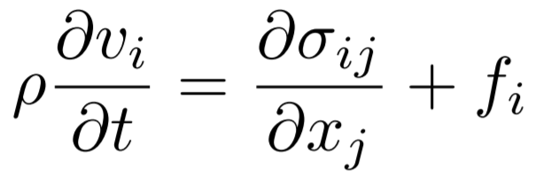


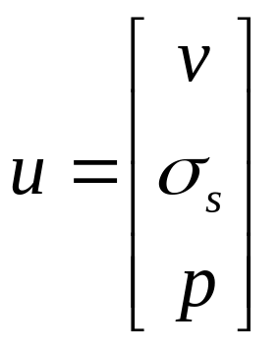

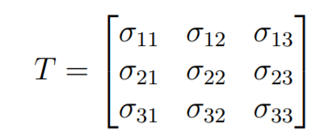
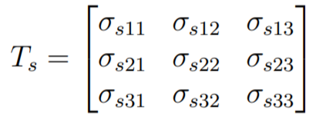

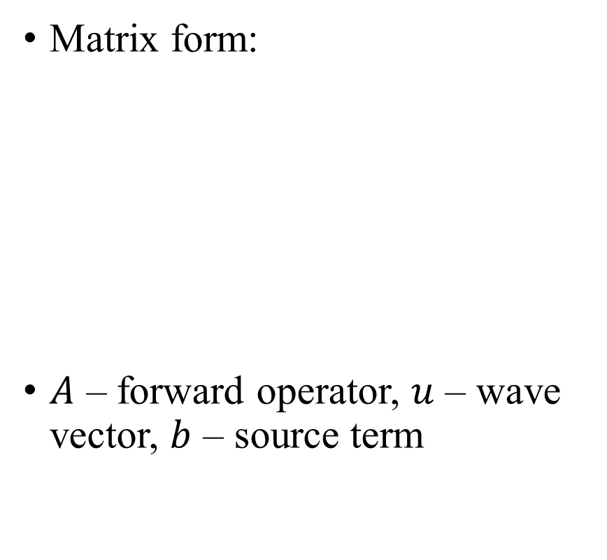
Forward problem
3D case
Matrix form:
$A$ – forward operator, $u$ – wave vector, $b$ – source term
(Yu, Geng, Li, & Wang, 2016)
Notes:
This is the backbone of our work. We start from velocity-stress equations. And the deviatoric stresses and isotropic pressure are extracted from stress components. In this case, we have wave vector composed of velocity, deviatoric stresses and isotropic pressure.

Slide 5
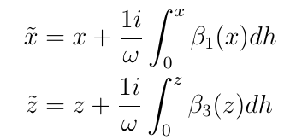


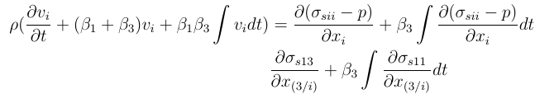

New formulation with PML (example in 2D)
Conventional
Application to the equation of motion
Simplified
Application to the equation of motion
“1i” for imaginary unit. “i” for cartesian index
Notes:
To simulate unbounded wavefield, we need perfectly matched layers, PML. We employed a simplified PML version to reduce the computational burden.

Slide 6
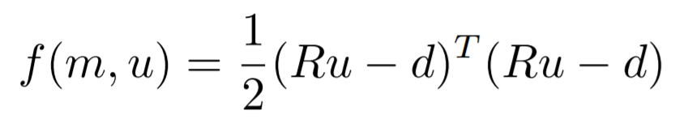






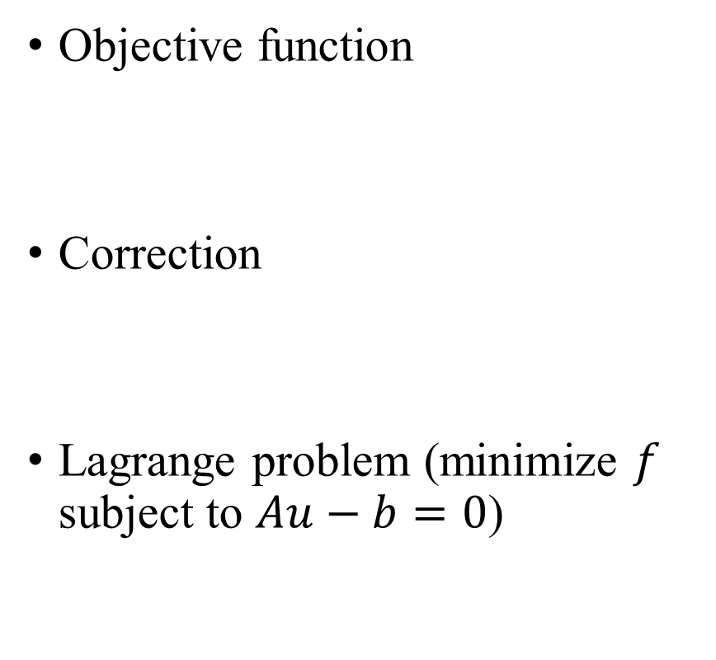
Full-waveform inversion
Objective function
Correction
Lagrange problem (minimize $f$ subject to $Au−b=0$)
We require
After manipulation,
Notes:
Our inversion is based on adjoint state method, which is derived from Lagrange multiplier.

Slide 7
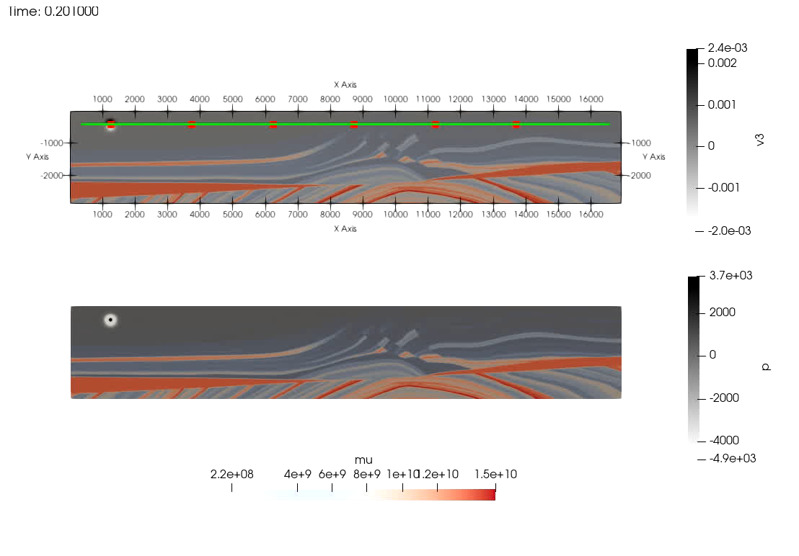
FWI
Red dots: 6 sources
Green line: 326 receivers
Generating synthetic signals
Frequency: 4 Hz
nt = 20000
nx = 1360
nz = 230
dt = 10 ⁻³ s
dx = 12.45 m
dz = 12.45 m
209 s for one source (16 coure-CPU, 128GB RAM)
Marmousi model (Irons, 1988)
Notes:
This is the case study for marmousi model. Firstly, we generate the synthetic recordings by forward simulation. You can see vertical partical velocity on the top and pressure field in the bottom. There is no S-wave component in the pressure field.

Slide 8
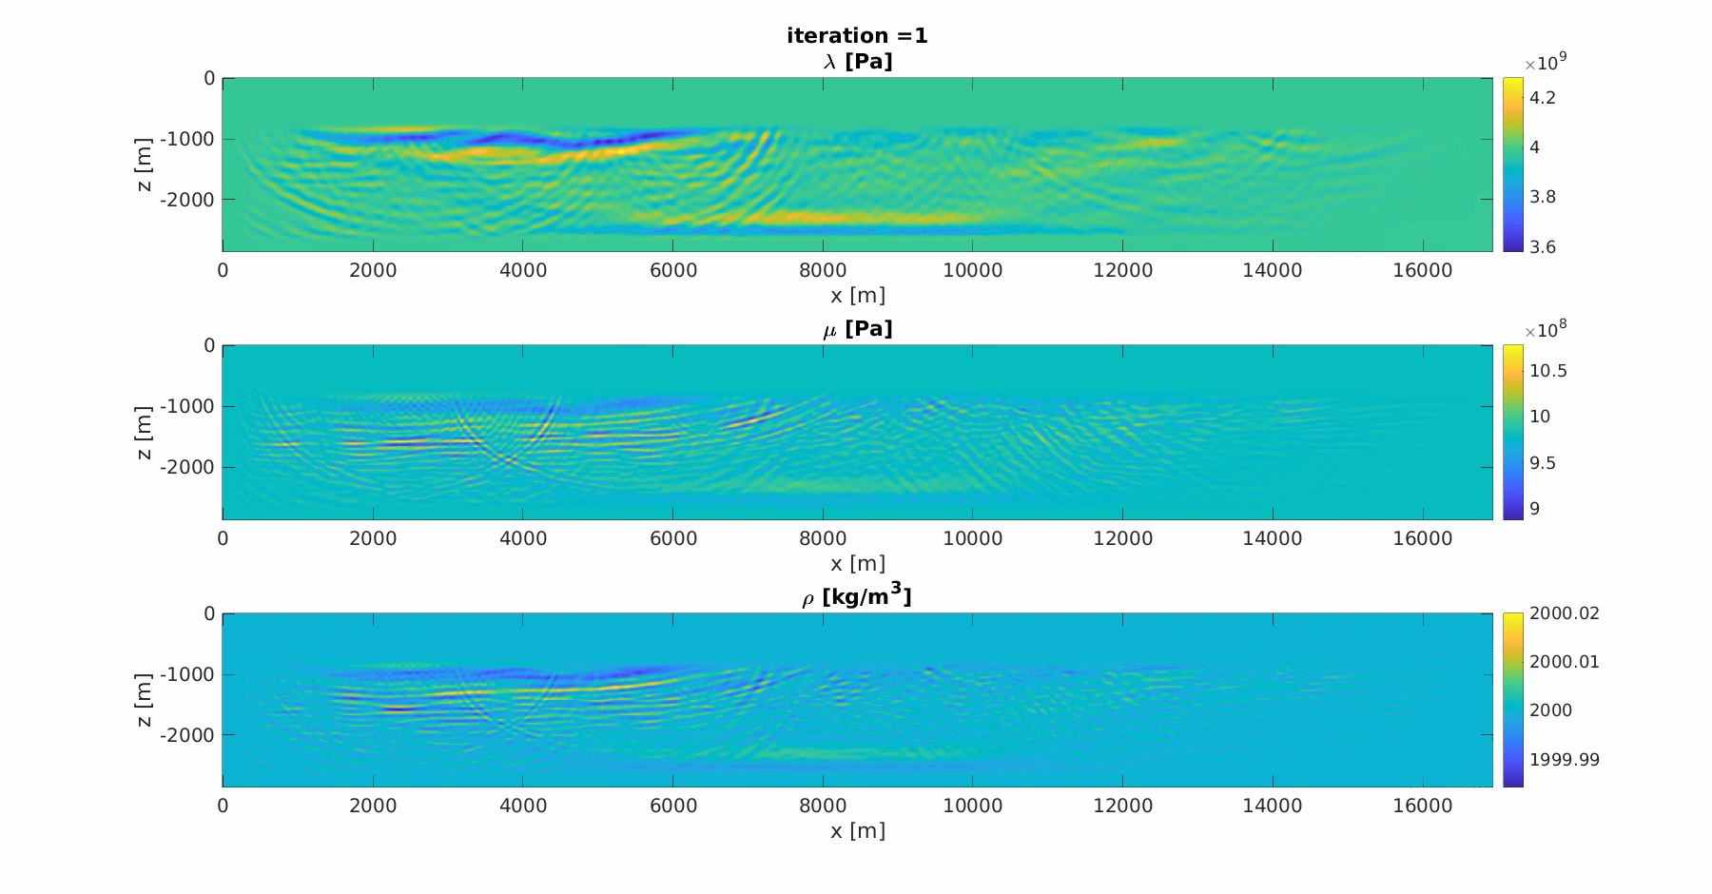
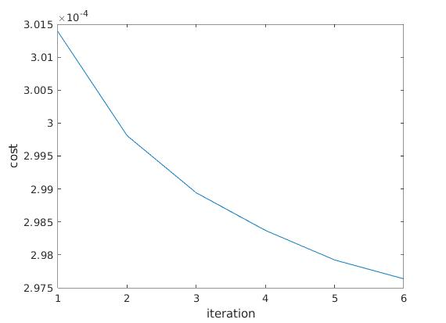
FWI
Initial model: constant modulus
Frequency: 4 Hz
Due to few sources or few iterations, the result is not promising currently. Only a rough structure is resolved.
Notes:
Currently the inversion only resolves a very rough structure after 6 times of iteration. But the cost is constantly decreasing.

Slide 9
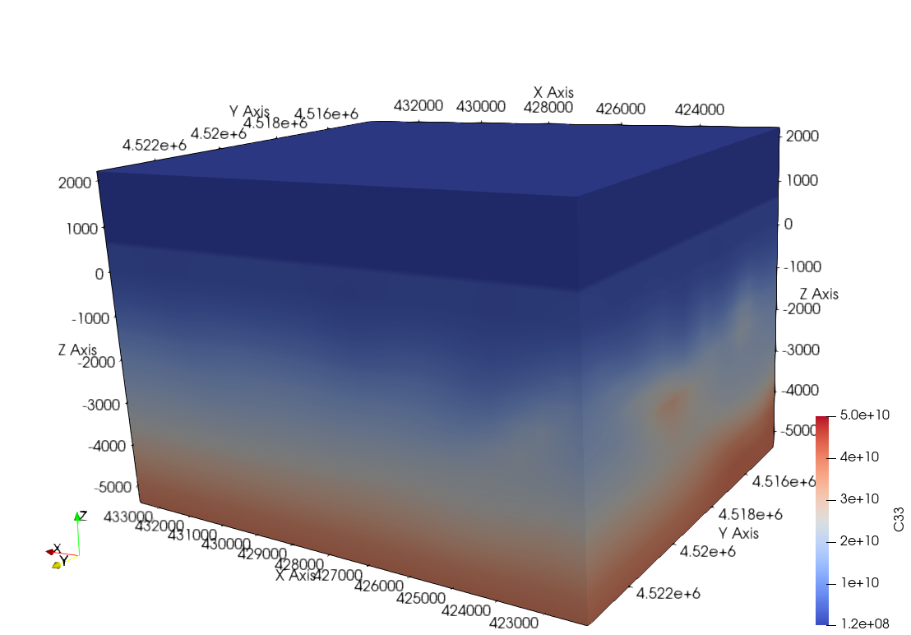
3D forward modelling
Application on a volcanic media: Campi Fleigrei (for one event)
Velocity model by travel time tomography
Can we improve seismogram fitting to the real data by
  Adding random media (as volcano is highly heterogenous)?
  Reconstructing source signals through time reversal receivers as virtual sources?
P-wave modulus: Campi Fleigrei (Tramelli, Del Pezzo, Bianco, & Boschi, 2006)
Notes:
For 3D modelling, we have a case study for a volcanic media, Campi Fleigrei. We want to fit the data better by adding random media and reconstructing source signals thourhg time reversal receivers as virtual sources.

Slide 10
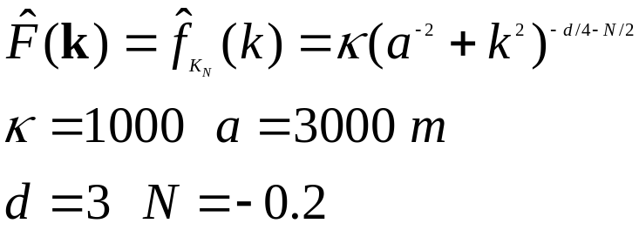
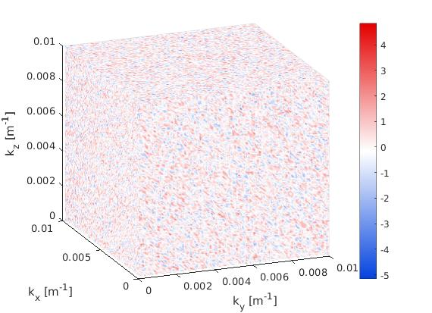
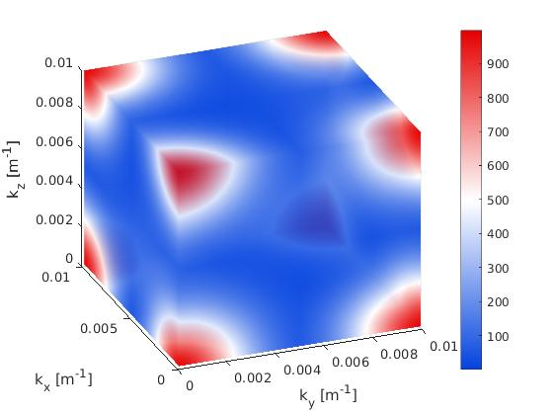
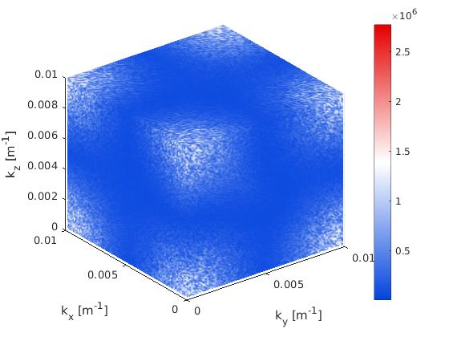
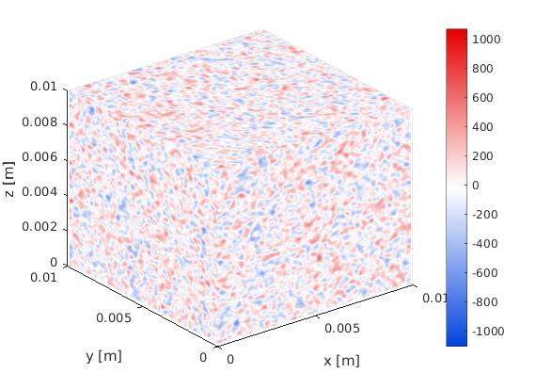

3D forward modelling
Gaussian filter (Klimeš, 2002)
IFFT
$$∘$$
=
White noise in wavenumber domain
Gaussian filter in wavenumber domain (repeated above Nyquist wavenumber)
Filtered spectrum
Fluctuation
Notes:
For random media generation, the Gaussian filter is used.

Slide 11
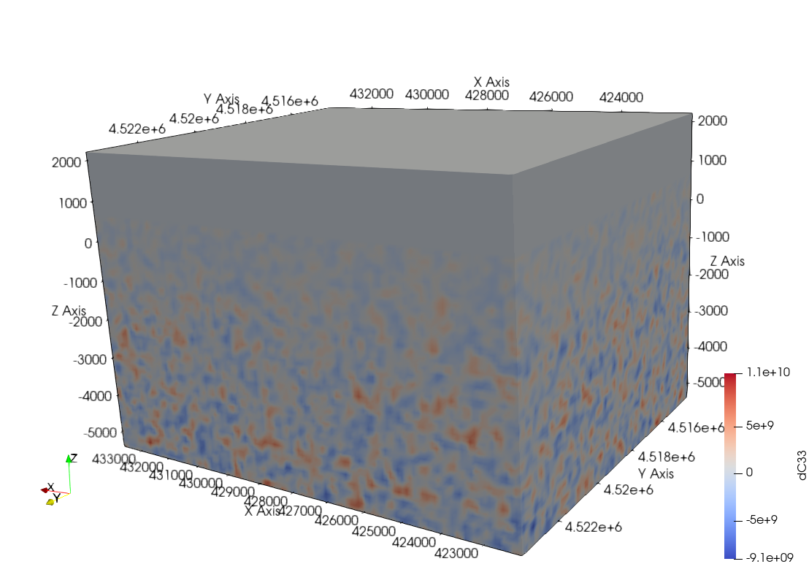



3D forward modelling
$$+$$
$$=$$
P-wave modulus: Campi Fleigrei
random P-wave modulus
P-wave modulus with fluctuation
Notes:
Here you can see how we add fluctuation to the background media to create fluctuated P-wave modulus.

Slide 12
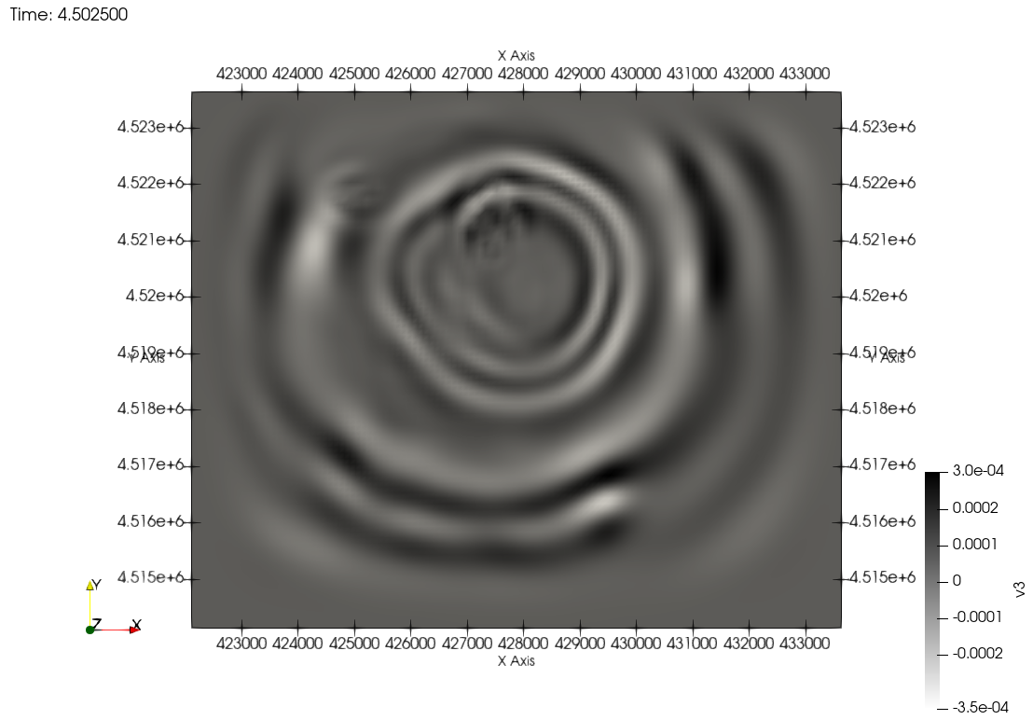
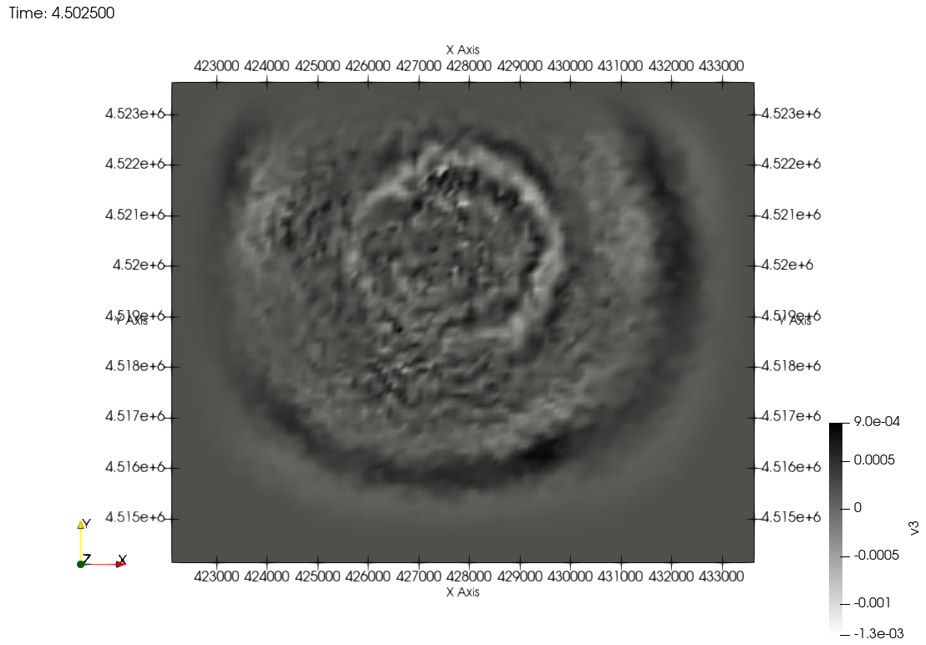
3D forward modelling
nt = 20000
nx = 1360
nz = 230
dt = 10 ^ -3 s
dx = 12.45 m
dz = 12.45 m
598 s for one source (16 coure-CPU, 128GB RAM)
Wavefield v3 (top view)
P-wave source
No fluctuation
Wavefield v3 (top view)
P-wave source
Fluctuation
Notes:
With the background model and fluctuated model, we have 2 simulations. And the wavefront loses coherency in the fluctuated model.

Slide 13
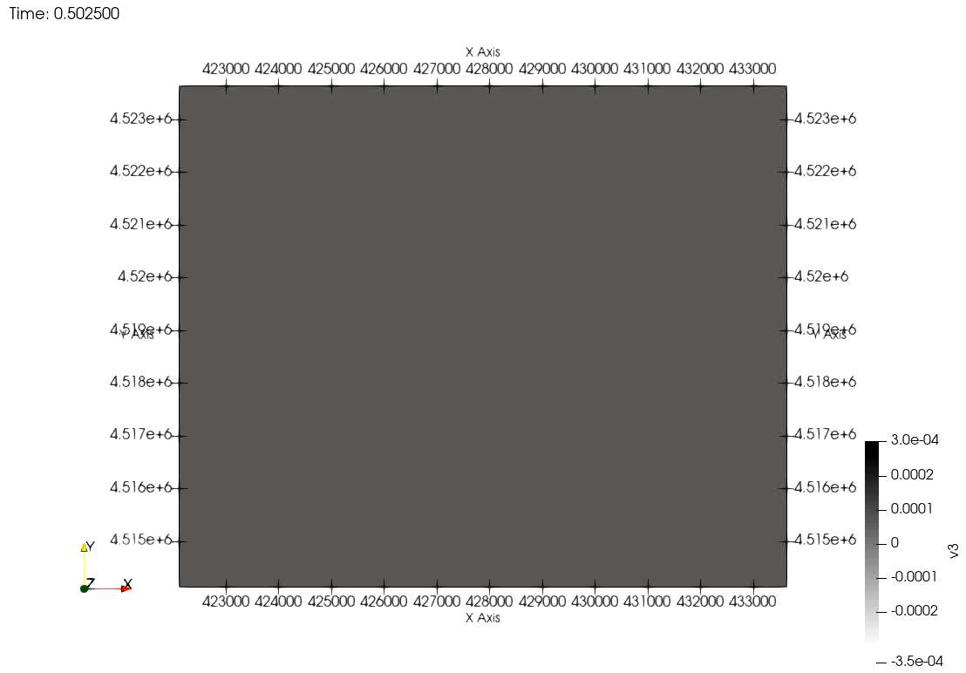

3D forward modelling
Wavefield v3 (top view)
P-wave source
No fluctuation
Wavefield v3 (top view)
P-wave source
Fluctuation
Notes:
You can see the animation of the 2 wavefields.

Slide 14
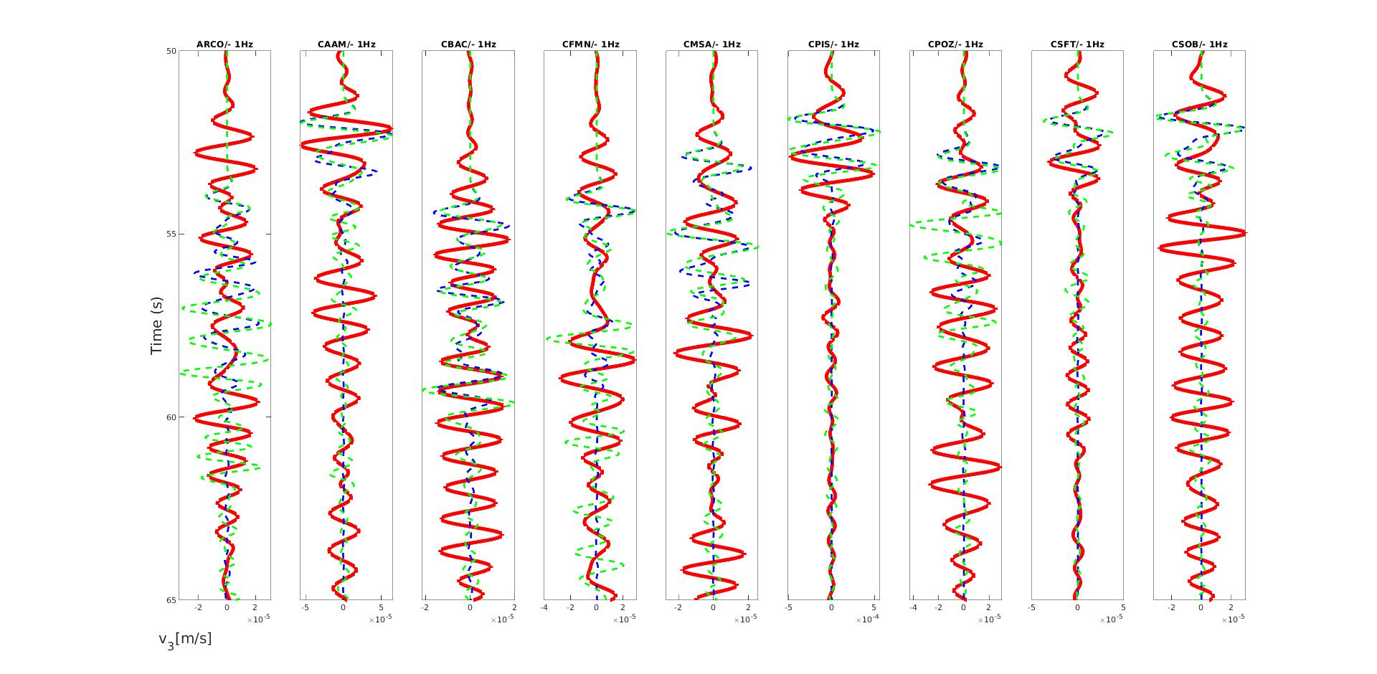
3D forward modelling
Seismogram v3, P-wave source
Red: true recordings
Blue: simulated, without fluctuation Green: simulated, with fluctuation
Notes:
This is the seismogram with explosion source. With velocity fluctuation, stronger coda waves are present.

Slide 15
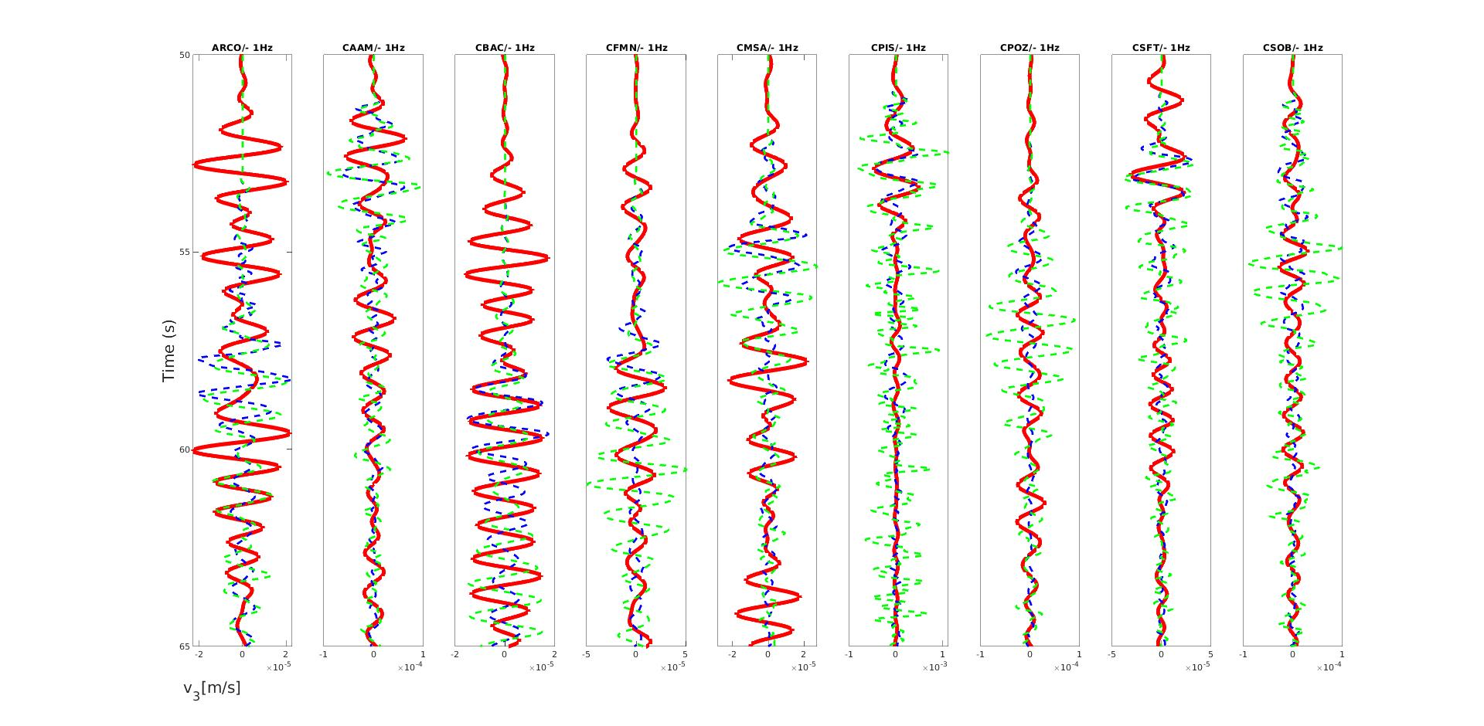
3D forward modelling
Seismogram v3, reconstructed source.
Red: true recordings
Blue: simulated, without fluctuation Green: simulated, with fluctuation
Notes:
If we used the reconstructed source, coda can be also reproduced. However, reconstructed source together with fluctuation result in too strong coda, whose result is more deviated from the true data.

Slide 16
Conclusion
The adjoint state of velocity-deviatoric stress-isotropic pressure formulation is derived.
We created parallelized packages in Julia for 2D P-SV waves modelling, 2D full-waveform inversion and 3D forward modelling.
The introduction of random media leads to stronger coda waves. The reconstructed source is able to reproduce the data better.
Notes:
To conclude, our work creates fast codes for simulation and inversion. And we applied the codes to 2 case studies, Marmousi and Campi Flegrei.

Slide 17
References
Omlin, S., Räss, L., Kwasniewski, G., Malvoisin, B., & Podladchikov, Y. Y. (2020). Solving Nonlinear Multi-Physics on GPU Supercomputers with Julia. JuliaCon Conference.
Yu, P., Geng, J., Li, X., & Wang, C. (2016). Acoustic-elastic coupled equation for ocean bottom seismic data elastic reverse time migration. GEOPHYSICS, 18, 333-345.
Irons, T. (1988). Marmousi Model. In. http://www.ifp.fr/IFP/en/aa.htm: Institut Fran¸cais du P´etrole.
Tramelli, A., Del Pezzo, E., Bianco, F., & Boschi, E. (2006). 3D scattering image of the Campi Flegrei caldera (Southern Italy). Physics of the Earth and Planetary Interiors, 155(3-4), 269-280. doi:10.1016/j.pepi.2005.12.009
Klimeš, L. (2002). Correlation Functions of Random Media. Pure appl. geophys., 159, 1811-1831.

