Slide 1
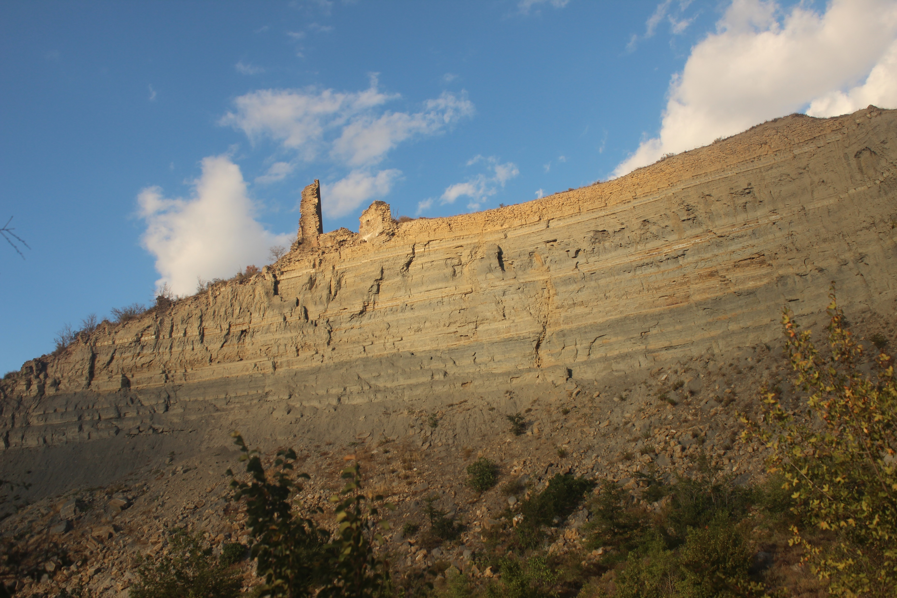


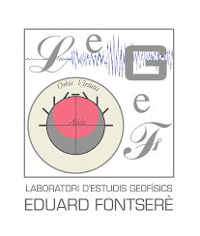



Identification and characterization of rockfalls using seismic signals, LiDAR, and imagery. Advances on real-time detection
Bixen Telletxea¹, Mar Tapia², Marta Guinau¹, Manuel J. Royán¹, Pere Roig Lafon¹, Xabier Blanch¹,
Giorgi Khazaradze¹, Emma Suriñach^{1,2}, Gloria Furdada¹, David Garcia-Sellés¹, Antonio Abellán³, and
Joan Manuel Vilaplana¹
¹Grup RISKNAT, Institut Geomodels, University of Barcelona, Faculty of Earth Sciences, Department of Earth and Ocean
Dynamics, Barcelona, Spain
²Laboratori d’Estudis Geofísics Eduard Fontserè, Institut d’Estudis Catalans, Barcelona, Spain
³Centre de Recherche sur l'Environnement Alpin (CREALP), Sion, CH1950, Valais, Switzerland corresponding author: bixteliguz@gmail.com
Notes:
Good morning, my name is Bixen Telletxea and I’m going to talk about the work titled: “Identification and characterization of rockfalls using seismic signals, LiDAR and imagery. Advances on real-time detection”.

Slide 2
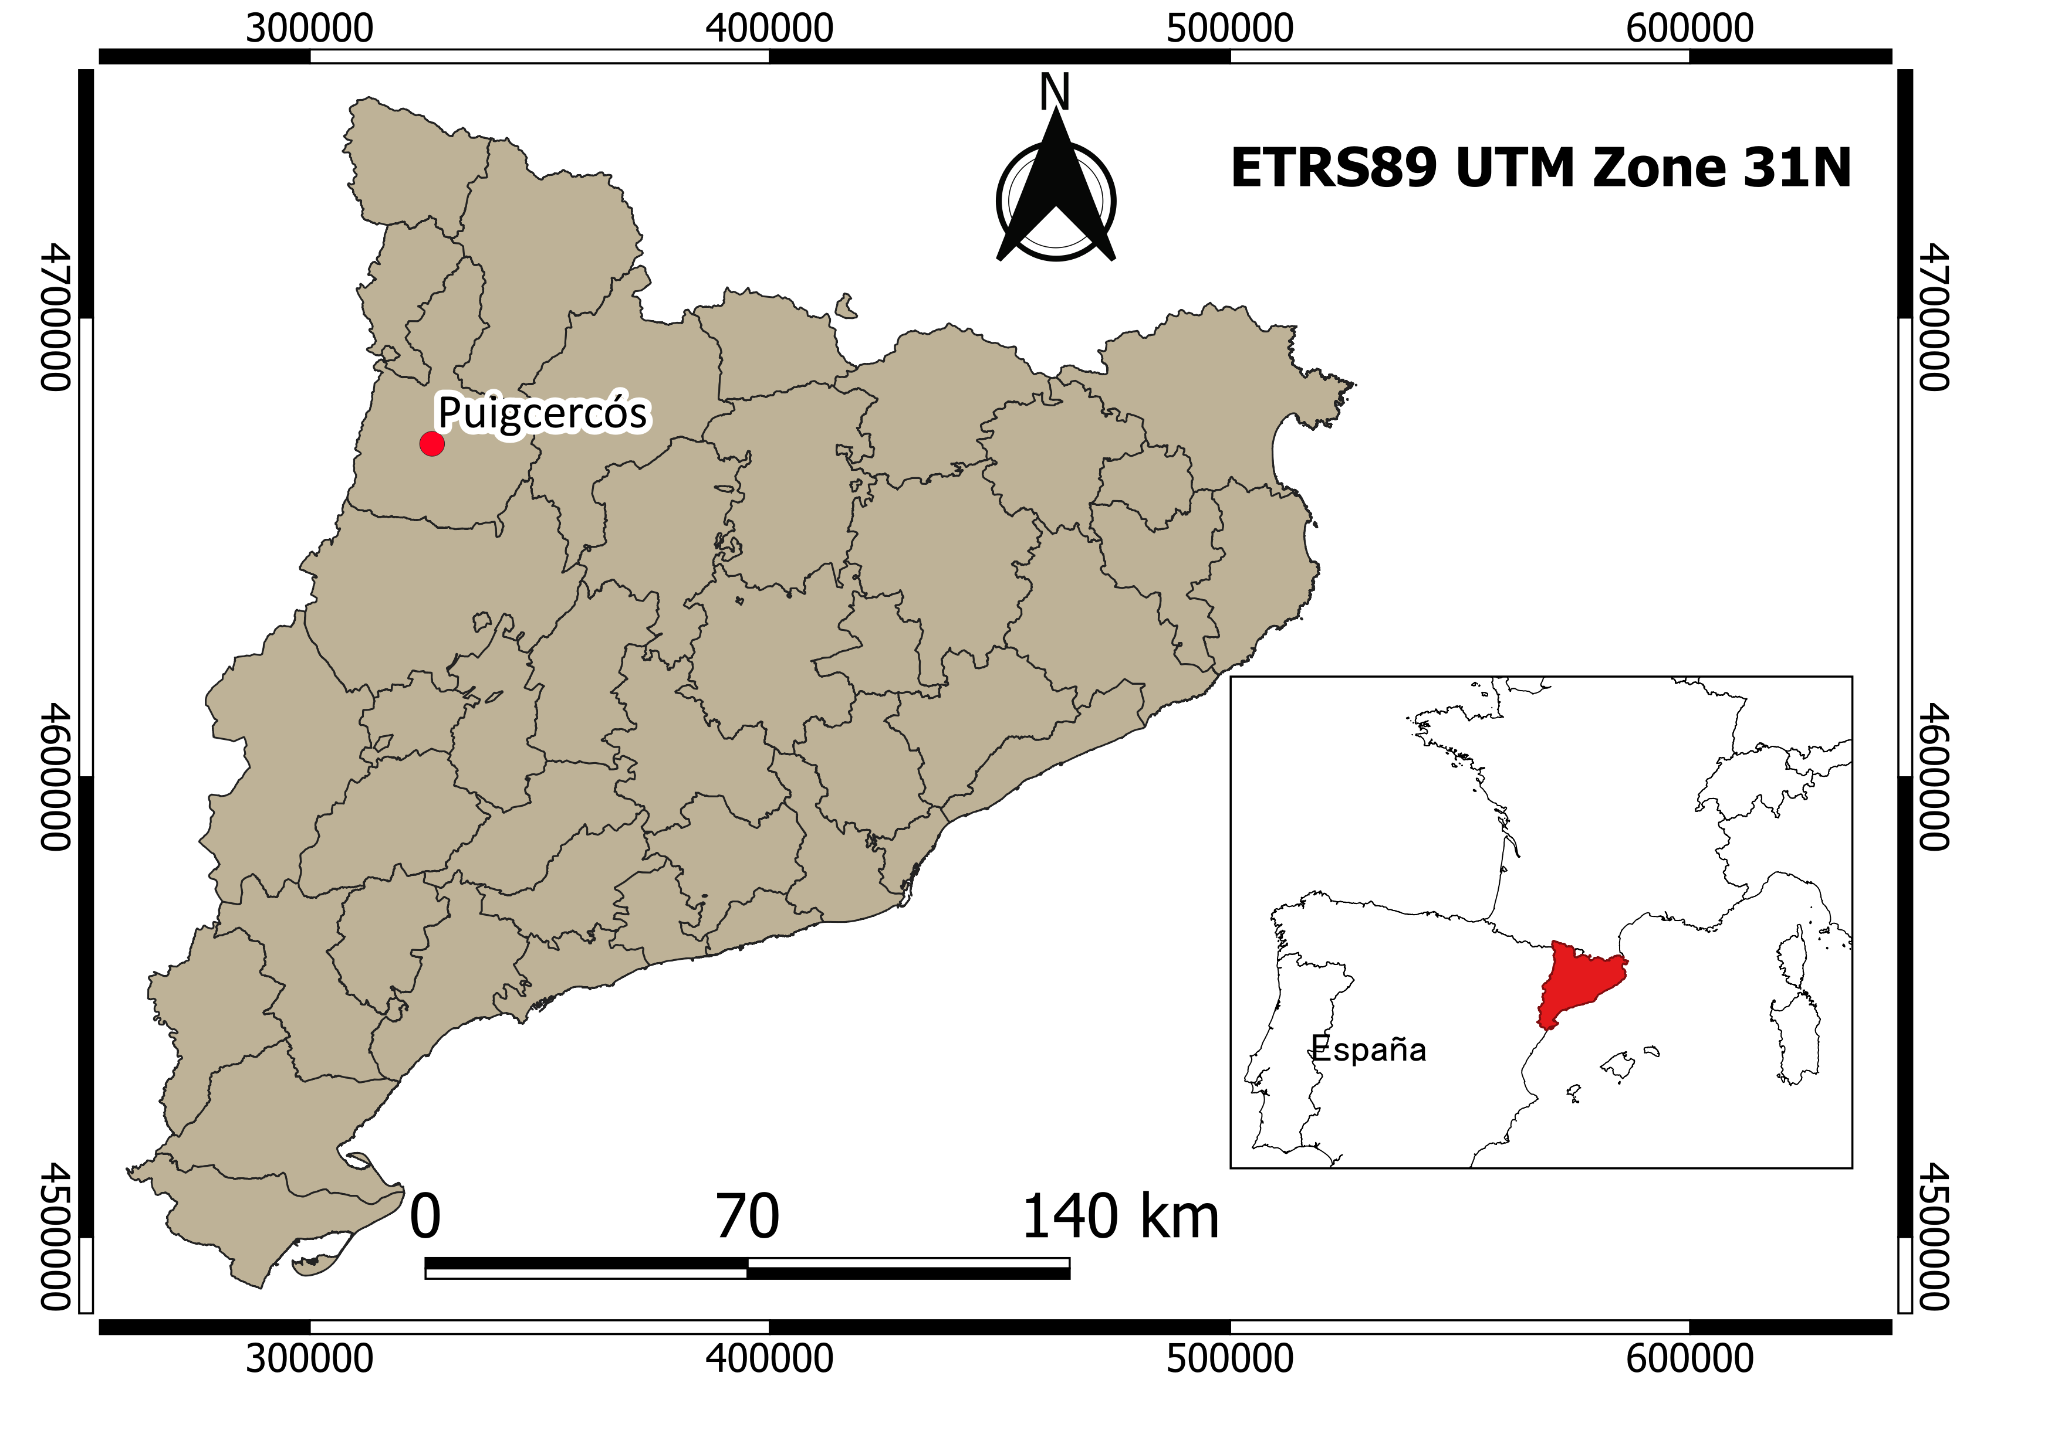
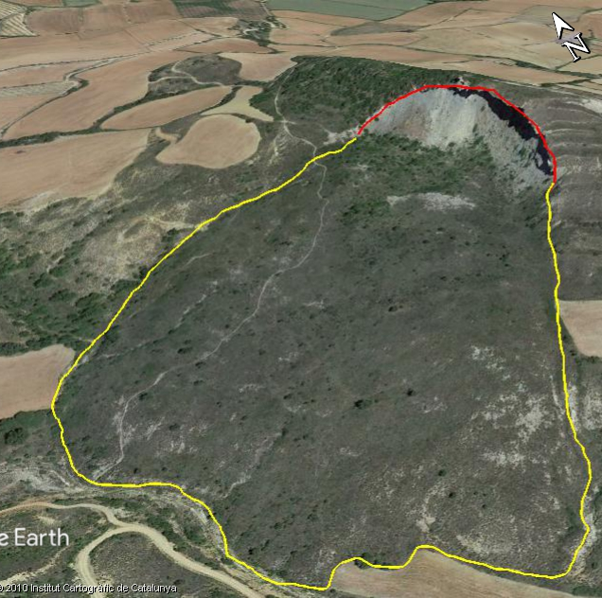


STUDY AREA
h= 27 m
I
200 m
I’
GoogleEarth©,2020
Notes:
Due to seismic signals depend on event dynamics and on the geotechnical characteristics. An experiment with the goal of detecting small rockfalls in real-time has been carried out in the Puigcercós cliff (NE Spain).

Slide 3
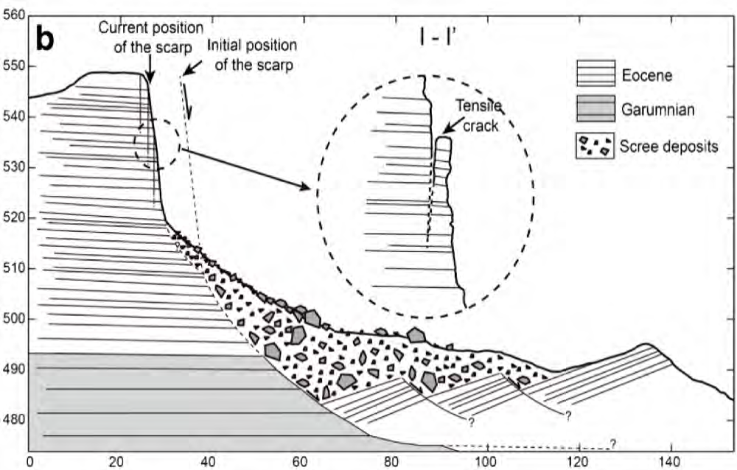
STUDY AREA
h= 50 m
I
200 m
I’
GoogleEarth©,2020
Royán et al.,2014
Notes:
This is a head scarp of an ancient landslide occurred on 1881 with high rockfall activity

Slide 4
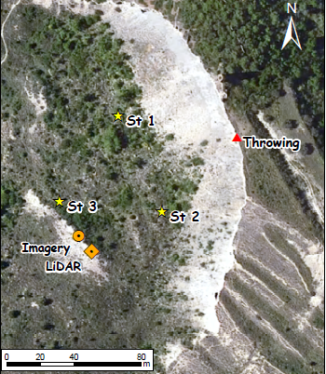
ARTIFICIALLY TRIGGERED ROCKFALLS MONITORING
21 rocks were thrown from the top of the cliff (V= 0.015-0.0004 m³).
The seismic signals were recorded in St1, St2 and St3
67 m
107 m
57 m
Notes:
In this experiment 21 rocks with volume ranging from 0.015 to 0.0004 m3 were thrown from the top of the cliff, and the seismic signals were registered with three seismic sensors

Slide 5
ARTIFICIALLY TRIGGERED ROCKFALLS MONITORING
Rocks were thrown from the top of the cliff (V= 0.015-0.0004 m³).
The seismic signals were recorded in St1, St2 and St3
67 m
107 m
57 m
It was left there for the automatic detection of rockfalls
Notes:
After the experiment, the furthest one was kept functioning

Slide 6
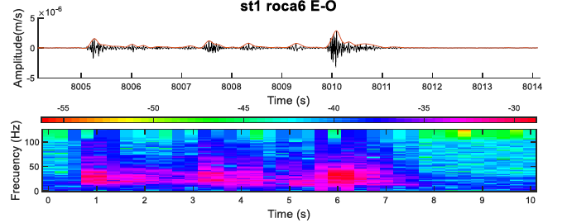
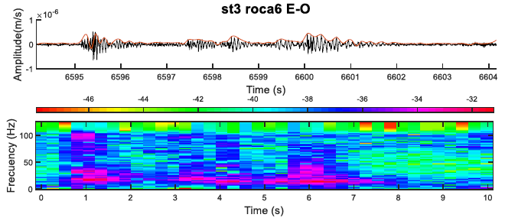
EXPERIMENT RESULTS
0,45 s
0,4 s
0,5 s
0,35 s
0,35 s
0,6 s
St1_rock_6_E-W
Main impact
Flights
Rebound
Rolling
Final stop
Amplitude peaks
5
1
2
3
2
4
Duration of the peak’s amplitudes
30 Hz
Frequency
10 Hz
St3_rock_6_E-W
Less seismic signal. seismic attenuation phenomena is detectable
Notes:
The recorded signals have mostly a frequency of 10 to 30 Hz, and the duration of the peak’s amplitudes are between 0.3 and 0.6 sec. In view of these results different phases of main impacts, rebounds, flights, rolling and final stop has been classified on the rockfalls signals. However, the furthest station has lower frequency and amplitude values than the closest one, limiting the possibility to classify different phases in seismic signals. ( For this reason, the seismic attenuation phenomena is detectable even at only 40 m)

Slide 7
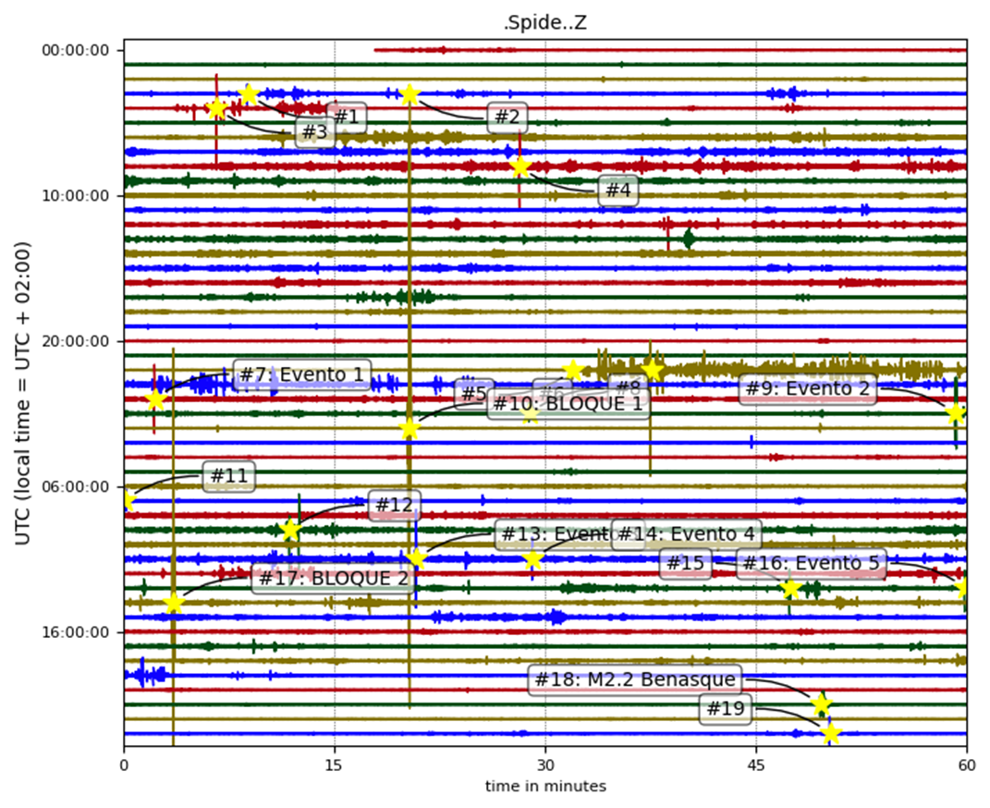
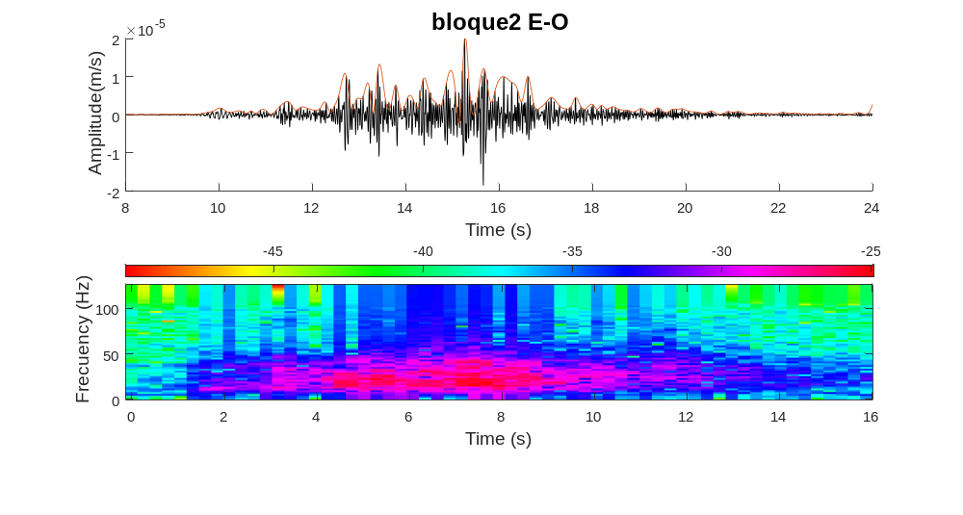
IDENTIFICATION OF ROCKFALLS
Main events
Prior events
Discarded events
Notes:
Applying an automatic detection using sta/lta methods in the continuous seismic record, some possible rockfalls have been identify. Then based on the seismic characterization in the experiment, for those possibly rockfalls, two main events, three precursors are detected, discarding the others. In addition, those main events were also identified using LiDAR and imagery but small rockfalls prior to main events were not.
These results show that the continuous seismic signals are useful for the automatic detection of small rockfalls that might be precursor of main events. These abilities provide new insight for the development of an early warning systems in the future

Slide 8

Thank you for your attention
Notes:
, Thank you for your attention

