Slide 1
Unveiling ductile deformation during
fast exhumation of a granitic pluton in a transfer zone
Richard Spiess^{1,*}, Antonio Langone², Alfredo Caggianelli³, Finlay M. Stuart⁴,
Martina Zucchi³, Caterina Bianco³, Andrea Brogi^{3,5}, Domenico Liotta^{3,5}
¹ Geosciences Department, University of Padova, Italy
² CNR-IGG, Institute of Geosciences and Earth Resources, Pavia
³ Department of Earth and Geoenvironmental Sciences, University of Bari, Italy
⁴ Isotope Geosciences, Scottish Universities Environmental Research Centre, East Kilbride, UK
⁵ CNR-IGG, Institute of Geosciences and Earth Resources, Pisa, Italy
Corresponding author: richard.spiess@unipd.it
Journal of Structural Geology, https://doi.org/10.1016/j.jsg.2021.104326.

Slide 2
Abstract
Exhumation and cooling of upper crustal plutons is generally assumed to develop in the brittle domain, thus determining an abrupt passage from crystallization to faulting. To challenge this general statement, we applied an integrated approach involving meso- and micro-structural studies, thermochronology, geochronology and rheological modelingto the Miocene syn-tectonic Porto Azzurro pluton on Elba (Tuscan archipelago – Italy). This pluton is emplaced in an extensional setting, and we have realized that its fast exhumation is accompanied by localized ductile shear zones, developing along dykes and veins, later affected by brittle deformation. This is unequivocally highlighted by field studies and EBSD-aided microstructural analysis. To constrain the emplacement and exhumation rate of the Porto Azzurro pluton we performed U-Pb zircon dating and (U+Th)/He apatite thermochronology, which resulted in a magma emplacement age of 6.4 ± 0.4 Ma and an exhumation rate of 3.4 to 3.9 mm/yr. Thermo-rheological modeling established that localized ductile deformation occurred at two different time steps: within felsic dykes when the pluton first entered into the brittle field at 380 kyr, and along quartz-rich hydrothermal veins at c. 550 kyr after pluton emplacement. Hence, the major conclusion of our data is that ductile deformation can affect a granitic intrusion even when it is entered into the brittle domain in a fast exhuming extensional regime.
Key Words: Granite emplacement, fast exhumation, extensional tectonics, shearing, EBSD, geochronology –thermochronology, rheological modeling.

Slide 3
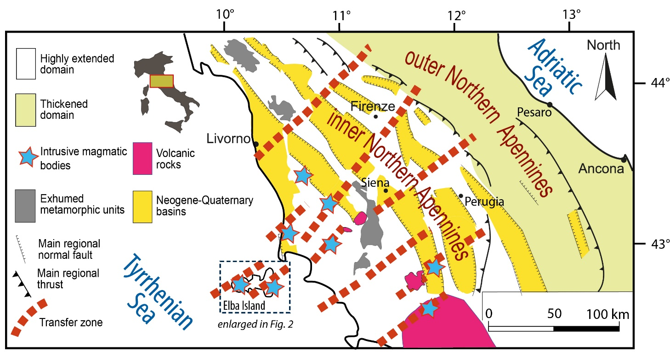
Fig. 1 - Structural sketch map of Northern Tyrrhenian Basin and Northern Apennines. The main Pliocene–Quaternary basins, transfer zones and Neogene–Quaternary intrusive bodies are indicated (after Dini et al., 2008).

Slide 4
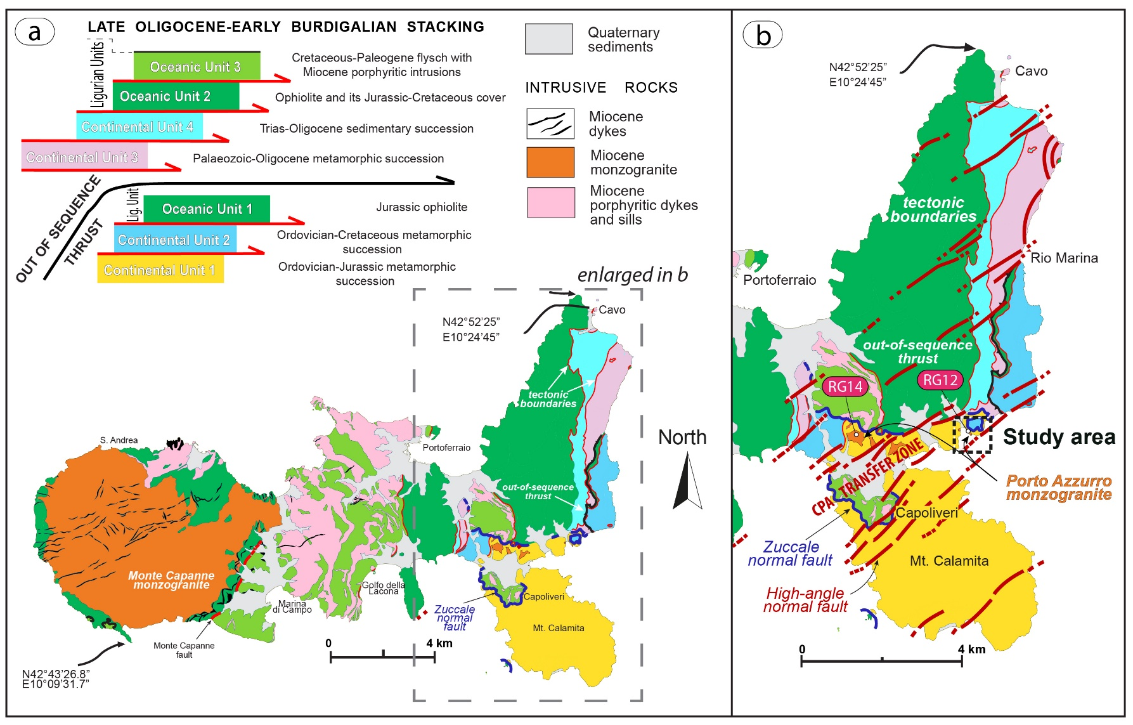
Fig. 2 - Geological sketch map of Elba Island. The main faults, the study area and the location of the dated (²⁰⁶Pb/²³⁸U in zircon) samples (RG12 and RG14) are indicated.

Slide 5
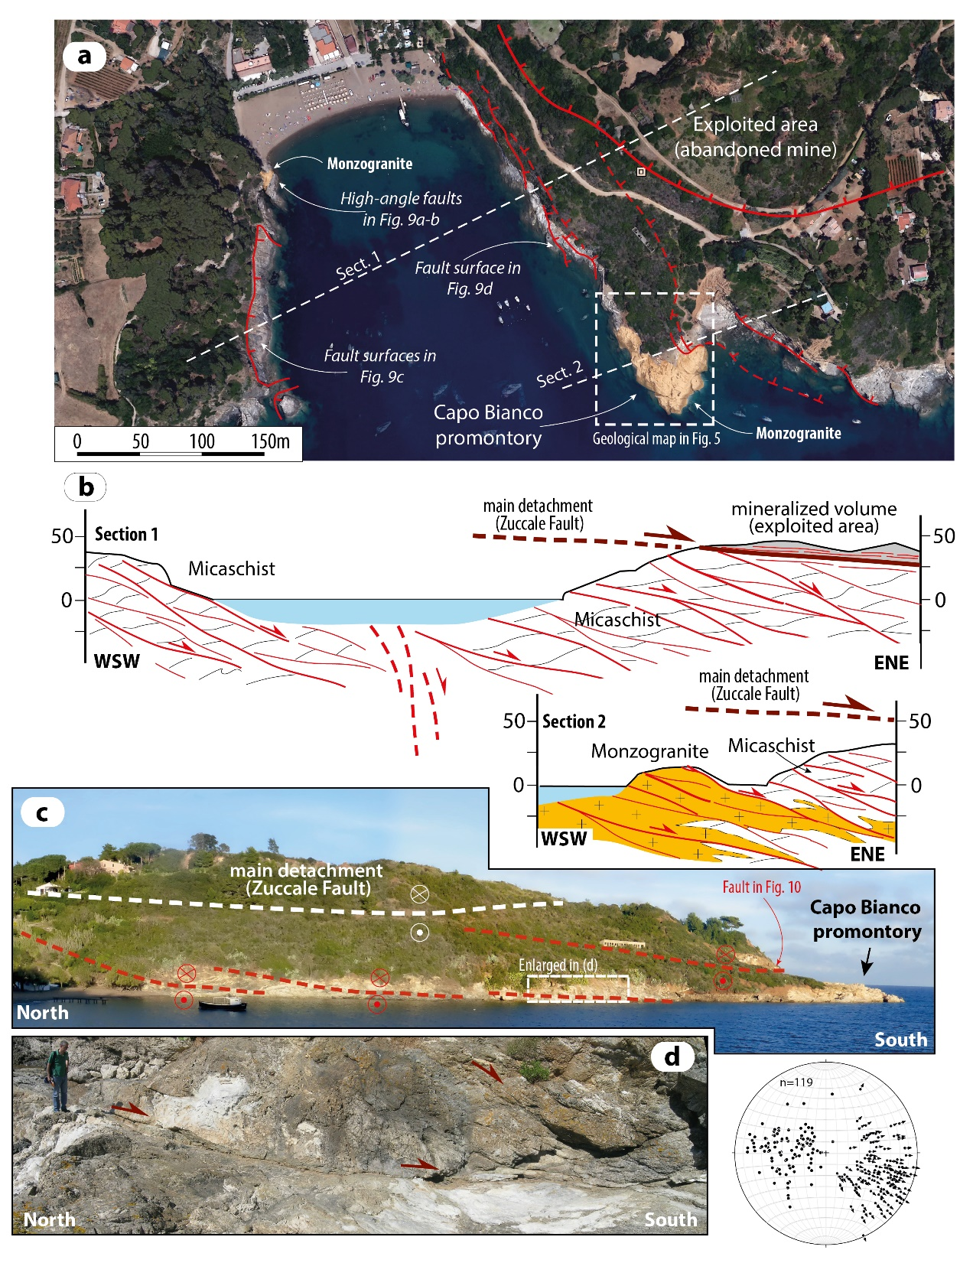
Fig. 3 – a) Google Earth photograph of the Barbarossa bay where the analyzed monzogranite is exposed; the main structural elements and the mineralized volume corresponding to the Zuccale Fault is also indicated; b) geological sections across the bay with the main structural elements; c) panoramic view of the eastern side of the bay with the main faults and the analyzed monzogranite; d) detail of an extensional detachment fault accompanying the deformation in the footwall of the Zuccale Fault; the stereographic diagram (lower hemisphere, equiareal projection) illustrates the poles of the minor faults linked to the detachments and their kinematics.

Slide 6
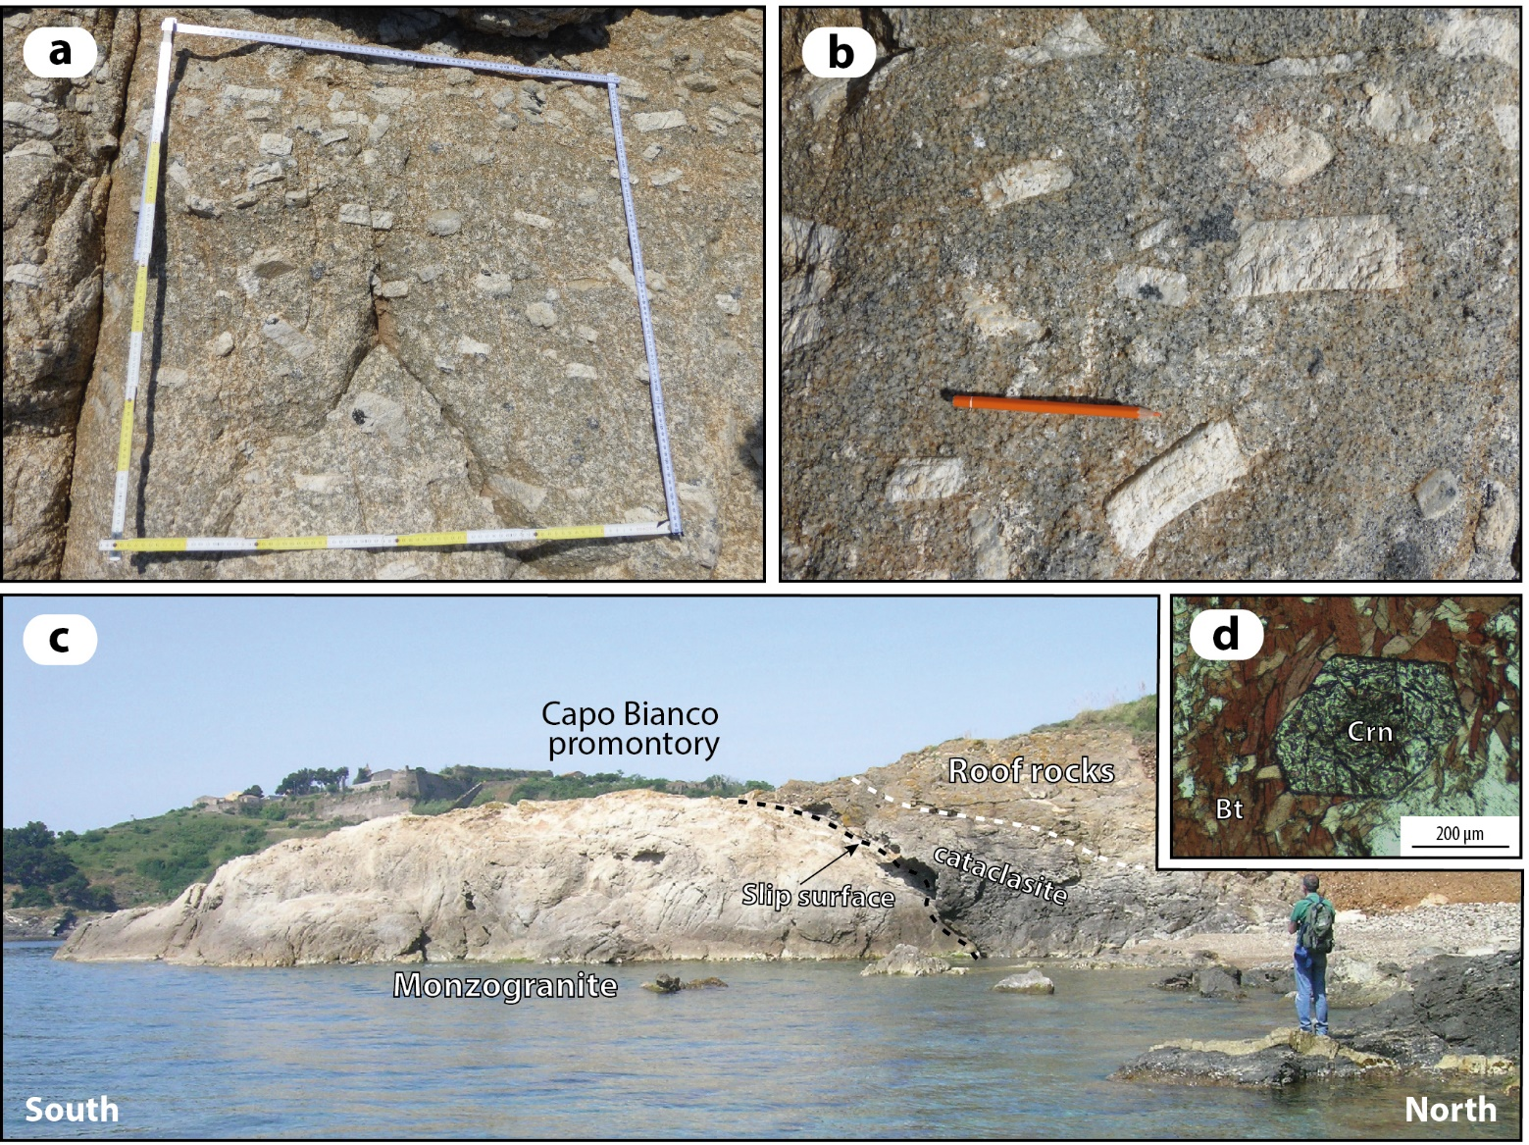
Fig. 4 – a) Aligned K-feldspar megacrysts defining the magmatic foliation of the monzogranite; b) details of K-feldspar megacrysts; c) panoramic view of the Capo Bianco promontory with the tectonic relations of the monzogranite and the hosting rocks; d) euhedral corundum growing within quartz-free, biotite-rich domain of the micaschist next to the monzogranite.

Slide 7
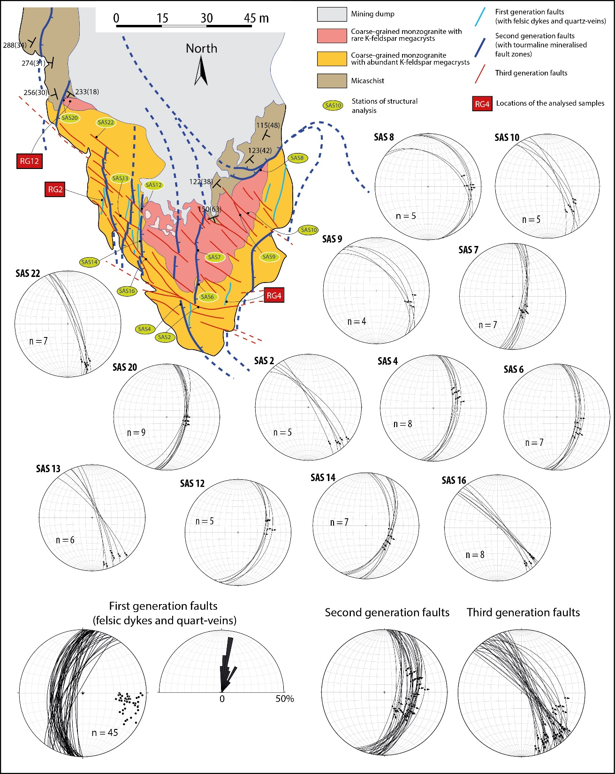
Fig. 5 - Geological map of the Capo Bianco promontory. Stations of structural analyses and relative data are reported in stereographic diagrams (lower hemisphere, equiareal projection). The location of the analysed samples for microstructural analyses is also indicated. Structural and kinematic data of each fault generation, as described in the text, are reported in stereographic and rose diagrams (lower emisphere, equiareal projection).

Slide 8
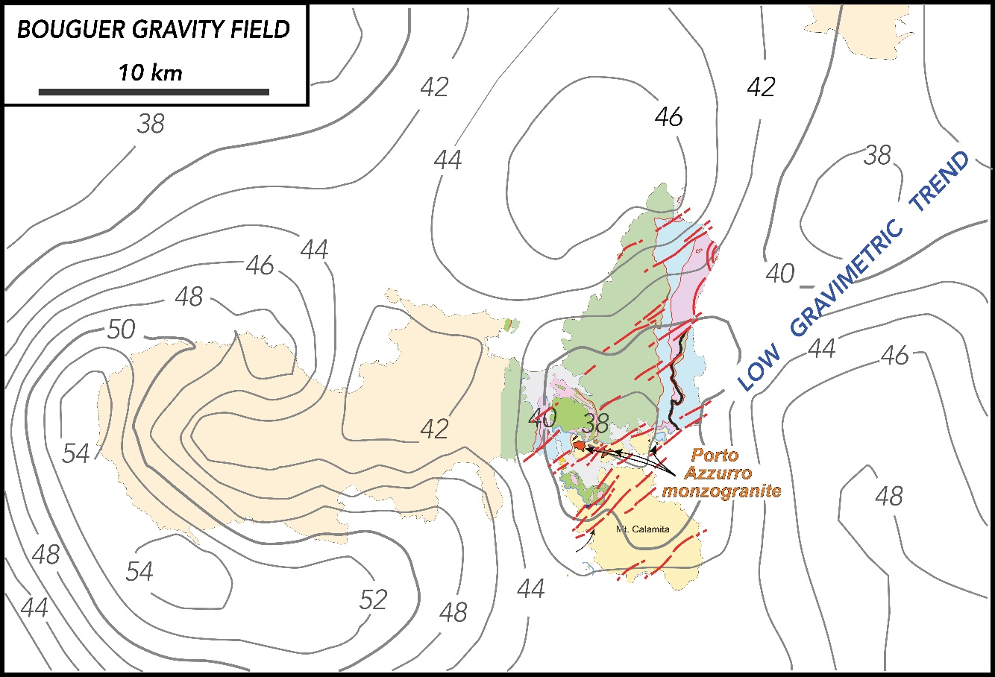
Fig. 6 – Bouguer gravity field after Milano et al. (2019). Isolines are in mGal. NE-trending faults are matching the low gravimetric trend, that is here related to a regional transfer zone where magmatic bodies emplaced.

Slide 9
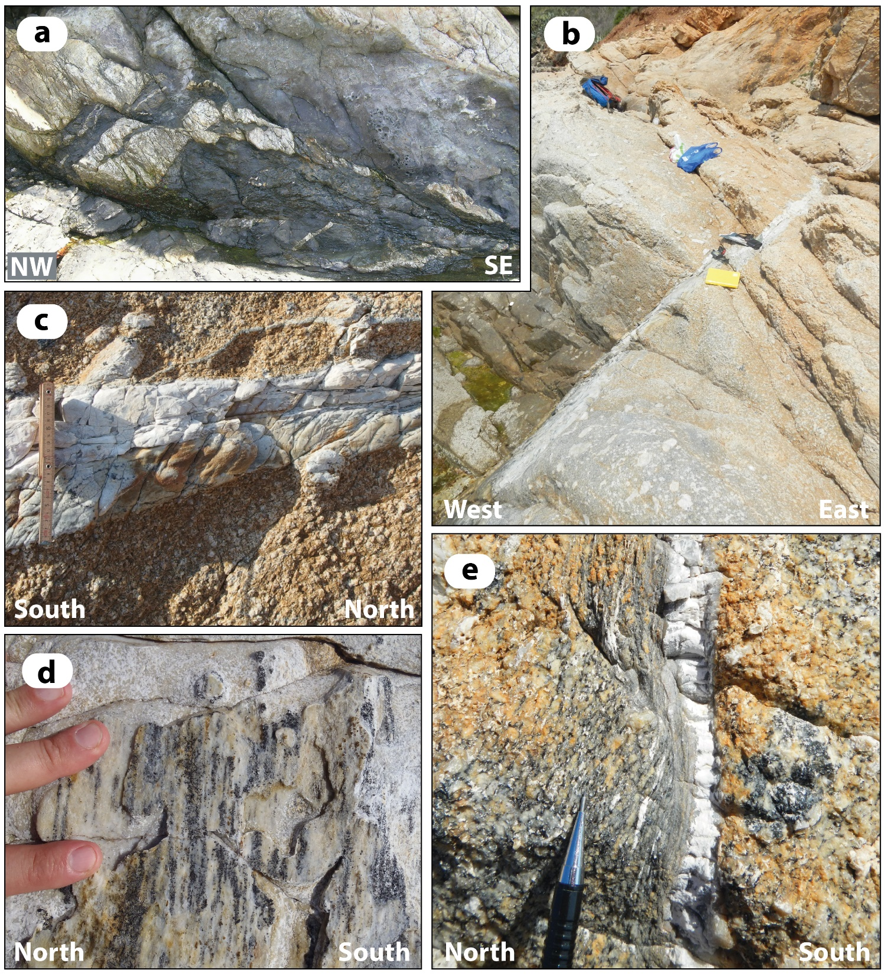
Fig. 7 – a) dm-thick felsic dykes intruded within micaschist affected by second generation extensional faults;
b) felsic dyke intruded within the monzogranite sampled for microstructural analyses (sample RG2);
c) detail of the felsic dyke analysed with EBSD, illustrating the internal foliation and S-C fabric;
d) L-tectonite consisting of tourmaline lineation developed on the felsic dyke-surface foliation;
e) hydrothermal quartz-rich vein and the mylonitic foliation (analysed with EBSD) affecting the adjacent monzogranite.

Slide 10
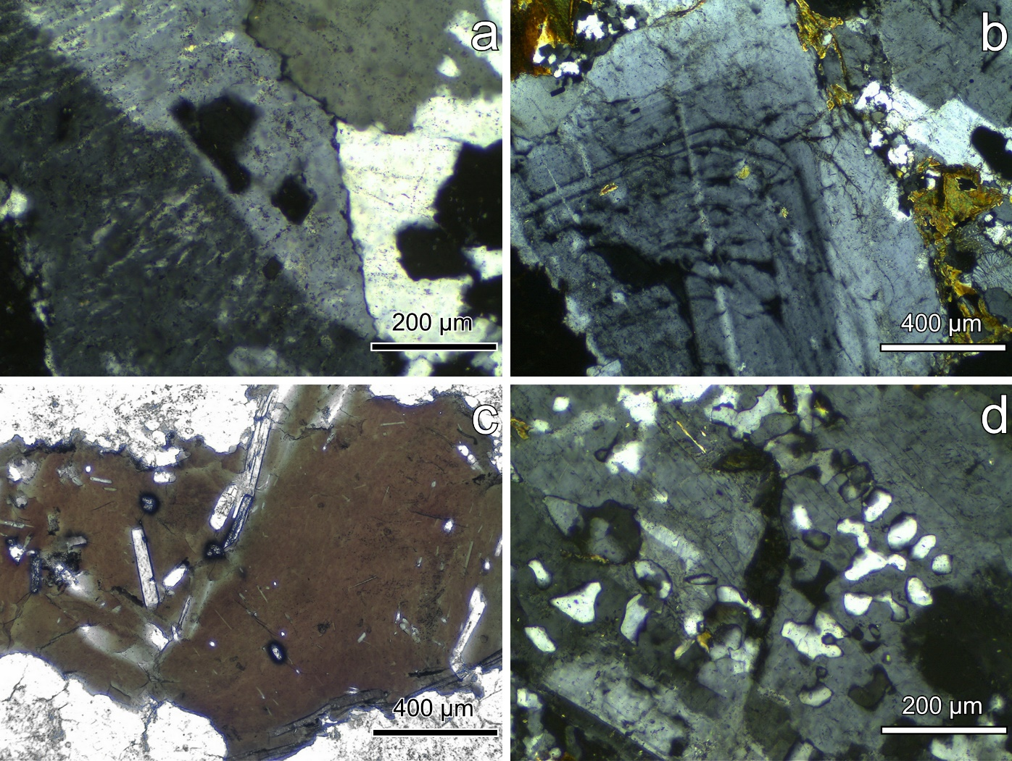
Fig. 8 - Micrographs of petrographic features of the Porto Azzurro monzogranite in plane polarized (PPL) and crossed polars (CP) light. a) Karlsbad twinned K-feldspar with perthitic exsolution lamellae; b) plagioclase with oscillatory zoning (CP image); c) basal section of biotite including elongated apatites and tiny zircon and monazite crystals surrounded by metamictic halos (PPL image); d) K-feldspar-Quartz granophyric intergrowth (CP image).

Slide 11
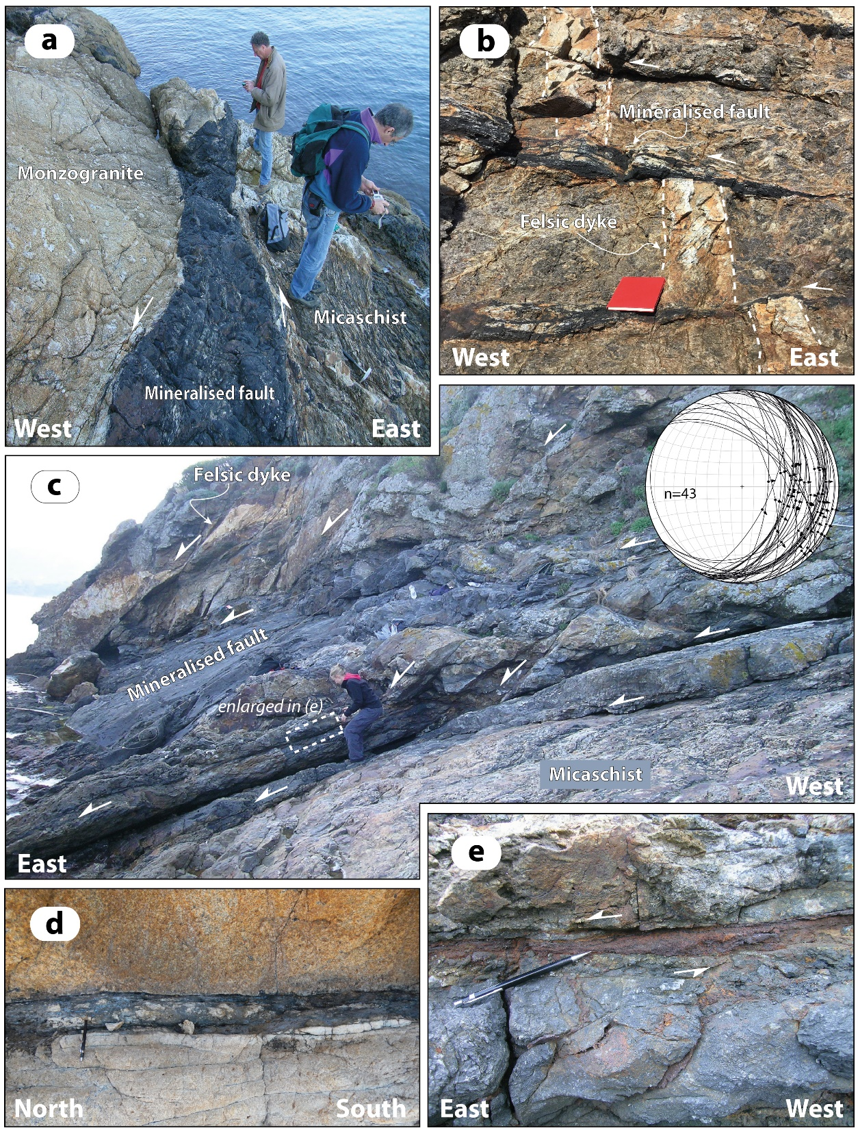
Fig. 9 - Photographs illustrating details of the second generation faults in the Barbarossa bay and Capo Bianco promontory:
meter-thick tourmaline-rich mineralized fault at the boundary between the monzogranite and the host rocks;
b) shear veins parallel to cm-thick fault zones mineralised by quartz and tourmaline, dissecting a dm-thick felsic dyke;
c) panoramic view of the low-angle normal faults characterizing the footwall of the Zuccale Fault;
d) detail of a fault zone mineralized by tourmaline and quartz characterizing the footwall of the Zuccale Fault and affecting the monzogranite;
e) detail of a fault zone mineralized by Fe-oxyhydroxides characterizing the footwall of the Zuccale Fault and affecting the micaschist in the fault system shown in (c).

Slide 12
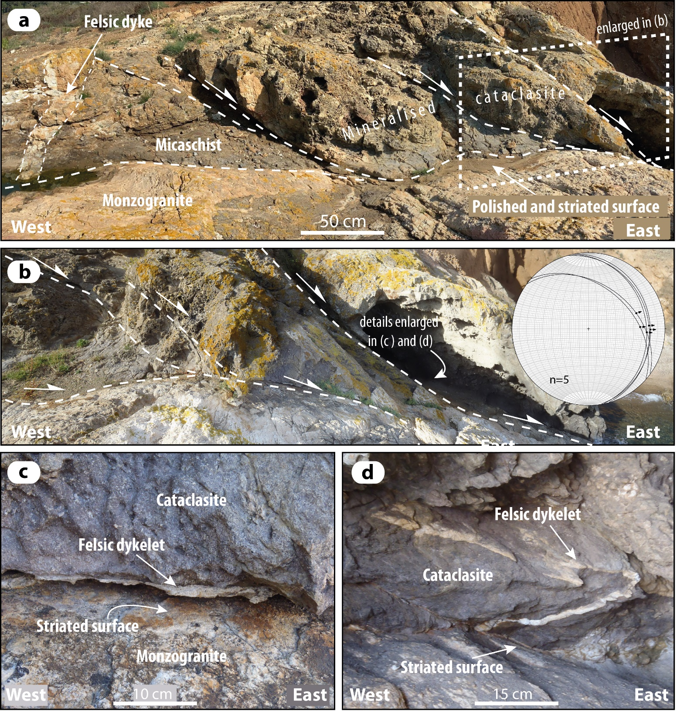
Fig. 10 - Photographs illustrating second generation faults:
a-b) panoramic view of the extensional fault system separating the monzogranite from the roof rocks (micaschist) characterizing the footwall of the Zuccale Fault in the Capo Bianco promontory;
c) detail of a cm-thick felsic dykelet assisting deformation along the slip surface of the fault zone illustrated in (a) and (b);
d) felsic dykelet injected in the cataclasite and ductilely deformed during faulting.

Slide 13
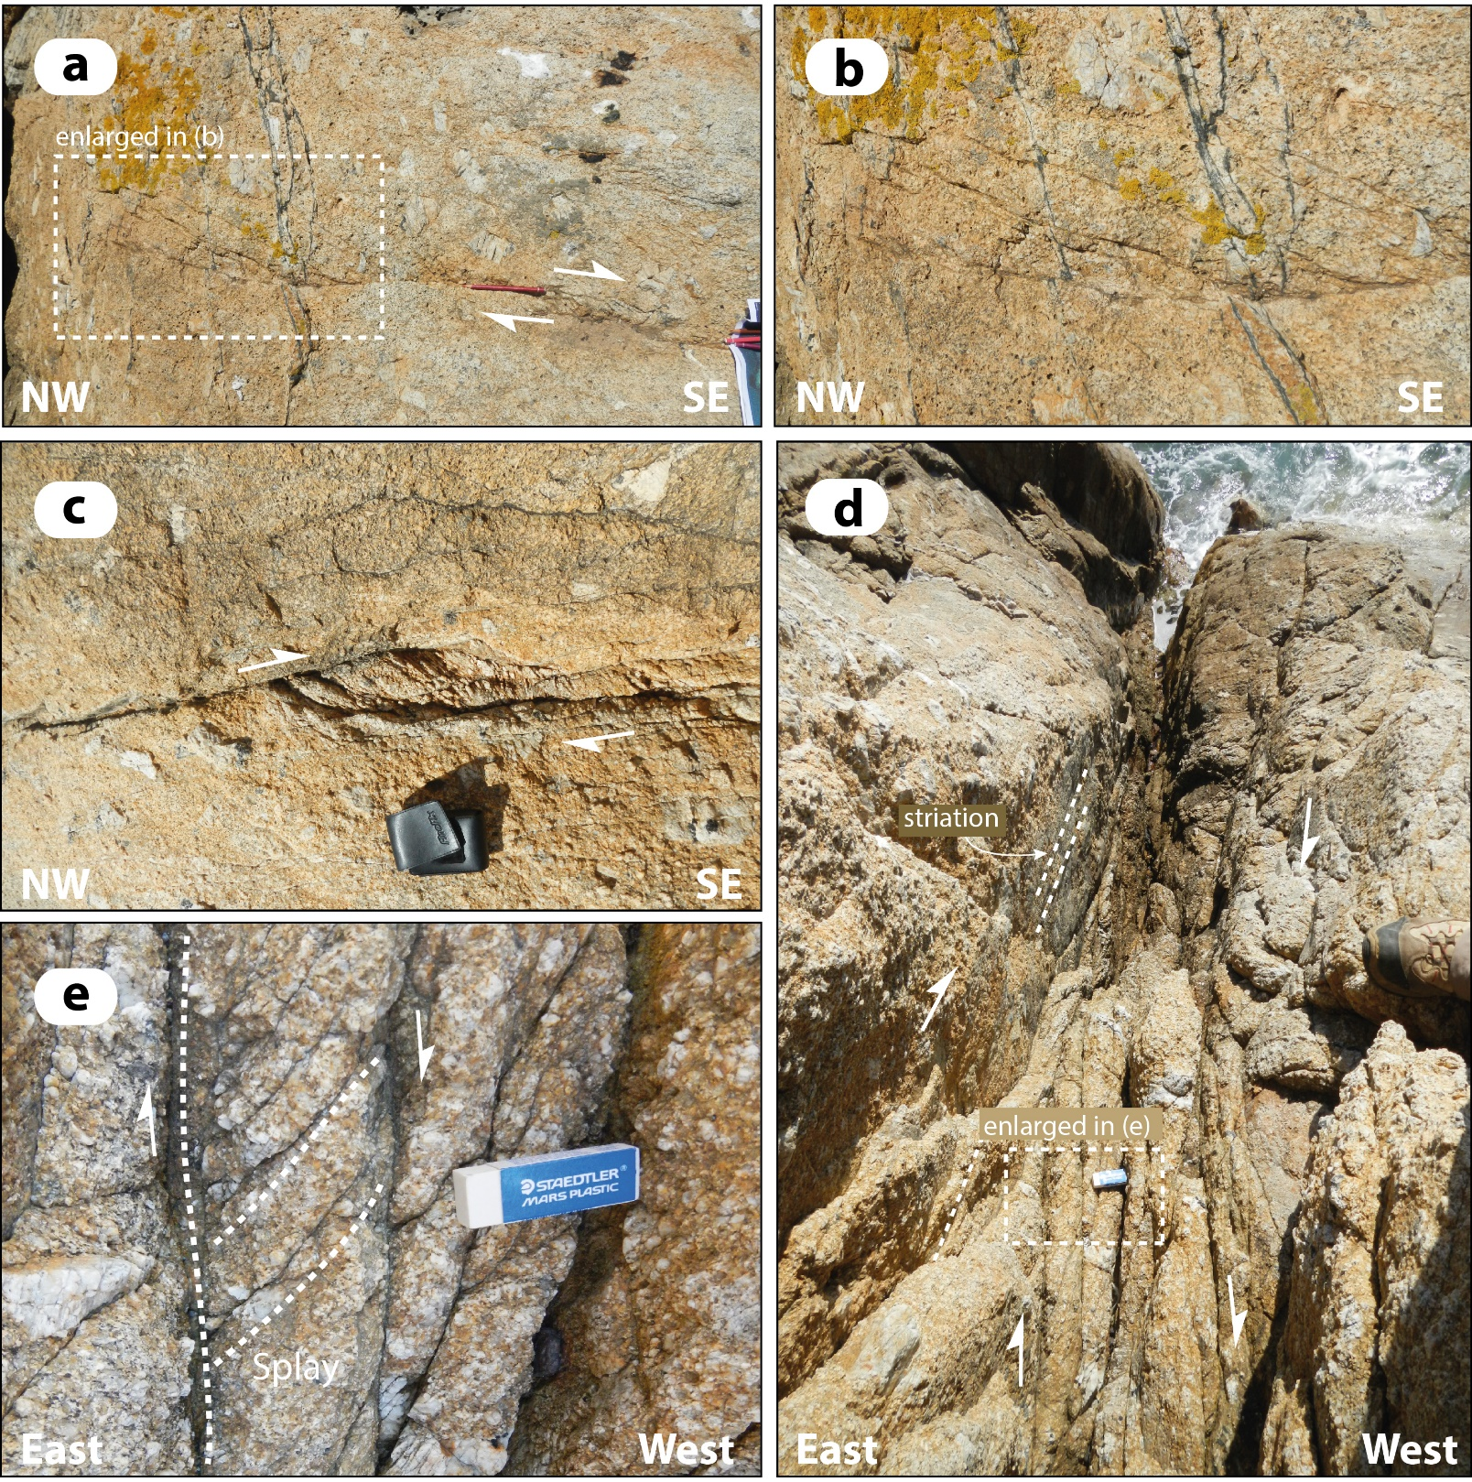
Fig. 11) - Photographs illustrating details of the third generation faults affecting the monzogranite in the Capo Bianco promontory:
a-b) horsetail fractures developed in the tip-damage zone of a right-lateral strike-slip fault;
c) dm-sized extensional jog formed in the linking damage zone of two overstepping right-lateral strike-slip faults;
d-e) detail of a right-lateral strike-slip fault zone and minor (i.e. splay) structures.

Slide 14
Fig. 12 – EBSD misorientation maps of sample RG2.
Kfs shown with IPF color coding, quartz distinguished as phase (red) and plagioclase shown in band contrast mode (grey tones). Boudinaged Kfs recrystallizes to new grains in the neck, showing crystallographic mismatches between 10 and > 90°;
Anastomosing recrystallized quartz bands (IPF color coded) show a large preference for reddish colors, proving that the c-axis distribution of recrystallized grains is oriented towards the observer. Maximum of crystallographic mismatches along grain boundaries is > 30°.

Slide 15
Fig. 13 - Pole figures, equal area projections, lower hemisphere.
Multiples of Mean Unit Densities expressed by color bars. Bar with maxima just above 7 belong to pole figures b,c,e, while bar with maximum at 14 belongs to pole figure d;
pole figure of recrystallized grains in the neck of the boudinaged Kfs (Fig. 12a). White line is foliation trace. Maximum of {110} poles is consistent with this plane being the slip plain, while dispersion of slip direction <1-12> in a girdle centered on that maximum suggests that dislocation creep was accommodated by grain boundary sliding;
quartz c-axis of grains within anastomosing bands within sample RG2 form a maximum in the central part of the pole figure, while poles to a- and m-prisms are dispersed along the equatorial section of the pole figure;
distribution of c-axes within recrystallized quartz-rich band in sample RG2 forms a pronounced maximum in the center, while poles to a- and m-prisms form single maxima consistent with dextral shear and activation of prism <a> slip;
quartz c-axis distribution within recrystallized grains of mylonitic monzogranite (sample RG4, Fig. 15b) forms a typical type-I crossed girdle, suggesting activation of basal <a>, rhomb <a> and prism <a> slip, and hence lower deformation T than for sample RG2.

Slide 16
Fig. 14 - Micrograph of a discrete shear zone localized within Sample RG4 and EBSD analysis areas.
The foliated monzogranite (top) evolves to a mylonite in correspondence of EBSD analysis area Fig. 15a. There is a deformation gradient from mylonite towards ultramylonite next to the quartz-rich vein with green tourmaline clasts;
b) sketch of Fig. 14a highlighting the different deformational domains: G = foliated monzogranite; GM = mylonite ; UM = ultramylonite. Location of Figures 15a and b is also shown.

Slide 17
Fig. 15. EBSD misorientation maps (IPF color coding) of the areas indicated in Fig. 14.
Monzogranite next to the mylonite boundary. Large quartz crystals are still preserved showing evidence of sub-grain boundaries. Recrystallization starts at sites of stress localization. Crystallographic mismatches are between 10 and >60°. The small grain size and evidence for mixing up of recrystallized grains belonging to different quartz domains suggest grain-boundary sliding to have been important;
Monzogranite deformed to higher strain. Quartz is fully recrystallized and forms a mylonitic foliation trending ENE-WSW in the map. Some remnants of larger grains with core and mantle structure are still preserved. Maximum misorientation of adjacent grains is larger than 30°. Variegated colors of grains testify that slip occurred along multiple systems during mylonitic deformation. Non indexed grey phases are Kfs and plagioclase.

Slide 18
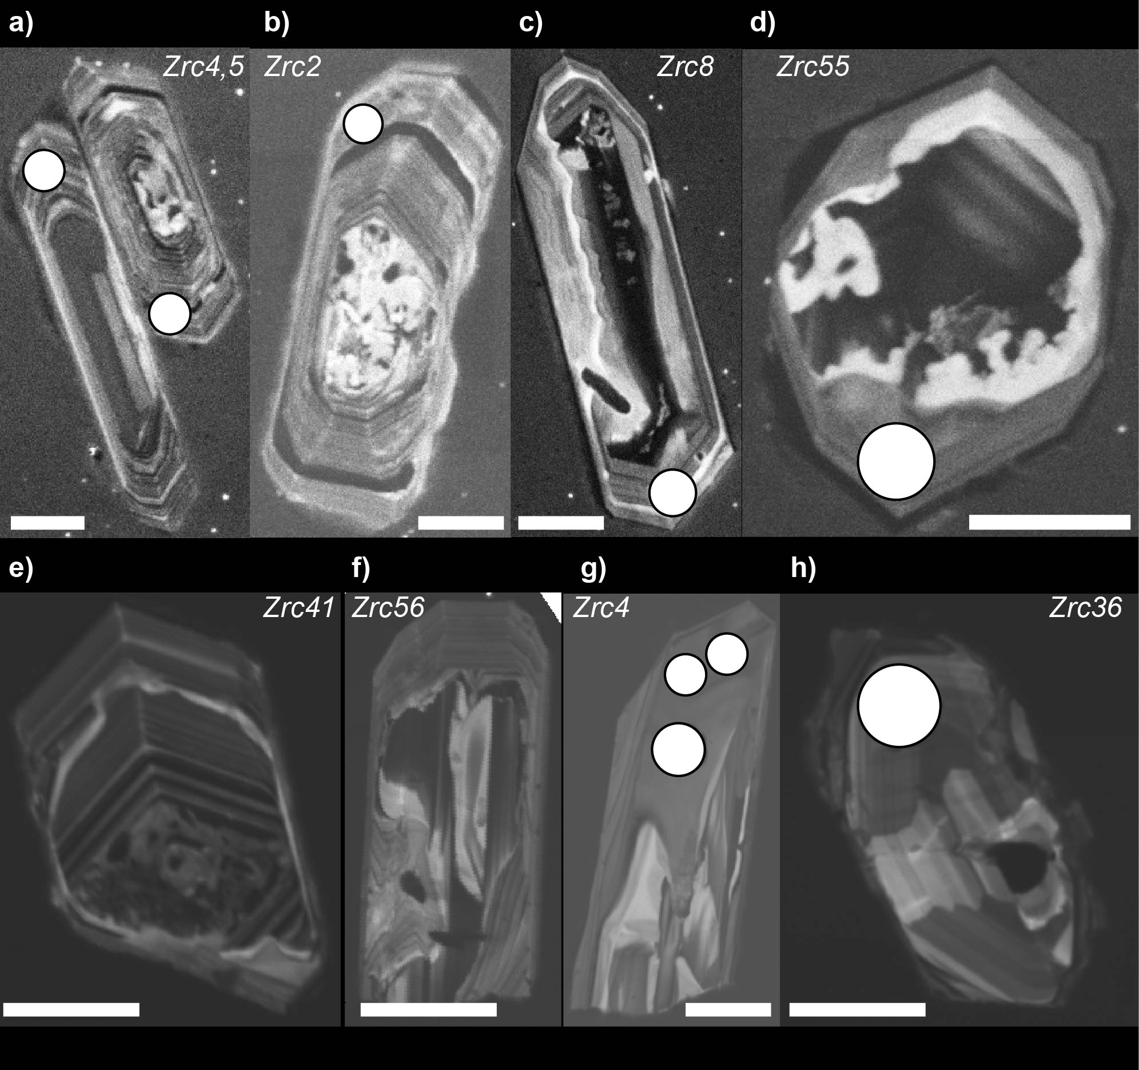
Fig. 16 – Selected BSE-CL images of zircon grains from samples RG14 (a-d) and RG12 (e-h) representative of different CL features. Location of LA-ICP-MS spots is shown as well as Zrc#. Scale bar is 50 μm.

Slide 19
Fig. 17 – ²⁰⁶Pb/²³⁸U zircon data for RG14 and RG12 samples. U-Pb data are ordered and shown as vertical bars comprising 2sigma errors. Grey filled bars were considered for calculation of weighted average ages (horizontal hemi transparent boxes).
Available U-Pb zircon data, with relative errors, for the Porto Azzurro pluton are also shown: white circles refer to SIMS U/Pb ages from three zircon grains in Gagnevin et al. (2011); black square is the LA-ICP-MS U/Pb age of a zircon rim from the contact aureole (Musumeci et al., 2011).

Slide 20
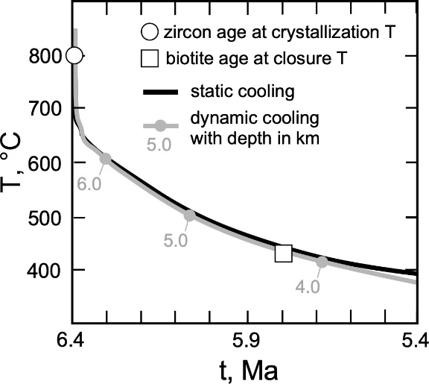
Fig. 18 - T-t diagram showing the cooling history of the Porto Azzurro monzogranitic pluton reproduced for 1 Myr after the magma emplacement fixed at 6.4 Ma at a depth of c. 6.5 km. The two cooling curves result from a static model (black line) and a dynamic model (grey line), incorporating the effect of unroofing simulated by an exponential law (see Table 1). Details of the modelling are provided in Caggianelli et al. (2018) and Caggianelli et al. (2014). Age obtained from zircon is plotted at the corresponding saturation temperature. Age of biotite (Maineri et al., 2003) is plotted at the corresponding closure temperature, calculated by Dobson (1973) formula.

Slide 21
Fig. 19 - Depth - strength diagrams at 300 kyr, 600 kyr and 1 Myr. They show depth of the brittle/ductile transitions and the contact between the Porto Azzurro monzogranite with the roof rocks.
(a) Static model;
(b) dynamic model incorporating the effect of unroofing

Slide 22
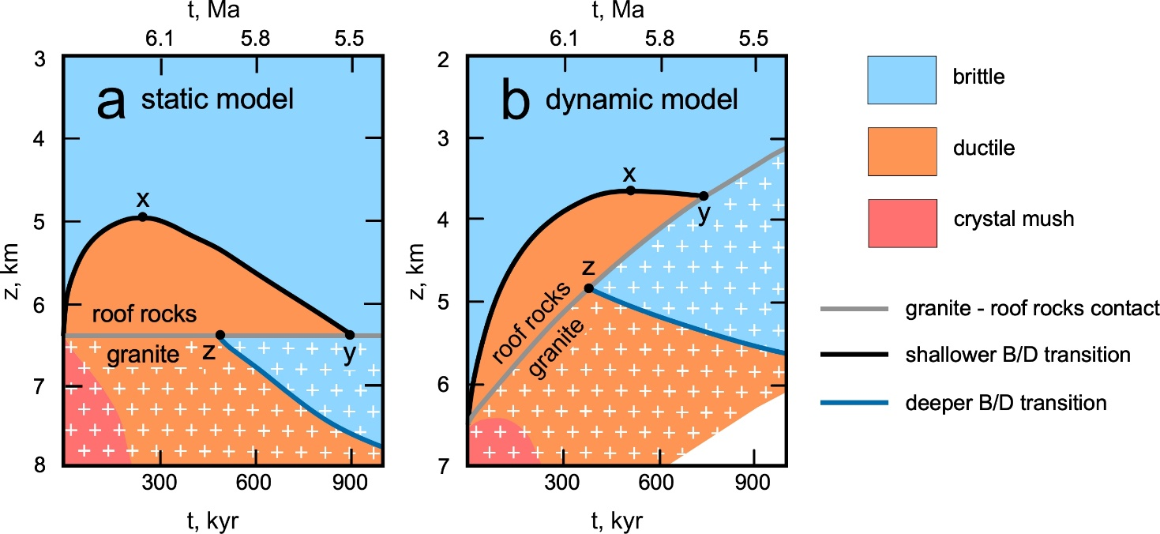
Fig. 20 - z-t diagram showing the depth change of the rheological boundaries (black and blue lines) and of the monzogranite - roof rocks lithological boundary (grey line), as reproduced by a static (a) and dynamic model (b). The simulation lasts 1 Myr starting from 6.4 Ma and from a magma emplacement depth of 6.5 km. The shallower brittle-ductile (B/D) transition (black line), within the roof rocks, culminates to a minimum depth in correspondence of point x and disappears after point y. The deeper B/D transition (blue line), within the monzogranite, starts from point z and progressively sinks. The co-existence of B/D transitions is confined to the time interval between z and y points. The rheological evolution of the top of the pluton, relevant for the Capo Bianco outcrop, can be followed along the grey line. Thus, the points z and y mark the transition to the brittle domain for the monzogranite and the roof rocks, respectively.

Slide 23
Table 1 - Physical parameters used in the thermal model.
Parameter | Symbols and equations | Values
Thermal conductivity [W m⁻¹ K⁻¹] | K | 1.85 (crust) 3.35 (mantle)
Density [kg m⁻³] | r | 2750 (crust) 3300 (mantle)
Specific heat [J kg⁻¹ K⁻¹] | C_{P} | 1000 (crust) 1100 (mantle)
Heat generation rate [µW m⁻³] | A =A₀ e^{(-z/D)} | A₀ = 2 D = 12000 m
Latent heat of crystallization [kJ kg⁻¹] | DH | 300 (for a T range of 850-650 °C)
Unroofing rate [m yr⁻¹] | v_{z} = dz/dt = -c z | v_{z} _{(t=0)} = 5 x 10^{–3} m yr⁻¹ c = 8.93 x 10⁻⁷ yr⁻¹

