Slide 1
Rapid Mapping of Landslides by Deep-Learning of Combined Optical and SAR Data
Lorenzo Nava¹, Oriol Monserrat² and Filippo Catani³
¹University of Florence, Department of Earth Sciences, Italy (lorenzo.nava@stud.unifi.it)
²Centre Tecnològic Telecomunicacions Catalunya, Department of Remote Sensing, Spain (omonserrat@cttc.cat)
³University of Padua, Department of Geosciences, Italy (filippo.catani@unipd.it)
EGU General Assembly 2021 - Session NH3.6 - ‘Landslide investigation using Remote Sensing and Geophysics’ - 26 April 2021

Slide 2
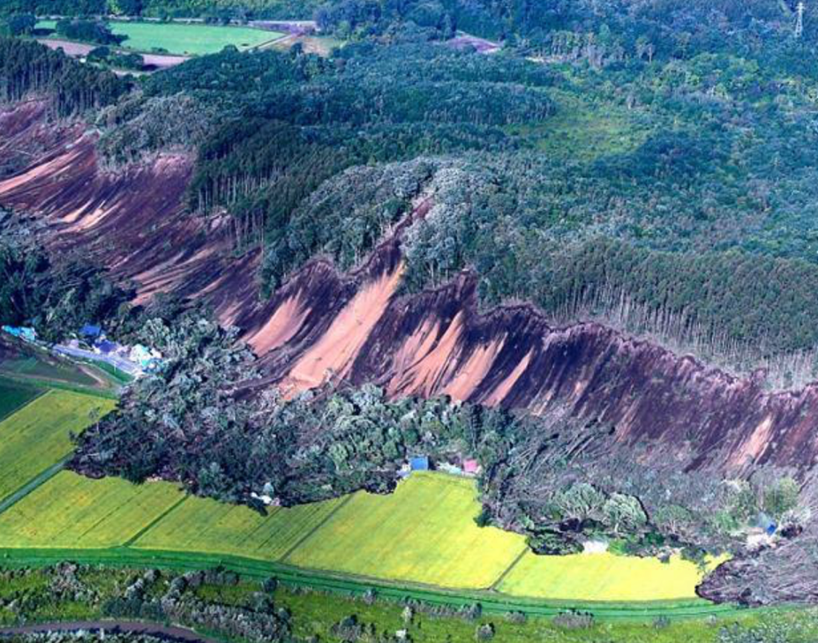
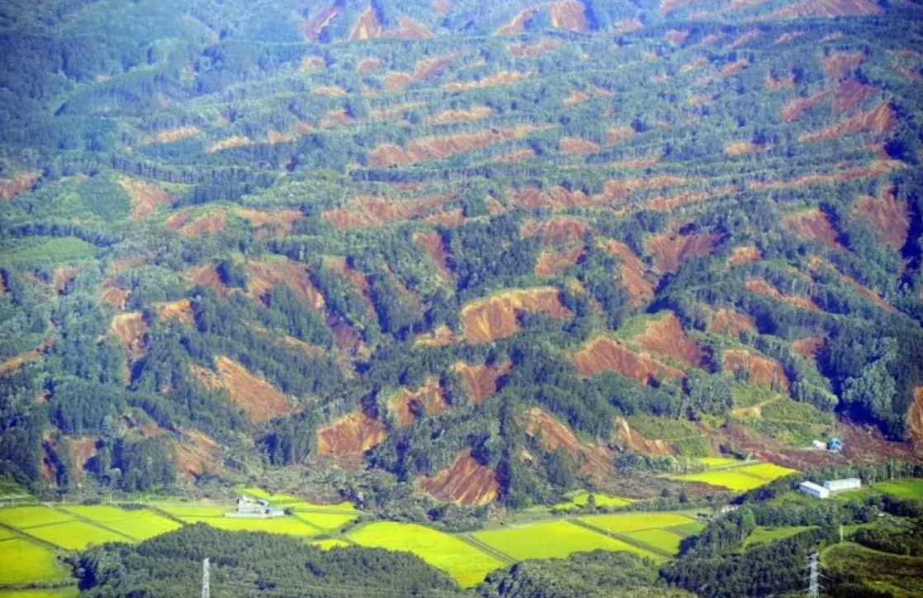
EGU General Assembly 2021
Chile, in 2010 (Serey et al., 2019).
Kumamoto (Song et al., 2019) and Ecuador (Chunga et al., 2019), in 2016.
Hokkaido (Wang et al., 2019) and Lombok (Ferrario, 2019), in 2018.
Introduction:
In the world, various natural calamities, can trigger multiple landslide events, that can occur in group of hundreds to thousands in a region, in a short time span.
Source: https:\\video.corriere.it
Source: http:\\meteoweb.eu

Slide 3
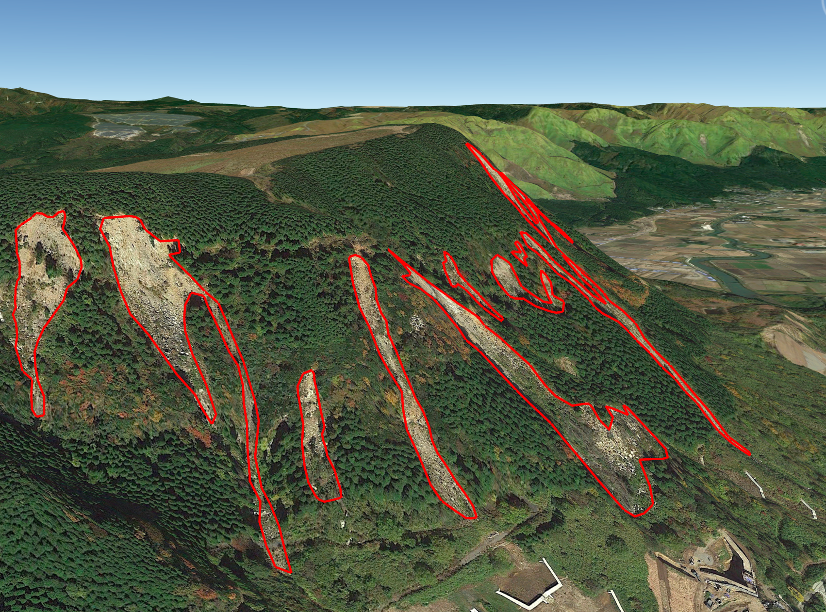
EGU General Assembly 2021
Purpose of the study:
Potential and limits of convolutional neural networks (CNN) applied to SAR data to detect landslides.
Method able to define the spatial activation of landslides right after a multiple event, that can be applied independently from the presence of cloud cover.

Slide 4
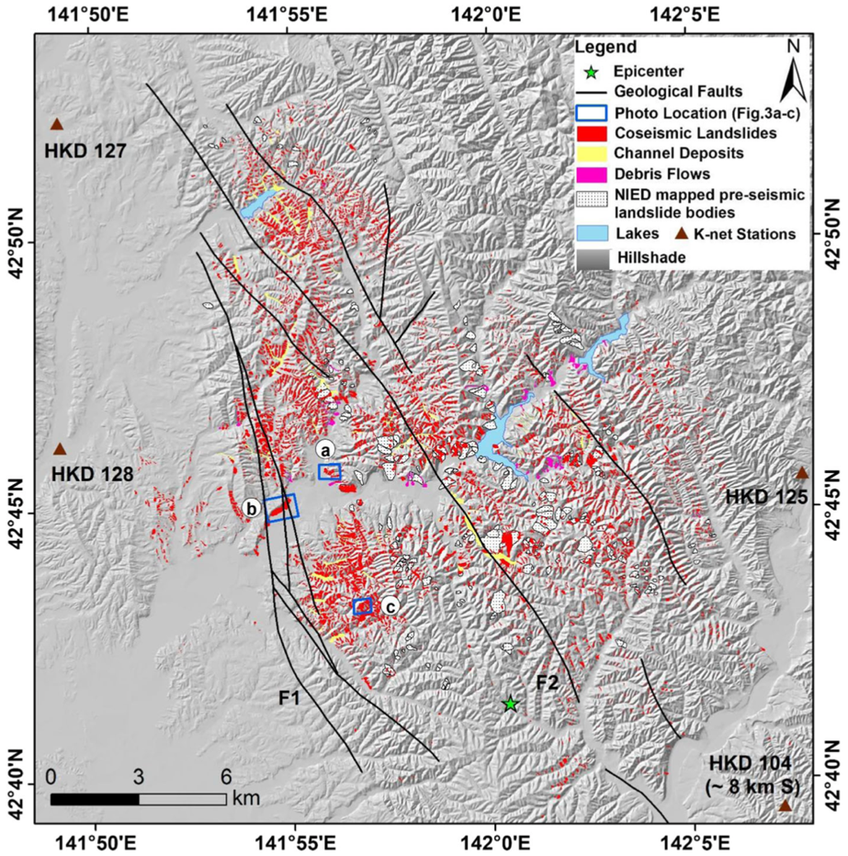
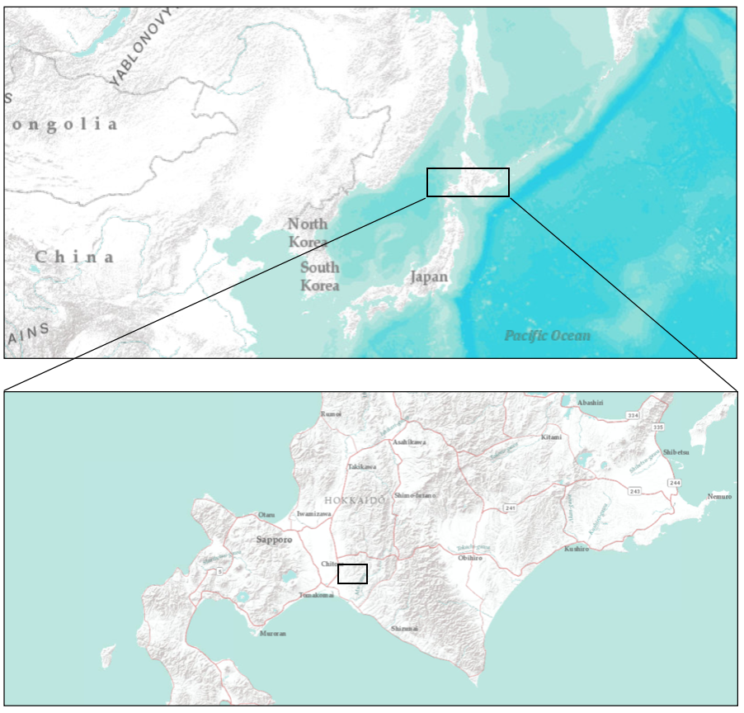
EGU General Assembly 2021
Study area:
Event considered:
Iburi sub-prefecture, Hokkaido, Japan.
A 6.6 Mw earthquake triggered about 7837 coseismic landslides on September 6, 2018.
Fig. 1: Localization of the study area.
Fig. 2: Coseismic landslides in the study area. (Source: Wang et al. 2019).

Slide 5
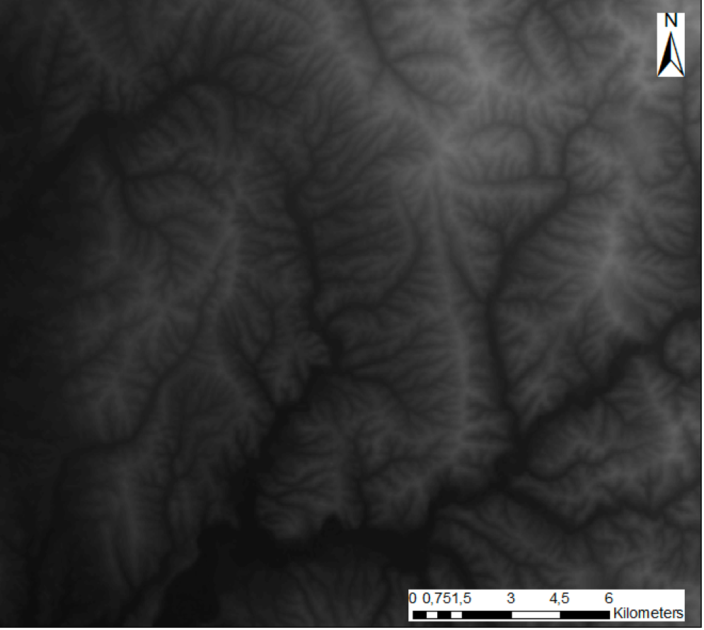
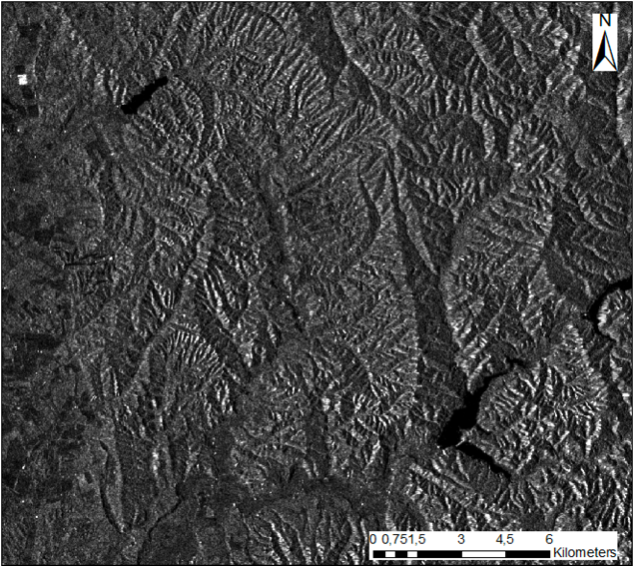
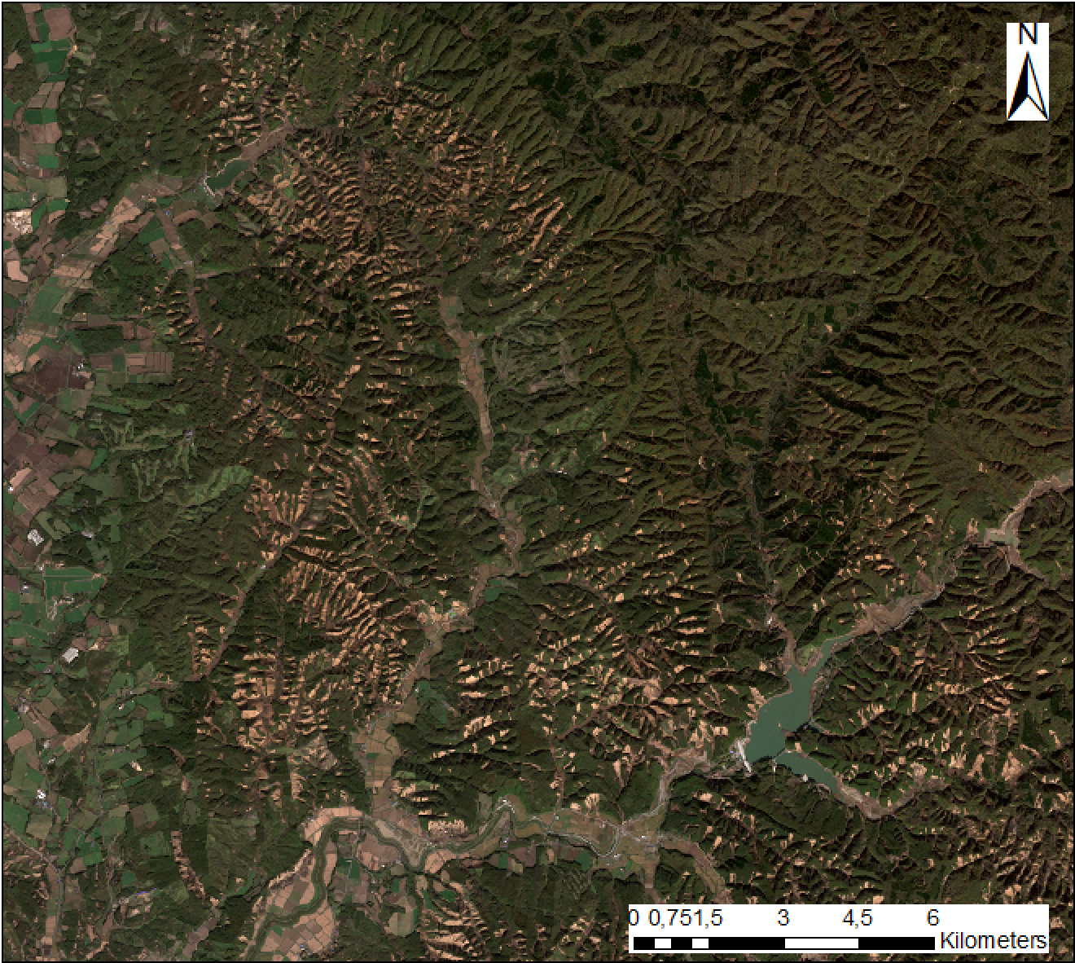
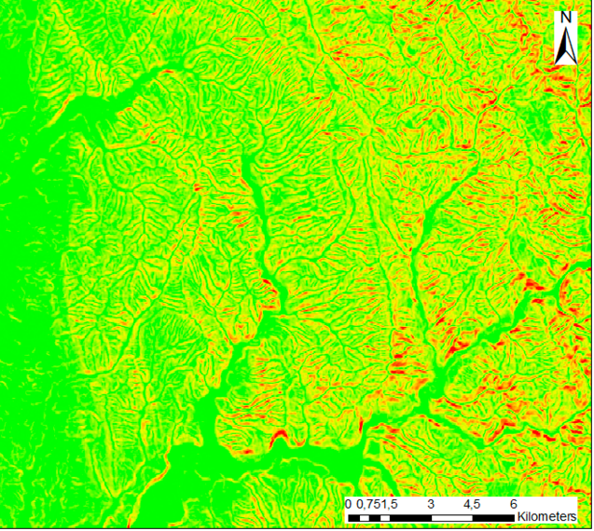
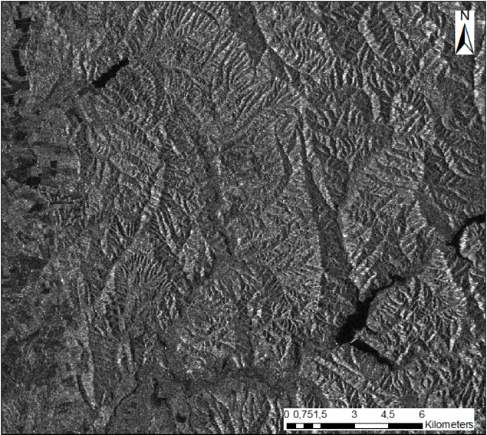
EGU General Assembly 2021
Materials:
Sentinel-1 SAR GRD products with VV and VH polarizations, and IW acquisition mode (5 m x 20 m).
Sentinel-2 VHR RGB image (10 m x 10 m).
Digital Elevation Model (DEM) (30 m x 30 m) and slope obtained from the same.
Region and Year | Sentinel-2 | Sentinel-1
 |  | 01-09
Iburi, Hokkaido 2018 | 20-10 | 13-09
 |  | 25-09
Multiple landslide event
Tab. 1: Dates of acquisition of Sentinel-2 and Sentinel-1 for the study area in Hokkaido 2018.

Slide 6
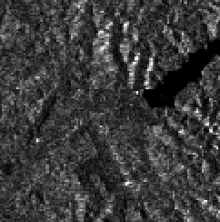
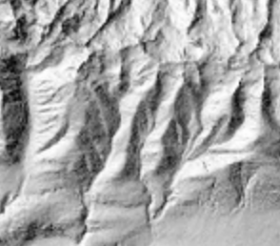
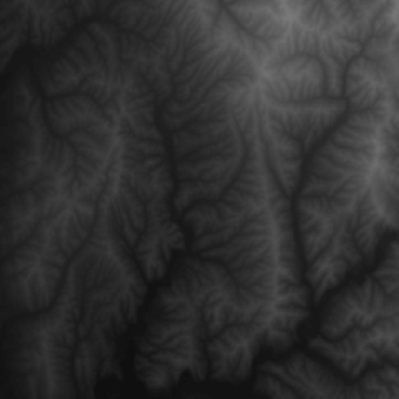
EGU General Assembly 2021
Supervised classification:
Rete Neurale
Input
CNN
Input
Output
Sentinel-1 SAR Layers
Conv2D, 3x3
Output
ReLU
MaxPool2D, 2x2
LANDSLIDE
Conv2D, 3X3
NO LANDSLIDE
ReLU
MaxPool2D, 2x2
Topographic Layers
+

Slide 7
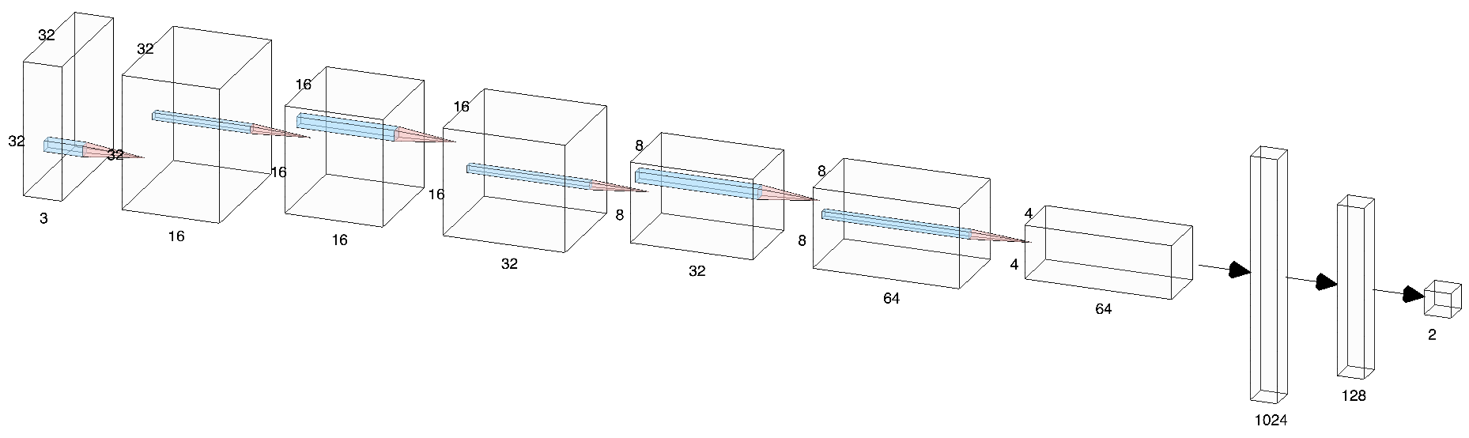
EGU General Assembly 2021
CNN architecture:
Input
3x3
Convolution
3x3
Convolution
3x3
Convolution
Output
Max Pooling
Max Pooling
Max Pooling
Fig. 3: CNN architecture.
Flatten
Fully Connected

Slide 8
EGU General Assembly 2021
Results of test datasets:
Dataset Name | Band1 | Band2 | Band3
RGB | Red | Green | Blue
SSD | VV after-event | VH after-event | DEM
SSs | VV after-event | VH after-event | Slope
BAD | VV before-event | VV after-event | DEM
BAs | VV before-event | VV after-event | Slope
HHH | VH before-event | VH after-event | VH after-event
BAA | VV before-event | VV after-event | VV after-event
BAC | VV before-event | VV after-event | VV after-event - VV before-event
BAH | VV before-event | VV after-event | VH after-event
Accuracy(%) | Precision(%) | Recall(%)
99.20 | 99.60 | 98.81
86.63 | 92.24 | 80.16
80.84 | 82.77 | 78.17
89.96 | 95.83 | 83.47
88.55 | 96.58 | 79.84
81.87 | 93.22 | 68.75
94.17 | 97.32 | 90.83
90.83 | 93.36 | 87.92
93.33 | 95.22 | 91.25
Tab. 2: Datasets characteristics.
Tab. 4: Accuracy, precision and recall on the test datasets.

Slide 9
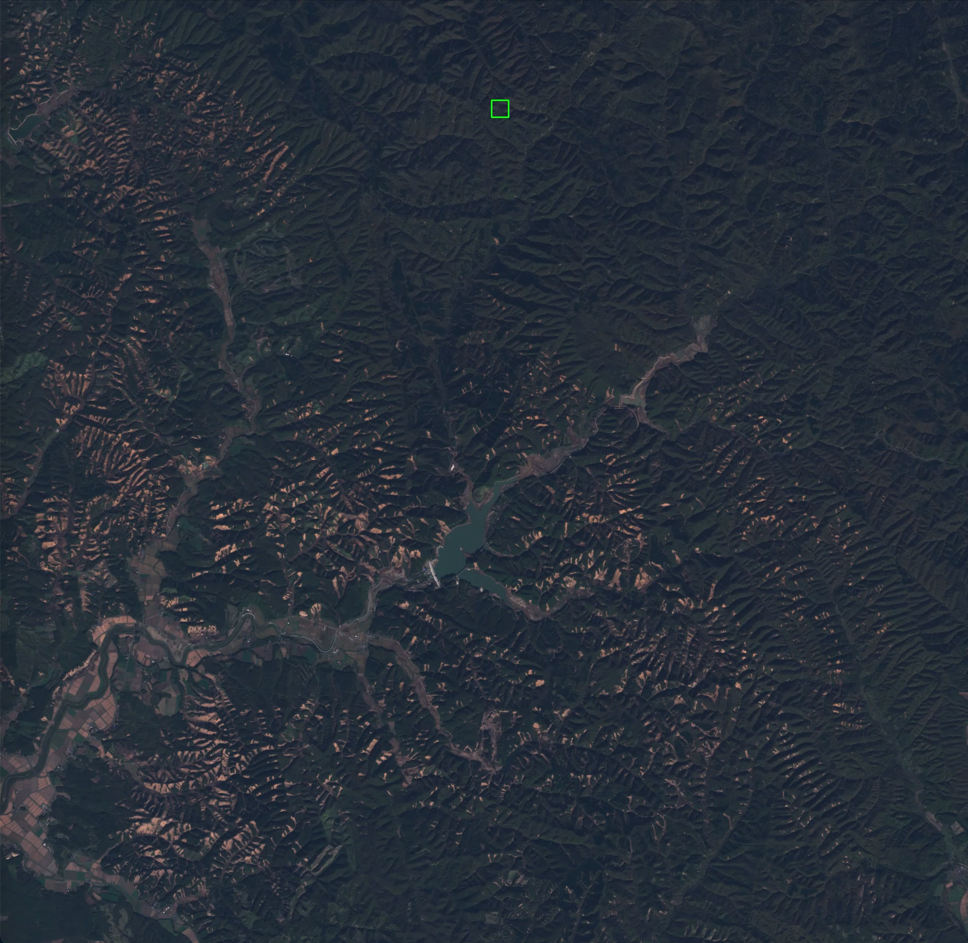
EGU General Assembly 2021
Object detection - sliding window:
Window size: 25 m x 25 m.
Window step: 2 pixels.
Classification of the center pixel of each ROI analyzed.

Slide 10
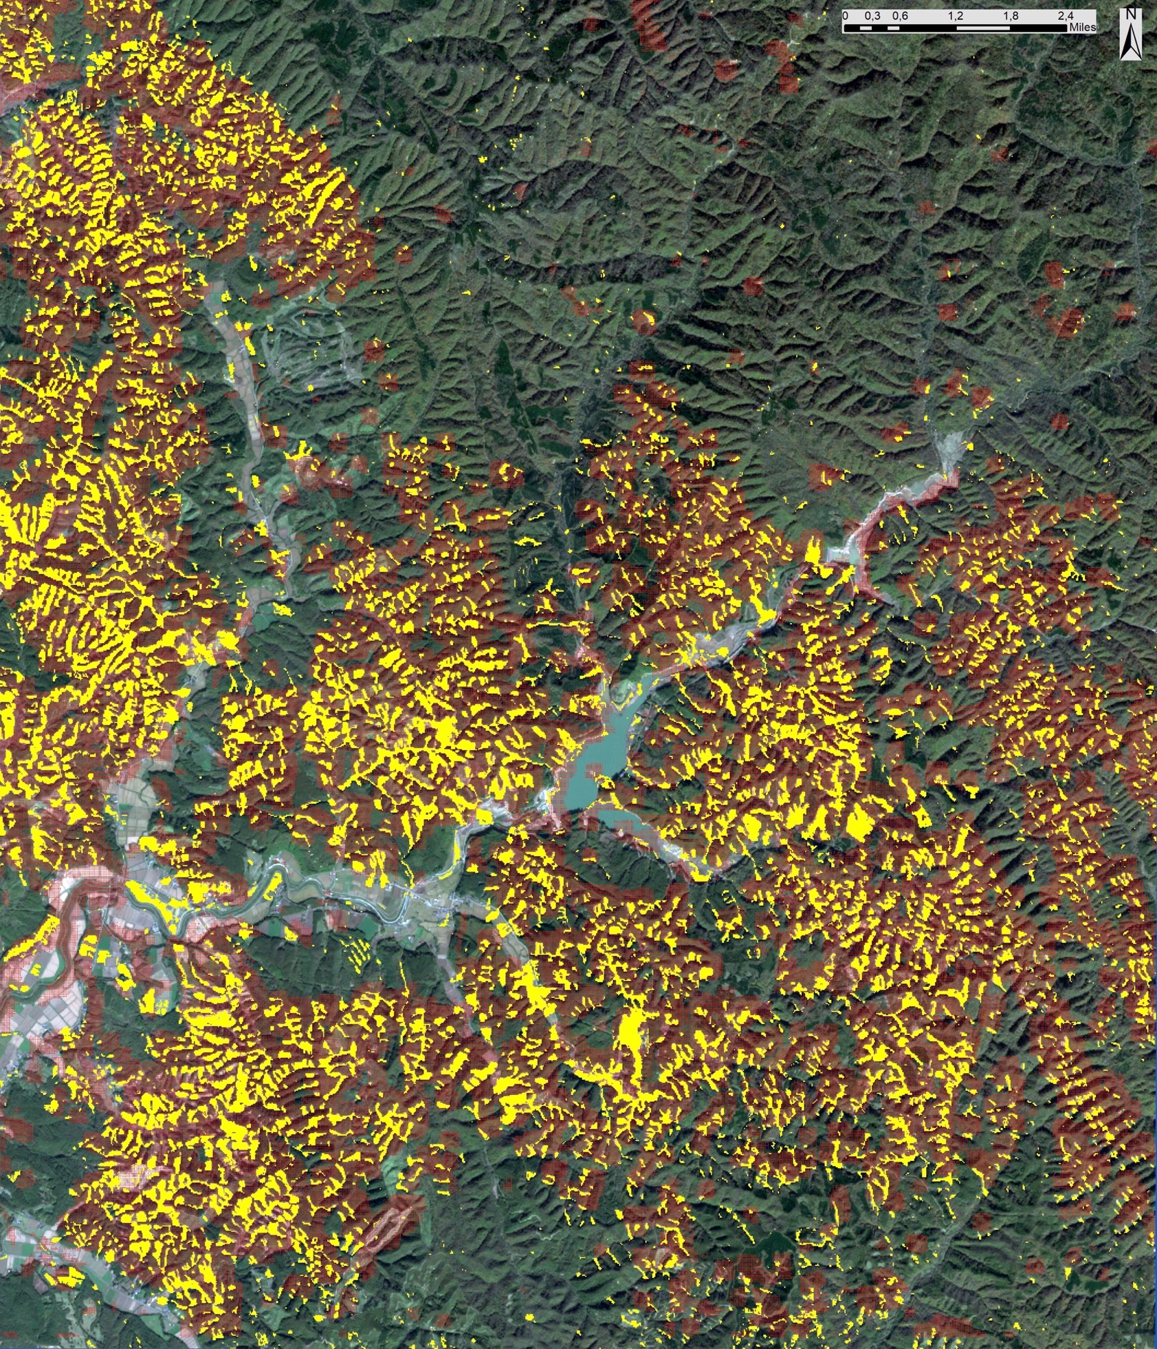
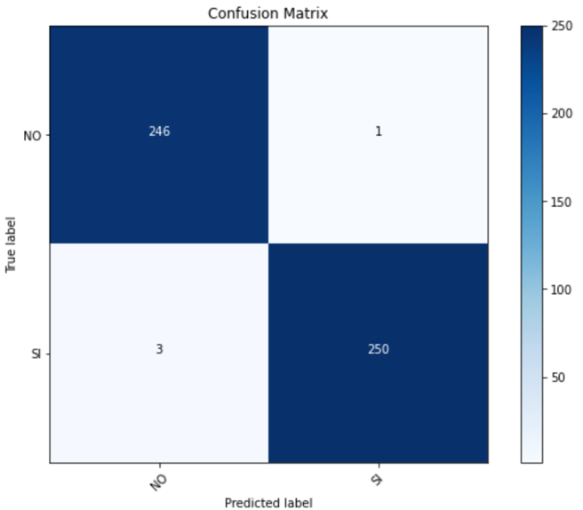
EGU General Assembly 2021
Landslide mapping - RGB:
Dataset Name | Band1 | Band2 | Band3 | Band4
RGB | Red | Green | Blue
Accuracy(%) | Precision(%) | Recall(%)
99.20 | 99.60 | 98.81

Slide 11
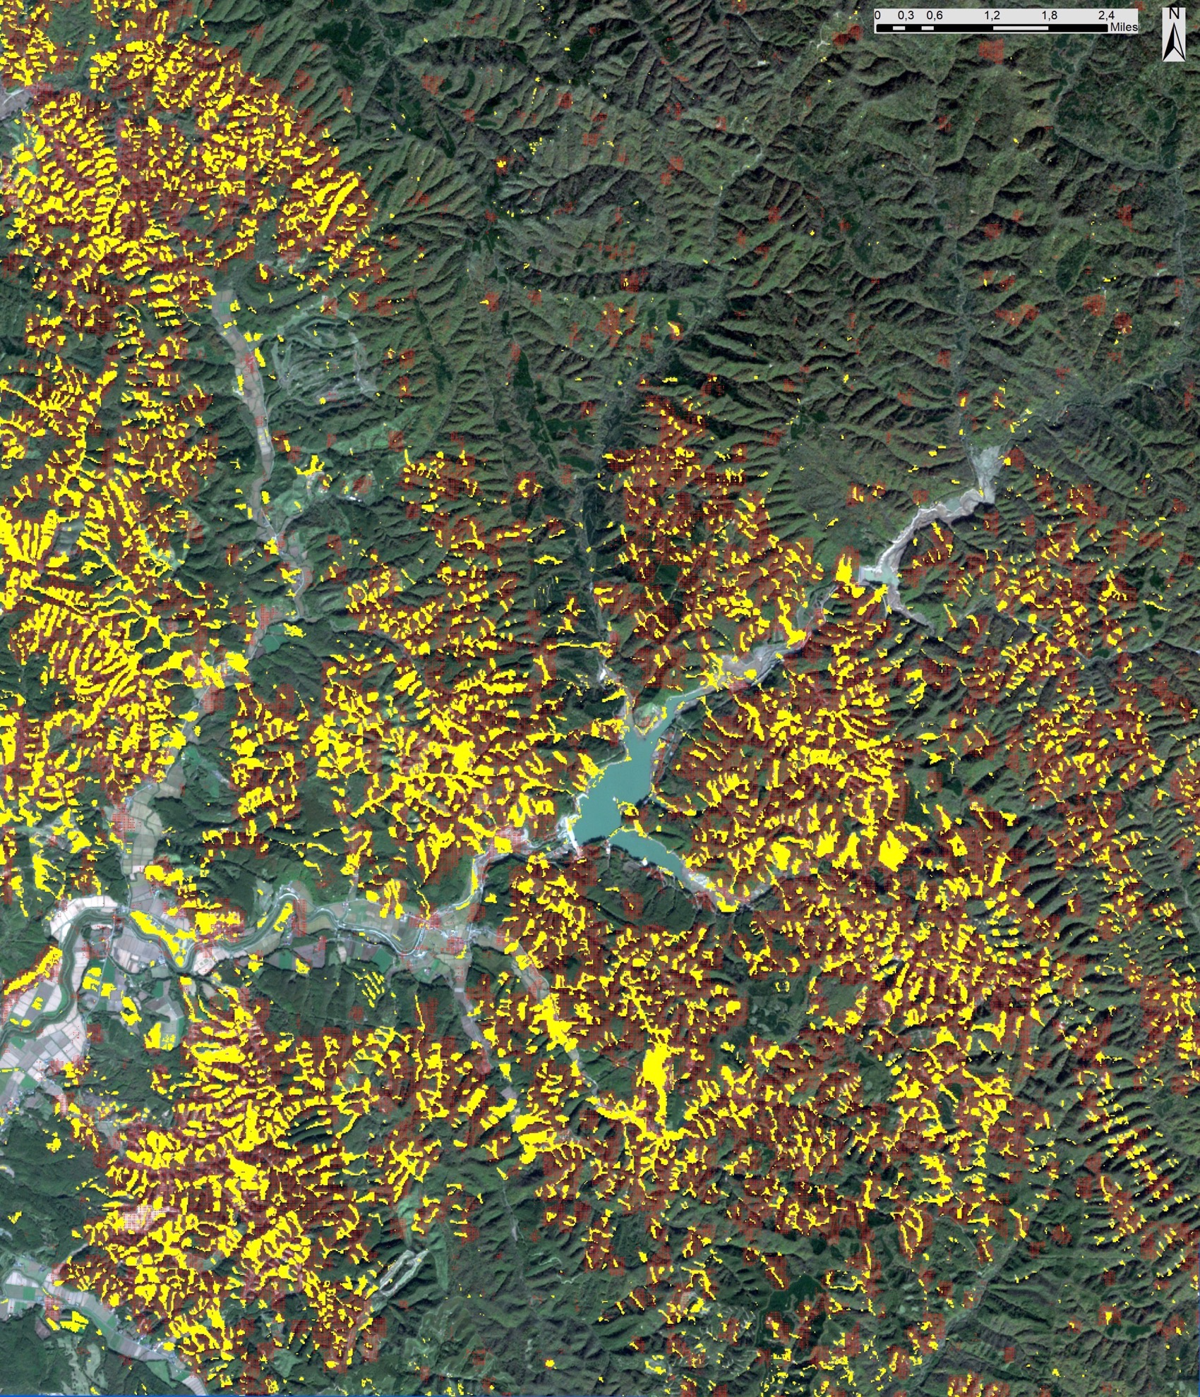
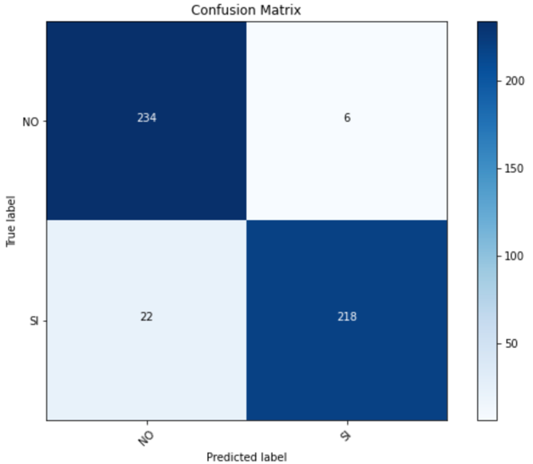
EGU General Assembly 2021
Landslide mapping - baa:
Dataset Name | Band1 | Band2 | Band3 | Band4
BAA | VV before-event | VV after-event | VV after-event
Accuracy(%) | Precision(%) | Recall(%)
94.17 | 97.32 | 90.83

Slide 12
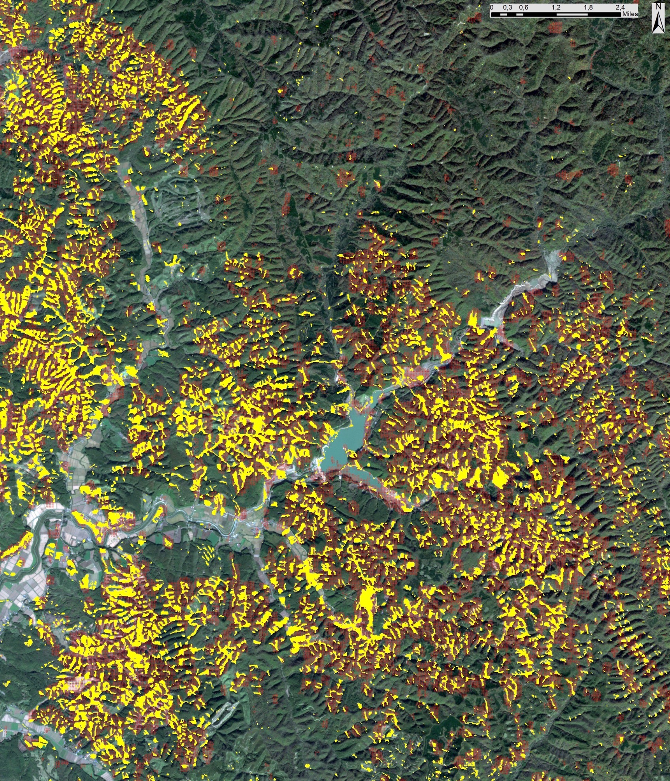
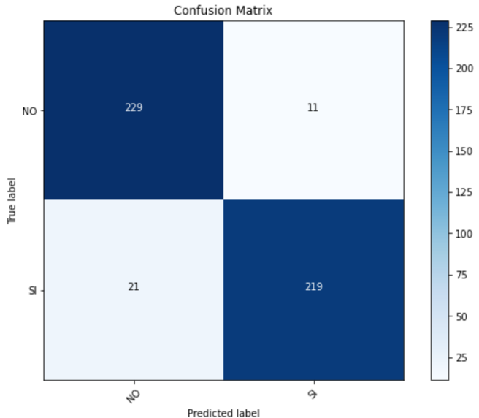
EGU General Assembly 2021
Landslide mapping - baH:
Dataset Name | Band1 | Band2 | Band3 | Band4
BAH | VV before-event | VV after-event | VH after-event
Accuracy(%) | Precision(%) | Recall(%)
93.33 | 95.22 | 91.25

Slide 13

EGU General Assembly 2021
Conclusions:
We verified that the developed method, using SAR data, can achieve accuracies comparable to the optical data, but it is exploitable also in presence of cloud cover.
The time spent by the model to analyze the entire study area (about 460 km ) is less than five minutes.
The next steps will be to evaluate the application of segmentation deep-learning-based methods on SAR data to define the perimeter of each individual landslide and to exploit composite images with 4+ bands, e.g., to combine RGB, SAR and topographic factors.
2

Slide 14
THANK YOU
FOR YOUR ATTENTION

