Slide 1


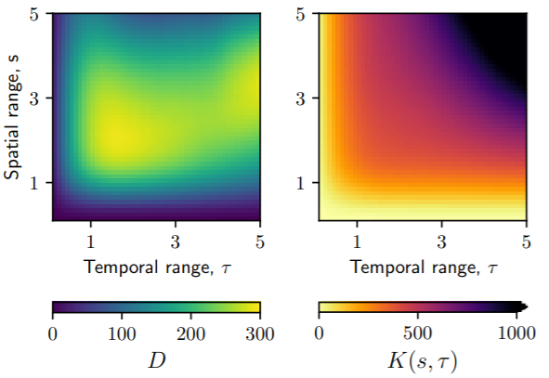
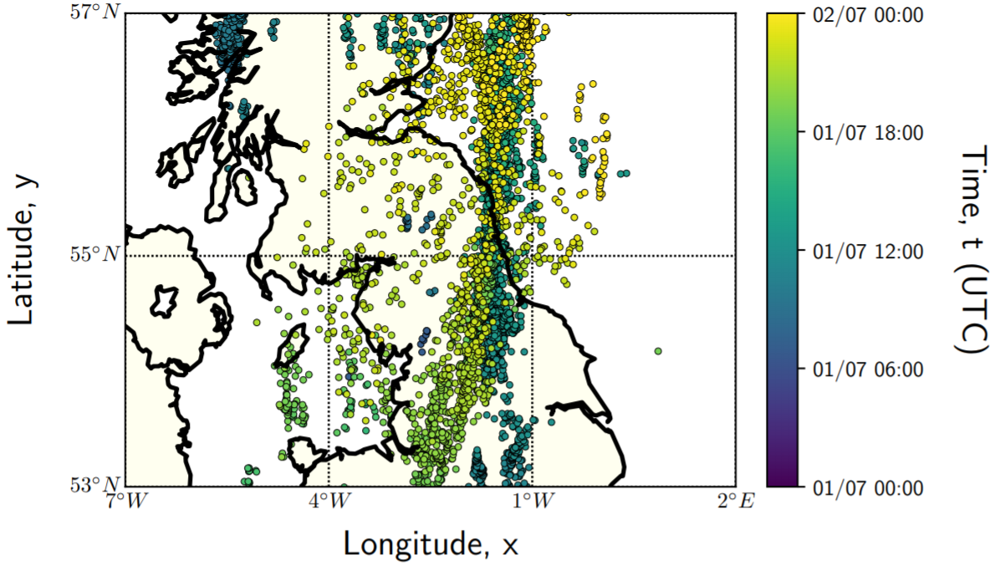
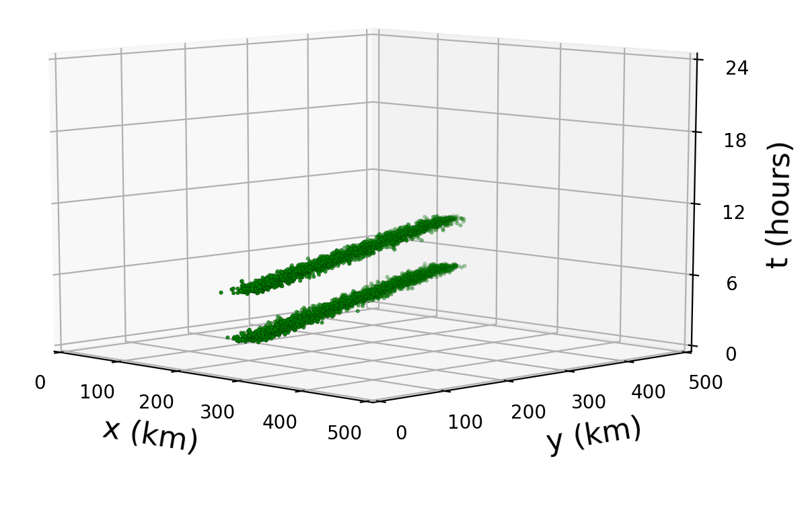
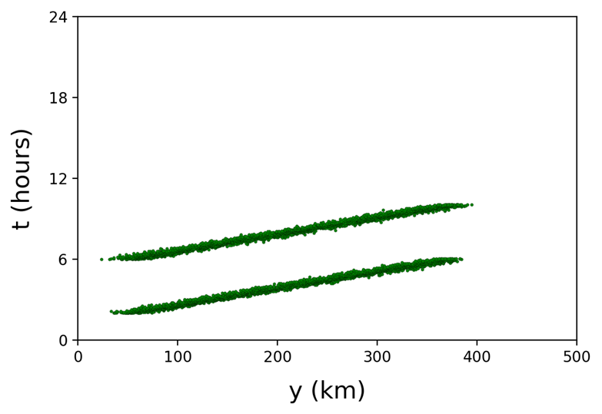
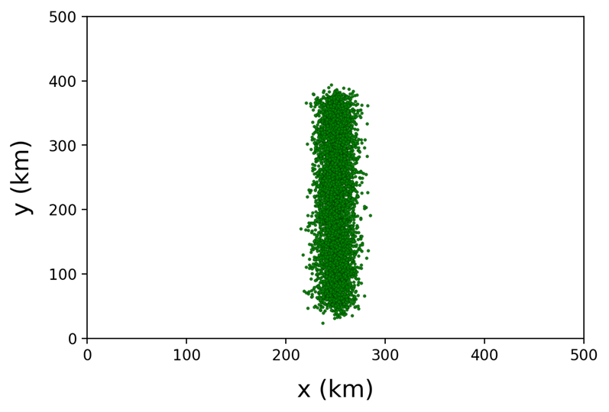
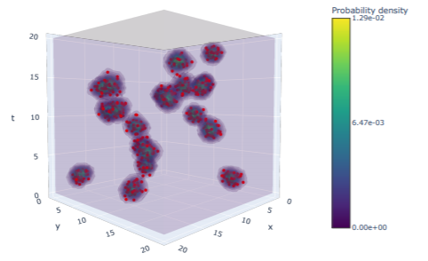
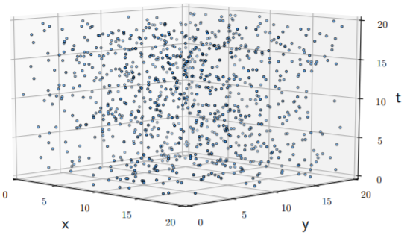
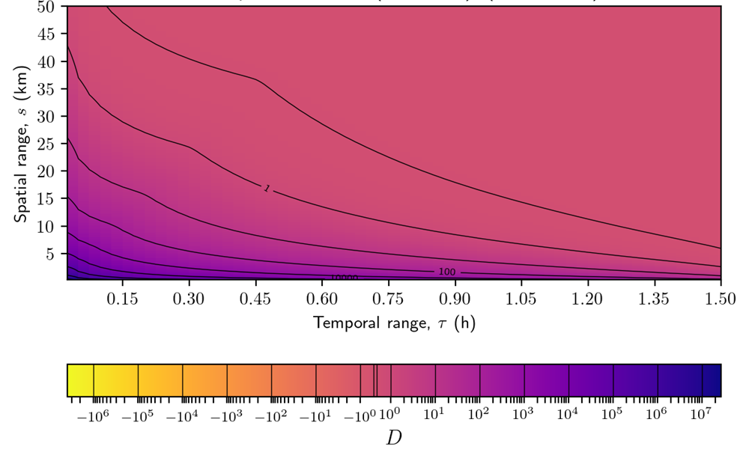
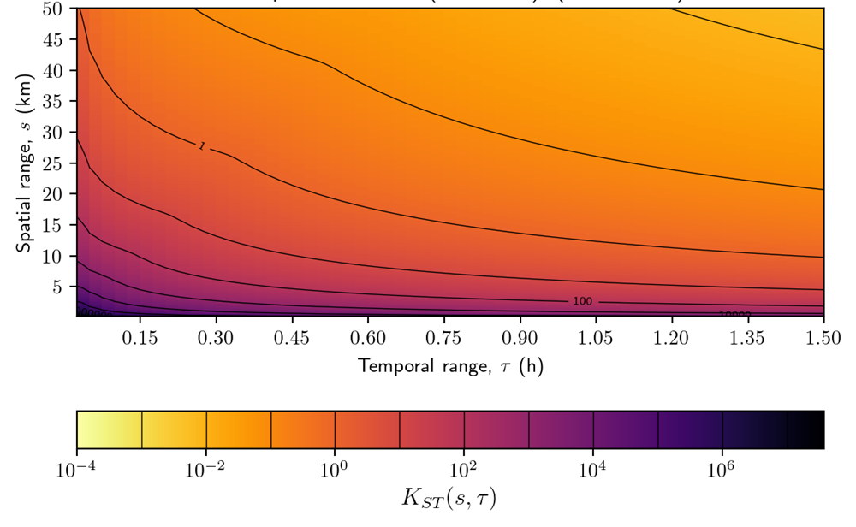
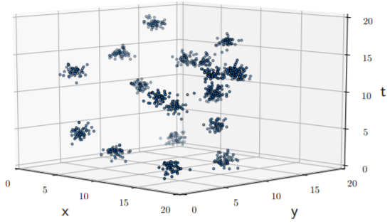
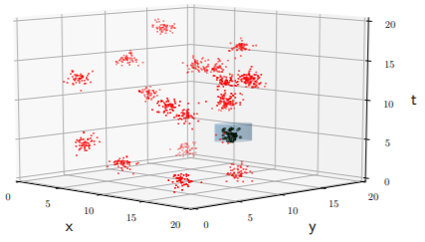

Spatio-Temporal Clustering Methodologies for Point-Event Natural Hazards
Uldis Zandovskis¹, Bruce D. Malamud¹, Davide Pigoli²
(1) Dept. of Geography and (2) Dept. of Mathematics, King’s College London, UK (e-mail: uldis.zandovskis@kcl.ac.uk)
A
Critical review of spatio-temporal clustering procedures
1a. Global clustering procedures:
Provide a single quantitative measure of dataset clustering.
1b. Local clustering procedures:
Asign individual point events to a cluster.
B
C
D
Real-world and synthetic point-event datasets
Initial results
Current and future work
1. Synthetic point-event datasets produced by moving source models
Different moving time and space topologies representing various physical properties of the moving source producing the lightning strikes.
Inform bandwidth choice
Fig. C1. K-function analysis results.
Fig. B1. Real-world: 7021 lightning strikes from 1-2 July 2015 over UK.
Fig. D1. Base model of two identical moving sources.
Apply to
Results
Extend
2. Use of global clustering procedures to supplement local ones
Global clustering procedures can further be used to supplement local ones (e.g. limit the choice of input parameters, distance functions).
Limit input parameter set
Fig. C2. Kernel density estimation.
Fig. D2. K-function analysis example of spatial and temporal scales for global clustering.
3. Main research strands in current and future research
How and which input parameters in synthetic data result in diagnostic changes to clustering procedure results?
Which local procedures can identify two moving sources as individual clusters?
What modifications can improve the performance of clustering procedures?
Fig. B2. Synthetic: point-event datasets from homogeneous Poisson and Thomas point processes.
Fig. C3. Spatio-temporal scan statistic.

Slide 2
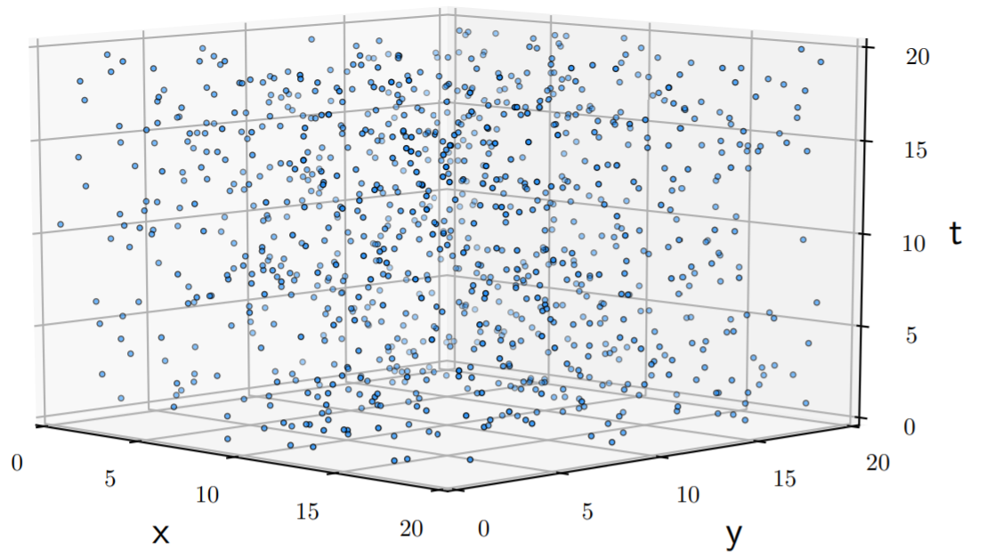
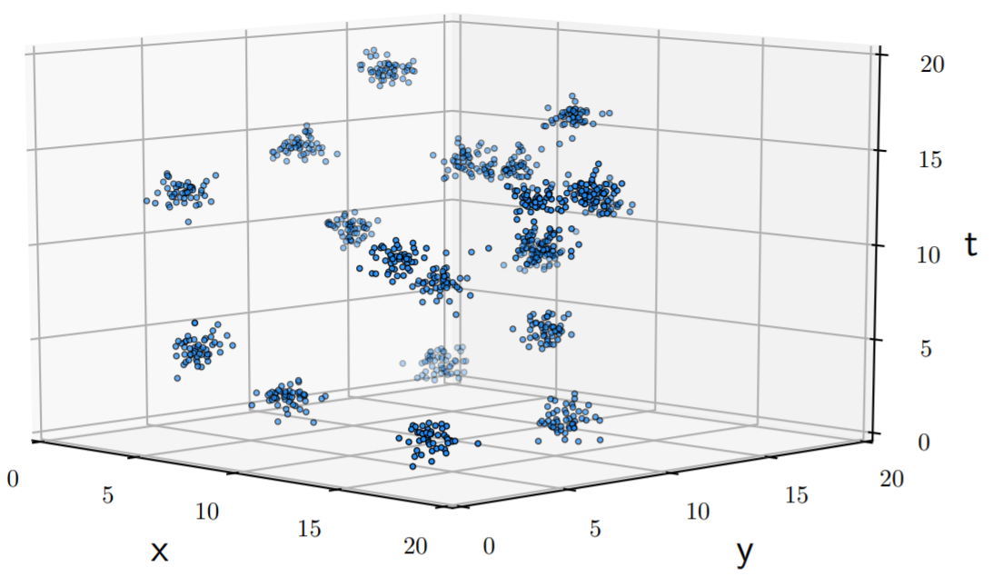
Spatio-Temporal Clustering Methodologies for Point-Event Natural Hazards
Uldis Zandovskis¹, Bruce D. Malamud¹, Davide Pigoli²
(1) Dept. of Geography and (2) Dept. of Mathematics, King’s College London, UK (e-mail: uldis.zandovskis@kcl.ac.uk)
Column B: Synthetic point event datasets
(a)
(b)
Fig. 1. Synthetic point-event datasets used for initial assessment and comparison of global and local clustering procedures. Both datasets consist of 1000 events, which are distributed over a {X=20, Y=20, T=20} space-time cube as (a) homogeneous Poisson process and (b) Thomas point process.

Slide 3
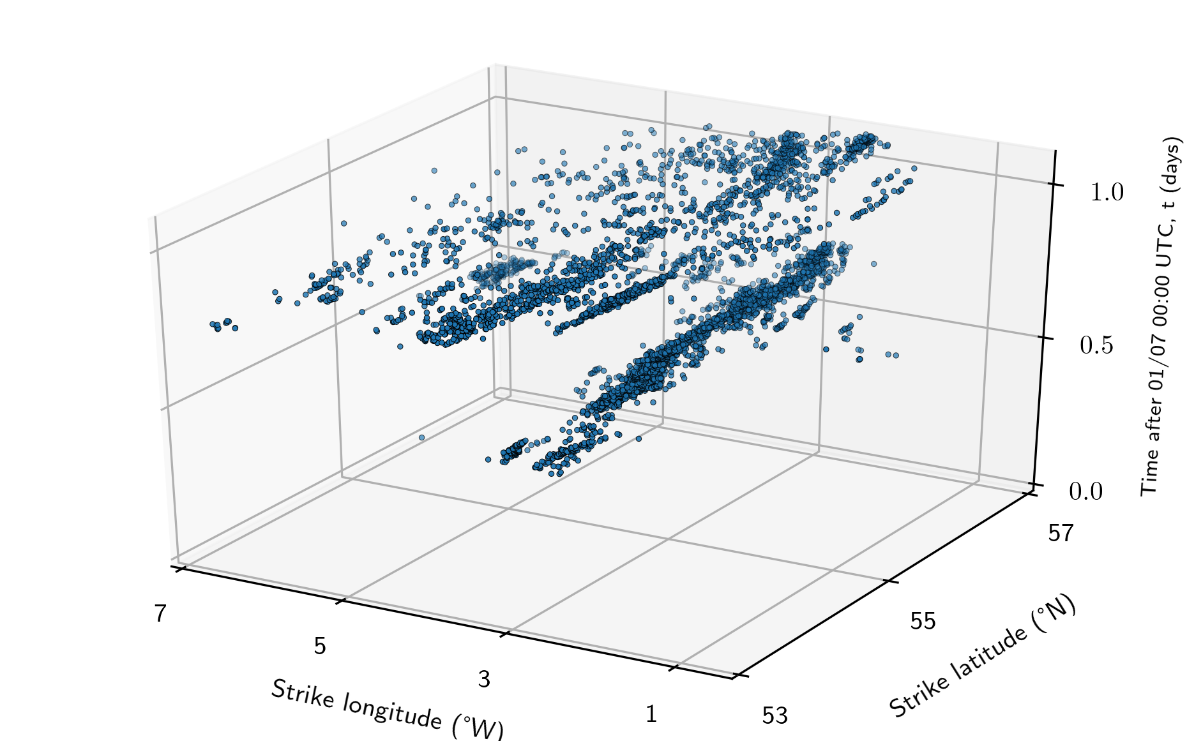
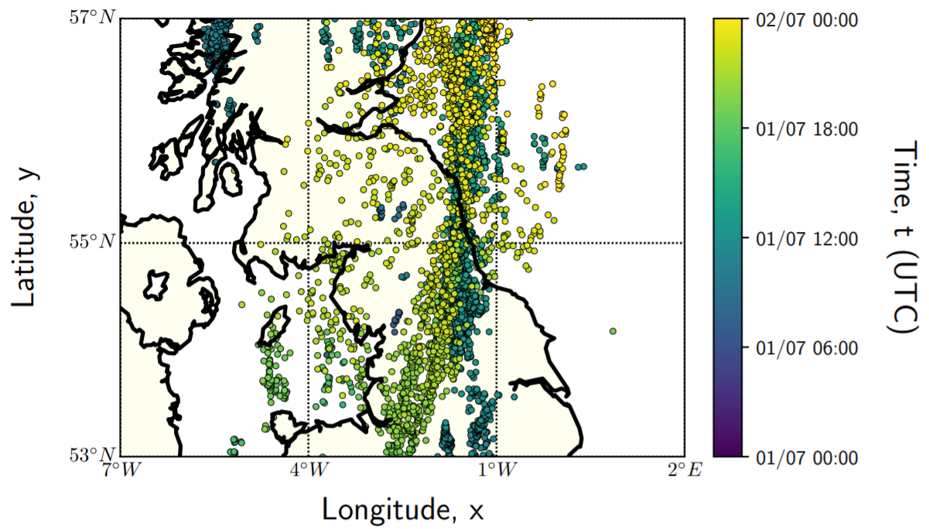
Spatio-Temporal Clustering Methodologies for Point-Event Natural Hazards
Uldis Zandovskis¹, Bruce D. Malamud¹, Davide Pigoli²
(1) Dept. of Geography and (2) Dept. of Mathematics, King’s College London, UK (e-mail: uldis.zandovskis@kcl.ac.uk)
Column B: Real-world point event dataset
(a)
(b)
Fig. 2. The subset (single day data collected on 1 July over a restricted spatial area within 53◦ and 57◦N latitude and 7 ◦W and 2 ◦E longitude) of the 2015 ATDnet (Gaffard et al., 2008) lightning strike location dataset. Shown in (a) is the 2D spatial view of the subset with the timestamp of each point event given by the colour, according to the colourscale, while (b) is the 3D spatio-temporal view of the subset.

Slide 4
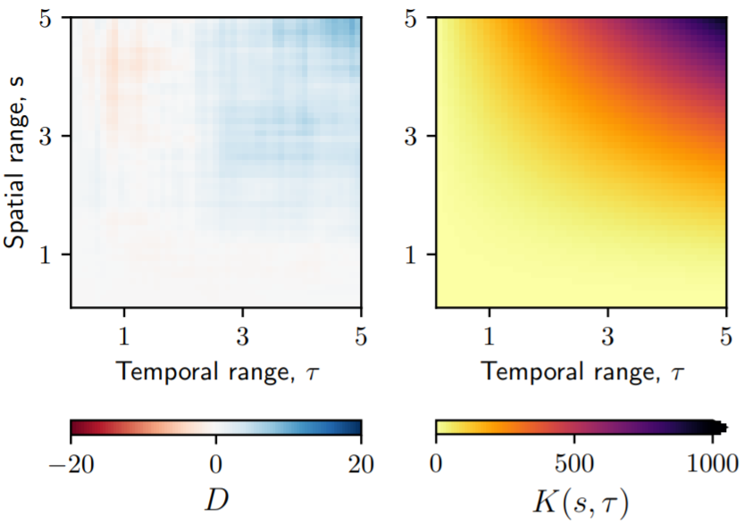

Spatio-Temporal Clustering Methodologies for Point-Event Natural Hazards
Uldis Zandovskis¹, Bruce D. Malamud¹, Davide Pigoli²
(1) Dept. of Geography and (2) Dept. of Mathematics, King’s College London, UK (e-mail: uldis.zandovskis@kcl.ac.uk)
Column C: K-function analysis results for synthetic data
(a)
(b)
Fig. 3. Diagnostic D (difference between spatio-temporal K-function and product of individual K-functions) and spatio-temporal K-function results for (a) homogeneous Poisson process and (b) Thomas point process.

Slide 5
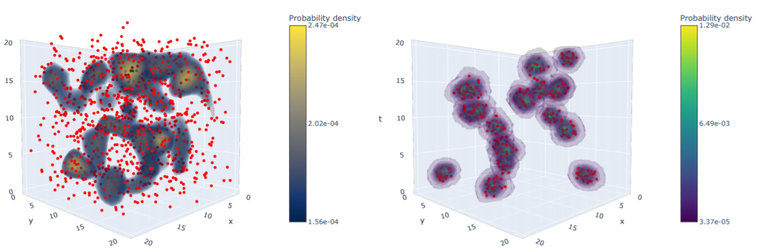
Spatio-Temporal Clustering Methodologies for Point-Event Natural Hazards
Uldis Zandovskis¹, Bruce D. Malamud¹, Davide Pigoli²
(1) Dept. of Geography and (2) Dept. of Mathematics, King’s College London, UK (e-mail: uldis.zandovskis@kcl.ac.uk)
Column C: Kernel density estimation results for synthetic data
(a)
(b)
Fig. 4. Volume rendering of voxels with highest 10% of the probability density values as returned by the kernel density estimation procedure for (a) homogeneous Poisson process and (b) Thomas point process.

Slide 6
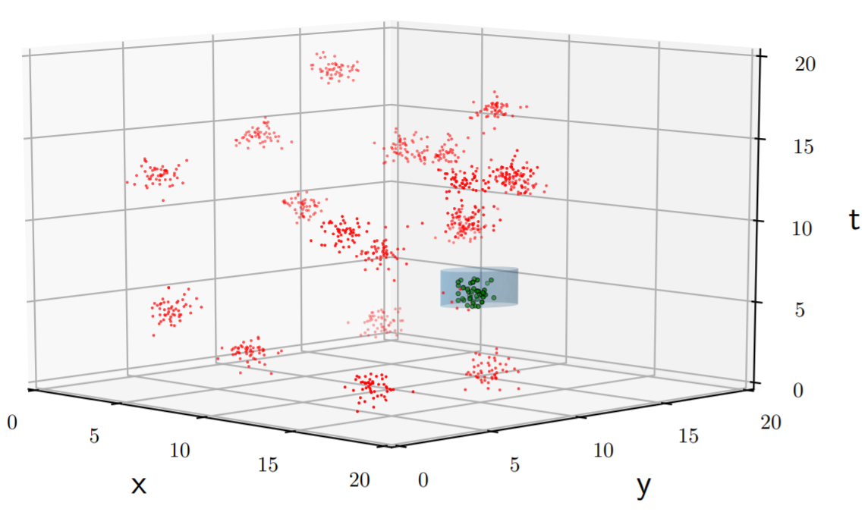
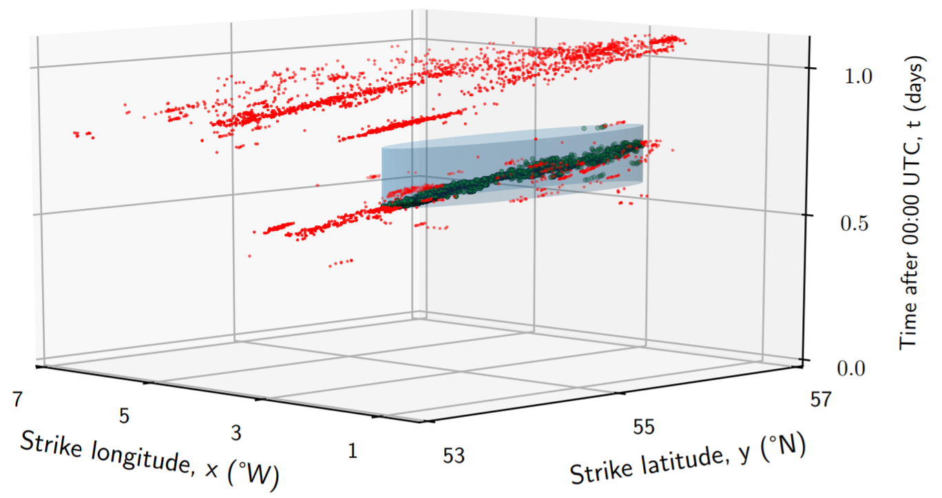
Spatio-Temporal Clustering Methodologies for Point-Event Natural Hazards
Uldis Zandovskis¹, Bruce D. Malamud¹, Davide Pigoli²
(1) Dept. of Geography and (2) Dept. of Mathematics, King’s College London, UK (e-mail: uldis.zandovskis@kcl.ac.uk)
Column C: Spatio-temporal scan statistic for both data types
(a)
(b)
Fig. 5. Spatio-temporal scan statistic results for (a) Thomas point process and (b) real-world lightning strike datasets. The returned elliptic cylinder volume is transparent and light blue, while point events contained within it are coloured green.

Slide 7
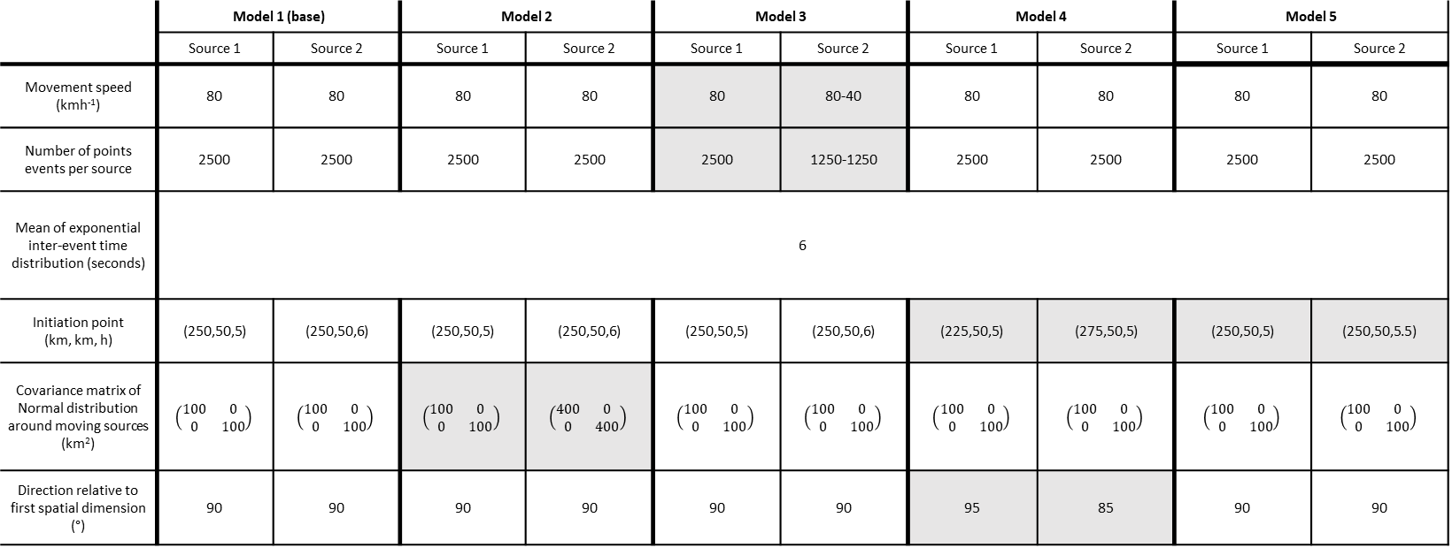
Spatio-Temporal Clustering Methodologies for Point-Event Natural Hazards
Uldis Zandovskis¹, Bruce D. Malamud¹, Davide Pigoli²
(1) Dept. of Geography and (2) Dept. of Mathematics, King’s College London, UK (e-mail: uldis.zandovskis@kcl.ac.uk)
Column D: Synthetic point-event datasets produced by moving source models
 | Model 1 (base) |  | Model 2 |  | Model 3 |  | Model 4 |  | Model 5
 | Source 1 | Source 2 | Source 1 | Source 2 | Source 1 | Source 2 | Source 1 | Source 2 | Source 1 | Source 2
Movement speed (kmh⁻¹) | 80 | 80 | 80 | 80 | 80 | 80-40 | 80 | 80 | 80 | 80
Number of points events per source | 2500 | 2500 | 2500 | 2500 | 2500 | 1250-1250 | 2500 | 2500 | 2500 | 2500
Mean of exponential inter-event time distribution (seconds) | 6
Initiation point (km, km, h) | (250,50,5) | (250,50,6) | (250,50,5) | (250,50,6) | (250,50,5) | (250,50,6) | (225,50,5) | (275,50,5) | (250,50,5) | (250,50,5.5)
Covariance matrix of Normal distribution around moving sources (km²) | $$\left(\begin{matrix}100 & 0 \\ 0 & 100\end{matrix}\right)$$ | $$\left(\begin{matrix}100 & 0 \\ 0 & 100\end{matrix}\right)$$ | $$\left(\begin{matrix}100 & 0 \\ 0 & 100\end{matrix}\right)$$ | $$\left(\begin{matrix}400 & 0 \\ 0 & 400\end{matrix}\right)$$ | $$\left(\begin{matrix}100 & 0 \\ 0 & 100\end{matrix}\right)$$ | $$\left(\begin{matrix}100 & 0 \\ 0 & 100\end{matrix}\right)$$ | $$\left(\begin{matrix}100 & 0 \\ 0 & 100\end{matrix}\right)$$ | $$\left(\begin{matrix}100 & 0 \\ 0 & 100\end{matrix}\right)$$ | $$\left(\begin{matrix}100 & 0 \\ 0 & 100\end{matrix}\right)$$ | $$\left(\begin{matrix}100 & 0 \\ 0 & 100\end{matrix}\right)$$
Direction relative to first spatial dimension (°) | 90 | 90 | 90 | 90 | 90 | 90 | 95 | 85 | 90 | 90
Fig. 6. Five different topologies of the two-source moving source point-event model. Variations from the base model (Model 1) for each of the different topologies are highlighted in grey.

Slide 8
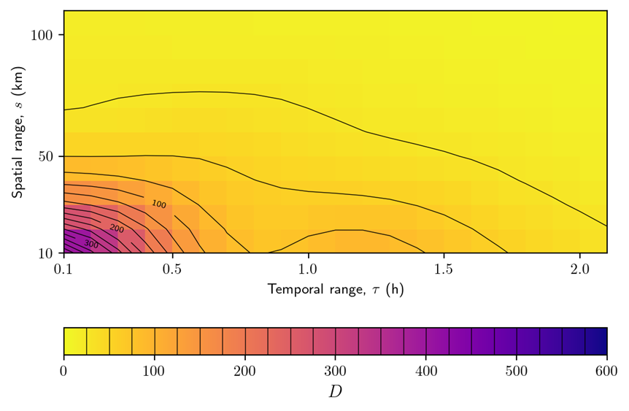
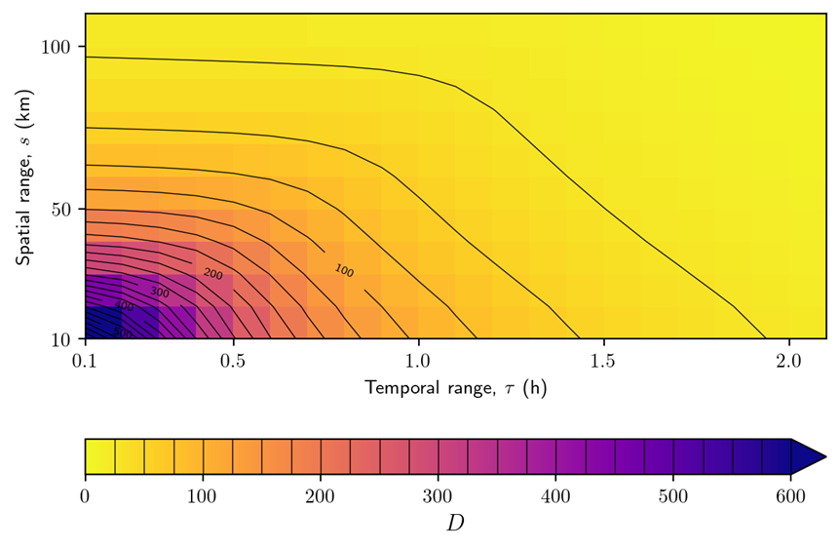
Spatio-Temporal Clustering Methodologies for Point-Event Natural Hazards
Uldis Zandovskis¹, Bruce D. Malamud¹, Davide Pigoli²
(1) Dept. of Geography and (2) Dept. of Mathematics, King’s College London, UK (e-mail: uldis.zandovskis@kcl.ac.uk)
Column D: K-function results for synthetic moving source models
(a)
(b)
Fig. 7. Diagnostic D (difference between spatio-temporal K-function and product of individual K-functions) results for (a) Model 1 (base model) and (b) Model 4 from Fig. 6.

Slide 9
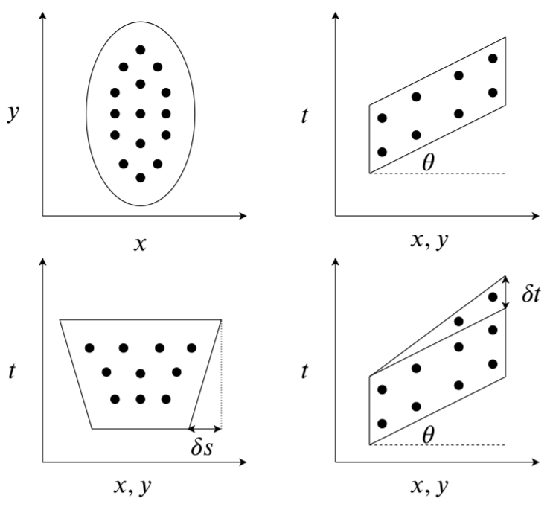
Spatio-Temporal Clustering Methodologies for Point-Event Natural Hazards
Uldis Zandovskis¹, Bruce D. Malamud¹, Davide Pigoli²
(1) Dept. of Geography and (2) Dept. of Mathematics, King’s College London, UK (e-mail: uldis.zandovskis@kcl.ac.uk)
Column D: An example of a modification to existing clustering procedures for moving source models
Fig. 8. Various geometries of the space-time statistic for the lightning strike location (represented by arbitrary point events as black dots) dataset. Upper left subplot displays the current elliptic scan statistic in the 2D spatial domain. Upper right subplot displays the side-view in the space-time domain of the elliptic cylinder with an angle of inclination, capturing the direction and speed of propagation directly. Lower left subplot displays an isosceles trapezoid base scan statistic in the space-time view of the propagation direction, capturing the changes in spatial extent of the thunderstorm. Lower right subplot displays the side-view in the space-time domain of the isosceles trapezoid base scan statistic with changing height value, capturing the persistence of lightning strikes over various locations.

