Slide 1


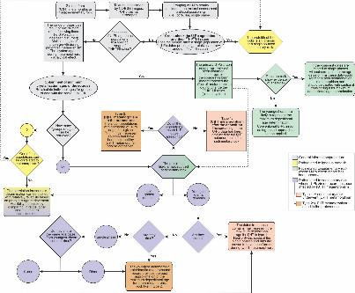
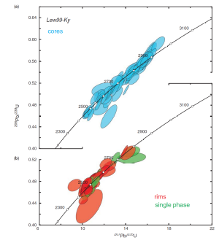
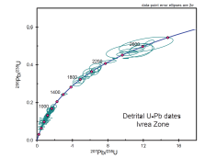
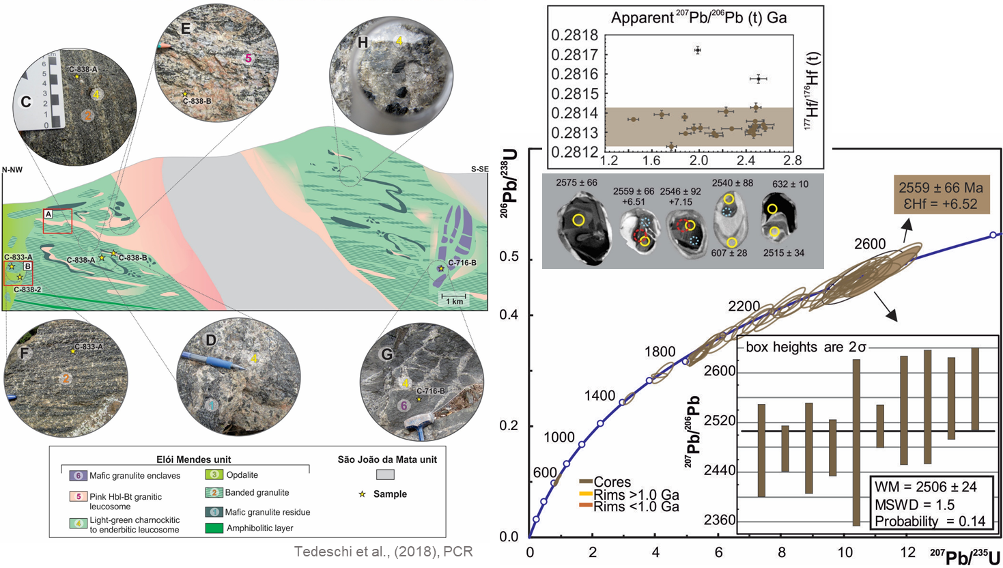
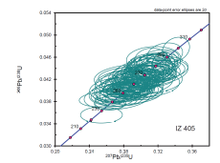
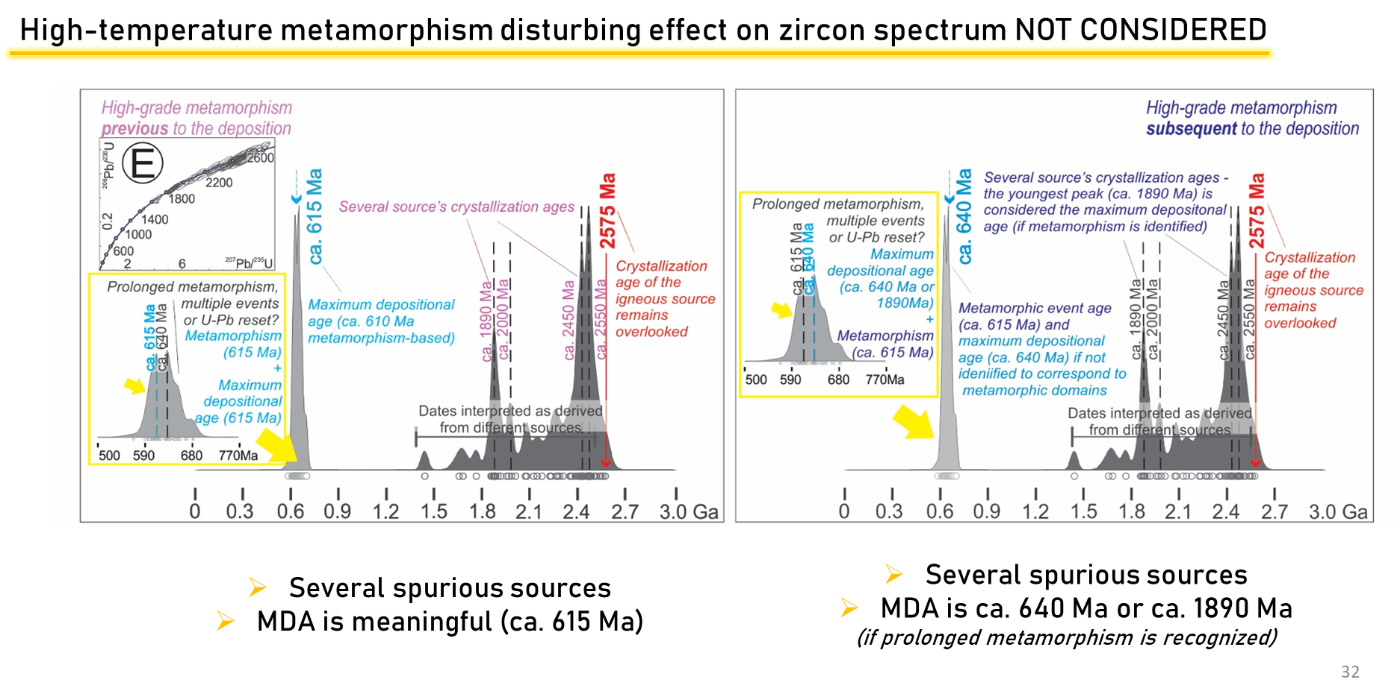
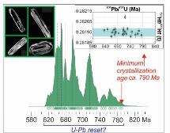
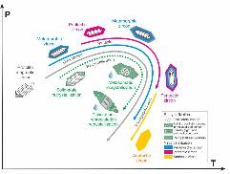
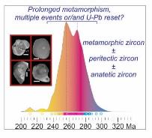
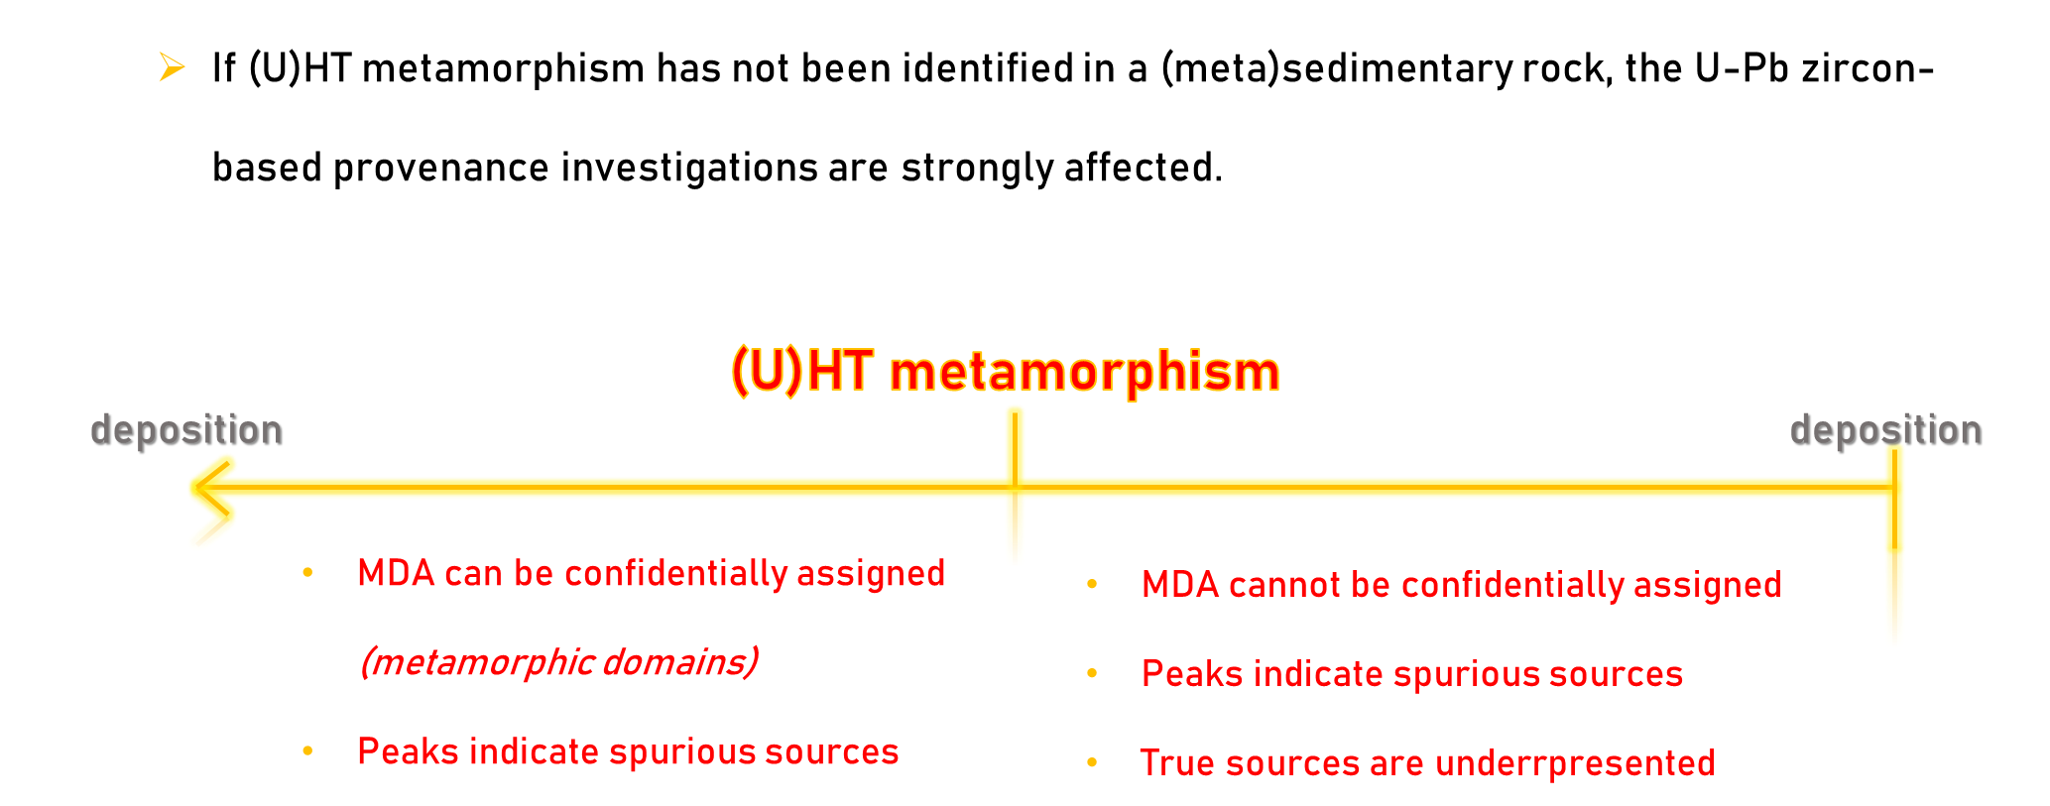
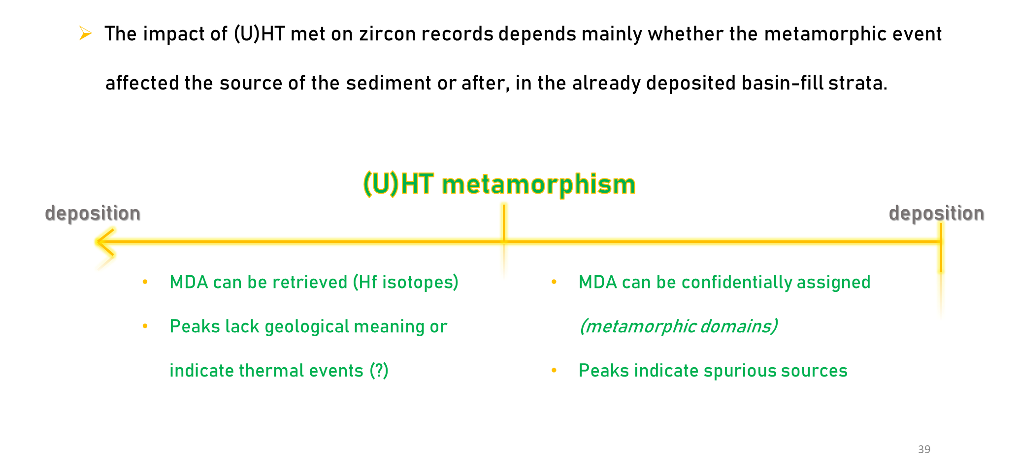
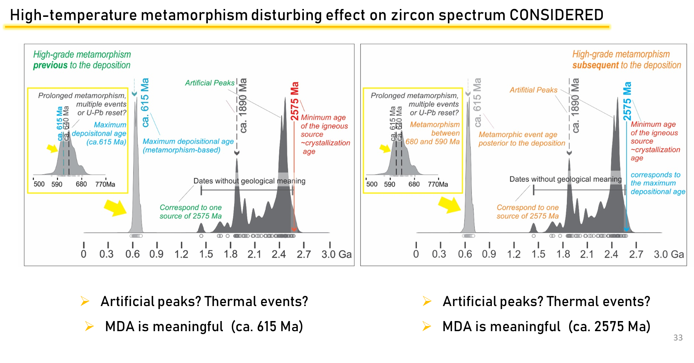






Unraveling potential biases in U-Pb detrital zircon record induced by high-temperature metamorphism (> 850 ºC)
Mahyra Tedeschi^{1*}, Humberto Reis², Laura Stutenbecker³, Matheus Kuchenbecker⁴, Bruno Ribeiro⁵, Vitor Barrote⁶, Pedro Leonardo Vieira¹, Cristiano Lana²
¹Universidade Federal de Minas Gerais, Brazil; ²Universidade Federal de Ouro Preto, Brazil; ³TU Darmstadt, Germany; ⁴Universidade Federal dos Vales do Jequitinhonha e Mucuri, Brazil; ⁵Monash University, Australia; ⁶Ruhr-Universität Bochum, Germany *mtedeschi@ufmg.br
Introduction
In modern Geology, detrital zircon extracted from sedimentary or metasedimentary rocks play an important role in assembling the puzzle of the evolution of continental crust. Matching detrital zircon age populations to the crystallization ages and age peaks of their source rocks is currently the main approach in sedimentary provenance studies. We explore additional processes taking place during high- (> 850 ºC) to (ultra)high-temperature U(HT) metamorphism, which can result in protracted U-Pb zircon geochronological records in sedimentary sources and basin-fill strata and analyze the potential biases these phenomena may induce on sedimentary provenance studies based on U-Pb detrital zircon ages.
Mafic granulite from the Guaxupé nappe (Brazil) as a hypothetical metasedimentary rock
Avoiding (U)HT metamorphism bias in provenance studies based on
U-Pb detrital zircon ages: alternatives and complementary strategies
Igneous vs sedimentary protoliths
Throughout geological time
Different techniques (SIMS and LA-ICP-MS)
Several compositions
Identification of the protosources;
In situ Hf-isotope analyses and U-Pb dating on zircon works towards retrieving the protolith age for several metamorphic rocks;
Unravelling the metamorphic events
Coupled assessment of zircon and other heavy minerals = Petrochronology!
Concordant U-Pb zircon spectrum span up to 700 Myr.
Igneous protolith identified through ¹⁷⁶Hf/¹⁷⁷Hf_{(t)};
Igneous protolith
Sedimentary protolith
Investigated sample
U-Pb, Lu-Hf and trace elements zircon data for the banded granulite C-833-A. Data interpreted as magmatic (see text) are plotted in (A) Concordia diagram (ellipses: 2σ uncertainty); the brown filled ellipse represents the older grain containing ¹⁷⁶Hf/¹⁷⁷Hf(t) within the cogenetic range from (B) initial ¹⁷⁶Hf/¹⁷⁷Hf(t) ratio against age using 207Pb/206Pb dates; black squares correspond to possibly inherited grains; and (C) Weighted average
age from the oldest 10 grains.
Sketch cross-section showing the field relationships of the granulitic – Elói Mendes unit: (A) Schollen diatexite from the northern part of the section. (B) Light-green opdalitic rock with enclaves of banded granulite. Mesoscopic aspects of each sample: (C) Banded granulite with concordant light green charnockitic leucosome in stromatic structure (C-838-A); (D) mafic schollen (residue) in charnockitic leucosome with peritectic orthopyroxene and clinopyroxene (C-838-2); (E) schlieren of biotite and schollen of stromatic metatexite in the pink hornblende-biotitebearing granitic leucosome (C-838-B);
(F) banded granulite (C-833-A); (G) Agmatic structure formed by the mafic granulite enclaves (sample C-716-B) in the diatexite; and (H) euhedral peritectic
hornblende in the nebulitic diatexite.
What do these protracted record?
Inheritance?
Prolonged metamorphism?
Several processes?
Pb-loss?
Whitehouse and Kemp, (2010), GSL
Kunz et al. (2018), CMP
(Ultra)high-temperature metamorphism and protracted records
Disturbance of the original spectra and artificial age peaks
Conclusions
Post-crystallization disturbance of the U-Pb isotopic system
Neocrystallization of zircon during metamorphism
By disturbing the U-Pb system in zircon, creating artificial age peaks, and/or crystallizing zircon during multiple and/or prolonged metamorphic events, the (U)HT metamorphism can affect the U-Pb record of detrital zircon from sedimentary protoliths, impacting provenance interpretations based on the age distributions. The degree of this impact on zircon records and consequently the potential influence on tectonic studies, however, depends on numerous variables. The first variable is whether the (U)HT metamorphism affected the source rocks of the detrital zircon, or the sedimentary protolith, post deposition. The maximum depositional age is less affected in the first case, as grains recording the metamorphism of the source likely pre-date the subsequent sedimentation. In cases where the basin-fill successions underwent (U)HT metamorphism, post sedimentation, their maximum depositional age might be substantially affected, creating a recording a false younger age. This will also impact the zircon age peak distributions used in provenance interpretations, causing disparity with the source rocks.
(U)HT metamorphism has been reported in multiple locations over the geological time and could significantly impact U-Pb detrital zircon studies. The effects of the (U)HT metamorphism can be resolved or minimized by the use of combined U-Pb and Hf-isotope analyses if the sources have sufficiently different ¹⁷⁶Hf/¹⁷⁷Hf_{(t)} Hf signatures.
Recrystallization (i.e. changes in the internal structure without modification of the external shape and texture of zircon);
Metamictization;
Younger cores, older rims;
“Pb nuggets”.
Tedeschi et al. (2018), PCR
Data and CL-images from Kunz et al. (2018), CMP
Acknowledgements
Adapted from Chen and Zheng (2017), JAES
Schematic cartoon summarizing potential zircon formation and recrystallization events during metamorphism (gray trajectory), the respective resulting zircon textures visible in cathodoluminescence images, and their U-Pb zircon record in probability density diagrams. A - Growth of zircon under different pressure, temperature, and fluid conditions. Zircon recrystallization can occur along the whole pressure-temperature path, strongly controlled by the availability of fluids. Fluid-absent systems result in solid-state recrystallization, while metasomatic and dissolution recrystallization occur in the presence of fluid (adapted from Chen and Zheng, 2017; the blue path for subsolidus, pink for peritectic, and yellow for anatectic reactions in A). B - Zircon dates spectrum of a single Neoproterozoic metamorphosed igneous rock exhibiting a protracted record of concordant grains with partial preservation of igneous textures and Lu-Hf signatures. Besides the presence of several artificial “age peaks” (dashed vertical lines) the rock has only one geological meaningful age of ca. 790 Ma, interpreted as the minimum crystallization age. The protracted record is attributed to post-crystallization U-Pb disturbance (recrystallization, corresponding to the green path in A; Metaopdalite C-838-2; Tedeschi et al., 2018). C - Zircon age spectrum of zircon with metamorphic textures from a Cambrian migmatite (Paragneiss IZ-405; Kunz et al., 2018) showing a protracted record with two dates peaks. The spreading of U-Pb data from Kunz et al. (2018) is herewith interpreted as likely representing different or combined protracted processes: prolonged metamorphic event, multiple metamorphic events, domanial zircon growth and U-Pb disturbance (the colored areas and circles through the detrital zircon spectrum represent the predominance of each of the processes from A).
(U)HT metamorphism can produce zircon through subsolidus reactions and melt crystallization, recording mainly the cooling path;
The domain effect can be particularly important in heterogeneous rocks such as migmatites.
References
Chen, R.-X., Zheng, Y.-F, 2017. Metamorphic zirconology of continental subduction zone. Journal of Asian Earth Sciences 145, 149–176.
Kunz, B.E., Regis, D., Engi, M., 2018. Zircon ages in granulite facies rocks: decoupling from geochemistry above 850 °C? Contrib. Mineral. Petrol. 173, 26. https://doi.org/10.1007/s00410-018-1454-5.52.
Tedeschi, M., Pedrosa-Soares, A.C., Dussin, I., Lanari, P., Novo, T., Pinheiro, M.A., Lana, C., Peters, D., 2018. Protracted zircon geochronological record of UHT garnet-free granulites in the Southern Brasília orogen (SE Brazil): Petrochronological constraints on magmatism and metamorphism. Precambrian Research 316, 101-126. doi: 10.1016/j.precamres.2018.07.023.
Whitehouse, M., Kemp, A.I.S., 2010. On the difficulty of assigning crustal residence, magmatic protolith and metamorphic ages to Lewisian granulites: constraints from combined in situ U-Pb and Lu–Hf isotopes. Geol. Soc., London, Spec. Publ. 335, 81–101.

