Slide 1


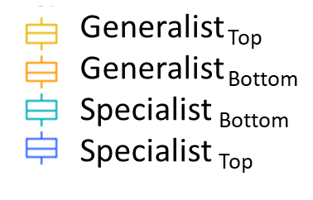
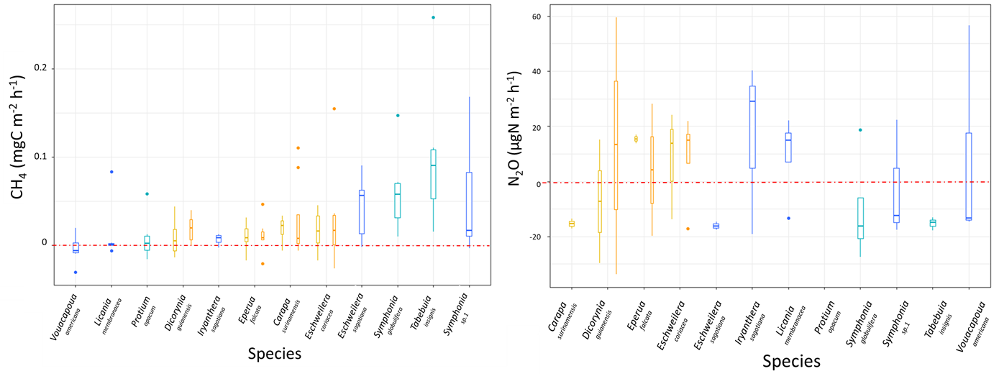
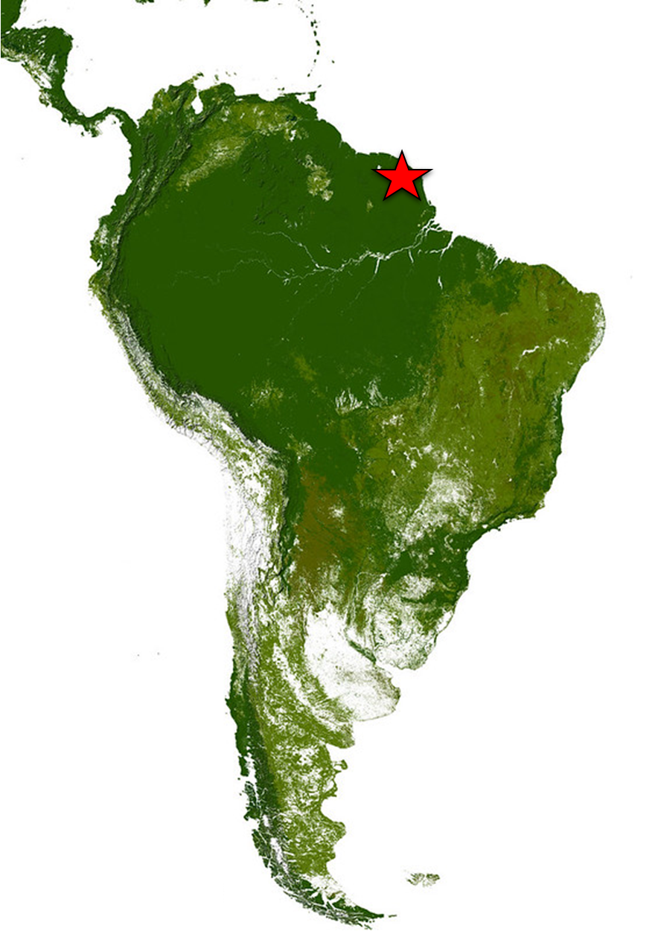

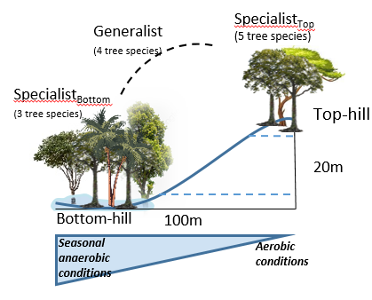


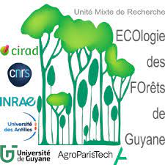


Inter-specific variations in tree stem methane (CH₄) and nitrous oxide (N₂O) exchanges in a tropical rainforest
Warren Daniel^{1,2}, Clément Stahl², Benoît Burban², Jean-Yves Goret², Jocelyn Cazal², Andreas Richter³, Ivan Janssens¹ and Laëtitia M. Bréchet^{1,2}
¹ Centers of Excellence Global Change Ecology and PLECO (Plants and Ecosystems), Department of Biology University of Antwerp, Universiteitsplein 1, B-2610 Wilrijk, Belgium
² INRAE, UMR EcoFoG, CNRS, CIRAD, AgroParisTech, Université des Antilles, Université de Guyane, 97310 Kourou, France
³ University of Vienna, Centre for Microbiology and Environmental Systems Science Althanstr. 14, 1090 Wien, Austria
Results
Aims
CH₄ emissions were significantly different between 3 tropical tree species in bottom-hill area.
Overall, N₂O fluxes were not significantly different between the tree species and between habitat
Tree diameter and bark moisture did not explain CH₄ and N₂O fluxes measured in tree stems.
Quantify CH₄ and N₂O fluxes of 12 different tropical tree species present in two contrasted habitats.
Determine the specific tree traits correlated with greenhouse gas (GHG) fluxes.
Study site
Paracou field station
situated in French Guiana
Materials and Methods
Conclusion / Perspective
Between 150 and 200 species ha⁻¹
Manual chamber/ Gas samples
Spatial variations in GHG fluxes do not seem to depend only on soil water conditions
Interspecific variations (diameter, bark moisture) have no effect on GHG fluxes
Other specific tree traits (wood density, lenticels) can promote CH₄ emissions
There is a limited influence on N₂O fluxes
x4
Rainfall = 3102 ± 70 mm yr⁻¹
Temperature = 25.7 ± 0.1°C (Aguilos et al., 2019)
Gas chromatographic analyzes
Quality check based on:
Detection limit
Minimum Detectable Fluxes
Study a possible contribution of the microbial community living inside the tree to CH₄ fluxes

