Slide 1
Detecting and analyzing regional trends in sub-daily rainfall annual maxima by using the Meta-statistical Extreme Value Distribution
Eleonora Dallan¹, Mattia Zaramella¹, Marco Borga¹, Francesco Marra²
¹ Department of Land Environment Agriculture and Forestry, University of Padova, Padova, Italy
² National Research Council of Italy - Institute of Atmospheric Sciences and Climate (CNR-ISAC), Bologna, Italy
EGU21-13271
(27 April 2021)

Slide 2
Table of contents
Background
Objectives
Data and
Methods
Results
Conclusions

Slide 3
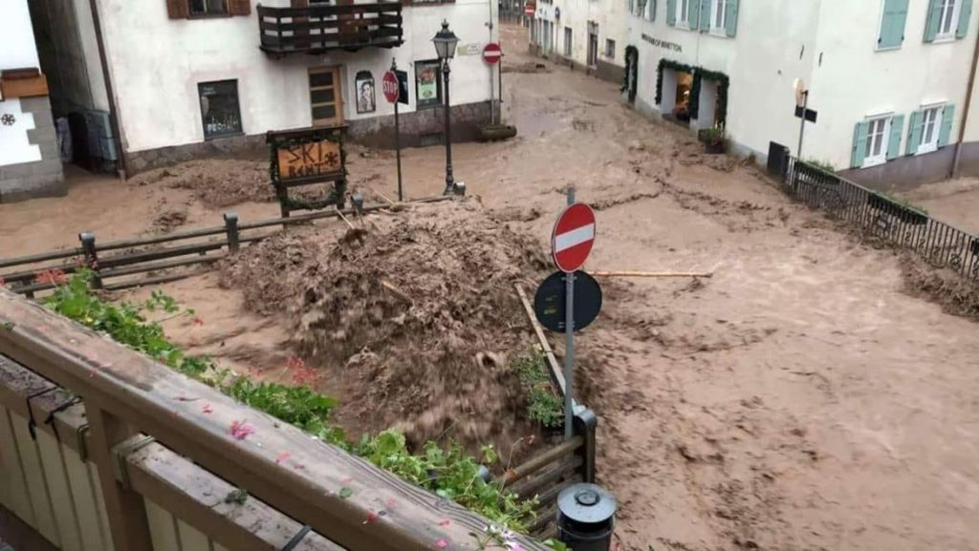
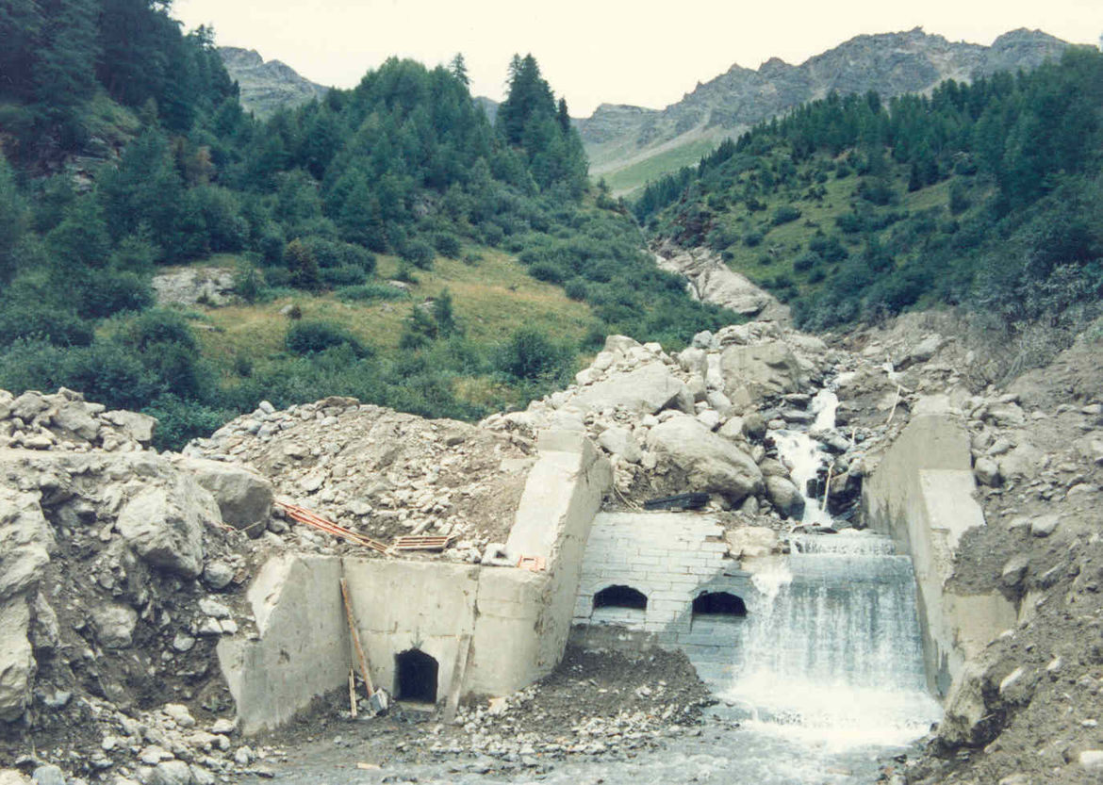
Background – Changing rainfall
Extreme subdaily precipitation intensities are responsible for several serious hazards: flash floods, urban floods, landslides and debris flows.
The scientific community is concerning about the intensification of the water cycle due to global warming. The literature generally agrees that extreme precipitation is changing.
Trends in observed annual maximum (AM) are found to be highly variable in space and uncertain, also as a result of the large stochastic uncertainty of rainfall maxima and to the different local response to climate forcing
Flash flood, Moena (TN, Italy) – 03/07/2018. Source: Government of Trentino
Some of the findings in literature on the rainfall extremes changes:
Statistically significant changes in the frequency of extreme precipitation
Stronger increases in subdaily and sub-hourly rainfall extremes over many areas
Changes in the spatial and temporal storm structure, with more marked increasing intensities at small spatial scales and short durations
In some cases, opposing trends between short and long durations, with complex implications for flood risk
Different trends for intensities associated to different exceedance probabilities, with differences depending on duration, season, local condition. In general, increasing trends for rarer events
Debris flow, r. Taviela, Pejo (TN, Italy) – 30/07/20120. Source: Government of Trentino

Slide 4
Background - Methodologies
Changes in extreme precipitation and at different exceedance probabilities can be detected by nonstationary extreme value models
But….
strong assumptions concerning the high order statistical moments
limitations in the parameter estimation accuracy → the shape (sometime also the scale) parameter of the extreme value distribution is assumed to be constant, violating observations and model results
no direct link between extremes and the properties of the underlying process, such as precipitation occurrence frequency and intensity distribution (e.g. Marra et al., 2019)
The Metastatical Extreme Value (MEV) methodology is a recent framework for extreme precipitation frequency analysis (Marani and Ignaccolo, 2015)
It relies on the concept of ordinary events (the independent realizations of a process of interest)
The ordinary events distribution is assumed as known
The EV distribution is derived by considering:
occurrence frequency of the ordinary events
inter-annual variability of their intensity distribution and of their occurrence frequency
Multiple types of ordinary events and their changes can be considered in the formalism (Marra et al., 2019)
It proved highly effective in reducing the stochasting uncertainties (Zorzetto et al., 2016)
The distribution parameters and their yearly number are treated separately and estimated on a yearly basis
Return levels can be quantified from individual years (Marra et al., 2019)
Some issues
→ High uncertainties on the provided information
→ Difficulties in attributing the observed changes to specific physical and meteorological processes
MEV
→ provides the ground for addressing the issues about nonstationary EV models
→ has great potential for trend detection studies (Miniussi and Marani, 2020)
→ gives the chance of developing attribution studies (Marra et al., 2021)
Marani M., Ignaccolo M. (2015). A metastatistical approach to rainfall extremes, Advances in Water Resources, Volume 79, 2015, Pages 121-126, ISSN 0309-1708, https://doi.org/10.1016/j.advwatres.2015.03.001.
Marra F., Zoccatelli D., Armon M., Morin E. (2019). A simplified MEV formulation to model extremes emerging from multiple nonstationary underlying processes. Advances in Water Resources, 127, 280–290. https://doi.org/10.1016/j.advwatres.2019.04.002
Zorzetto E., Botter G., Marani M. (2016). On the emergence of rainfall extremes from ordinary events. Geophysical Research Letters, 43, 8076–8082. https://doi.org/10.1002/2016GL069445

Slide 5
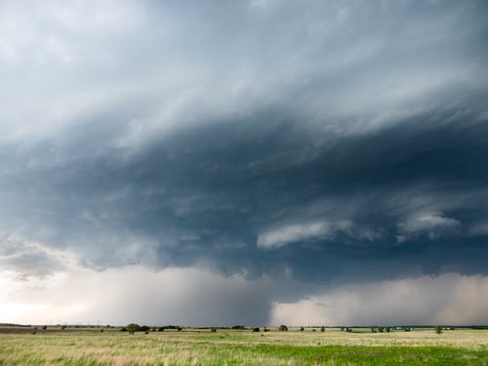
Objectives
General aim
Investigating the statistical processes behind the extreme rainfall changes and understanding how they can be related to changing meteorological conditions.
Specific objectives
detecting and quantifying trends in sub-daily annual maxima and extreme return levels by …
independently considering the changes in both statistical properties and occurrence frequency of precipitation
attributing the observed trends in extremes to specific changes in the local event-type composition (convective-like vs other-types).
Storm clouds. Source: NOAA on Unsplash

Slide 6
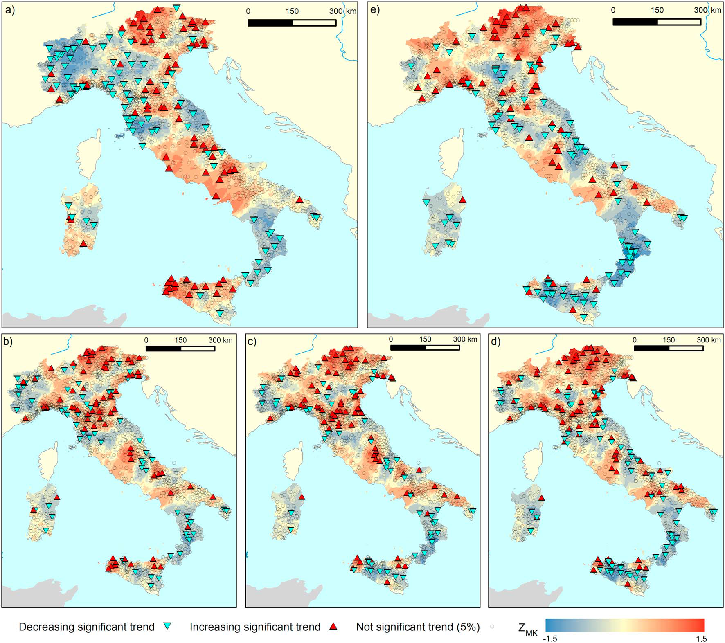
Data
The study area
The Trentino area, a mountain region located in the Eastern Italian Alps.
Precipitation regimes ranging from 900 to 1300 mm/year.
It has showed significant increasing trends in short-duration rainfall intensities over the last decades (Libertino et al., 2019)
Rainfall data
More than 100 rain gauges in the area
Selected stations:
5-min resolution records
at least 25 complete years (<10% missing data)
→ final set of 33 station, with average density of 1/190 km⁻² and covering the period 1986 - 2019.
Trends on 1-, 3-, 6-, 12-, 24-hr rainfall AM, from Libertino et al. (2019).
Libertino A., Ganora D., & Claps P. (2019). Evidence for increasing rainfall extremes remains elusive at large spatial scales: The case of Italy. Geophysical Research Letters, 46, 7437–7446. https://doi.org/10.1029/2019GL083371

Slide 7
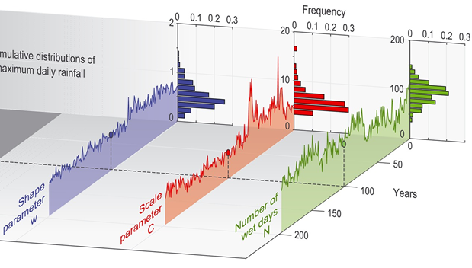
Methods – 1. MEV analysis
1
For each stations
Definition of “storms”, that is consecutive records of wet time intervals separated by a dry hiatus (24 h in our study)
For each duration of interest, definition of ordinary events (the maximum intensities within each storm)
Series of ordinary events per year, for each station and duration
and
computation of the observed annual maxima (AM), for each station and duration
2
In many cases, the right tails of subdaily precipitation intensities is found to be a Weibull distribution (e.g., Marra et al., 2020)
A Weibull distribution F is assumed, and checked → $F\left(x,λ,κ\right)=1−e^{−{\left(\frac{x}{λ}\right)}^{κ}}$
Left-censoring of ordinary events (analyzing different censoring thresholds)
→ upper 25% of data is used
Yearly distribution parameters (scale λ and shape κ) and number of events, for each station and duration, are obtained
Example of the yearly parameters (in blue and red) and number of wet days (green), from Zorzetto et al. (2016).
3
Calculation of several return levels (2-, 10-, 25-, 50-yr) by inverting the estimated distributions
Yearly estimated return levels, for each station and duration
Marra F., Borga M., Morin E. (2020). A unified framework for extreme subdaily precipitation frequency analyses based on ordinary events. Geophysical Research Letters, 47, e2020GL090209.

Slide 8
Methods – 2. Trend evaluation
1
Regional Kendall (RK) trend test and nonparametric Sen’s slope estimator
checked that serial correlation in our series is negligible
considered the spatial correlation correction
Performed the homogeneity test among the trends at the different sites
→ RK test outcomes gives evidence of a trend over time if a trend of consistent direction occurs in many of the individual sites
Trend significance and slope for the yearly estimated quantities: AM, scale λ, shape κ, events number n, return levels
2
Trend test on Modelled AM
Trends on the estimated 2-yr return level as a model quantification of trend on AM
1000 Montecarlo simulations for generating 1000 modelled regional AM series and quantifying their trends
Trend significance and slope for modelled AM
and
Estimation of the 90% confidence interval of the modelled regional trends
3
Sensitivity analysis on trends for the modelled AM
Estimation of the 2-yr return level for different combinations of varying parameters (their MEV yearly estimations) and of fixed parameters (their average in the period)
Understanding the effect of parameters in the trend slope for the modelled AM

Slide 9
Methods – 3. Event-type composition
1
Trends on the number of events per season
Calculation of the total number of events per year and season:
March-May-April (MMA), June-July-August (JJA), September-October-November (SON), December-January-February (DJF)
Trend test on seasonal number of events
Trend significance and slope for the yearly estimated number of events per season
2
Trend test on two types of events, per season
For each season, separation of the event types on the basis of the decorrelation time b.
A threshold of 2h is used.
Evaluation of trends on the number of convective-like events (b≤2h)
Evaluation of trends on the number of not-convective-like events (b≥2h)
Evaluation of the changes in the composition of the events in the different seasons

Slide 10
Results – 1. Trend on AM
In the maps, example of the trends detected at the individual stations (Mann-kendall test), for the 15-min duration
In figure a):
Observed AM trends are increasing, and significant for up to 6h
Similarly for modelled AM trends: increasing, and significant for up to 3h
Observed AM trends are higher at the shorter durations (≤1h)
Similarly for modelled AM trends: higher at the shorter durations (≤1h)
The observed AM trends are within the stochastic uncertainty of the model (grey area)
1
Key messages
Observed AM trends likely samples from the model → we trust the model
Increasing significant trends at the shorter durations
the SLOPE is relative to the median value of the variable in the period and expressed as %change per year

Slide 11
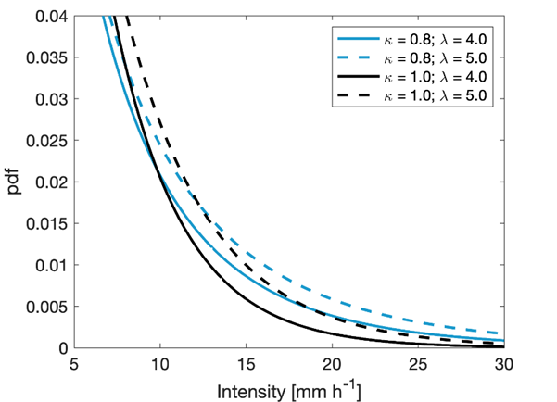
Results – 2. Trend on parameters
To better understand what happens in next figure b),
look at the Scale and Shape effect on the TAIL of a synthetic Weibull pdf
(Extremes events are in the tail)
Increasing scales λ increases the whole distribution, and the tail heaviness
Decreasing shape κ increases the tail heaviness
→ Synergic action in make the tail heavier → larger probability of having high intensities
In figure b)
Events number (the same for all durations) has an increasing significant trend
Scale has increasing trends, higher and significant at the longer durations
Shape shows decreasing trend at the shorter durations → heavier tail
Shape shows increasing trend at the longer durations → lighter tail
2
Key messages about the tail heaviness
When shape and scale act synergically, observed AM trends are significant
When shape and scale have opposite effect, the shape governs the outcome
In our area, at the shorter duration the increasing tail heaviness explains the increasing AM
Synergic action in increasing extremes

Slide 12
Results – 3. Sensitivity analysis
In figure c), trend in the modelled AM when some of the parameters are fixed (that is, not considering their trend)
Labels indicate the varying parameters
Line 8 = no trend (three fixed parameter)
Fixed n (dotted lines)→ little effect : downshift with respect to the same cases when increasing n is considered
Varying scale (yellow lines)→ trends are increasing, governed by the trends in the scale parameter (all increasing)
Varying shape (green lines)→ positive and higher trends for the shorter durations, then trend decrease and become negative
Line 1 is the actual modelled AM trend when three parameters vary
→ It is mostly dominated by the effect of the shape trends (tail heaviness)
3
Key message
Trend in modelled AM are mostly dominated by the trends on the tail heaviness

Slide 13
Results – 4. Trend on quantiles
Since we trust the model … let’s look at the trend on the estimated high return levels!
Trends are significant also for the rarer quantiles → the signal-to-noise ratio in estimated 50-yr events is similar to the one in AM
The higher the quantile, the stronger the effect of the shape
At shorter durations (≤ 2h), significant increasing trends are for all return levels
At longer durations, no trends for rarer events
4
Key messages
We can trust to the estimated high return level
Again … the stronger (increasing) trends at the shorter durations

Slide 14
Results – 5. Trend on events number
Since n is increasing , and the tail heaviness is increasing at the shorter durations …
Hp1: is something changing in the number of convective-like events, typically associated with the shorter intense rainfall?
Trends on events number n per season:
No trend in spring and summer (MMA and JJA)
Increasing trend in autumn and winter (SON and DJF)
Significant only in SON
5
Key message
Only in SON increasing significant trend in the event number

Slide 15
Results – 5. Trend on composition-type
Hp2: are there more convective-like events in SON?
Events are divided on the basis of the decorrelation time b:
convective-like events ( b≤2h)
Other-types (b>2h)
Only in summer (JJA) convective events are significantly increasing
Other-types generally increases…
But in summer they decreases
6
The significant change in the proportion between convective-like and other-types events in summer is the only explanatory change for the finding on AM and their statistical parameters at the short durations

Slide 16
Conclusions
1
Observed and modelled AM:
Observed AM trends likely samples from the model → we trust the model
Increasing significant trends at the shorter durations
2
About the tail heaviness
When shape and scale act synergically, observed AM trends are significant
When shape and scale have opposite effect, the shape governs the outcome
In our area, at the shorter duration the increasing tail heaviness explains the increasing AM
In the study area, increasing AM at shorter durations can be explain by heavier distribution tail and by enhanced summer convection.
The MEV methods + trend analysis allow to investigate the statistical processes behind the extreme rainfall changes and to understand how they can be related to changing meteorological conditions.
3
From the sensitivity analysis
Trend in modelled AM are mostly dominated by the trends on the tail heaviness
4
Estimation of high return levels from the model
We can trust the estimated high return level
Again … the stronger (increasing) trends at the shorter durations
5
About the underlying physical processes …
Only in SON increasing significant trend in the event number
6
The only explanatory change is in the proportion between convective-like and other-types events in summer
16

Slide 17
Thank you for your attention
Waiting for your feedback and questions
in the chat box!
EGU21-13271
(27 April 2021)
Conctact email: eleonora.dallan@unipd.it

