Slide 1








Hydrostratigraphic setting and groundwater dynamics in high salinized low-lying farmlands at the southern margin of the Venice Lagoon
Chiara Cavallina1, Alessandro Bergamasco2, Jacopo Boaga3, Sandra Donnici1, Benedetta Surian3, Luigi Tosi1, Luca Zaggia1, Valentina Bassan4, Giuditta Gabrielli4, Roberto Socin4, Andrea Artuso5, Lorenzo Frison5, and Giuseppe Gasparetto-Stori5
¹IGG-CNR, Padova, Italy (chiara.cavallina@igg.cnr.it)
²Institute of Marine Sciences, CNR, Venice, Italy
³Department of Geosciences, University of Padova, Padova, Italy
⁴Regione Veneto - Soil Defence Regional Directorate, Venice, Italy
⁵Land Reclamation Authority Adige Euganeo, Este-Padova, Italy
Cavallina, C., Bergamasco, A., Boaga, J., Donnici, S., Surian, B., Tosi, L., Zaggia, L., Bassan, V., Gabrielli, G., Socin, R., Artuso, A., Frison, L., and Gasparetto-Stori, G.: Hydrostratigraphic setting and groundwater dynamics in high salinized low-lying farmlands at the southern margin of the Venice Lagoon, EGU General Assembly 2021, online, 19–30 Apr 2021, EGU21-13280, https://doi.org/10.5194/egusphere-egu21-13280, 2021

Slide 2
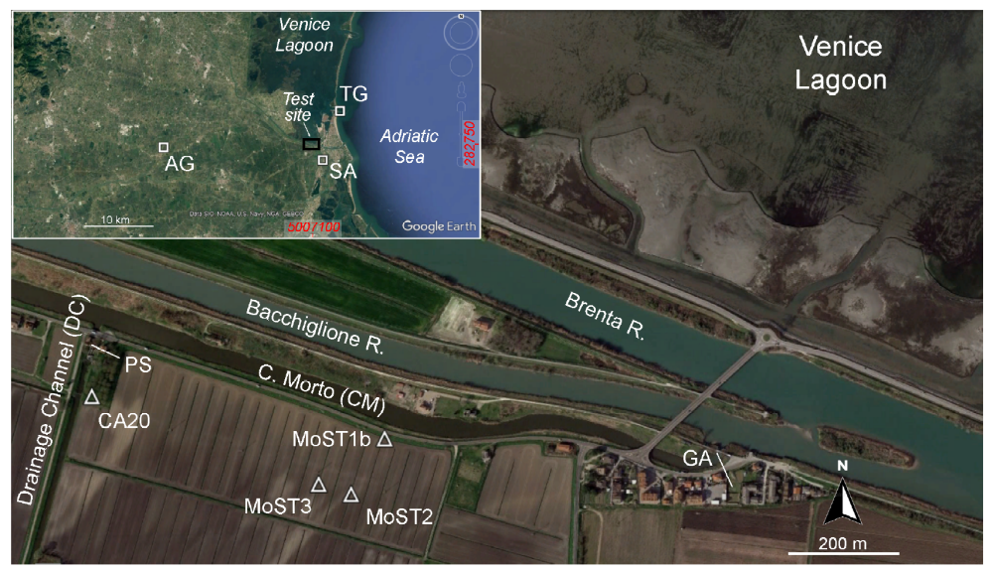
Area of interest: the southern Venice lagoon coastal area
The southern Venice lagoon coastal area test site with the location of the piezometers (MoST1b, MoST2, MoST3, and CA20), the monitoring points of the surface water levels of the drainage channel (DC) controlled by the pumping station (PS), and the Canal Morto (CM). SA and AG are the locations of meteorological stations, Sant’ Anna and Agna, respectively, while Chioggia tide gauge station is denoted by TG and GA indicates gates at CM
(from Lovrinović et al., 2021, Water 13(4), 561, https://doi.org/10.3390/w13040561).
Cavallina, C., Bergamasco, A., Boaga, J., Donnici, S., Surian, B., Tosi, L., Zaggia, L., Bassan, V., Gabrielli, G., Socin, R., Artuso, A., Frison, L., and Gasparetto-Stori, G.: Hydrostratigraphic setting and groundwater dynamics in high salinized low-lying farmlands at the southern margin of the Venice Lagoon, EGU General Assembly 2021, online, 19–30 Apr 2021, EGU21-13280, https://doi.org/10.5194/egusphere-egu21-13280, 2021

Slide 3
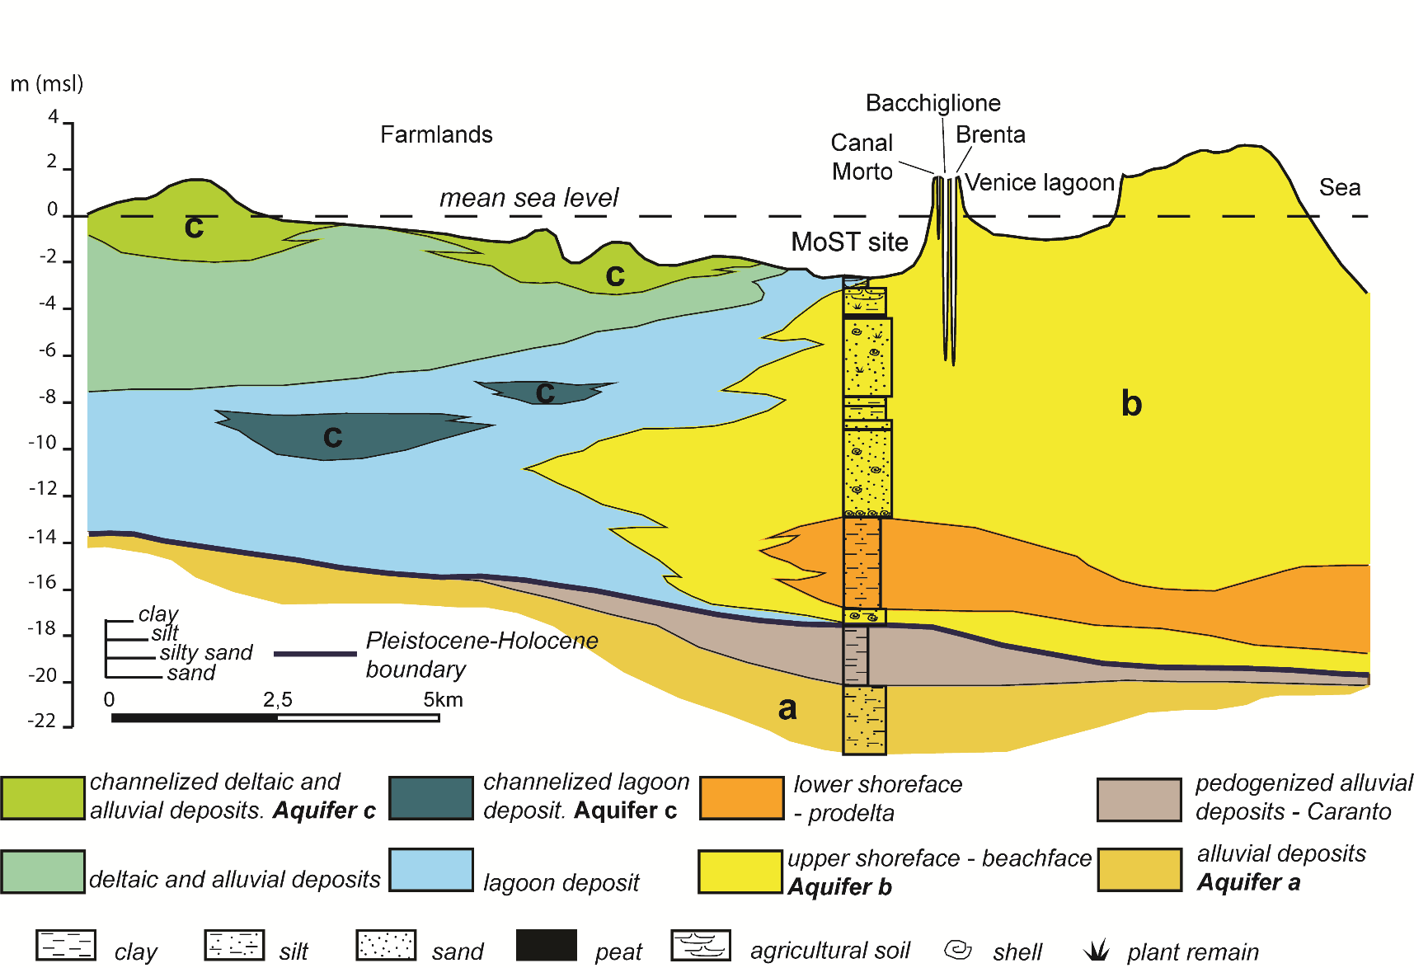
Hydrogeological setting
The heteropic relationships among littoral, deltaic, lagoon and alluvial deposits led to the development of a complex hydrogeologic system including, confined, locally confined and unconfined aquifers:
a) semi-confined aquifer located in the Pleistocene alluvial deposits at around 20 m depth, and, locally, confined at the top by the caranto layer
b) unconfined aquifer, located along the coastline in the sandy littoral deposits
c) local, smaller, aquifers, from confined to semi-confined in sedimentary bodies as paleo-channels or remnants of littoral ridges
Hydrogeological setting of the Upper Pleistocene and Holocene depositional units of the southern Venice lagoon costal area (from Lovrinović et al., 2021, Water 13(4), 561, https://doi.org/10.3390/w13040561).
Cavallina, C., Bergamasco, A., Boaga, J., Donnici, S., Surian, B., Tosi, L., Zaggia, L., Bassan, V., Gabrielli, G., Socin, R., Artuso, A., Frison, L., and Gasparetto-Stori, G.: Hydrostratigraphic setting and groundwater dynamics in high salinized low-lying farmlands at the southern margin of the Venice Lagoon, EGU General Assembly 2021, online, 19–30 Apr 2021, EGU21-13280, https://doi.org/10.5194/egusphere-egu21-13280, 2021

Slide 4
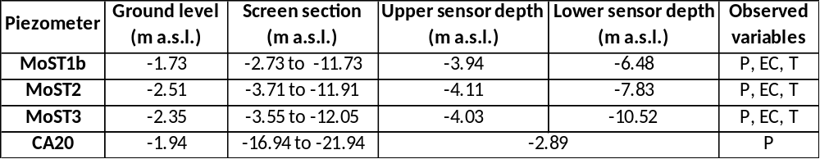
Methods
The aquifer system has been monitored through three piezometers screened approximatively from the top to the bottom in the phreatic aquifer (piezometers MoST1b, MoST2, MoST3)
P, EC and T data have been recorded by CTD Divers® logging sensor in piezometers MoST1b, MoST2, and MoST3
MoST1b, MoST2, MoST3 piezometers have been setup with two sensors, approximatively at the top and the bottom of the phreatic aquifer. P, EC and T have been recorded with a 10-min frequency from July 16th to October 22nd 2020 in MoST1b, MoST2, MoST3
EC and T vertical profiles have been acquired 2-3 times/month in all piezometers.
Hydrogeological setting of the Upper Pleistocene and Holocene depositional units of the southern Venice lagoon coastal area (from Lovrinović et al., 2021, Water 13(4), 561, https://doi.org/10.3390/w13040561).
Cavallina, C., Bergamasco, A., Boaga, J., Donnici, S., Surian, B., Tosi, L., Zaggia, L., Bassan, V., Gabrielli, G., Socin, R., Artuso, A., Frison, L., and Gasparetto-Stori, G.: Hydrostratigraphic setting and groundwater dynamics in high salinized low-lying farmlands at the southern margin of the Venice Lagoon, EGU General Assembly 2021, online, 19–30 Apr 2021, EGU21-13280, https://doi.org/10.5194/egusphere-egu21-13280, 2021

Slide 5
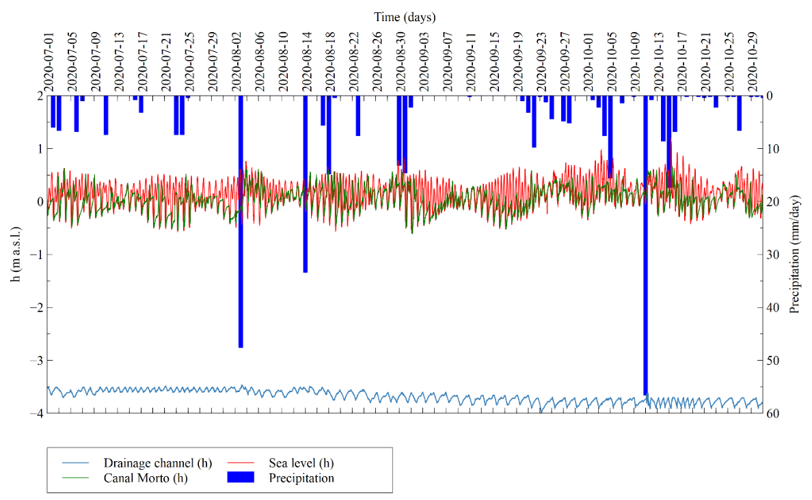
Forcing factors
The groundwater dynamics in the study area is controlled by the precipitations, the tide, the Pumping Station (PS) and the Brenta-Bacchiglione river system together with the Canal Morto (CM).
The precipitation regime is characterized by sporadic and intense short-term precipitations in July and August, which increases in both frequency and amount in mid-September-October
Tide gauge time series shows the semidiurnal cycle, characteristics of the Adriatic Sea with a maximum amplitude of 1 m
The Canal Morto h value follows that of the sea but with the higher levels significantly reduced by tide gate located at the confluence of the canal with Bacchiglione-Brenta river system
The Drainage Channel water level is controlled by the Pumping Station in a range of levels determined by the requirements of irrigation and the occurrence of heavy precipitations
Time series of forcing factors of the aquifer dynamics in the southern Venice Lagoon during the period July 1st – October 31st: Daily precipitation from SA meteorological station , Sea level observed at TG; CM water level (PS outflow) and DC h (PS inflow) (from Lovrinović et al., 2021, Water 13(4), 561, https://doi.org/10.3390/w13040561).
.
Cavallina, C., Bergamasco, A., Boaga, J., Donnici, S., Surian, B., Tosi, L., Zaggia, L., Bassan, V., Gabrielli, G., Socin, R., Artuso, A., Frison, L., and Gasparetto-Stori, G.: Hydrostratigraphic setting and groundwater dynamics in high salinized low-lying farmlands at the southern margin of the Venice Lagoon, EGU General Assembly 2021, online, 19–30 Apr 2021, EGU21-13280, https://doi.org/10.5194/egusphere-egu21-13280, 2021

Slide 6
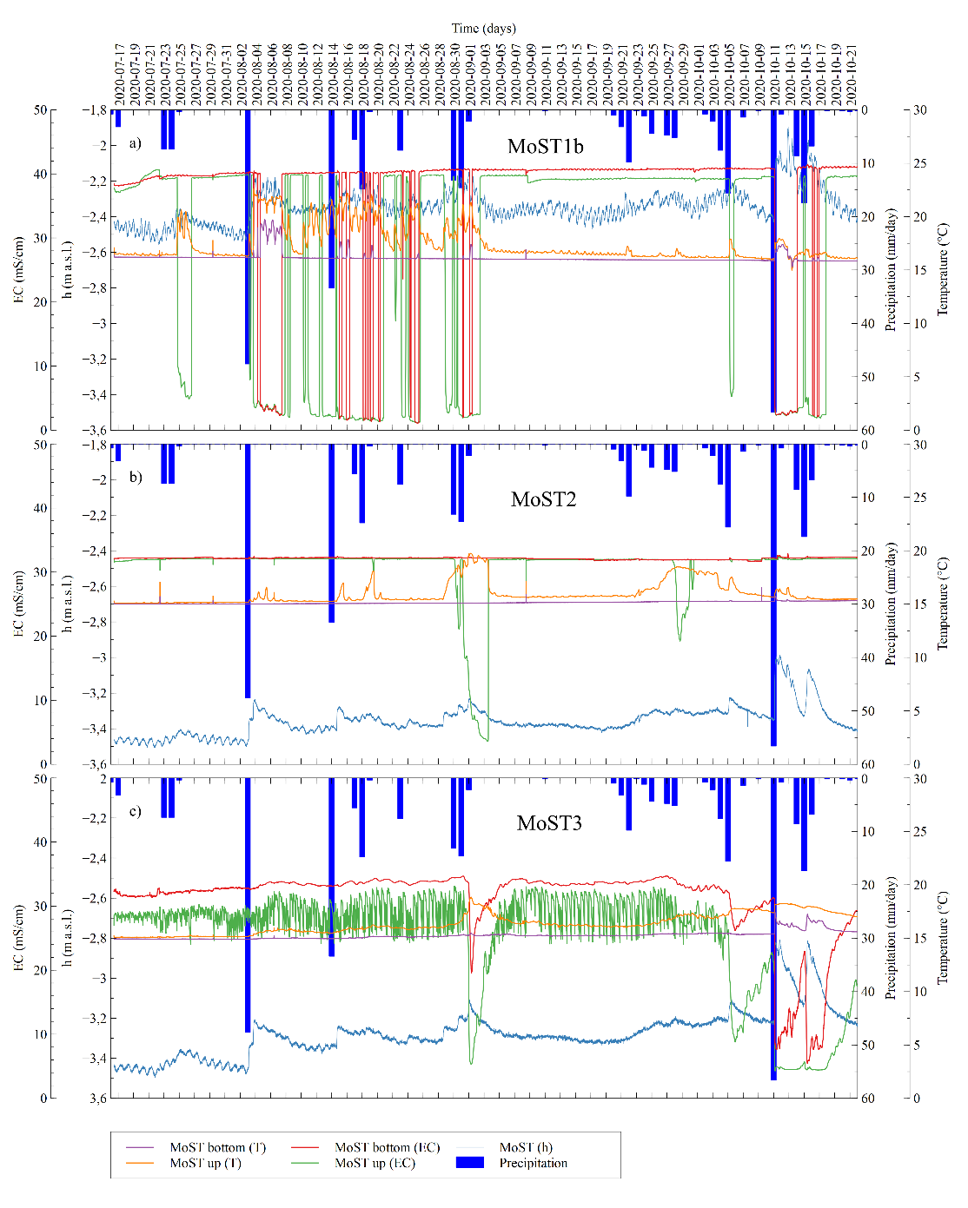
Growndwater dynamics vs precipitation
MoST1b:
the dynamics of groundwater is well correlated with the freshwater recharge during precipitation events and the freshening effect involves the whole thickness of the aquifer.
MoST2:
the groundwater dynamics at MoST2 is also linked to the precipitation,
which recharge the aquifer with freshwater. However, the decrease in EC values is reduced, compared to MoST1b and happens only in some precipitation events. The freshening effect is limited to the upper layer of the aquifer.
MoST3:
the groundwater dynamics at MoST2 is linked to the precipitation,
which recharge the aquifer with freshwater. However, the decrease in EC values is reduced, compared to MoST1b and happens only in some precipitation events.
Groundwater dynamics of the unconfined aquifer in the period July 16th - October 22nd (from Lovrinović et al., 2021, Water 13(4), 561, https://doi.org/10.3390/w13040561).
.
Cavallina, C., Bergamasco, A., Boaga, J., Donnici, S., Surian, B., Tosi, L., Zaggia, L., Bassan, V., Gabrielli, G., Socin, R., Artuso, A., Frison, L., and Gasparetto-Stori, G.: Hydrostratigraphic setting and groundwater dynamics in high salinized low-lying farmlands at the southern margin of the Venice Lagoon, EGU General Assembly 2021, online, 19–30 Apr 2021, EGU21-13280, https://doi.org/10.5194/egusphere-egu21-13280, 2021

Slide 7
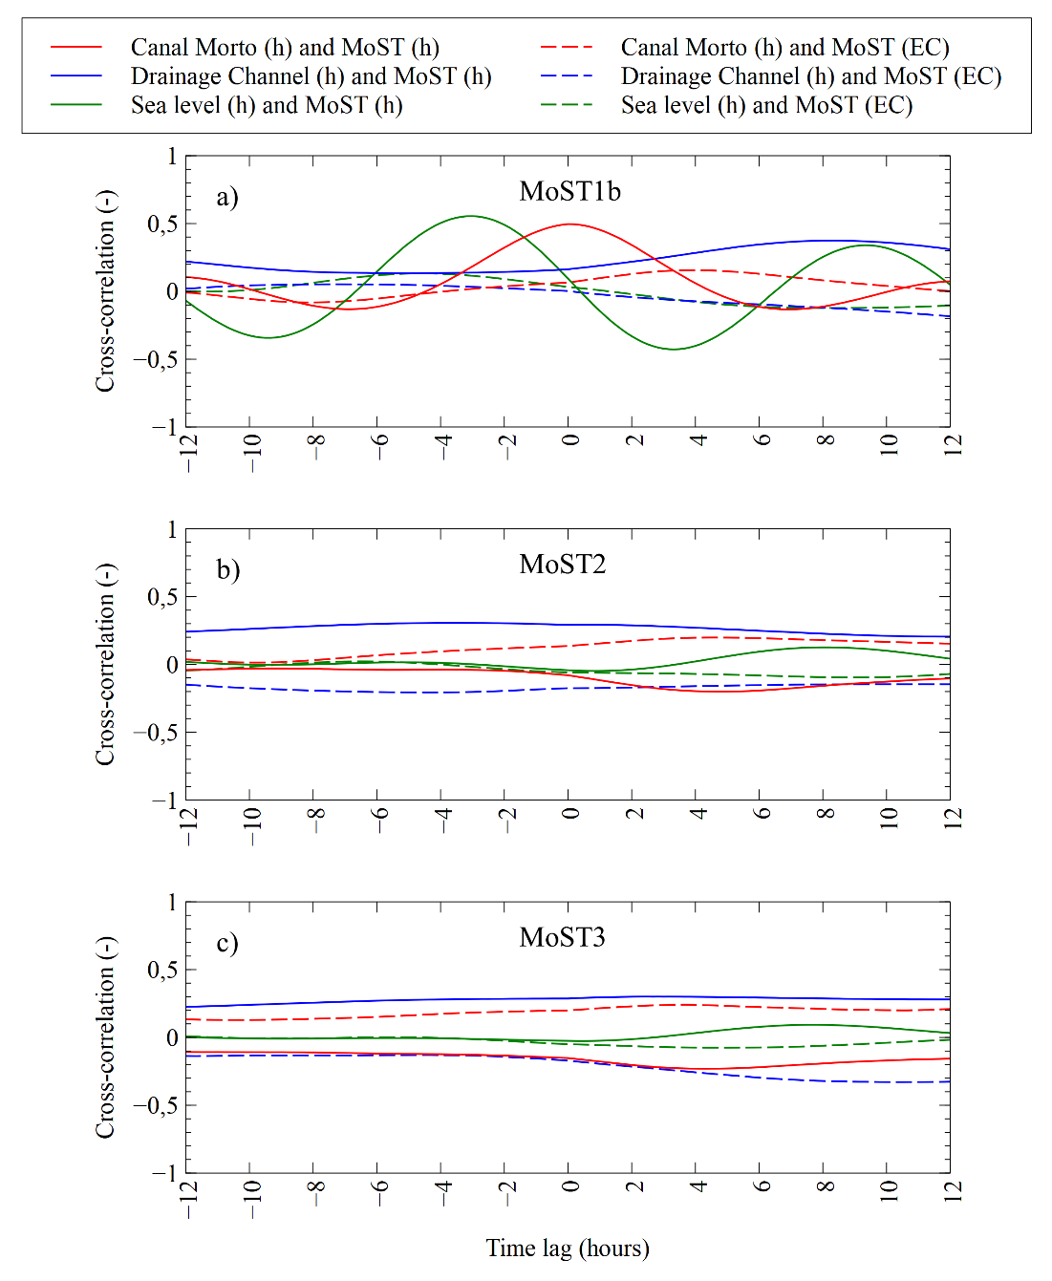
Cross-correlation
MoST1b:
h and EC are in phase with the tidal signal with delays of 3 hours and 4 hours 40 minutes, respectively.
Maximum cross-correlation between h and CM levels is in phase without any delay.
MoST1b EC correlates with CM levels in phase with about 4h early. (Taken into consideration that MoST1b level and EC directly rise with CM levels, and that CM brings freshwater, we can assume no direct relationship between them during the rising level, while it occurs during lowering levels. Hence, the freshening of groundwater is not due to the influence of CM but it is likely the effect of leakage from the Brenta – Bacchiglione system)
MoST2 and MoST3:
No significant correlation with tide and CM.
Only the drainage channel affects the levels of the phreatic aquifer at both MoST2 and MoST3 sites. The EC background is given by the SWI from the lagoon and the river mouths and is modulated by the freshwater leakage from the Brenta and Bacchiglione river beds especially during the lowering of the tidal level
Cross correlation functions determined for the period September 2nd – 19th 2020: (a) piezometer MoST1b; (b) piezometer MoST2 and (c) piezometer MoST3 (from Lovrinović et al., 2021, Water 13(4), 561, https://doi.org/10.3390/w13040561).
.
Cavallina, C., Bergamasco, A., Boaga, J., Donnici, S., Surian, B., Tosi, L., Zaggia, L., Bassan, V., Gabrielli, G., Socin, R., Artuso, A., Frison, L., and Gasparetto-Stori, G.: Hydrostratigraphic setting and groundwater dynamics in high salinized low-lying farmlands at the southern margin of the Venice Lagoon, EGU General Assembly 2021, online, 19–30 Apr 2021, EGU21-13280, https://doi.org/10.5194/egusphere-egu21-13280, 2021

Slide 8
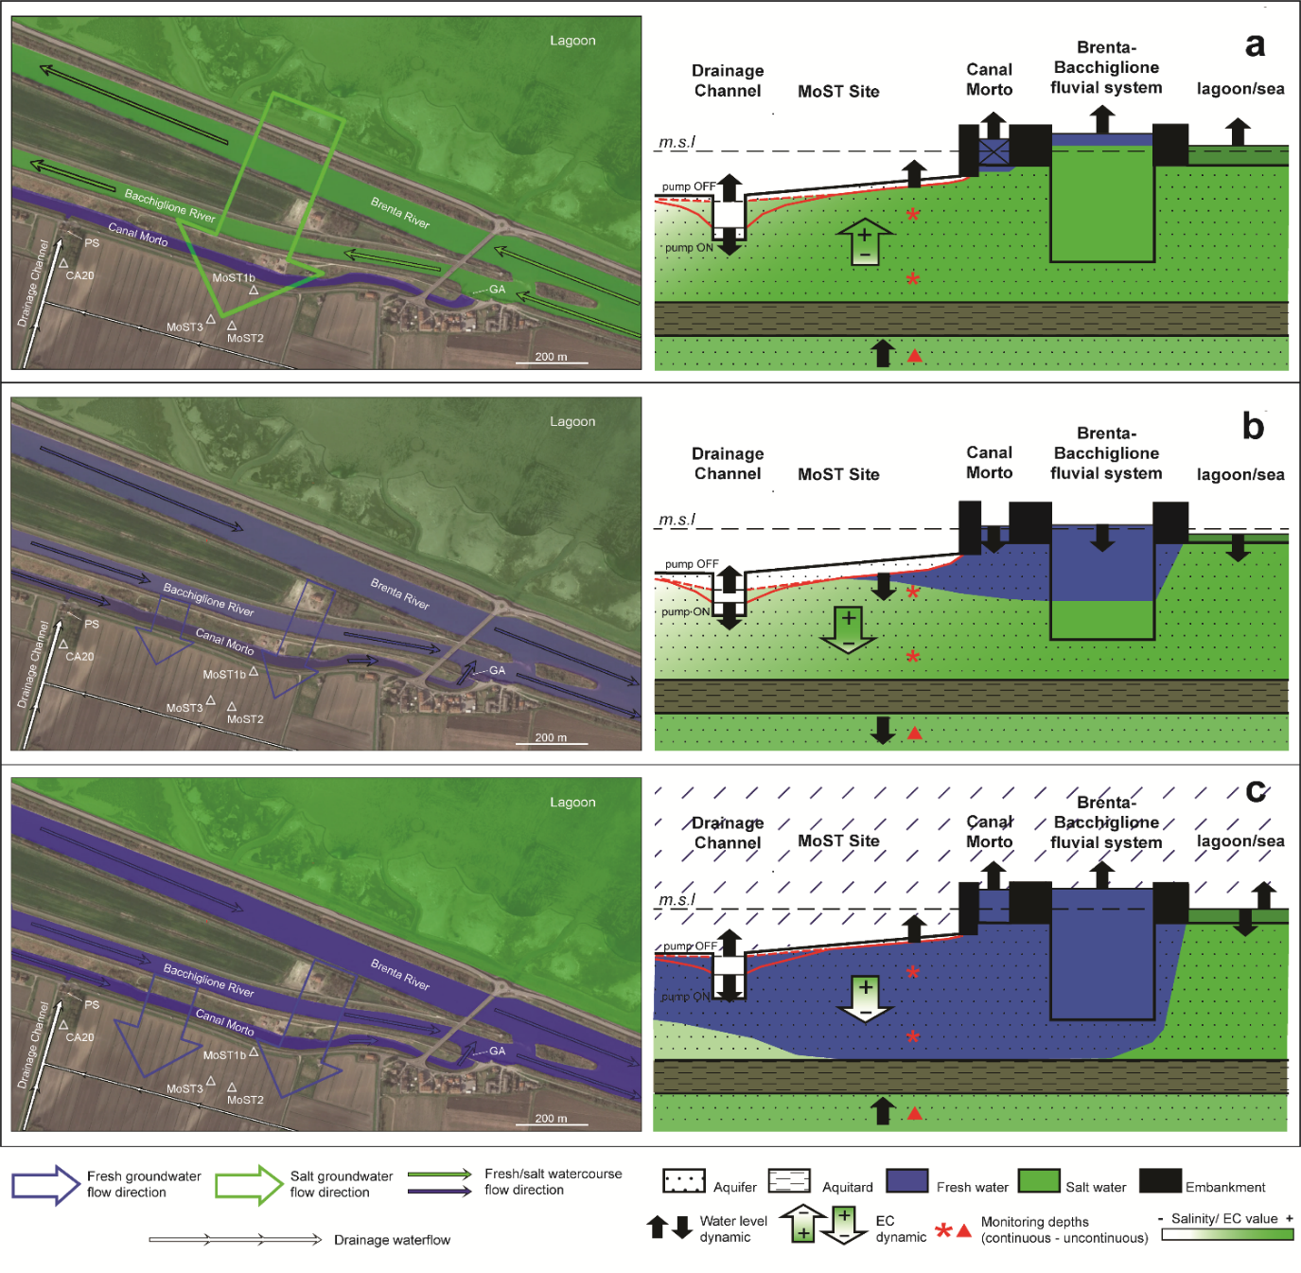
Salt-water and fresh-water dynamic
a: dry periods with high tide and CM gate closed:
The salt-water flows from the lagoon and from the river-mouths into the aquifer.
Water table rises.
The leakage of fresh-water from the CM is negligible.
b: dry periods with low tide and gate opened
Brenta and Bacchiglione rivers fresh-water leakages into the aquifer, mitigating the salinity of the north-easternmost sector of the test area.
Water table decreases.
c: wet period with intense precipitation (high/low tide, gate opened/closed)
Intense precipitations lead to significant EC decreases in the uppermost layer and sometimes in the whole aquifer thickness.
Water table rises.
SWI and fresh water pathways, obtained over the monitoring period July - October 2020, in three different scenarios (from Lovrinović et al., 2021, Water 13(4), 561, https://doi.org/10.3390/w13040561).
.
Cavallina, C., Bergamasco, A., Boaga, J., Donnici, S., Surian, B., Tosi, L., Zaggia, L., Bassan, V., Gabrielli, G., Socin, R., Artuso, A., Frison, L., and Gasparetto-Stori, G.: Hydrostratigraphic setting and groundwater dynamics in high salinized low-lying farmlands at the southern margin of the Venice Lagoon, EGU General Assembly 2021, online, 19–30 Apr 2021, EGU21-13280, https://doi.org/10.5194/egusphere-egu21-13280, 2021

Slide 9
Conclusion
The high EC background of the phreatic aquifer is given by the seawater intrusion from the lagoon and the river mouths
The EC changes in the aquifer during the examined dry period are modulated by the exchanges with Brenta and Bacchiglione riverbeds especially during the ebb tide phase, in wich the leakage of fresh-water from the river beds mitigates the salinity of the northern part of the aquifer
The tidal regulation gates of the Canal Morto hamper the seawater encroachment during high sea levels and keep a freshwater storage in the last stretch of the watercourse. However, the dispersion of the freshwater from the CM is negligibile or, at least, limited to the proximity of the embankment in the very shallow subsoil
Since the almost constant high salinity background, the salinity intake from the Brenta and Bacchiglione river beds during the encroachment phase has been much more important than the dilution effect given by their freshwater outflows during low tides.
The artificial drainage seasonally constrains the water table levels on the basis of the farmland activities.
The rainfall events significantly mitigate the relevant high background of the saltwater contamination in the groundwater.
Cavallina, C., Bergamasco, A., Boaga, J., Donnici, S., Surian, B., Tosi, L., Zaggia, L., Bassan, V., Gabrielli, G., Socin, R., Artuso, A., Frison, L., and Gasparetto-Stori, G.: Hydrostratigraphic setting and groundwater dynamics in high salinized low-lying farmlands at the southern margin of the Venice Lagoon, EGU General Assembly 2021, online, 19–30 Apr 2021, EGU21-13280, https://doi.org/10.5194/egusphere-egu21-13280, 2021

Slide 10





Acknowledgments
Cavallina, C., Bergamasco, A., Boaga, J., Donnici, S., Surian, B., Tosi, L., Zaggia, L., Bassan, V., Gabrielli, G., Socin, R., Artuso, A., Frison, L., and Gasparetto-Stori, G.: Hydrostratigraphic setting and groundwater dynamics in high salinized low-lying farmlands at the southern margin of the Venice Lagoon, EGU General Assembly 2021, online, 19–30 Apr 2021, EGU21-13280, https://doi.org/10.5194/egusphere-egu21-13280, 2021

