Slide 1

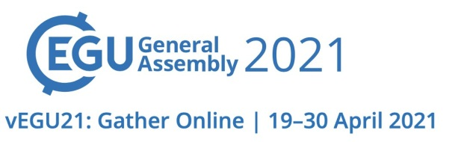
Combining volatiles measurements in fluid inclusions with petrology of ultramafic xenoliths: new insights on the evolution of the West Eifel and Siebengebirge (Germany) Sub-Continental Lithospheric Mantle
Andrea Luca Rizzo^{a,b}, Barbara Faccini^{b}, Federico Casetta^{b,*}, Luca Faccincani^{b}, Theodoros Ntaflos^{c}, Francesco Italianoª, Massimo Coltorti^{a,b}
ª Sezione di Palermo, Istituto Nazionale di Geofisica e Vulcanologia; ^{b} Department of Physics and Earth Sciences, University of Ferrara; ^{c} Department of Lithospheric Research, University of Vienna
Siebingebirge volcanic province, 30-6 Ma
- Anhydrous porphyroclastic Hz and (minor) Lh in Siebingebirge.
- Anhydrous to amph (+/- Phlog) bearing Hz, Lh, Weh, Ol-Cpxte and Ol-Wb in West Eifel.
Eifel volcanic province, 0.5-0.01 Ma
Higher degrees of partial melting experienced by Siebingebirge mantle section: > 30%. Variable degrees in West Eifel: Gees 22-30%, Meerfelder Maar 10-20%; Dreiser Weiher is fertile, even more than PM.
If compared to the Mg# of the host minerals, the volatiles content of FI does not follow the typical trend expected for simple partial melting processes (i.e. decreasing at increasing Mg#), lying instead on multiple trends with variable (⁴He/⁴⁰Ar*)/Mg# gradients.
This behavior further suggests that one or multiple enrichment events postdated the melt extraction event. Moreover, since the increase of fusible elements and volatiles is recorded only by xenoliths from West Eifel, it is arguable that these metasomatic/refertilization processes were spatially and temporally connected to the Quaternary magmatism of the Eifel area.
The ³He/⁴He ratio corrected for air contamination (Rc/Ra values) is 5.5-6.8 Ra in olivine, 3.1-6.8 Ra in Opx, and 5.6-6.8 Ra in Cpx.
The concentrations of noble gas in FI show higher depletion in samples from Siebengebirge than in those from West Eifel, in agreement with the evidence provided by mineral chemistry.
FI in Opx and Cpx from West Eifel xenoliths are richer in volatiles than those from Siebengebirge, suggesting the superimposition of other processes that masked the original composition of the residual mantle beneath West Eifel.
This is also evident in the Rc/Ra vs. Mg# diagram, where enriched samples lie on a well-defined trend characterized by a progressive decrease of the ³He/⁴He ratio with decreasing Mg#, moving towards the low ³He/⁴He measured in cumulate products as well as in the nowadays gaseous emissions in East Eifel.
Moving towards West Eifel lherzolites, the equilibrium T and Al content of pyroxene increase and the Rc/Ra ratio decreases, testifying for the progressive infiltration into the German SCLM of hot, Al-rich melts/fluids with ³He/⁴He ratio similar to Laacher See gases.
The melt/fluid-rock reactions responsible for the modification of the German SCLM took place in a restricted temporal window, being mostly related to the Quaternary magmatic episodes.

