Slide 1
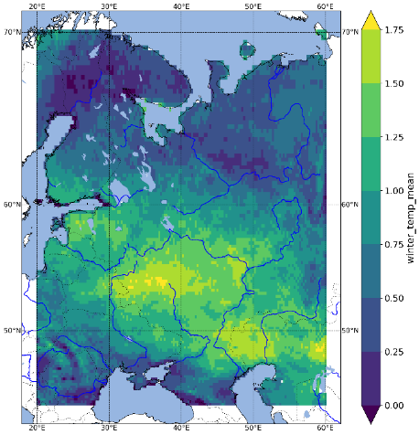
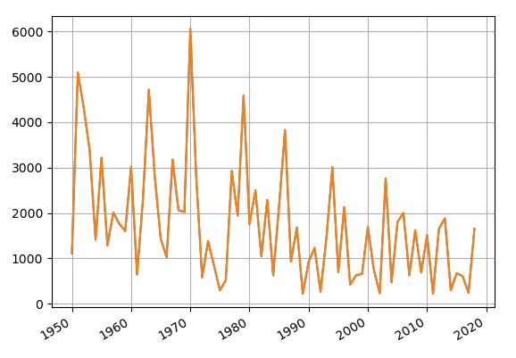
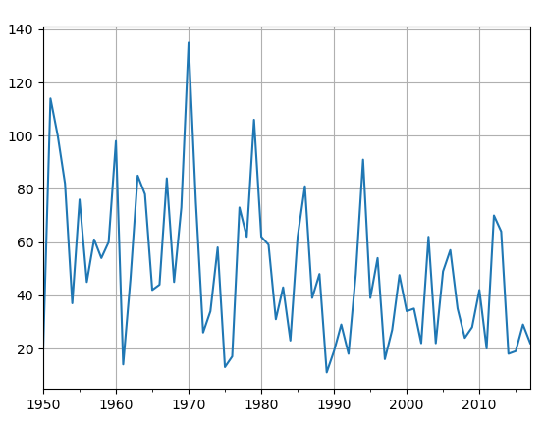
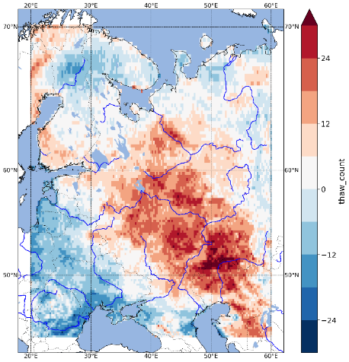
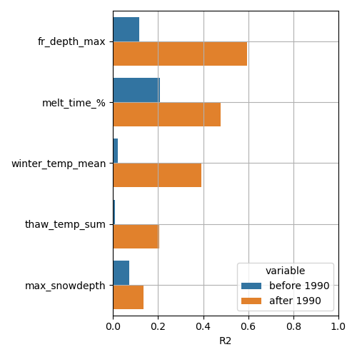
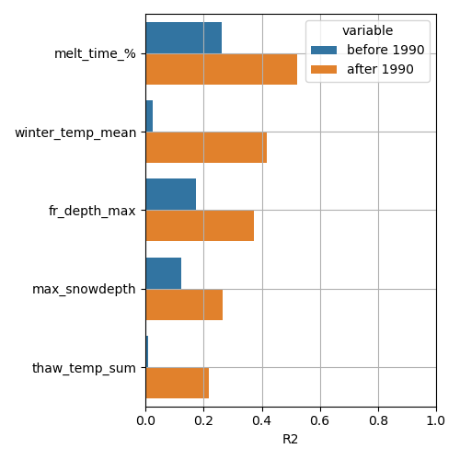
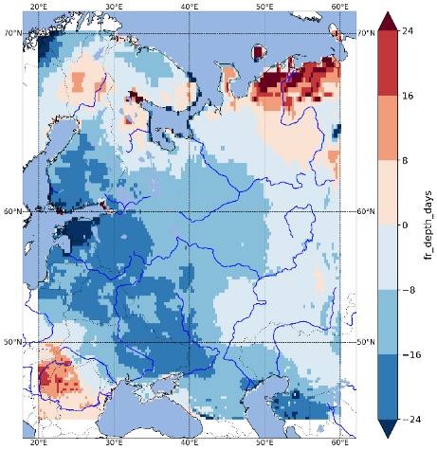
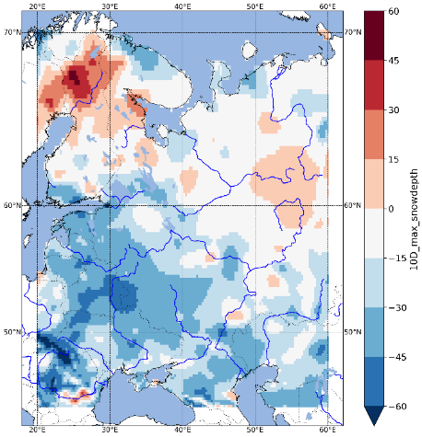
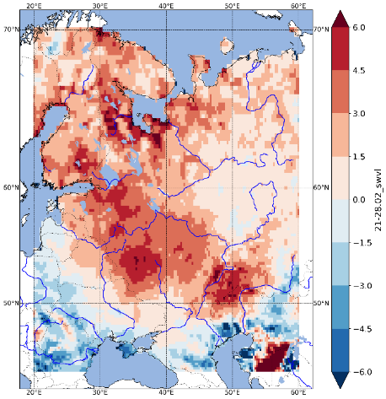
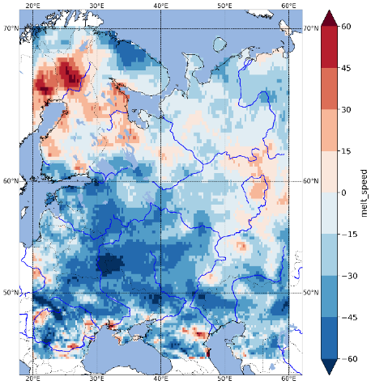
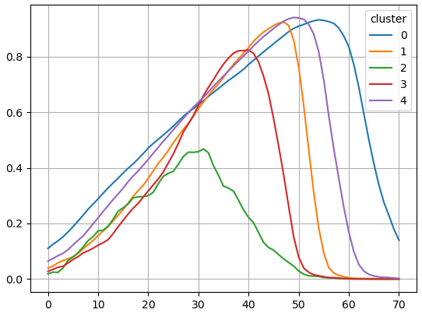
Spring freshet on East European plain: changes in drivers and conditions during last three decades
M. Kharlamov, M. Kireeva, and N. Varentsova
Average value for 1990-2020 relative to 1950-1989
Maximum discharge
Runoff depth of spring freshet
Average winter temperature, ⁰C
Number of thaws, %
Dataset
We used daily 2m temperature, total precipitation, snow depth, volumetric soil water layer, soil temperature variables from ERA5 reanalysis (including ERA5 back extension from 1950 to 1978)
Methodology
For each winter, the basic parameters were calculated and estimated change (average value for 1990-2020 relative to 1950-1989). Also was estimated relationship with the maximum discharge and runoff depth of spring freshet
Results
We registered a decrease in the period of stable snow accumulation (on average by 20% in the southern and southwestern parts of the East European Plain) because of the increase in winter temperatures. The number of thaws and their duration also increase and this leads to earlier and more prolonged melting of the snow pack. In these conditions, an extremely low spring freshet is formed. Our studies show that with the condition of an equal maximum snow depth the slow snowmelt forms the spring freshet up to 4 times less in volume than the fast melting.
Correlation with
maximum discharge, R²
Correlation with
runoff depth of spring freshet, R²
, R2
Days with soil freezing, %
Maximum snow depth, %
Typical snow depth curve
Soil moisture (February), %
Average melting rate, %
Before 1990
After 1990

