Slide 1
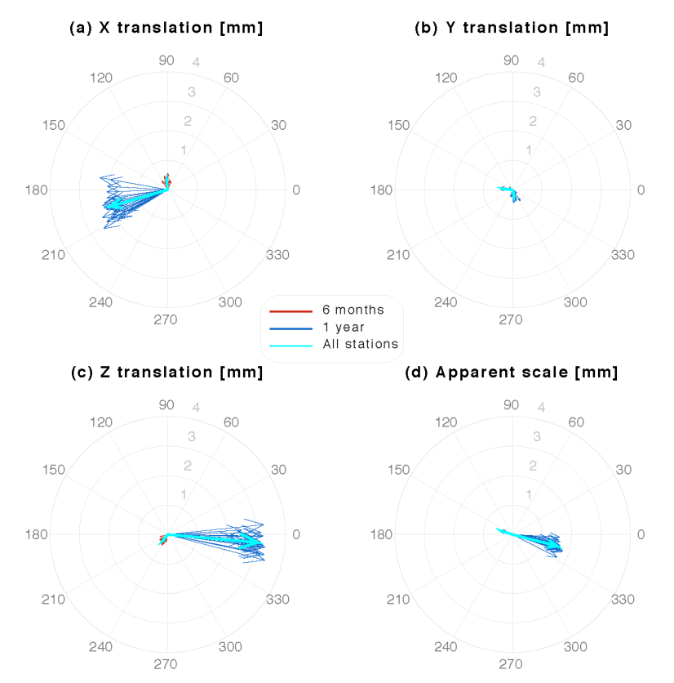
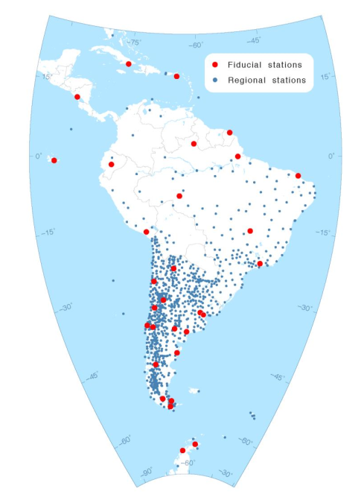
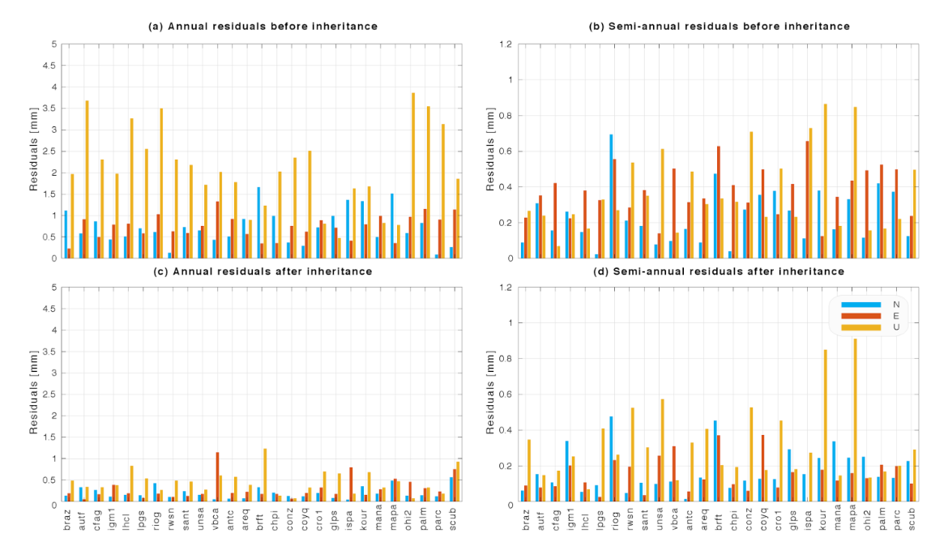


Realizing ITRF-Consistent Continental-Scale Geodetic Reference Frames
Demián D. Gómez, Michael G. Bevis, and Dana J. Caccamise II
ITRF 2014 provides periodic fits for station positions that favor the realization of better, more consistent regional continental-scale frames.
Regional subset of periodic parameters of ITRF defines a ‘periodic space’ that can be ‘inherited’ by a regional frame.
Difference in station positions with and without inheriting the periodic space from ITRF 2014 can reach ~4 mm for a
continental realization in South America
Figure 1: Map of the stations (continuous and campaign) used to realize POSGAR07b processed by the Scientific Processing Center – Argentina (Centro de Procesamiento Científico – Argentina) IGN. Red dots represent stations common to POSGAR, SIRGAS, and the ITRF reference frames.
Figure 2: Phasorial plots of common-modes observed in ITRF 2014 using 27 stations in Central and South America. Blue and red arrows represent the 27 common-mode components (annual and semi-annual), leaving one station out of the analysis at the time; cyan arrows represent the phasor computed by using all stations. A significant component exists in the X and Z components of annual translation. An apparent seasonal scale change is also observed for the annual component.
Figure 3: Annual and semi-annual residuals between SP07b and ITRF 2014. a) Residuals before inheriting the periodic space of ITRF 2014. b) Same as (a) for semi-annual. c) Residuals after inheriting the seasonal terms of ITRF 2014. d) Same as (c) for semi-annual.
For more information
Gomez.124@osu.edu

