Slide 1
Quantifying Teleconnection pathways leading to Low Rainfall anomalies during Borneo Summer in Indonesian Borneo
Timothy Lam¹, Marlene Kretschmer², Samantha Adams³, Alberto Arribas⁴, Rachel Prudden³, Elena Saggioro⁵, Jennifer Catto⁶, Rosa Barciela⁷
¹Centre for Doctoral Training in Environmental Intelligence, University of Exeter ²Department of Meteorology, University of Reading
³Informatics Lab, Met Office ⁴Microsoft UK ⁵Department of Mathematics and Statistics, University of Reading
⁶College of Engineering, Mathematics and Physical Sciences, University of Exeter ⁷Met Office
Correspondence email address: t.lam@exeter.ac.uk

Slide 2
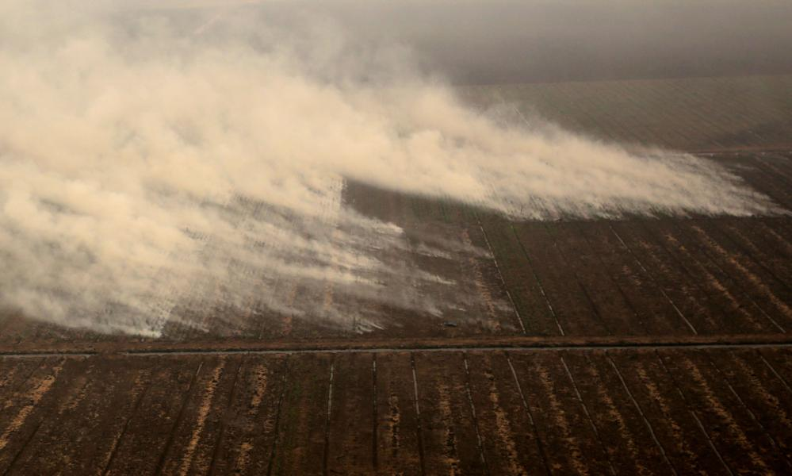
Motivation and Objectives
To develop climate risk assessment and resilience building strategies for droughts and peatland fires in Central Kalimantan Province, Indonesian Borneo
Identify ocean-/land-atmosphere causal links leading to droughts in Indonesian Borneo
Identify land-atmosphere causal links leading to peatland fires in Indonesian Borneo
Devise risk assessment and resilience building strategies based on plausible pathways leading to droughts and peatland fires in Indonesian Borneo
For more information about the project:
https://www.exeter.ac.uk/news/homepage/title_827766_en.html
Source of pictures:
The Guardian (2015)

Slide 3
Detecting climate drivers using causal inference
The Ladder of Causation (Pearl 2018): Association, Intervention, Counterfactuals
Causal inference: Development of rigorous mathematical framework to explore and quantify causal links
Peter & Clark Algorithm (Runge et al. 2019)
Causal Network for Discussion of Wildfires (Lloyd & Shepherd 2020)

Slide 4
Knowledge-driven Causal Inference
A literature-based causal diagram depicting drivers of drought in Indonesian Borneo is as follows:
Conduct partial correlational analysis amongst precursors and target variables to test the hypotheses (Kretschmer et al. submitted to BAMS).
Central Kalimantan Province
Borneo Drought
INDO SST
ENSO
ENSO+
IOD
IOD+
Cool SST over Indonesia

Slide 5
Main findings for now
ENSO is a driver of Borneo drought, but IOD is not.
Shortcomings of existing causal inference methodologies to depict tropical teleconnections
Borneo Drought
driver same sign as predicted
driver opposite sign of predicted
insignificant driver
IOD+
Cool SST over Indonesia
ENSO+

Slide 6
Next steps
Draw event chains depicting how individual drought occurrences were facilitated by El Niño onset.
Use CMIP6 models to project any possible changes of drought drivers in Borneo in the future.
Explore the role of local drivers such as land use change in influencing drought occurrence and impacts.

