Slide 1
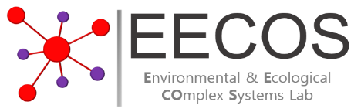

The role of small wetlands for resilient ecological networks in a wetlandscape
2021. 04. 28
Bin Kim and Jeryang Park
Environmental & Ecological Complex Systems Laboratory
Department of Civil & Environmental Engineering, Hongik University, South Korea

Slide 2
Background
Wetlands provide valuable ecosystem services
- biodiversity conservation,
- water purification,
- flood protection, etc.
Changes in habitat migration patterns of inhabiting species can occur through the change of interconnectivity between distributed wetlands according to the wetlandscape hydrology
Necessity of improving existing wetlands conservation (replacement) plan
- Focused on wetland area or number (Massachusetts inland wetland replication guidelines, Provincial wetland restoration guide (Alberta Environment), etc.)
- Underestimation of ecological benefit and importance of small wetlands
Wetlands (blue circle) of various size are connected to each other by dispersal models (e.g., heavy-tailed dispersal model) to form an ecological network in wetlandscape.

Slide 3
Objectives
Identify the contribution of small wetlands on structure and function of ecological network
Analyzed two different scenarios in which the sum of wetland areas are similar, but their area distributions are distinct
Analyzed the multiple ecological states (based on network metrics) with change in hydro-climatic conditions
Suggest a wetlands conservation plan based on the functional role of wetlands
State (<k> or E)
Ecological condition
(Sum of wetlands area)

Slide 4
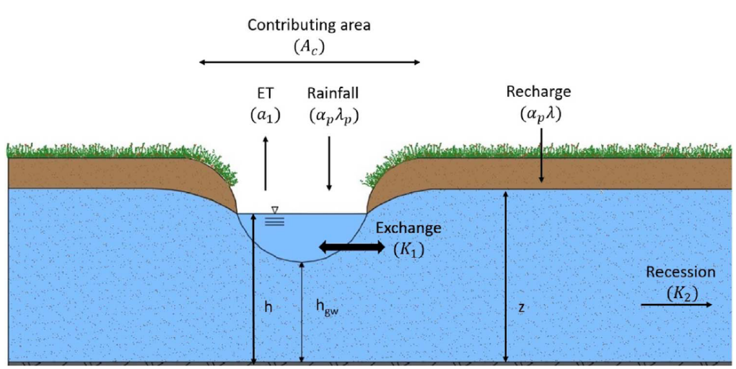
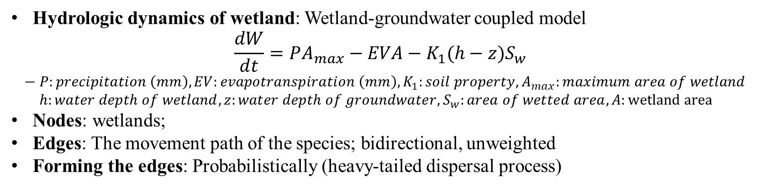
Representations of hydrology and network
Source: Leonardo et al., 2018
Source: Kim and Park, 2020
Hydrologic dynamics of wetland: Wetland-groundwater coupled model
$$\frac{dW}{dt}=PA_{max}−EVA−K_{1}(h−z)S_{w}$$
$$− P:precipitation \left(mm\right), EV:evapotranspiration \left(mm\right), K_{1}:soil property, A_{max}:maximum area of wetland$$
$h:water depth of wetland, z:water depth of groundwater, S_{w}:area of wetted area, A:wetland area$
Nodes: wetlands;
Edges: The movement path of the species; bidirectional, unweighted
Forming the edges: Probabilistically (heavy-tailed dispersal process)

Slide 5
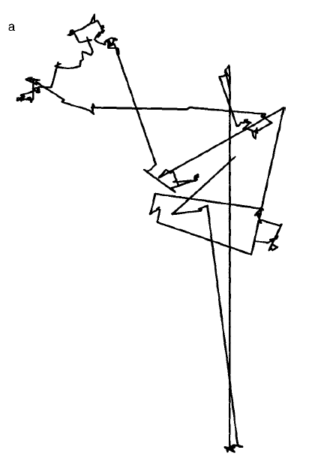
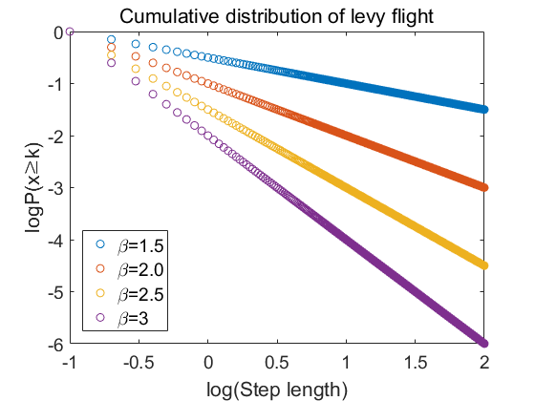
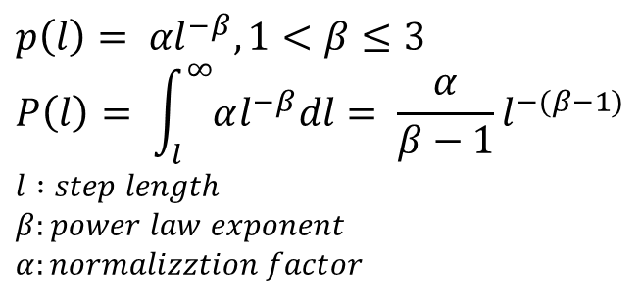
Network Representation - Edge
Heavy tailed dispersal model: Describe a random walk characterized by a power law distribution (heavy tailed distribution) (Bartumeus, 2007)
$$p\left(l\right)= {αl}^{−β}, 1<β≤3$$
$$P\left(l\right)= \int_{l}^{∞}{αl^{−β}dl}= \frac{α}{β−1}l^{−(β−1)}$$
$$l :step length$$
$β:power law exponent$
$$α:normalizztion factor$$
Frequently occurring short movements are interspersed with rarely occurring longer movements
(Reynolds and Rhodes, 2009)

Slide 6
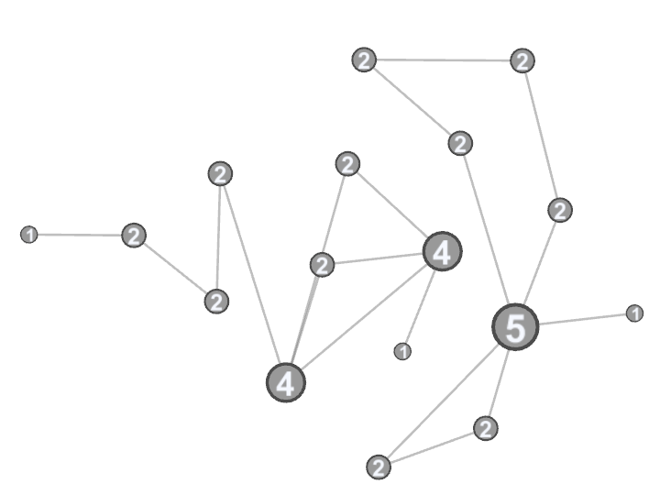
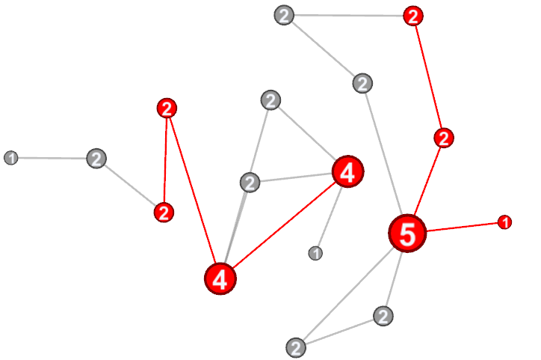
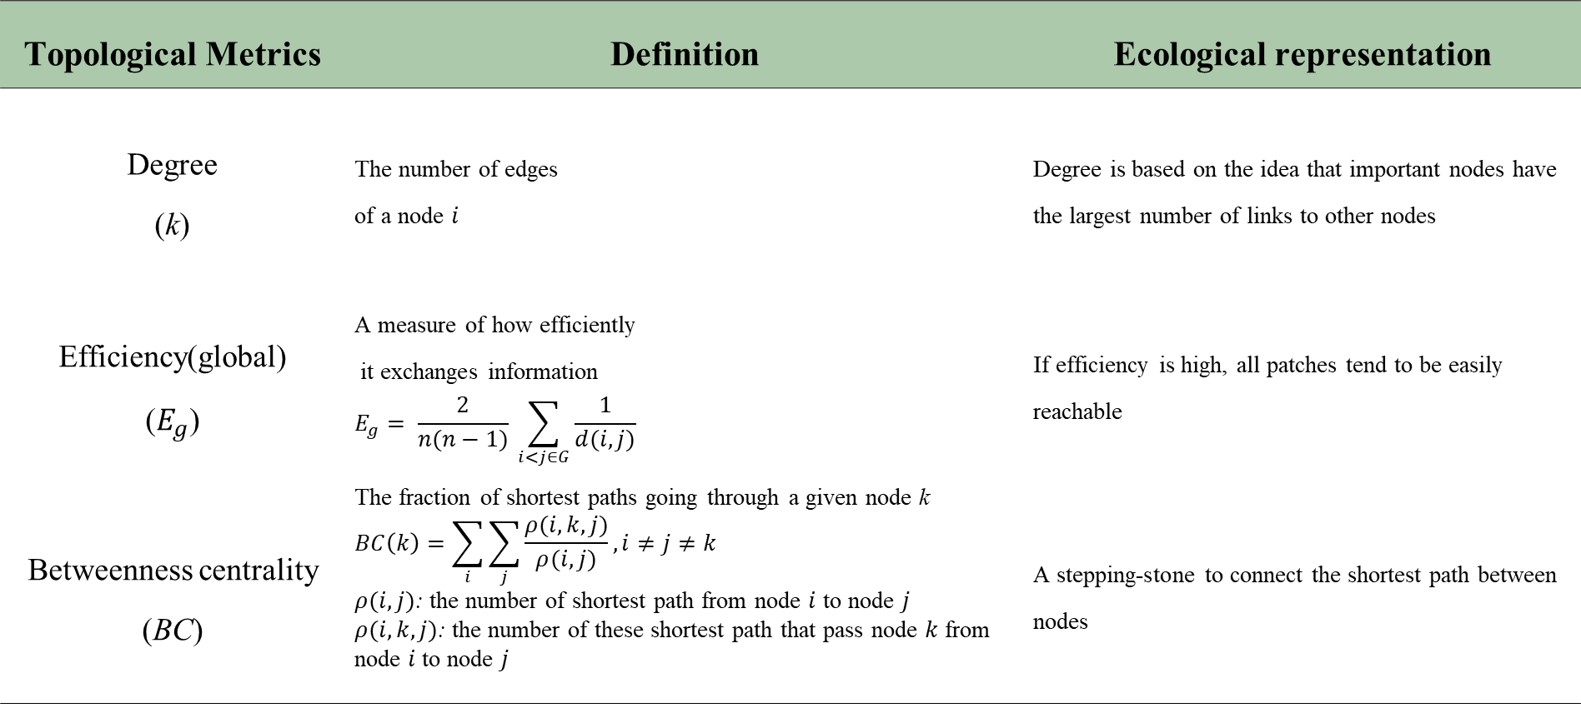
Network Topology
Topological Metrics | Definition | Ecological representation
Degree (k) | The number of edges of a node $i$ | Degree is based on the idea that important nodes have the largest number of links to other nodes
Efficiency(global) ($E_{g}$) | A measure of how efficiently it exchanges information $$E_{g}= \frac{2}{n(n−1)} \sum_{i<j∈G}{\frac{1}{d(i,j)}}$$ | If efficiency is high, all patches tend to be easily reachable
Betweenness centrality (BC) | The fraction of shortest paths going through a given node k $$BC\left(k\right)=\sum_{i}{\sum_{j}{\frac{ρ(i,k,j)}{ρ(i,j)}}, i≠j≠k}$$ $ρ(i,j)$: the number of shortest path from node $i$ to node $j$ $ρ(i,k,j)$: the number of these shortest path that pass node $k$ from node $i$ to node $j$ | A stepping-stone to connect the shortest path between nodes

Slide 7
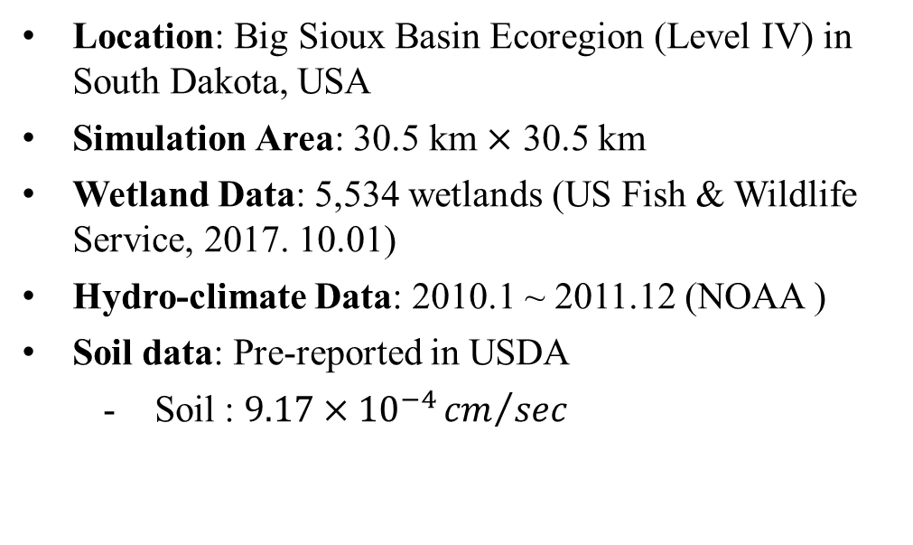
Site & Data for Simulation
Location: Big Sioux Basin Ecoregion (Level IV) in South Dakota, USA
Simulation Area: 30.5 km $×$ 30.5 km
Wetland Data: 5,534 wetlands (US Fish & Wildlife Service, 2017. 10.01)
Hydro-climate Data: 2010.1 ~ 2011.12 (NOAA )
Soil data: Pre-reported in USDA
Soil : $9.17×{10}^{−4}{cm}/{sec}$

Slide 8
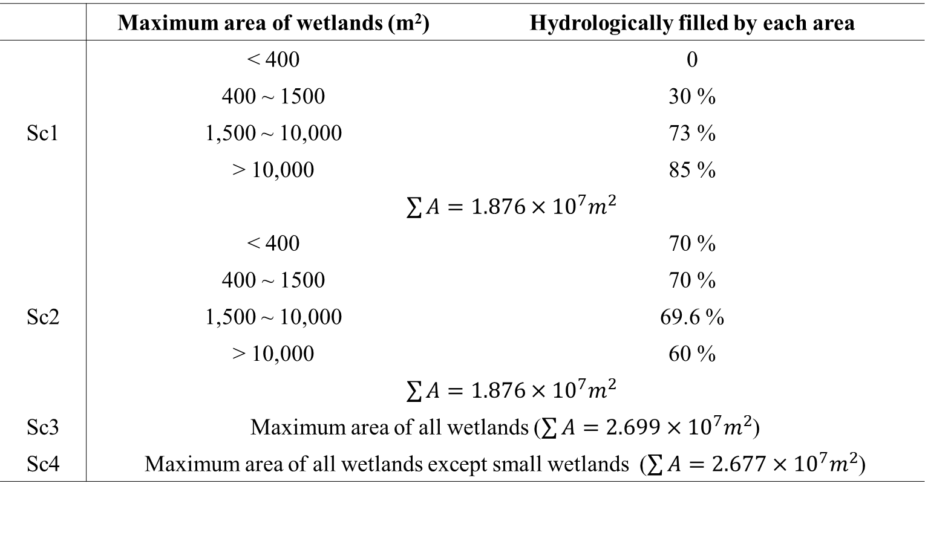
Network Simulations – Area scenario
• Small wetlands: Under 400 m² of all wetlands
 | Maximum area of wetlands (m²) | Hydrologically filled by each area
Sc1 | < 400 | 0
 | 400 ⁓ 1500 | 30 %
 | 1,500 ⁓ 10,000 | 73 %
 | > 10,000 | 85 %
 | d$\sum{A}=1.876×{10}^{7}m^{2}$
Sc2 | < 400 | 70 %
 | 400 ⁓ 1500 | 70 %
 | 1,500 ⁓ 10,000 | 69.6 %
 | > 10,000 | 60 %
 | d$\sum{A}=1.876×{10}^{7}m^{2}$
Sc3 | Maximum area of all wetlands ($\sum{A}=2.699×{10}^{7}m^{2}$)
Sc4 | Maximum area of all wetlands except small wetlands ($\sum{A}=2.677×{10}^{7}m^{2}$)

Slide 9
Results: k and BC distribution
Some wetlands play important structural (k) and functional (BC) roles in ecological network. And among small wetlands, some wetlands of high importance exist.
Different wetlands have different structural and functional roles (correlation coefficient: 0.61(all wetlands), 0.57(small wetlands))

Slide 10


Results: Node deletion
Removal by order of high BC
Removal by order of high k
Removal by order of high k
Removal by order of high BC
The impact that reduces the network characteristics (<k> and E) appears differently depending on the deleted node’s function (k or BC).
Removal of some small wetlands (red) also have a significant impact on network degradation.

Slide 11
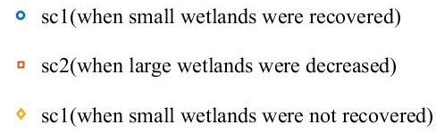

Results: Temporal change of <k>
SDI (Seasonal Climate Index)
$$\frac{(Evapotranspiration rate+Exfiltration rate)}{(Precipitation∗Frequency)}$$
<k> decreased nearly 20% (yellow) when the function of small wetlands was lost (0.8% of total wetlands area), but recovered when small wetlands were filled by rainfall (blue)

Slide 12
Results: Temporal change of E
SDI (Seasonal Climate Index)
$$\frac{(Evapotranspiration rate+Exfiltration rate)}{(Precipitation∗Frequency)}$$
E decreased nearly 25% (yellow) when the function of small wetlands was lost (0.8% of total wetlands area), but recovered when small wetlands were filled by rainfall (blue)

Slide 13
Results: All cases of change of <k> and E
Sc2 (Large wetlands decreased)
Sc2 (Large wetlands decreased)
Sc3 (max area of all wetlands)
Sc3 (max area of all wetlands)
Sc1 (recover small wetlands)
Sc1 (recover small wetlands)
Sc4 (max area except small wetlands)
Sc4 (max area except small wetlands)
Sc1 (not recover small wetlands)
Sc1 (not recover small wetlands)
Ecological states (<k> and E) have multiple regimes according to hydrologically dried wetlands (loss of function) in similar ecological condition (sum of wetlands area)

Slide 14
Conclusions
Different impact according to wetland functions
The role in the network differs depending on the function of the wetland (k or BC), and the impact caused by the loss of function also appears differently.
Some small wetlands play an important role and also have huge impact when their functions were lost.
Find multiple ecological states following the condition of small wetlands
In the case of extremely dry season, a large decrease in network function appears.
Both network metrics (<k> and E) decreased when small wetlands lose their function (hydrologically dry).
It is necessary to consider the function of the wetlands as well as the area or number of wetlands when establishing a conservation plan

Slide 15
Thank You
Acknowledgements
This research was supported by National Research Foundation of Korea (NRF) funded by the Ministry of Education and Ministry of Science and ICT .
(NRF-2020R1A6A3A13075479, NRF-2020M3H5A108077511)

Slide 16

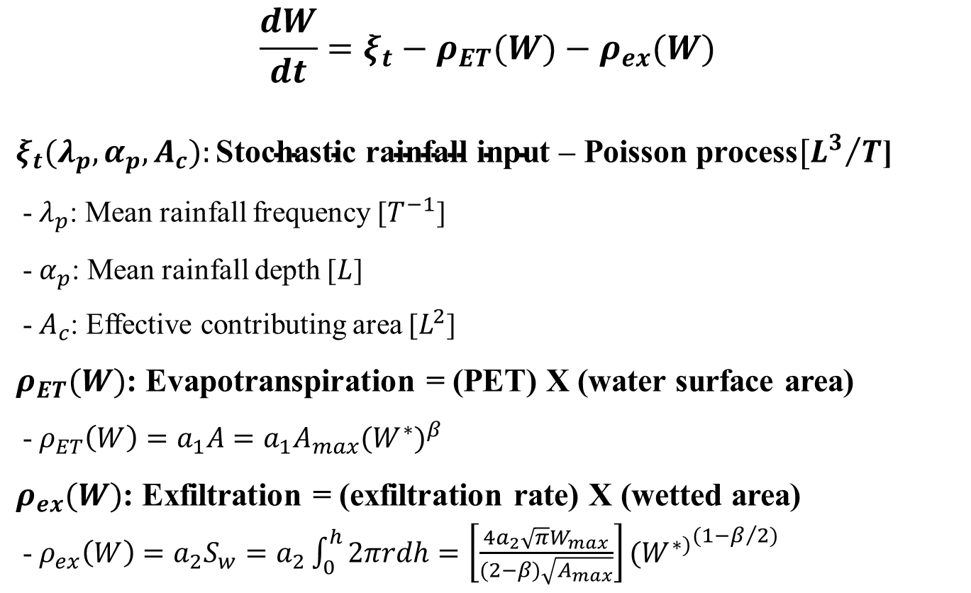
Hydrology of GIWs: Dynamic Nodes
Dynamics of water volume (W)
$$\frac{dW}{dt}=ξ_{t}−ρ_{ET}(W)−ρ_{ex}(W)$$
$ξ_{t}(λ_{p},α_{p},A_{c}):\text{Stochastic} \text{rainfall} \text{input}\text{ – }\text{Poisson} \text{process}[{L^{3}}/T$]
-$λ_{p}$: Mean rainfall frequency [$T^{−1}$]
-$α_{p}$: Mean rainfall depth [$L$]
-$A_{c}$: Effective contributing area [$L^{2}$]
$ρ_{ET}(W)$: Evapotranspiration = (PET) X (water surface area)
-$ρ_{ET}\left(W\right)=a_{1}A=a_{1}A_{max}{(W^{∗})}^{β}$
$ρ_{ex}(W)$: Exfiltration = (exfiltration rate) X (wetted area)
-$ρ_{ex}\left(W\right)=a_{2}S_{w}=a_{2}\int_{0}^{h}{2πrdh}=\left[\frac{4a_{2}\sqrt{π}W_{max}}{(2−β)\sqrt{A_{max}}}\right]{(W^{∗)}}^{(1−β/2)}$

Slide 17
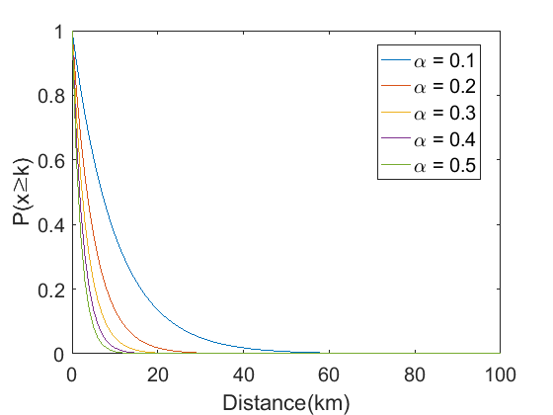
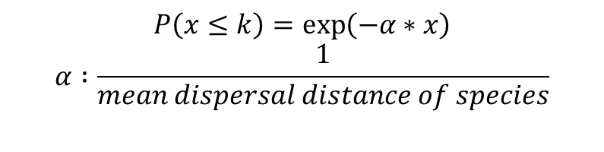
Network Representation - Edge
Model Ⅰ: Threshold distance
(deterministic approach)
Any pair of wetlands less than the threshold distance apart are connected by undirected edges
Model Ⅱ: Exponential dispersal kernel
(probabilistic approach)
The probability function for dispersal distances of inhabiting species in a wetland
$$P\left(x≤k\right)=\exp\left(−α∗x\right)$$
$$α :\frac{1}{mean dispersal distance of species}$$

Slide 18
Probabilistic Manipulation of Bathymetry
Statistics of the data from Hayashi and van der Kamp (2000)
Wetland area – p relation
PDFs of wetland depths

Slide 19
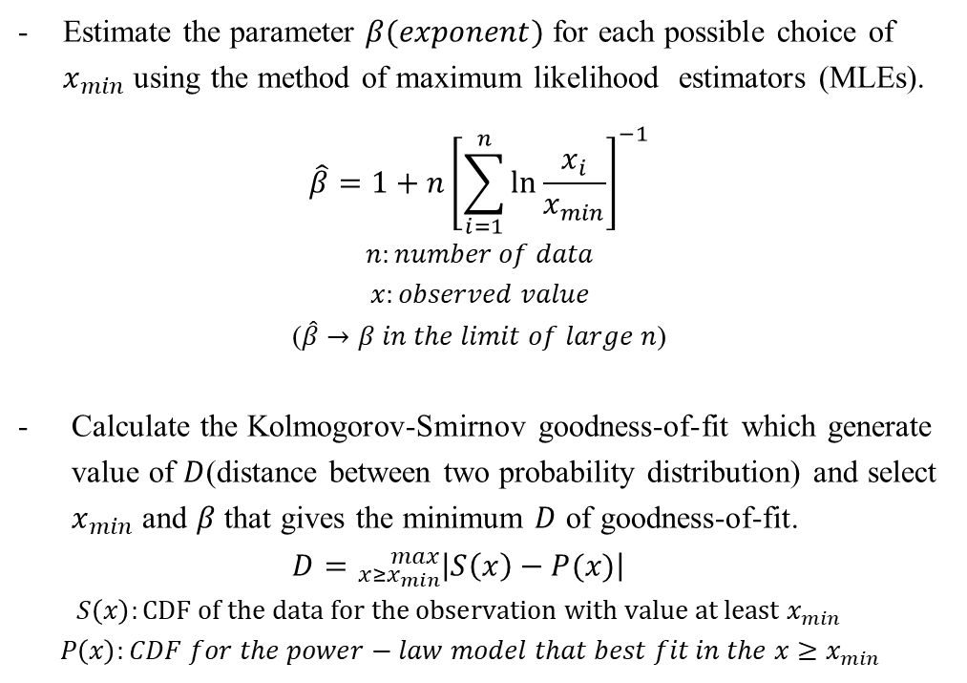
Estimating Power-law Exponents
Estimate the parameter $β(exponent)$ for each possible choice of $x_{min}$ using the method of maximum likelihood estimators (MLEs).
$$\hat{β}=1+n{\left[\sum_{i=1}^{n}{\ln{\frac{x_{i}}{x_{min}}}}\right]}^{−1}$$
$$n:number of data$$
$$x:observed value$$
($\hat{β}→β in the limit of large n$)
Calculate the Kolmogorov-Smirnov goodness-of-fit which generate value of $D$(distance between two probability distribution) and select $x_{min}$ and $β$ that gives the minimum $D$ of goodness-of-fit.
$$D={}_{x≥x_{min}}^{max}{\left|S\left(x\right)−P(x)\right|}$$
$$S\left(x\right):CDF of the data for the observation with value at least x_{min}$$
$$P\left(x\right):CDF for the power−law model that best fit in the x≥x_{min}$$
L : Log-likelihood of the data $x>x_{min}$ under the fitted power law

